Slide 1

Lecture 4
August 18, 2023
1

Slide 2
LED On/Off using electronic circuit
+15V
What is the problem with this circuit?
LED
2

Slide 3
LED On/Off using electronic circuit
+15V
For most of the LED required only 1.8V to glow and 10mA current
If you apply 15V, an enormous current will flow through the LED, and it goes bad.
LED
We should be aware of basic rule of design
3

Slide 4
LED On/Off using electronic circuit
+15V
The voltage drop across 1.8V
The remaining voltage of 13.2 will drop across R.
If 10mA current flows through the circuit, then the R=13.2V/10mA=1.32kΩ ~ 1.5KΩ
LED
R
4

Slide 5
How to use the Transistor to LED to glow ON/OFF
+15V
LED
R
If I have 15V supply in the base, then what will be the resistance value of R1 ?
R1
+15V
5

Slide 6


How to use the Transistor to LED to glow ON/OFF
+15V
LED
The base needs some current. Now we need to find the $I_{b}?$
R
To find the base current $I_{b}$what is the parameter we should know?
R1
+15V
6

Slide 7
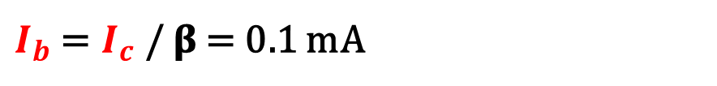
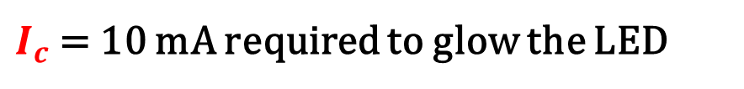
How to use the Transistor to LED to glow ON/OFF
+15V
𝛃 = 100
LED
$I_{c}$ = 10 mA required to glow the LED
R
$I_{b}$ = $I_{c}$ / 𝛃 = 0.1 mA
The voltage at E=0V hence voltage at B=0.6V required to conduct the Transistor
C
R1
0.1 mA
B
+15V
E
7

Slide 8
How to use the Transistor to LED to glow ON/OFF
+15V
LED
R
What is the value of R1 ?
C
R1
0.1 mA
B
+15V
E
8

Slide 9
How to use the Transistor to LED to glow ON/OFF
+15V
The voltage at E=0V hence the voltage at B=0.6V required a transistor to conduct.
LED
R
The voltage across the R1 should be 15-0.6 = 14.4 V
The current is 0.1mA
C
R1
0.1 mA
B
3019
Hence the resistor R1 should be 14.4V/0.1mA = 144 kΩ
+15V
E
9

Slide 10
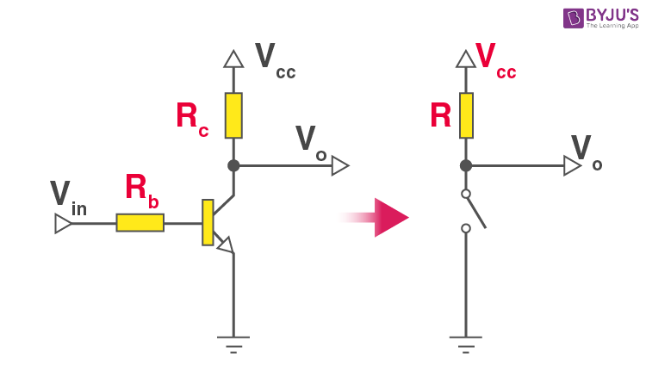
Circuit – ON/OFF
10

Slide 11
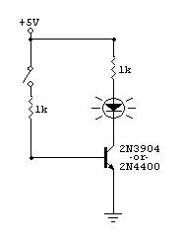
Circuit – ON/OFF
Transistor
LEDs
ON
ON
OFF
OFF
11

Slide 12









Bias compensation with diode
$${+V}_{CC}$$
Working mechanism ?
$$I_{C}$$
$$R_{L}$$
$$C_{2}$$
$$R_{B}$$
$$I$$
Advantages?
$$V_{o}$$
$$I_{B}$$
Disadvantages?
Input
Signal
$$I_{D}$$
12

Slide 13


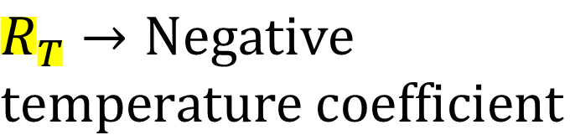












Bias compensation using a Thermistor
$${+V}_{CC}$$
$$R_{T}→Negative$$
$$temperature coefficient$$
$$I_{C}$$
$$R_{L}$$
$$C_{2}$$
$$R_{1}$$
$$V_{o}$$
Working mechanism ?
$$I_{B}$$
$$+$$
Advantages?
Input
Signal
$$V_{BE}$$
$$−$$
$$R_{2}$$
Disadvantages?
$$R_{T}$$
$$C_{e}$$
$$R_{e}$$
13

