Slide 1

Lecture 5
August 23, 2023
1

Slide 2







Transistor –Biasing
Normal operation of transistor
$$J_{EB}(Emitter −Base Junction should be forward bias)$$
$$J_{CB}(Collector −Base junction should be reverse bias)$$
Mode of operation
CE
CB
CC
$$R_{L}$$
$$R_{L}$$
$$V_{CC}$$
$$R_{L}$$
$$V_{EE}$$
$$V_{BB}$$
$$V_{CE}$$
$$V_{BB}$$
$$V_{CC}$$
2

Slide 3

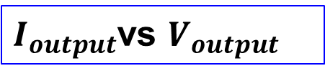
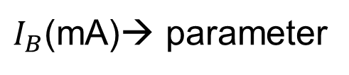

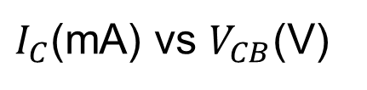
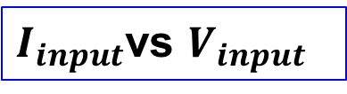
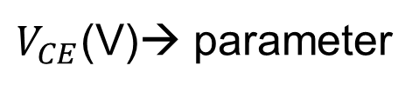

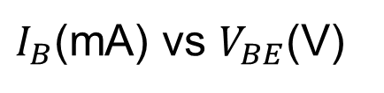
Transistor Characteristics
$$Transistor Characteristics$$
$$Input$$
$$Output$$
$I_{input}$vs $V_{input}$
$I_{output}$vs $V_{output}$
Output voltage is parameter
Input current is parameter
In CE configuration
In CE configuration
$I_{B}$(mA) vs $V_{BE}$(V)
$I_{C}$(mA) vs $V_{CB}$(V)
$V_{CE}$(V)→ parameter
$I_{B}$(mA)→ parameter
3

Slide 4

















Transistor characteristics PNP
$$A_{2}$$
$$+$$
$$−$$
$$T$$
$$A_{1}$$
$$−$$
$$B_{1}$$
$$−$$
$$+$$
$$V_{2}$$
$$B_{2}$$
$$−$$
$$R_{2}$$
$$+$$
$$R_{1}$$
$$V_{1}$$
$$+$$
A circuit arrangement to study transistor characteristics for CE configuration
4

Slide 5












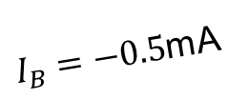





















Transistor characteristics PNP
$$Input characteristics$$
$$Output characteristics$$
$I_{B}=−0.5$mA
$−0.$4
$$−80$$
$−0.4m$A
$−0.2$V
$−0.3m$A
$−0.$3
$−0.1$V
$−1$V
$$−60$$
$V_{CE}=0$V
$−0.2m$A
$I_{B}$(mA)
$I_{C}$(mA)
$$−0.2$$
$$−40$$
$−0.1m$A
$$−0.1$$
$$−20$$
$$0$$
$$0$$
$$0$$
$$−0.2$$
$−0.$4
$$−0.6$$
$$−0.2$$
$−0.$4
$$−0.6$$
$−0.$4
$$−0.6$$
$V_{BE}$(V)
$V_{CE}$(V)
5

Slide 6












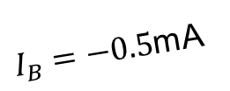


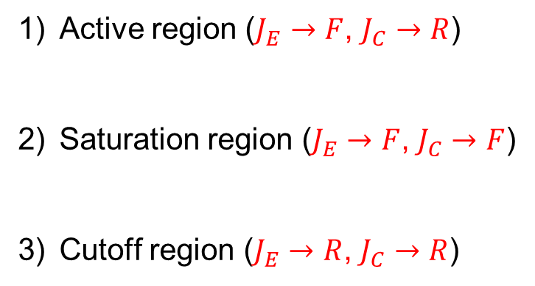



Transistor characteristics PNP
Output characteristics:
$I_{B}=−0.5$mA
Active region ($J_{E}→F$, $J_{C}→R$)
Saturation region ($J_{E}→F$, $J_{C}→F$)
Cutoff region ($J_{E}→R$, $J_{C}→R$)
$$−80$$
$−0.4m$A
$−0.3m$A
$$−60$$
$−0.2m$A
$I_{C}$(mA)
$$−40$$
$−0.1m$A
$$−20$$
$$0$$
$$0$$
$$−0.2$$
$−0.$4
$$−0.6$$
$−0.$4
$$−0.6$$
$V_{CE}$(V)
6

Slide 7
Transistor as a switch PNP
Input
Output
7

Slide 8


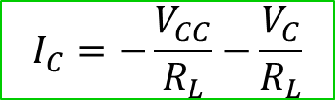












Transistor Biasing
Kirchhoff’s voltage law
$$I_{C}$$
$$R_{L}$$
$$V_{CC}={−I}_{C}R_{L}−V_{C}$$
$$R_{g}$$
$$+$$
$$I_{B}$$
$$I_{C}=−\frac{V_{CC}}{R_{L}}−\frac{V_{C}}{R_{L}}$$
$$V_{C}$$
$$V_{CC}$$
$$+$$
$$V_{B}$$
$$−$$
$$−$$
$$V_{BB}$$
$$I_{E}$$
8

Slide 9





















Transistor Biasing-LOAD LINE
$$I_{C}(mA)$$
$$I_{C}=−\frac{V_{CC}}{R_{L}}−\frac{V_{C}}{R_{L}}$$
$$\left(0,−\frac{V_{CC}}{R_{L}}\right)$$
$$I_{C}$$
$$R_{g}$$
$$R_{L}$$
$$+$$
$$I_{B}$$
$$Slope=−\frac{1}{R_{L}}$$
$$V_{C}$$
$$V_{CC}$$
$$+$$
$$Load line$$
$$V_{B}$$
$$−$$
$$V_{BB}$$
$$−$$
$$I_{E}$$
$$({−V}_{CC},0)$$
$$V_{C}(V)$$
$$R_{L}=300 Ω,V_{CC}=15V$$
9

Slide 10


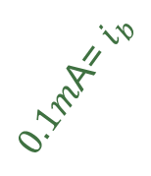

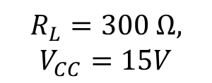

























Transistor Biasing
$$Output characteristics:Q−points$$
$I_{C}$(mA)
$$I_{B}=−0.5mA$$
$$\left(0,−\frac{V_{CC}}{R_{L}}\right)$$
$0.1m$A= $i_{b}$
$−0.4m$A
$$−40$$
$$Q_{1}$$
$−0.3m$A
$I_{B}=9m$A
$$−30$$
$$Q_{2}$$
$$R_{L}=300 Ω,$$
$$V_{CC}=15V$$
$$Q_{3}$$
$−0.2m$A
$$−20$$
$$Q_{4}$$
$−0.1m$A
$$Load line$$
Output waveform
$$−10$$
$$Q_{6}$$
$$0$$
$$Q_{7}$$
$$({−V}_{CC},0)$$
$$0$$
$$−3$$
$$−6$$
$$−9$$
$$−12$$
$$−15$$
$V_{CE}$(V)
10

Slide 11
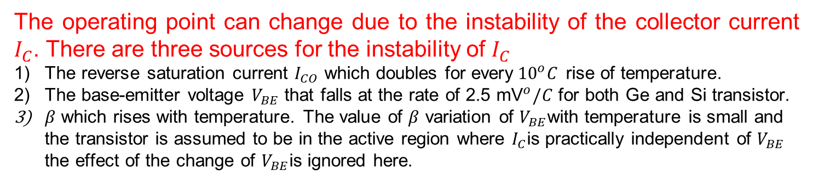
Transistor Biasing → Q point
The choice of Q-point is determined by
The availability of supply voltage
The load resistance of amplifiers
The amplitude of the signal to be amplified
The allowable distortion of the output signal
The operating point can change due to the instability of the collector current $I_{C}$. There are three sources for the instability of $I_{C}$
The reverse saturation current $I_{CO}$ which doubles for every${10}^{o}C$ rise of temperature.
The base-emitter voltage $V_{BE}$ that falls at the rate of 2.5 ${\text{mV}}^{o}/C$ for both Ge and Si transistor.
$β$ which rises with temperature. The value of $β$ variation of $V_{BE}$with temperature is small and the transistor is assumed to be in the active region where $I_{C}$is practically independent of $V_{BE}$ the effect of the change of $V_{BE}$is ignored here.
11

Slide 12





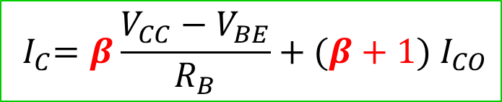





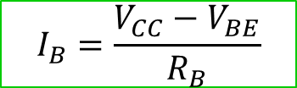


Transistor Biasing→ FIXED BIAS (FB)
Using the Kirchhoff law
$$I_{C}$$
$$R_{L}$$
$$I_{B}=\frac{V_{CC}−V_{BE}}{R_{B}}$$
$$R_{B}$$
$$V_{o}$$
The collector current
$$C_{1}$$
$$I_{B}$$
$$V_{CC}$$
$$+$$
$${ I}_{C}=β{ I}_{B}+(β+1{) I}_{CO}$$
Input
Signal
$$V_{BE}$$
$$−$$
$${ I}_{C}=β\frac{V_{CC}−V_{BE}}{R_{B}}+(β+1{) I}_{CO}$$
12

Slide 13
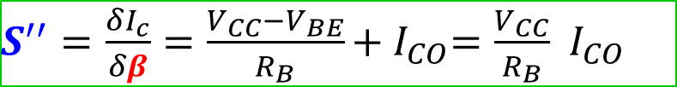
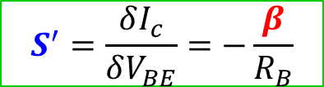
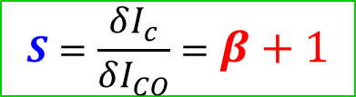
Transistor Biasing→ Stability Factors
FIXED BIAS (FB)
Lower the stability factor, the better stability of Q-point
$$S=\frac{δI_{c}}{δI_{CO}}=β+1$$
$$S^{′}=\frac{δI_{c}}{δV_{BE}}=−\frac{β}{R_{B}}$$
$S^{′′}=\frac{δI_{c}}{δβ}=\frac{V_{CC}−V_{BE}}{R_{B}}+{ I}_{CO}=\frac{V_{CC}}{R_{B}}$ ${ I}_{CO}$
13

Slide 14







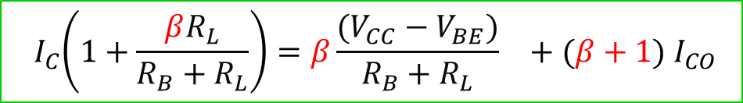
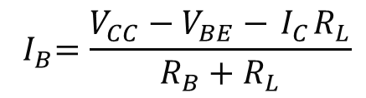








Transistor Biasing→ C to B bias (CB)
Collector to Base Bias
Using the Kirchhoff law
$$I_{C}+I_{B}$$
$$V_{CE}={ I}_{B}R_{B}+V_{BE}$$
$$R_{B}$$
$$R_{L}$$
$$V_{CC}={(I_{C}+I}_{B})R_{L}+V_{CE}$$
$$V_{o}$$
Using the above equations
$$V_{CC}={(I_{C}+I}_{B})R_{L}+{ I}_{B}R_{B}+V_{BE}$$
$$C_{1}$$
$$V_{CC}$$
$$I_{B}$$
$${ I}_{B}=\frac{V_{CC}−V_{BE}−{ I}_{C}R_{L}}{R_{B}+R_{L}}$$
$$+$$
Input
Signal
$$V_{BE}$$
$$−$$
$${ I}_{C}=β{ I}_{B}+(β+1{) I}_{CO}$$
Substituting for ${ I}_{B}$ and rearranging
$${ I}_{C}\left(1+\frac{βR_{L}}{R_{B}+R_{L}}\right)=β{\frac{(V_{CC}−V_{BE})}{R_{B}+R_{L}}}_{}+(β+1{) I}_{CO}$$
14

Slide 15
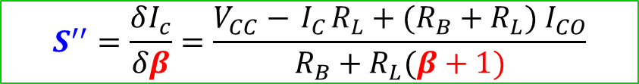
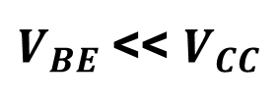
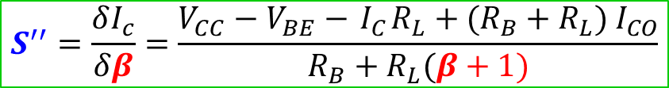
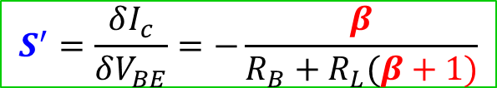
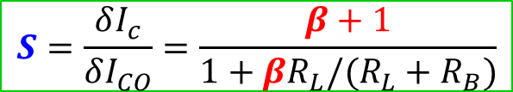
Transistor Biasing→ Stability Factors
Collector to Base Bias
Lower the stability factor, the better stability of Q-point
$$S=\frac{δI_{c}}{δI_{CO}}=\frac{β+1}{1+βR_{L}/(R_{L}+R_{B})}$$
$$S^{′}=\frac{δI_{c}}{δV_{BE}}=−\frac{β}{R_{B}+R_{L}(β+1)}$$
$$S^{′′}=\frac{δI_{c}}{δβ}=\frac{V_{CC}−V_{BE}−{ I}_{C}R_{L}+(R_{B}+R_{L}){ I}_{CO}}{R_{B}+R_{L}(β+1)}$$
$V_{BE}$<< $V_{CC}$
$$S^{′′}=\frac{δI_{c}}{δβ}=\frac{V_{CC}−{ I}_{C}R_{L}+(R_{B}+R_{L}){ I}_{CO}}{R_{B}+R_{L}(β+1)}$$
15

Slide 16












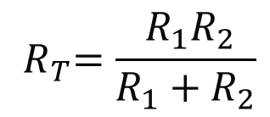
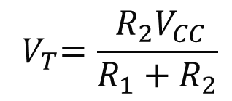


Self-Bias or Emitter Bias
Emitter Bias
Thevenin source
$$I_{C}$$
$$R_{L}$$
$${ V}_{T}=\frac{{ R}_{2}V_{CC}}{R_{1}+R_{2}}$$
$$C_{2}$$
$$R_{1}$$
$$V_{o}$$
$$V_{CC}$$
$$C_{1}$$
$$I_{B}$$
Thevenin resistance
$$+$$
$$V_{BE}$$
$${ R}_{T}=\frac{{ R}_{1}R_{2}}{R_{1}+R_{2}}$$
Input
Signal
$$−$$
$$R_{2}$$
$$C_{e}$$
$$R_{e}$$
16

Slide 17










Self-Bias or Emitter Bias
Emitter Bias
Thevenin source
$$I_{C}$$
$$R_{L}$$
$${ V}_{T}=\frac{{ R}_{2}V_{CC}}{R_{1}+R_{2}}$$
$$R_{T}$$
$$+$$
$$V_{CC}$$
$$V_{CE}$$
Thevenin resistance
$$+$$
$$−$$
$$I_{B}$$
$${ R}_{T}=\frac{{ R}_{1}R_{2}}{R_{1}+R_{2}}$$
$$V_{BE}$$
$$−$$
$$V_{T}$$
$$R_{e}$$
$${(I}_{c}+I_{B})$$
17

Slide 18
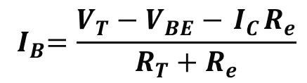


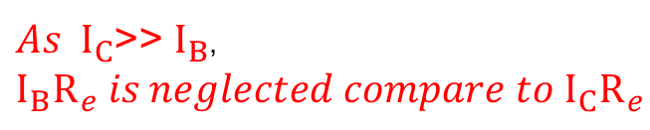

Self-Bias or Emitter Bias
Emitter Bias
Using the Kirchhoff law around base
$$I_{B}R_{T}+V_{BE}+(I_{B}+I_{C})R_{e}=V_{T}$$
$$I_{C}$$
$$R_{L}$$
$${ I}_{B}=\frac{V_{T}−V_{BE}−{ I}_{C}R_{e}}{R_{T}+R_{e}}$$
$$R_{T}$$
$$+$$
$$V_{CC}$$
$$V_{CE}$$
Using the Kirchhoff law around Collector
$$+$$
$$−$$
$$R_{e}(I_{c}+I_{B})+I_{C}R_{L}+V_{CE}=V_{CC}$$
$$I_{B}$$
$$V_{BE}$$
$As I_{C}$>> $I_{B}$, $I_{B}R_{e} is neglected compare to I_{C}R_{e }$
$$−$$
$$V_{T}$$
$$R_{e}$$
$${(I}_{c}+I_{B})$$
$$V_{CE}={−I}_{C}(R_{L}+R_{e})+V_{CC}$$
18

Slide 19























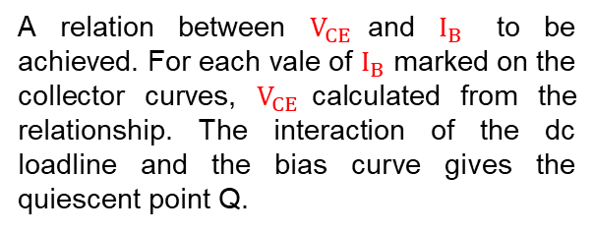
Self-Bias or Emitter Bias- Q point
Emitter Bias
LOADLINE
$I_{B}=0.$2V
$$V_{CE}={−I}_{C}(R_{L}+R_{e})+V_{CC}$$
Load line slope: $−(R_{L}+R_{e})$
$$8$$
$0.15 m$A
BIAS CURVE
$$6$$
$$Load line$$
$$I_{B}R_{T}+V_{BE}+(I_{B}+I_{C})R_{e}=V_{T}$$
$$Bias curve$$
$I_{C}$(mA)
$$4$$
$0.1m$A
A relation between $V_{CE}$and $I_{B}$ to be achieved. For each vale of $I_{B}$ marked on the collector curves, $V_{CE}$calculated from the relationship. The interaction of the dc loadline and the bias curve gives the quiescent point Q.
$$Q$$
$$1$$
$0.05m$A
$$0mA$$
$$0$$
$$0$$
$$2$$
$$5$$
$$6$$
$$8$$
$V_{CE}$(V)
19

Slide 20
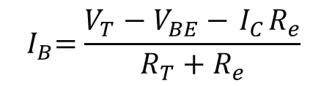
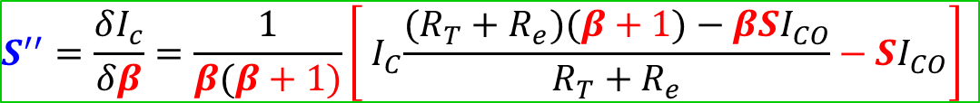

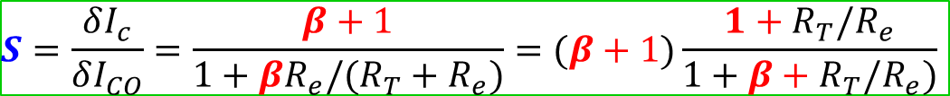

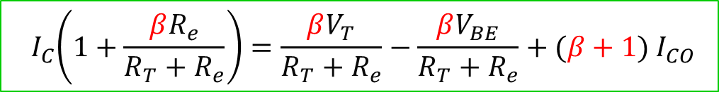
Self-Bias or Emitter Bias- Stability factors
Emitter Bias
The collector current can be represented as
$${ I}_{C}=β{ I}_{B}+(β+1{) I}_{CO}$$
$${ I}_{B}=\frac{V_{T}−V_{BE}−{ I}_{C}R_{e}}{R_{T}+R_{e}}$$
The base current can be represented as
$${ I}_{C}\left(1+\frac{βR_{e}}{R_{T}+R_{e}}\right)=\frac{βV_{T}}{R_{T}+R_{e}}−\frac{βV_{BE}}{R_{T}+R_{e}}+(β+1{) I}_{CO}$$
Using above 2 eqn:
$$S=\frac{δI_{c}}{δI_{CO}}=\frac{β+1}{1+βR_{e}/(R_{T}+R_{e})}=(β+1)\frac{1+R_{T}/R_{e}}{1+β+R_{T}/R_{e})}$$
$$S^{′}=\frac{δI_{c}}{δV_{BE}}=−\frac{β}{R_{T}+R_{e}(β+1)}$$
$$S^{′′}=\frac{δI_{c}}{δβ}=\frac{1}{β(β+1)}\left[{ I}_{C}\frac{(R_{T}+R_{e})(β+1{)−βSI}_{CO}}{R_{T}+R_{e}}−{SI}_{CO}\right]$$
20

Slide 21
Comparison of biasing
Which is the best biasing condition?
Fixed bias, Collector to Base bias and Emitter bias
Advantages?
Disadvantages?
21

Slide 22









Bias compensation with diode
$${+V}_{CC}$$
Working mechanism ?
$$I_{C}$$
$$R_{L}$$
$$C_{2}$$
$$R_{B}$$
$$I$$
Advantages?
$$V_{o}$$
$$I_{B}$$
Disadvantages?
Input
Signal
$$I_{D}$$
22

Slide 23


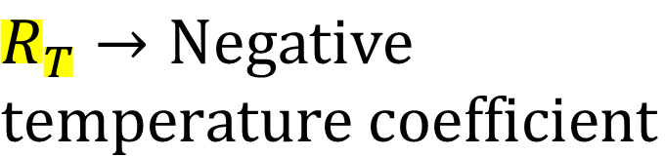











Bias compensation using a Thermistor
$${+V}_{CC}$$
$$R_{T}→Negative$$
$$temperature coefficient$$
$$I_{C}$$
$$R_{L}$$
$$C_{2}$$
$$R_{1}$$
$$V_{o}$$
Working mechanism ?
$$I_{B}$$
$$+$$
Advantages?
Input
Signal
$$V_{BE}$$
$$−$$
$$R_{2}$$
Disadvantages?
$$R_{T}$$
$$C_{e}$$
$$R_{e}$$
23

Slide 24
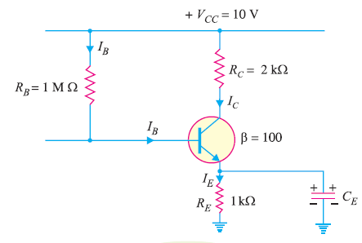




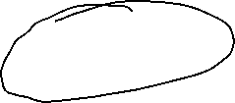
Calculate the values of three currents in the circuit shown in Figure below.(Take base-emitter voltage V_{BE} = 0.)
Concept Question-4
24

Slide 25
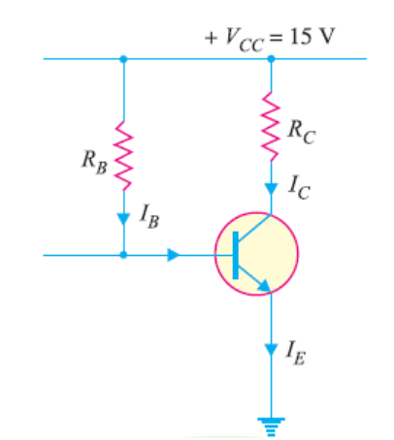
Concept Questions - 5
2. For a given CE amplifier, operating point is V_{CE} = 8V and I_{C} = 2 mA. You are supplied with a fixed 15V d.c. supply and a silicon transistor with β = 100. Take base-emitter voltage V_{BE} = 0.6V. Calculate the value of load resistances that would be employed.
25

Slide 26
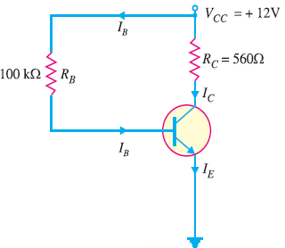
Concept Questions - 6
3. For the given base bias circuit, determine V_{CE} and IC.(Take base-emitter voltage V_{BE} = 0.7V.)
26

