Slide 1

Lecture 7
August 30, 2023
1

Slide 2





OPAMP-First analog computer
$$+15V$$
E2
B3
C1
C2
$$V_{o}$$
B1
B2
C3
$$+$$
$$−$$
E1
E2
$$−15V$$
2

Slide 3
OPAMP-First analog computer
$$+15V$$
E2
B3
C1
C2
$$V_{o}$$
B1
B2
C3
$$−$$
E1
E2
V
$$−15V$$
3

Slide 4





OPAMP-First analog computer
1942: Loebe Julie
$$+15V$$
C
$$V_{o}$$
B
B
$$+$$
$$−$$
E
E
$$−15V$$
4

Slide 5
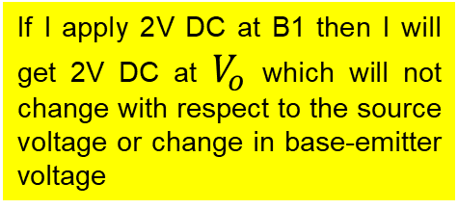




OPAMP-First analog computer
$$+15V$$
If I apply 2V DC at B1 then I will get 2V DC at $V_{o}$ which will not change with respect to the source voltage or change in base-emitter voltage
E3
C1
B3
C2
B1
B2
$$V_{o}$$
$$−$$
C3
2V
2V
E1
E2
$$−15V$$
5

Slide 6
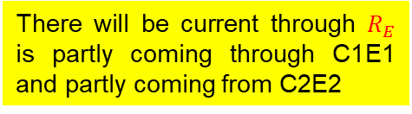


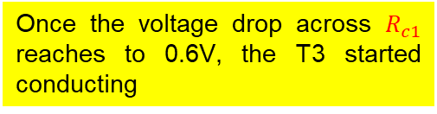
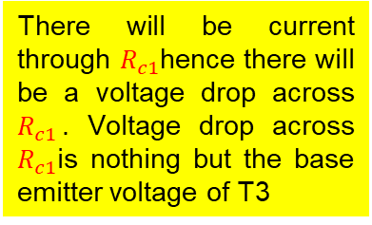

OPAMP-First analog computer
If I apply 2V DC at B1 the E1 will be 1.4V because base-emitter voltage difference is 0.6V
$$+15V$$
E3
$$R_{C1}$$
There will be current through $R_{E}$ is partly coming through C1E1 and partly coming from C2E2
P
C1
B3
T3
C2
N
P
There will be current through $R_{c1}$hence there will be a voltage drop across $R_{c1}$. Voltage drop across $R_{c1}$is nothing but the base emitter voltage of T3
B1
T1
B2
$$V_{o}$$
T2
C3
2V
2V
E1
E2
$$R_{C2}$$
1.4V
Once the voltage drop across $R_{c1}$ reaches to 0.6V, the T3 started conducting
$$R_{E}$$
$$−15V$$
Positive voltage starts increasing at C3 hence base of T2 will get more and more voltage
6

Slide 7
OPAMP-First analog computer
Assumed voltage at B2 is more than 2V ie 2.1V
$$+15V$$
E2 is sitting at 1.4V and B2 is sitting at 2.1V. Hence the base-emitter voltage of T2 is 0.7V (Very large voltage)
E3
$$R_{C1}$$
P
C1
B3
T3
Enormous current will flow through the transistor T2
C2
N
P
B1
T1
B2
2.1V
$$V_{o}$$
T2
C3
2V
2V
E1
E2
$$R_{C2}$$
1.4V
$$R_{E}$$
$$−15V$$
7

Slide 8
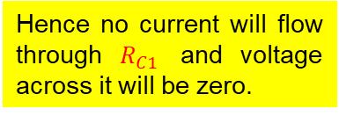
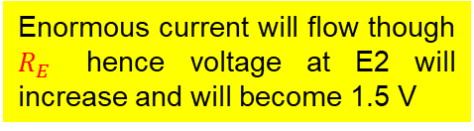
OPAMP-First analog computer
Assumed voltage at B2 is more than 2V ie 2.1V
Enormous current will flow though $R_{E}$ hence voltage at E2 will increase and will become 1.5 V
$$+15V$$
E3
$$R_{C1}$$
The T1 is not going to conduct anymore because the base emitter voltage of T1 is 0.5 V
P
C1
B3
T3
C2
N
P
Hence no current will flow through $R_{C1}$ and voltage across it will be zero.
B1
T1
B2
2.1V
$$V_{o}$$
T2
C3
2V
2V
E1
E2
$$R_{C2}$$
Indicating base-emitter voltage of T3 is zero hence T3 is not going to conduct
1.5V
$$R_{E}$$
Hence C3 will decrease → B2 will decrease.
$$−15V$$
8

Slide 9
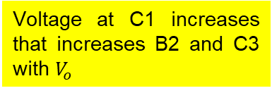

OPAMP-First analog computer
Assumed voltage at B2 is going to below 2V ie 1.9V
B1 is at 2V hence E1 will be at 1.4V
$$+15V$$
E3
Hence T2 is not going to conduct due to base-emitter voltage of 0.5V
$$R_{C1}$$
P
C1
B3
T3
C2
N
Heavy current flows through T1 and $R_{C1}$
P
B1
T1
B2
1.9V
$$V_{o}$$
T2
Voltage at C1 increases that increases B2 and C3 with $V_{o}$
C3
2V
2V
E1
E2
$$R_{C2}$$
1.4V
$$R_{E}$$
$$−15V$$
9

Slide 10
OPAMP-First analog computer
What about temperature drift issue?
At 65C only 0.5V base-emitter voltage is required for both transistors.
$$+15V$$
E3
$$R_{C1}$$
P
C1
B3
T3
C2
N
P
B1
T1
B2
2V
$$V_{o}$$
T2
C3
2V
2V
E1
E2
$$R_{C2}$$
1.5V
$$R_{E}$$
$$−15V$$
10

Slide 11

OPAMP-First analog computer
What about supply change?
If supply voltage increase to 20V ?
$$+20V$$
T1 will conduct high hence C1 will increase with B3.
E3
$$R_{C1}$$
P
T3 will conduct high, C3 will increase with B2
C1
B3
T3
C2
N
P
E2 will increase with E1
B1
T1
B2
$$V_{o}$$
T2
T1 will conduct less due to decrease in base emitter voltage
C3
E1
E2
$$R_{C2}$$
Voltage at C1 will decrease and B3 and C3
$$R_{E}$$
$$−15V$$
How to amplify the signal ?
11

Slide 12
OPAMP-First analog computer
How to amplify the signal ?
Connect 2 resistor in B2 terminal
$$+15V$$
Condition: if B1 is 2V then B2 must be in 2V
E3
$$R_{C1}$$
P
Assuming the resistor are same.
C1
B3
T3
C2
N
The output will be 4V while B2=2V
2V
P
B1
T1
B2
$$V_{o}$$
T2
2V
R
C3
4V
E1
E2
$$R_{C2}$$
R
$$R_{E}$$
$$−15V$$
What happed if I want 10 gain ?
12

Slide 13




OPAMP-First analog computer
What happed if I want 10 gain ?
$$+15V$$
E3
$$R_{C1}$$
P
C1
B3
T3
C2
N
1V
P
B1
T1
B2
$$V_{o}$$
T2
1V
R=9k
C3
10V
E1
E2
$$R_{C2}$$
R=1k
$$R_{E}$$
$$−15V$$
13

Slide 14










OPAMP-Non-Inverting
Gain 10 → non-inverting amplifier
$$R_{2}$$
$$+15V$$
E3
$$R_{C1}$$
$$R_{1}$$
P
B3
$$−$$
C1
T3
C2
N
$$+$$
P
B1
T1
B2
T2
C3
$$V_{o}$$
$R_{2}$=9k
E1
E2
$$R_{C2}$$
$R_{1}$=1k
$$R_{E}$$
$$−15V$$
How can you make inverting amplifier?
14

Slide 15
OPAMP-Inverting
Gain 10 → inverting amplifier
$$R_{2}$$
$$+15V$$
E3
$$R_{C1}$$
$$R_{1}$$
P
B3
$$−$$
C1
T3
C2
N
$$+$$
P
B1
T1
B2
T2
C3
$$V_{o}$$
$R_{2}$=9k
E1
E2
$$R_{C2}$$
$R_{1}$=1k
$$R_{E}$$
$$−15V$$
15

Slide 16


Voltage regulator
$$V_{o}$$
Let's assume 20V DC is the un-regulated input varied anywhere between 28 V to 15V
We want output $V_{o}$=10V (steady)
Input 20V DC (15V←20V→28V)
How this circuit works?
16

Slide 17
Voltage regulator
$$V_{o}$$
If I remove all connections !
Assumed 5V Zener. If sufficient current flowing through it, then there will be voltage drop of 5V.
How much current needs to flow through Zener? How can we find that?
This is biasing the Zener
Input 20V DC (15V←20V→28V)
5V
17

Slide 18
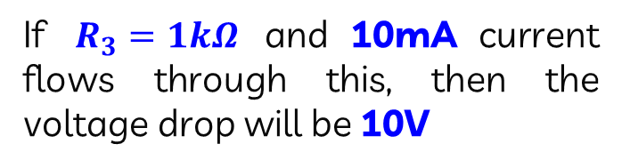

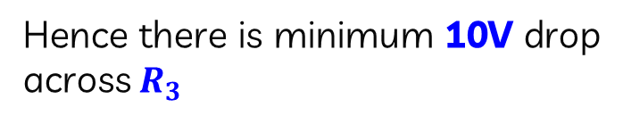
Voltage regulator
Data sheet to the Zener Diode
P
$$V_{o}$$
10mA is the knee current of Zener diode then only voltage drop will be 5V across Zener diode
C
LED
$$R_{3}$$
We know the voltage at point P is never going to be below 15V
R1
This is biasing the Zener
Input 20V DC (15V←20V→28V)
Hence there is minimum 10V drop across $R_{3}$
E
+15V
5V
If $R_{3}=1kΩ$ and 10mA current flows through this, then the voltage drop will be 10V
0.1 mA
18

Slide 19
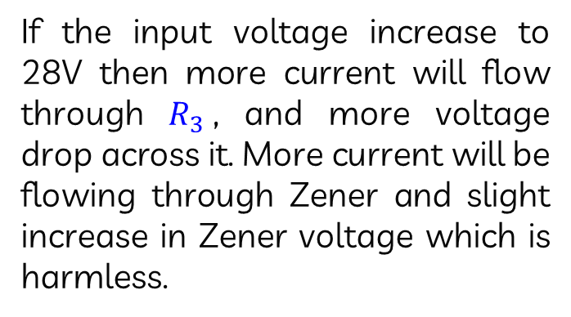
Voltage regulator
P
$$V_{o}$$
If the input voltage increase to 28V then more current will flow through $R_{3}$, and more voltage drop across it. More current will be flowing through Zener and slight increase in Zener voltage which is harmless.
$$R_{3}$$
This is biasing the Zener
Input 20V DC (15V←20V→28V)
5V
19

Slide 20


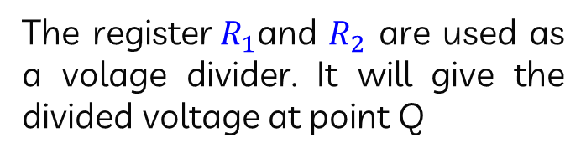
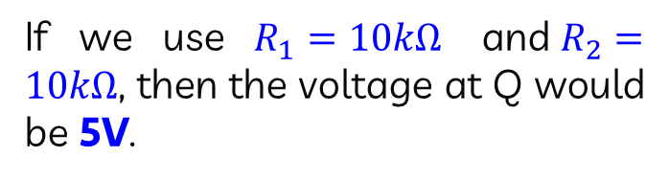
Voltage regulator
The register$R_{1}$and $R_{2}$ are used as a volage divider. It will give the divided voltage at point Q
P
$$V_{o}$$
$$R_{1}$$
If we use $R_{1}=10kΩ$ and$R_{2}=10kΩ$, then the voltage at Q would be 5V.
$$R_{3}$$
Q
Input 20V DC (15V←20V→28V)
Now if we add transistor?
This is biasing the Zener
$$R_{2}$$
5V
20

Slide 21
Voltage regulator
P
C2
E2
The E1 point will be always sitting at 5V
$$V_{o}$$
T2
$$V_{o}$$
B2
$$R_{1}$$
C1
What happened if the output voltage increases more than 10 V?
$$R_{3}$$
Q
T1
Input 20V DC (15V←20V→28V)
B1
This is biasing the Zener
E1
$$R_{2}$$
5V
21

Slide 22


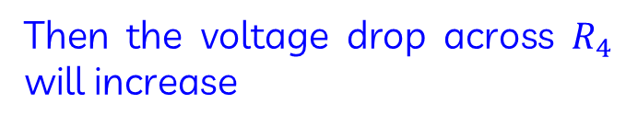
Voltage regulator
If E1 is at 5V then B1 should be 5.6V
P
C2
E2
$$V_{o}$$
T2
$$V_{o}$$
If B1 increase more than 5.6V then T1 will conduct heavily through P→S→C1
$$R_{4}$$
B2
$$R_{1}$$
S
C1
$$R_{3}$$
Q
Then the voltage drop across $R_{4}$ will increase
T1
5.6V
Input 20V DC (15V←20V→28V)
B1
This is biasing the Zener
E1
The voltage at point C1=Voltage at P – Voltage drop across $R_{4}$
5V
$$R_{2}$$
5V
Voltage at E2 =Voltage at C1-0.6V
22

Slide 23

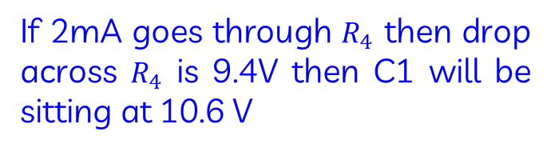

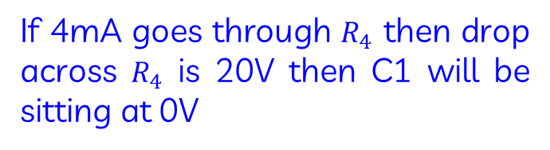

Voltage regulator
Assume P is sitting at 20V at any given time.
P=20V
C2
E2
$$V_{o}$$
T2
$$V_{o}$$
Assume $R_{4}=4.7$k
$R_{4}=4.7$k
B2
$$R_{1}$$
S
If 4mA goes through $R_{4}$ then drop across $R_{4}$ is 20V then C1 will be sitting at 0V
C1
$$R_{3}$$
5.6V
Q
T1
Input 20V DC (15V←20V→28V)
B1
If 1mA goes through $R_{4}$ then drop across $R_{4}$ is 4.7V then C1 will be sitting at 15.3 V
This is biasing the Zener
E1
5V
$$R_{2}$$
5V
If 2mA goes through $R_{4}$ then drop across $R_{4}$ is 9.4V then C1 will be sitting at 10.6 V
23

Slide 24
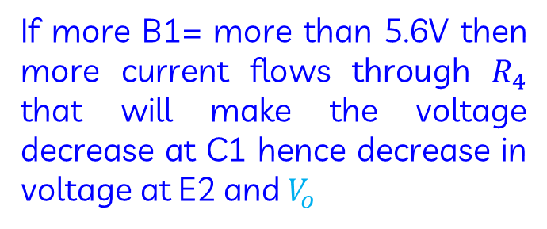
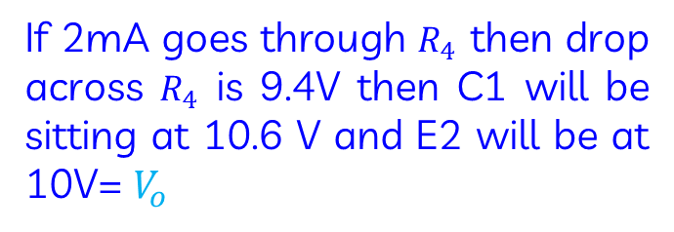
Voltage regulator
P=20V
E2
Voltage at E2 =Voltage at C1-0.6V
C2
$$V_{o}$$
T2
$$V_{o}$$
If 2mA goes through $R_{4}$ then drop across $R_{4}$ is 9.4V then C1 will be sitting at 10.6 V and E2 will be at 10V= $V_{o}$
$R_{4}=4.7$k
B2
$$R_{1}$$
S
C1
$$R_{3}$$
5.6V
Q
T1
Input 20V DC (15V←20V→28V)
B1
If more B1= more than 5.6V then more current flows through $R_{4}$ that will make the voltage decrease at C1 hence decrease in voltage at E2 and $V_{o}$
This is biasing the Zener
E1
5V
$$R_{2}$$
5V
Hence voltage at Q will decrease
24

Slide 25



Voltage regulator
B2 point is less than 5.6 V
E2
$$V_{o}=11.2V$$
The T1 will conduct less
P=20V
C2
T2
The current through $R_{4}$ will be less
$R_{4}=4.7$k
B2
$$R_{1}$$
S
Voltage drop across $R_{4}$ reduce
C1
$$R_{3}$$
The voltage at C1 will increase
5.6V
Q
T1
Input 20V DC (15V←20V→28V)
B1
This is biasing the Zener
The voltage at E2 will increase
E1
5V
$$R_{2}$$
The voltage at Q will increase
5V
The T1 will conduct high
25

Slide 26
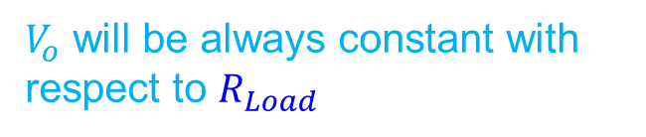




Voltage regulator
P=20V
C2
E2
If I vary $R_{2}$resistance the $V_{o}$ is changing
$$V_{o}$$
T2
$$V_{o}$$
$$R_{Load}$$
$R_{4}=4.7$k
B2
$$R_{1}$$
Nevertheless $V_{o}$ will be always constant
S
C1
$$R_{3}$$
5.6V
Q
$V_{o}$ will be always constant with respect to $R_{Load}$
T1
Input 20V DC (15V←20V→28V)
B1
This is biasing the Zener
E1
5V
$$R_{2}$$
5V
26

Slide 27
Voltage regulator
What are the drawbacks of this voltage regulator?
27

Slide 28


Voltage regulator
Base emitter temperature drift
P=20V
C2
E2
$$V_{o}$$
T2
$$V_{o}$$
At 65C, $V_{BE}\left(T1\right)=0.5V$ only
$$R_{Load}$$
$R_{4}=4.7$k
B2
$$R_{1}$$
E1 =5V , so B1= 5.5V, $V_{o}$=11 V
S
C1
$$R_{3}$$
Hence the output is changing with respect to temperature
5.6V
Q
T1
Input 20V DC (15V←20V→28V)
B1
This is biasing the Zener
E1
5V
$$R_{2}$$
5V
28

Slide 29


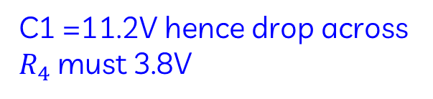
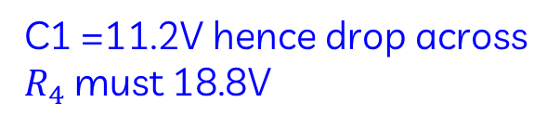
Voltage regulator
Change in supply voltage
P=20V
C2
E2
If the supply voltage become high hence P=30V
$$V_{o}$$
T2
$$V_{o}$$
$$R_{Load}$$
C1 =11.2V hence drop across $R_{4}$ must 18.8V
$R_{4}=4.7$k
B2
$$R_{1}$$
S
C1
$$R_{3}$$
If the supply voltage become low hence P=15V
5.6V
Q
T1
Input 20V DC (15V←20V→28V)
B1
This is biasing the Zener
C1 =11.2V hence drop across $R_{4}$ must 3.8V
E1
5V
$$R_{2}$$
5V
More current =More $V_{BE}$(T1)
Less current =Less $V_{BE}$(T1)
Then the output voltage will change
29

