Slide 1

Lecture 08
September 01, 2023
1

Slide 2





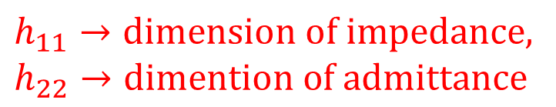


HYBRID PARAMETER MODEL
$$I_{1}$$
$$I_{2}$$
+
+
1
2
Input
ports
$${ v}_{1}$$
Black Box
$${ v}_{2}$$
Output
ports
1’
2’
-
$${ v}_{1}=h_{11}{ i}_{1}+h_{12}{ v}_{2}$$
-
$${ i}_{2}=h_{21}{ i}_{1}+h_{22}{ v}_{2}$$
$$h_{11}→dimension of impedance,$$
$$h_{22}→dimention of admittance$$
$$h_{12 }\& h_{21 }→dimensionless$$
2

Slide 3
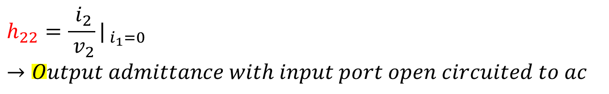
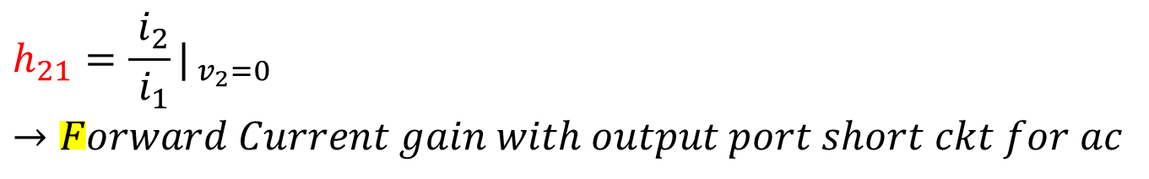
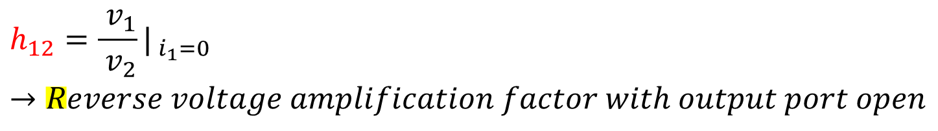

HYBRID PARAMETER MODEL
$$h_{11}=\frac{{ v}_{2}}{{ i}_{1}}|_{{ v}_{2}=0}→Input impedence with output port short circuited for ac$$
$$h_{12}=\frac{{ v}_{1}}{{ v}_{2}}|_{{ i}_{1}=0}→Reverse voltage amplification factor with output port open$$
-
-
$$h_{21}=\frac{{ i}_{2}}{{ i}_{1}}|_{{ v}_{2}=0}→Forward Current gain with output port short ckt for ac$$
$$h_{22}=\frac{{ i}_{2}}{{ v}_{2}}|_{{ i}_{1}=0}→Output admittance with input port open circuited to ac$$
3

Slide 4


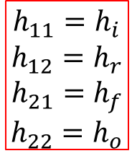




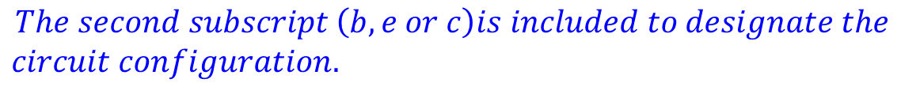








HYBRID PARAMETER MODEL
$$h_{11}$$
$$i_{1}$$
$$i_{2}$$
$$+$$
$$+$$
$$+$$
$$h_{21}i_{1}$$
$$v_{1}$$
$$h_{12}v_{2}$$
$$h_{22}$$
$$v_{2}$$
$$−$$
$$−$$
$$−$$
h-equivalent circuit model for two port network
$$h_{11}=h_{i}$$
$$h_{12}=h_{r}$$
$$h_{21}=h_{f}$$
$$h_{22}=h_{o}$$
$$i, r, f, 0 stands for input, reverse, and forward and output$$
$$The second subscript \left(b, e or c\right)is included to designate the$$
$$circuit configuration.$$
4

Slide 5
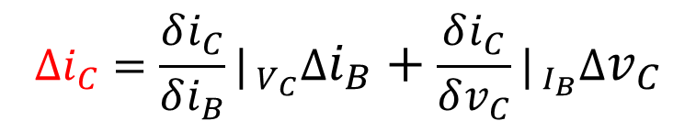
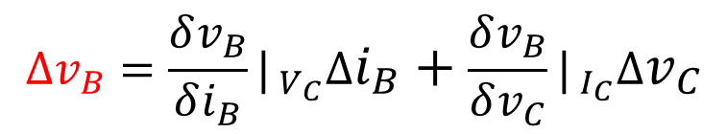


HYBRID PARAMETER MODEL
$${v_{B}=f_{1}(i}_{B},v_{C})$$
$${i_{C}=f_{2}(i}_{B},v_{C})$$
Taylor’s series expansion
$$∆v_{B}=\frac{δv_{B}}{δi_{B}}|_{{ V}_{C}}∆i_{B}+\frac{δv_{B}}{δv_{C}}|_{{ I}_{C}}∆v_{C}$$
$$∆i_{C}=\frac{δi_{C}}{δi_{B}}|_{{ V}_{C}}∆i_{B}+\frac{δi_{C}}{δv_{C}}|_{{ I}_{B}}∆v_{C}$$
$$∆v_{B},∆v_{C},∆i_{B} and ∆i_{B} are the small signal the incremental base collector$$
$$voltage and currents$$
5

Slide 6


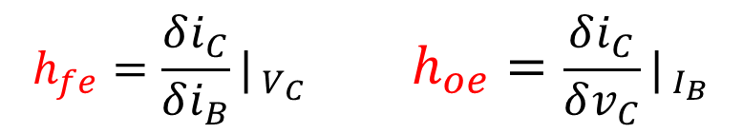
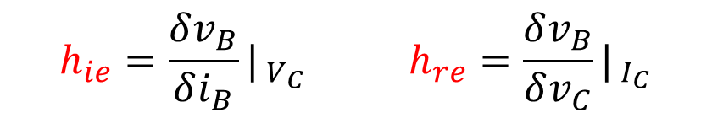
HYBRID PARAMETER MODEL
Taylor’s series expansion
$${ v}_{1}=h_{11}{ i}_{1}+h_{12}{ v}_{2}$$
$${ i}_{2}=h_{21}{ i}_{1}+h_{22}{ v}_{2}$$
Taylor’s series expansion
$$h_{ie}=\frac{δv_{B}}{δi_{B}}|_{{ V}_{C}} h_{re}=\frac{δv_{B}}{δv_{C}}|_{{ I}_{C}}$$
$$h_{fe}=\frac{δi_{C}}{δi_{B}}|_{{ V}_{C}} h_{oe}=\frac{δi_{C}}{δv_{C}}|_{{ I}_{B}}$$
6

Slide 7




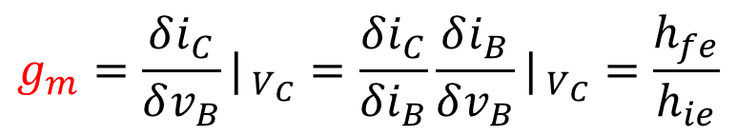






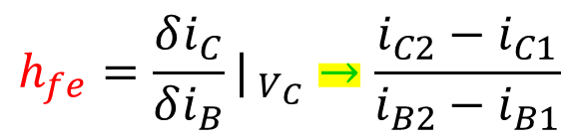


HYBRID PARAMETER MODEL
$$h_{fe}=\frac{δi_{C}}{δi_{B}}|_{{ V}_{C}}→\frac{i_{C2}−i_{C1}}{i_{B2}−i_{B1}}$$
$I_{C}$(mA)
$$i_{B2}$$
$$i_{C2}$$
$$N$$
$$i_{B}$$
Transconductance
$$i_{C}$$
$$Q$$
$$g_{m}=\frac{δi_{C}}{δv_{B}}|_{{ V}_{C}}=\frac{δi_{C}}{δi_{B}}\frac{δi_{B}}{δv_{B}}|_{{ V}_{C}}=\frac{h_{fe}}{h_{ie}}$$
$$i_{C1}$$
$$i_{B1}$$
$$0$$
$$V_{C}$$
$V_{CE}$(V)
7

Slide 8







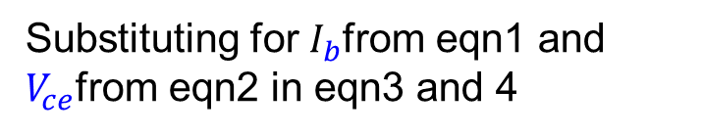









HYBRID PARAMETER MODEL
Kirchhoff’s current law equation
$$+$$
$$I_{c}$$
$$+$$
$$V_{cb}$$
$$I_{c}+I_{e}+I_{b}=0$$
Eqn 1
$$−$$
$$I_{b}$$
$$V_{ce}$$
$$+$$
Kirchhoff’s voltage law equation
$$V_{be}$$
$$−$$
$$V_{ce}=V_{cb}+V_{be}$$
$$−$$
$$I_{e}$$
Eqn 2
h-parameter eqn for CE mode
$$V_{be}={h_{ie}I}_{b}+h_{re}V_{ce}$$
Eqn 3
CE circuit for h-parameter conversion formulas
$$I_{c}={h_{fe}I}_{b}+h_{oe}V_{ce}$$
Eqn 4
Substituting for $I_{b}$from eqn1 and $V_{ce}$from eqn2 in eqn3 and 4
8

Slide 9

















HYBRID PARAMETER MODEL
$$V_{be}={{−h}_{ie}(I}_{c}+I_{e})+h_{re}{(V}_{ce}+V_{be})$$
Eqn 5
$$+$$
$$I_{c}$$
$$+$$
$$V_{cb}$$
$$I_{c}={{−h}_{fe}(I}_{c}+I_{e})+h_{oe}(V_{cb}+V_{be})$$
$$I_{b}$$
Eqn 6
$$−$$
$$V_{ce}$$
$$+$$
Egn 5 and 6 can be re-arranged to give
$$V_{be}$$
$$−$$
$$−$$
$$I_{e}$$
$$V_{be}(1{−h}_{re})={{−h}_{ie}(I}_{c}+I_{e})+h_{re}V_{cb}$$
Eqn 7
$$I_{c}({1+h}_{fe})={{−h}_{fe}I}_{e}+h_{oe}(V_{cb}+V_{be})$$
Eqn 8
CE circuit for h-parameter conversion formulas
Eliminating $V_{be}$between eqn7 and 8 we get
$$I_{c}\left(1+h_{fe}+\frac{h_{oe}h_{ie}}{1−h_{re}}\right)=−I_{e}\left(h_{fe}+\frac{h_{oe}h_{ie}}{1−h_{re}}\right)+{ V}_{cb}h_{oe}\left(1+\frac{h_{re}}{1−h_{re}}\right)$$
Eqn 9
9

Slide 10
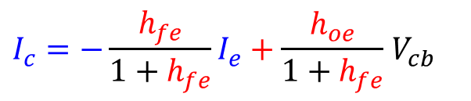
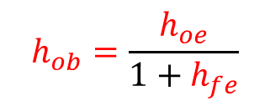


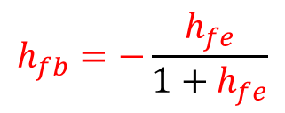

HYBRID PARAMETER MODEL
Since $h_{re}$ <<1 and $h_{oe}h_{ie}$<<1
$$+$$
$$I_{c}$$
$$+$$
$$V_{cb}$$
$$I_{c}\left(1+h_{fe}\right)=−h_{fe}I_{e}+{ V}_{cb}h_{oe}$$
$$−$$
$$I_{b}$$
$$V_{ce}$$
$$I_{c}=−{\frac{h_{fe}}{1+h_{fe}}I}_{e}+\frac{h_{oe}}{1+h_{fe}}{ V}_{cb}$$
$$+$$
Eqn 10
$$V_{be}$$
$$−$$
$$−$$
$$I_{e}$$
The eqn for CB h-parameter is
$$I_{c}=−h_{fb}I_{e}+{ V}_{cb}h_{ob}$$
Eqn 11
CE circuit for h-parameter conversion formulas
Comparing eqn 10 and 11
$$h_{fb}=−\frac{h_{fe}}{1+h_{fe}}$$
$$h_{ob}=\frac{h_{oe}}{1+h_{fe}}$$
10

Slide 11
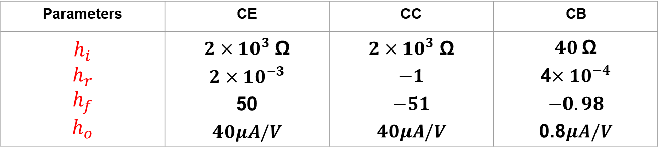

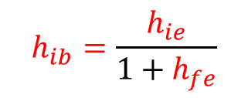

HYBRID PARAMETER MODEL
Eliminating $I_{c}$ between eqn7 & 8 and making approximation Since $h_{re}$ <<1 and $h_{oe}h_{ie}$<<1 , CB h-parameter equation
$$V_{eb}={−V}_{be}={h_{ib}I}_{e}+h_{rb}V_{cb}$$
Eqn 12
$$h_{ib}=\frac{h_{ie}}{1+h_{fe}}$$
$$h_{rb}=\frac{{h_{ie}h}_{oe}}{1+h_{fe}}−h_{re}$$
Parameters | CE | CC | CB
$$h_{i}$$ $$h_{r}$$ $$h_{f}$$ $$h_{o}$$ | $2×{10}^{3}$ Ω $2×{10}^{−3}$ 50 $40μA/V$ | $2×{10}^{3}$ Ω $$−1$$ $$−51$$ $40μA/V$ | $40$Ω 4$×{10}^{−4}$ $$−0.98$$ 0.8$μA/V$
11

Slide 12





















h-parameter for transistor as amplifier
$$h_{j}$$
$$I_{1}$$
$$1$$
2
$$I_{2}$$
$$I_{L}$$
$$R_{i}$$
$$+$$
$$+$$
$$+$$
$$h_{f}I_{1}$$
$$V_{1}$$
$$h_{r}v_{2}$$
$$h_{o}$$
$$V_{2}$$
$$R_{L}$$
$$−$$
$$−$$
$$−$$
$$1′$$
Two port transistor circuit
$$2′$$
$$R_{i}$$
$$R_{o}$$
The h-parameter model of a transistor amplifier
12

Slide 13
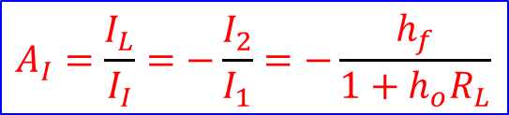



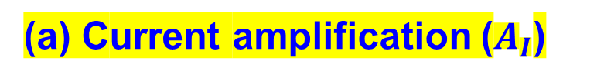
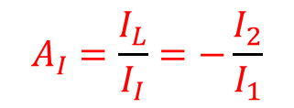

h-parameter for transistor as amplifier
(a) Current amplification ($A_{I}$)
Current gain or the current amplification ($A_{I}$)
Eqn 1
$$A_{I}=\frac{I_{L}}{I_{I}}=−\frac{I_{2}}{I_{1}}$$
Kirchhoff’s current law eqn for the output circuit,
Eqn 2
$$I_{2}=h_{o}V_{2}+{ I}_{1}h_{f}$$
Since $V_{2}=I_{L}R_{L}=−{ I}_{2}R_{L}$
Eqn 3
We obtain from eqn1 and 2,
$$A_{I}=\frac{I_{L}}{I_{I}}=−\frac{I_{2}}{I_{1}}=−\frac{h_{f}}{1+h_{o}R_{L}}$$
Eqn 4
When $R_{L}$<1/(10 $h_{o}$), we have $A_{1}=−h_{f}$
13

Slide 14

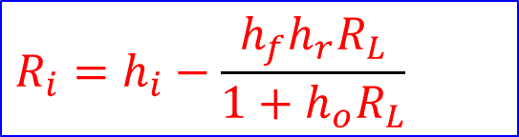


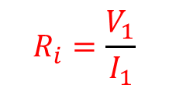
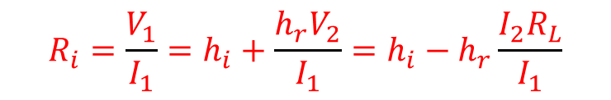
h-parameter for transistor as amplifier
(b) Input Resistance ($R_{i}$)
Input resistance ($R_{i}$):
$$R_{i}=\frac{V_{1}}{I_{1}}$$
Eqn 5
Kirchhoff’s voltage law eqn for the input circuit,
$$V_{1}=h_{i}I_{1}+V_{2}h_{r}$$
Eqn 6
$$R_{i}=\frac{V_{1}}{I_{1}}=h_{i}+\frac{{h_{r}V}_{2}}{I_{1}}=h_{i}−h_{r}\frac{{I_{2}R}_{L}}{I_{1}}$$
Since $V_{2}={−I}_{2}R_{L}=−{ I}_{2}R_{L}$, Again $A_{I}=−\frac{I_{2}}{I_{1}}$, Therefore $R_{i}=h_{i}+A_{I}h_{r}R_{L}$
Eqn 7
We obtain from eqn4 and 7,
$$R_{i}=h_{i}−\frac{h_{f}{h_{r}R}_{L}}{1+h_{o}R_{L}}$$
Eqn 8
14

Slide 15

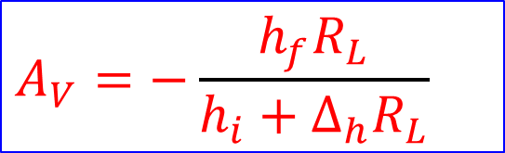



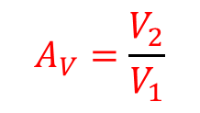
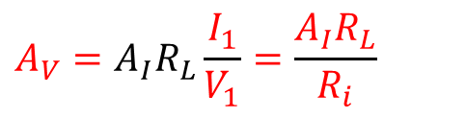
h-parameter for transistor as amplifier
(b) Voltage Gain ($A_{V}$)
Voltage gain ($A_{V}$):
$$A_{V}=\frac{V_{2}}{V_{1}}$$
Eqn 9
We have,
$$V_{2}=−I_{2}R_{L}=A_{I}I_{1}R_{L}$$
Eqn 10
Therefore,
$$A_{V}=A_{I}R_{L}\frac{I_{1}}{V_{1}}=\frac{{A_{I}R}_{L}}{R_{i}}$$
Eqn 11
Substituting $A_{I}$ from eqn4 and $R_{i}$ from eqn8 in to eqn11, we obtain
$$A_{V}=−\frac{h_{f}R_{L}}{h_{i}+∆_{h}R_{L}}$$
Eqn 12
$∆_{h}=h_{i}h_{o}−h_{f}$ $h_{r}$
Eqn 13
15

Slide 16

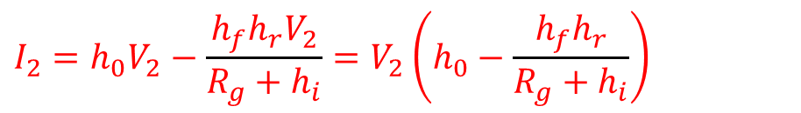


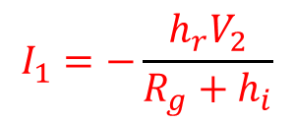
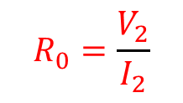

h-parameter for transistor as amplifier
(b) Output Resistance ($R_{0}$)
Output resistance ($R_{0}$):
$$R_{0}=\frac{V_{2}}{I_{2}}$$
Eqn 14
Kirchhoff’s current law eqn for the output circuit,
$$I_{2}=h_{o}V_{2}+h_{f}I_{1}$$
Eqn 15
Kirchhoff’s voltage law eqn for the input circuit,
$$\left(R_{g}+h_{i}\right)I_{1}+h_{r}V_{2}=0$$
$$I_{1}=−\frac{h_{r}V_{2}}{{R_{g}+h}_{i}}$$
Eqn 16
Substituting from eqn16 to eqn15,
$$I_{2}=h_{0}V_{2}−\frac{h_{f}{h_{r}V}_{2}}{R_{g}+h_{i}}=V_{2}\left(h_{0}−\frac{h_{f}h_{r}}{R_{g}+h_{i}}\right)$$
16

Slide 17
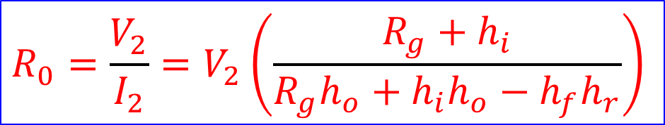
h-parameter for transistor as amplifier
(b) Output Resistance ($R_{0}$)
Therefore,
$$R_{0}=\frac{V_{2}}{I_{2}}=V_{2}\left(\frac{{R_{g}+h}_{i}}{R_{g}h_{o}+h_{i}h_{o}−h_{f}h_{r}}\right)$$
Eqn 17
17

Slide 18
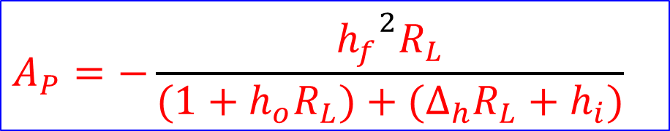


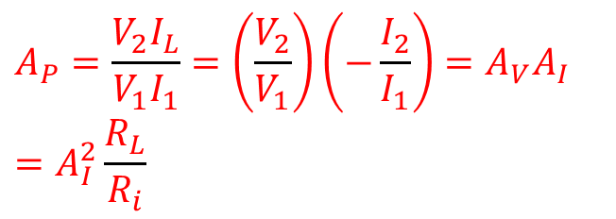

h-parameter for transistor as amplifier
(b) Power gain ($A_{P}$)
Power gain ($A_{P}$):
$$A_{P}=\frac{V_{2}I_{L}}{V_{1}I_{1}}=\left(\frac{V_{2}}{V_{1}}\right)\left(−\frac{I_{2}}{I_{1}}\right)=A_{V}A_{I}$$
$$=A_{I}^{2}\frac{R_{L}}{R_{i}}$$
Eqn 18
using eqn11
Substituting $A_{I}$ from eqn4 and $R_{i}$ from eqn8 in to eqn18, we obtain
$$A_{P}=−\frac{{h_{f}}^{2}R_{L}}{(1+h_{o}R_{L})+(∆_{h}R_{L}+h_{i})}$$
Eqn 19
$∆_{h}=h_{i}h_{o}−h_{f}$ $h_{r}$
18

Slide 19





























h-parameter for transistor as amplifier
$$h_{ie}$$
$$i_{b}$$
$$B$$
C
$$i_{c}$$
$$i_{c}$$
$$C$$
$$R_{1}$$
$$+$$
$$+$$
$$h_{fe}i_{b}$$
$$+$$
$$V_{cc}$$
$$h_{oe}$$
$$R_{L}$$
$$i_{b}$$
$$B$$
$$V_{g}$$
$$h_{re}v_{c}$$
$$v_{C}$$
$$V_{c}$$
$$+$$
$$−$$
$$−$$
$$V_{g}$$
$$−$$
$$−$$
$$E$$
$$E$$
$$E$$
$$E$$
A CE transistor amplifier
Hybrid model ac equivalent circuit for the amplifier
19

Slide 20
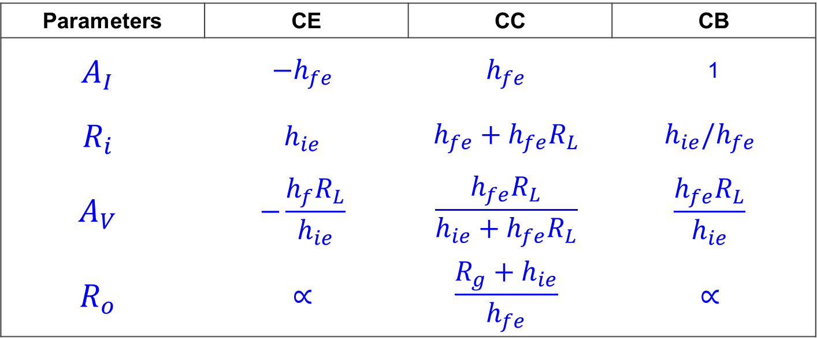
h-parameter for transistor as amplifier
Parameters | CE | CC | CB
$$A_{I}$$ | $$−h_{fe}$$ | $$h_{fe}$$ | 1
$$R_{i}$$ | $$h_{ie}$$ | $$h_{fe}+h_{fe}R_{L}$$ | $$h_{ie}/h_{fe}$$
$$A_{V}$$ | $$−\frac{h_{f}R_{L}}{h_{ie}}$$ | $$\frac{h_{fe}R_{L}}{h_{ie}+h_{fe}R_{L}}$$ | $$\frac{h_{fe}R_{L}}{h_{ie}}$$
$$R_{o}$$ | $$∝$$ | $$\frac{R_{g}+h_{ie}}{h_{fe}}$$ | $$∝$$
20

Slide 21
Concept Questions
Q.1 An npn transistor is used as a CE amplifier and has a collector-to-base bias arrangement. Find the Q point analytically and the stability factors. Given: $β$ = 99, $V_{BE}$=0.7 V, $V_{CC}$=12 V, $R_{L}$= 2 kΩ and $R_{B}$= 100 kΩ.
Q.2 A Ge transistor with $β$ = 49 has a self base bias arrangement. The stability factor S desired to be 10. Obtain the value $R_{1}$, $R_{2}$and $R_{e}$. Given: $V_{CE}$=5 V, $V_{CC}$=10 V, $I_{C}$= 4.9mA and $R_{L}$= 1 kΩ, $V_{BE}$= 0.2 V.
Q.3 A CB h-parameters of a transistor are $h_{ie}$= 30 Ohm, $h_{rb}$= 4$×{10}^{−4}$, $h_{fb}$= -0.99, $h_{ob}$= 0.9$×{10}^{−6}$ S for a suitable operating point. The amplifier used in CB mode with a load resistance of 6kOhm. Calculate the current gain, input resistance, voltage gain and power gain.
21

