Slide 1

Lecture 9
September 08, 2023
1

Slide 2
Transistor Amplifier
Specifications:
Input Signal = 0.1 V
Signal Frequency = 1Khz
Amplification factor = 10
Supply Voltage = 10 V
Load Resistance = 10 𝑘Ω
2

Slide 3
Transistor Applications
1 V
Amplifier
0.1V AC
1 KHz
10 𝑘Ω
3

Slide 4




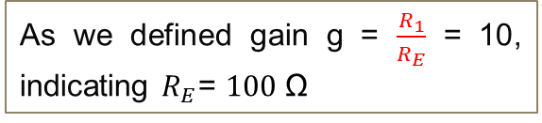

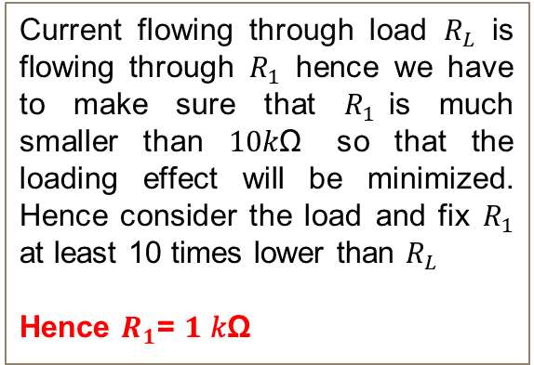




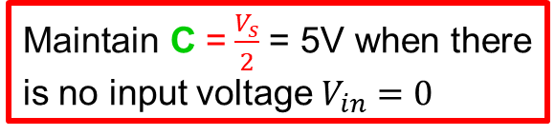

Transistor Applications (AC Amplifier)
$$V_{s}=10 V$$
Amplification Policy
Maintain C =$\frac{V_{s}}{2}$ = 5V when there is no input voltage $V_{in}=0$
$R_{1}$= $100\text{Ω}$
$$C_{out}$$
$$C$$
Current flowing through load $R_{L}$ is flowing through $R_{1}$ hence we have to make sure that $R_{1}$is much smaller than $10\text{k}\text{Ω}$ so that the loading effect will be minimized. Hence consider the load and fix $R_{1}$ at least 10 times lower than $R_{L}$
Hence $R_{1}$= $1 \text{k}\text{Ω}$
$$R_{2}$$
$$C_{in}$$
$$R_{L}=10\text{k}\text{Ω}$$
$V_{in}$= AC, 0.1V, 1KHz
$$R_{3}$$
$$R_{E}$$
As we defined gain g = $\frac{R_{1}}{R_{E}}$ = 10, indicating $R_{E}$= $1\text{00} \text{Ω}$
4

Slide 5
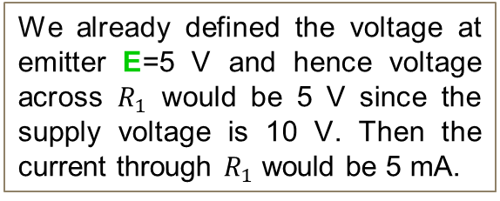
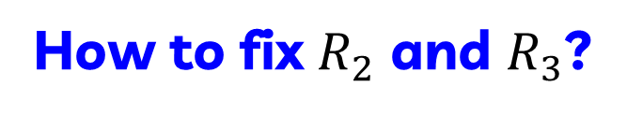





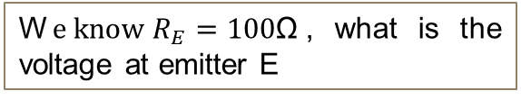


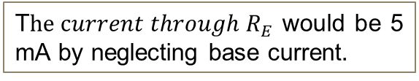


How to fix $R_{2}$ and $R_{3}$?
$$V_{s}=10 V$$
W$e know R_{E}=100\text{Ω}$, what is the voltage at emitter E
$R_{1}$= $1k\text{Ω}$
We already defined the voltage at emitter E=5 V and hence voltage across $R_{1}$ would be 5 V since the supply voltage is 10 V. Then the current through $R_{1}$ would be 5 mA.
$$C_{out}$$
$$C$$
$$R_{2}$$
$$C_{in}$$
$$B$$
$$R_{L}=10\text{k}\text{Ω}$$
T$he current through R_{E}$ would be 5 mA by neglecting base current.
$$E$$
$V_{in}$= AC, 0.1V, 1KHz
$$R_{3}$$
$R_{E}$=100$\text{Ω}$
5

Slide 6
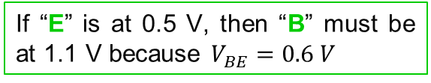
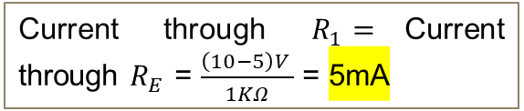

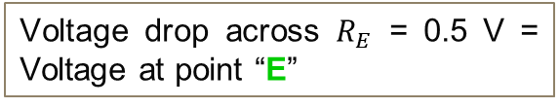
What is current through $R_{E}$and Base Vol ?
$$V_{s}=10 V$$
$R_{1}$= $1k\text{Ω}$
Current through $R_{1}=$Current through $R_{E}$ = $\frac{\left(10−5\right)V }{1KΩ}$ = 5mA
$$C_{out}$$
$$C$$
$$R_{2}$$
Voltage drop across $R_{E}$ = 0.5 V = Voltage at point “E”
$$C_{in}$$
$$B$$
$$R_{L}=10\text{k}\text{Ω}$$
1.1 V
If “E” is at 0.5 V, then “B” must be at 1.1 V because $V_{BE}=0.6 V$
$$E$$
0.5 V
$V_{in}$= AC, 0.1V, 1KHz
$$R_{3}$$
$R_{E}$=100$\text{Ω}$
6

Slide 7
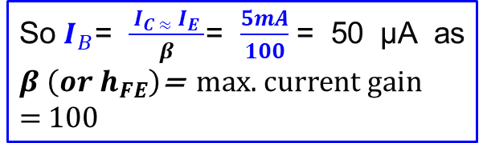
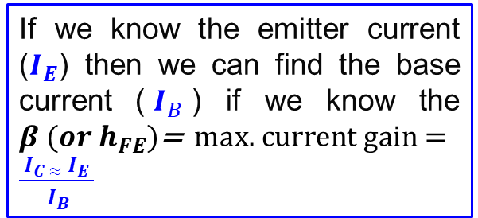
What is current through Base ?
$$V_{s}=10 V$$
Although we assumed the base current is negligible but there is a very small amount of current flowing through the base.
$R_{1}$= $1k\text{Ω}$
$$C_{out}$$
$$C$$
If we know the emitter current ($I_{E}$) then we can find the base current ($I_{B}$) if we know the $β (or h_{FE})\text{=} \text{max}\text{. }\text{current} \text{gain}\text{ = }\frac{{ I}_{C ≈}{ I}_{E }}{{ I}_{B}}$
$$R_{2}$$
$$C_{in}$$
$$B$$
$$R_{L}=10\text{k}\text{Ω}$$
1.1 V
$$E$$
0.5 V
$V_{in}$= AC, 0.1V, 1KHz
So$I_{B}$= $\frac{{ I}_{C ≈}{ I}_{E }}{β}$= $\frac{5mA}{100}$= 50 µA as $β \left(or h_{FE}\right)\text{=} \text{max}\text{. }\text{current} \text{gain}\text{ = }100$
$$R_{3}$$
$R_{E}$=100$\text{Ω}$
7

Slide 8
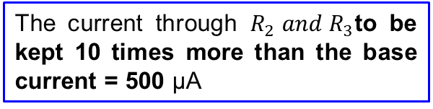
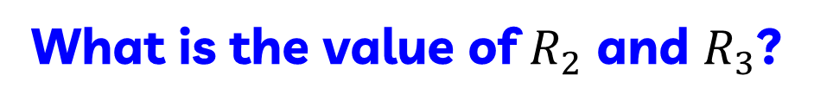
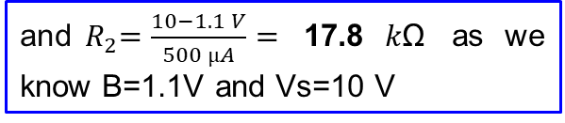

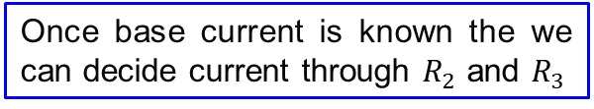




What is the value of $R_{2}$ and $R_{3}$?
$$V_{s}=10 V$$
Once base current is known the we can decide current through $R_{2}$ and $R_{3}$
$R_{1}$= $1k\text{Ω}$
The current through $R_{2} and{ R}_{3}$to be kept 10 times more than the base current = 500 µA
$$C_{out}$$
18.7 𝑘Ω
$$C$$
$$R_{2}$$
The voltage across ${ R}_{3}$ is 1.1 V = ${ V}_{BE}$
$$C_{in}$$
$$B$$
$$R_{L}=10\text{k}\text{Ω}$$
S$o{ R}_{3}=\frac{1.1 V}{500 µA}=$ 2.2 $k\text{Ω}$
1.1 V
and${ R}_{2}=\frac{10−1.1 V}{500 µA}=$ 17.8 $k\text{Ω}$ as we know B=1.1V and Vs=10 V
$$E$$
0.5 V
$V_{in}$= AC, 0.1V, 1KHz
$$R_{3}$$
2.2 𝑘Ω
$R_{E}$=100$\text{Ω}$
8

Slide 9
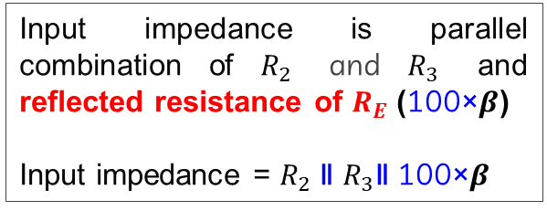

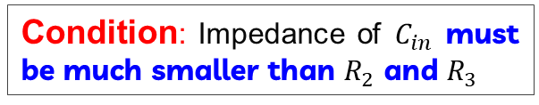
What is value of $C_{in}$?
$$V_{s}=10 V$$
Condition: Impedance of $C_{in}$ must be much smaller than $R_{2}$ and $R_{3}$
$R_{1}$= $1k\text{Ω}$
What is the input impedance of amplifier?
$$C_{out}$$
18.7 𝑘Ω
$$C$$
Input impedance is parallel combination of $R_{2}$ and $R_{3}$ and reflected resistance of $R_{E}$ (100×$β$)
Input impedance = $R_{2}$ ǁ $R_{3}$ǁ 100×$β$
$$R_{2}$$
$$C_{in}$$
$$B$$
$$R_{L}=10\text{k}\text{Ω}$$
1.1 V
$$E$$
0.5 V
$V_{in}$= AC, 0.1V, 1KHz
$$R_{3}$$
2.2 𝑘Ω
$R_{E}$=100$\text{Ω}$
9

Slide 10
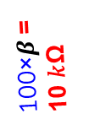
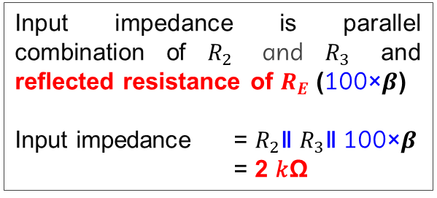
What is value of $C_{in}$?
$$V_{s}=10 V$$
Input impedance equivalent ckt
$R_{1}$= $1k\text{Ω}$
100×$β$=10 𝑘Ω
2.2 𝑘Ω
18.2 𝑘Ω
$$C_{out}$$
18.7 𝑘Ω
$$C$$
$$R_{2}$$
$$C_{in}$$
$$B$$
$$R_{L}=10\text{k}\text{Ω}$$
1.1 V
Input impedance is parallel combination of $R_{2}$ and $R_{3}$ and reflected resistance of $R_{E}$ (100×$β$)
Input impedance = $R_{2}$ǁ $R_{3}$ǁ 100×$β$
= 2 𝑘Ω
$$E$$
0.5 V
$V_{in}$= AC, 0.1V, 1KHz
$$R_{3}$$
2.2 𝑘Ω
$R_{E}$=100$\text{Ω}$
10

Slide 11
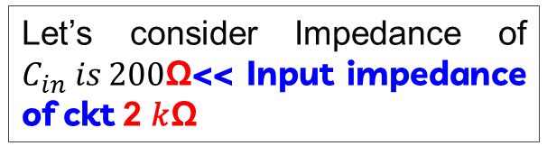
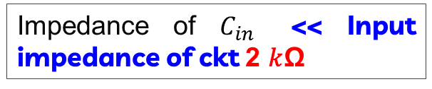
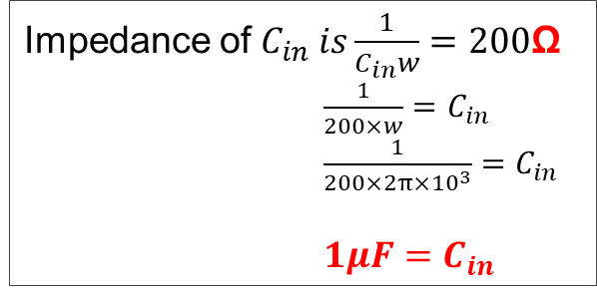

What is value of $C_{in}$?
$$V_{s}=10 V$$
Impedance of $C_{in}$ << Input impedance of ckt 2 𝑘Ω
$R_{1}$= $1k\text{Ω}$
Let’s consider Impedance of $C_{in} is 200$Ω<< Input impedance of ckt 2 𝑘Ω
$$C_{out}$$
18.7 𝑘Ω
$$C$$
$$R_{2}$$
Impedance of $C_{in} is\frac{1}{C_{in}w}=200$Ω
$\frac{1}{200×w}=C_{in}$ $\frac{1}{200×2π×{10}^{3}}=C_{in}$
$1μF=C_{in}$
$$C_{in}$$
$$B$$
$$R_{L}=10\text{k}\text{Ω}$$
$$\frac{1}{cw}$$
1.1 V
$$E$$
0.5 V
$V_{in}$= AC, 0.1V, 1KHz
$$R_{3}$$
2.2 𝑘Ω
$R_{E}$=100$\text{Ω}$
11

Slide 12
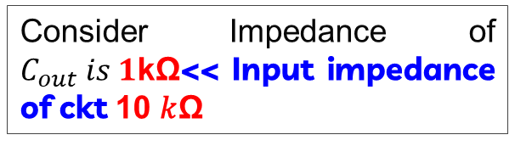

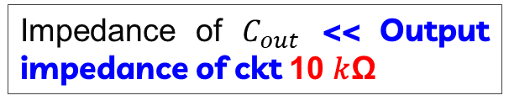

What is value of $C_{out}$?
$$V_{s}=10 V$$
Impedance of $C_{out}$ << Output impedance of ckt 10 𝑘Ω
$R_{1}$= $1k\text{Ω}$
$$C_{out}$$
$$C_{out}$$
18.7 𝑘Ω
$$C$$
10 𝑘Ω
$$R_{2}$$
$$C_{in}$$
$$B$$
$$R_{L}=10\text{k}\text{Ω}$$
$$\frac{1}{cw}$$
1.1 V
$$E$$
0.5 V
Consider Impedance of $C_{out} is 1$kΩ<< Input impedance of ckt 10 𝑘Ω
$V_{in}$= AC, 0.1V, 1KHz
$$R_{3}$$
2.2 𝑘Ω
$R_{E}$=100$\text{Ω}$
12

Slide 13
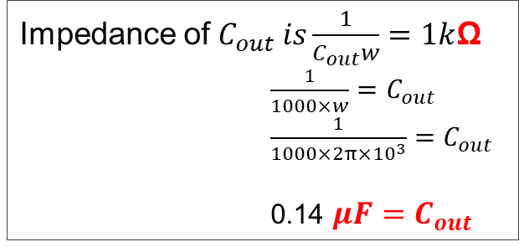


What is value of $C_{out}$?
$$V_{s}=10 V$$
Impedance of $C_{out} is\frac{1}{C_{out}w}=1k$Ω
$\frac{1}{1000×w}=C_{out}$ $\frac{1}{1000×2π×{10}^{3}}=C_{out}$
0.14 $μF=C_{out}$
$R_{1}$= $1k\text{Ω}$
$$C_{out}$$
18.7 𝑘Ω
$$C$$
$$R_{2}$$
$$0.14 μF$$
$$C_{in}$$
$$1μF$$
$$B$$
$$R_{L}=10\text{k}\text{Ω}$$
$$\frac{1}{cw}$$
1.1 V
$$E$$
0.5 V
$V_{in}$= AC, 0.1V, 1KHz
$$R_{3}$$
2.2 𝑘Ω
$R_{E}$=100$\text{Ω}$
13

Slide 14
Transistor Relay Circuit
14

Slide 15



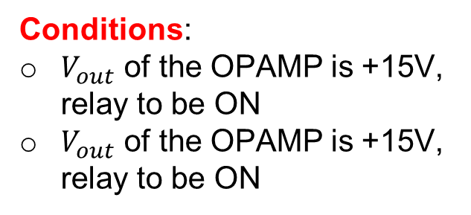





Transistor Relay Circuit
+12V
Conditions:
$V_{out}$ of the OPAMP is +15V, relay to be ON
$V_{out}$ of the OPAMP is +15V, relay to be ON
$D_{2}$
+15V
$D_{1}$
$V_{out}$
$R_{1}$
$$−$$
$$+$$
We need to find $R_{1}$and $R_{2}$?
-15V
$R_{2}$
15

Slide 16

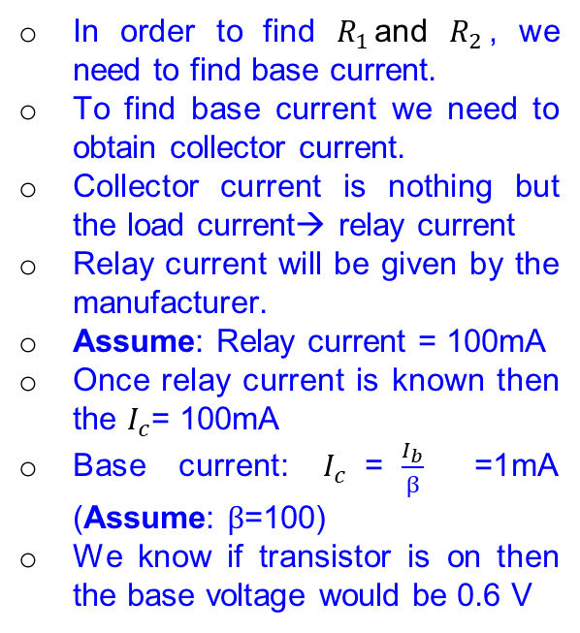

We need to find $R_{1}$and $R_{2}$?
+12V
In order to find $R_{1}$and $R_{2}$, we need to find base current.
To find base current we need to obtain collector current.
Collector current is nothing but the load current→ relay current
Relay current will be given by the manufacturer.
Assume: Relay current = 100mA
Once relay current is known then the $I_{c}$= 100mA
Base current: $I_{c}$=$\frac{I_{b}}{β}$ =1mA (Assume: $β$=100)
We know if transistor is on then the base voltage would be 0.6 V
$D_{2}$
+15V
$D_{1}$
$R_{1}$
0.6V
$$−$$
$V_{out}$
1mA
$$+$$
-15V
$R_{2}$
16

Slide 17
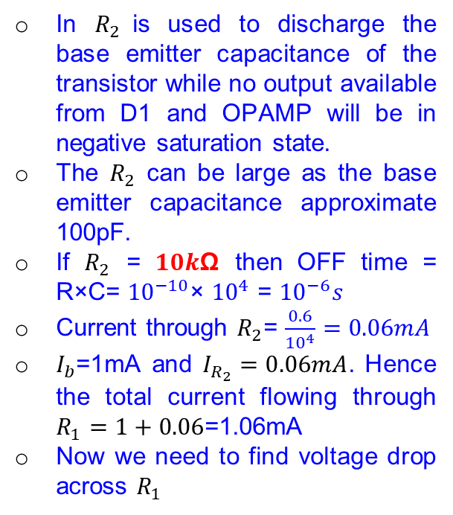
We need to find $R_{1}$and $R_{2}$?
+12V
In $R_{2}$is used to discharge the base emitter capacitance of the transistor while no output available from D1 and OPAMP will be in negative saturation state.
The $R_{2}$ can be large as the base emitter capacitance approximate 100pF.
If $R_{2}$ = $10k\text{Ω}$ then OFF time = R×C= ${10}^{−10}$× ${10}^{4}$ = ${10}^{−6}s$
Current through $R_{2}$= $\frac{0.6}{{10}^{4}}=0.06mA$
$I_{b}$=1mA and $I_{R_{2}}=0.06mA$. Hence the total current flowing through $R_{1}=1+0.06$=1.06mA
Now we need to find voltage drop across $R_{1}$
$D_{2}$
+15V
$D_{1}$
$R_{1}$
0.6V
$$−$$
$V_{out}$
1mA
$$+$$
-15V
$R_{2}$
17

Slide 18
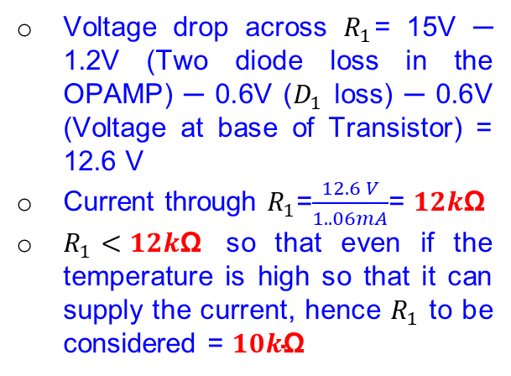
We need to find $R_{1}$and $R_{2}$?
+12V
Voltage drop across $R_{1}$= 15V ─ 1.2V (Two diode loss in the OPAMP) ─ 0.6V ($D_{1}$ loss) ─ 0.6V (Voltage at base of Transistor) = 12.6 V
Current through $R_{1}$=$\frac{12.6 V}{1..06mA}$= $12k\text{Ω}$
$R_{1}<12k\text{Ω}$ so that even if the temperature is high so that it can supply the current, hence $R_{1}$ to be considered = $10k\text{Ω}$
$D_{2}$
13.8V
13.2V
0.6V
+15V
$D_{1}$
$V_{out}$
$R_{1}$
$$−$$
1mA
$$+$$
-15V
$R_{2}$
18

Slide 19
Relay Drive using MOSFET
19

Slide 20
MOSFET equivalent ckt
+12V
The output voltage after the D1 is 13.8V that is sufficient to drive the MOSFET (No need to worry for current)
$D_{2}$
13.8V
13.3V
+15V
$D_{1}$
$$−$$
$V_{out}$
MOSFET
$$+$$
-15V
20

Slide 21

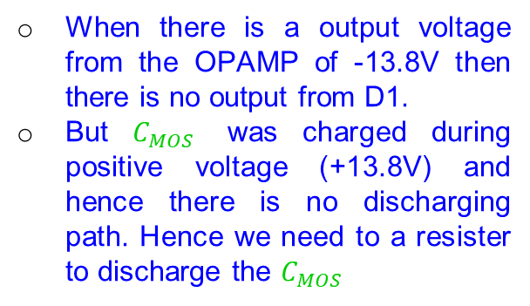
MOSFET equivalent ckt
+12V
When there is a output voltage from the OPAMP of -13.8V then there is no output from D1.
But $C_{MOS}$ was charged during positive voltage (+13.8V) and hence there is no discharging path. Hence we need to a resister to discharge the $C_{MOS}$
$D_{2}$
-13.8V
0V
+15V
$D_{1}$
$$−$$
$V_{out}$
MOSFET
$$+$$
-15V
$$C_{MOS}$$
21

Slide 22

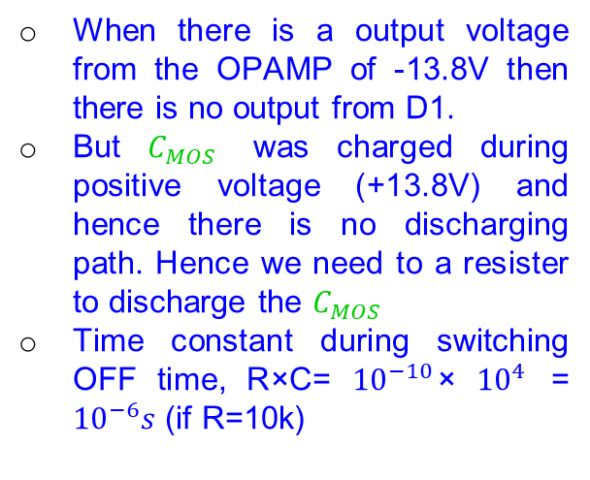
MOSFET equivalent ckt
+12V
When there is a output voltage from the OPAMP of -13.8V then there is no output from D1.
But $C_{MOS}$ was charged during positive voltage (+13.8V) and hence there is no discharging path. Hence we need to a resister to discharge the $C_{MOS}$
Time constant during switching OFF time, R×C= ${10}^{−10}$× ${10}^{4}$ = ${10}^{−6}s$ (if R=10k)
$D_{2}$
-13.8V
0V
+15V
$D_{1}$
$$−$$
$V_{out}$
MOSFET
BS-170
$$+$$
-15V
$R_{}$
$$C_{MOS}$$
22

Slide 23
Disadvantage MOSFET Switch
+12V
Designing of MOSFET switch is easy but limited with high voltage operation.
BS-170 operates with 5V only.
If any circuit needs to be operated at low voltage (say +/- 2V) then the MOSFET circuit will not work for such operation.
Where the transistor require only 0.6V base-emitter voltage to operate in the transistor.
$D_{2}$
-14.2V
0V
+15V
$D_{1}$
$$−$$
$V_{out}$
MOSFET
BS-170
$$+$$
-15V
$R_{}$
$$C_{MOS}$$
23

Slide 24
What is the function of diode D2 ?
24

Slide 25

Use of D2
+12V
Relay has 100mA current with 15V supply
The resistance of the coil = $\frac{12V}{100mA}$ = 120 Ohm
Energy stored in the inductor = $\frac{1}{2}LI^{2}$
Switch
25

Slide 26



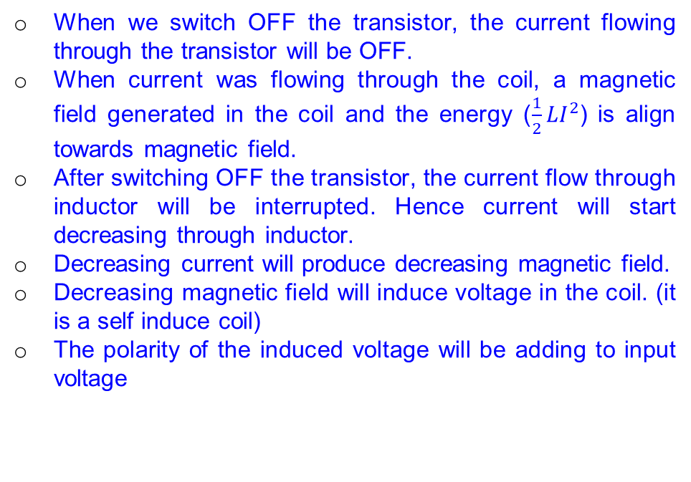
Use of D2
+12V
When we switch OFF the transistor, the current flowing through the transistor will be OFF.
When current was flowing through the coil, a magnetic field generated in the coil and the energy ($\frac{1}{2}LI^{2}$) is align towards magnetic field.
After switching OFF the transistor, the current flow through inductor will be interrupted. Hence current will start decreasing through inductor.
Decreasing current will produce decreasing magnetic field.
Decreasing magnetic field will induce voltage in the coil. (it is a self induce coil)
The polarity of the induced voltage will be adding to input voltage
$D_{2}$
$R_{1}$
0V
$R_{2}$
26

Slide 27

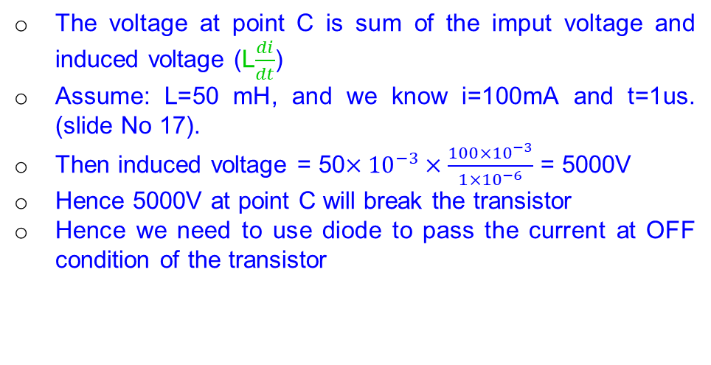
Use of D2
The voltage at point C is sum of the imput voltage and induced voltage (L$\frac{di}{dt}$)
Assume: L=50 mH, and we know i=100mA and t=1us. (slide No 17).
Then induced voltage = 50$×{10}^{−3}×\frac{100×{10}^{−3}}{1×{10}^{−6}}$ = 5000V
Hence 5000V at point C will break the transistor
Hence we need to use diode to pass the current at OFF condition of the transistor
+12V
L$\frac{di}{dt}$
C
$R_{1}$
0V
$R_{2}$
27

Slide 28
Use of D2
+12V
Diode operating voltage is 0.6V and C point can’t increase beyond 12.6 voltage.
The current will flow across the diode-inductor loop and heat will dissipate through this.
The transistor will not be destroyed.
$D_{2}$
C
$R_{1}$
0V
$R_{2}$
28

