Slide 1

Lecture 10
September 13, 2023
1

Slide 2
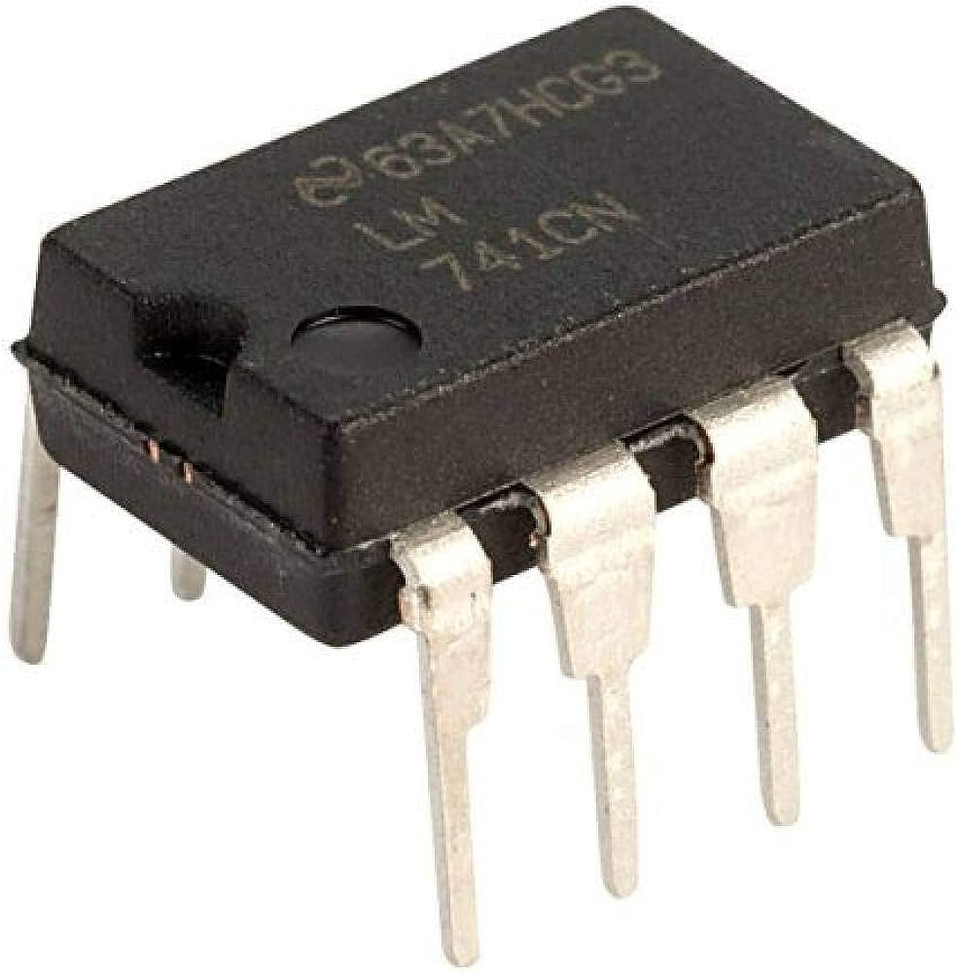
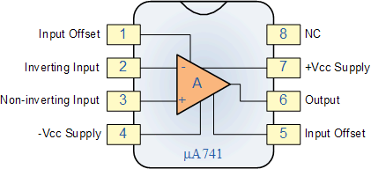
Ideal OPAMP
Adder, Subtractor, Differentiator, Amplifier, Integrator
2

Slide 3












OPAMP-Non-Inverting
Gain 10 → non-inverting amplifier
$$R_{2}$$
$$+15V$$
E3
$$R_{C1}$$
$$R_{1}$$
P
B3
$$−$$
C1
T3
C2
N
$$+$$
P
B1
T1
B2
T2
C3
$$V_{o}$$
$R_{2}$=9k
E1
E2
$$R_{C2}$$
$R_{1}$=1k
$$R_{E}$$
$$−15V$$
How can you make inverting amplifier?
3

Slide 4









Ideal OPAMP
Differential inputs → Single ended Output
$i_{N}$=0
Infinite→ i/p resistance
$$−$$
$$V_{0}$$
$$+$$
Zero → O/p resistance
$$+$$
_
$i_{P}$=0
$$V_{N}$$
$$+$$
_
$$V_{P}$$
$A_{V}\text{→}$ Open loop gain → Infinite
$$ZERO COMMON MODE GAIN$$
4

Slide 5






Differential Amplifier
Differential Amplifier
$$V_{N}$$
$$−$$
$$+$$
_
$$A_{V}(V_{P}−V_{N})$$
$$+$$
$$V_{P}$$
5

Slide 6
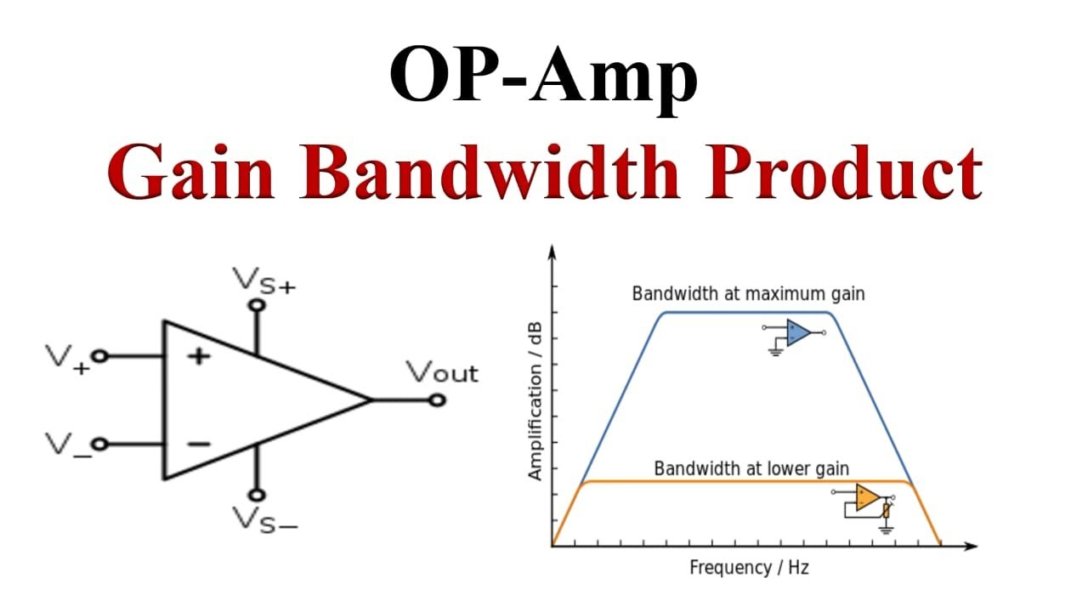
Bandwidth
6

Slide 7










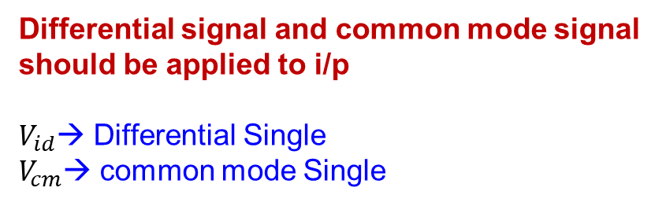










Differential Amplifier
$$V_{DD}$$
$$V_{N}$$
$$−$$
Differential signal and common mode signal should be applied to i/p
$V_{id}$→ Differential Single
$V_{cm}$→ common mode Single
$$A_{V}(V_{P}−V_{N})$$
$V_{id}$
$$+$$
$$V_{P}$$
$$V_{GND}$$
$$V_{N}$$
$$V_{DD}$$
$$−$$
$$−$$
$V_{id}$/2
$$+$$
$$A_{V}(V_{P}−V_{N})$$
$$+$$
$$−$$
$V_{id}/2$
$$+$$
$$V_{CM}$$
$$+$$
$$−$$
$$V_{P}$$
$$V_{GND}$$
7

Slide 8













Transfer Charac Differential Amplifier
$$V_{N}$$
$$V_{DD}=5V$$
$$−$$
$$−$$
$V_{id}$/2
$$+$$
$$A_{V}(V_{P}−V_{N})$$
$$+$$
$$−$$
$V_{id}/2$
$$+$$
$$V_{CM}$$
$$+$$
$$−$$
$$V_{P}$$
$V_{GND}$=0
5V
Av
$$V_{CM}$$
Vp = CM+Vid/2
Vn = CM+Vid/2
2.5V
5V
Vn = CM-Vid/2
8

Slide 9
Transfer Charac Differential Amplifier
$$V_{N}$$
$$V_{DD}=5V$$
$$−$$
$$−$$
$V_{id}$/2
$$+$$
$$A_{V}(V_{P}−V_{N})$$
$$+$$
$$−$$
$V_{id}/2$
$$+$$
$$V_{CM}$$
$$+$$
$$−$$
$$V_{P}$$
$V_{GND}$=0
5V
Av
Vp = CM+Vid/2
$$V_{CM}$$
Vn = CM+Vid/2
Vn = CM-Vid/2
2.5V
5V
9

Slide 10
Transfer Charac Differential Amplifier
10

Slide 11








Output of OPAMP
$$V_{DD}=5V$$
??
$$−$$
$$V_{out}=5V$$
$$+$$
$$+$$
$$100 Ohm$$
$$ac$$
$$−$$
$V_{GND}$=0
11

Slide 12




Non-inverting
$V_{CC}$=1.6V
$$−$$
$$+$$
$V_{BE}$=0.6V
12

Slide 13










Inverting Amplifier
$$V_{DD}=5V$$
$$+$$
$$−$$
$$V_{Out}=−AV_{P}$$
$$ac$$
$V_{BE}$=0V
$$−$$
$$+$$
$V_{EE}$=-5V
$$V_{out}$$
$$A_{V}$$
$$V_{in}$$
13

Slide 14






Non-Inverting Amplifier
$$V_{DD}=5V$$
$$−$$
$$V_{Out}=AV_{P}$$
$V_{BE}$=0V
$$+$$
$$+$$
$$ac$$
$V_{BE}$=-5V
$$V_{out}$$
$$−$$
$$A_{V}$$
$$V_{in}$$
14

Slide 15

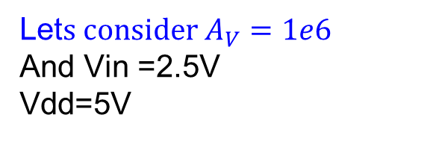
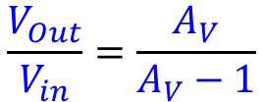



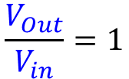
Inverting Amplifier
$$2.501V$$
$$V_{DD}=5V$$
$$V_{Out}=A_{V}(V_{P}−V_{N})$$
$$+$$
$$−$$
$$−2.5$$
$$\frac{V_{Out}}{V_{in}}=\frac{A_{V}}{A_{V}−1}$$
$$Vin$$
$$−$$
$$+$$
$V_{EE}$=-5V
Let$s consider A_{V}=1e6$
And Vin =2.5V
Vdd=5V
Lowering the signal
$$\frac{V_{Out}}{V_{in}}=1$$
15

