Slide 1

Lecture 12
October 04, 2023
1

Slide 2
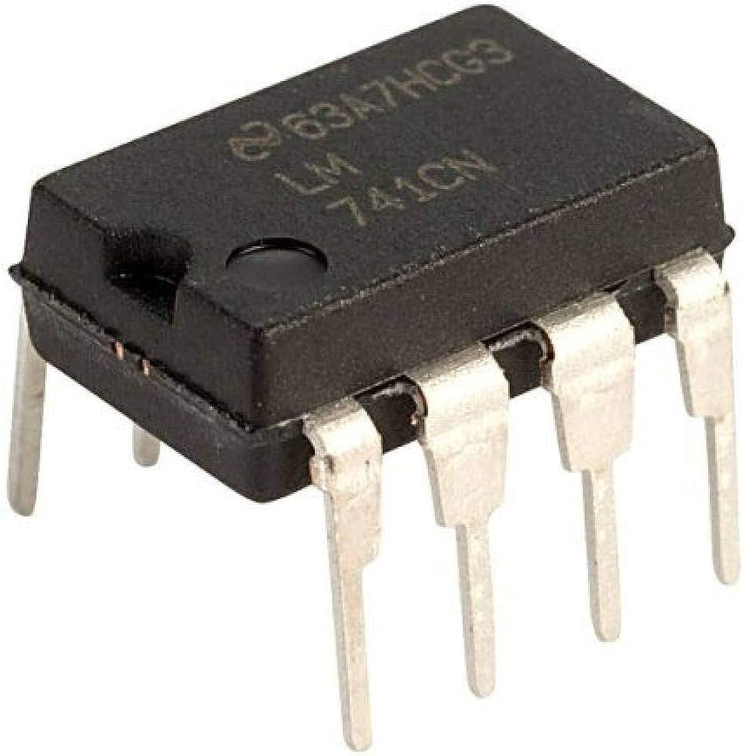
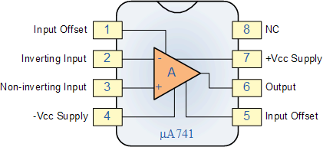
Ideal OPAMP
Adder, Subtractor, Differentiator, Amplifier, Integrator
2

Slide 3








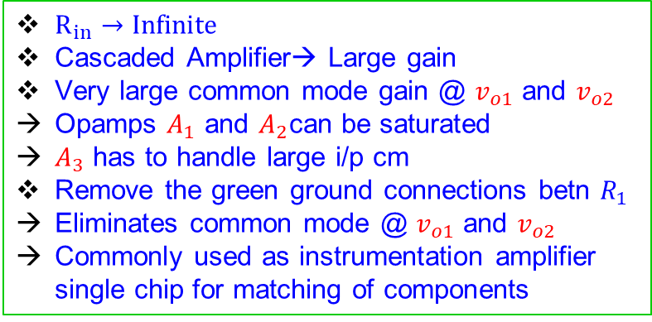







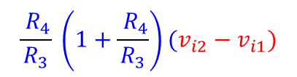






Three Stage Instrument Amplifier
$\left(1+\frac{{ R}_{2}}{R_{1}}\right)$ $v_{i1}$
$$v_{i1}$$
$$+$$
_
$$A_{1}$$
$$v_{o1}$$
$$R_{4}$$
$$R_{3}$$
$$R_{2}$$
$$v_{o}$$
$$\frac{{ R}_{4}}{R_{3}} \left(1+\frac{{ R}_{4}}{R_{3}}\right)(v_{i2}−v_{i1})$$
$$R_{1}$$
$$A_{3}$$
$$+$$
_
$$R_{1}$$
$$R_{2}$$
$$v_{id}$$
$$R_{3}$$
$$R_{4}$$
$$v_{o2}$$
$R_{in}→Infinite$
Cascaded Amplifier→ Large gain
Very large common mode gain @ $v_{o1}$ and $v_{o2}$
Opamps $A_{1}$ and $A_{2}$can be saturated
$A_{3}$ has to handle large i/p cm
Remove the green ground connections betn $R_{1}$
Eliminates common mode @ $v_{o1}$ and $v_{o2}$
Commonly used as instrumentation amplifier single chip for matching of components
$$A_{2}$$
$$+$$
_
$$v_{i2}$$
$\left(1+\frac{{ R}_{2}}{R_{1}}\right)$ $v_{i2}$
3

Slide 4

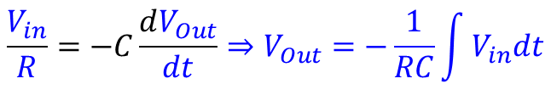
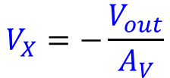

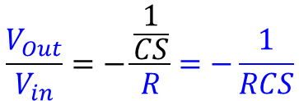

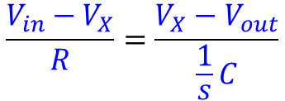
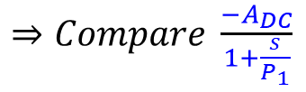









Integrator
$$C$$
$$\frac{V_{Out}}{V_{in}}=−\frac{\frac{1}{CS}}{R}=−\frac{1}{RCS}$$
$$R$$
$$\frac{V_{in}}{R}=−C\frac{dV_{Out}}{dt}⇒V_{Out}=−\frac{1}{RC}\int{V_{in}dt}$$
$$+$$
$$−$$
$$X$$
$$V_{Out}$$
$$Vin$$
$\frac{1}{S}→Integrator operator$, Pole @dc (f=0)
$$−$$
$$+$$
$Effective$OPAMP gain being infinite
$$V_{X}=−\frac{V_{out}}{A_{V}}$$
$$\frac{V_{in}−V_{X}}{R}=\frac{V_{X}−V_{out}}{\frac{1}{s}C}$$
$\frac{V_{out}}{V_{in}}=\frac{{−A}_{V}}{1+\left(1+A_{V}\right)RCS}$
$⇒Compare \frac{{−A}_{DC}}{1+\frac{s}{P_{1}}}$
4

Slide 5









Integrator
Pole
$$V_{in}$$
$$V_{Out}$$
$$=\frac{1}{1+RCS}$$
$$\frac{1}{RC(1+A)}$$
Compare with
$$C$$
dB
Gain
Ideal Integrator
$$\frac{1}{RC(1+A)}$$
20 log $A_{V}$
OPAMP based integrator
$$\frac{1}{RC}$$
__Ideal Integrator
__OPAMP based Integrator
__RC Integrator (Lossy Integrator)
RC Only
f
(log)
$$\frac{1}{1+SRC}$$
5

Slide 6




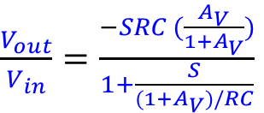



Differentiator
$$R$$
$$\frac{V_{Out}}{V_{in}}=−RCs$$
$$V_{Out}=−RC\frac{dV_{in}}{dt}$$
$$C$$
$$+$$
$$−$$
Similar analysis for OPAMP finite gain $A_{V}$
$$X$$
$$V_{Out}$$
$$Vin$$
$\frac{V_{out}}{V_{in}}=\frac{−SRC (\frac{A_{V}}{{1+A}_{V}})}{1+\frac{S}{(1+A_{V})/RC}}$
ZERO@Origin
$$−$$
$$+$$
Pole@ $\frac{1+A_{V}}{RC}$
Gain @ infinite
$$A_{V}$$
20 log $A_{V}$
6

Slide 7



Differentiator
$$V_{in}$$
$$V_{Out}$$
$$=\frac{SCR}{1+RCS}$$
Compare with
$$C$$
dB
Gain
Ideal Integrator
$$\frac{1+A}{RC}$$
20 log $A_{V}$
OPAMP based integrator
RC Only
f
(log)
__Ideal Integrator
__OPAMP based Integrator
__RC Integrator (Lossy Integrator)
$$\frac{1}{RC}$$
7

