Slide 1

Lecture 16
October 18, 2023
1

Slide 2









MOSFET-Body Effect
+
$$V_{G}$$
-
Gate (G)
Source (S)
GND
-
$$V_{D}$$
+
Drain (D)
Body (B)
Metal
GND
Oxide
GND
GND
n+
n+
p+
P- Substrate
+
$$V_{D}$$
-
Body (back gate) acts like another gate affecting channel potential
+
+
$$V_{SB}$$
The require higher $V_{GS}$ to invert the channel
$$V_{G}$$
$$V_{B}$$
Gate (G)
+
-
$$V_{S}$$
-
$$V_{TH}$$
-
2

Slide 3

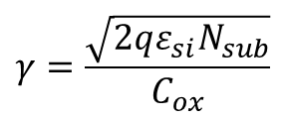
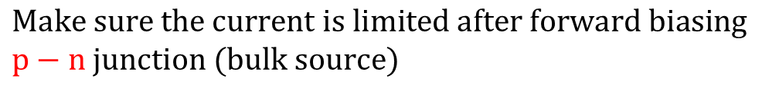





MOSFET-Body Effect
$$V_{TH}=V_{THo}+γ\left(\sqrt{|2φ_{F}+V_{SB}|}−\sqrt{|2φ_{F}|}\right)$$
$$γ=\frac{\sqrt{2qε_{si}N_{sub}}}{C_{ox}}$$
$$I_{DS}=μ_{n}\frac{W}{L} C_{ox} \frac{{\left(V_{GS}−V_{TH}\right)}^{2}}{2}$$
Body effect co-efficient,
$γ$→ Technology dependent parameter ~ 0.3 to 0.4$\sqrt{V}$
$$V_{SB}$$
$$Make V_{SB} negative$$
$$V_{TH}$$
$V_{TH}$ can be reduced from $V_{THo}$by forward biasing B-S junction
$$Make sure the current is limited after forward biasing$$
$$p−n junction (bulk source)$$
3

Slide 4
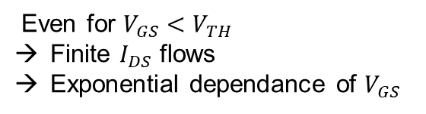






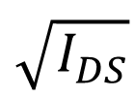

SUBTHRESHOLD Condition
$$ε_{f}$$
$$\sqrt{I_{DS}}$$
Even for $V_{GS}<V_{TH}$
Finite $I_{DS}$ flows
Exponential dependance of $V_{GS}$
100 – 200 mV
$$V_{TH}$$
Subthreshold
(weak inversion region)
$$I_{DS}={I_{o}\exp{\frac{V_{GS}}{ξV_{TH}}}}_{}$$
Keep transistor in this region for saturation
$$V_{TH}=\frac{KT}{q}$$
$ξ$ > 1
$$V_{GS}$$
Similar to $I_{C}−V_{BE}$of bipolar transistor
4

Slide 5
PMOS Transistor
B
S
G
D
B
S
G
D
Metal
Metal
Oxide
Oxide
n+
n+
p+
p+
n+
n-well
p-Substrate
G
G
S
D
S
D
B
NMOS
B
PMOS
5

Slide 6









PMOS Transistor
$$Generally connected toV_{DD}$$
$$V_{DD}$$
Linear / Triode region, $V_{SD}$< ($V_{SG}−|V_{THP}|)$
+
+
$$V_{GS}$$
$$V_{SB}$$
+
$$I_{SD}=μ_{p}\frac{W}{L} C_{ox} \left(V_{SG}−{|V}_{THP}|\right)V_{SD}−\frac{{V_{SD}}^{2}}{2}$$
-
-
$$V_{SD}$$
-
Large signal behavior
Saturation region, $V_{SD}>$ ($V_{SG}−|V_{THP}|)$
$$I_{SD}=μ_{p}\frac{W}{L} C_{ox} {\left(V_{SG}−{|V}_{THP}|\right)}^{2}(1+λ_{p}V_{SD})$$
6

Slide 7



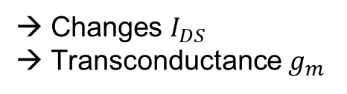




Transconductance
In saturation region, changing $V_{SG}$
Changes $I_{DS}$
Transconductance $g_{m}$
$$I_{DS}$$
+
$$I_{DS}={\frac{1}{2}μ}_{p}\frac{W}{L} C_{ox} {\left(V_{GS}−V_{TH}\right)}^{2}(1+{λV}_{DS})$$
$$V_{DS}$$
+
-
$$g_{m}=\frac{∂I_{DS}}{∂V_{GS}}=μ_{n}\frac{W}{L} C_{ox} (V_{GS}−V_{TH}) (1+{λV}_{DS})$$
$$V_{GS}$$
-
$$g_{m}=\frac{∂I_{DS}}{∂V_{GS}}=\frac{1}{2}μ_{n}\frac{W}{L} C_{ox}{\left(V_{GS}−V_{TH}\right)}^{2} (1+{λV}_{DS})\frac{2}{(V_{GS}−V_{TH})}$$
$$g_{m}=\frac{∂I_{DS}}{∂V_{GS}}=\frac{2I_{DS}}{(V_{GS}−V_{TH})}$$
7

Slide 8




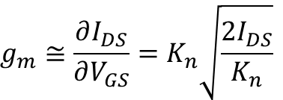


MOS Small Signal Model (AC Model)
$$K_{n}=μ_{n}\frac{W}{L} C_{ox}$$
$$I_{DS}$$
$$I_{DS}≅\frac{K_{n}}{2}{\left(V_{GS}−V_{TH}\right)}^{2}$$
→ Ignored channel length modulation
+
$$V_{DS}$$
$$g_{m}≅\frac{∂I_{DS}}{∂V_{GS}}=K_{n}\left(V_{GS}−V_{TH}\right)−−−−(2)$$
+
-
$$V_{GS}$$
$$g_{m}≅\frac{∂I_{DS}}{∂V_{GS}}=K_{n}\sqrt{\frac{2I_{DS}}{K_{n}}}$$
-
$$I_{DS}$$
$g_{m}≅\frac{∂I_{DS}}{∂V_{GS}}=K_{n}\sqrt{2I_{DS}K_{n}}$ $−−−−−−(3)$
DC bias from DC operating point
$$V_{G>S}$$
8

Slide 9
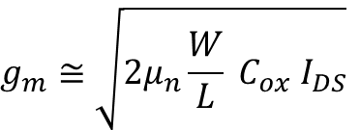





MOS Small Signal Model (AC Model)
The three $g_{m}$form,
Looks similar to BJT,
Gate
Drain
$$g_{m}=\frac{∂I_{DS}}{∂V_{GS}}=\frac{2I_{DS}}{(V_{GS}−V_{TH})}$$
$$g_{m}=\frac{I_{C}}{V_{T}}$$
+
$$g_{m}≅μ_{n}\frac{W}{L} C_{ox} (V_{GS}−V_{TH})$$
$$g_{m}V_{GS}$$
-
$$g_{m}≅\sqrt{{2μ}_{n}\frac{W}{L} C_{ox}{ I}_{DS}}$$
Source
First small signal Model
9

Slide 10





Calculating Out put resistance
$$I_{DS}=\frac{k_{n}}{2}{\left(V_{GS}−V_{TH}\right)}^{2}(1+{λV}_{DS})$$
Gate
Drain
$$\frac{∂I_{DS}}{∂V_{DS}}=\frac{k_{n}}{2}{\left(V_{GS}−V_{TH}\right)}^{2}λ ≅λ{ I}_{DS}$$
+
$$g_{m}V_{GS}$$
-
$${ r}_{o}={(\frac{∂I_{DS}}{∂V_{DS}})}^{−1}≅\frac{1}{λI_{DS}}$$
Output resistance:
Large L → $Low λ$
Source
First small signal Model
10

