Slide 1

Lecture 2
August 11, 2023
1

Slide 2
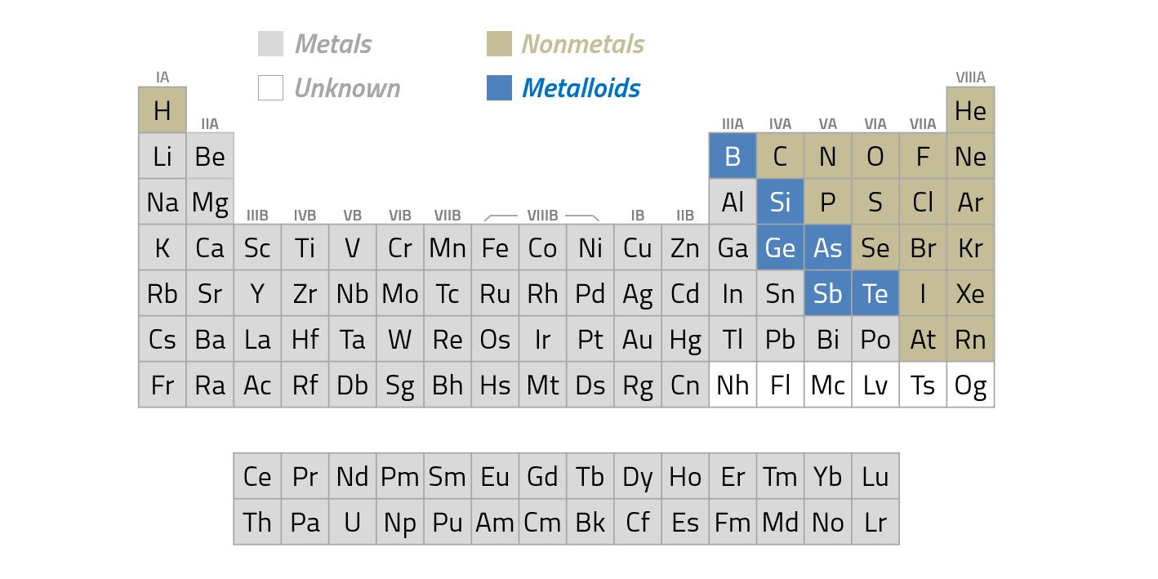
Extrinsic Semiconductors
n-Type (group IV)→ Al, B, Ga
p-Type (group III)→ P
2

Slide 3
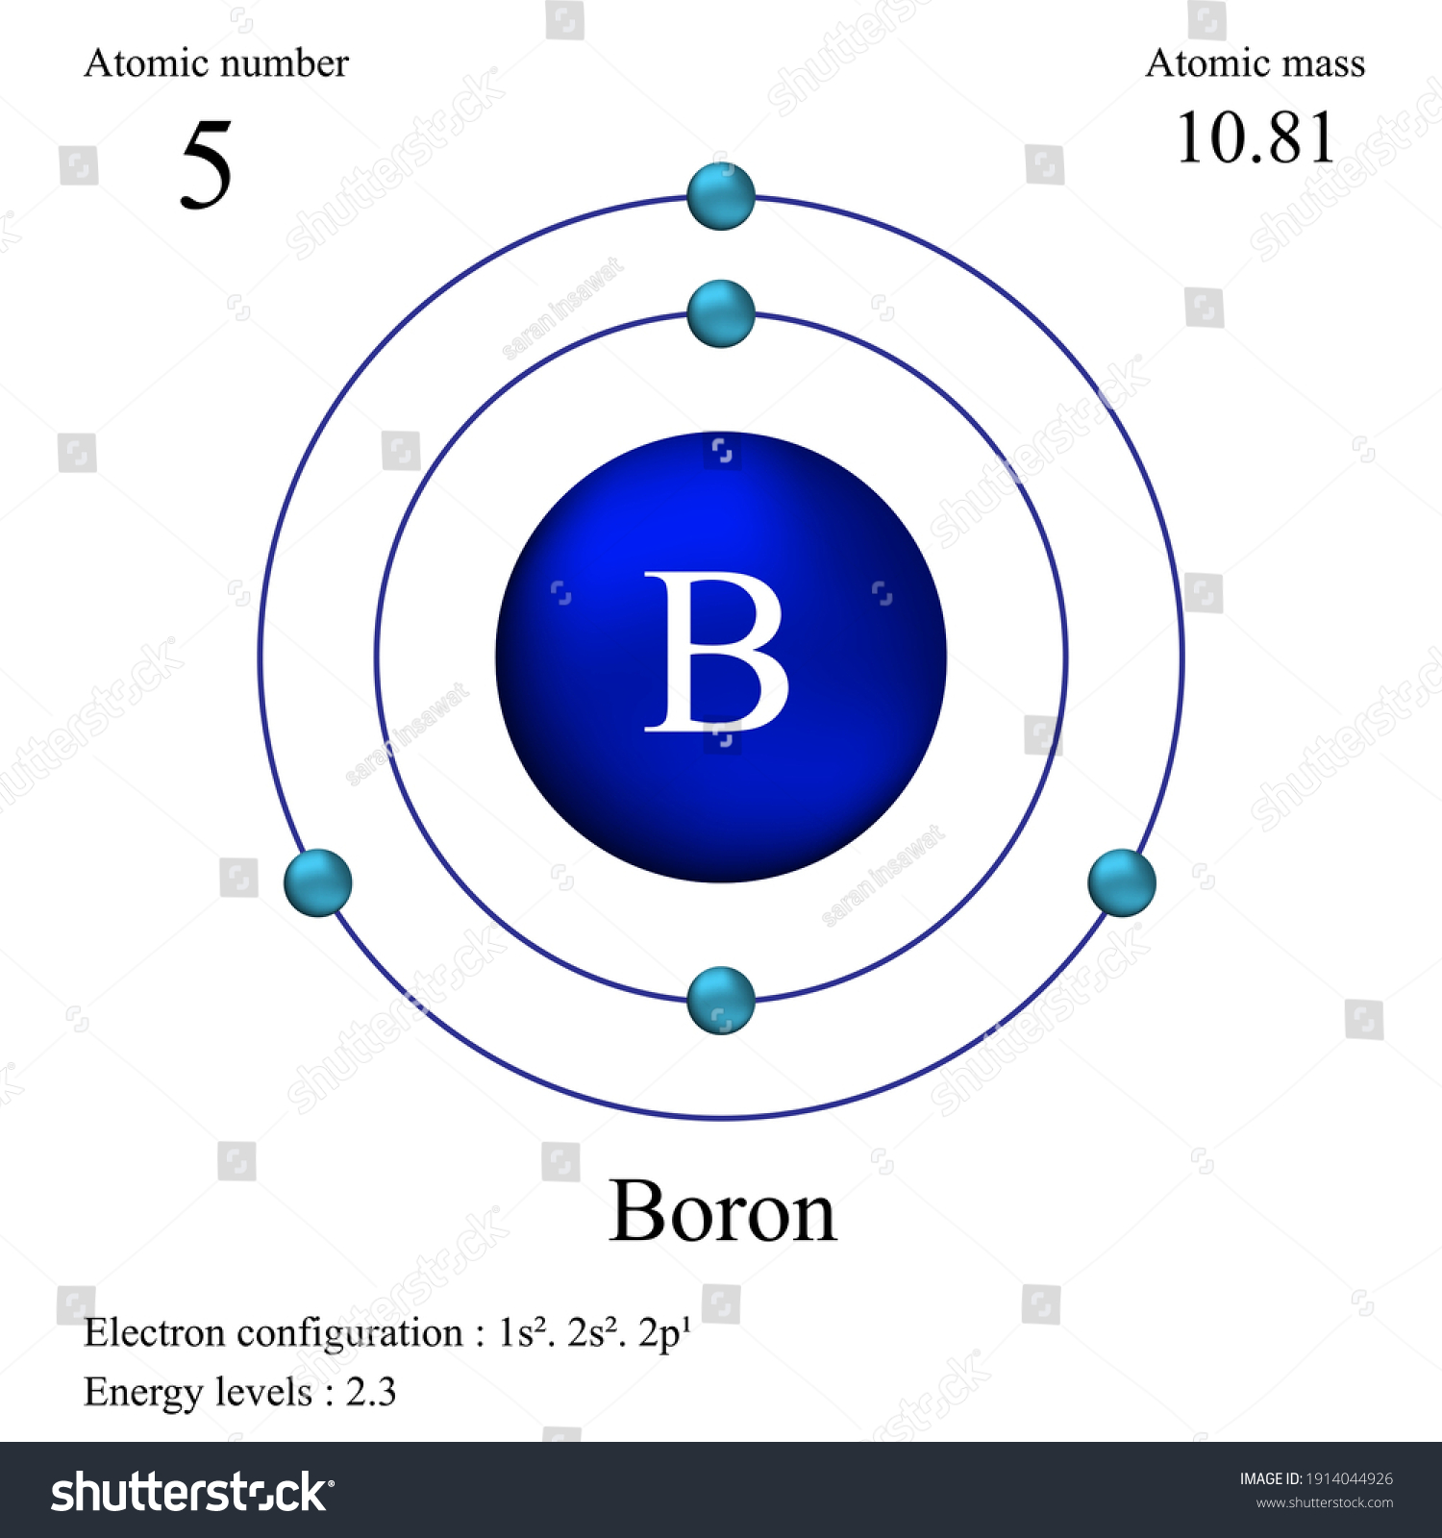
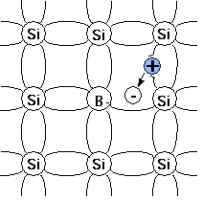
p-type Silicon Semiconductor
Atomic details of Boron
Doping in Silicon
3

Slide 4
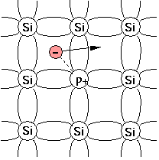
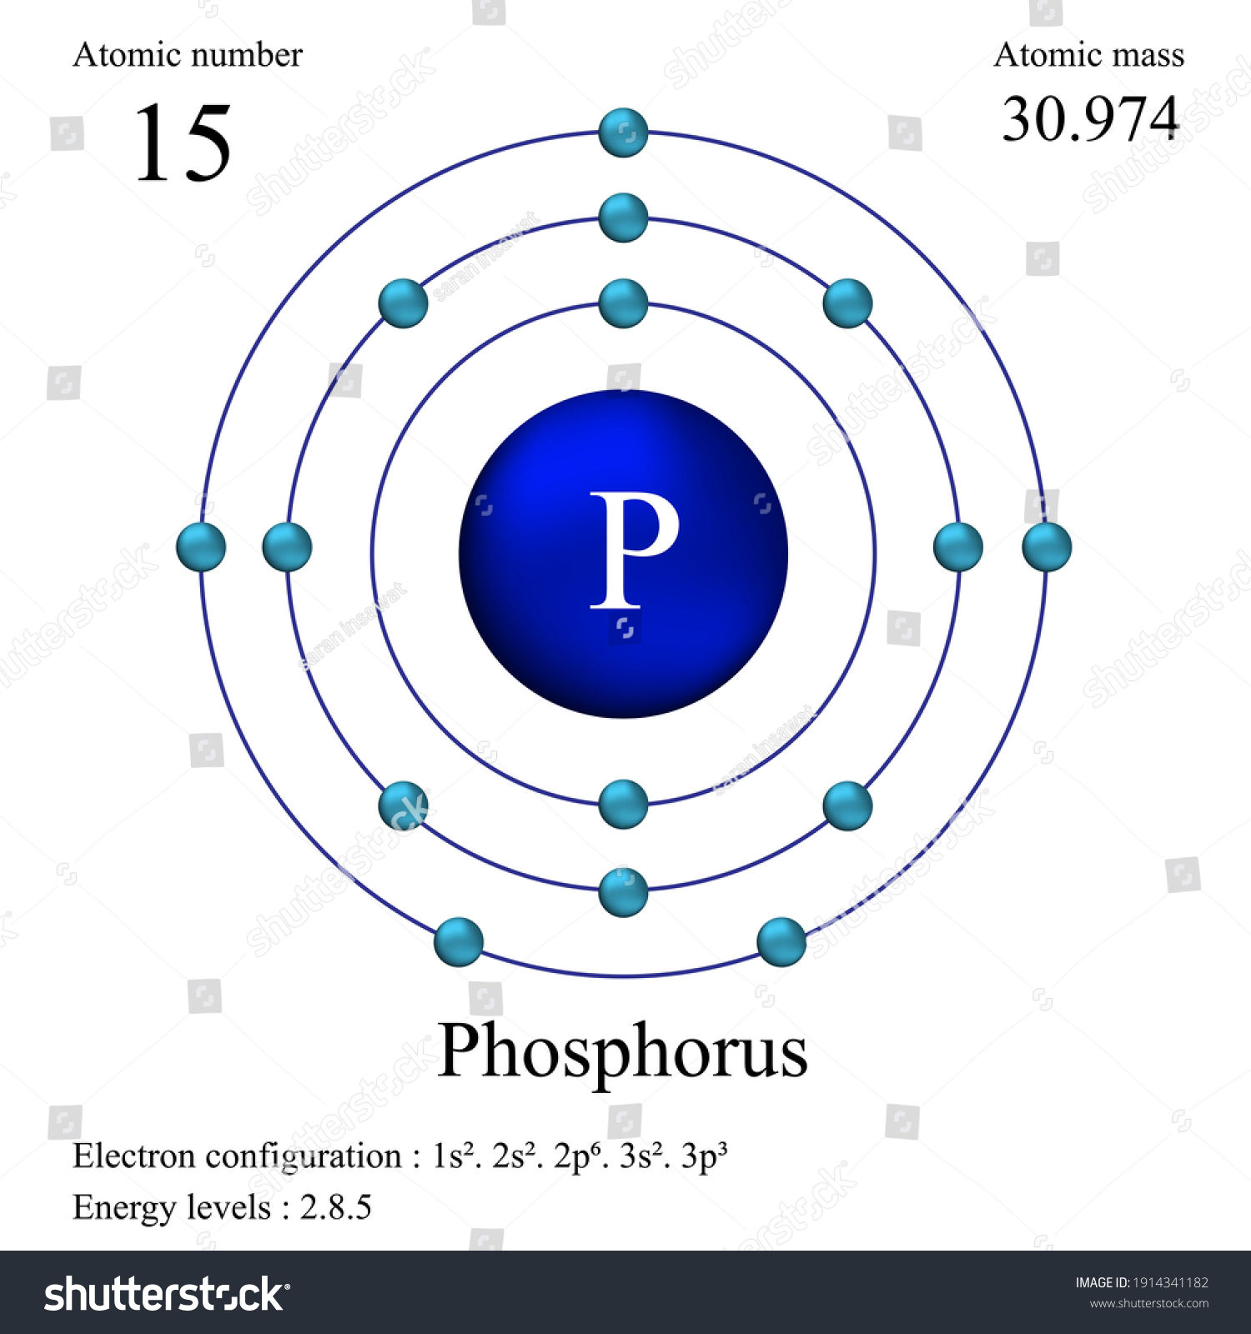
n-type Silicon Semiconductor
Atomic details of Phosphorus
Doping in Silicon
4

Slide 5
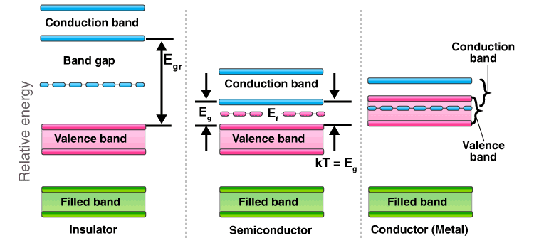
Energy Band Diagram
Metals: Resitivity~10⁻⁶ Ω cm
Semiconductors: resitivity~10⁻³ to 10⁹ Ω cm
Insulators: resitivity~10²² Ω cm
5

Slide 6
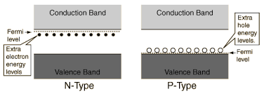
P and n-Type Semiconductors
http://hyperphysics.phy-astr.gsu.edu/hbase/Solids/dope.html
6

Slide 7
Diode
7

Slide 8
p-n Semiconductor (Diode)
p-Silicon
n-Silicon
8

Slide 9
p-n Semiconductor (Diode)
p-Silicon
n-Silicon
9

Slide 10
p-n Semiconductor (Diode)
Acceptor ion
p-Silicon
Junction
n-Silicon
Donner ion
+
-
+
-
+
-
+
-
+
-
+
-
Hole
+
+
Electron
-
-
+
-
+
-
+
-
+
-
+
-
+
-
+
-
-
+
-
+
-
+
+
+
+
-
-
-
-
-
-
+
+
+
+
-
+
-
+
-
-
+
-
+
-
+
10

Slide 11
p-n Semiconductor (Diode)
p-Silicon
Junction
n-Silicon
+
-
+
-
+
-
+
-
+
-
+
-
+
+
+
-
-
-
-
-
-
+
+
+
Concentration of Acceptor
Concentration of Donner
Concentration of hole
Concentration of electron
11

Slide 12






p-n Semiconductor (Diode)
p-Silicon
Junction
n-Silicon
+
-
+
-
+
-
+
-
+
-
+
-
+
+
+
-
-
-
-
-
-
+
+
+
Negative space charge
Positive space charge
+
-
$$V_{n}$$
$$V_{n}$$
$${−x}_{p}$$
$$x_{n}$$
$$V_{p}$$
$${−V}_{p}$$
Potential change across the junction
12

Slide 13








p-n Semiconductor (Diode)
p-Silicon
Junction
n-Silicon
+
-
+
-
+
-
+
-
+
-
+
-
+
+
+
-
-
-
-
-
-
+
+
+
P-type
}
$$E_{cp}$$
$$eV_{B}$$
n-type
$$E_{p}$$
$$E_{cn}$$
$$E_{vp}$$
$$E_{p}$$
$$E_{cp}−E_{cn}=E_{vp}=E_{B}=eV_{B}$$
$$E_{vn}$$
13

Slide 14
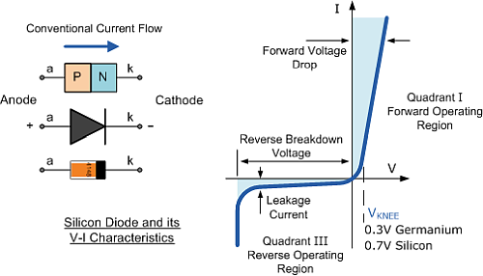
p-n Semiconductor (Diode)
14

Slide 15
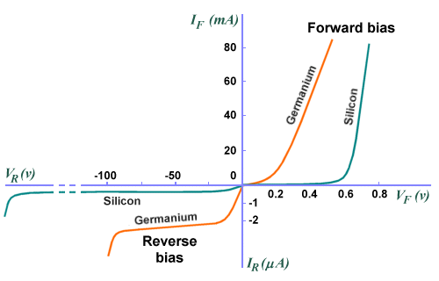
Ge and Si: p-n Diode
15

Slide 16
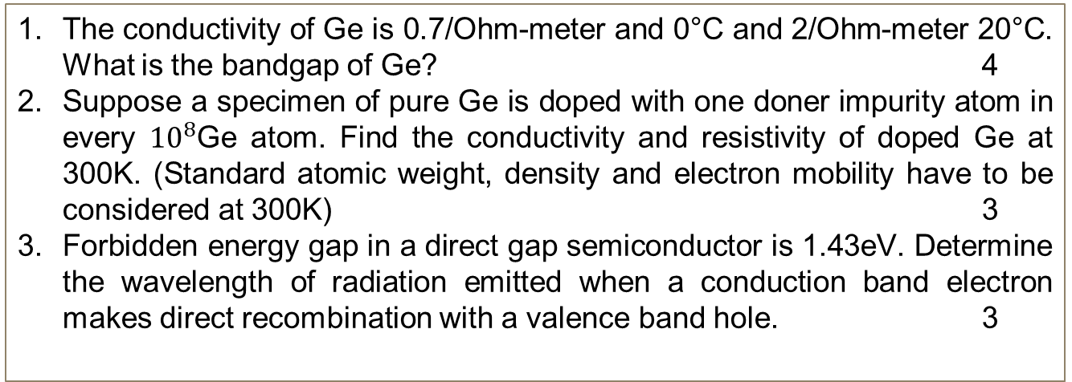
Concept Questions-2
The conductivity of Ge is 0.7/Ohm-meter and 0°C and 2/Ohm-meter 20°C. What is the bandgap of Ge? 4
Suppose a specimen of pure Ge is doped with one doner impurity atom in every ${10}^{8}$Ge atom. Find the conductivity and resistivity of doped Ge at 300K. (Standard atomic weight, density and electron mobility have to be considered at 300K) 3
Forbidden energy gap in a direct gap semiconductor is 1.43eV. Determine the wavelength of radiation emitted when a conduction band electron makes direct recombination with a valence band hole. 3
16

Slide 17



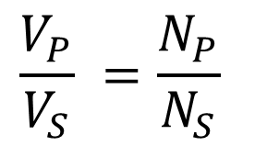


Induced Voltage: Transformer
$$V_{1}$$
$$\frac{V_{P}}{V_{S}} =\frac{N_{P}}{N_{S}}$$
$$Pri$$
$$Sec$$
$$N_{P}$$
$$N_{S}$$
Reference book: The Art of Electronics by Paul Horowitz and Windfield Hill
17

Slide 18







Application: p-n Diode
Rectifier
Half-wave Rectifier
$$V_{1}$$
$$R$$
$$Pri$$
$$Sec$$
$$Load$$
$$N_{P}$$
$$N_{S}$$
18

Slide 19







Application: p-n Diode: Rectifier
Dynamic characteristics
$$i_{a}$$
V
0
$$\frac{π}{ω}$$
$$\frac{2π}{ω}$$
$$\frac{3π}{ω}$$
t
0
$$\frac{π}{ω}$$
Half-wave Rectifier
$$\frac{2π}{ω}$$
$$\frac{3π}{ω}$$
t
19

Slide 20




















Application: p-n Diode
Full-wave Rectifier
Outputs
D1
0
$$T$$
$$+$$
$$+$$
$$R$$
$$i_{a1}$$
$$i_{a1}$$
$$v$$
$$i_{L}$$
$$0$$
0
$$−$$
$AC$Mains
$$+$$
$$i_{a2}$$
$$v$$
$$i_{a2}$$
0
$$−$$
$$−$$
$$i_{L}$$
0
$$\frac{π}{ω}$$
$$\frac{2π}{ω}$$
$$\frac{3π}{ω}$$
$$\frac{4π}{ω}$$
t
D2
20

Slide 21







Application: p-n Diode: Bridge Rectifier
B
$$T$$
$$+$$
$$+$$
D1
D2
A
C
E
$AC$Mains
$$−$$
$$−$$
$$R_{L}$$
D3
D4
S
D
F
During +Ve half cycle: D2 and D3 are forward bias and D4 and D1 are reversed bias
Current through: BCEFADSB
During -Ve half cycle: D1 and D4 are forward bias and D3 and D2 are reversed bias
Current through: DCEFABSD
21

Slide 22







Application: p-n Diode: Bridge Rectifier
D1
D2
$$+$$
Different Design
$$+$$
$$−$$
$$T$$
$$R$$
$$−$$
$AC$Mains
What is the advantage of a bridge rectifier?
D3
D4
What is the disadvantage of a bridge rectifier?
22

Slide 23














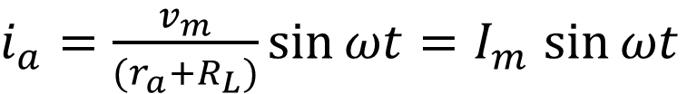

Analysis: Half Wave Rectifier
$$v=v_{a}+v_{L}$$
$r_{a}=$Diode resistance
$$v={i_{a}r}_{a}+{i_{a}R}_{L}$$
$R_{L}=$Load resistance
$$i_{a}$$
$$R_{L}$$
AC
$$v$$
$$v={i_{a}(r}_{a}+R_{L})$$
$$v=v_{m}\sin{ωt}+v_{a}$$
$v_{m}=$Peak inverse voltage if input
$$i_{a}=v{/(r}_{a}+R_{L})$$
$I_{m}=$Peak inverse value of diode
For half cycle $0≤t≤\frac{T}{2}$
For next half cycle $\frac{T}{2}≤t≤T$
$i_{a}=\frac{v_{m}}{{(r}_{a}+R_{L})}\sin{ωt}=I_{m}$ $\sin{ωt}$
Diode is reverse bias
$$i_{a}=0$$
23

Slide 24
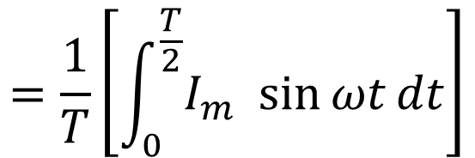
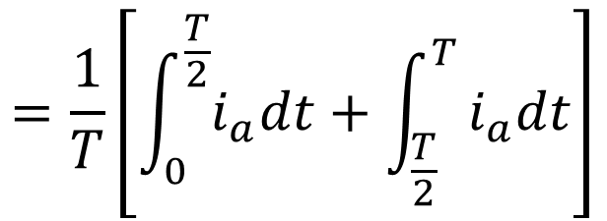
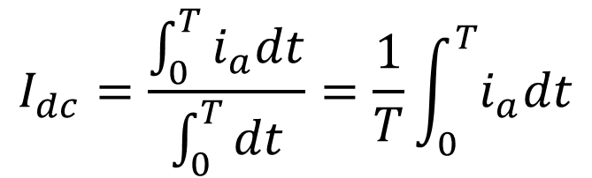


Half Wave Rectifier: DC component of current
$$I_{dc}=\frac{\int_{0}^{T}{i_{a}dt}}{\int_{0}^{T}{dt}}=\frac{1}{T}\int_{0}^{T}{i_{a}dt}$$
$$v_{L}$$
$$i_{a}$$
$$R_{L}$$
AC
$$v$$
$$=\frac{1}{T}\left[\int_{0}^{\frac{T}{2}}{i_{a}dt}+\int_{\frac{T}{2}}^{T}{i_{a}dt}\right]$$
$$=\frac{1}{T}\left[\int_{0}^{\frac{T}{2}}{I_{m} \sin{ωt}dt}\right]$$
$i_{a}=I_{m}$ $\sin{ωt}$
24

Slide 25
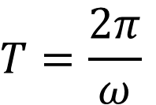
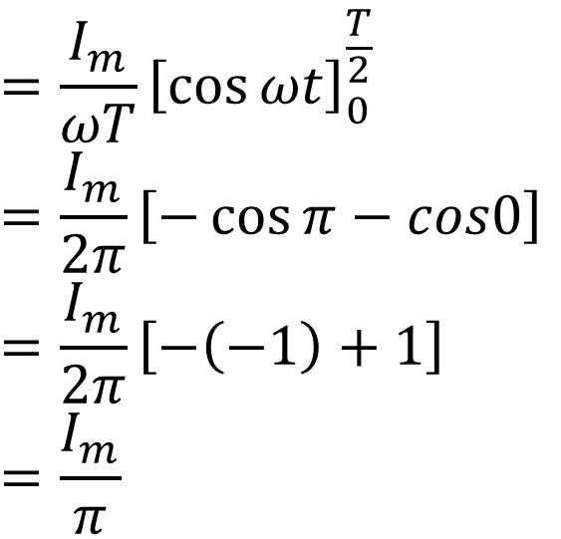
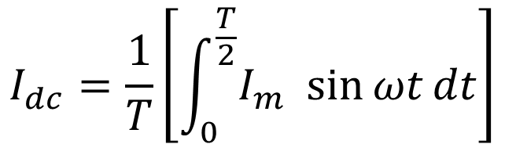
Half Wave Rectifier: DC component of current
$$I_{dc}=\frac{1}{T}\left[\int_{0}^{\frac{T}{2}}{I_{m} \sin{ωt}dt}\right]$$
$$i_{a}$$
$$R_{L}$$
AC
$$v$$
$$=\frac{I_{m}}{ωT}{\left[\cos{ωt}\right]}_{0}^{\frac{T}{2}}$$
$$=\frac{I_{m}}{2π}\left[−\cos{π}−cos0\right]$$
$$=\frac{I_{m}}{2π}\left[−\left(−1\right)+1\right]$$
$$=\frac{I_{m}}{π}$$
$$T=\frac{2π}{ω}$$
25

Slide 26
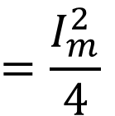
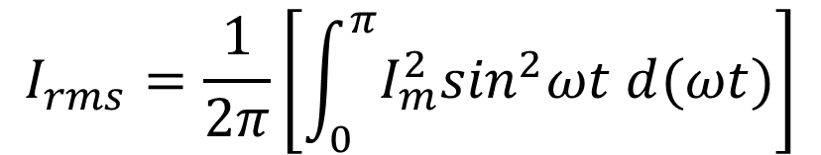
Half Wave Rectifier: DC component of current
$$I_{rms}=\frac{1}{2π}\left[\int_{0}^{π}{I_{m}^{2}\sin^{2}ωt d(ωt)}\right]$$
$$i_{a}$$
$$R_{L}$$
AC
$$v$$
$$=\frac{I_{m}^{2}}{4}$$
26

Slide 27
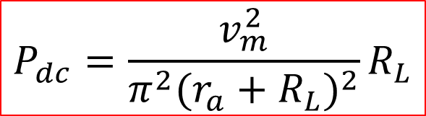
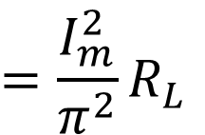

Half Wave Rectifier: Power dissipated in load
$$P_{dc}=I_{dc}^{2}R_{L}$$
$$i_{a}$$
$$R_{L}$$
AC
$$R_{L}$$
$$=\frac{I_{m}^{2}}{π^{2}}R_{L}$$
$$v$$
$$P_{dc}=\frac{v_{m}^{2}}{π^{2}{(r_{a}+R_{L})}^{2}}R_{L}$$
27

Slide 28
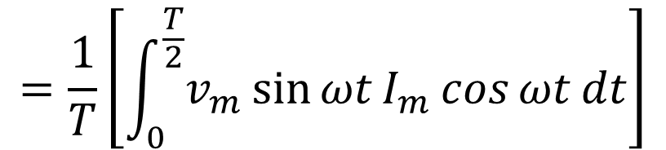
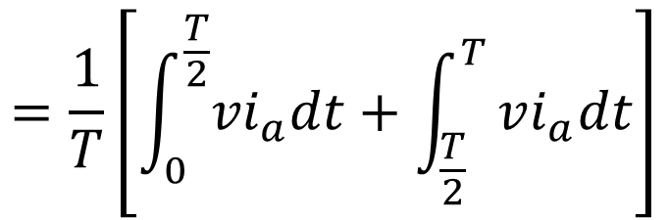
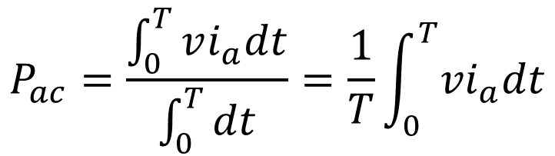
Half Wave Rectifier: Input AC power from Source
$$P_{ac}=\frac{\int_{0}^{T}{vi_{a}dt}}{\int_{0}^{T}{dt}}=\frac{1}{T}\int_{0}^{T}{{vi}_{a}dt}$$
$$i_{a}$$
$$R_{L}$$
AC
$$v$$
$$=\frac{1}{T}\left[\int_{0}^{\frac{T}{2}}{{vi}_{a}dt}+\int_{\frac{T}{2}}^{T}{vi_{a}dt}\right]$$
$$=\frac{1}{T}\left[\int_{0}^{\frac{T}{2}}{v_{m}\sin{ωt}I_{m}\cos{ωt}dt}\right]$$
28

Slide 29
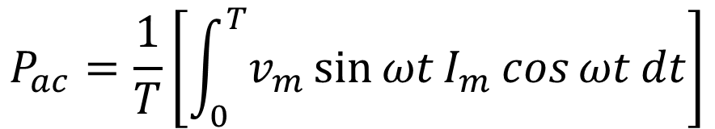
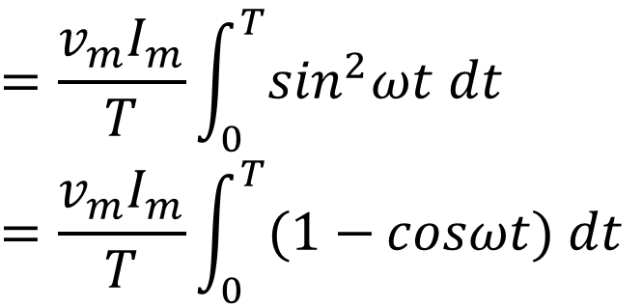
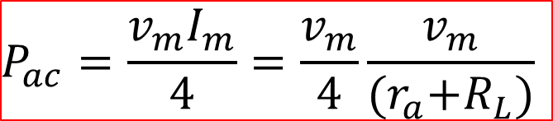
Half Wave Rectifier: DC component of current
$$P_{ac}=\frac{1}{T}\left[\int_{0}^{T}{v_{m}\sin{ωt}I_{m}\cos{ωt}dt}\right]$$
$$i_{a}$$
$$R_{L}$$
AC
$$v$$
$$=\frac{v_{m}I_{m}}{T}\int_{0}^{T}{\sin^{2}ωt dt}$$
$$=\frac{v_{m}I_{m}}{T}\int_{0}^{T}{(1−{cosωt) dt}}$$
$$P_{ac}=\frac{v_{m}I_{m}}{4}=\frac{v_{m}}{4}\frac{v_{m}}{{(r}_{a}+R_{L})}$$
29

Slide 30
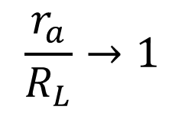
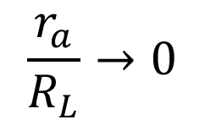
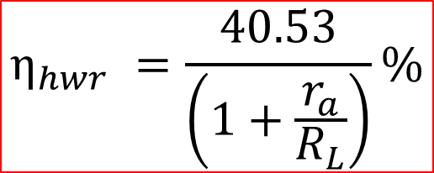
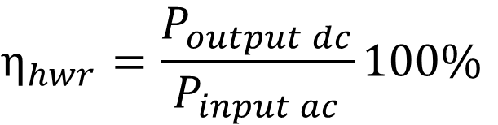
Half Wave Rectifier: Efficiency
$$η_{hwr}=\frac{P_{output dc}}{P_{input ac}}100\%$$
$$i_{a}$$
$$R_{L}$$
AC
$$v$$
$$\frac{r_{a}}{R_{L}}→0$$
Maximum for
$$η_{hwr} =\frac{40.53}{\left(1+\frac{r_{a}}{R_{L}}\right)}\%$$
$$\frac{r_{a}}{R_{L}}→1$$
Minimum for
30

Slide 31
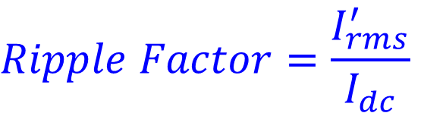
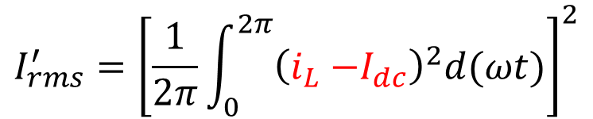


Half Wave Rectifier: Ripple Factor
$$i_{L}=I_{dc}+i^{′}$$
$$i_{L}$$
$$Ripple Factor=\frac{rms value of hermonic component of output current}{Stedy dc value of output current }$$
AC
$$R_{L}$$
$$v$$
$$Ripple Factor=\frac{I_{rms}^{′}}{I_{dc}}$$
Instantaneous ac component of the load current is: $i_{L}{−I}_{dc}=i^{′}$
The rms value of alternating component of load current (or ripple current)
$$I_{rms}^{′}={\left[\frac{1}{2π}\int_{0}^{2π}{{\left(i_{L}{−I}_{dc}\right)}^{2}d(ωt)}\right]}^{2}$$
31

Slide 32
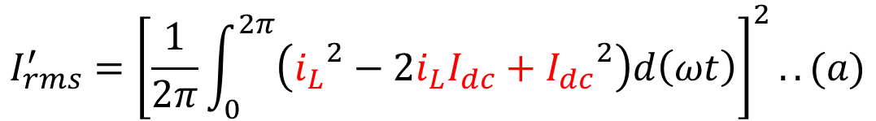




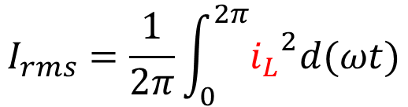
Half Wave Rectifier: Ripple Factor
$$I_{rms}^{′}={\left[\frac{1}{2π}\int_{0}^{2π}{{\left(i_{L}{−I}_{dc}\right)}^{2}d(ωt)}\right]}^{2}$$
$$i_{L}$$
$$R_{L}$$
AC
$$I_{rms}^{′}={\left[\frac{1}{2π}\int_{0}^{2π}{\left({i_{L}}^{2}−2i_{L}I_{dc}+{I_{dc}}^{2}\right)d\left(ωt\right)}\right]}^{2}..(a)$$
$$v$$
If $I_{rms}$ is the rms or the effective value of the total load current, we have
$$I_{rms}=\frac{1}{2π}\int_{0}^{2π}{{i_{L}}^{2}d(ωt)}$$
The first term of integral gives ${I_{rms}}^{2}$ and the second term (a) yields -2${I_{dc}}^{2}$
$$I_{rms}^{′}={({I_{rms}}^{2}−2{I_{dc}}^{2}+{I_{dc}}^{2})}^{1/2}={({I_{rms}}^{2}−{I_{dc}}^{2})}^{1/2}$$
32

Slide 33
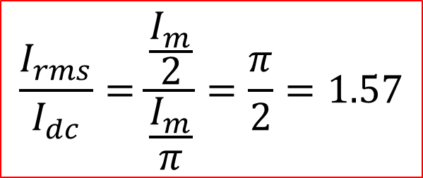

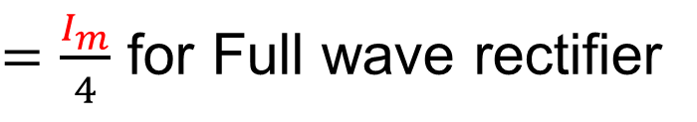
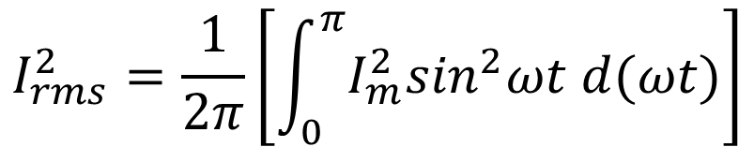
Half Wave Rectifier: AC component of current
$$I_{rms}^{2}=\frac{1}{2π}\left[\int_{0}^{π}{I_{m}^{2}\sin^{2}ωt d(ωt)}\right]$$
$$i_{a}$$
$$R_{L}$$
AC
$$v$$
$I_{rms}=\frac{I_{m}}{2}$ for Half wave rectifier
$=\frac{I_{m}}{4}$ for Full wave rectifier
$$\frac{I_{rms}}{I_{dc}}=\frac{\frac{I_{m}}{2}}{\frac{I_{m}}{π}}=\frac{π}{2}=1.57$$
33

Slide 34
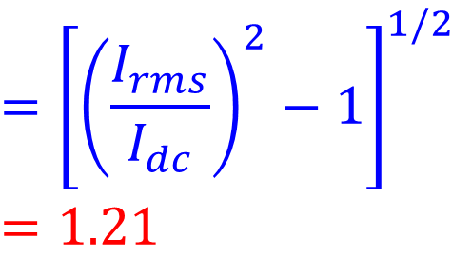
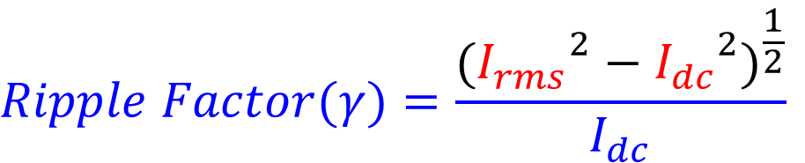
Half Wave Rectifier: Ripple Factor
$$Ripple Factor(γ)=\frac{{({I_{rms}}^{2}−{I_{dc}}^{2})}^{\frac{1}{2}}}{I_{dc}}$$
$$i_{L}$$
$$R_{L}$$
AC
$$v$$
$$={\left[{\left(\frac{I_{rms}}{I_{dc}}\right)}^{2}−1\right]}^{1/2}$$
$$=1.21$$
34

Slide 35

Analysis: Full Wave Rectifier
Full-wave Rectifier
Outputs
D1
0
$$T$$
$$+$$
$$+$$
$$R_{L}$$
$$i_{a1}$$
$$i_{a1}$$
$$v$$
$$i_{L}$$
$$0$$
0
$$−$$
$AC$Mains
$$+$$
$$i_{a2}$$
$$v$$
$$i_{a2}$$
0
$$−$$
$$−$$
$$i_{L}$$
0
$$\frac{π}{ω}$$
$$\frac{2π}{ω}$$
$$\frac{3π}{ω}$$
$$\frac{4π}{ω}$$
t
D2
35

Slide 36


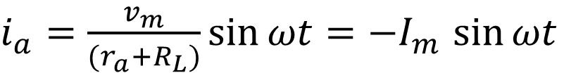

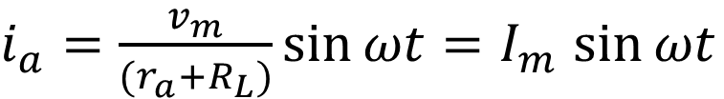



Analysis: Full Wave Rectifier
$i_{a}=\frac{v_{m}}{{(r}_{a}+R_{L})}\sin{ωt}=I_{m}$ $\sin{ωt}$
For half cycle $0≤t≤\frac{T}{2}$
$i_{a}=\frac{v_{m}}{{(r}_{a}+R_{L})}\sin{ωt}=−I_{m}$ $\sin{ωt}$
For half cycle $\frac{T}{2}≤t≤T$
For half cycle $0≤t≤\frac{T}{2}$
$v=v_{m}$ $\sin{ωt}$
For half cycle $\frac{T}{2}≤t≤$T
$v=−v_{m}$ $\sin{ωt}$
36

Slide 37
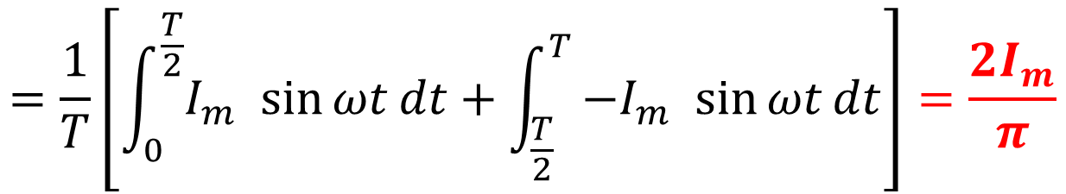
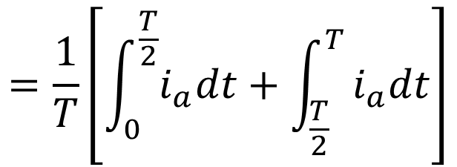
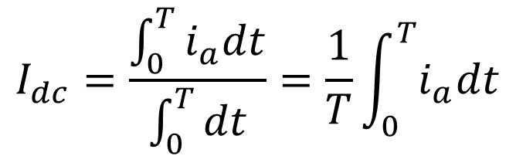
Full Wave Rectifier: DC component of current
$$I_{dc}=\frac{\int_{0}^{T}{i_{a}dt}}{\int_{0}^{T}{dt}}=\frac{1}{T}\int_{0}^{T}{i_{a}dt}$$
$$=\frac{1}{T}\left[\int_{0}^{\frac{T}{2}}{i_{a}dt}+\int_{\frac{T}{2}}^{T}{i_{a}dt}\right]$$
$$=\frac{1}{T}\left[\int_{0}^{\frac{T}{2}}{I_{m} \sin{ωt}dt}+\int_{\frac{T}{2}}^{T}{−I_{m} \sin{ωt}dt}\right]=\frac{{2I}_{m}}{π}$$
37

Slide 38
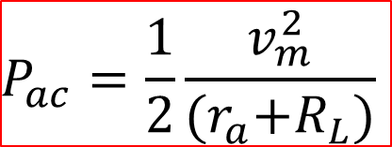
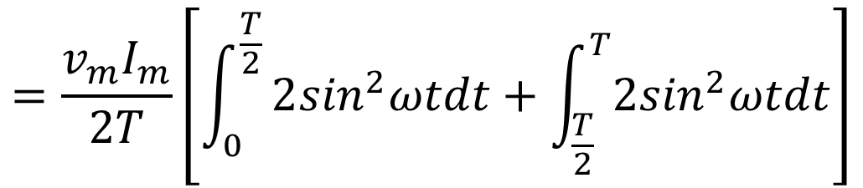
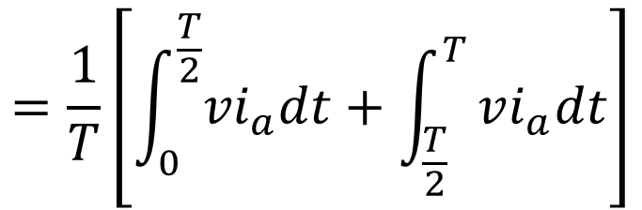
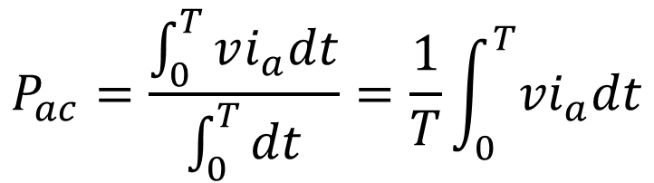
Full Wave Rectifier: Input AC power from Source
$$P_{ac}=\frac{\int_{0}^{T}{vi_{a}dt}}{\int_{0}^{T}{dt}}=\frac{1}{T}\int_{0}^{T}{{vi}_{a}dt}$$
$$=\frac{1}{T}\left[\int_{0}^{\frac{T}{2}}{{vi}_{a}dt}+\int_{\frac{T}{2}}^{T}{vi_{a}dt}\right]$$
$$=\frac{v_{m}I_{m}}{2T}\left[\int_{0}^{\frac{T}{2}}{2\sin^{2}ωtdt+\int_{\frac{T}{2}}^{T}{2\sin^{2}ωtdt}}\right]$$
$$P_{ac}=\frac{1}{2}\frac{v_{m}^{2}}{{(r}_{a}+R_{L})}$$
38

Slide 39



Full Wave Rectifier: Efficiency
$$η_{fwr}=\frac{P_{output dc}}{P_{input ac}}100\%$$
$$=\frac{4}{π^{2}}\frac{v_{m}^{2}R_{L}}{{{(r}_{a}+R_{L})}^{2}}\frac{(r_{a}+R_{L})}{v_{m}^{2}}100\%$$
$$η_{fwr} =\frac{81.06}{\left(1+\frac{r_{a}}{R_{L}}\right)}\%$$
39

Slide 40



Full Wave Rectifier: Ripple Factor
$$Ripple Factor(γ)=\frac{{({I_{rms}}^{2}−{I_{dc}}^{2})}^{\frac{1}{2}}}{I_{dc}}$$
$$={\left[{\left(\frac{I_{rms}}{I_{dc}}\right)}^{2}−1\right]}^{1/2}$$
$$=0.48$$
What is the difference between bridge, full wave and half wave rectifiers ?
40

Slide 41
















Regulation of Rectifier
Steady DC current
$$I_{dc}=\frac{I_{m}}{π}=\frac{1}{π}.\frac{V_{m}}{\left(r_{a}+R_{L}\right)}=k\frac{V_{m}}{\left(r_{a}+R_{L}\right)}$$
→ Half wave rectifier
$$k=1/π$$
$$=\frac{2}{π}.\frac{V_{m}}{\left(r_{a}+R_{L}\right)}=k\frac{V_{m}}{\left(r_{a}+R_{L}\right)}$$
→ Full wave rectifier
$$k=2/π$$
$$V_{dc}$$
$$I_{dc}\left(r_{a}+R_{L}\right)=kV_{m}$$
$$V_{NL}$$
When, $I_{dc}=0$
$$V_{RL}$$
$$V_{dc}=kV_{m}=V_{NL}$$
$$I_{dc}R_{L}=kV_{m}−I_{dc}r_{a}$$
$$No load voltage$$
$$V_{dc}=kV_{m}−I_{dc}r_{a}$$
$$I_{dc}$$
$$V_{dc}=V_{NL}−I_{dc}r_{a}$$
$$I_{RL}$$
41

Slide 42






Filters
Steady DC current
$$L$$
$$To$$
$$rectifier$$
$$To$$
$$rectifier$$
$$C$$
$$R_{L}$$
$$R_{L}$$
Capacitor filter
Inductor filter
42

Slide 43










Filters
Steady DC current
$$L$$
$$L$$
$$To$$
$$rectifier$$
$$To$$
$$rectifier$$
$$C$$
$$R_{L}$$
$$C$$
$$C$$
$$R_{L}$$
L-type LC filter
$π$-type LC filter

Slide 44














Analysis: Full Wave Rectifier with $π$-Filter
Full-wave Rectifier with filter
Inputs
D1
$$L$$
$$i_{a1}$$
0
$$T$$
$$i_{L}$$
$$+$$
D1
$AC$Mains
$$+$$
$$i_{a1}$$
$$R_{L}$$
$$v$$
$$−$$
0
$$0$$
D2
$$+$$
$$−$$
$$v$$
$$i_{a2}$$
0
$$−$$
$$i_{a2}$$
$$i_{L}$$
Output from rectifier
0
$$\frac{π}{ω}$$
$$\frac{2π}{ω}$$
$$\frac{3π}{ω}$$
$$\frac{4π}{ω}$$
t
D2
Output from filter
44

Slide 45


Percentage of Regulation of Rectifier
Steady DC current
$$\frac{V_{NL}−V_{RL}}{V_{RL}}×100=\frac{V_{m}−I_{dc}R_{dc}}{I_{dc}R_{dc}}×100$$
$$=\frac{I_{dc}R_{0}}{I_{dc}R_{L}}×100=\frac{100}{4fCR_{L}} percent of regulation$$
45

Slide 46


Full Wave Rectifier: Ripple Factor C-type ckt
$$Ripple Factor(γ)=\frac{V_{rms}}{V_{dc}}$$
$$=\frac{1}{{4\sqrt{3}fCR}_{L}}$$
46

Slide 47



Concept Questions-3
Q.1 Having lost his 2.4-V cellphone charger, an electrical engineering student
tries several stores but does not find adaptors with outputs less than 3 V.
He then decides to put his knowledge of electronics to work and constructs the
circuit shown in Fig. a, where three identical diodes in forward bias produce
a total voltage of Vout = 3VD ≈ 2.4 V and resistor R sustains the remaining 600 mV.
Neglect the current drawn by the cellphone.
Determine the reverse saturation current (Is) of diode so that Vout = 2.4 V.
(b) Compute Vout if the adaptor voltage is in fact 3.1 V.
(a)
Q.2 Plot the currents trough R1 and D1 as a function of Vin for the circuit shown in Fig. b .
Assume a constant voltage diode model and VB =2V.
(b)
Q.3 While constructing a full- wave rectifier. A student mistakenly
has swapped the terminals of D3 as depicted in Fig. c.
Explain what happens by showing the output waveform.
(c)
47

Slide 48


Other type of diodes
48

Slide 49


Other type of diodes
Photo diode
Solar cell diode
49

Slide 50

Other type of diodes
50

