Slide 1

Lecture 20
Nov 3, 2023
1

Slide 2







Proportional (P)+ Integrated(I) Temp Controller
+15V
$$Temp$$
$$−$$
$$−$$
$$+$$
$$+$$
Error Voltage
Amplifier
+15V
$$Set temp$$
Heater
Problem of this temperature controller
1) Set temperature $≠$ Actual Temperature
2) Error voltage x Gain = Heater voltage
2

Slide 3












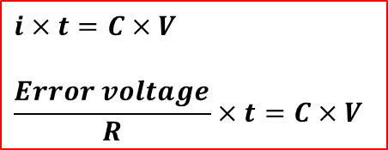



PI Temp Controller removes errors
100KΩ
+15V
1KΩ
R
+15V
$$−$$
$$Temp$$
$$+$$
R
$$−$$
$$−$$
$$+$$
$$Error$$
$$−$$
$$+$$
$$+$$
$$Error$$
C
R
-15V
$$Amplifier$$
R
$$−$$
$$+$$
Heater
$$Set Temp$$
$$i×t=C×V$$
$$\frac{Error voltage}{R}×t=C×V$$
3

Slide 4




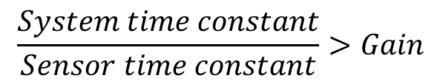


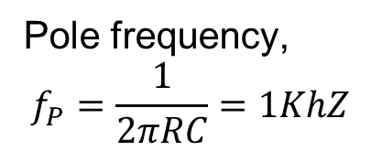






Control Theory: Electrical equivalent of PI controller
Time constant of system
(100seconds)
Time constant of sensor
(1s)
Phase shift 90°
Phase shift 90°
$$R_{1}$$
$$R_{2}$$
Phase shift 180°
Total Phase shift 360°
g
$$−$$
$$+$$
Pole frequency,
$$f_{P}=\frac{1}{2πRC}=1KhZ$$
$$C_{1}$$
$$C_{2}$$
$$V_{R}$$
$$θ$$
Condition for NOT oscillation
$$45°$$
$$√2$$
Temperature gain
$$\frac{System time constant}{Sensor time constant}>Gain$$
$$f$$
$$f_{P}$$
4

Slide 5
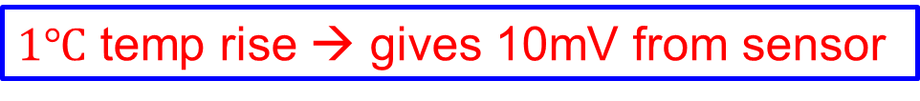
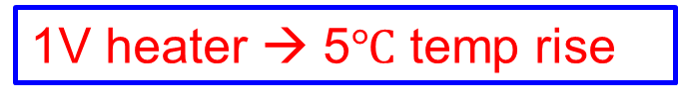
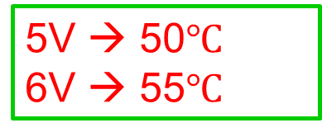
How to convert temp gain → Electronic gain
Drawback
+15V
Thermocouple
Heater
5V → 50$℃$
6V → 55$℃$
1V heater → 5$℃$ temp rise
$1℃$ temp rise → gives 10mV from sensor
$$f$$
5

Slide 6
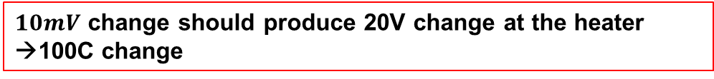
PI Temp Controller removes errors
100KΩ
+15V
1KΩ
R
+15V
$$−$$
$$Temp$$
$$+$$
R
$$−$$
$$−$$
$$+$$
$$Error$$
$$−$$
$$+$$
$$+$$
$$Error$$
C
R
-15V
$$Amplifier$$
R
$$−$$
$$+$$
Heater
$$Set Temp$$
$10mV$ change should produce 20V change at the heater →100C change
$$Electronic gain= \frac{20V}{100mV}=2000$$
6

Slide 7









PID Temp Controller removes errors
100KΩ
+15V
1KΩ
R
+15V
$$−$$
$$Temp$$
$$+$$
R
$$−$$
$$−$$
$$−$$
$$+$$
$$−$$
$$Proportional$$
$$+$$
$$Error$$
$$+$$
$$+$$
C
-15V
$$Amplifier$$
R
$$−$$
R
$$+$$
Heater
$$Set Temp$$
$$Integrater$$
R
$$−$$
$$+$$
$$Differentiator$$
7

