Slide 1

Lecture 6
August 25, 2023
1

Slide 2


















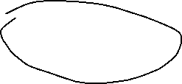






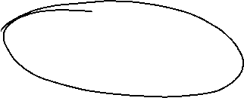





Transistor Amplifier
What is the problem associated with this circuit?
$$I_{C}$$
$$R_{L}$$
$$C_{2}$$
$$R_{1}$$
$$V_{o}$$
$$C_{1}$$
$$I_{B}$$
How the analog electronics grown?
$$15 V$$
$$+$$
$$V_{BE}$$
$$−$$
Input
Signal
$$R_{2}$$
$$R_{E}$$
2

Slide 3






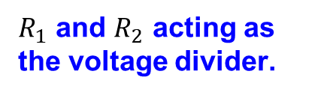
Transistor Amplifier
$R_{1}$ and $R_{2}$ acting as the voltage divider.
$$R_{1}=10kΩ$$
We need to find $R_{1}$ and $R_{2}$
$$7.5 V$$
$$15 V$$
If $R_{1}$ and $R_{2}$=10 kΩ
$$R_{2}=10kΩ$$
3

Slide 4












Transistor Amplifier
If I connect the base to the voltage divider, then the applied bias to the base would be 7.5V
$$R_{L}$$
$$C_{2}$$
$$R_{1}=10kΩ$$
$$V_{o}$$
$$7.5 V$$
$$7.5 V$$
$$15 V$$
$$+$$
$$V_{BE}$$
$$−$$
$$R_{2}=10kΩ$$
$$R_{E}$$
4

Slide 5

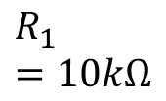




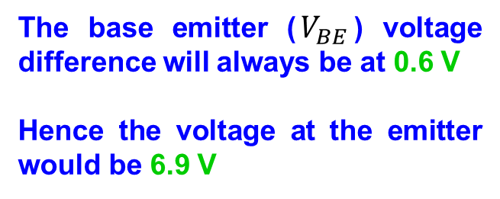














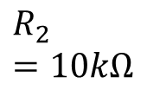


Transistor Amplifier
The base emitter ($V_{BE}$) voltage difference will always be at 0.6 V
Hence the voltage at the emitter would be 6.9 V
$$R_{1}=10kΩ$$
$$R_{L}$$
$$C_{2}$$
$$V_{o}$$
$0.$4
$$7.5 V$$
$$7.5 V$$
$$15 V$$
$$+$$
$0.$3
$$V_{BE}$$
$$−$$
$$6.9 V$$
$I_{B}$(mA)
$$0.2$$
$$R_{2}=10kΩ$$
$$R_{E}$$
$$0.1$$
$$0$$
$V_{BE}$(V)
$$0.2$$
$0.$4
$$0.6$$
5

Slide 6

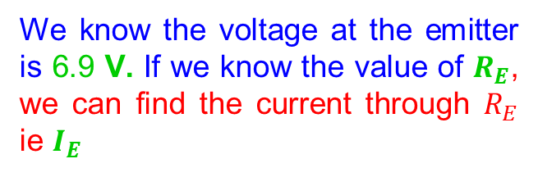
Transistor Amplifier
$$R_{1}=10kΩ$$
$$R_{L}$$
$$C_{2}$$
$$V_{o}$$
We know the voltage at the emitter is 6.9 V. If we know the value of $R_{E}$, we can find the current through $R_{E}$ ie $I_{E}$
$$7.5 V$$
$$7.5 V$$
$$15 V$$
$$+$$
$$V_{BE}$$
$$−$$
$$6.9 V$$
$$R_{2}=10kΩ$$
$$R_{E}$$
$$I_{E}$$
6

Slide 7


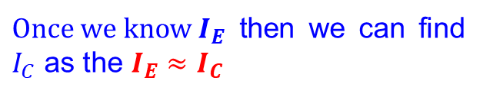

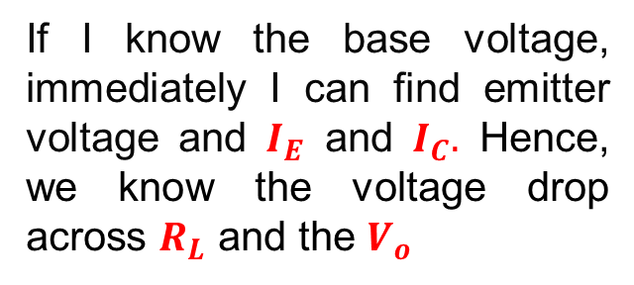



Transistor Amplifier
$Once we know I_{E}$ then we can find $I_{C}$ as the $I_{E}$ $≈$ $I_{C}$
$$R_{1}=10kΩ$$
$$I_{C}$$
$$R_{L}$$
$$C_{2}$$
$Ideally I_{E}$ $=$ $I_{C}+I_{B}$
$$V_{o}$$
$I_{B}$ is very small compared to $I_{C}$
$$7.5 V$$
$$7.5 V$$
$$15 V$$
Once I know $I_{C},$we can find voltage drop across $R_{L}$= $R_{L}I_{C}$
$$I_{B}$$
$$+$$
$$V_{BE}$$
$$−$$
$$6.9 V$$
$$R_{2}=10kΩ$$
If I know the base voltage, immediately I can find emitter voltage and $I_{E}$ and $I_{C}.$ Hence, we know the voltage drop across $R_{L}$ and the $V_{o}$
$$R_{E}$$
$$I_{E}$$
7

Slide 8

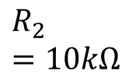



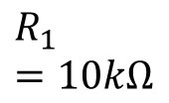












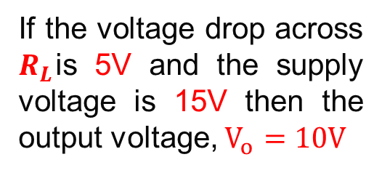
Transistor Amplifier
$$15 V$$
If the voltage drop across $R_{L}$is 5V and the supply voltage is 15V then the output voltage, $V_{o}=10V$
$$5 V$$
$$R_{1}=10kΩ$$
$$I_{C}$$
$$R_{L}$$
$$C_{2}$$
$$V_{o}=10V$$
$$7.5 V$$
Once I know the base voltage the I will know the emitter voltage and collector voltage and find the output from the amplifier.
$$7.5 V$$
$$15 V$$
$$I_{B}$$
$$+$$
$$V_{BE}$$
$$−$$
$$6.9 V$$
$$R_{2}=10kΩ$$
$$R_{E}$$
$$I_{E}$$
8

Slide 9
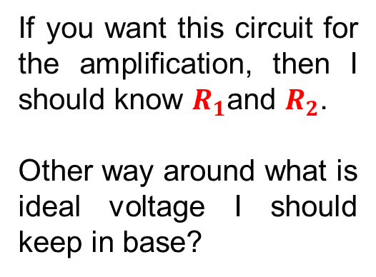
Transistor Amplifier
$$15 V$$
If you want this circuit for the amplification, then I should know $R_{1}$and $R_{2}$.
Other way around what is ideal voltage I should keep in base?
$$5 V$$
$$R_{1}=10kΩ$$
$$I_{C}$$
$$R_{L}$$
$$C_{2}$$
$$V_{o}=10V$$
$$7.5 V$$
$$7.5 V$$
$$15 V$$
$$I_{B}$$
$$+$$
$$V_{BE}$$
$$6.9 V$$
What is the AC swing you want ?
$$−$$
$$R_{2}=10kΩ$$
$$R_{E}$$
What is the gain you required?
$$I_{E}$$
9

Slide 10

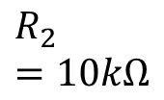



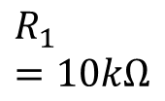












Transistor Amplifier
$$15 V$$
What is the AC swing you want?
$$5 V$$
$$R_{1}=10kΩ$$
$$I_{C}$$
$$R_{L}$$
Variation in base = AC+DC
$$C_{2}$$
$$V_{o}=10V$$
$$15 V$$
$$7.5 V$$
DC
$$7.5 V$$
$$+$$
Variation in the base will reflect the emitter voltage.
$$I_{B}$$
$$V_{BE}$$
$$−$$
$$6.9 V$$
AC
Input
Signal
$$R_{2}=10kΩ$$
For example, if base voltage 8V the emitter voltage will be 7.4 V. If base voltage is 7V then emitter voltage will be 6.4V
$$R_{E}$$
$$I_{E}$$
This indicates whatever AC signal is given to base that will appear to the emitter
10

Slide 11













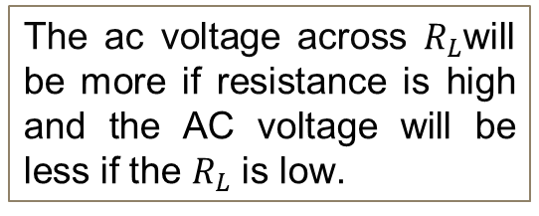


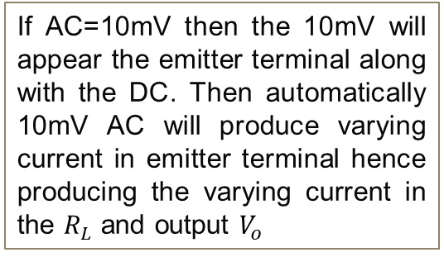

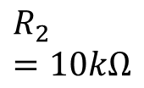

Transistor Amplifier
$$15 V$$
If AC=10mV then the 10mV will appear the emitter terminal along with the DC. Then automatically 10mV AC will produce varying current in emitter terminal hence producing the varying current in the $R_{L}$ and output $V_{o}$
$$5 V$$
$$I_{C}$$
$$R_{L}$$
$$R_{1}=10kΩ$$
$$C_{2}$$
$$V_{o}=10V$$
$$7.5 V$$
$$15 V$$
DC
$$7.5 V$$
$$I_{B}$$
$$+$$
$$V_{BE}$$
The ac voltage across $R_{L}$will be more if resistance is high and the AC voltage will be less if the $R_{L}$ is low.
$$−$$
$$6.9 V$$
AC
Input
Signal
$$R_{2}=10kΩ$$
$$R_{E}$$
$$I_{E}$$
The gain is determined by the ratio between $R_{L}$and $R_{E}$, $g=\frac{R_{L}}{R_{E}}$
11

Slide 12






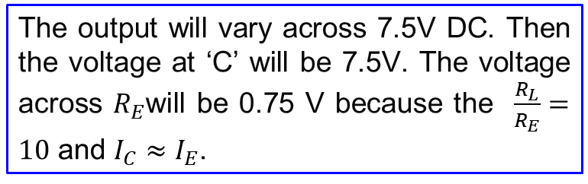




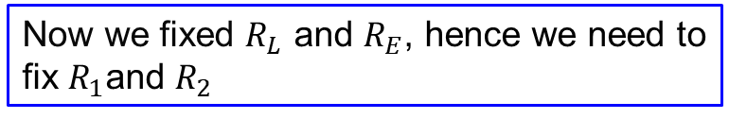




Transistor Amplifier
What happened if I need a gain 10?
$$7.5 V$$
$$R_{L}=10kΩ$$
Make sure that $g=\frac{R_{L}=10}{R_{E}=1}=10$
$$R_{1}$$
$$C_{2}$$
C
$$V_{o}$$
$$1.35 V$$
Now we fixed $R_{L}$ and $R_{E}$, hence we need to fix $R_{1}$and $R_{2}$
$$15 V$$
DC
B
$$+$$
Assuming no biasing voltage is applied to the circuit.
$$V_{BE}$$
$$−$$
E
$$R_{2}$$
$$0.75 V$$
$$R_{E}=1kΩ$$
The output will vary across 7.5V DC. Then the voltage at ‘C’ will be 7.5V. The voltage across $R_{E}$will be 0.75 V because the $\frac{R_{L}}{R_{E}}=10$ and $I_{C}≈I_{E}$.
If point E is at 0.75V then the base terminal should be 1.35V (= 0.75V + $V_{BE}\left(0.6V\right)$)
12

Slide 13






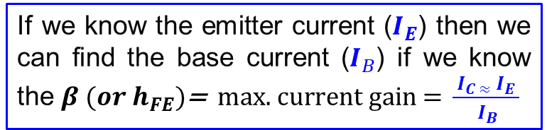
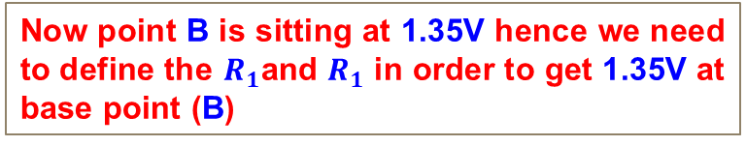


Transistor Amplifier
Now point B is sitting at 1.35V hence we need to define the $R_{1}$and $R_{1}$ in order to get 1.35V at base point (B)
$$7.5 V$$
$$R_{L}=10kΩ$$
$$R_{1}$$
$$C_{2}$$
C
$$V_{o}$$
$$1.35 V$$
What is the value of $R_{1}$and $R_{1}$ ?
$$15 V$$
B
Although we assumed the base current is negligible but there is a very small amount of current flowing through the base.
DC
$$I_{B}=7.5μA$$
$$+$$
$$V_{BE}=0.6V$$
$$−$$
E
$$R_{2}$$
$$0.75 V$$
$$R_{E}=1kΩ$$
If we know the emitter current ($I_{E}$) then we can find the base current ($I_{B}$) if we know the $β (or h_{FE})\text{=} \text{max}\text{. }\text{current} \text{gain}\text{ = }\frac{{ I}_{C ≈}{ I}_{E }}{{ I}_{B}}$
$$I_{E}=0.75mA$$
If $β$= 100, $I_{E}=0.75mA$, the $I_{B}=\frac{0.75}{100}=7.5μA$
13

Slide 14


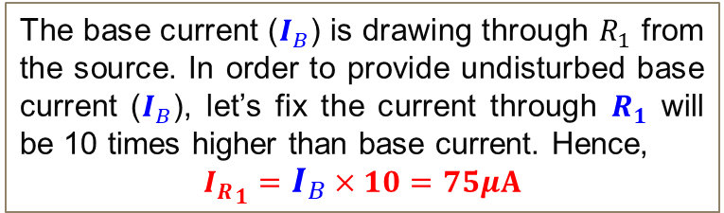
Transistor Amplifier
The base current ($I_{B}$) is drawing through $R_{1}$ from the source. In order to provide undisturbed base current ($I_{B}$), let’s fix the current through $R_{1}$ will be 10 times higher than base current. Hence,
$${I_{R}}_{1}=I_{B}×10=75μA$$
$$7.5 V$$
$$R_{L}=10kΩ$$
$$R_{1}$$
$$C_{2}$$
$${I_{R}}_{1}=75μA$$
C
$$V_{o}$$
$$1.35 V$$
$$15 V$$
B
So, the current through $R_{1}$ = 75$μA$
DC
$$I_{B}=7.5μA$$
$$+$$
$$V_{BE}=0.6V$$
$$−$$
E
$$R_{2}$$
$$0.75 V$$
$$R_{E}=1kΩ$$
$$I_{E}=0.75mA$$
14

Slide 15












Transistor Amplifier
$$7.5 V$$
$$R_{L}=10kΩ$$
If AC=10mV then the 10mV will appear in the base terminal (B). The total voltage in the base terminal (B) = 1.35V+10mV. This AC voltage will appear to the emitter hence emitter voltage (E) = 0.75V+10mV. Increase in current, 10mV/1kΩ=10µA Hence the same variation will be there at C indicating 10 times amplified voltage in the output terminal
$${I_{R}}_{1}=75μA$$
1.35V+10mV
$$R_{1}$$
$$C_{2}$$
C
$$15 V$$
DC
B
$$I_{B}=7.5μA$$
$$+$$
$$V_{BE}=0.6V$$
E
AC
Input
10mV
$$−$$
$$R_{2}$$
$$0.75 V+10mV$$
$$I_{E}=0.75mA$$
$$R_{E}=1kΩ$$
15

Slide 16




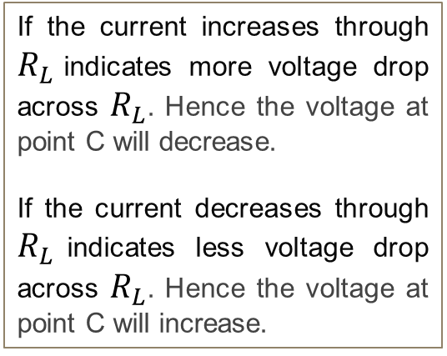
Transistor Amplifier
$$15 V$$
$$7.5 V$$
$$R_{L}=10kΩ$$
If the current increases through $R_{L}$indicates more voltage drop across $R_{L}$. Hence the voltage at point C will decrease.
If the current decreases through $R_{L}$indicates less voltage drop across $R_{L}$. Hence the voltage at point C will increase.
$${I_{R}}_{1}=75μA$$
1.35V+10mV
$$C_{2}$$
$$R_{1}$$
C
$$15 V$$
DC
B
$$I_{B}=7.5μA$$
$$+$$
$$V_{BE}=0.6V$$
E
AC
Input
10mV
$$−$$
$$0.75 V+10mV$$
$$R_{2}$$
$$I_{E}=0.75mA$$
$$R_{E}=1kΩ$$
Input
Output
16

Slide 17
Transistor Amplifier
It was good for AC operation and hence used during the second world war for radio operation!
What happened if this circuit is used for DC amplifier?
17

Slide 18








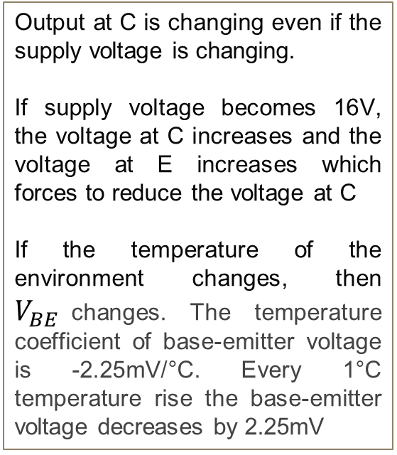


Transistor Amplifier
$$15 V$$
Output at C is changing even if the supply voltage is changing.
If supply voltage becomes 16V, the voltage at C increases and the voltage at E increases which forces to reduce the voltage at C
If the temperature of the environment changes, then $V_{BE}$changes. The temperature coefficient of base-emitter voltage is -2.25mV/°C. Every 1°C temperature rise the base-emitter voltage decreases by 2.25mV
$$R_{L}=10kΩ$$
$$R_{1}$$
$$C_{2}$$
C
$$15 V$$
B
$$+$$
$$V_{BE}=0.6$$
E
DC
$$R_{2}$$
$$−$$
$$R_{E}=1kΩ$$
18

Slide 19




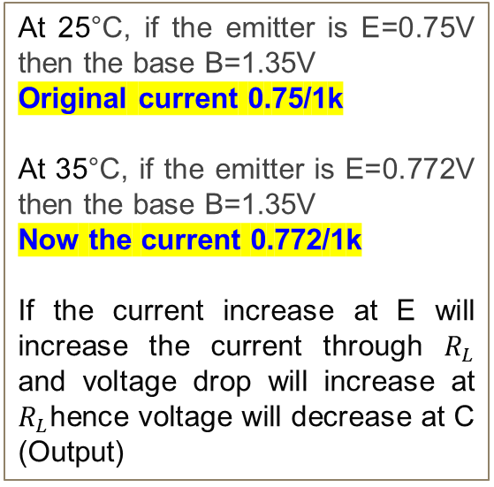
Transistor Amplifier
$$15 V$$
At 25°C, if the emitter is E=0.75V then the base B=1.35V
Original current 0.75/1k
At 35°C, if the emitter is E=0.772V then the base B=1.35V
Now the current 0.772/1k
If the current increase at E will increase the current through $R_{L}$ and voltage drop will increase at $R_{L}$hence voltage will decrease at C (Output)
$$R_{L}=10kΩ$$
$$R_{1}$$
$$C_{2}$$
C
$$7.5V$$
$$15 V$$
B
$$1.35V$$
$$+$$
E
$$0.772V$$
$$V_{BE}=0.6V+22mV$$
DC
$$R_{2}$$
$$−$$
$$R_{E}=1kΩ$$
19

Slide 20
Transistor Amplifier
How can we solve the drift issue?
20

Slide 21





Summing Transistor Amplifier
1941: H SWARTZAL patent
$$15 V$$
$$R_{1}$$
C1
C2
C3
B1
B2
B3
E1
E2
E3
DC
$$R_{2}$$
$$R_{2}$$
$$R_{2}$$
21

Slide 22
Transistor Amplifier
Second world war
A Gun director was required with radar
MIT to develop Gun director
Columbia University to develop OPAMP
Bell Lab
22

Slide 23





OPAMP-First analog computer
$$+15V$$
C
$$V_{o}$$
B
B
$$+$$
$$−$$
E
E
$$−15V$$
23

