Slide 1
Terraform, Azure and GitHub Actions
Scott Alexander

Slide 2
What is Terraform?
Terraform is a tool for building, changing, and versioning infrastructure safely and efficiently. https://www.terraform.io/intro/index.html
Infrastructure as Code – Put it in a repo!
Execution Plans – Convert your code into a plan of action.
Resource Graphs – Automatically prioritise dependencies.
Change Automation – Create your environment fast.

Slide 3
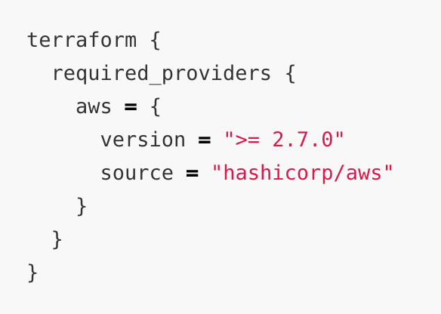
Terraform - Providers
AWS
Azure
Google Cloud Platform (GCP)
Oracle Cloud Infrastructure (OCI)
Terraform Cloud
https://learn.hashicorp.com/collections/terraform/azure-get-started

Slide 4
Terraform - CLI
You will need to install the Terraform CLI - https://www.terraform.io/downloads.html
You will need to be authenticated to run terraform fully. For Azure you can use the Azure CLI to test with the “az login” command - https://docs.microsoft.com/en-us/cli/azure/install-azure-cli
Part one of the terraform process is to intialise the project. Run “terraform init” in your project directory.

Slide 5
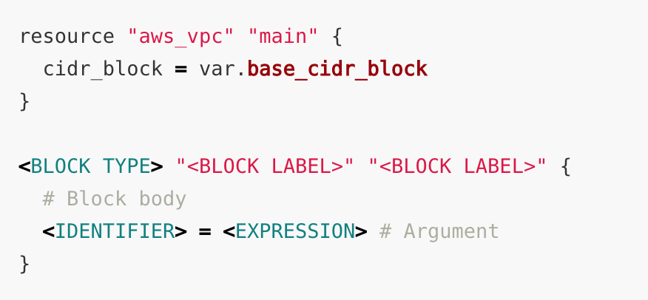
Write, Plan and Apply
Write your code In Terraform Configuration Language (.tf)
https://www.terraform.io/docs/language/index.html

Slide 6
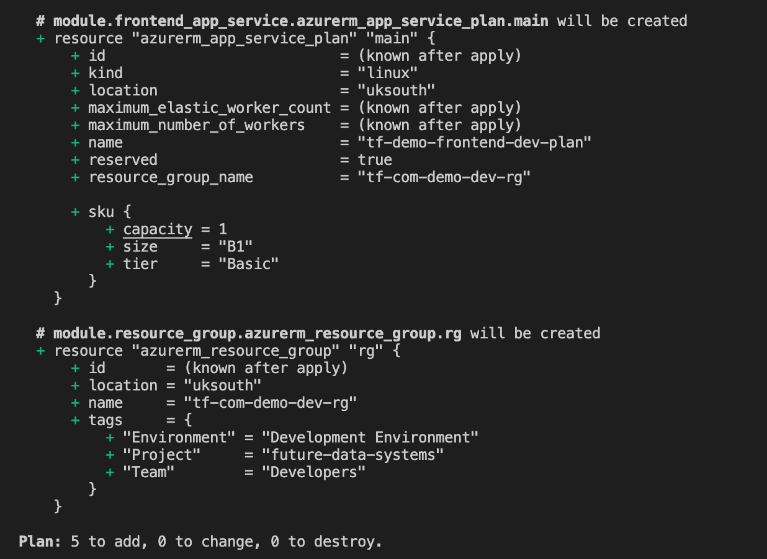
Write, Plan and Apply
Run a plan “terraform plan –out plan”
This will analyse your code and produce a plan of action to create your required resources.

Slide 7
Write, Plan and Apply
Apply the plan by running ‘terraform apply “plan”’
Your defined resources will now be applied to your cloud provider.
Following the apply process, a tstate will be created to keep track of the providers state.

Slide 8
Modules & Variables
Each resource can be broken down into modules to increase reusability and readability.
Modules can help define different configurations for different environments.
Dev, Systest, Prod ect…
Azure, AWS ect…
There are four levels of variable configurations. In order of priority…
CLI Variables
Environment Variables
Global Variables
Local Variables

Slide 9
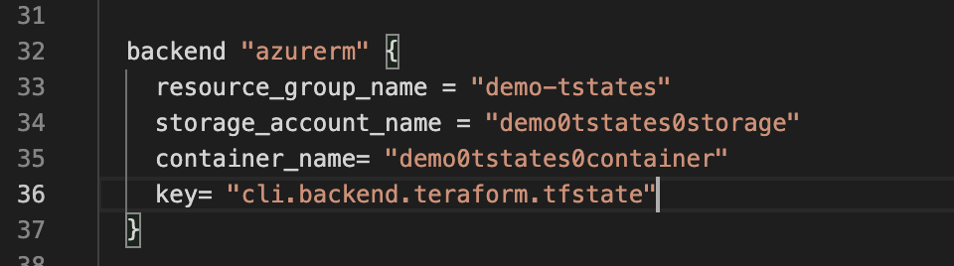
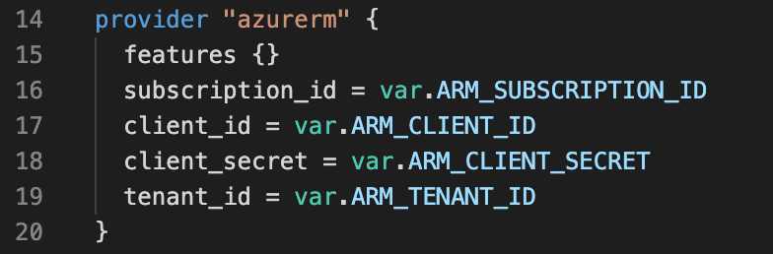
Terraform State with Azure
Concerns
State should not be stored in a repository!
The Azure CLI is restricted in automation.
Solutions
Terraform can store it’s state in blob storage out of the box.
We can use Azure Service Principals for Authentication

Slide 10
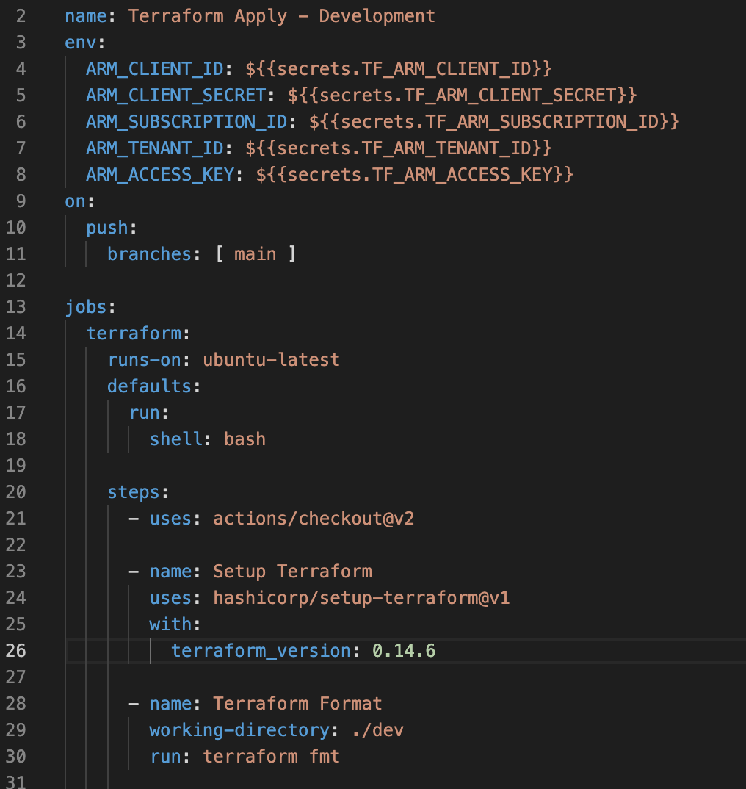
Terraform with GitHub Actions
Simple step by step .yaml files
Environment variables can be used alongside Github Secrets. No exposed keys!
The deploy process is exactly the same as the local test process!
We can also include a format step to make sure our code is semantically correct

