Slide 1
Validation Processes using Angular
Scott Alexander

Slide 2
Validation Basics
Where is Validation required?
Backend only!
However, it’s not user friendly.

Slide 3
Backend Only Validation
Validation should be done on a form submission by default.
One validation call per submission (Acceptable)
If validation messages are clear, this could be acceptable although annoying.
Validation on a blur event.
One validation call per form field change, x+1 calls per user where x = number of form fields
Pending on the extent of the validation processes, this could be acceptable and is more user friendly.
This should require individual validation API calls for each form field to reduce processing. Running all validation checks on every blur event produces redundant server side processing!
Validation per keystroke
Avoid! 20 character inputs = 20 validation calls. 10 Simultaneous users = 200 API calls.

Slide 4
Frontend Validation
Not Required from a security perspective, is required from a user perspective!
How do we sell frontend validation to our customers?
Provide more user guidance as and when required, less documentation.
“Username is invalid, a username must contain 6 or more characters.” As opposed to “Username Invalid”.
Create reusable validation rules that can be tested independently and globally.
We have to be able to implement it quickly.

Slide 5
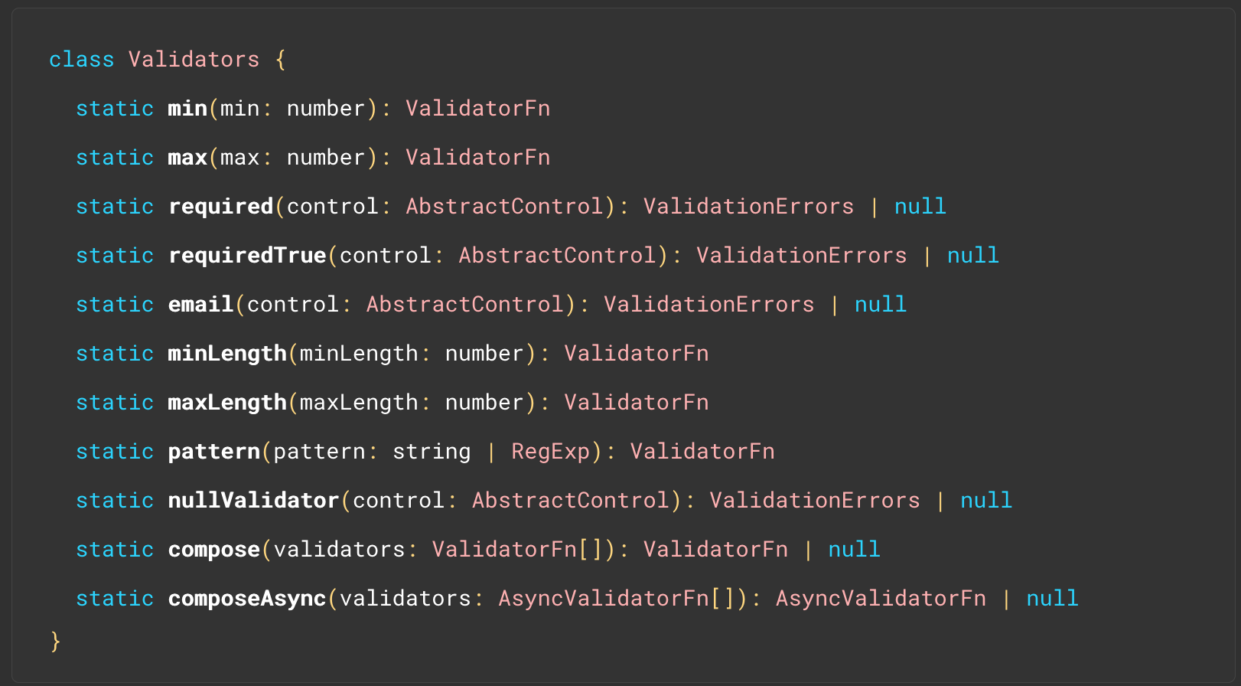
What can Angular provide?
Reactive Forms, build your form as a model.
Predefined Validators.
FormGroup & FormControl classes that contain states!
Invalid
Touched
Dirty
Errors

Slide 6
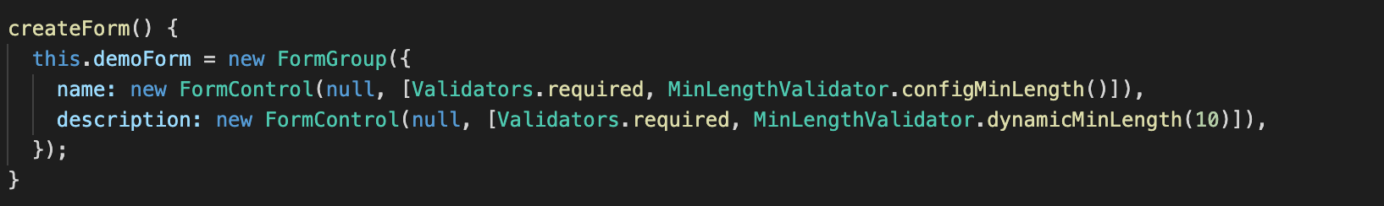
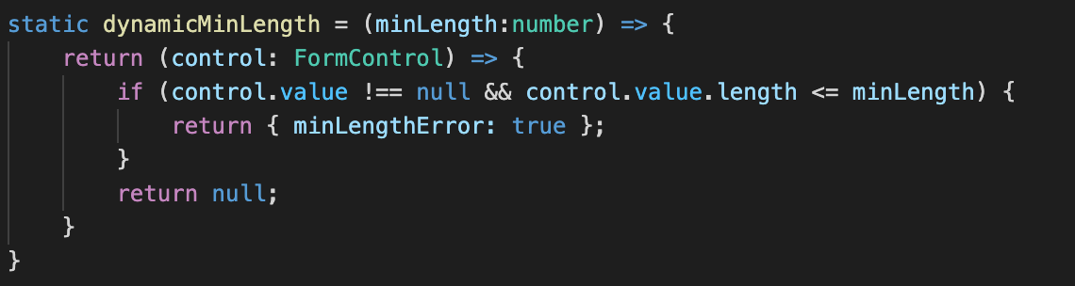
Custom Validators
Each form control can have an array of Validators making them modular.
As long as your function returns an error state: { notLongEnough: true}, it will be added to the errors model… errors?.notLongEnough

Slide 7
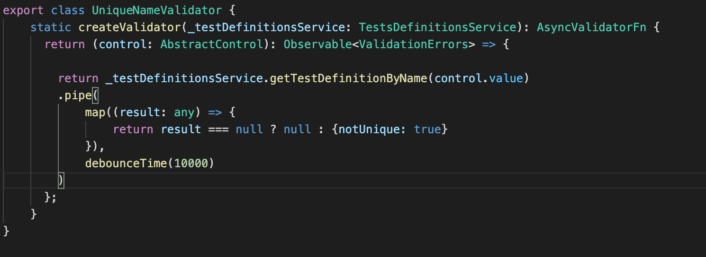
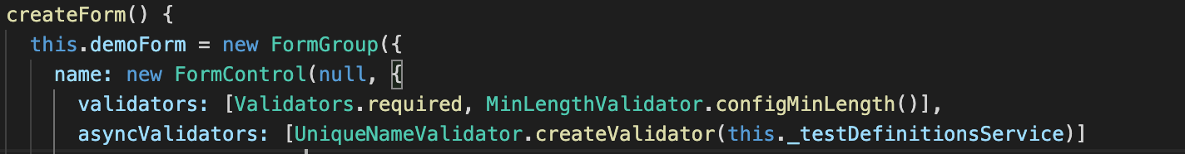
ASYNC Validators
FormControls have a secondary array specifically for async validators.
You create the Validator instance using your components services. Since this is an interface, your design could mean a single validator for multiple API endpoints..

Slide 8
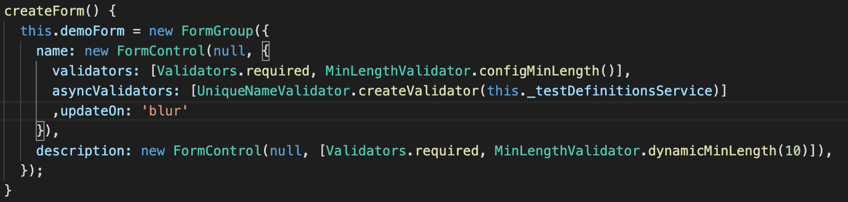
Reduce API Calls
Option 1: Set your FormControl to update on Blur.
Option 2: Implement Debouncing, a call will only be made after x amount of time has passed after the last keypress.

Slide 9
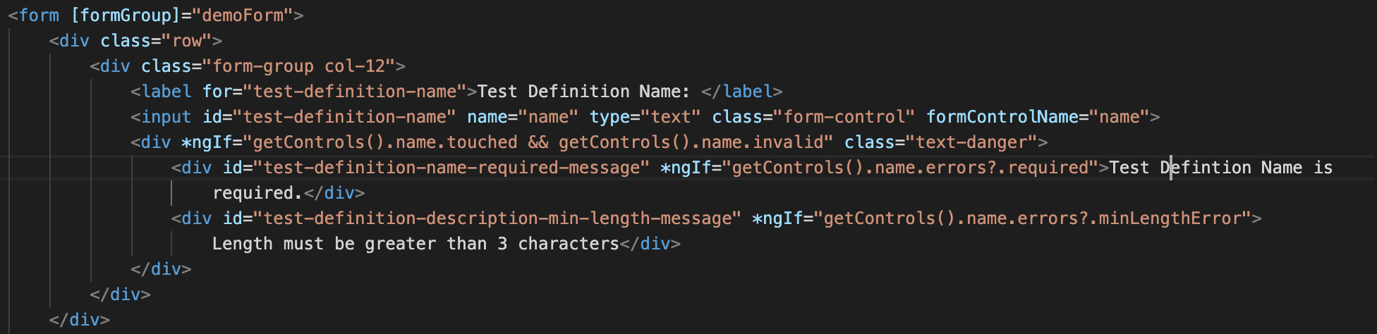
Testing
Rather than testing for exact messages, look for ID’s, they should be unique and their existence is easy to detect via cypress.
cy.get(‘#test-definition-name-required-message’).should(“be.visible”)
Cy.get('body').find('##test-definition-name-required-message').should("have.length",0)

Slide 10
Questions

