Slide 1

ZERO HUNGER

Slide 2
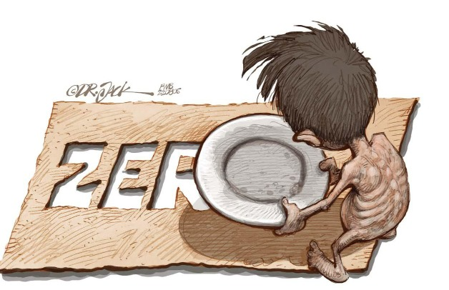
Introduction To Zero Hunger:
->What Is Zero Hunger?
Zero Hunger means making sure everyone has enough food to eat every day. It's about ending hunger and making sure nobody goes to bed hungry.
-> Importance Of Zero Hunger Goal:-
The importance of the Zero Hunger goal is simple: it's about ensuring that no one goes hungry. By achieving this goal, we can improve people's health, help children grow and learn better, and create a more equal and prosperous world for everyone. Ultimately, Zero Hunger is essential for building a brighter future where everyone has the opportunity to thrive.

Slide 3
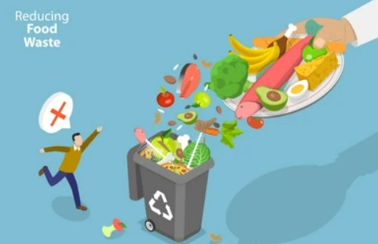
Wastage of food:-
"In India, a lot of food gets thrown away or wasted instead of being eaten. This happens for different reasons. Sometimes, food doesn't get stored properly, so it spoils quickly and can't be eaten. Other times, people buy too much food and can't finish it before it goes bad. Restaurants and big events also produce a lot of leftover food that often gets thrown away. This wastage is a big problem because many people in India don't have enough to eat. It's important to find ways to reduce food wastage so that more people can have access to the food they need."

Slide 4
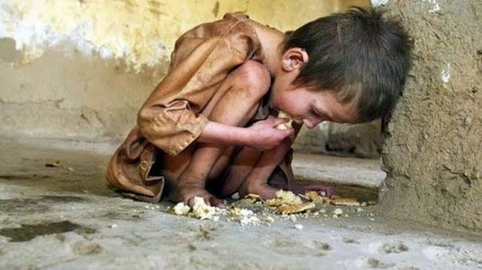
Hunger In India:-
Hunger deaths in India happen when people don't have enough food to eat, which makes them very sick and can even cause them to die. This is a big problem because some people in India don't have money to buy food or access to healthy meals. It's important for the government and organizations to work together to make sure everyone has enough food to eat and doesn't suffer from hunger and malnutrition.

Slide 5
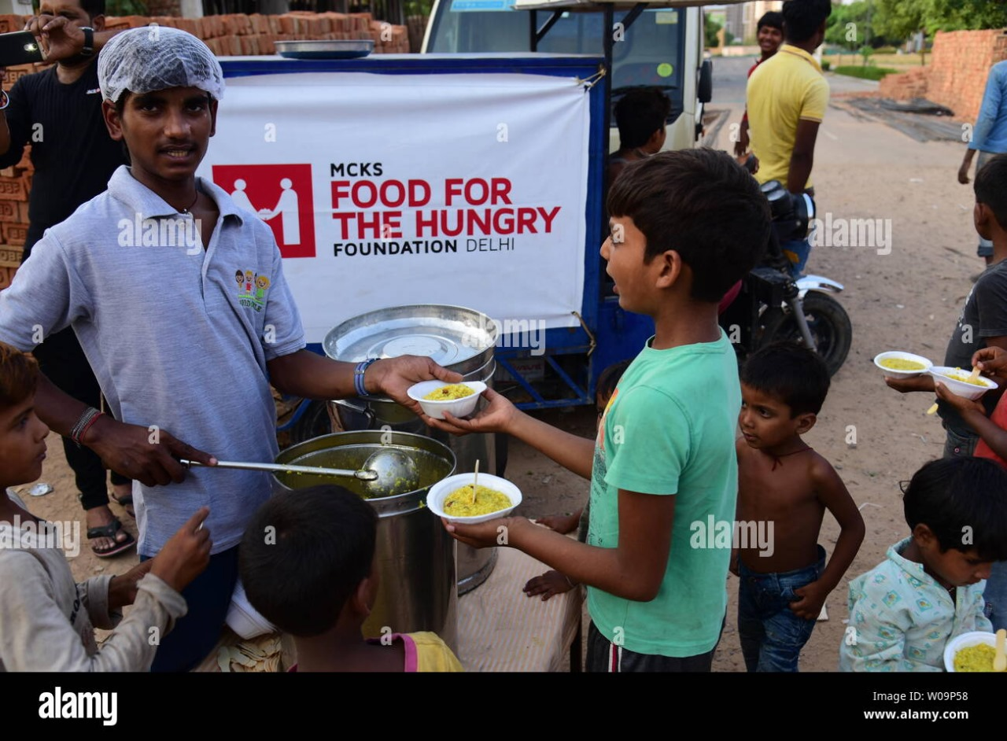
Conclusion :-
When we connect waste food with hungry individuals, we can make a big difference. By sharing excess or unused food with those in need, we can help reduce hunger and ensure that more people have access to nutritious meals. Organizations and individuals can work together to donate surplus food to food banks, shelters, or community kitchens, making sure that no one goes hungry. This act of connecting waste food with hungry ones not only addresses food waste but also helps combat hunger and promote a more sustainable future for everyone.

Slide 6

Thank you..!

