Slide 1

SALES FORECASTING
Nov-2015

Slide 2
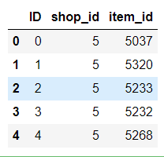
Problem: We have daily historical sales data. The task is to forecast total amount of a particular product sold in every shop for the test data.

Slide 3
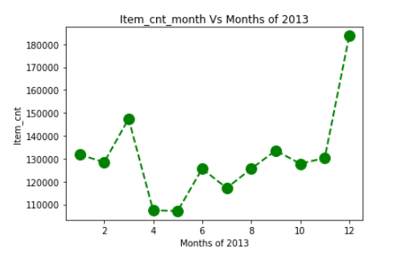
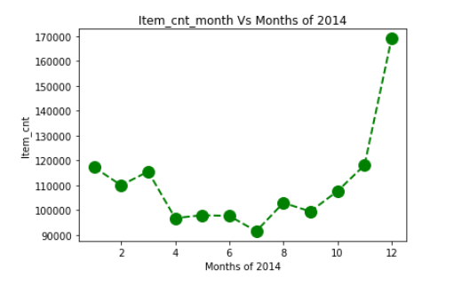
Item Count Per Month
2013 and 2014
1) At the end of 2013 and 2014 there is increase / spike in sales
2) Year end spike in sales due to festive season/ year end sale offers

Slide 4
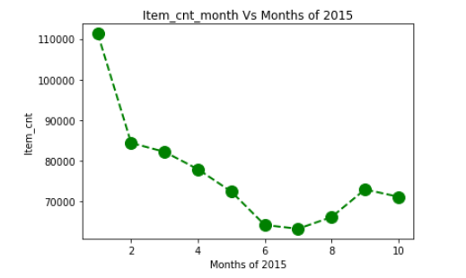
Item Count Per Month for the year 2015
::) Sales are falling initially and picking up later

Slide 5
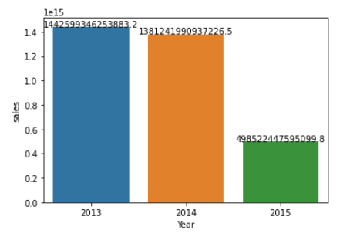
Sales are Falling Year on Year basis

Slide 6
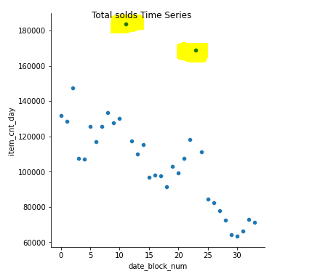
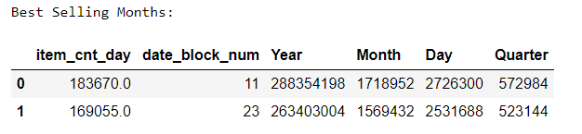
::) We can observe two data points (shaded) as extreme value. These are at the end of the year.

Slide 7
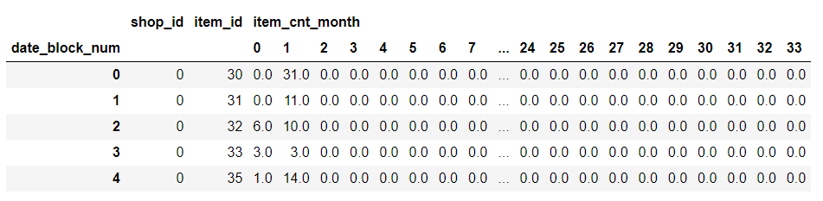
Using Pivot Table constructed data frame on item count monthly group by shop_id and item_id

Slide 8
Test File data frame top five rows
::) Shape of test file is
(214200, 3)

Slide 9
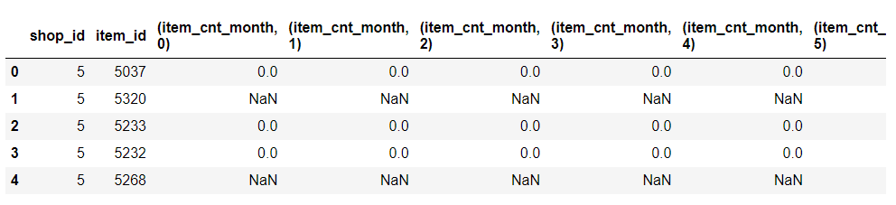
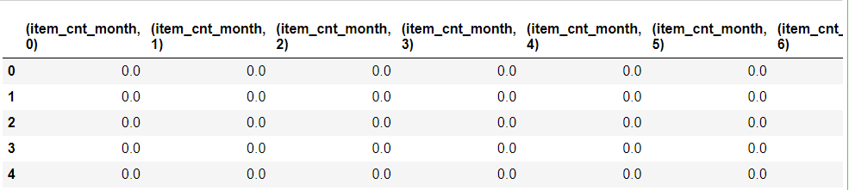
::) Merging test file with train file on the basis of shop_id and Item_id so that we have same shape as submission file/test file
::) Removing shop_id and item_id columns as they are primary keys and does not help in forecasting
This will make out model robust as the forecast values will not dependent on shop_id or item_id

Slide 10
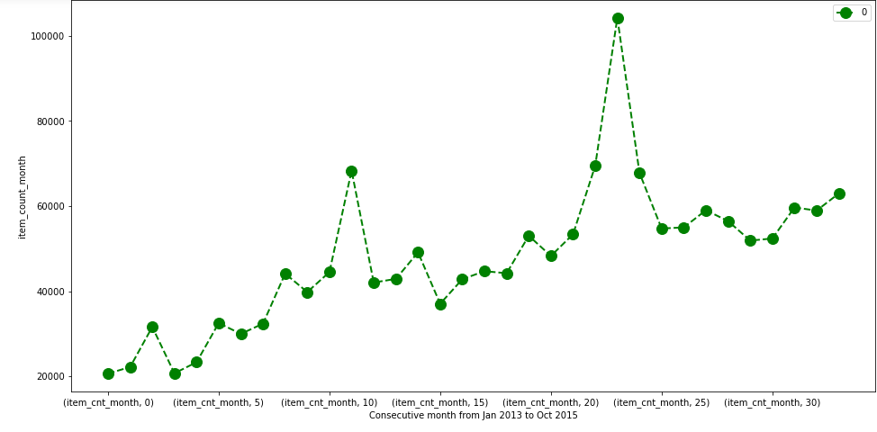

Slide 11
Using Machine learning models we will predict the next sequence is item_cnt_month for Dec-2015 i.e. item_block_num #34
1) Linear Regression
2) AdaBoost
3) XGBoost

Slide 12

Splitting final dataset into ::)X_train( all columns except last one)
::)Y_train ( last column as label)
::)X_test (all columns except 1st one)

Slide 13
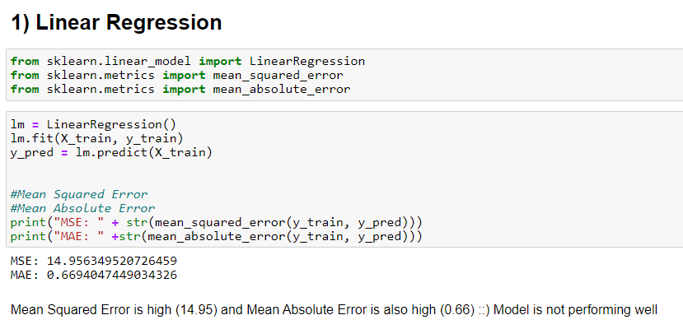
1) Linear Regression
::) MSE is 14.95 (high) and MAE is 0.66(high)
::) Model is not performing well

Slide 14
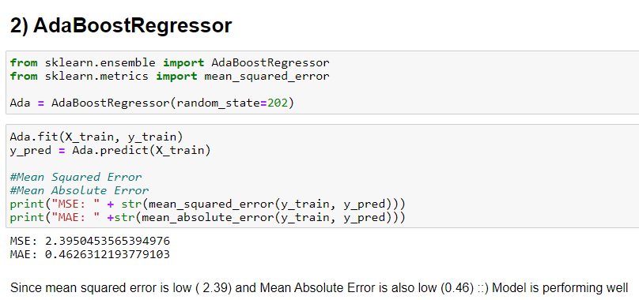
2)AdaBoost
::) MSE is 2.39 (low) and MAE is 0.46 (low)
::) Model is performing well

Slide 15
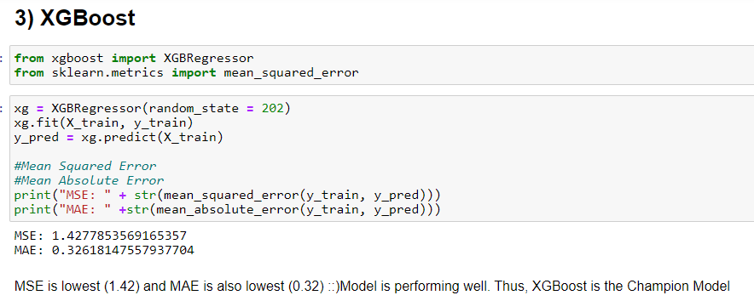
3)XGBoost
::) MSE is 1.42 (lowest) and MAE is 0.32 (lowest)
::) Model is performing best of three
::) This is the Champion Model

Slide 16
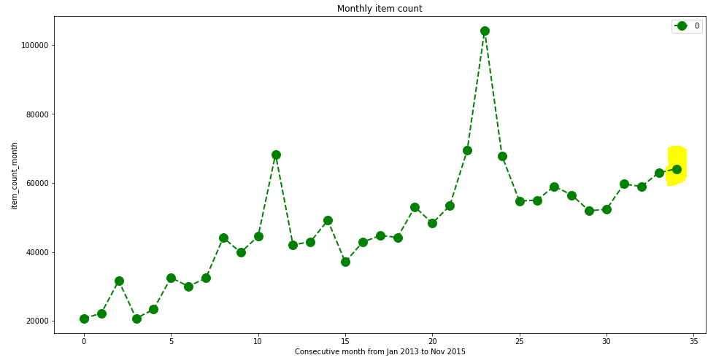

Slide 17
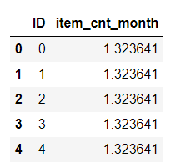
Conclusion
1) In the end of 2013 and 2014 there is increase / spike in sales due to year end offers (Seasonality)
2) XGBoost is the champion model with lowest mean squared error
3) Year end spike is not observed in 2015 sales..
4) Total sale for Nov 2015 is 62264

Slide 18
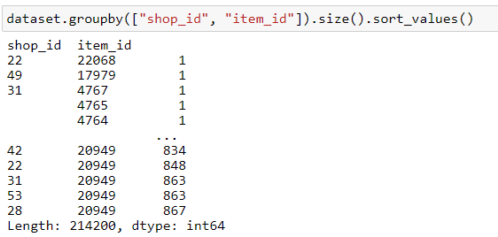
4) Time Series
::) Since, none of the Shop_id and item_id combination has data for all dates (2 years 11 month, 1063), have not applied time series analysis…
Solution: We will have to find out which dates data are missing and impute them. It may be the case where large chunk of data may be missing in between. In that case forecasting would be inaccurate.

