Slide 1
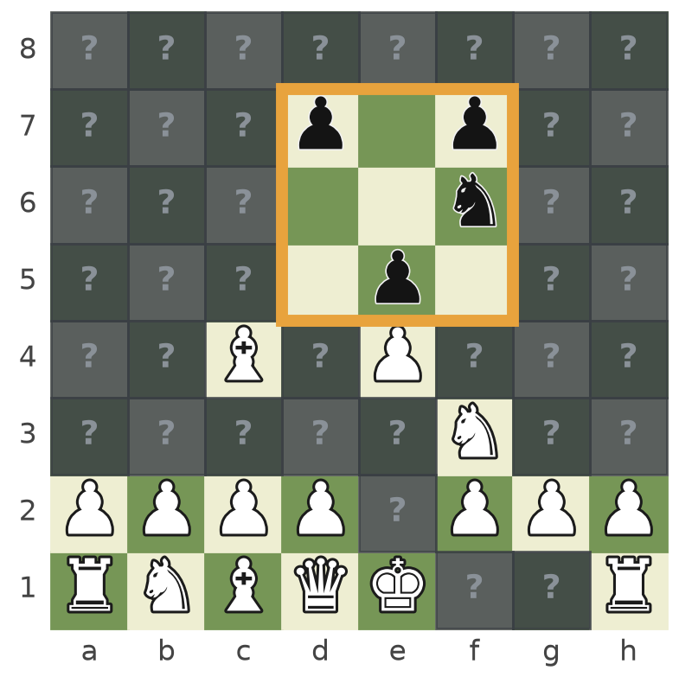
Generative Reward Machines for Reconnaissance Blind Chess
uccchess: training and implementation of a GRM-driven RBC bot
Saeid Rezaei · University College Cork
Notes:
This talk introduces Reconnaissance Blind Chess, compares it with normal chess, and then presents the uccchess bot: StrangeFish2 whose strategy is chosen by a Generative Reward Machine. The image shows what White actually knows during an RBC game: its own pieces, plus the nine squares it has just sensed.

Slide 2
What this talk covers
1
2
3
4
5
RBC, simply
Chess vs RBC
The bot
The GRM
Code and results
Chess where you cannot see the opponent
Same pieces, very different game
StrangeFish2 tracks every possible board
Rewards on an estimated state
Pipeline, tournament bot, NeurIPS 2022
Notes:
Five parts: the game itself explained with pictures, a direct comparison with chess, the StrangeFish2 bot that uccchess builds on, the Generative Reward Machine idea, and finally the code and the tournament results.

Slide 3
Reconnaissance Blind Chess, simply
1
The rules in four pictures
Notes:
First the game itself. Everything here can be explained with a board and a few highlighted squares.

Slide 4
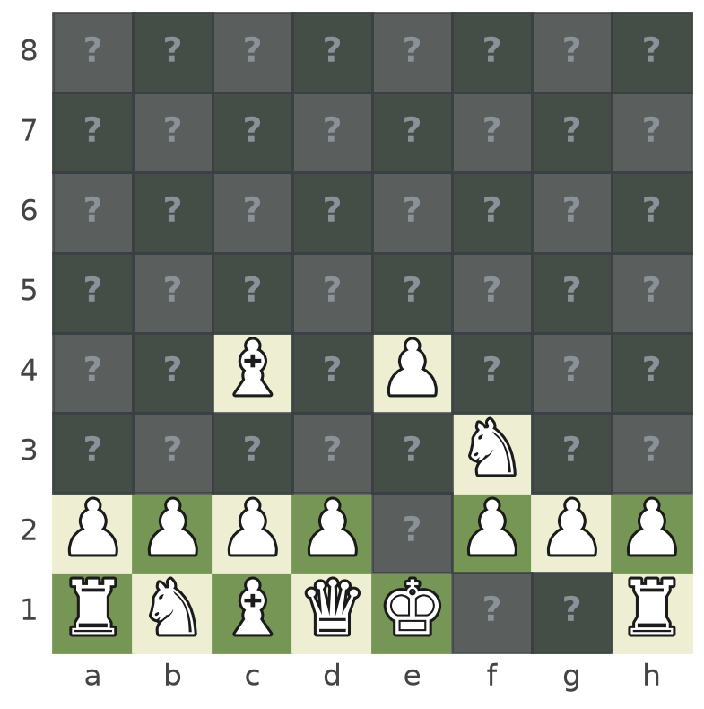
Chess where you cannot see your opponent
♞
Same pieces, same moves
Board, pieces and movement rules are those of chess.
?
Opponent's pieces are hidden
You see your own pieces only. Every other square is unknown.
▣
Peek, then move
Each turn you look at one 3×3 window of the board, then make a move.
Created at the Johns Hopkins University Applied Physics Laboratory (2016) as a testbed for decisions under uncertainty.
Notes:
RBC was designed at JHU/APL as a research testbed. Pieces and moves are exactly chess, but each player only sees its own pieces. The grey squares with question marks are everything White does not know: they may hold a black piece or be empty.

Slide 5
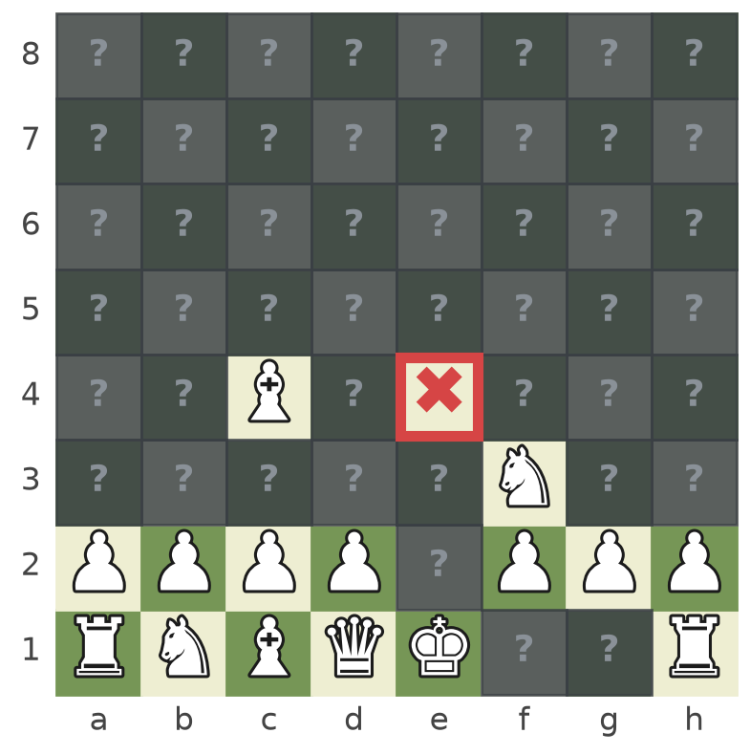
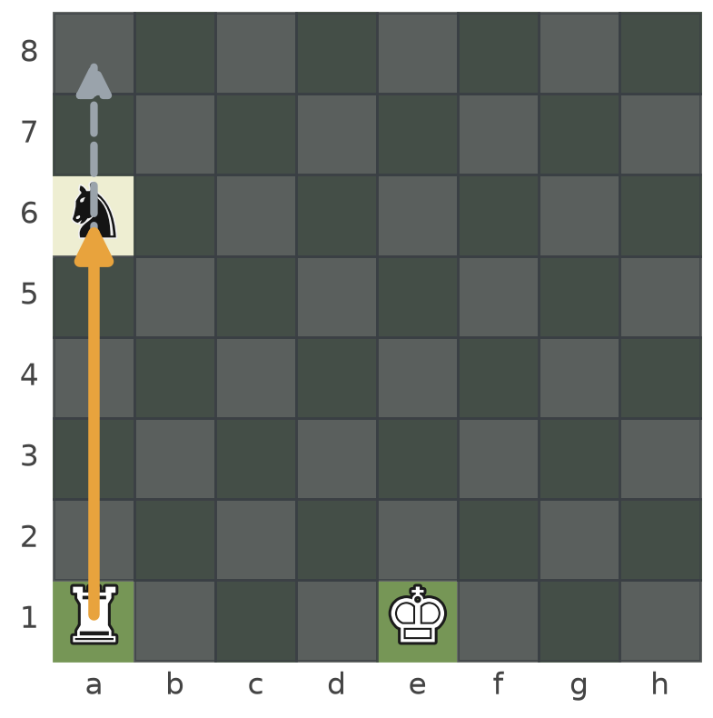
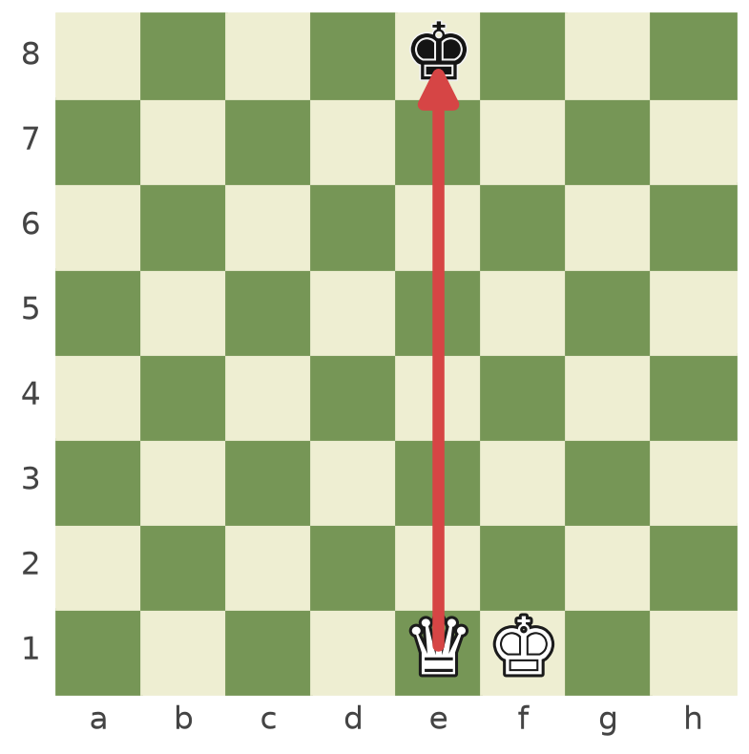
One turn in RBC
1 Captures
2 Sense
3 Move
4 King capture
Told only where one of your pieces was taken, not by what.
Pick any square; see the nine squares around it.
Request a move; it may be cut short by a hidden piece.
No check or checkmate: taking the king wins.
Notes:
A turn has a fixed order. First you are told whether the opponent captured one of your pieces and on which square. Then you choose a square to sense and see the 3 by 3 block around it. Then you request a move and learn what actually happened. The game is won by capturing the opponent's king.

Slide 6
Sensing reveals nine squares
4
pieces found
5
squares now known empty
before
after sensing e6
Notes:
White senses e6. Inside the orange window it now sees the pawns on d7, f7 and e5 and the knight on f6, and it knows the other five squares of the window are empty. The rest of the board stays unknown. Choosing where to look is half of the skill in RBC.

Slide 7
A move can be cut short by a piece you cannot see
White requests the rook move a1 to a8 (grey, dashed).
A hidden knight stands on a6: the rook stops there and captures it (orange).
White is told the move that was actually made and that it captured on a6.
Black is told only that a piece was captured on a6.
Illegal requests simply become a pass; every result is information.
Notes:
Because you do not see the opponent's pieces, the move you ask for is not always the move that happens. Sliding pieces stop at the first hidden piece and capture it. Both players learn something from the result, but not the same thing.

Slide 8
No check, no checkmate: capture the king
1
Nobody warns you
There is no check: a king can be left attacked without either side knowing.
2
Taking the king wins
The game ends the moment a king is captured.
3
Clock and draw rules
A player who runs out of time loses; long runs of moves without captures or pawn moves end in a draw.
Notes:
In RBC the concepts of check and checkmate disappear, because a player may not know its king is attacked. The winner is whoever actually captures the other king. Games also end on time, and by draw rules for long sequences without captures or pawn moves.

Slide 9
Chess vs RBC
2
Same pieces, very different game
Notes:
Now the same position seen as chess and as RBC.

Slide 10
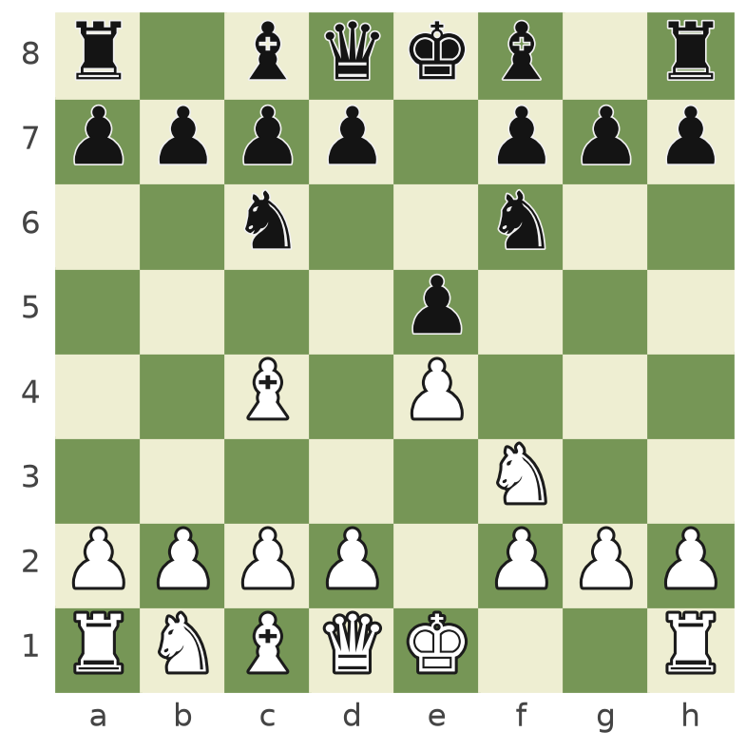
The same position, two different games
vs
Chess: both players see the whole board
RBC: White's knowledge after one sense
Notes:
Left: the actual position, which both players see in chess. Right: the same position in RBC, from White's side, after it sensed e6. White must decide on a move knowing only its own pieces and these nine squares.

Slide 11
What changes for a computer player
 | Chess | Reconnaissance Blind Chess
What you see | The whole board | Own pieces + one 3×3 sense per turn
What you reason about | One position | A set of possible positions (often thousands)
Check and checkmate | Yes | No; the king is captured
Result of a move | Always as requested | Can be cut short or become a pass
Best engine alone | Stockfish is superhuman | Not enough: it needs a known board
Key skills | Calculation | Sensing, belief tracking, risk, opponent modelling
Notes:
The rules are almost the same, but the problem for a program is completely different. A chess engine works on one known position. An RBC program has to keep a whole set of possible positions, choose what to look at, and decide under risk. Stockfish is still useful, but only as a tool for scoring candidate boards.

Slide 12
Why RBC is hard for computer players
≈ Go
9,180
21
game size
games
possible boards
comparable to Go, with far larger information sets than heads-up limit poker (Markowitz et al.)
played at the NeurIPS 2022 tournament: 18 bots, 60 games per pair
median size of uccchess's board set during tournament games
No program has yet found a sound, unexploitable strategy (Gardner et al., PMLR 220, 2023).
Notes:
Three numbers. RBC's game tree is about as large as Go's, and the uncertainty per decision is much larger than in poker. The 2022 tournament played over nine thousand games. During its games uccchess typically had around twenty boards it could not tell apart. Even the best bots are still exploitable.

Slide 13
The bot
3
StrangeFish2: tracking every board that could be true
Notes:
uccchess is built on StrangeFish2, the NeurIPS 2022 winner. First, how StrangeFish2 plays.

Slide 14
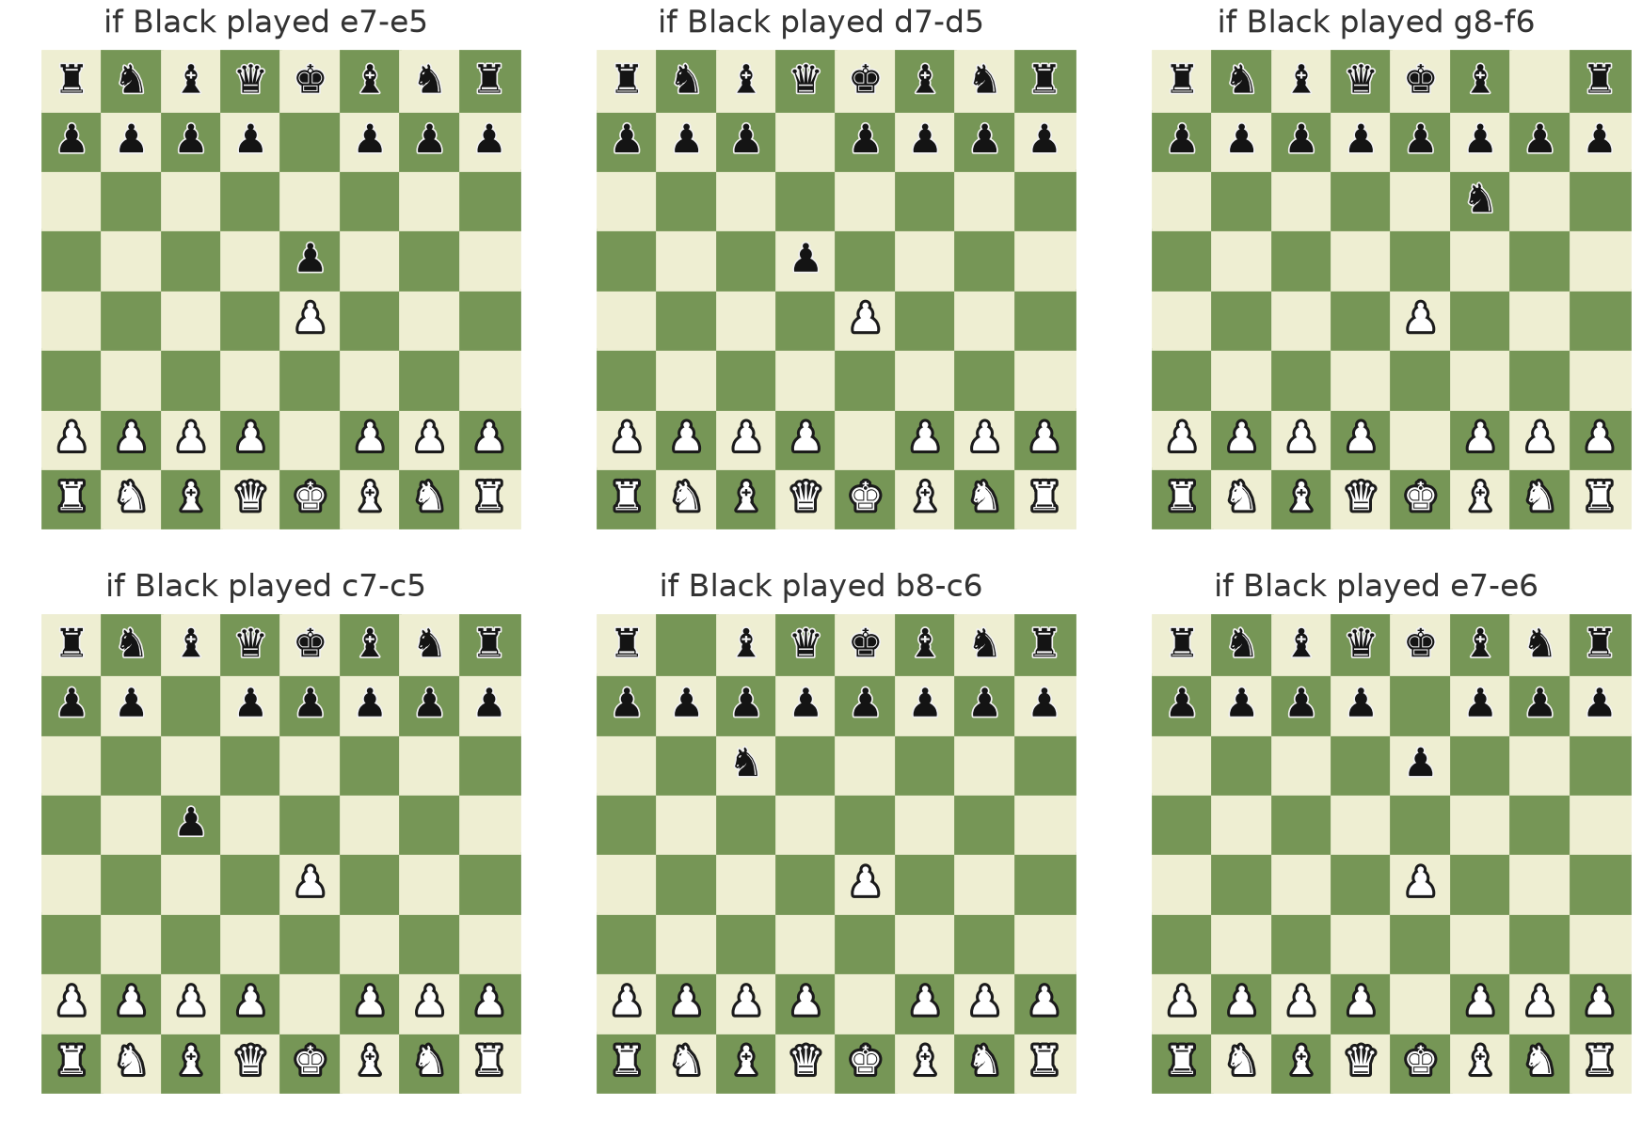
Tracking every board that could be true
1
Expand
For every board in the set, add every move the opponent could have made.
2
Filter
Keep only boards consistent with the capture report, the sense result and the move result.
3
Repeat
Every turn. After 1.e4, Black has 20 replies, so White starts its next turn with 20 boards.
Notes:
StrangeFish2 is a multiple-hypothesis tracker. It keeps the complete set of boards consistent with everything it has observed, expanding the set by every possible opponent move and filtering it by each observation. The six boards shown are six of the twenty possibilities after 1.e4. The size of this set is the bot's uncertainty, and we will use it later to recognise opponents.

Slide 15
StrangeFish2 decides over the whole set
Sense
Move
Style
Choose the square whose result most improves the coming move, with a bonus for shrinking the set.
Score every move on many boards with Stockfish and RBC heuristics; combine mean, worst and best case.
Weights for mean / worst / best case, a randomisation band and exploration decide how it plays.
Strategic personalities used by uccchess
default
aggressive
gambler
cautious
unpredictable
explorer
focused
info_seeker
Notes:
Sensing and moving are both evaluated over the whole board set. How the scores are combined is controlled by hyperparameters, so the same engine can play aggressively, cautiously or unpredictably. uccchess turns these settings into a small menu of personalities.

Slide 16
A personality is a vector of hyperparameters
Personality | mean | worst (min) | best (max) | threshold | exploration | other
default | 0.7 | 0.3 | 0.0 | 10 | 1000 | StrangeFish2 tournament settings
aggressive | 0.6 | 0.1 | 0.3 | 10 | 1000 | larger king-attack rewards
gambler | 0.5 | 0.0 | 0.5 | 20 | 1000 | ignores worst cases when sensing
cautious | 0.5 | 0.5 | 0.0 | 5 | 1000 | pessimistic, low-variance sensing
unpredictable | 0.7 | 0.3 | 0.0 | 40 | 1000 | wide band of near-best moves
explorer | 0.7 | 0.3 | 0.0 | 10 | 5000 | evaluates rare moves more
focused | 0.7 | 0.3 | 0.0 | 2 | 200 | concentrates on the best moves
info_seeker | 0.7 | 0.3 | 0.0 | 10 | 1000 | 80% of turn time on sensing
Notes:
These are the eight named personalities in the code. Mean, worst and best are the weights of a move's average, worst-case and best-case score across the board set; threshold is how many centipawns below the best a move may be and still be chosen; exploration is the UCT constant for sampling moves to evaluate. A 27-point grid over the three key parameters is also available.

Slide 17
The Generative Reward Machine
4
Learning which personality to play, when the true state is hidden
Notes:
Now the central idea: the Generative Reward Machine.

Slide 18
Why a standard reward machine is not enough
Reward machine
What RBC gives us
A finite-state machine that exposes the structure of the reward.
A labelling function reads events from the true state.
Each machine state has its own reward; learning over (state, machine state) becomes Markovian.
No true state: the board and the opponent are hidden.
No reliable events: observations are partial and noisy.
No stable reward: one game's result changes from game to game for the same choice.
Notes:
Reward machines make RL much more sample-efficient when the reward has structure, but they rely on reading clear events from the true environment state. RBC belongs to the hard class described in the thesis: the state is hidden and the reward of a single game is too noisy to be stationary.

Slide 19
GRM: rewards defined on an estimated state
true state ts
observation os
estimator
estimate es
machine state u
hidden board and opponent
board-set size each turn
20 autoencoders
opponent class 1–20
reward function r_u
Two parts
An estimator (or mapping) turns noisy, partial observations into a small, stable, designed state space.
A reward machine defined on that space: its labelling function, transitions and rewards all use estimated transitions es → es′.
It is “generative” because it generates this intermediate state space and a stationary reward on it.
Notes:
The GRM keeps the reward machine but moves it from the true state to an estimated state that the GRM itself builds. In RBC the observation is the bot's own uncertainty over time, the estimator turns that into an opponent class, and the machine's reward is defined on that class. The goal is an approximately Markovian problem where an exact reward machine is impossible.

Slide 20
Reward machine vs Generative reward machine
Component | Reward machine | Generative reward machine
State basis | True states S (or observations) | Designed, estimated states E
Reward function | On transitions S × A × S | On transitions E × A × E
Labelling function | Events from true transitions | Events from estimated transitions
Truth assignment | Read from the true state | Read from the estimated state
Goal | Markovian over S × U | Approximately Markovian when S is unavailable
Notes:
Component by component, the GRM is a reward machine whose every element is moved onto the estimated state space. This is what makes the idea usable in problems with poor observability.

Slide 21
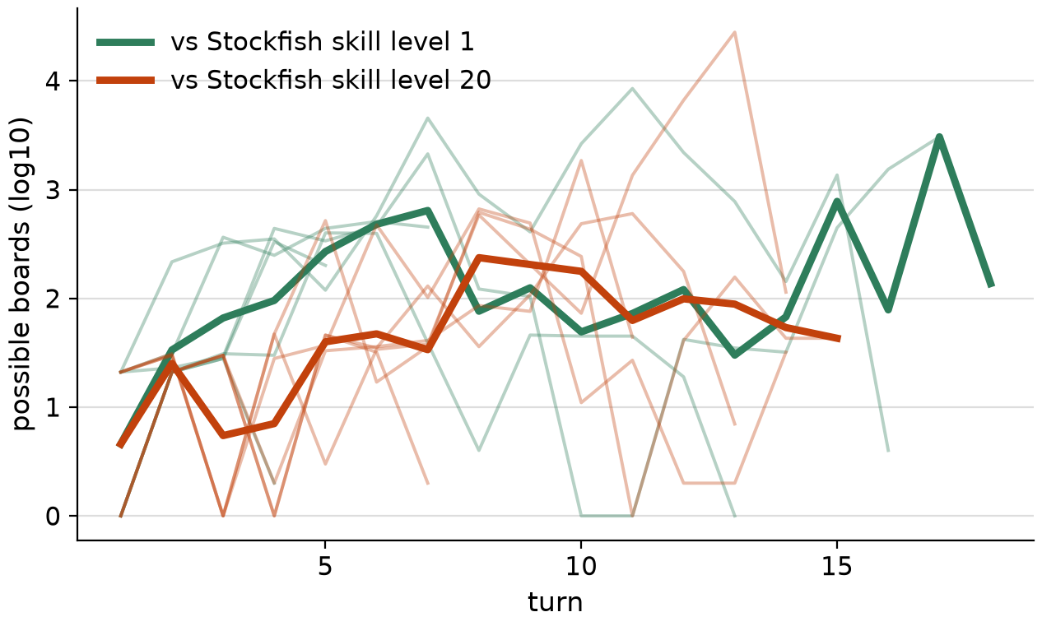
The estimator: one autoencoder per opponent class
1
Train
20 autoencoders, one per Stockfish skill level; each only sees games against its own level.
2
Encode
Per turn: boards at start, after sensing, after moving (log-scaled), on partial games too.
3
Classify
Feed the game so far to all 20; the lowest reconstruction error names the opponent class.
Board-set size per turn against a weak and a strong opponent (example traces from a short test run).
Notes:
The bot's own uncertainty behaves differently against different opponents. Each autoencoder learns what a game against one opponent class looks like. During a game, the class whose model reconstructs the trace best is the estimated state of the GRM. The plot uses traces from a short test run of the code, only to illustrate the signal.

Slide 22
Training the GRM: a batch reward machine
1
2
3
4
5
Pick
Play
Collect
Emit
Update
opponent class s and personality a (UCB1, ε-greedy or sweep)
100 games against an opponent of class s
machine stores win / draw / loss; reward 0 while collecting
mean outcome R of the batch (win +1, draw 0, loss −1)
Q(s, a) = mean of all R seen for (s, a)
Policy: π(s) = argmax_a Q(s, a) — one personality per opponent class. Averaging over a batch makes the reward stationary where single games are not.
Notes:
This is Algorithm 3 of the thesis. The reward machine has two states: collecting and emit. It only produces a reward after a full batch of games, and that reward is the mean outcome. The Q-value of a class and personality pair is the mean of all its batch rewards, and the policy picks the best personality for each class.

Slide 23
In the game: from calibrating to committed
calibrating
tracking
committed
frozen
first 6 turns, default personality
estimate each turn; wait for 2 identical estimates
switch to the learned personality π(es)
under 60 s left: no more switches
A real game of the bot (test run): what the machine did
Turn | Machine state | Estimated opponent | Symbols | Generated reward | Personality
3 | tracking | level 1 | same_class | – | default
4 | committed | level 1 | same_class | – | cautious (switched)
5–14 | committed | level 1 | same_class | 0.042 | cautious
Notes:
During a game the GRM runs as a small state machine. It plays the default personality while calibrating, then tracks the estimated opponent class, and commits to the learned personality once the estimate is confirmed. Under time pressure it freezes. The table is the real log of one test game: the estimator named level 1 at turn 3, the estimate was confirmed at turn 4 and the bot switched to the cautious personality. The generated reward is the learned Q-value of the current personality for the estimated class.

Slide 24
Baseline: single-game Q-learning (srcork)
Q-learning (Algorithm 2)
GRM (Algorithm 3)
State: own colour × opening (5 lines + “other”) = 12 states.
Action: a personality.
Reward: the result of one game.
Update: Q ← Q + α (R − Q).
State: estimated opponent class (from the autoencoders).
Action: a personality.
Reward: mean outcome of a batch of 100 games.
Update: Q = mean of batch rewards; switch during the game.
Notes:
To measure what the GRM adds, the same personalities were also learned with plain Q-learning: the state is our own colour and opening, and the reward is a single game. That bot played as srcork. The only differences are the estimated state and the batch reward.

Slide 25
Code and results
5
From games to a tournament bot
Notes:
Finally the repository and the tournament results.

Slide 26
The repository at a glance
grm_rbc/
The method
scripts/
The pipeline
GRM and reward machines, estimator, personalities, the GRM bot, parallel games, server client
Trace generation, estimator training (CUDA 11.4 and 12.2), GRM training, evaluation, export
uccchess/
The tournament bot
strangefish/
Base engine
UCCChess agent, tournament_config.json, estimator model, local and server play
StrangeFish2 (BSD-3), unchanged except one Python 3.11 fix
Install files: environment-*.yml, requirements-*.txt, pyproject.toml, install_stockfish.sh, check_installation.py
Notes:
The code is organised in four folders. grm_rbc holds the method, scripts the six pipeline steps, uccchess the self-contained tournament bot, and strangefish the vendored StrangeFish2. Conda and pip environments are provided for CUDA 12.2, CUDA 11.4 and CPU, together with a Stockfish installer and an installation checker.

Slide 27
Pipeline: from games to a tournament bot
1
generate_traces.py
record board-set traces vs skill levels 1–20
2
train_estimator_cuda122.py / _cuda114.py
train the 20 autoencoders
3
train_grm_policy.py
learn Q(class, personality) with batch rewards
4
evaluate.py
compare GRM, StrangeFish2 and Q-learning
5
export_tournament_bot.py
write hyperparameters into uccchess/
6
uccchess/connect_server.py
play on rbc.jhuapl.edu
Notes:
Six steps. Generate traces, train the estimator, train the GRM policy, evaluate, export the learned choices as explicit hyperparameters into the bot folder, and play. Every training step writes a time-stamped run folder with a model and predictions for every epoch or episode and a running report.

Slide 28
Every option in one CONFIG block
Two CUDA variants
CONFIG = {
"gpu_ids": [0, 1], # [] = CPU | [0] | [0, 1]
"arch": "gru", # "gru" | "mlp" | "conv1d"
"loader": "tensor", # | "torch_dataloader"
"sampler": "balanced", # | "shuffle"
"loss_type": "own", # | "own_plus_margin"
"decision_rule": "raw", # | "zscore"
"optimizer": "adamw", # | "adam" | "sgd"
"scheduler": "cosine", # | "step" | "plateau"
"epochs": 60,
...
}
PyTorch < 1.10 (CUDA 11.4) and PyTorch 2.x (CUDA 12.2)
Multi-GPU
gpu_ids → CUDA_VISIBLE_DEVICES + DataParallel
Every epoch saved
model, validation predictions and a report row
Fails loudly
missing or empty data stops the run
Notes:
Each training script opens with one CONFIG dictionary listing every option with its alternatives. The estimator comes in two versions, one for the older PyTorch on the CUDA 11.4 machine and one for PyTorch 2 on CUDA 12.2. Several GPUs are used through DataParallel. Each epoch's model and predictions are saved, and the script stops if data cannot be loaded.

Slide 29
The tournament bot is configured, not hard-coded
{
"estimator": "models/estimator.pt",
"class_policy": {"1": "cautious", ...,
"20": "default"},
"personalities": {
"cautious": {"move": {
"mean_score_factor": 0.5,
"min_score_factor": 0.5,
"max_score_factor": 0.0,
"threshold_score": 5, ...}}},
"runtime": {"warmup_turns": 6,
"confirm_turns": 2, ...},
"engine": {"threads": 3, "hash_mb": 2048}
}
uccchess/tournament_config.json holds everything the bot does in a tournament.
export_tournament_bot.py writes it from a training run, with every hyperparameter written out.
Review or edit it by hand; the bot validates it on load.
Without an estimator the bot plays StrangeFish2's own settings.
Notes:
After training, the export script resolves the learned table into explicit StrangeFish2 hyperparameters and writes them into the bot folder, together with the estimator. The tournament behaviour is therefore readable and editable in one JSON file.

Slide 30
Results at the NeurIPS 2022 tournament
+175
Elo for the GRM over the Q-learning baseline
1025
official Bayes Elo including forfeits (rank 14 of 18)
1762
tournament winner StrangeFish2, uccchess's base engine
Notes:
Excluding forfeits, the GRM-trained uccchess averaged 1365 Elo against 1190 for the Q-learning bot srcork. The official ratings include forfeits from crashes and connection problems, which the tournament paper notes lowered uccchess's rating to 1025. The code in this repository addresses those failure modes with one process per game, bounded engine memory and server retries.

Slide 31
Takeaways
Tournament paper
proceedings.mlr.press/v220/gardner23a.html
Thesis
cora.ucc.ie
Base engine
github.com/ginoperrotta/reconchess-strangefish2
RBC turns chess into a game of hidden information and noisy outcomes.
The GRM estimates the opponent class and puts a stationary batch reward on it.
uccchess: StrangeFish2 whose personality is chosen by the GRM during the game.
Notes:
Three points to remember. RBC is chess with hidden information and very noisy results. The GRM makes reinforcement learning work there by learning on an estimated state with a batch reward. uccchess applies that to choose StrangeFish2's personality against each kind of opponent. The tournament paper, the thesis and the StrangeFish2 code are linked here.

