Slide 1



Encapsulation
LECTURE 2
class Student
private name
private age
Abstraction, access modifiers, getters and setters, instances and static
getName()
other
classes
setName()
data hidden, methods public
Notes:
Lecture 2 is about encapsulation: keeping an object's data hidden and letting other classes use it only through methods. The picture shows the idea: the private data is locked away, and other classes can only reach the public methods.

Slide 2



What we cover today
LECTURE 2
01
Hiding the details
Abstraction, encapsulation and access modifiers
How each topic works
02
Getters and setters
Read the idea and look at the example
Reading and changing private data safely
Try the quick check: A, B, C or D?
03
Instances and static
Objects in memory, and things that belong to the class
See the answer, and why, on the next slide
04
Let Eclipse do the typing
Generating getters and setters for us
Notes:
Four parts today. After each idea there's a quick check with four options. For each one, give everyone about 30 seconds, take a show of hands for A, B, C and D, then go to the answer slide.

Slide 3

Hiding the details
01
Abstraction, encapsulation and who can see what
Abstraction
Encapsulation
Access levels
private
Notes:
Part 1: why we hide details, and how Java controls who can see what.

Slide 4









Abstraction: hide what we don’t need
HIDING THE DETAILS
Abstraction means showing only what we need to use something, and hiding how it works inside.
Code can get very complex, and the information we want gets lost in the details.
So we hide the parts of the data we don’t need to see.
LIKE DRIVING A CAR
What the driver uses
Wheel
Brake
Dashboard
Simplicity
What stays hidden
It’s easier to code when we don’t have to worry about how something works inside.
Security
We can’t break what we can’t access.
Engine
Gearbox
Wiring
Notes:
Abstraction means showing only what we need to use something, and hiding how it works inside. The car is the classic example: the driver uses the wheel and the brake and never needs to see the engine.

Slide 5
What is the main idea of abstraction?
QUICK CHECK 1
Abstraction
Show only what we need and hide the rest
Make every attribute and method public
A
B
Make the program run faster
Hide everything, even the methods other code needs
C
D
Notes:
Correct answer: A, “Show only what we need and hide the rest”.

Slide 6


What is the main idea of abstraction?
ANSWER 1
Abstraction
Show only what we need and hide the rest
A
Why?
Make every attribute and method public
B
Abstraction hides the details we don’t need. Like driving a car: we use the wheel and the brake without seeing how the engine works. Hiding everything (D) would leave nothing to use, and speed (C) isn’t the point.
Make the program run faster
C
Hide everything, even the methods other code needs
D
Notes:
The answer is A, “Show only what we need and hide the rest”.
Abstraction hides the details we don’t need. Like driving a car: we use the wheel and the brake without seeing how the engine works. Hiding everything (D) would leave nothing to use, and speed (C) isn’t the point.

Slide 7


Encapsulation
HIDING THE DETAILS
Encapsulation keeps a class’s data and the methods that use it together, and hides the details. It’s a core idea of object-oriented programming.
A class keeps its details inside and only shows what is relevant.
Users see the public method names, not the code inside them.
Not every attribute or method should be open to everyone, so we split them into public and private.
Scanner
PUBLIC
nextLine()
You
nextInt()
PRIVATE
We don’t need Scanner’s internal helper methods to use it, so Scanner keeps them private.
Notes:
Encapsulation keeps a class's data and the methods that use it together, and hides the details. Scanner is a good example students already know: they call nextLine() and nextInt() without ever seeing the code inside, and its internal helper methods are kept private.

Slide 8
When we use a class like Scanner, what do we get to see?
QUICK CHECK 2
Encapsulation
Every line of code inside each of its methods
All of its private methods and private attributes
A
B
Its public method names, but not the code inside
Nothing at all, so we can’t use it in our code
C
D
Notes:
Correct answer: C, “Its public method names, but not the code inside”.

Slide 9
When we use a class like Scanner, what do we get to see?
ANSWER 2
Encapsulation
Every line of code inside each of its methods
A
Why?
All of its private methods and private attributes
B
Encapsulation hides how a class is built. We see the public methods we need, like nextLine(), but not the code inside them. Scanner keeps its internal helper methods private.
Its public method names, but not the code inside
C
Nothing at all, so we can’t use it in our code
D
Notes:
The answer is C, “Its public method names, but not the code inside”.
Encapsulation hides how a class is built. We see the public methods we need, like nextLine(), but not the code inside them. Scanner keeps its internal helper methods private.

Slide 10




Four access levels in Java
HIDING THE DETAILS
private
default
protected
public
(no keyword)
Only inside its own class.
Classes in the same package.
Classes in the same package, and subclasses.
Anywhere.
Most restrictive
Least restrictive
Notes:
Java has four access levels. Here they are in order, from the most restrictive (private) to the least restrictive (public). Default is what you get when you don't write any keyword; Eclipse calls it package. A subclass is a class that extends another one, which is Lecture 3.

Slide 11
Which access level means “can be used only inside its own class”?
QUICK CHECK 3
Access modifiers
public
protected
A
B
default (no keyword)
private
C
D
Notes:
Correct answer: D, “private”.

Slide 12
Which access level means “can be used only inside its own class”?
ANSWER 3
Access modifiers
public
A
Why?
protected
B
private is the most restrictive level: only code inside the same class can use it. public is the least restrictive: it can be used from anywhere.
default (no keyword)
C
private
D
Notes:
The answer is D, “private”.
private is the most restrictive level: only code inside the same class can use it. public is the least restrictive: it can be used from anywhere.

Slide 13

Who can see what
HIDING THE DETAILS
Can it be used from… | private | default | protected | public
Inside the same class | Yes | Yes | Yes | Yes
A subclass, same package | No | Yes | Yes | Yes
Another class, same package | No | Yes | Yes | Yes
A subclass, other package | No | No | Yes | Yes
Another class, other package | No | No | No | Yes
The further right, the more places can use it. Only public reaches a class in another package that isn’t a subclass.
Notes:
Read the table row by row. Inside the class, everything is visible. The further right you go, the more places can reach it. Only public reaches a class in another package that isn't a subclass.

Slide 14
A class in another package, which is not a subclass, needs to call a method. Which access level must the method have?
QUICK CHECK 4
Who can see what
protected
default (no keyword)
A
B
public
private
C
D
Notes:
Correct answer: C, “public”.

Slide 15
A class in another package, which is not a subclass, needs to call a method. Which access level must the method have?
ANSWER 4
Who can see what
protected
A
Why?
default (no keyword)
B
Only public reaches a class in another package that isn’t a subclass. protected stops at the same package and subclasses, even if the class creates an object first.
public
C
private
D
Notes:
The answer is C, “public”.
Only public reaches a class in another package that isn’t a subclass. protected stops at the same package and subclasses, even if the class creates an object first.

Slide 16


Make attributes private
HIDING THE DETAILS
To encapsulate data, we make it private.
Other classes can then no longer reach it directly.
It’s standard practice not to let attributes be accessed directly from outside their class.
Java
public class Student {
private String name;
private int age;
}
In another class:
Student student = new Student();
student.name = "bob";
But if it’s private, how can other classes use it?
Next: getters and setters.
Error: name has private access in Student
Notes:
Making attributes private is the normal way to encapsulate data. The error on the right is exactly what javac says if another class tries to touch a private attribute.

Slide 17
What is the standard practice for attributes in a class?
QUICK CHECK 5
Private attributes
Make them public so any class can change them
Make them static so all objects share them
A
B
Leave out the access modifier completely
Make them private to block direct access
C
D
Notes:
Correct answer: D, “Make them private to block direct access”.

Slide 18
What is the standard practice for attributes in a class?
ANSWER 5
Private attributes
Make them public so any class can change them
A
Why?
Make them static so all objects share them
B
To encapsulate data we make it private. Other classes then can’t read or change it directly; they have to go through the methods we choose to provide.
Leave out the access modifier completely
C
Make them private to block direct access
D
Notes:
The answer is D, “Make them private to block direct access”.
To encapsulate data we make it private. Other classes then can’t read or change it directly; they have to go through the methods we choose to provide.

Slide 19

Getters and setters
02
Reading and changing private data safely
Getters
Setters
this
Benefits
Notes:
Part 2: how other classes read and change private data.

Slide 20

Getters and setters
GETTERS AND SETTERS
Private data stays hidden, but we can still allow access when it’s needed, through two special methods:
setName("jack")
A Student object
Setter (mutator): sends in a new value
name = "jack"
getName()
Another class
private
Getter (accessor, observer): gives back the value
A getter lets us see a private attribute. A setter lets us update it.
Notes:
The private attribute stays hidden inside the object. Other classes ask for a copy of it with the getter, and send in a new value with the setter.

Slide 21
Which method lets another class update a private attribute?
QUICK CHECK 6
Getters and setters
A getter (accessor)
A setter (mutator)
A
B
A private method
The main method
C
D
Notes:
Correct answer: B, “A setter (mutator)”.

Slide 22
Which method lets another class update a private attribute?
ANSWER 6
Getters and setters
A getter (accessor)
A
Why?
A setter (mutator)
B
A setter, also called a mutator, updates a private attribute with a new value. A getter (accessor) only lets us read the value.
A private method
C
The main method
D
Notes:
The answer is B, “A setter (mutator)”.
A setter, also called a mutator, updates a private attribute with a new value. A getter (accessor) only lets us read the value.

Slide 23
Getters
GETTERS AND SETTERS
A getter returns the value of an instance variable (an attribute) from an object.
public
String
getName
()
{ return name; }
usually public
return type
get + Name
no arguments
returns it
so others can call it
matches the attribute
first letter capital
nothing is passed in
gives back the value
Another example: for private int age; the getter is public int getAge().
Notes:
Read the getter from left to right. Getters are normally public, so other classes can call them. In Java they don't have to be, but in our examples they always are.

Slide 24
Using a getter
GETTERS AND SETTERS
Student.java
Main.java
public class Student {
private String name = "jack";
public String getName() {
return name;
}
}
public static void main(String[] args) {
Student student = new Student();
System.out.println(student.getName());
}
Output
jack
The attribute is private, but the getter is public.
main is in another class, so it can only read name through the getter.
Notes:
main is in a separate class, Main.java, so it can't touch the private name directly, but it can call getName(). The program prints jack.

Slide 25
Which is a correct getter for private int age?
QUICK CHECK 7
Getters
A
public void getAge() { return age; }
B
public int getAge(int age) { return age; }
C
public String getAge() { return age; }
D
public int getAge() { return age; }
Notes:
Correct answer: D, “public int getAge() { return age; }”.

Slide 26
Which is a correct getter for private int age?
ANSWER 7
Getters
A
public void getAge() { return age; }
B
public int getAge(int age) { return age; }
C
public String getAge() { return age; }
D
public int getAge() { return age; }
A getter is usually public, returns the same type as the attribute (int), takes no arguments and returns the attribute. A can’t return a value from a void method, B returns the argument instead of the attribute, and C returns a String, but age is an int.
Why?
Notes:
The answer is D, “public int getAge() { return age; }”.
A getter is usually public, returns the same type as the attribute (int), takes no arguments and returns the attribute. A can’t return a value from a void method, B returns the argument instead of the attribute, and C returns a String, but age is an int.

Slide 27
A getter gives back a copy
GETTERS AND SETTERS
A getter returns a copy of the value, not the attribute itself.
We can read the copy, but we can’t assign to it, because a method call gives a value, not a variable.
So a getter on its own lets other classes read the attribute, never change it.
To change the attribute, we use the setter.
student.getName() = "bob";
Won’t compile: we can’t assign to a method call.
student.setName("bob");
Works: the setter changes the name.
Notes:
A getter hands back a value, not the attribute itself, so you can't assign to it. javac rejects the first line with 'unexpected type: required variable, found value'. If we want to change the name, that's what the setter is for. The lecture slide says this fails because the returned value is 'immutable'. The real reason is that Java can only assign to a variable, and a method call gives a value. In Java, immutable means an object that can never change once it is made, like a String; that comes up in Lecture 6.

Slide 28
Why won’t student.getName() = "bob"; work?
QUICK CHECK 8
Getters
Text must be written in single quotes, like 'bob'
A method call gives back a value, not a variable
A
B
Names can only be set inside the main method
getName() is private, so main can’t call it
C
D
Notes:
Correct answer: B, “A method call gives back a value, not a variable”.

Slide 29
Why won’t student.getName() = "bob"; work?
ANSWER 8
Getters
Text must be written in single quotes, like 'bob'
A
Why?
A method call gives back a value, not a variable
B
The getter hands back a copy of the value. We can read it, but we can’t assign to it, because only a variable can go on the left of =. To change the name we call the setter: student.setName("bob");
Names can only be set inside the main method
C
getName() is private, so main can’t call it
D
Notes:
The answer is B, “A method call gives back a value, not a variable”.
The getter hands back a copy of the value. We can read it, but we can’t assign to it, because only a variable can go on the left of =. To change the name we call the setter: student.setName("bob");

Slide 30
Setters
GETTERS AND SETTERS
A setter updates (modifies) the value of a private attribute.
public
void
setName
(String theName)
{ name = theName; }
usually public
void
set + Name
one parameter
stores it
so others can call it
returns nothing
first letter capital
same type as the attribute
saves the new value
A setter should only ever update one attribute at a time.
Notes:
Same idea as the getter, the other way round. A setter takes one value in and stores it. It should only ever update one attribute.

Slide 31

Using a setter
GETTERS AND SETTERS
Student.java
Main.java
public class Student {
private String name;
public void setName(String theName) {
name = theName;
}
}
public static void main(String[] args) {
Student student = new Student();
student.setName("tom");
}
The student object afterwards
theName is the new value passed in.
name = "tom"
main is in another class, so it can only change name through the setter.
Notes:
main is in a separate class, Main.java, so it can't write to the private name directly, but it can call setName("tom"). After that line, the object's name is tom.

Slide 32
Which is a correct setter for private String name?
QUICK CHECK 9
Setters
A
public String setName(String theName) { name = theName; }
B
public void setName() { name = theName; }
C
public void setName(String theName) { name = theName; }
D
public void setName(int theName) { name = theName; }
Notes:
Correct answer: C, “public void setName(String theName) { name = theName; }”.

Slide 33
Which is a correct setter for private String name?
ANSWER 9
Setters
A
public String setName(String theName) { name = theName; }
B
public void setName() { name = theName; }
C
public void setName(String theName) { name = theName; }
D
public void setName(int theName) { name = theName; }
A setter is usually public, returns void, and takes one parameter of the same type as the attribute (String). A has a return type but no return, B has no parameter, and D takes an int instead of a String.
Why?
Notes:
The answer is C, “public void setName(String theName) { name = theName; }”.
A setter is usually public, returns void, and takes one parameter of the same type as the attribute (String). A has a return type but no return, B has no parameter, and D takes an int instead of a String.

Slide 34


When to use getters and setters
GETTERS AND SETTERS
Not every attribute has to be private. It depends on the system you’re building. Getters and setters are worth it when we want to:
Read, but not change
Change, but not read
Give the class a getter only.
Give the class a setter only.
Check values first
Hand out a copy only
A setter can check that a number is in range before saving it.
A getter can hand out a copy, so the original value stays safe.
Notes:
Not everything has to be private. These are the situations where getters and setters are worth writing. One detail for later: if the attribute holds an object, a plain getter copies the reference, not the object, so a careful class hands out a copy of the object itself.

Slide 35
Other classes should be able to read a value, but never change it. What should the class provide?
QUICK CHECK 10
When to encapsulate
A getter, but no setter
A setter, but no getter
A
B
A public attribute
Both a getter and a setter
C
D
Notes:
Correct answer: A, “A getter, but no setter”.

Slide 36
Other classes should be able to read a value, but never change it. What should the class provide?
ANSWER 10
When to encapsulate
A getter, but no setter
A
Why?
A setter, but no getter
B
With only a getter, other classes can read the value but have no way to change it. A setter on its own (B) gives the opposite: they could change it but not read it.
A public attribute
C
Both a getter and a setter
D
Notes:
The answer is A, “A getter, but no setter”.
With only a getter, other classes can read the value but have no way to change it. A setter on its own (B) gives the opposite: they could change it but not read it.

Slide 37
The this keyword
GETTERS AND SETTERS
this lets an object refer to its own attributes and methods.
this means the current instance.
We can only use it inside the class. Outside the class, we use the object’s variable name.
It lets a parameter have the same name as an attribute and still be told apart.
Java
class Student {
private int id = 0;
private int age = 0;
public Student(int id, int age) {
this.id = id;
this.age = age;
}
}
this.id
id
the object’s own attribute
the parameter passed in
Notes:
this means the object the code is running on. In the constructor, this.id is the object's attribute and id is the parameter, so the same name can be used for both. One catch for later: there is no this inside a static method, because there's no current object there.

Slide 38
In this constructor, what does this.age refer to?
QUICK CHECK 11
The this keyword
public Student(int age) {
this.age = age;
}
The age parameter that was passed in
The current object’s own age attribute
A
B
A static age that is shared by every object
The age of the object that was made before it
C
D
Notes:
Correct answer: B, “The current object’s own age attribute”.

Slide 39
In this constructor, what does this.age refer to?
ANSWER 11
The this keyword
public Student(int age) {
this.age = age;
}
Why?
this means the current object. So this.age is the object’s own attribute, and age on its own is the parameter. The line copies the parameter into the attribute.
A
The age parameter that was passed in
B
The current object’s own age attribute
C
A static age that is shared by every object
D
The age of the object that was made before it
Notes:
The answer is B, “The current object’s own age attribute”.
this means the current object. So this.age is the object’s own attribute, and age on its own is the parameter. The line copies the parameter into the attribute.

Slide 40


Why encapsulate?
GETTERS AND SETTERS
Easier to maintain
Data integrity
Security
We can change how the code works inside without affecting anyone using it, as long as the inputs and outputs stay the same.
The data can only be changed through the methods we accept.
Some information is better kept hidden from casual users.
inputs
the method
outputs
the inside can change
Notes:
Three benefits. The picture at the bottom is the 'easier to maintain' idea: as long as the inputs and outputs stay the same, nobody outside cares how the inside works.

Slide 41
We rewrite the code inside a method, but its inputs and outputs stay the same, so the code that uses it keeps working. Which benefit is this?
QUICK CHECK 12
Benefits of encapsulation
Security
Data integrity
A
B
Faster-running code
Easier to maintain
C
D
Notes:
Correct answer: D, “Easier to maintain”.

Slide 42
We rewrite the code inside a method, but its inputs and outputs stay the same, so the code that uses it keeps working. Which benefit is this?
ANSWER 12
Benefits of encapsulation
Security
A
Why?
Data integrity
B
People using the method only rely on its inputs and outputs, so we can change how it works inside without affecting them. That makes the code easier to maintain.
Faster-running code
C
Easier to maintain
D
Notes:
The answer is D, “Easier to maintain”.
People using the method only rely on its inputs and outputs, so we can change how it works inside without affecting them. That makes the code easier to maintain.

Slide 43

Instances and static
03
Objects in memory, and things that belong to the class
Instances
Shared instances
static
Math
Notes:
Part 3: what happens in memory when we create objects, and what static means.

Slide 44

Instances in memory
INSTANCES AND STATIC
Each new Student() creates a separate instance (object) in memory.
The variable (studentOne) isn’t the object. It holds a reference that points to the object.
Each instance has its own attributes, so changing studentOne’s name doesn’t change studentTwo’s.
Student studentOne = new Student();
Student studentTwo = new Student();
studentOne.setName("Ann");
studentTwo.setName("Ben");
MEMORY
studentOne
Student instance
name = "Ann"
Writing studentOne = new Student(); again points studentOne at a brand-new instance. The old one can no longer be reached through studentOne.
studentTwo
Student instance
name = "Ben"
Notes:
Two calls to new, two separate instances. The variables only hold references to them. Changing one instance doesn't touch the other. The lecture slides call the variable 'the object'; in Java, object and instance mean the same thing, and the variable only holds a reference to it.

Slide 45
Two students are each made with new Student(). We change the first one’s name. What happens to the second one’s name?
QUICK CHECK 13
Instances
It changes to the same new name
Nothing, because they are separate instances
A
B
It is reset to the default value, null
The program stops with an error
C
D
Notes:
Correct answer: B, “Nothing, because they are separate instances”.

Slide 46
Two students are each made with new Student(). We change the first one’s name. What happens to the second one’s name?
ANSWER 13
Instances
It changes to the same new name
A
Why?
Nothing, because they are separate instances
B
Each new Student() creates a separate instance with its own attributes. Changing one does not affect the other.
It is reset to the default value, null
C
The program stops with an error
D
Notes:
The answer is B, “Nothing, because they are separate instances”.
Each new Student() creates a separate instance with its own attributes. Changing one does not affect the other.

Slide 47
Two variables, one instance
INSTANCES AND STATIC
studentOne = studentTwo; copies the reference, not the object.
Now both variables point to the same instance.
Change the name through studentOne, and studentTwo sees the change too.
Be careful: only share an instance like this when you mean to.
studentOne = studentTwo;
MEMORY
studentOne
Student instance
name = "Ann"
no longer used
studentTwo
Student instance
name = "Ben"
Notes:
After studentOne = studentTwo, both variables refer to the same instance: two references, one object. The instance that studentOne used to point to is no longer used. Only share an instance like this on purpose.

Slide 48
What does this code print?
QUICK CHECK 14
Two variables, one instance
null
A
Java
Student studentOne = new Student();
Student studentTwo = new Student();
studentTwo.setName("Ben");
studentOne = studentTwo;
studentOne.setName("Ann");
System.out.println(studentTwo.getName());
Ben
B
Ann
C
Student has a no-arg constructor, getName() and setName().
Nothing: it won’t compile
D
Notes:
Correct answer: C, “Ann”.

Slide 49
What does this code print?
ANSWER 14
Two variables, one instance
Student studentOne = new Student();
Student studentTwo = new Student();
studentTwo.setName("Ben");
studentOne = studentTwo;
studentOne.setName("Ann");
System.out.println(studentTwo.getName());
Why?
studentOne = studentTwo; makes both variables point to Ben’s instance. Setting the name through studentOne changes that one shared object, so studentTwo shows “Ann” too.
A
null
B
Ben
C
Ann
D
Nothing: it won’t compile
Notes:
The answer is C, “Ann”.
studentOne = studentTwo; makes both variables point to Ben’s instance. Setting the name through studentOne changes that one shared object, so studentTwo shows “Ann” too.

Slide 50
Static: it belongs to the class
INSTANCES AND STATIC
Something marked static belongs to the class itself, not to one object.
A class made of static parts, like Math, is used without creating any objects. We just write the class name.
A static attribute has only one copy, so it’s the same value wherever we use it.
Use static for values that don’t need to be different for each object, like Math.PI.
Math
static PI
static round()
Java
long r = Math.round(2.6); // 3
double p = Math.PI; // 3.14159...
Math is sometimes called a ‘static class’. Java won’t accept static on a top-level class, so this just means every member of Math is static.
no new Math() needed
Notes:
Static things belong to the class, not to any one object, so there's only one copy. Math is the everyday example: we never write new Math(), we just use Math.round() and Math.PI. (Math's constructor is private, so new Math() wouldn't even compile.) Java doesn't let us mark a top-level class itself as static (javac says 'modifier static not allowed here'), so 'static class' here means a class like Math whose members are all static.

Slide 51
When should we make an attribute static?
QUICK CHECK 15
Static
When each object needs its own, different value
When it is a private attribute with a getter
A
B
When one value can be shared by all objects
When its value is passed in to the constructor
C
D
Notes:
Correct answer: C, “When one value can be shared by all objects”.

Slide 52
When should we make an attribute static?
ANSWER 15
Static
When each object needs its own, different value
A
Why?
When it is a private attribute with a getter
B
A static attribute belongs to the class, so there is only one copy, shared by every object. That suits values that don’t need to be different for each object, like Math.PI.
When one value can be shared by all objects
C
When its value is passed in to the constructor
D
Notes:
The answer is C, “When one value can be shared by all objects”.
A static attribute belongs to the class, so there is only one copy, shared by every object. That suits values that don’t need to be different for each object, like Math.PI.

Slide 53
Static and instance: who can use what
INSTANCES AND STATIC
Why not?
static method
uses
static attribute
Yes
A static method belongs to the class, so it has no current object (no this). It can’t use instance attributes directly: it needs an object first, as main does.
static method
uses
instance attribute
No
Java
private int count = 0;
public static void show() {
System.out.println(count);
}
instance method
uses
static attribute
Yes
non-static variable count cannot be referenced from a static context
Notes:
A static method has no object of its own (no this), so it can't use instance attributes directly. To reach them it needs an object first, which is exactly what main does when it creates one. The code on the right shows the error javac gives.

Slide 54
Which of these can a static method NOT use directly?
QUICK CHECK 16
Static methods
Static attributes
Its own parameters
A
B
Other static methods
Instance attributes
C
D
Notes:
Correct answer: D, “Instance attributes”.

Slide 55
Which of these can a static method NOT use directly?
ANSWER 16
Static methods
Static attributes
A
Why?
Its own parameters
B
A static method belongs to the class, not to any one object, so it has no instance attributes of its own to use directly. It can use static attributes, its parameters and other static methods.
Other static methods
C
Instance attributes
D
Notes:
The answer is D, “Instance attributes”.
A static method belongs to the class, not to any one object, so it has no instance attributes of its own to use directly. It can use static attributes, its parameters and other static methods.

Slide 56



Example: the Currency class
INSTANCES AND STATIC
Java
Two static attributes
public class Currency {
public static double exchangeRateYuanEuro = 0.13;
public static double exchangeRateEuroYuan = 7.97;
public static double exchangeEuro(double amount) {
return amount * exchangeRateEuroYuan;
}
public static double exchangeYuan(double amount) {
return amount * exchangeRateYuanEuro;
}
}
The exchange rates. One copy, shared by everyone.
Two static methods
They use the static rates to convert an amount.
No object needed
Other classes write Currency.exchangeYuan(…).
Notes:
Everything in Currency is static: the two exchange rates and the two methods that use them. Nothing here needs a Currency object. The rates are public only to keep the example short; normally we'd still keep attributes private, as in part 1.

Slide 57
Using the Currency class
INSTANCES AND STATIC
Java
Output
public static void main(String[] args) {
System.out.println(Currency.exchangeRateEuroYuan);
double yuan = 500;
double euros = Currency.exchangeYuan(yuan);
System.out.println(euros);
}
7.97
65.0
7.97
the static rate, read through the class name
65.0
500 × 0.13, worked out by the static method
There is no new Currency() anywhere. Everything is used through the class name.
Notes:
main uses the rate and the method straight through the class name. 500 yuan times 0.13 gives 65.0 euro.

Slide 58
What does Currency.exchangeYuan(200) return?
QUICK CHECK 17
Static example
26.0
A
Java
1594.0
public class Currency {
public static double exchangeRateYuanEuro = 0.13;
public static double exchangeRateEuroYuan = 7.97;
public static double exchangeYuan(double amount) {
return amount * exchangeRateYuanEuro;
}
}
B
200.0
C
0.13
D
Notes:
Correct answer: A, “26.0”.

Slide 59
What does Currency.exchangeYuan(200) return?
ANSWER 17
Static example
// Currency.exchangeYuan(200)
return 200 * 0.13; // 26.0
Why?
26.0
exchangeYuan multiplies the amount by exchangeRateYuanEuro (0.13), so 200 × 0.13 = 26.0. We call it with the class name because it is static: no Currency object is needed.
A
B
1594.0
C
200.0
D
0.13
Notes:
The answer is A, “26.0”.
exchangeYuan multiplies the amount by exchangeRateYuanEuro (0.13), so 200 × 0.13 = 26.0. We call it with the class name because it is static: no Currency object is needed.

Slide 60

Let Eclipse do the typing
04
Generating getters and setters for us
Source menu
Quick Fix
Field reference
Notes:
Part 4: getting Eclipse to write getters and setters for us, and how the constructor can use them.

Slide 61

Generate code from the Source menu
LET ECLIPSE DO THE TYPING
One advantage of OOP is faster development. Classes follow a set layout, so Eclipse (and other IDEs) can generate a lot of the code for us.
1
Open your class in Eclipse.
2
Click Source on the top menu bar.
3
Near the bottom, choose Generate Getters and Setters…
4
Tick the ones you want, then click Generate.
The generate options at the bottom of the Source menu.
Notes:
Classes follow a set layout, so the IDE can write the routine parts for us. In Eclipse the generate options are under the Source menu. The same menu opens with a right-click in the editor (Source), or with Alt+Shift+S (Cmd+Alt+S on a Mac).

Slide 62
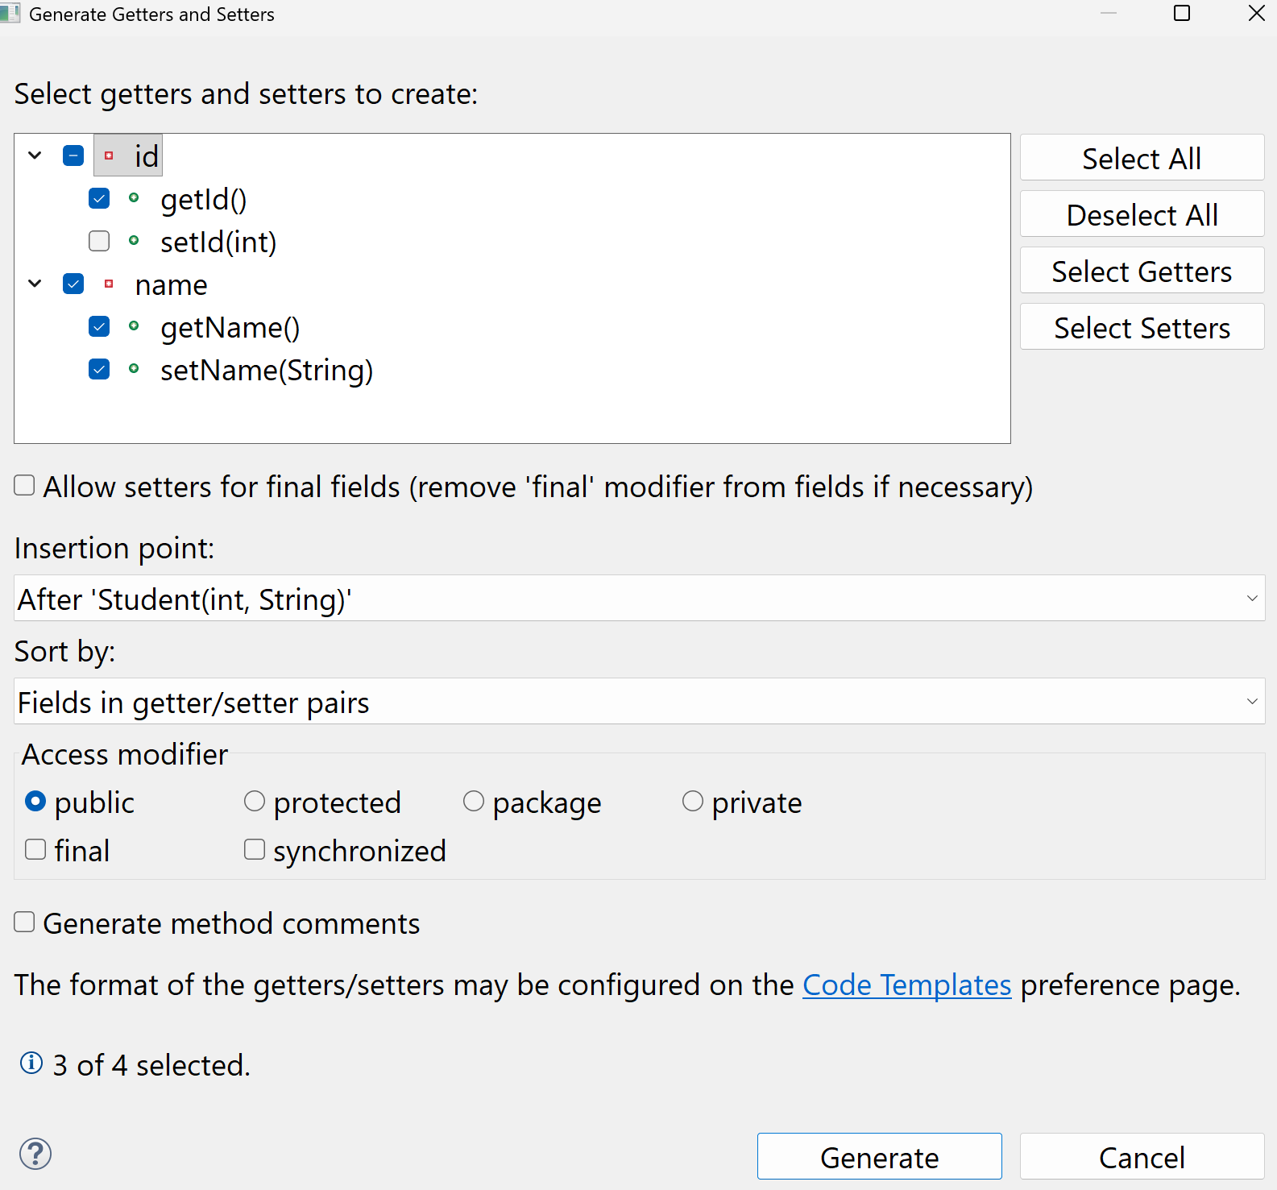
The Generate Getters and Setters window
LET ECLIPSE DO THE TYPING
1
Pick what to create
Tick the getters and setters you want. Here: getId(), getName() and setName(String).
1
2
Choose the access modifier
Leave it on public, so other classes can call the new methods. Eclipse’s package option means default access.
2
3
Click Generate
Eclipse writes the methods into your class.
3
Notes:
This is the window you get after choosing Generate Getters and Setters. Tick what you need, keep the access modifier as public, and click Generate.

Slide 63
In Eclipse, where do we find “Generate Getters and Setters…”?
QUICK CHECK 18
Eclipse auto-generation
In the Source menu
In the Run menu
A
B
In the Window menu
In the Search menu
C
D
Notes:
Correct answer: A, “In the Source menu”.

Slide 64
In Eclipse, where do we find “Generate Getters and Setters…”?
ANSWER 18
Eclipse auto-generation
In the Source menu
A
Why?
In the Run menu
B
Open the class, click Source on the top bar, and the generate options are near the bottom of that menu, including Generate Getters and Setters… and Generate Constructor using Fields…
In the Window menu
C
In the Search menu
D
Notes:
The answer is A, “In the Source menu”.
Open the class, click Source on the top bar, and the generate options are near the bottom of that menu, including Generate Getters and Setters… and Generate Constructor using Fields…

Slide 65
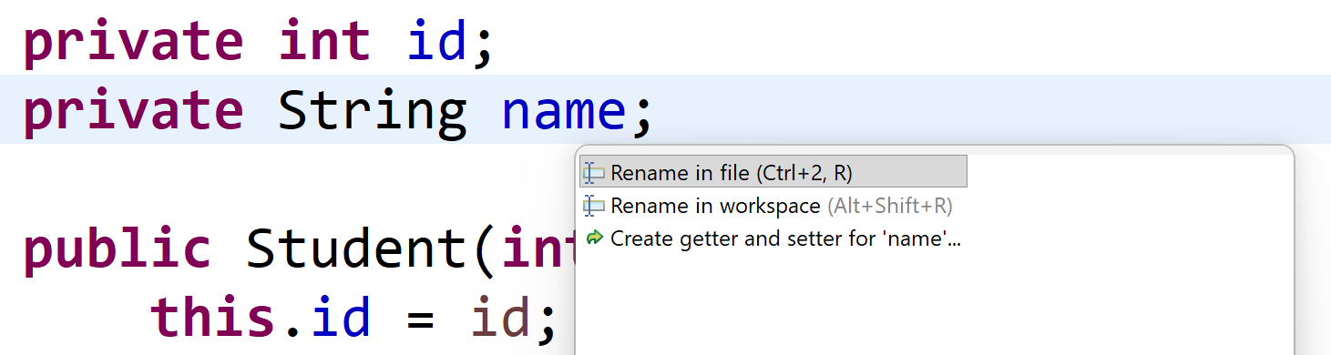
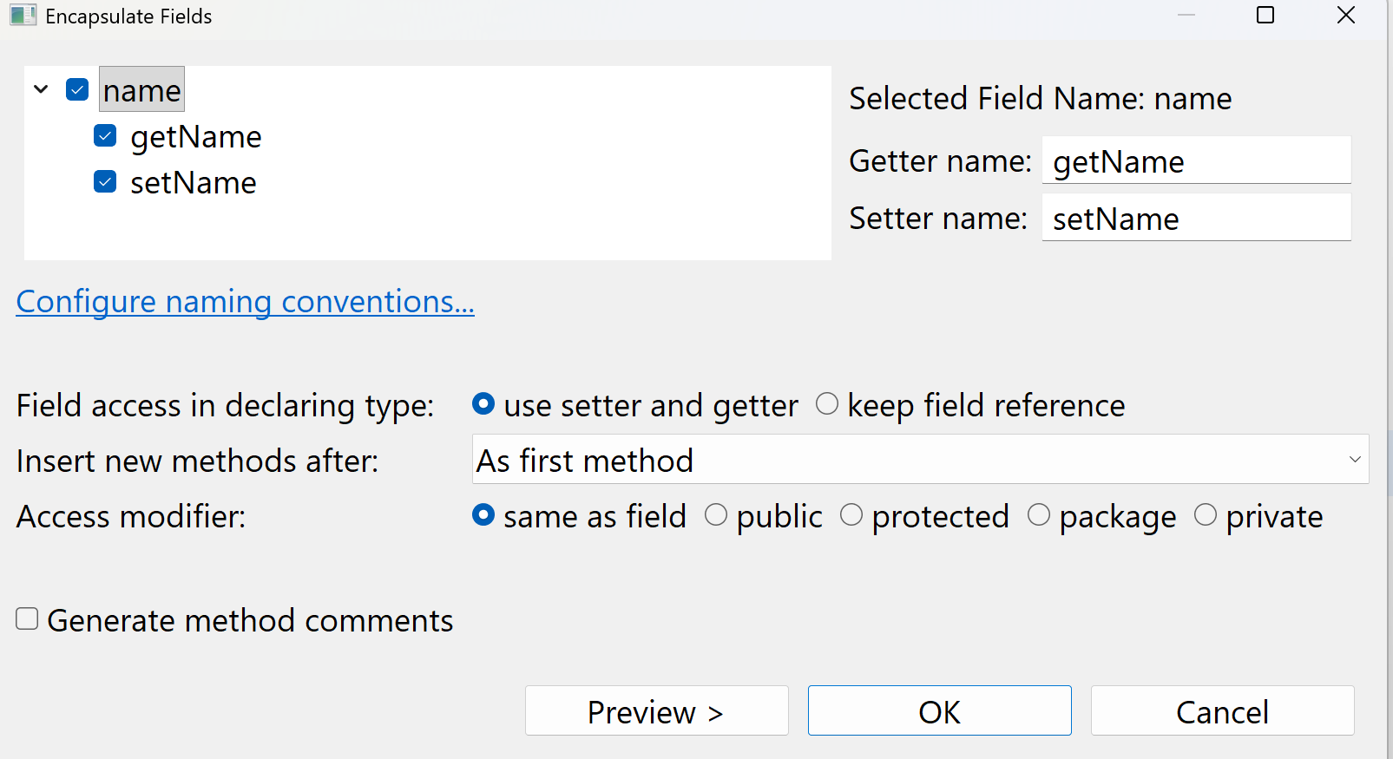
Quick Fix: Ctrl+1
LET ECLIPSE DO THE TYPING
1
Click on an attribute in your code.
2
Press Ctrl+1 to open Quick Fix.
3
Choose Create getter and setter for ‘name’…
4
Check the names in the Encapsulate Fields window, then click OK.
Notes:
The second way: click on the attribute and press Ctrl+1 (Cmd+1 on a Mac). Choose Create getter and setter, check the names in the Encapsulate Fields window and click OK.

Slide 66
Which shortcut opens Quick Fix on an attribute, with an option to create its getter and setter?
QUICK CHECK 19
Eclipse auto-generation
Ctrl+S
Ctrl+Z
A
B
Ctrl+Shift+F
Ctrl+1
C
D
Notes:
Correct answer: D, “Ctrl+1”.

Slide 67
Which shortcut opens Quick Fix on an attribute, with an option to create its getter and setter?
ANSWER 19
Eclipse auto-generation
Ctrl+S
A
Why?
Ctrl+Z
B
Click on the attribute and press Ctrl+1. Quick Fix suggests some options, including “Create getter and setter for ‘name’…”.
Ctrl+Shift+F
C
Ctrl+1
D
Notes:
The answer is D, “Ctrl+1”.
Click on the attribute and press Ctrl+1. Quick Fix suggests some options, including “Create getter and setter for ‘name’…”.

Slide 68
Field reference or setters?
LET ECLIPSE DO THE TYPING
In the Encapsulate Fields window, Field access in declaring type decides how the class’s own code, such as the constructor, uses the field (Eclipse’s word for an attribute):
keep field reference
use setter and getter
Java
Java
public Student(int id, String name) {
this.id = id;
this.name = name;
}
public Student(int id, String name) {
this.setId(id);
this.setName(name);
}
Assigning by setters is useful when the setter does validation checks: the checks also run when the object is created.
Notes:
In the Encapsulate Fields window, 'Field access in declaring type' decides whether the class's own code, such as the constructor, keeps using the field directly or goes through the new getter and setter. With setters, any checks inside them also run when the object is created.

Slide 69
When is it useful for a constructor to assign values through setters, like this.setId(id)?
QUICK CHECK 20
Eclipse auto-generation
When the setter checks the values it is given
When the class doesn’t have any attributes at all
A
B
When all of the attributes are public anyway
When we never want the values to change later
C
D
Notes:
Correct answer: A, “When the setter checks the values it is given”.

Slide 70
When is it useful for a constructor to assign values through setters, like this.setId(id)?
ANSWER 20
Eclipse auto-generation
When the setter checks the values it is given
A
Why?
When the class doesn’t have any attributes at all
B
If the setter checks the value (for example, that a number is in range), calling it from the constructor means those checks also run when the object is first created.
When all of the attributes are public anyway
C
When we never want the values to change later
D
Notes:
The answer is A, “When the setter checks the values it is given”.
If the setter checks the value (for example, that a number is in range), calling it from the constructor means those checks also run when the object is first created.

Slide 71




Lecture 2 at a glance
WRAP-UP
Abstraction
Encapsulation
Access levels
Getter
Hide the details we don’t need to see.
Keep the details inside the class and show only what’s relevant.
private, default, protected and public.
Returns the value of a private attribute.
Setter
this
Instance
static
Updates a private attribute with a new value.
The current instance, used inside the class.
One object in memory, with its own attributes.
Belongs to the class. One shared copy, used through the class name.
Notes:
The key words from today on one slide. Good one to leave up while taking questions.

Slide 72

Questions?
Object-Oriented Programming · Lecture 2
Notes:
Open the floor for questions. The summary slide before this one is a good one to go back to.

