Slide 1
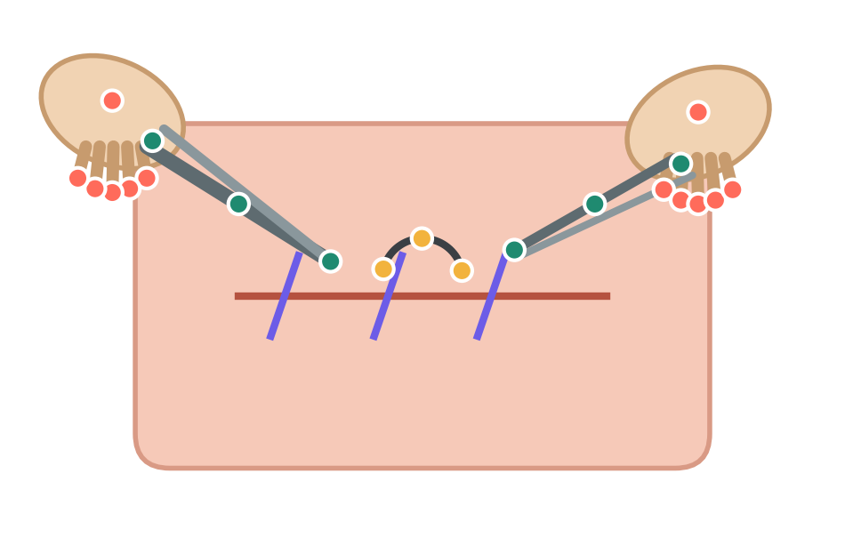
Reading surgical skill from video
Open Suturing Skills challenge · three tasks, one repository, and a GRM search over models and hyper-parameters
Team Saeid
Notes:
The talk covers the challenge tasks, the code in the repository and the GRM search used to choose the training configuration.

Slide 2
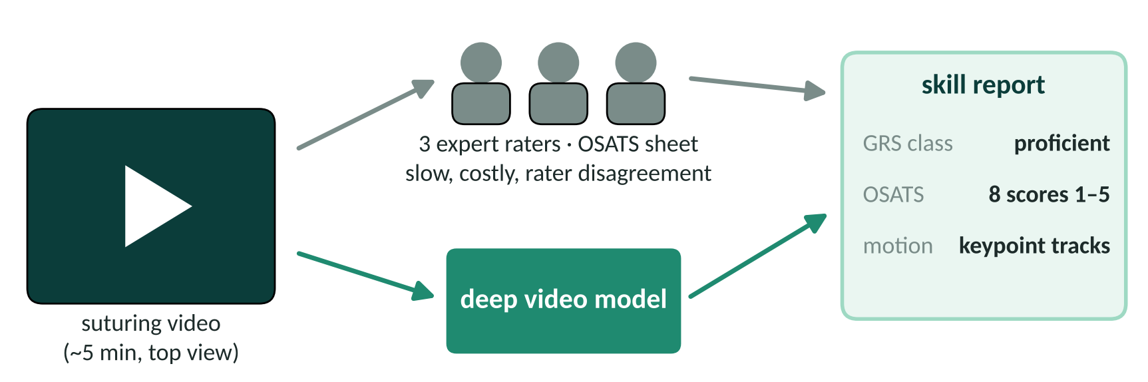
Today, skill is rated by people watching videos
Slow
Inconsistent
Automatable?
Each video needs three experts and a full OSATS sheet.
Raters often disagree by one point or more per item.
Can a video model give the same report in seconds?
Notes:
The question of the challenge: replace or support the expert rating with a model that watches the same video.

Slide 3
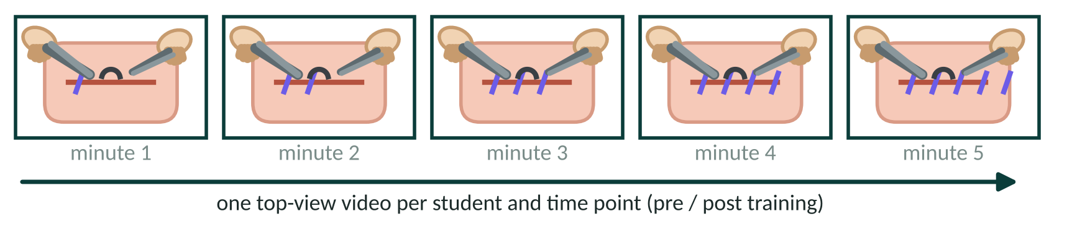
The data: top-view suturing videos, rated three times
3
8
8–40
annotation sheet
rater A 3 2 3 2 3 3 2 3
rater B 2 2 3 2 2 3 2 2
rater C 3 3 3 2 3 3 3 3
same student, pre and post training
independent raters per video
OSATS items, each scored 1 to 5
Global Rating Score = sum of the items
Notes:
Several videos belong to the same student, so the validation split keeps a student on one side only.

Slide 4
Three tasks
one overall class · eight item scores · the motion of hands and tools

Slide 5
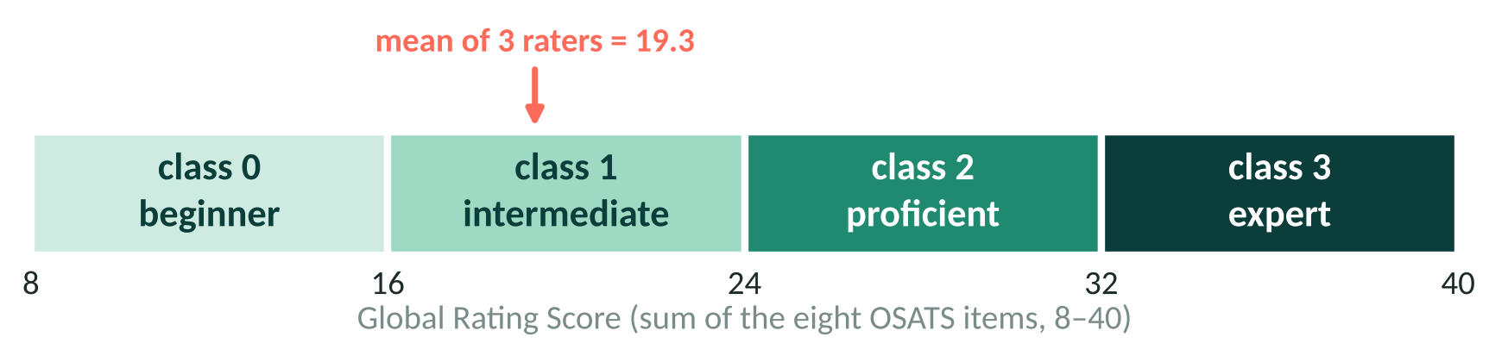
Task 1 – put each video in one of four skill classes
Input
Target
Why it is hard
Whole video, about five minutes, sampled into short clips of 16 frames.
Mean GRS of the three raters, mapped to an ordinal class 0–3.
Classes are ordered: calling an expert a beginner is worse than calling them proficient.
Notes:
Example: rater scores averaging 19.3 fall into class 1, intermediate.

Slide 6
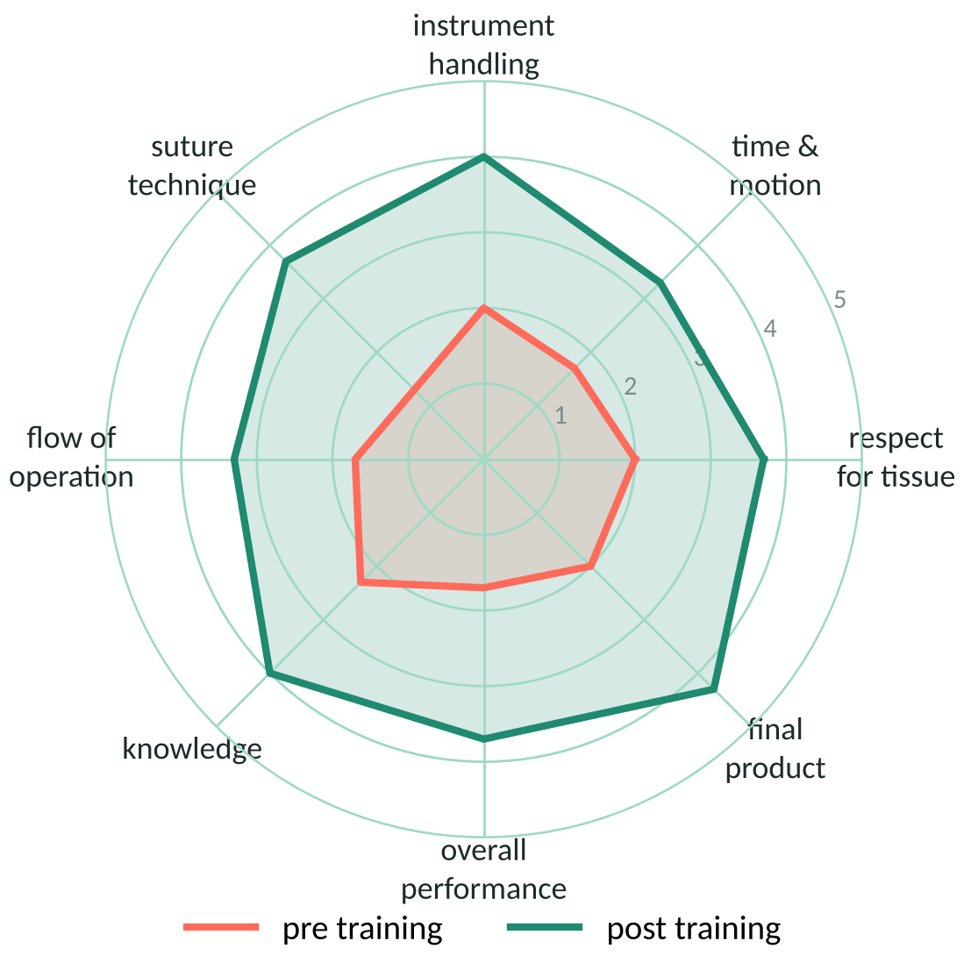
Task 2 – score each of the eight OSATS items
Every item is scored from 1 (poor) to 5 (excellent).
Ground truth per item: the rounded mean of the three raters.
One video gives a profile, not a single number – training shows up as a larger shape.
In the repository: regression, classification, CORAL or a hybrid head over a shared video encoder, with an optional GRS consistency term.
Notes:
The radar shows a made-up student before and after training, to illustrate what the eight items capture.

Slide 7
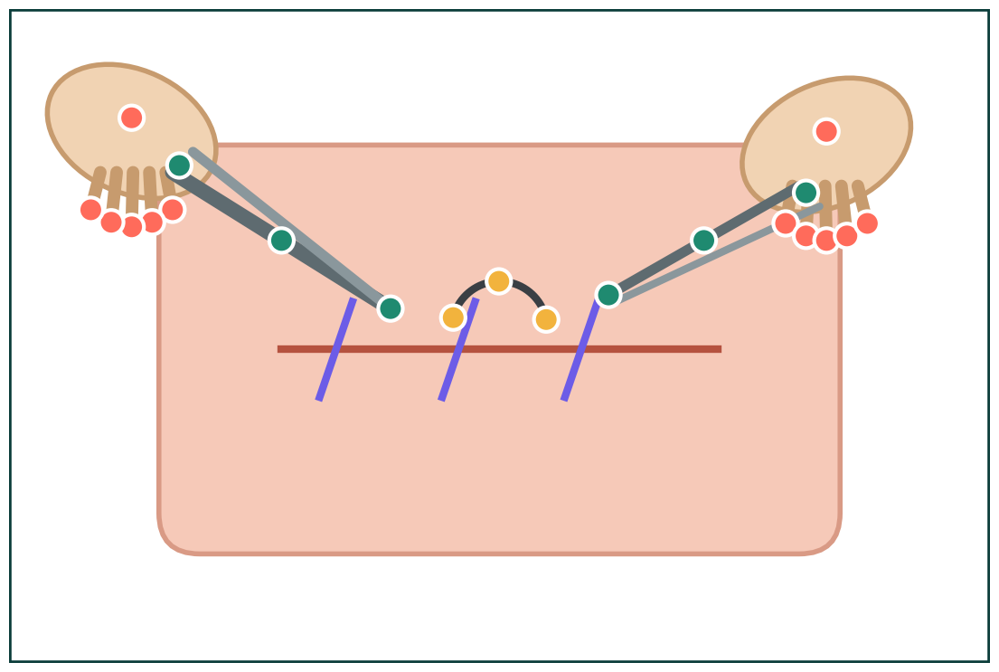
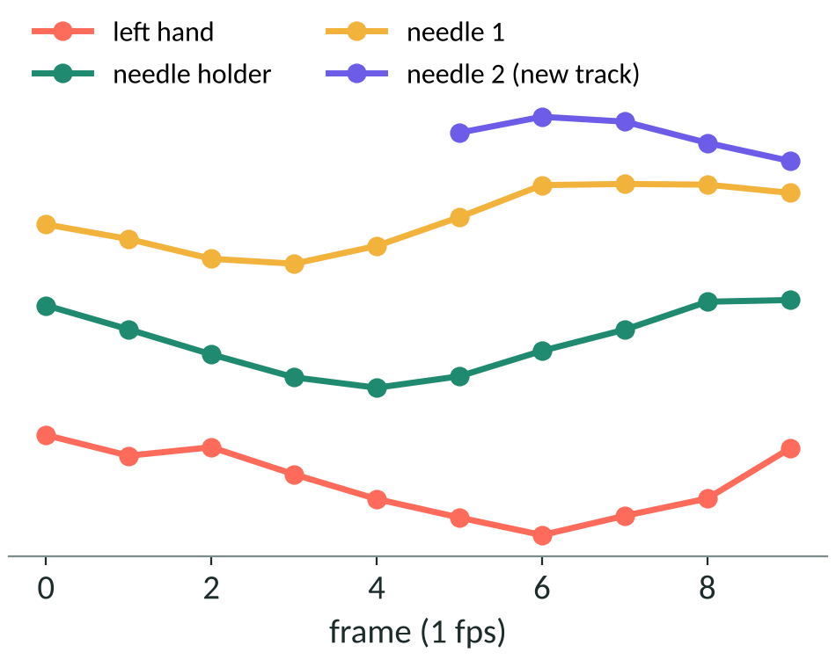
Task 3 – track the hands, tools and needle frame by frame
hands: 6 keypoints each
visibility per keypoint: 0 out of frame · 1 hidden · 2 visible
result written as MOT files, one line per object and frame
scissors · tweezers · needle holder: 3 each
needle: 3 keypoints, up to two needles
Notes:
Each object keeps a track id over time; a second needle opens a new track.

Slide 8
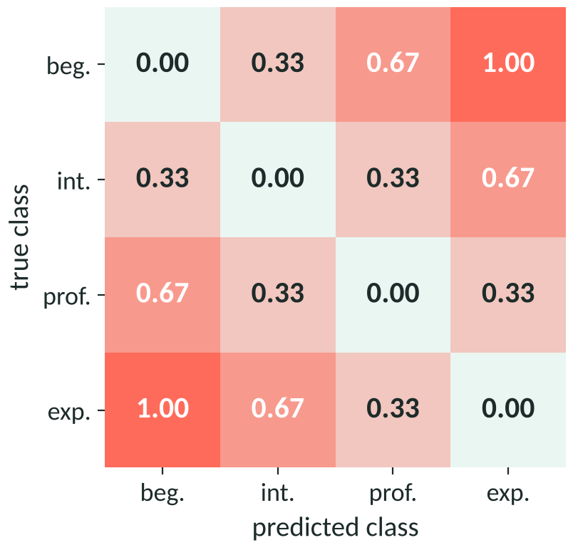
How results are scored
Macro F1 (Tasks 1 and 2)
Average of the per-class F1 scores, so rare classes count as much as common ones. Higher is better.
Expected cost (Tasks 1 and 2)
Mean of the cost matrix weights over all predictions – far-off classes cost more. Lower is better.
HOTA (Task 3)
Balances finding the keypoints (detection) and keeping the right identity over time (association).
expected-cost weights |true − predicted| / 3
Notes:
The training script reports all three after every epoch and picks the best epoch by F1 minus expected cost.

Slide 9
The repository
one training script per task, shared building blocks, inference and Docker

Slide 10
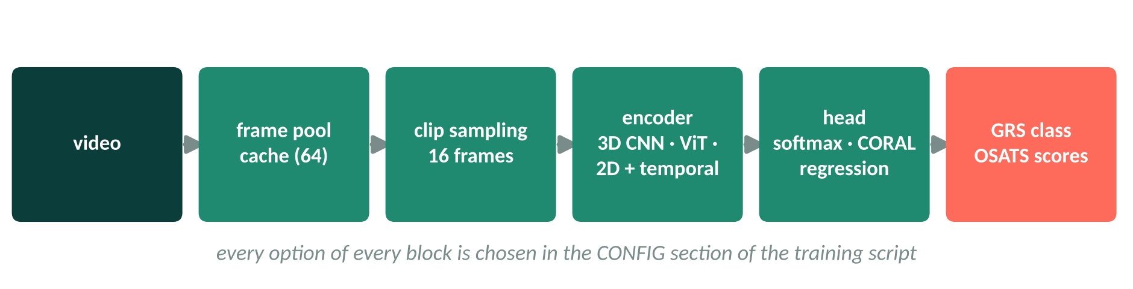
From video to scores in five blocks
Training scripts
Every epoch saved
Inference
task1_grs_classification.py
task2_osats_prediction.py
task3_keypoint_tracking.py
Model, submission file and a training report land in one run folder.
Multi-clip and flip test-time augmentation, checkpoint ensembles, Hungarian tracking for Task 3.
Notes:
Task 3 swaps the clip encoder for a frame encoder with an FPN, U-Net or simple decoder producing heatmaps.

Slide 11
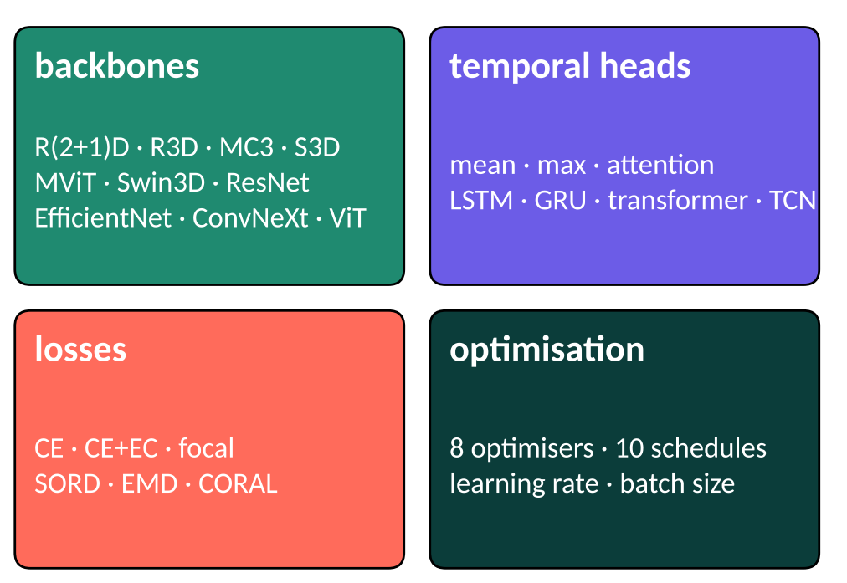
Many good choices – too many to try by hand
> 100 000
combinations of backbone, temporal head, loss, optimiser and schedule – before learning rate and batch size
One full training run takes hours on a single GPU.
Results change with the random seed, so one run per option is not enough.
We need a way to rank options after a few epochs, not after a full run.
Notes:
32 backbones, 7 heads, 7 losses, 8 optimisers and 10 schedules already give about 125 thousand combinations.

Slide 12
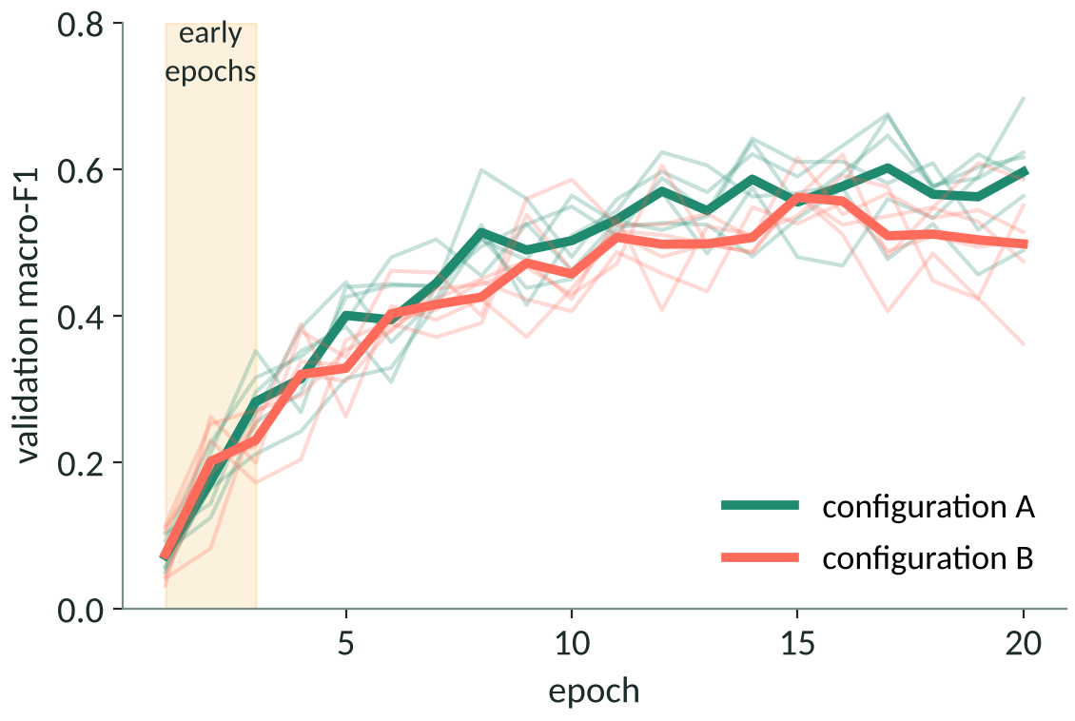
Early training curves are a noisy guide
Thin lines: six seeds of the same configuration. Thick lines: their mean.
In the first epochs (yellow band) A and B overlap – the raw score cannot tell them apart.
Yet the shape of the early curve – loss level, its spread over batches, its slope – still carries information about the final result.
GRM learns that relation once, and then uses it as the reward of the search.
Notes:
Using the raw early score as an RL reward is the baseline that GRM is compared against.

Slide 13
The GRM search
learn what a good start looks like, then search with that as the reward

Slide 14
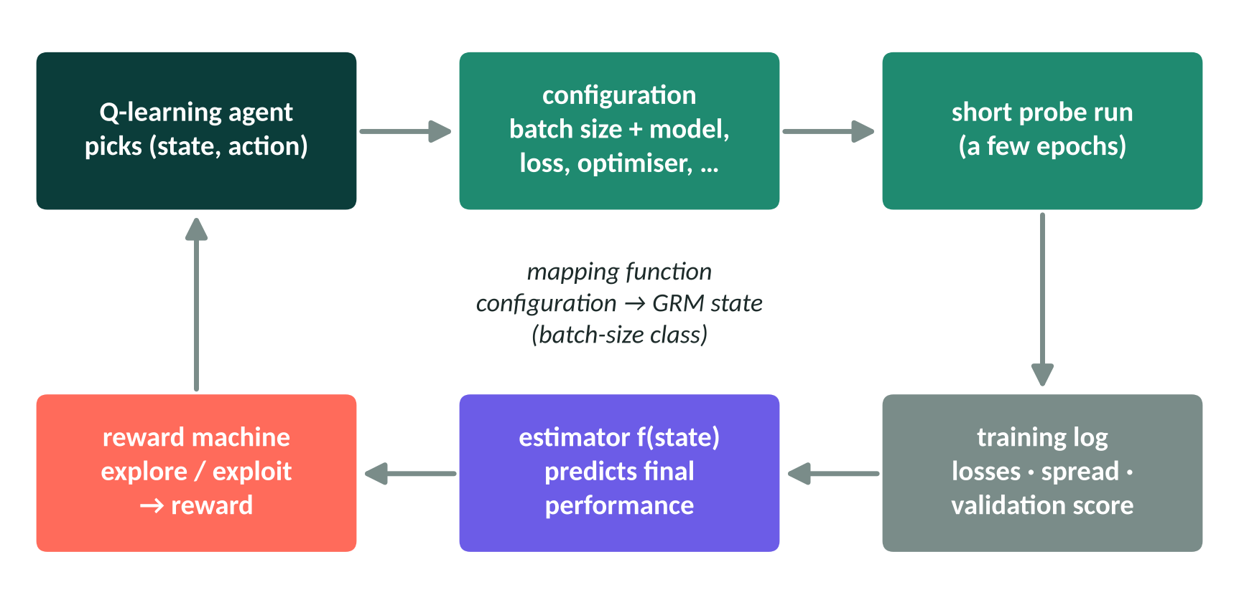
The GRM loop
State
The batch-size class of the configuration (mapping function).
Action
Backbone, loss, optimiser, schedule, learning rate …
Reward
Estimated final performance, shaped by the reward machine.
the agent never waits for a full training run inside the loop
Notes:
This follows the two-stage description of the GRM entry in the challenge paper and the general GRM framework of the thesis.

Slide 15
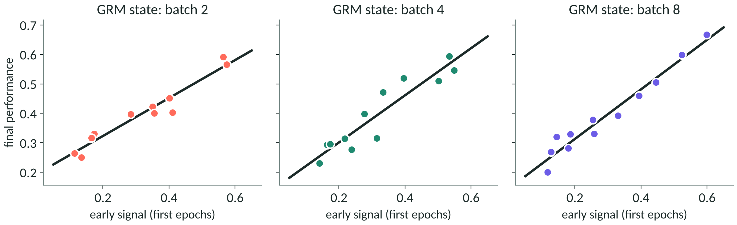
Phase 1 – calibrate one estimator per state
Probes
Signals
Estimator
Random actions per batch-size class, each trained for a few epochs and then in full.
OSS, StepUP or OGB sets: mean loss, batch-loss spread, early F1, RMSE, slope …
Linear, ridge, Huber or k-NN, checked by leave-one-out error.
Notes:
The StepUP variant fitted Perf ≈ w1·P1 + w2·P2 on fifteen runs per state; the OGB variant used ten runs per state.

Slide 16
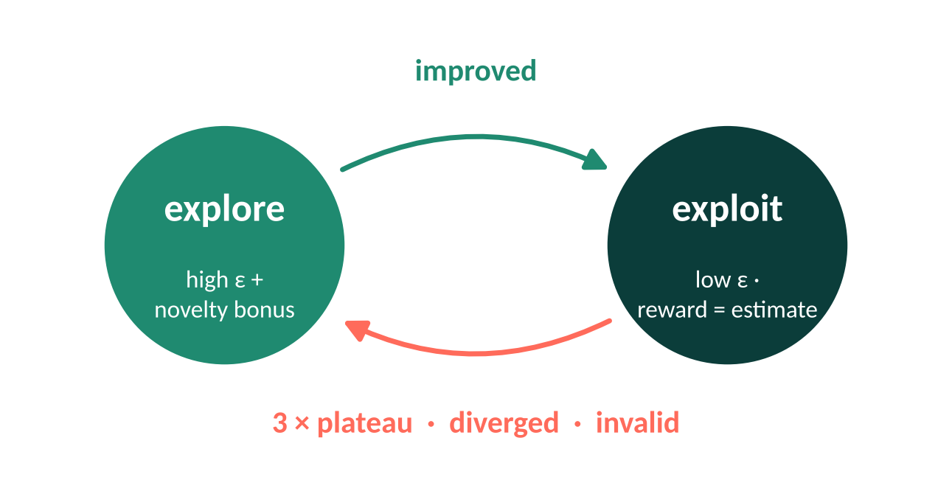
The reward machine decides how to read each probe
A labelling function turns each probe into a symbol: improved, plateau, diverged or invalid.
The symbol moves a small finite-state machine between explore and exploit.
Each state has its own exploration rate and reward rule – novelty bonus while exploring, plain estimate while exploiting.
Configurations that crash or run out of memory are masked out of the search.
Notes:
The penalty for an invalid configuration is set from the rewards seen so far when it is not fixed in CONFIG.

Slide 17
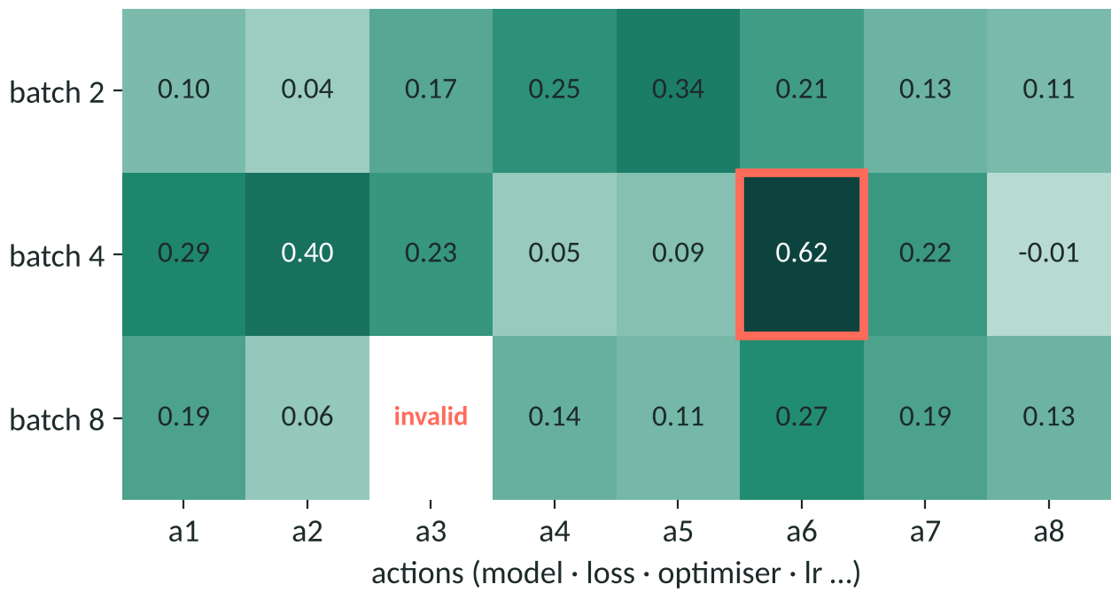
Phase 2 – Q-learning over (state, action) pairs
Pick a state, then an action with ε-greedy, UCB or softmax.
Train the pair for a few epochs only.
Reward = estimator output; update Q with the learning rule.
Stop after the step budget; take the top pairs forward to a full run.
best pair so far highlighted · invalid pairs never chosen again
Notes:
State choice can be random, round robin, least visited or greedy; updates are Q-learning or bandit style.

Slide 18
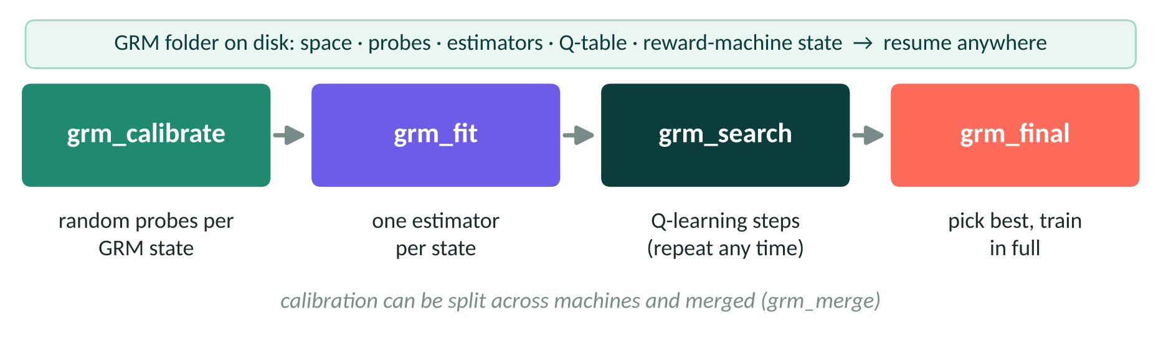
Each phase runs on its own, whenever there is GPU time
python oss_suturing/task1_grs_classification.py --mode grm_calibrate
python oss_suturing/task1_grs_classification.py --mode grm_search # repeat to add steps
python oss_suturing/task1_grs_classification.py --mode grm_final
Notes:
The same modes exist in the Task 2 and Task 3 scripts; grm_full runs everything in one call.

Slide 19
Results
Same idea on earlier problems
StepUP – EER (lower is better)
10.77
13.13
GRM
RL, raw reward
ECML OGB – weighted total (higher)
3.68
3.45
GRM · first place
RL, raw reward
best of the submitted Task 1 models · Task 2: F1 0.19, EC 0.33
Notes:
OSS setup: R(2+1)D-18, 16 frames at 128 pixels, AdamW, learning rate 1e-5 with plateau schedule, batch size 4. The baseline still leads on Task 1, so there is room to improve.

Slide 20
Using the repository
1
Install
pip install -r requirements-cu118.txt
pip install -e .
2
Train or search
set the CONFIG block, then
oss-task1 --mode train (or grm_full)
3
Build the container
docker build -f docker/Dockerfile
-t oss-skill:cu118 .
4
Run like the organisers
Process_SkillEval.sh GRS | OSATS | TRACK
/input videos → /output results
Notes:
CUDA 11.4 machines use the cu118 requirements, CUDA 12.2 machines the cu121 ones.

Slide 21
In short
Challenge
opencas.dkfz.de/endovis/challenges/2025
Challenge paper
arxiv.org/abs/2605.22200
GRM framework (PhD thesis)
cora.ucc.ie
Three video tasks: skill class, OSATS items, keypoint tracks.
One configurable pipeline per task, ready for Docker submission.
GRM turns a few epochs into a reliable reward for the search.
Notes:
Questions.

