Slide 1
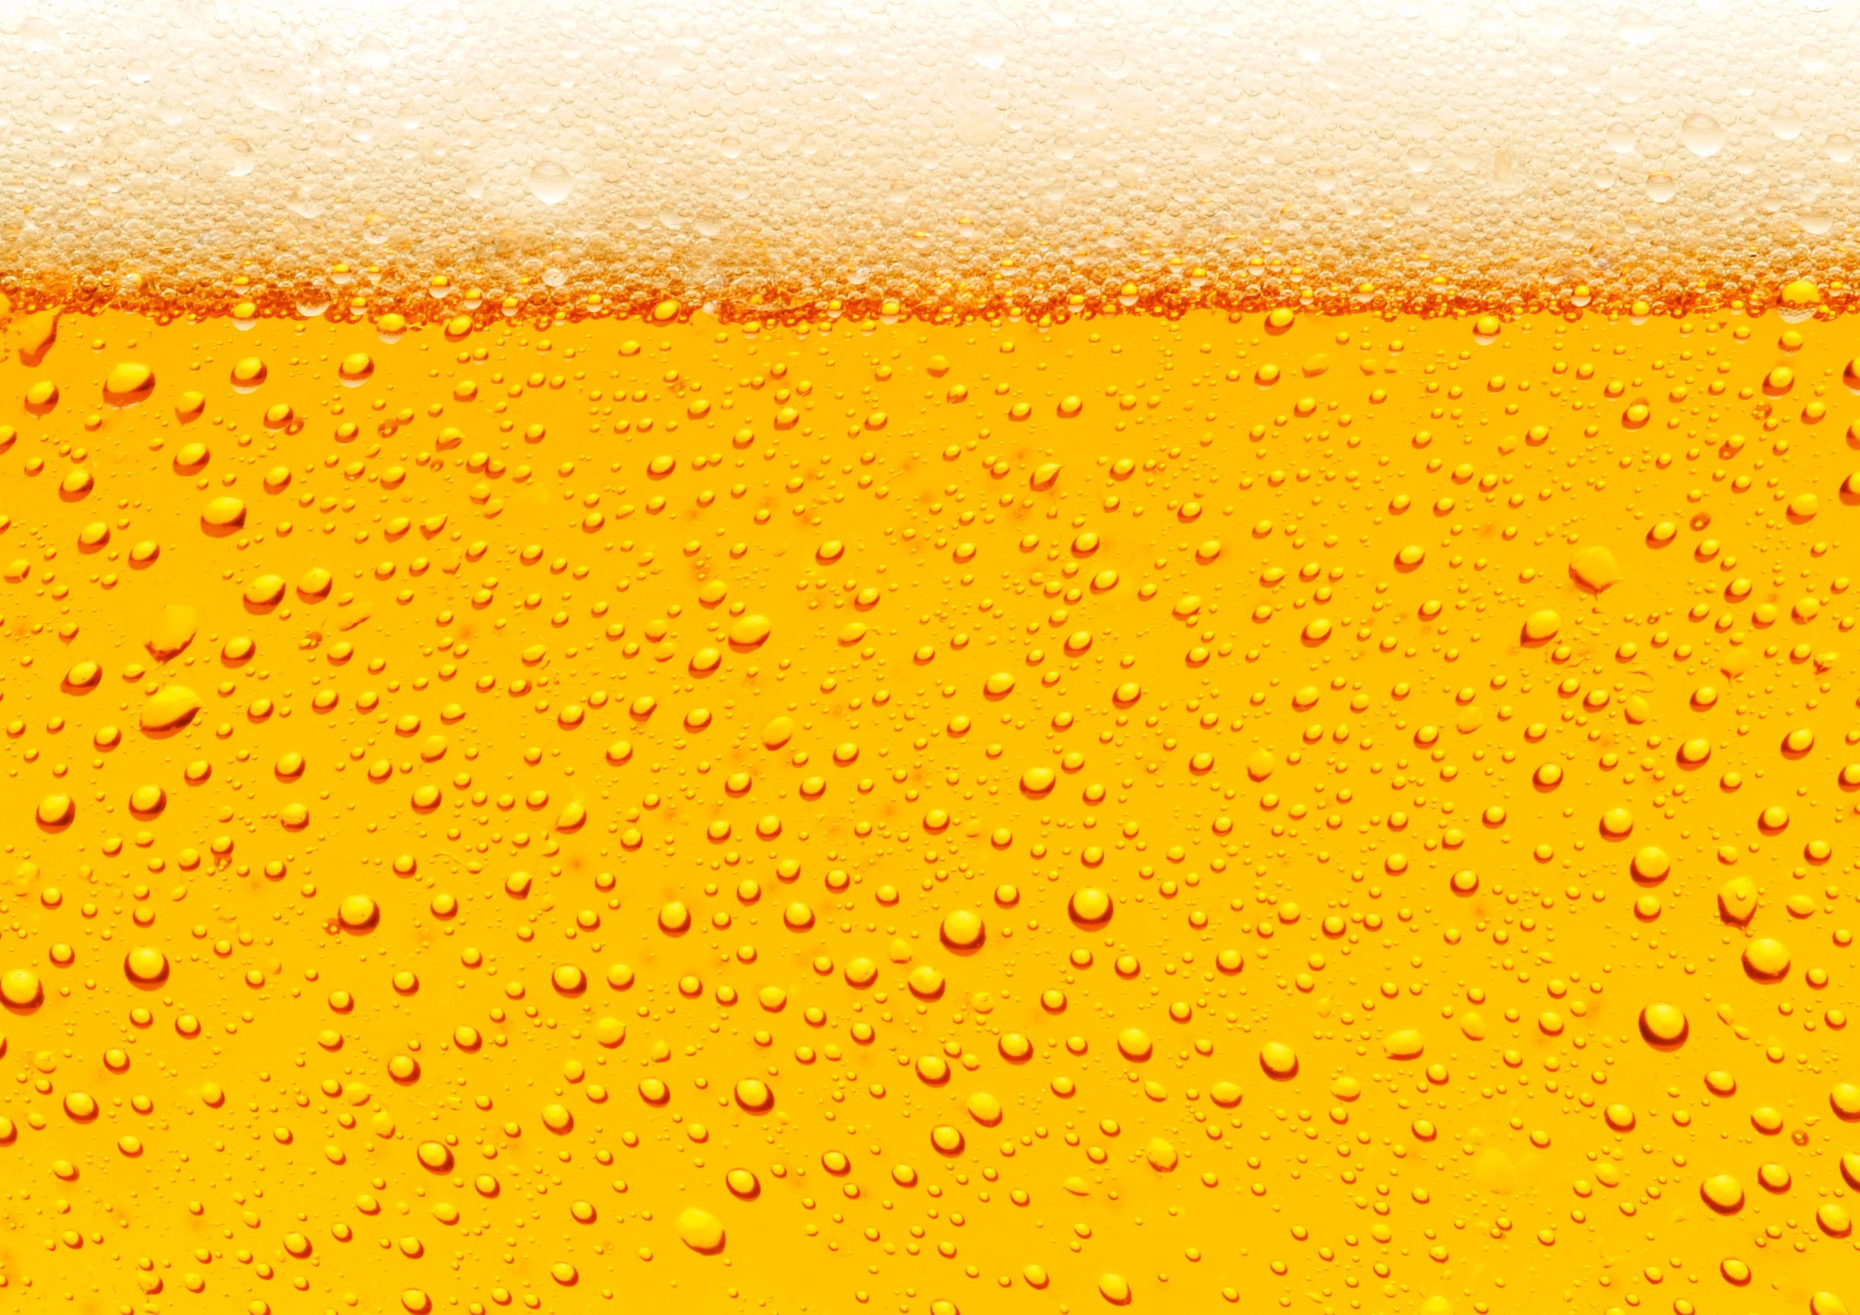
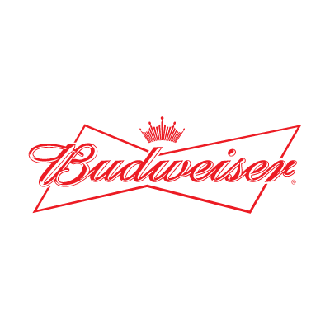
Craft Beers in the U.S.
Prepared for: Budweiser
26 October 19
Steven Garrity and Richard Palmer

Slide 2
Introduction
We were presented with data on 2410 beers produced by 558 breweries in the United States.
For each brewery, we have its name, and the city and state it is located in.
For each beer, we have its style as well as numeric values for ABV (alcohol by volume), IBU (international bitterness units), and the serving size in ounces.
In this dataset, there were 100 different styles of beer represented.
There were beers produced in every state of the nation, as well as in the District of Columbia.
We have studied how well the ABV and IBU correlate with styles of beer.
We also found what may be underserved markets and have recommendations for entering them.

Slide 3
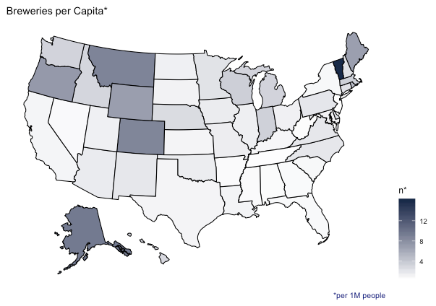
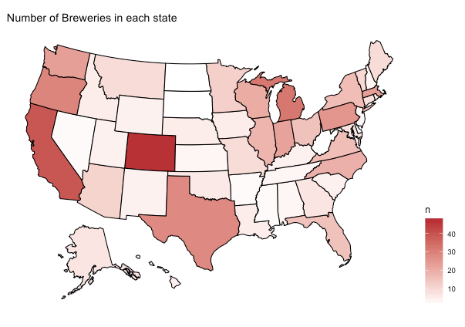
NUMBER OF BREWERIES IN EACH STATE

Slide 4
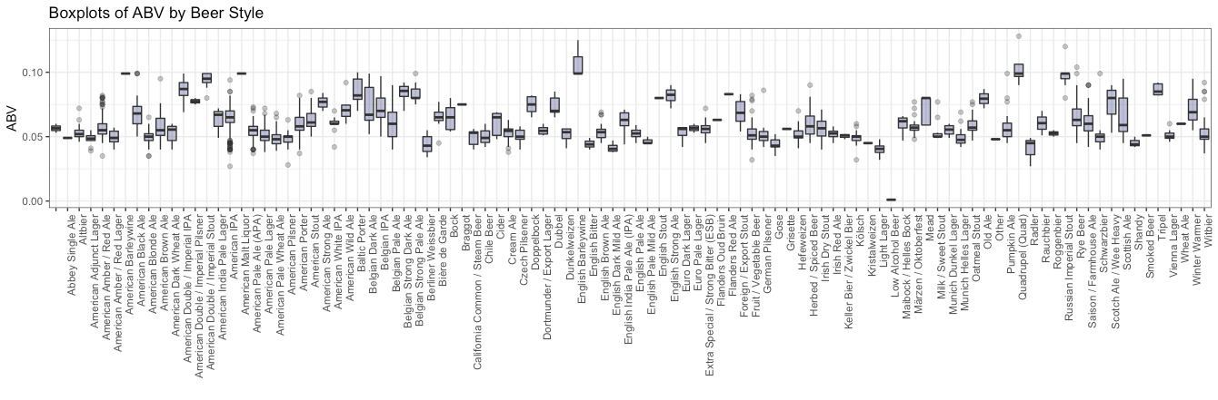
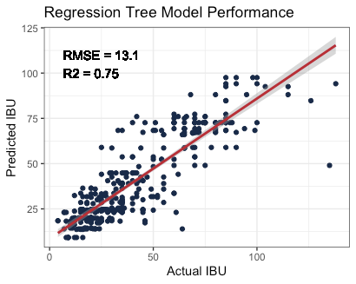
MISSING VALUES
ABV had 62 missing values and IBU had 1005 missing values.
We filled missing ABV values with the median ABV from beers of the same style.
To fill missing values in IBU, we fit a regression tree (ABV and Beer Style as inputs) to observations without missing values and then used that model to predict each missing IBU value.

Slide 5
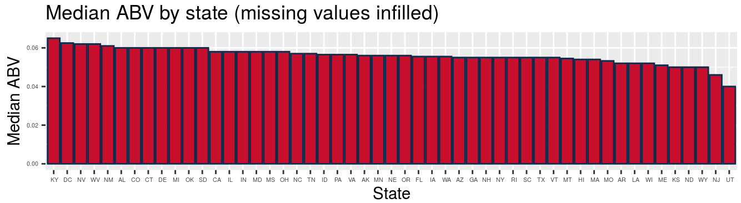
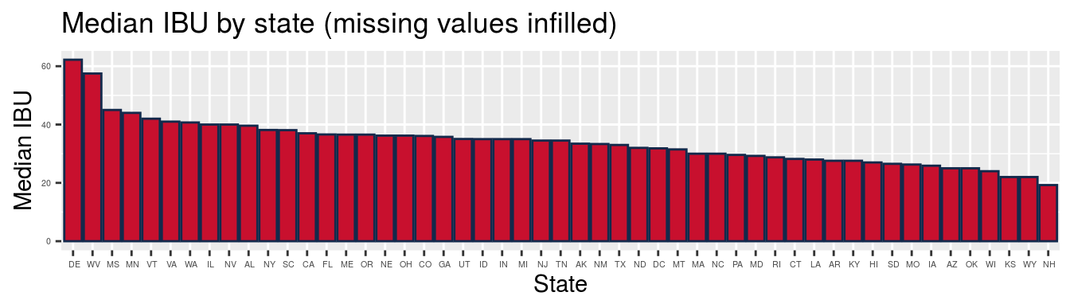

Slide 6
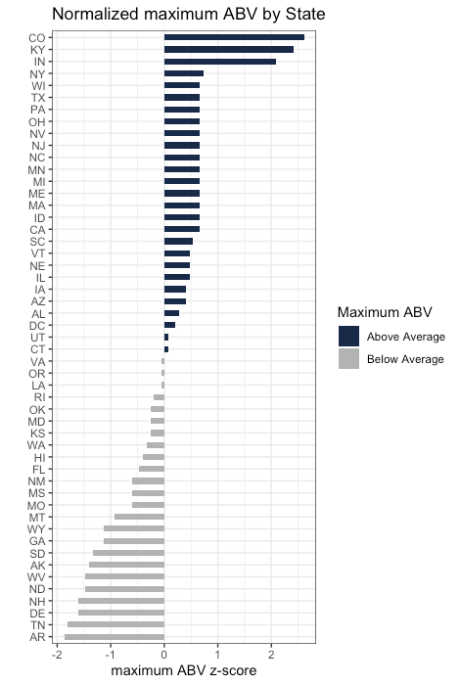
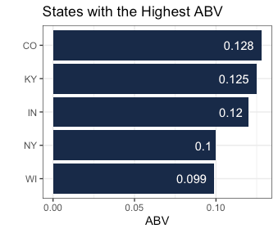
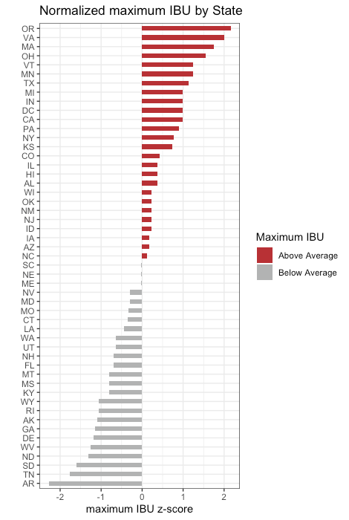
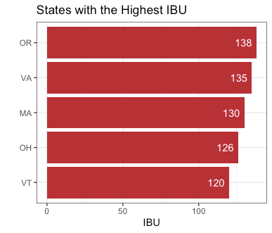
STATES WITH HIGHEST ABV AND IBU

Slide 7
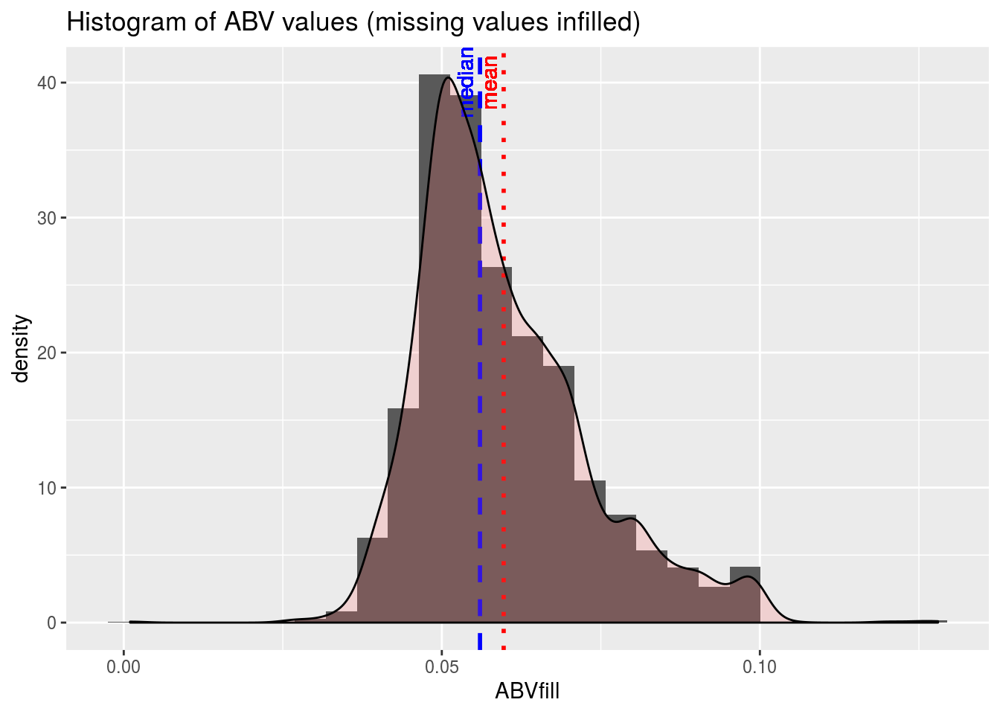
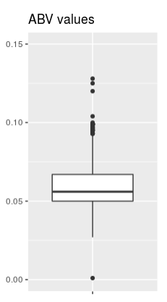
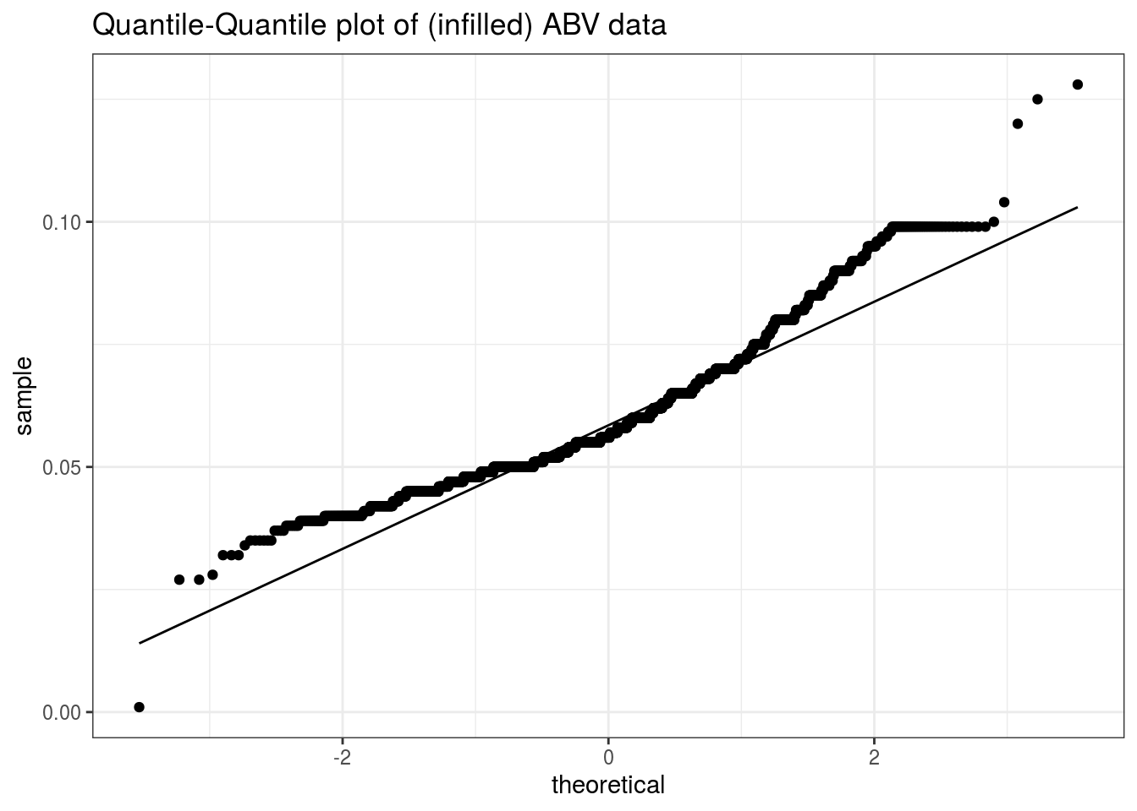
Examine distribution of ABV values.
The mean is slightly higher than the median, which would indicate a right skewed distribution, one with a long tail of high values.
The histogram bears this out, as does a box plot.
To investigate whether the ABV values are normally distributed, we do a Q-Q plot. This is a plot of the quantiles of the actual data against what would be expected from a normal distribution. If the data do follow a normal distribution, the plot would show a straight line. The more the plot deviates from a straight line, the less closely the data follow a normal distribution.
From the upward curve in this plot, we infer that the data are somewhat skewed. This confirms what the histogram shows. The apparent discontinuities at the ends of the curve are an indication that the ABV values have a few more extreme values than would be expected from a normal distribution. This confirms what was shown in the box plot.

Slide 8
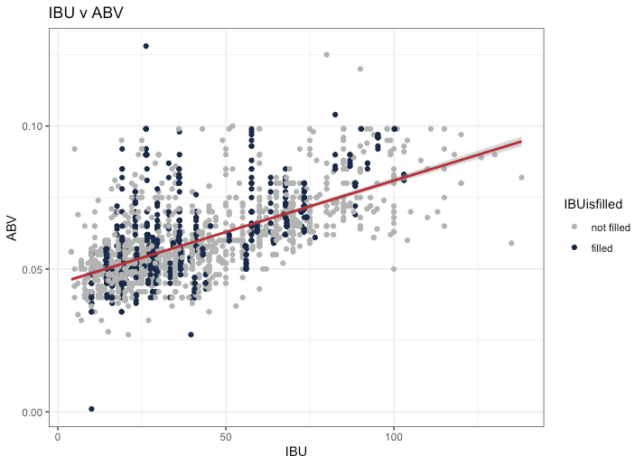
RELATIONSHIP BETWEEN IBU AND ABV
R² (w/ filled data) = 0.42
R² (w/o filled data) = 0.45
There is a moderate, positive relationship between IBU and ABV.

Slide 9
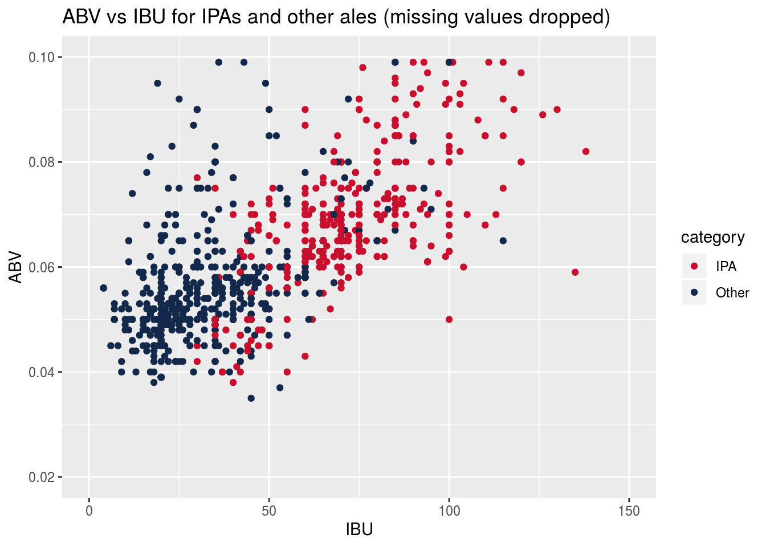
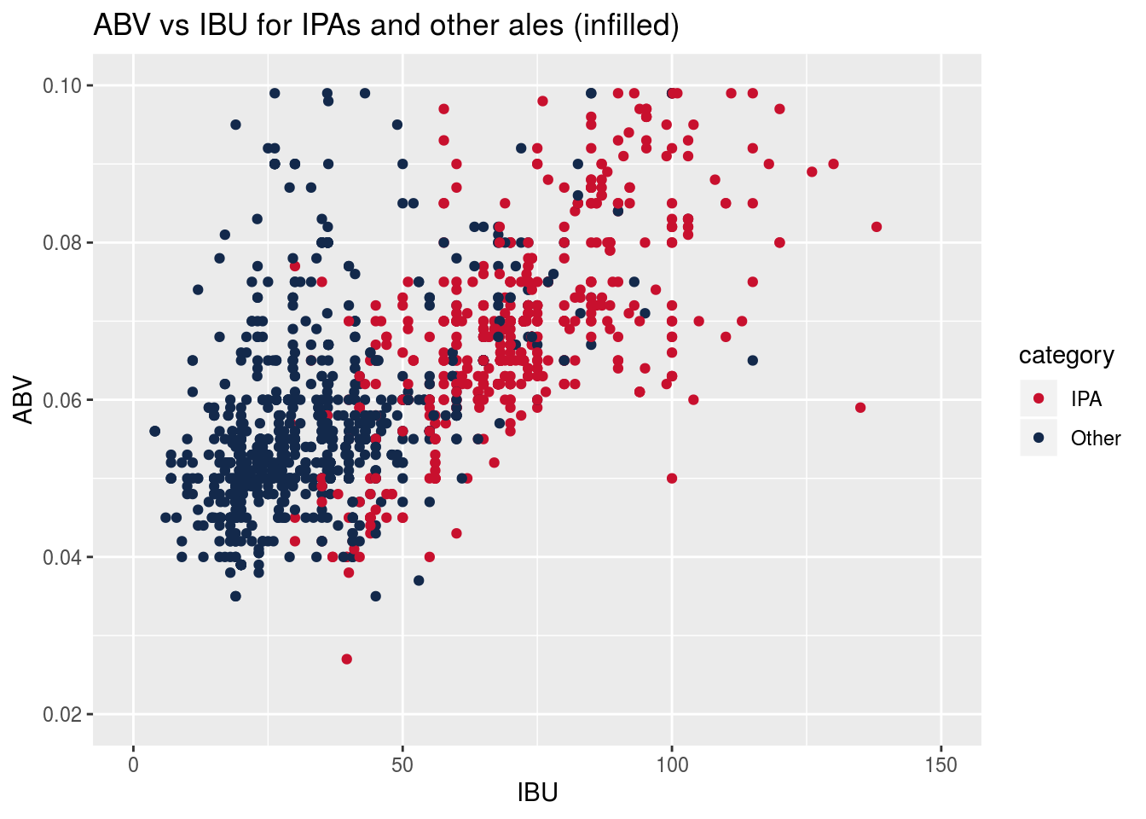
IPAs compared to other Ales
Infilling missing values for ABV and IBU does not change the character of their relationship, so subsequent analyses will use infilled datasets

Slide 10
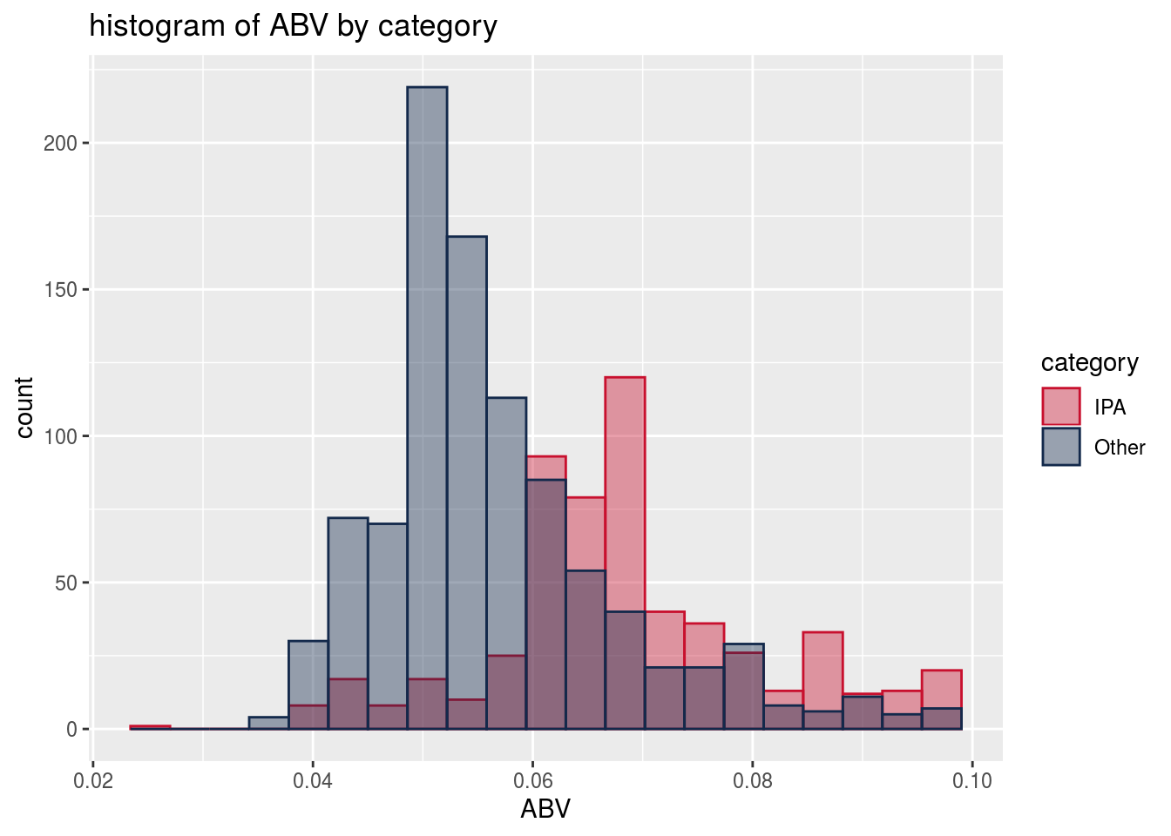
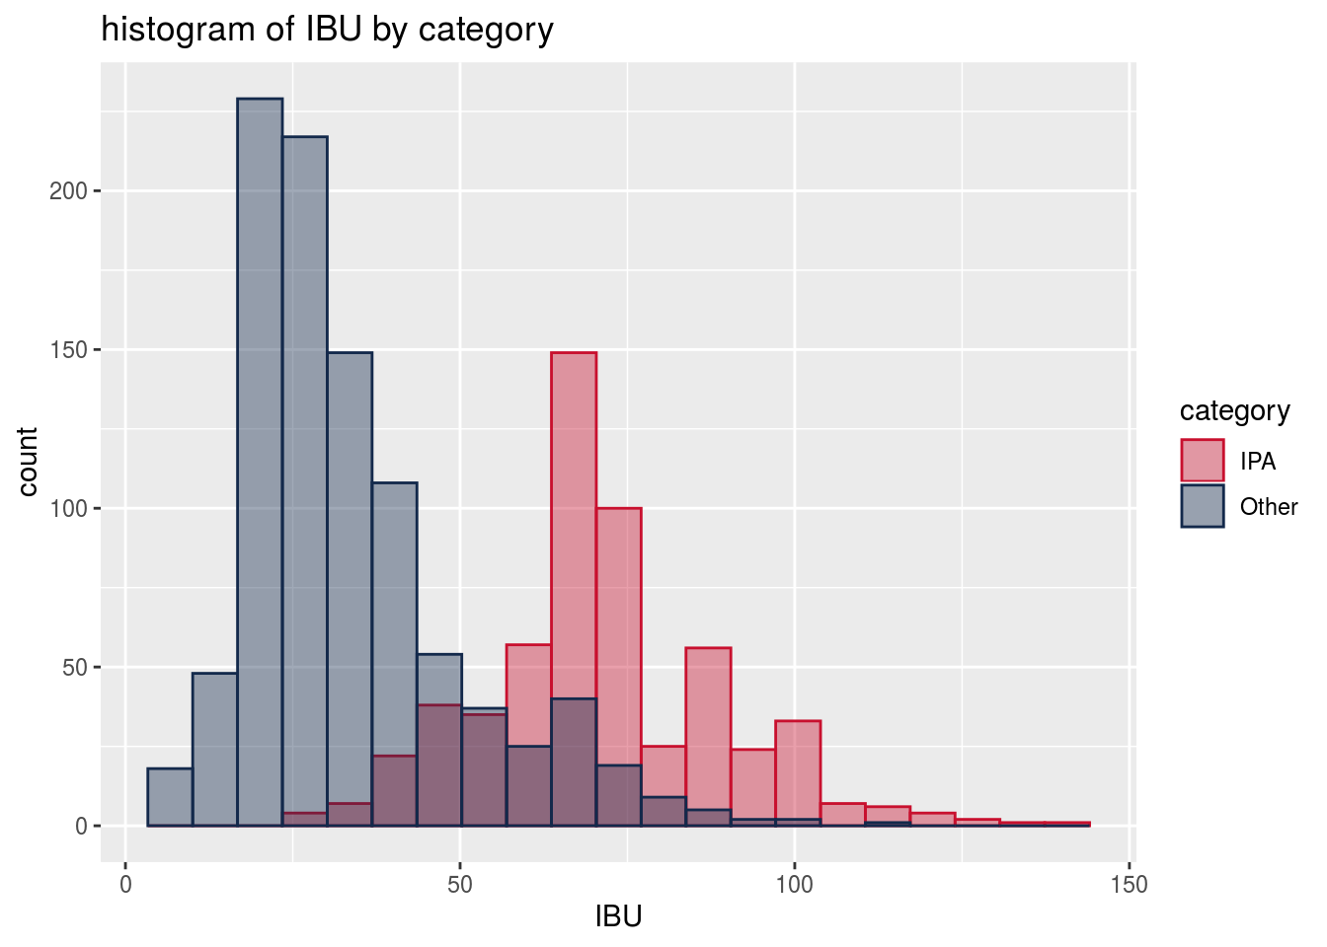
Look at distributions of ABV and IBU by category, for potential use in classifier.
Welch’s two-sample t-test shows statistically significant differences in both ABV and IBU between IPA’s and other ales
 | ABV (%) | IBU (Intl Bitterness Units)
IPA | 5.67 | 71.2
Other Ales | 6.88 | 33.9
P-value for Hypothesis Test | < 2.2e-16 | < 2.2e-16
95% Conf Interval for difference | [1.08 .. 1.33] | [35.4 .. 39.1]

Slide 11
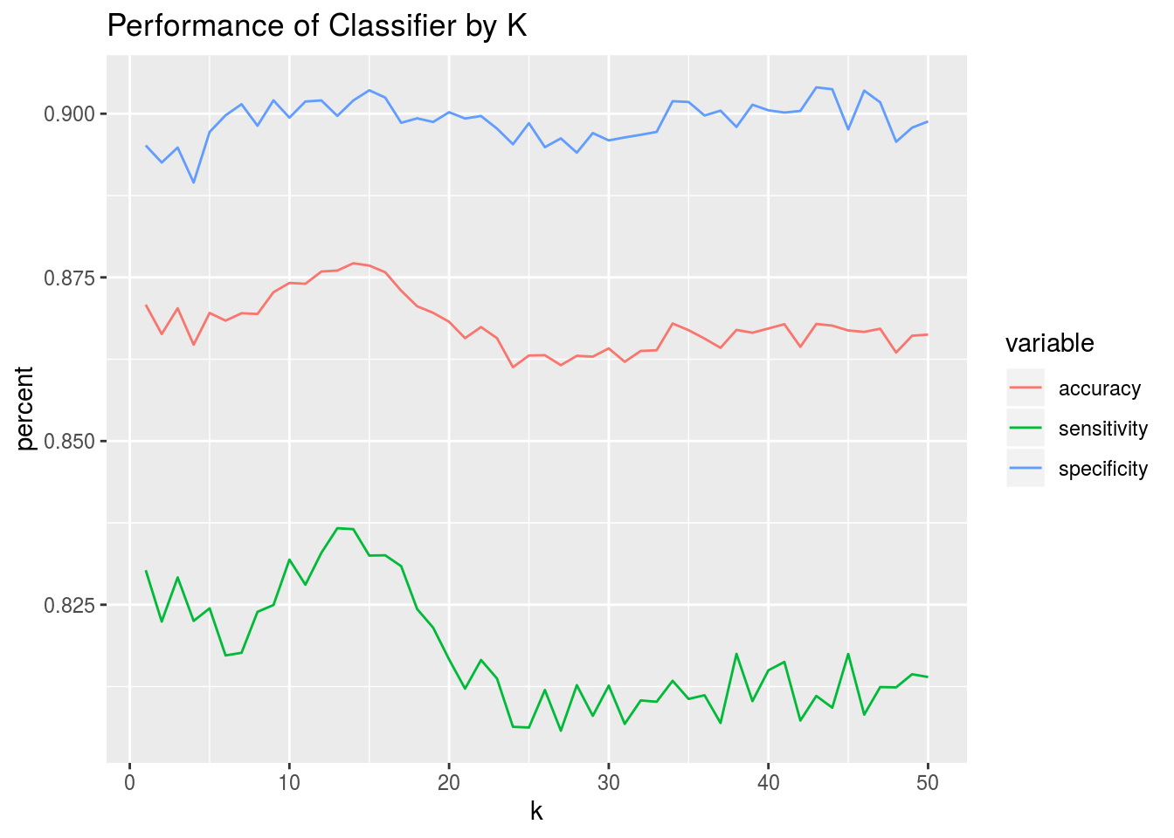
Constructing KNN Classifier
Do KNN classification. Make 100 iterations of the model, splitting the data into training (70%) and test (30%) datasets each time and averaging the performance statistics of the model. Do this for a number of different k values.
Look at all 50 values of k to determine what k value gives best performance.
k of 14 is best for accuracy.
k of 13 is best for sensitivity. k of 43 is best for specificity.
we choose 14 as best overall, since it gives the highest sum of accuracy, sensitivity, and specificity.

Slide 12
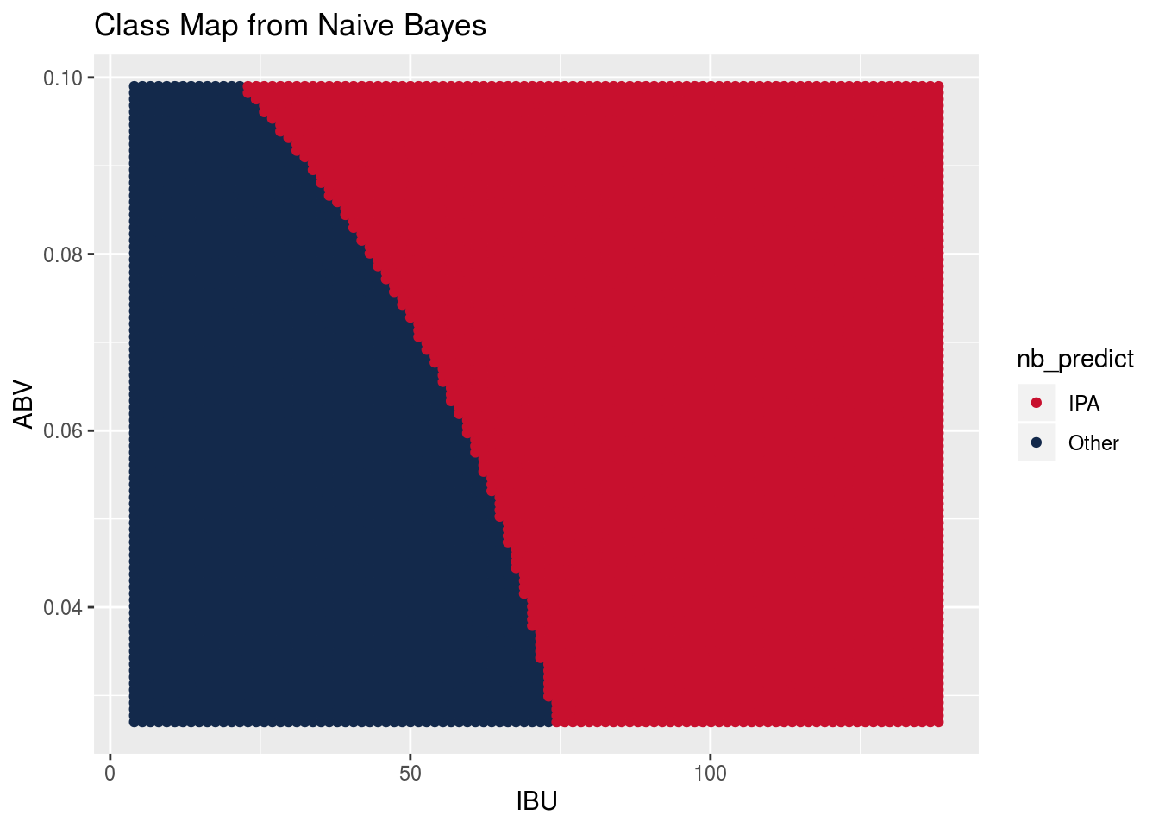
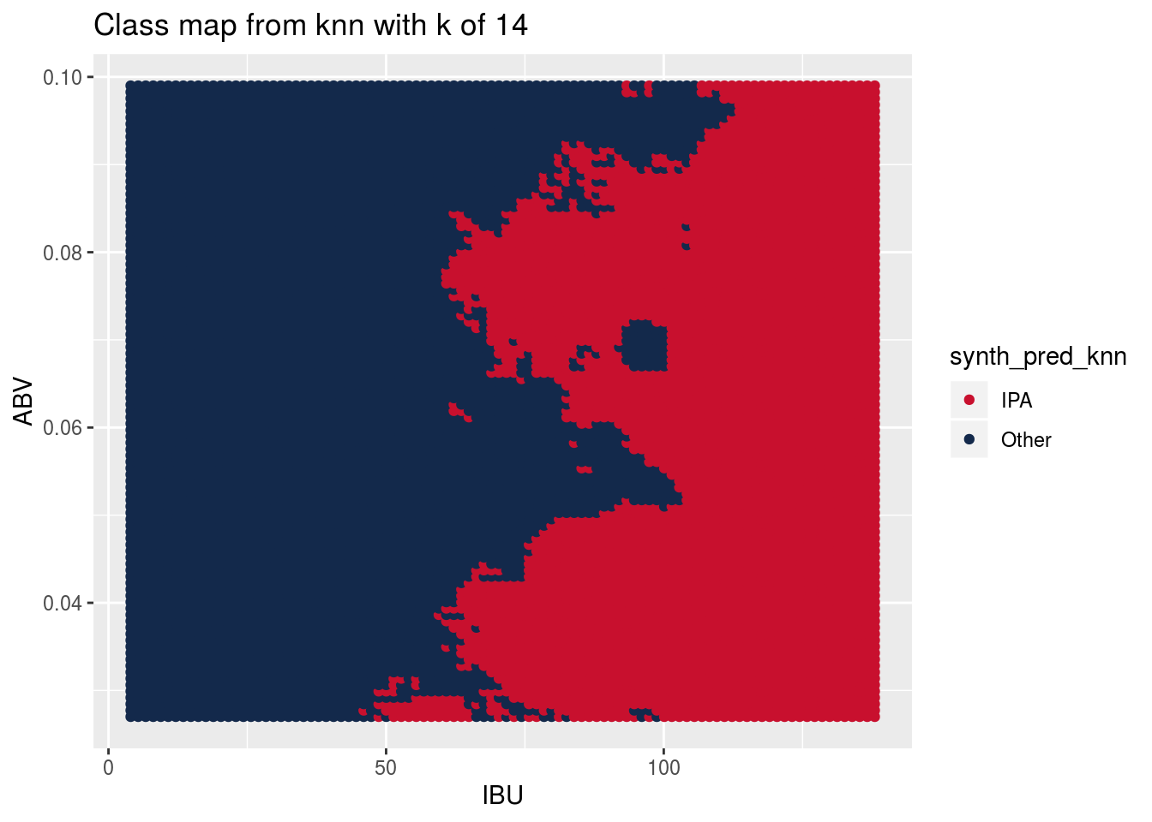
Which classifier captures the relationship between IPA and Other ales?
Truth
 | Constant ‘Other’ | Random | Naive Bayes | KNN
Sensitivity | 100% | 63% | 89% | 92%
Specificity | 0% | 37% | 81% | 85%
Overall Accuracy | 63% | 53% | 86% | 89%
Model Sophistication
low
high

Slide 13
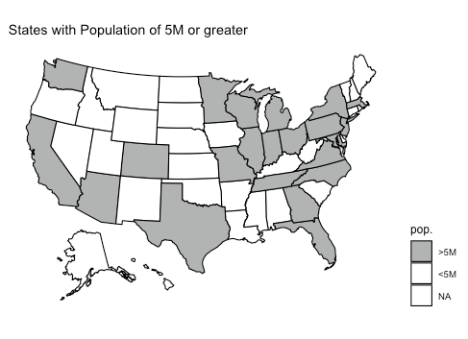
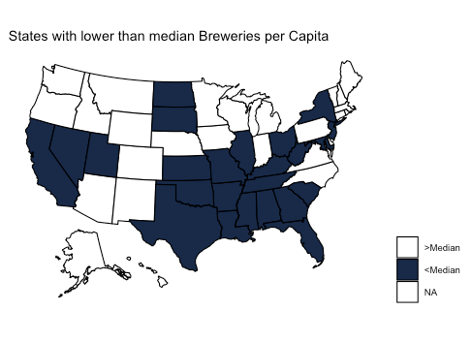
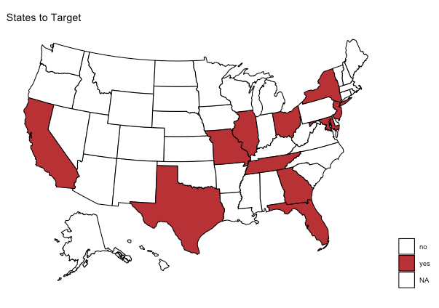
WHERE TO TARGET INVESTMENT
States to target are those that have population > 5M and a lower than median number of breweries per capita.

Slide 14
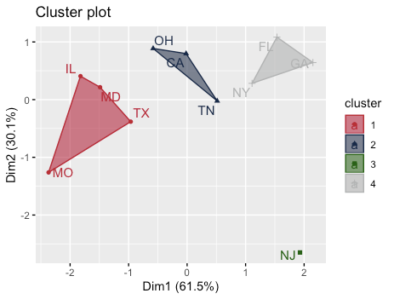
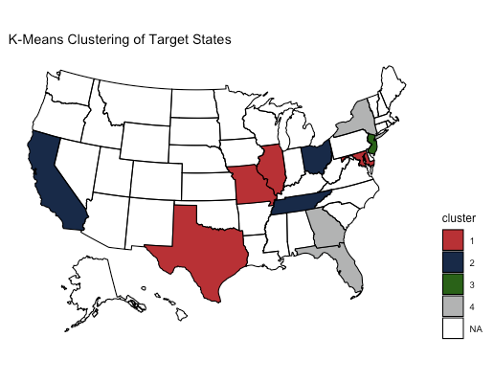
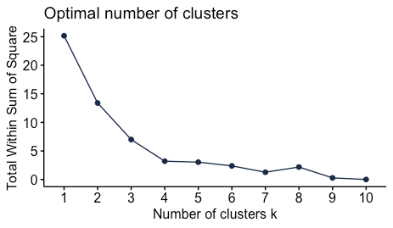
K-means diagnostics:
Median IBU
Median ABV
IBU:ABV ratio
Breweries per capita

Slide 15
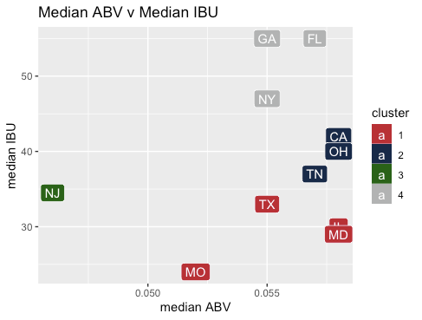
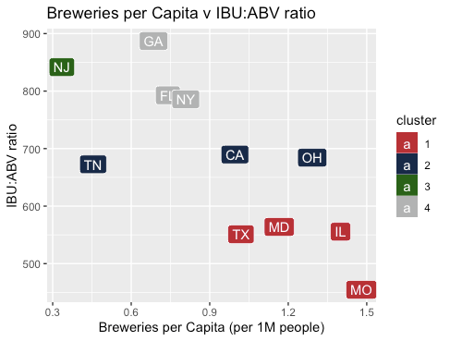
CLASSIFICATION OF TARGET STATES
Cluster 1: States with high ABV, low IBU beers and already have a high number of breweries per capita.
Cluster 2: States with high ABV, moderate IBU beers and a wide range of breweries per capita
Cluster 3: NJ has low ABV, moderate IBU beers and has a very low number of breweries per capita.
Cluster 4: States with high ABV, high IBU beers and a low number of breweries per capita.

Slide 16
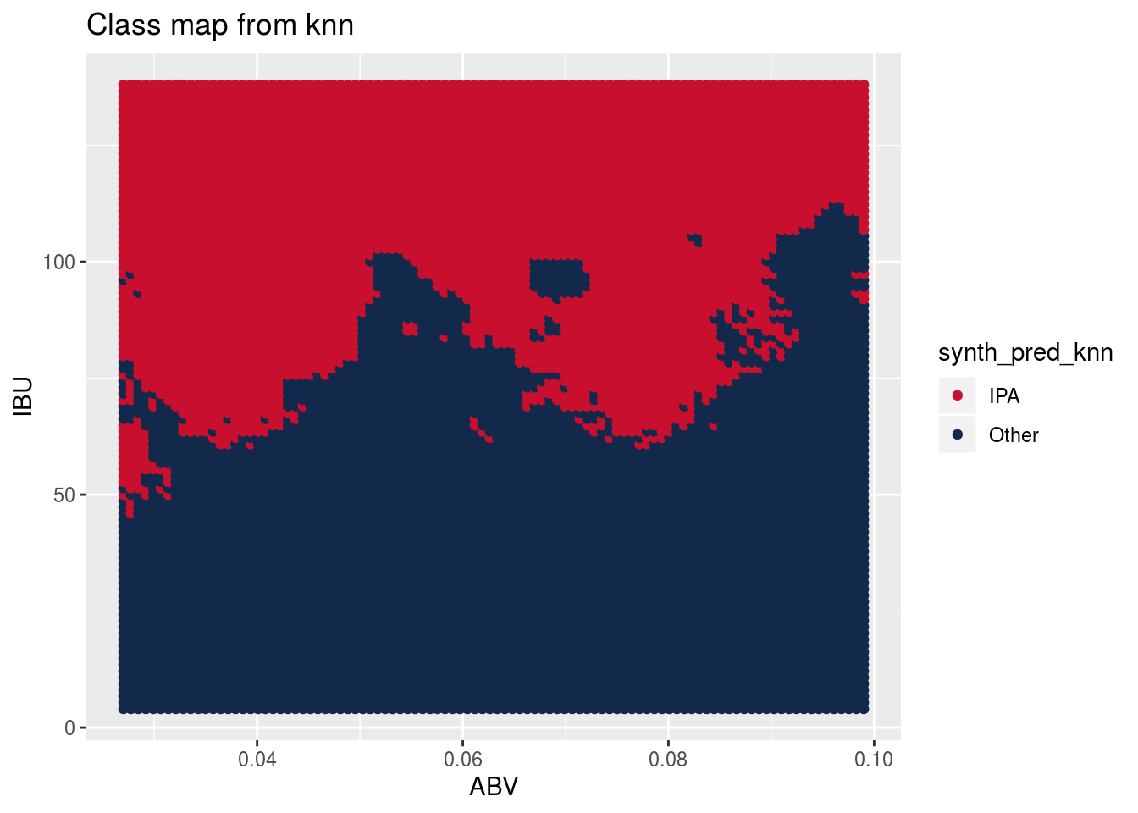
What Type of Beer would sell in each Underserved Market?
Target Market | Suggested Beer Style
GA, FL, NY | IPA
MO, TX, MD, IL, TN, OH, CA | Higher Alcohol Ale
NJ | Lower Alcohol Ale

Slide 17
Conclusions
Craft beers are available across the country; but are most popular in the mountain states, particularly Colorado.
There are modest variations in alcoholic content (ABV) and bitterness (IBU) throughout the US. The variations correlate well with beer style.
We have identified 11 states with potentially underserved market and have grouped them with recommended styles based on current tastes.

