Slide 1
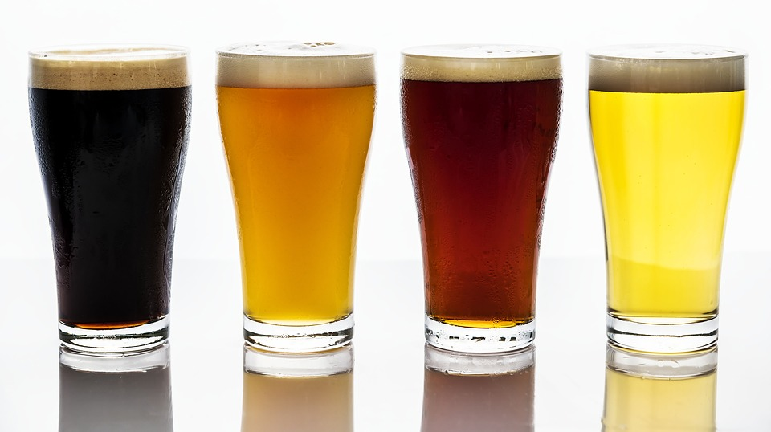
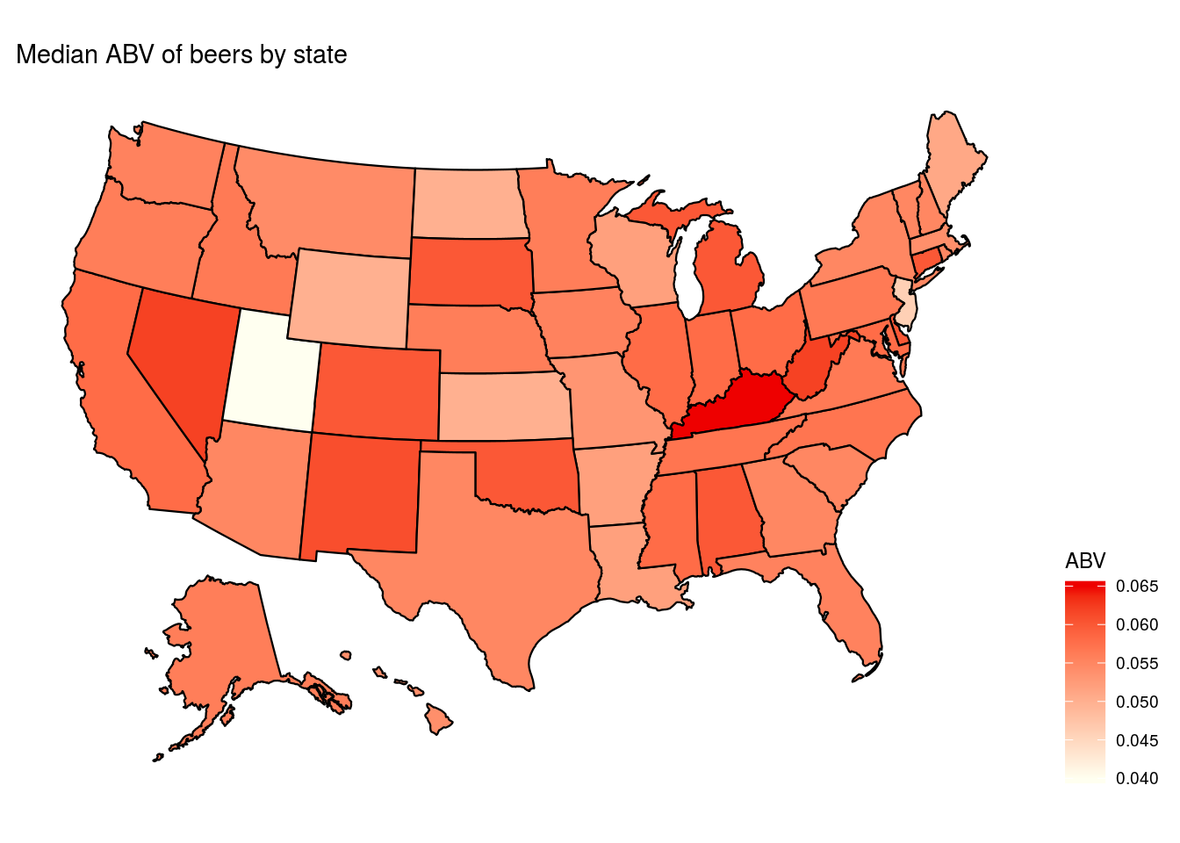
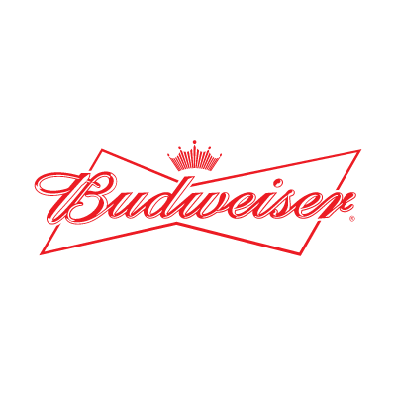
Beers in the United States
Preliminary Analysis prepared for
Budweiser CEO and CFO
17 October 19
Steven Garrity and Richard Palmer

Slide 2
Introduction
We were presented with data on 2410 beers produced by 558 breweries in the United States.
For each brewery, we have its name, and the city and state it is located in.
For each beer, we have its style as well as numeric values for ABV (alcohol by volume), IBU (international bitterness units), and the serving size in ounces.
In this dataset, there were 100 different styles of beer represented.
There were beers produced in every state of the nation, as well as in the District of Columbia.
Today we will present a summary of what we have found in the data so far, including
Count of breweries by state
Study of ABV and IBU by state
Distribution of ABV and its relationship to IBU
Examination of missing data and actions to address it

Slide 3
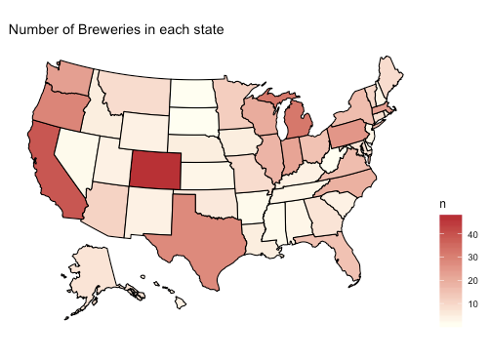
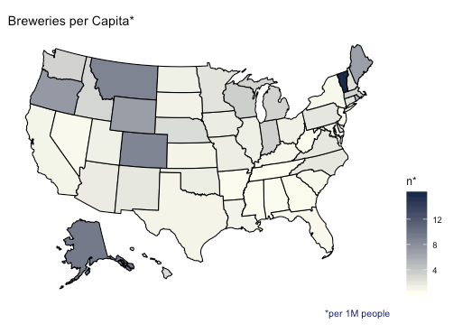
QUESTION 1 - BREWERIES BY STATE

Slide 4
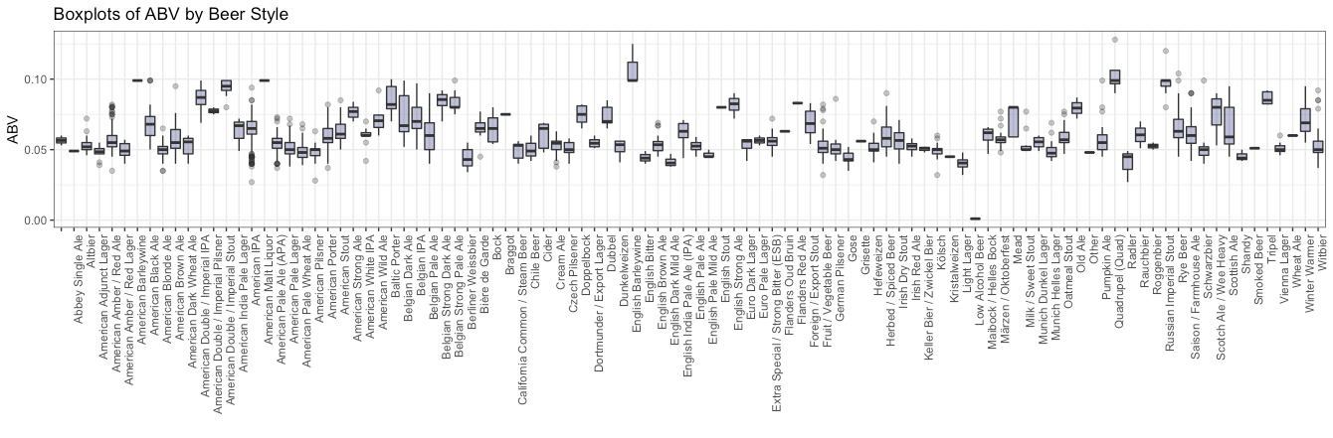
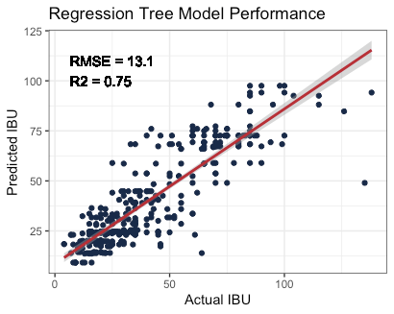
QUESTION 3 - ADDRESS THE MISSING VALUES
We found that ABV had 62 NAs and IBU had 1005 NAs. All of the ABV NAs also had NA IBU. We decided to fill ABV values with the median ABV from beers of the same type. To fill missing values in IBU, we fit a regression tree to observations without missing values and then used that model to predict each missing IBU value.

Slide 5
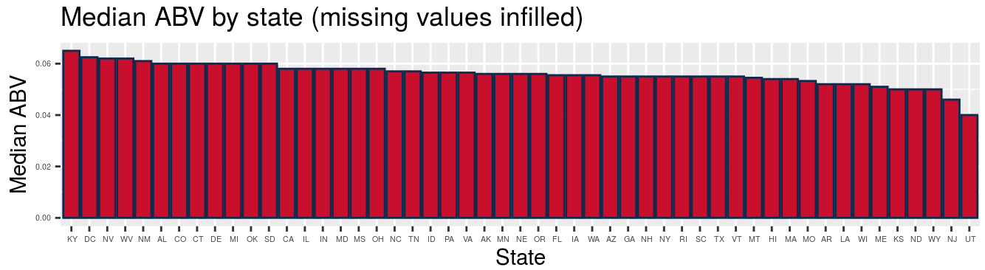
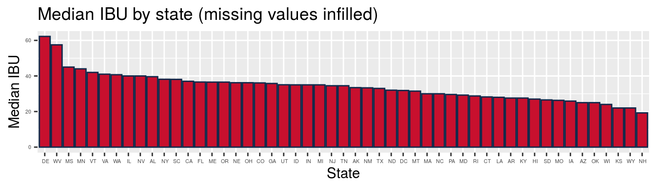

Slide 6
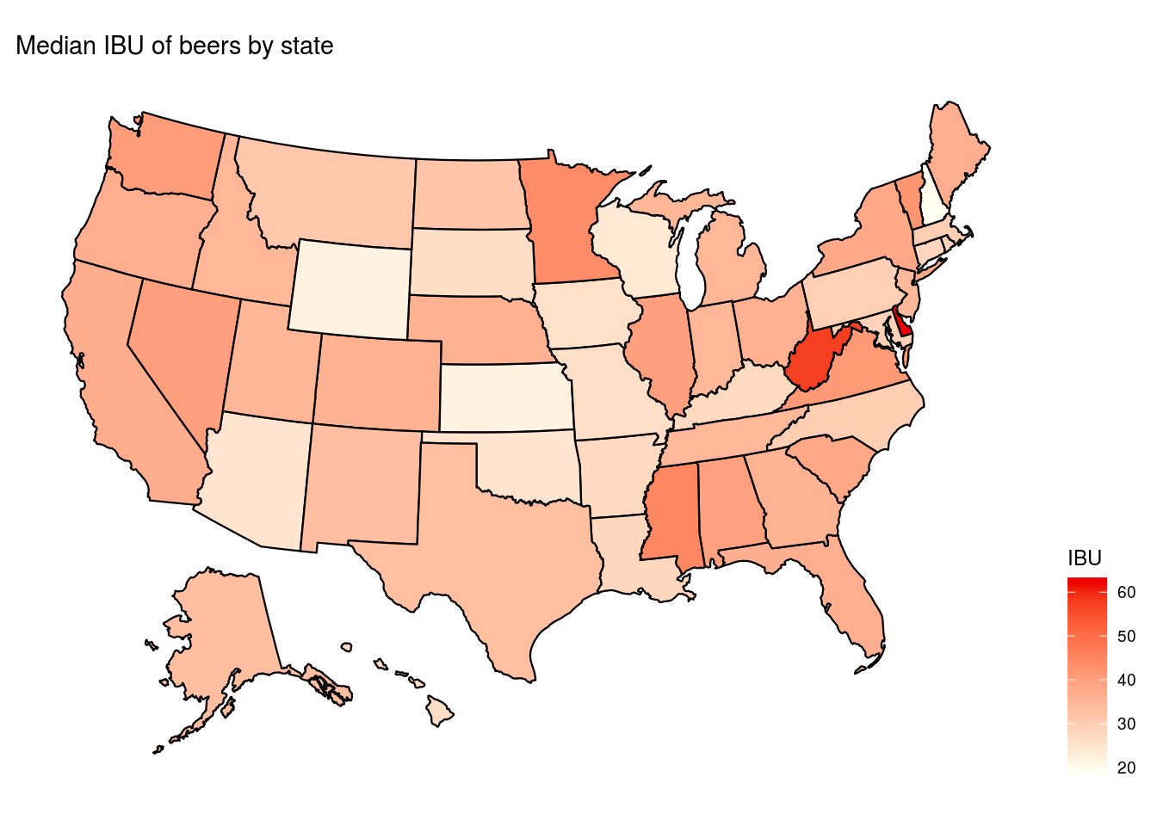

Slide 7
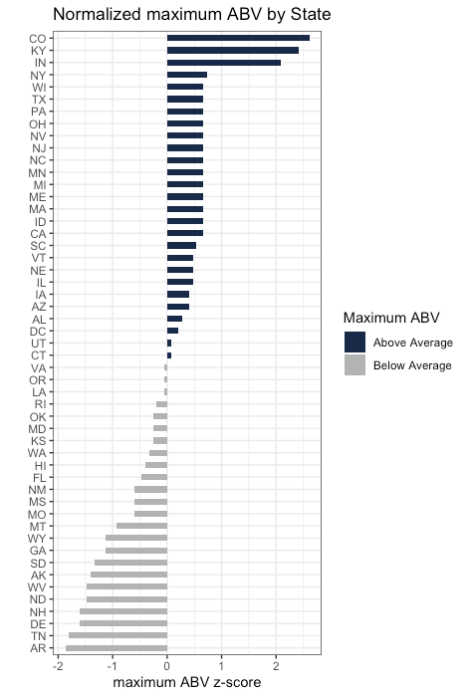
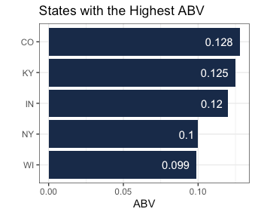
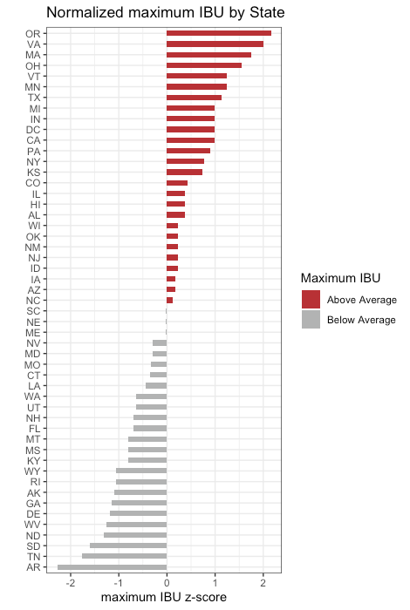
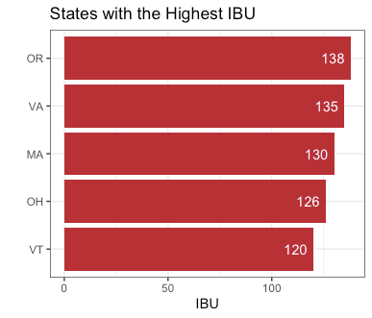
QUESTION 5 - Max ABV and IBU by state

Slide 8
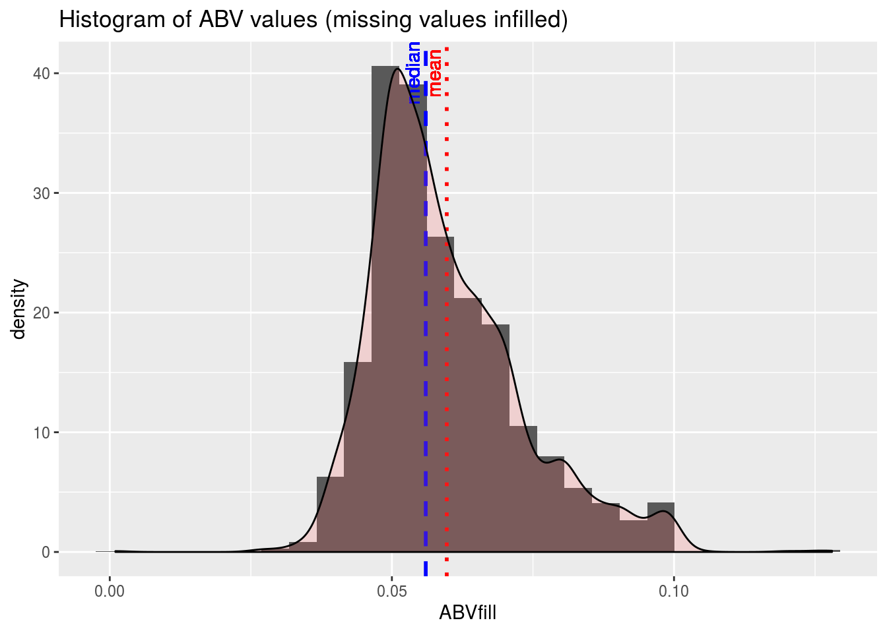
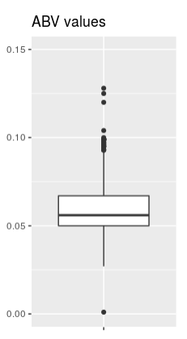
QUESTION 6 - Examine distribution of ABV values.
ABV values have a slightly right skewed distribution, indicating a small number of high-value outliers.
Otherwise, the values are closely grouped around the mean and median.

Slide 9
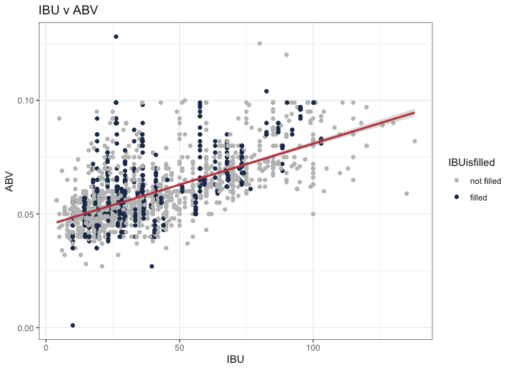
QUESTION 7 - SCATTERPLOT OF IBU VS. ABV
There is a moderate, positive relationship between IBU and ABV.
R² (w/ filled data) = 0.42
R² (w/o filled data) = 0.45

Slide 10
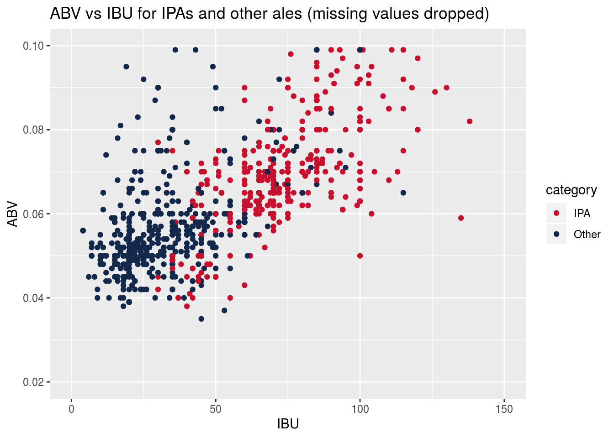
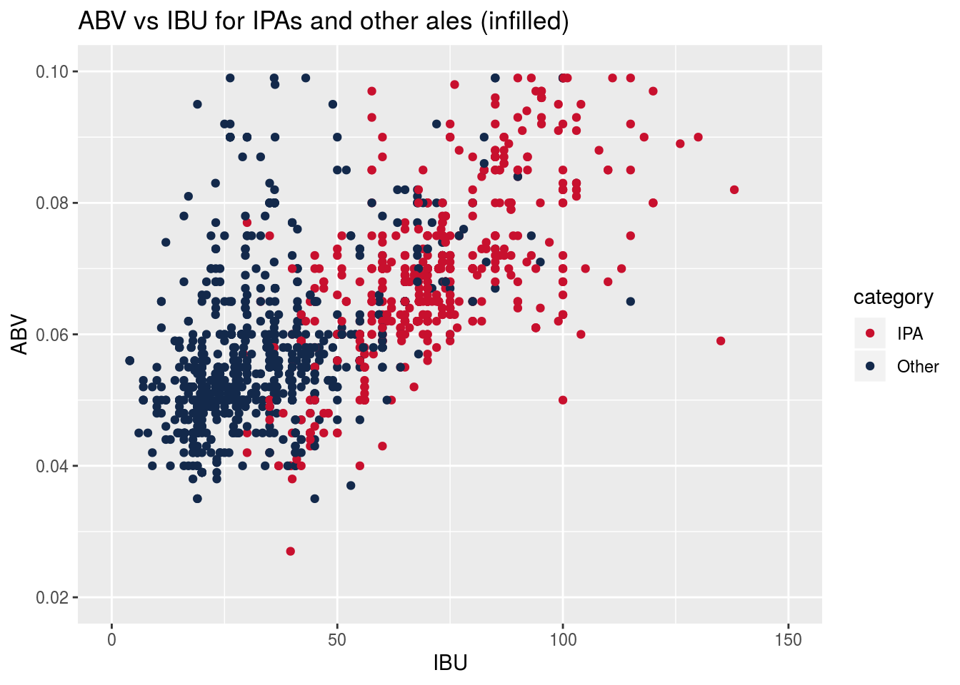
Question 8 - Investigate difference in ABV and IBU between IPAs and other ales.
Infilling missing values for ABV and IBU does not change the character of their relationship, so subsequent analysis will use infilled datasets

Slide 11
Question 8 - Discussion
Out of a total of 2410 beers, 571 are IPA and 963 are other ales.
64 % of beers are ales.
24 % of beers are IPA.
37 % of ales are IPA.
From the previous scatter plots, it appears that the character of the relationship between ABV and IBU, for both IPA’s and other ales, is unaffected by the infilling. This gives us confidence that the infilling was valid, so further analysis will use only the infilled values.
We know that 37 % of ales are IPA, so a fixed guess that any given Ale is not IPA is the simplest model. We expect this predictor will have an accuracy of 63 %. It would have a sensitivity of 100 % but specificity of 0 %.
Make a constant classifier and check its performance.
The accuracy turns out to be 63 %.
The sensitivity is 0 %.
The specificity is 100 %.
A slightly more sophisticated model would be to randomly guess that a beer is an ale 63 % of the time. We simulate this to see how such a ‘guessing’ model would perform.
Make a random guess classifier. Try it 100 times and find its average performance.
The random guess model has accuracy of 53 %.
Its sensitivity is 37 %.
Its specificity is 63 %.

Slide 12
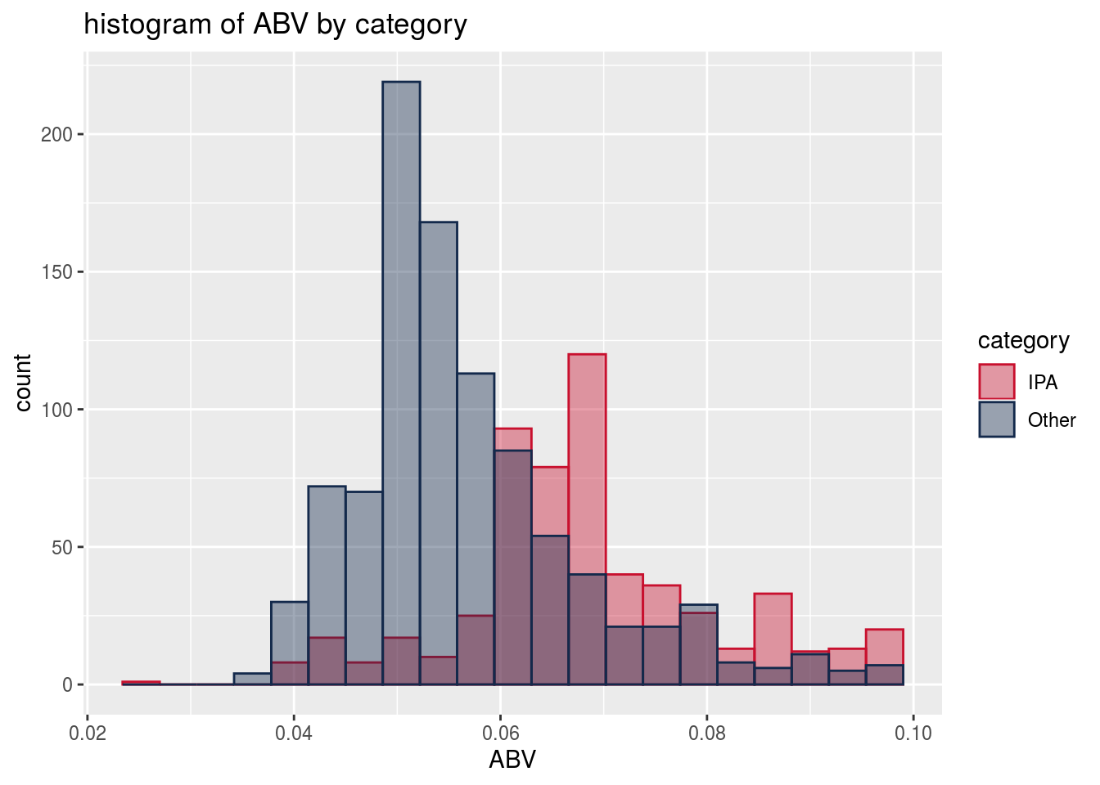
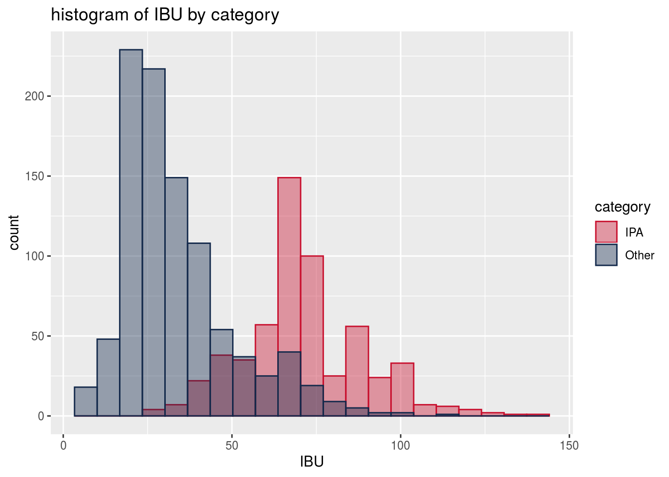
To see if ABV and IBU values can help us predict if an ale is IPA, look at distributions of these quantities, separated by IPA and other ales.
There is a statistically significant difference in both ABV and IBU between IPA’s and other ales
 | ABV (%) | IBU (Intl Bitterness Units)
IPA | 5.67 | 71.2
Other Ales | 6.88 | 33.9
95% Conf Interval for diff | [1.08 .. 1.33] | [35.4 .. 39.1]

Slide 13
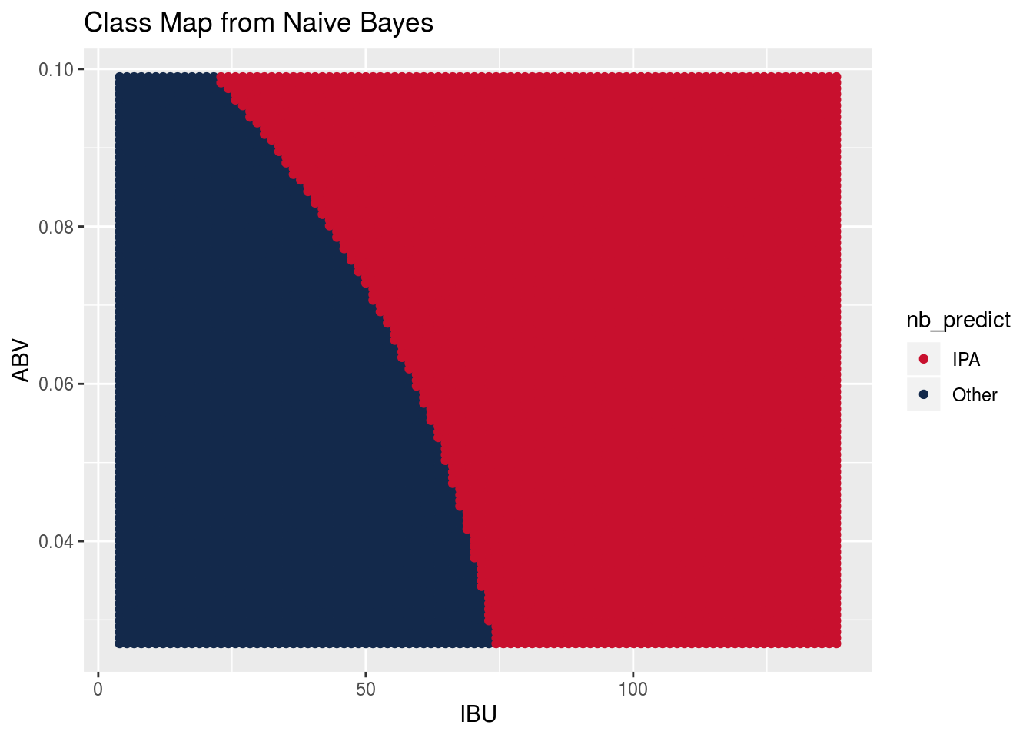
Since there are statistically signficant differences with ABV and IBU, we first try a Naive Bayes classifier.
Averaging over 100 trials, the Naive Bayes classifier has
accuracy of 86 %
sensitivity of 81 %
specificity of 89 %
To understand the classification regions of the Naieve Bayes classifier, we make a prediction at every point in the ABV vs IBU space.
The Naive Bayes classifier draws a clear boundary betweeen two regions. Ales with high ABV and IBU are predicted to be IPA.
However, this does not well capture the relationship that is apparent in the scatter plot of ABV vs IBU for IPA’s and other ales. To better use this information, we use a KNN classifier, labeling an ale as IPA or not according to the majority of its nearest neighbors. To tune the KNN model, we try several different neighborhood sizes (k).

Slide 14
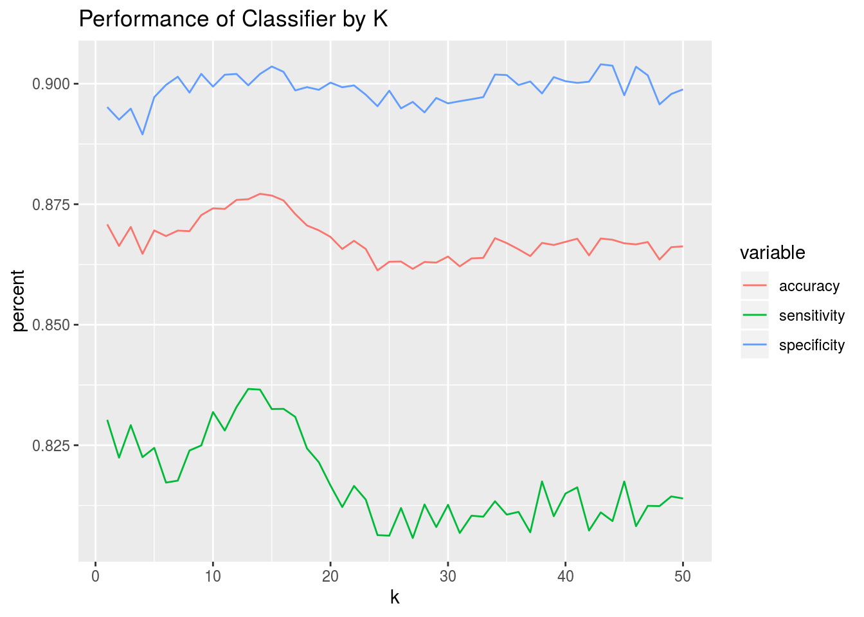
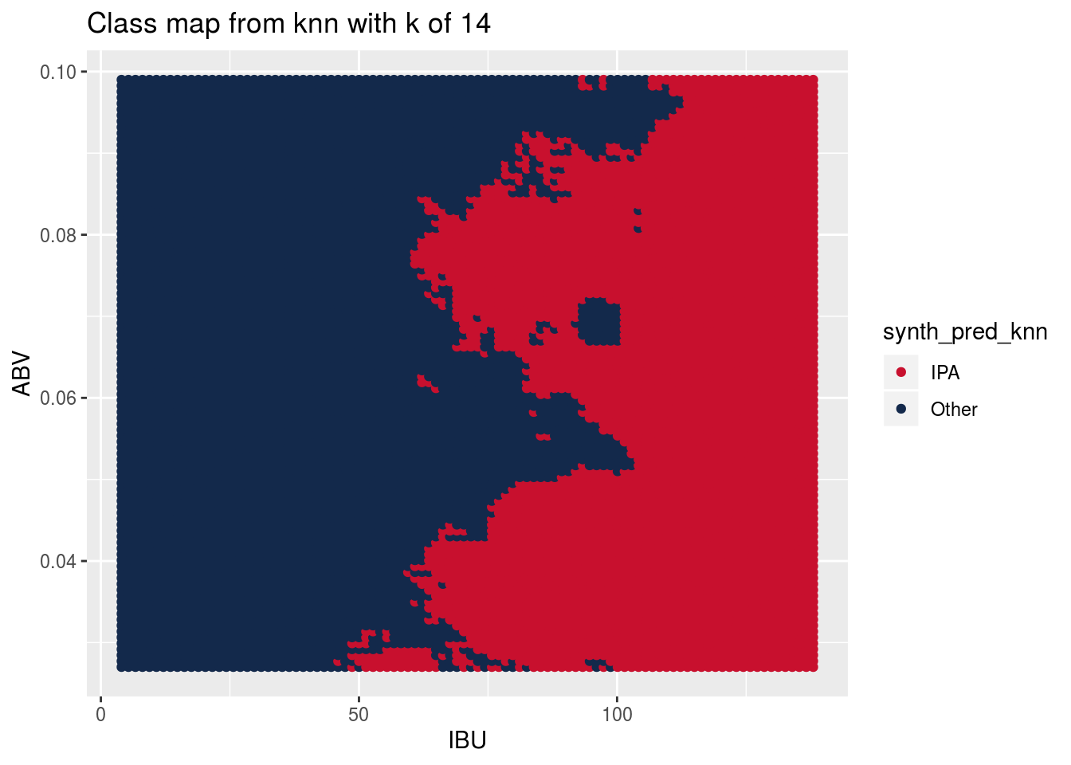
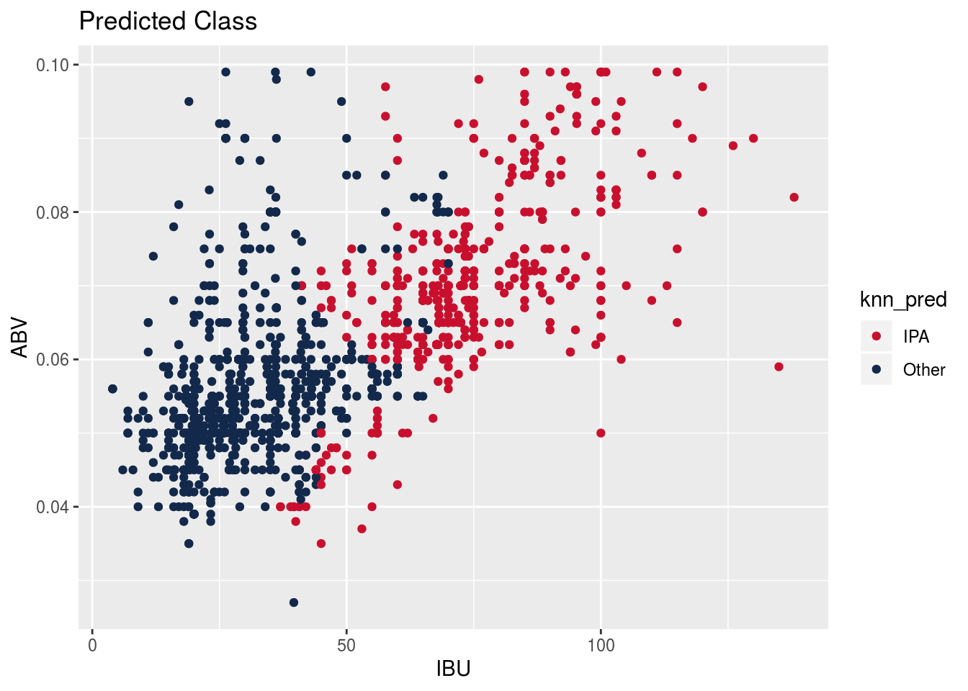
Do KNN classification. Make 100 iterations of the model, splitting the data into training and test datasets each time and averaging the performance statistics of the model. Do this for a number of different k values.
Look at all 50 values of k to determine what k value gives best performance.
k of 14 is best for accuracy.
k of 13 is best for sensitivity. k of 43 is best for specificity.
we choose 14 as best overall, since it gives the highest sum of accuracy, sensitivity, and specificity.
As with the Naive Bayes classifier, to understand the classification regions of the KNN classifier, we make a prediction at every point in the ABV vs IBU space.

Slide 15
Directions for Additional Work
Ideas for question 9: a) Group states into geographic regions and repeat analysis for mean/max ABV and IBU by region, b) do some feature engineering (IBU:ABV ratio) or external data (census data, etc.), c) deep dive into one state...maybe one with lots of breweries...and provide some state-level insights. I’m currently most inclined toward option “b”.

