Slide 1
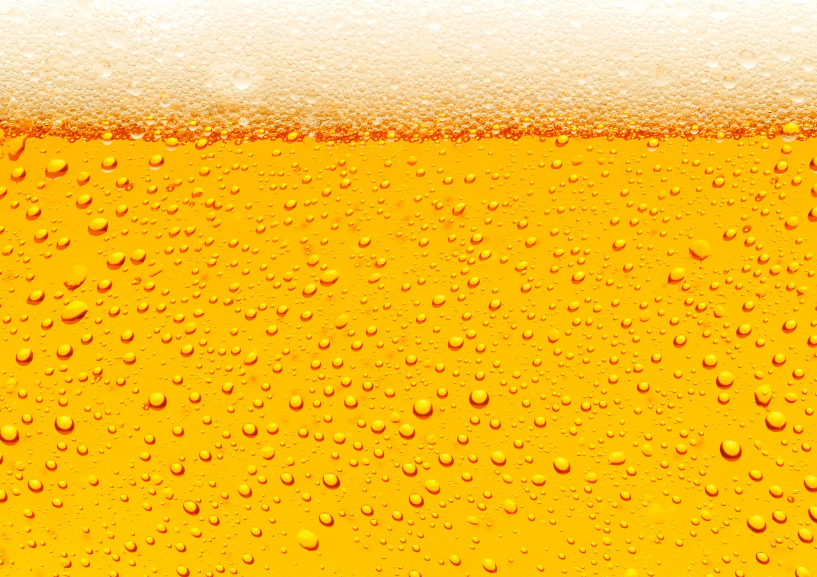
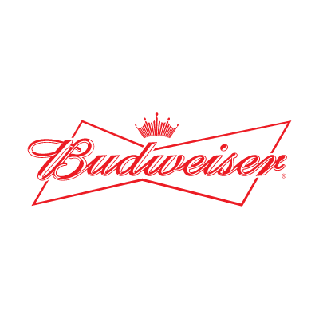
Craft Beers in the U.S.
Prepared for: Budweiser
26 October 2019
Steven Garrity and Richard Palmer

Slide 2
INTRODUCTION
DATA SUMMARY
We were provided with two datasets and added a third:
Beers and their characteristics
Breweries and their locations
State census data
We performed exploratory data analysis on a merged dataset to provide a broad overview of the craft beer market in the United States.
We identified markets that appear to be underserved and make recommendations on the type of beer styles that Budweiser should consider offering to these markets if they desire to capitalize on the secular growth of the domestic craft beer industry.
Variable:
Characteristics
Beer ID: | 2410 unique ids
Beer Name: | 2305 unique names
Beer Style: | 100 unique styles
ABV: | Range: 0.001 - 0.128
IBU: | Range: 4 - 138
Serving Size: | Range: 8.4 - 32 oz.
Brewery Name: | 551 unique breweries
Brewery City: | 384 cities
Brewery State: | 50 states + DC
Beers
Breweries

Slide 3
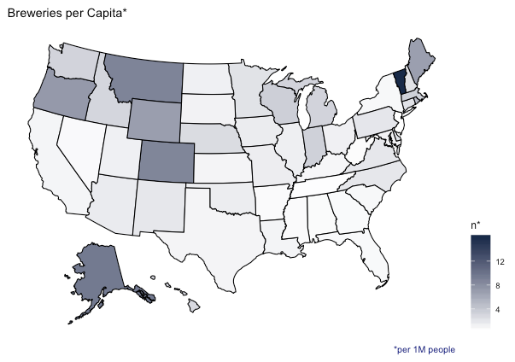
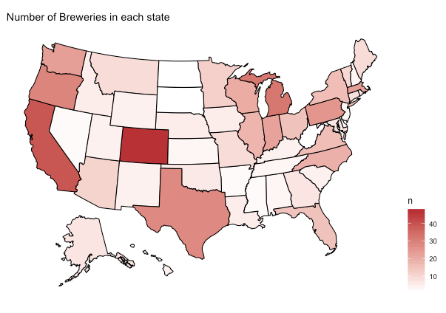
NUMBER OF BREWERIES IN EACH STATE

Slide 4
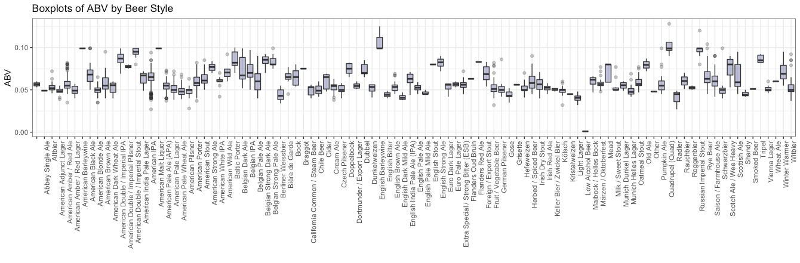
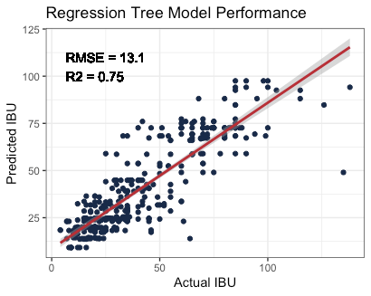
MISSING VALUES
ABV had 62 missing values (2.6% of observations) and IBU had 1005 missing values (42% of observations).
We filled missing ABV values with the median ABV from beers of the same style.
To fill missing values in IBU, we fit a regression tree (ABV and Beer Style as inputs) to observations without missing values and then used that model to predict each missing IBU value.

Slide 5
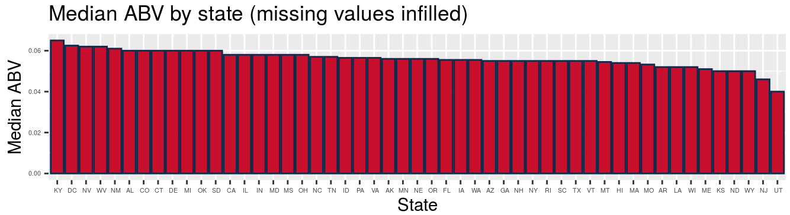
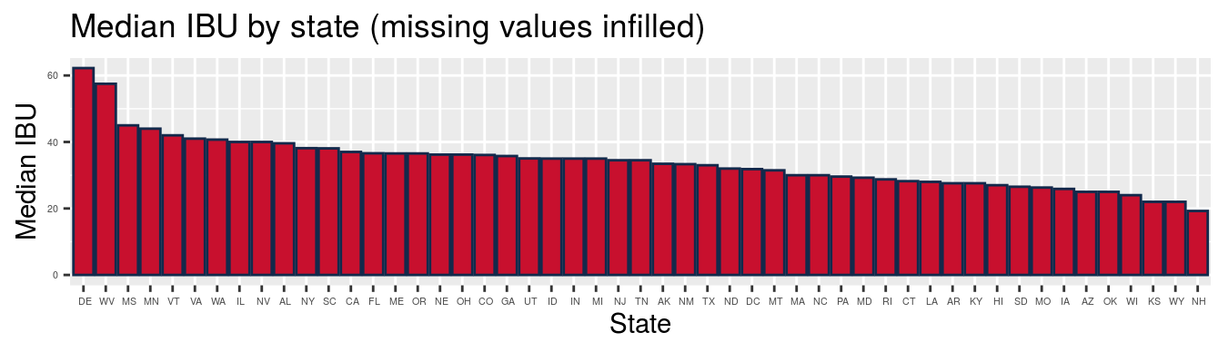

Slide 6
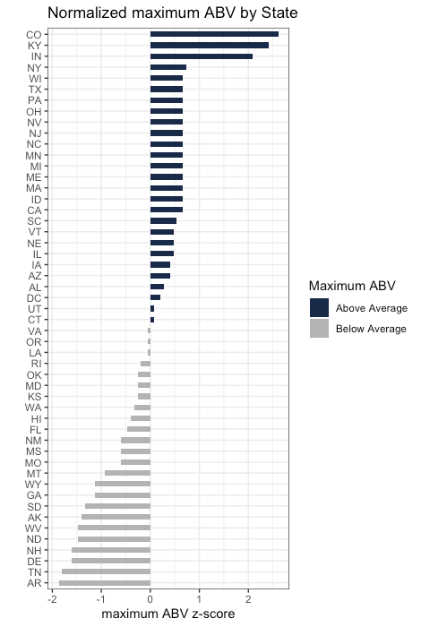
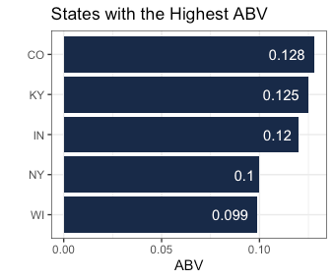
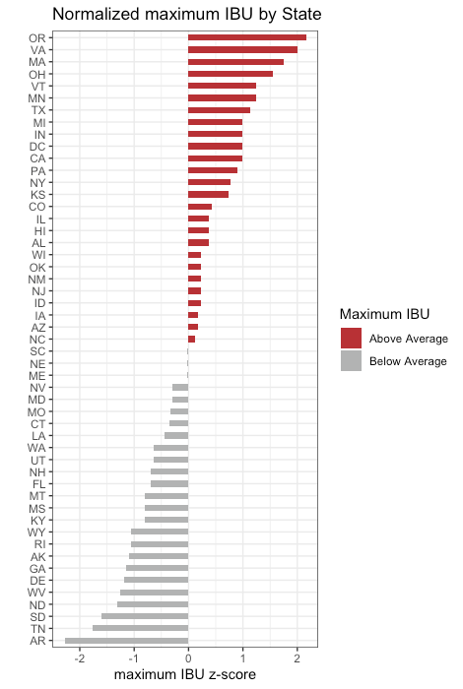
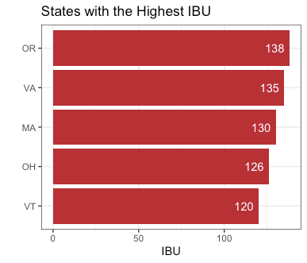
STATES WITH HIGHEST ABV AND IBU

Slide 7
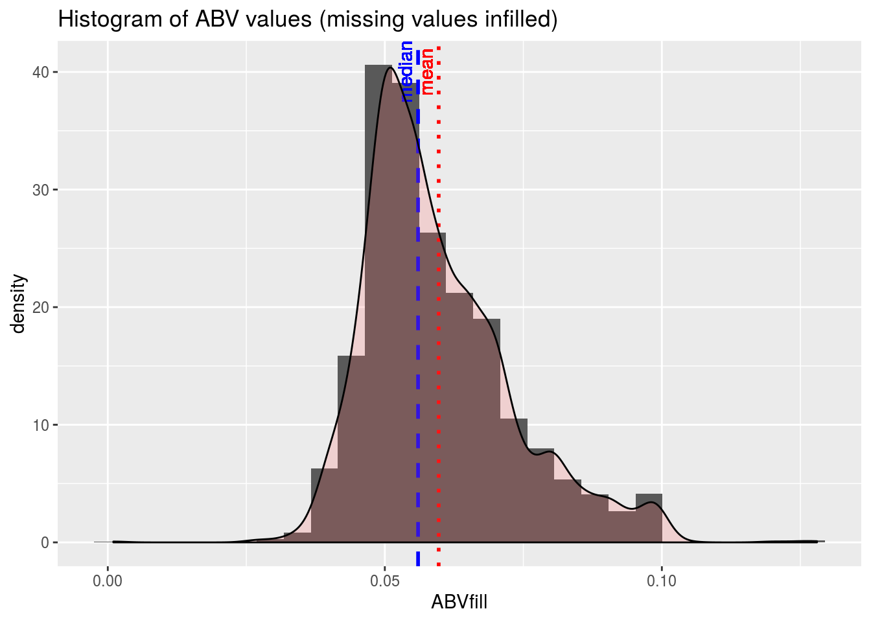
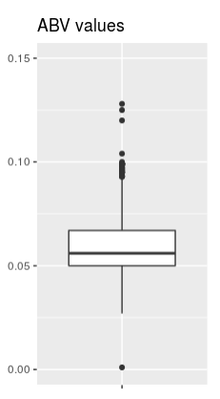
Examine distribution of ABV values.
Mean ABV = 0.06
Median ABV = 0.056
Craft beer ABV values are slightly right skewed

Slide 8
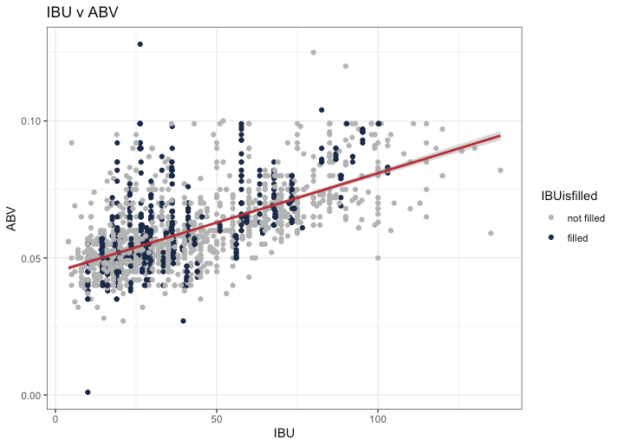
RELATIONSHIP BETWEEN IBU AND ABV
R² (w/ filled data) = 0.42
R² (w/o filled data) = 0.45
There is a moderate, positive relationship between IBU and ABV.

Slide 9
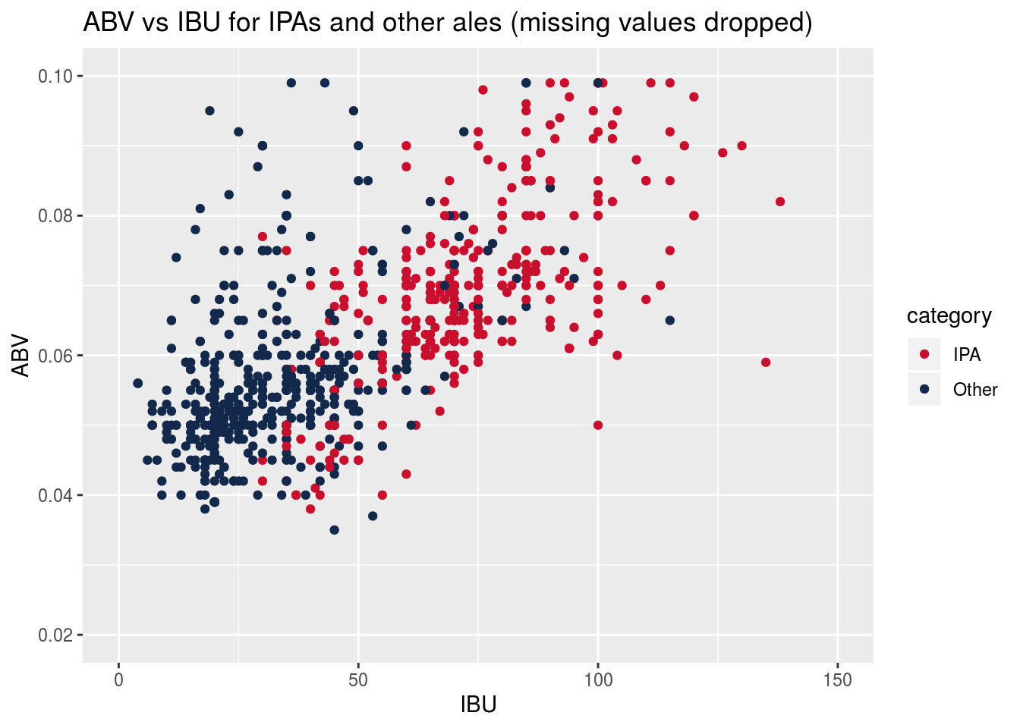
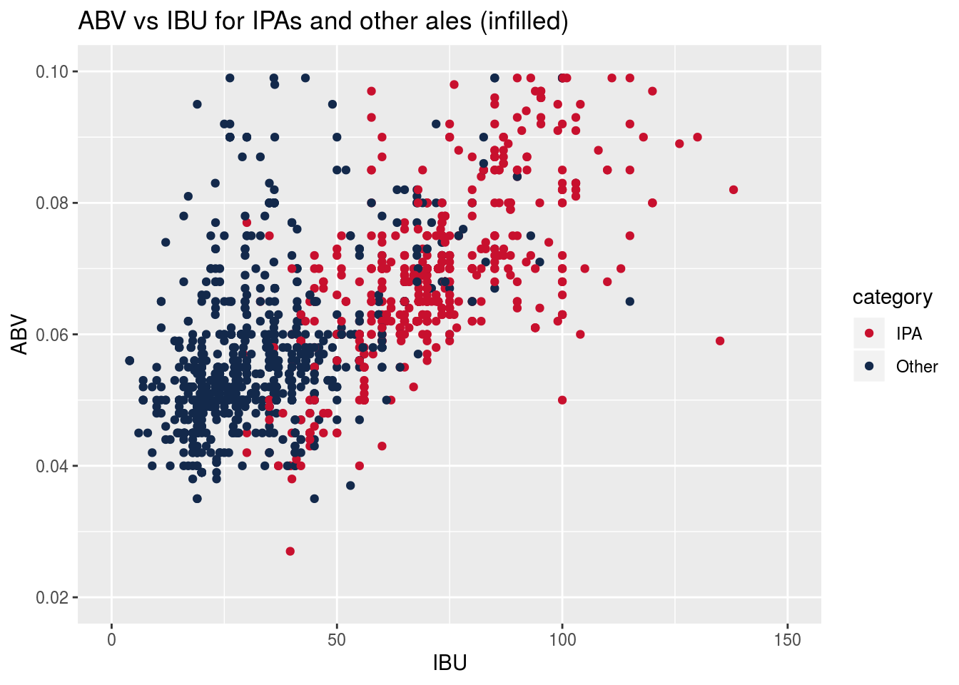
ABV AND IBU FOR IPAs AND OTHER ALES
Infilling missing values for ABV and IBU does not change the character of their relationship, so subsequent analyses will use infilled datasets

Slide 10
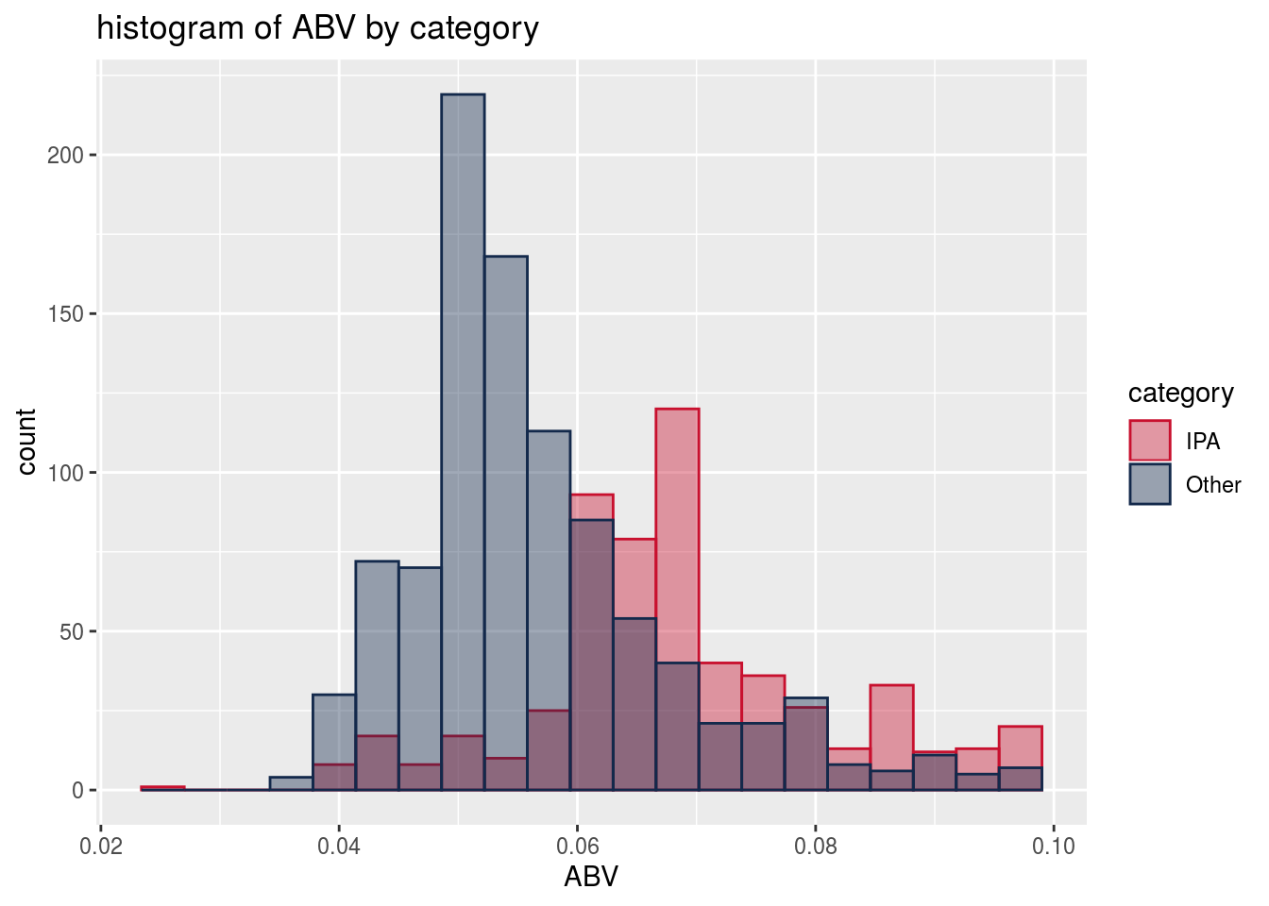
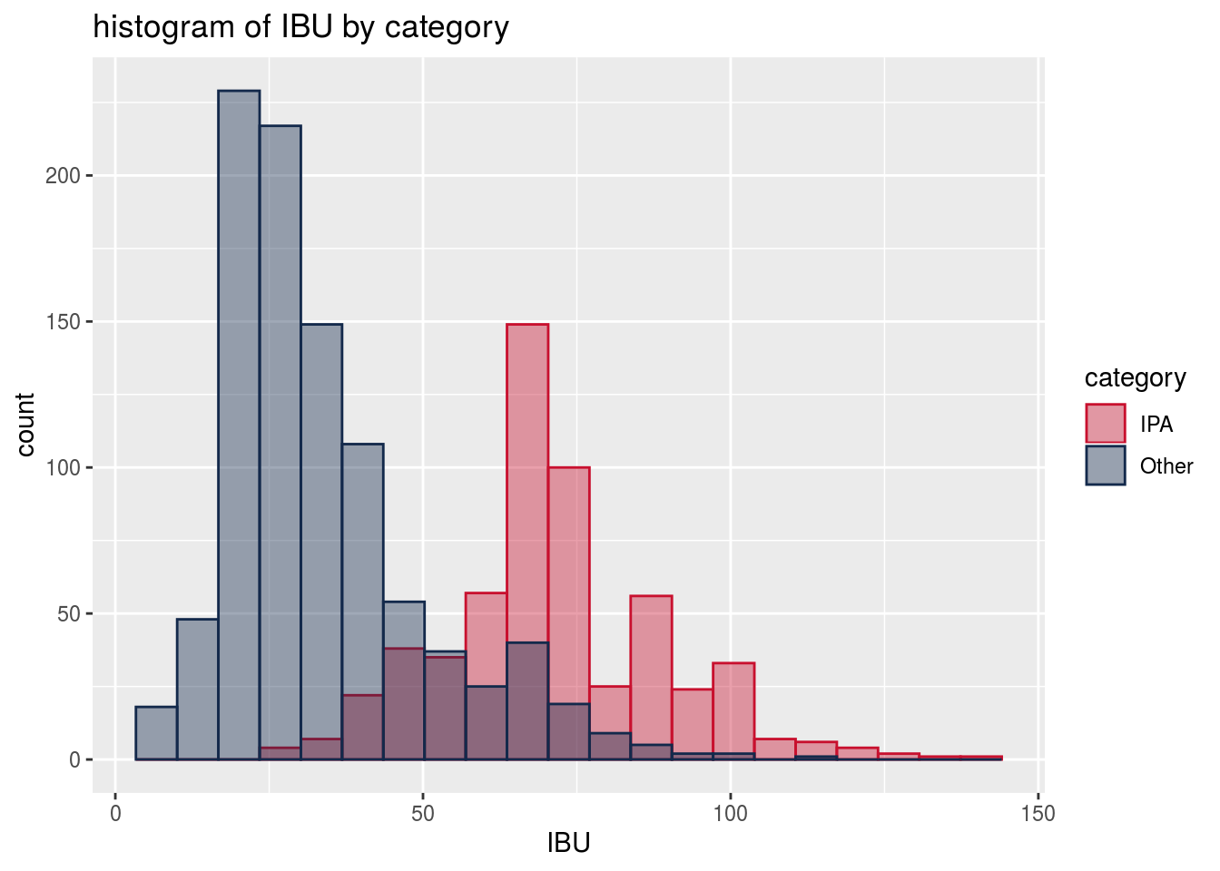
ABV AND IBU DATA DISTRIBUTIONS BETWEEN IPAs AND OTHER ALES
Welch’s two-sample t-test shows statistically significant differences in both ABV and IBU between IPA’s and other ales
 | ABV (%) | IBU (Intl Bitterness Units)
IPA | 5.67 | 71.2
Other Ales | 6.88 | 33.9
P-value for Hypothesis Test | < 2.2e-16 | < 2.2e-16
95% Conf Interval for difference | [1.08 .. 1.33] | [35.4 .. 39.1]

Slide 11
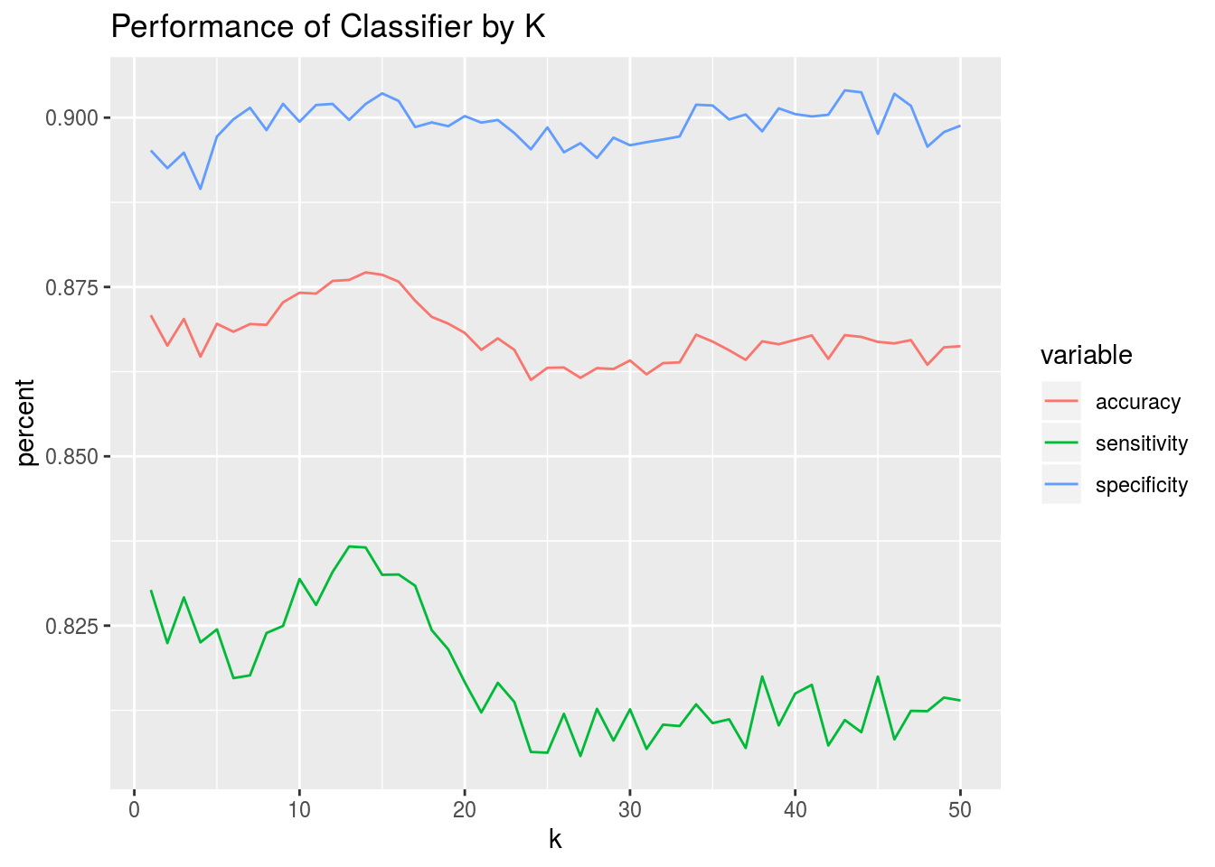
K-NN MODEL CONSTRUCTION
We choose k = 14 as best overall, since it provided the best balance among overall accuracy, sensitivity, and specificity.

Slide 12
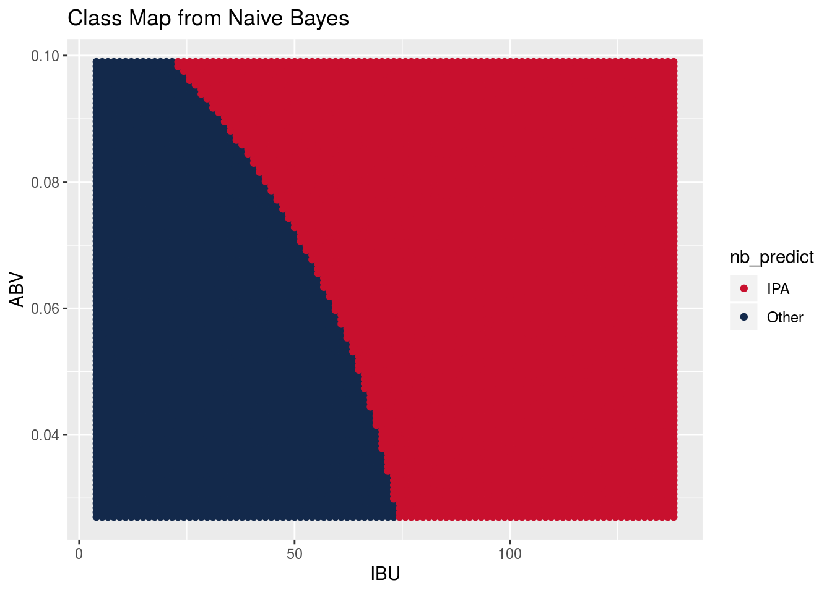
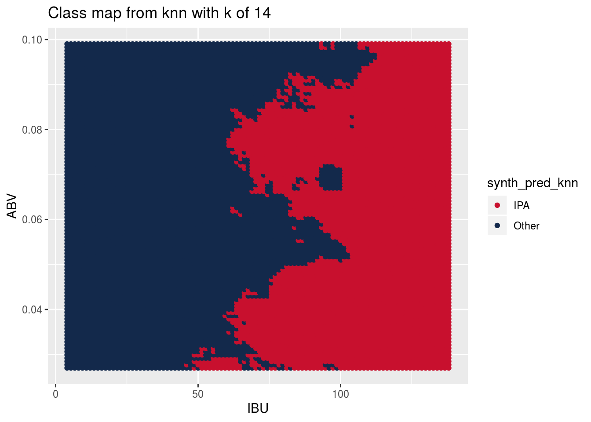
COMPARING K-NN WITH OTHER CLASSIFICATION MODELS
Truth
 | Constant ‘Other’ | Random | Naive Bayes | KNN
Sensitivity: | 100% | 63% | 89% | 92%
Specificity: | 0% | 37% | 81% | 85%
Overall Accuracy: | 63% | 53% | 86% | 89%
model sophistication
low
high

Slide 13
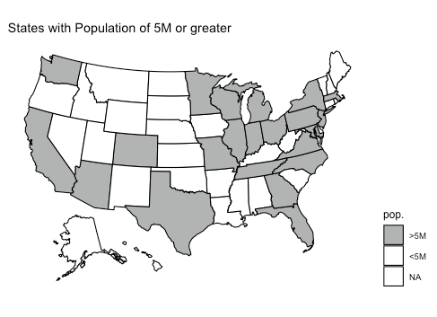
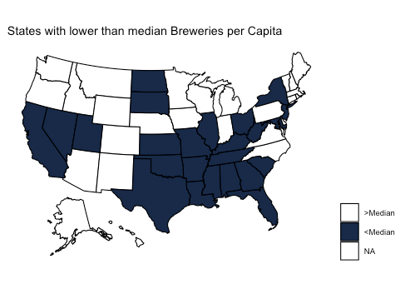
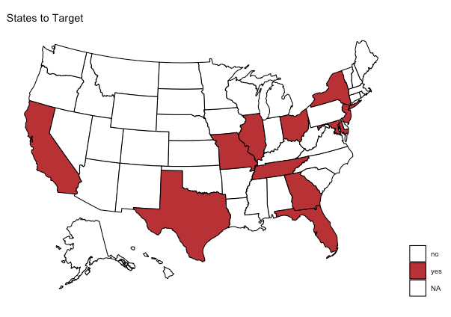
WHERE TO TARGET INVESTMENT
States to target are those that have population > 5M and a lower than median number of breweries per capita.

Slide 14
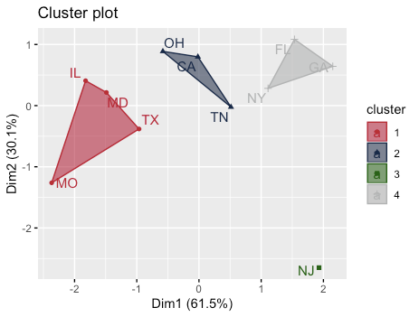
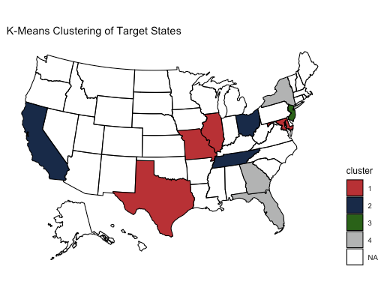
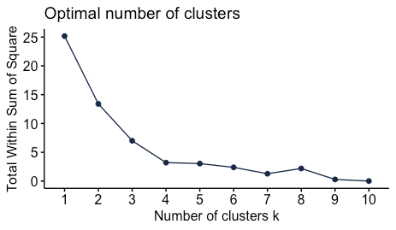
K-means diagnostics:
Median IBU
Median ABV
IBU:ABV ratio
Breweries per capita

Slide 15
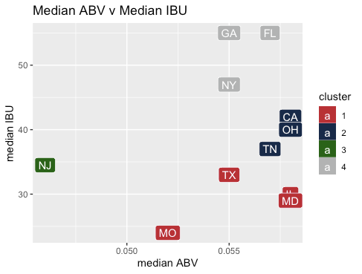
CLASSIFICATION OF TARGET STATES
Cluster 1: States with high ABV, low IBU beers
Cluster 2: States with high ABV, moderate IBU beers
Cluster 3: NJ has low ABV, moderate IBU beers
Cluster 4: States with high ABV, high IBU beers

Slide 16
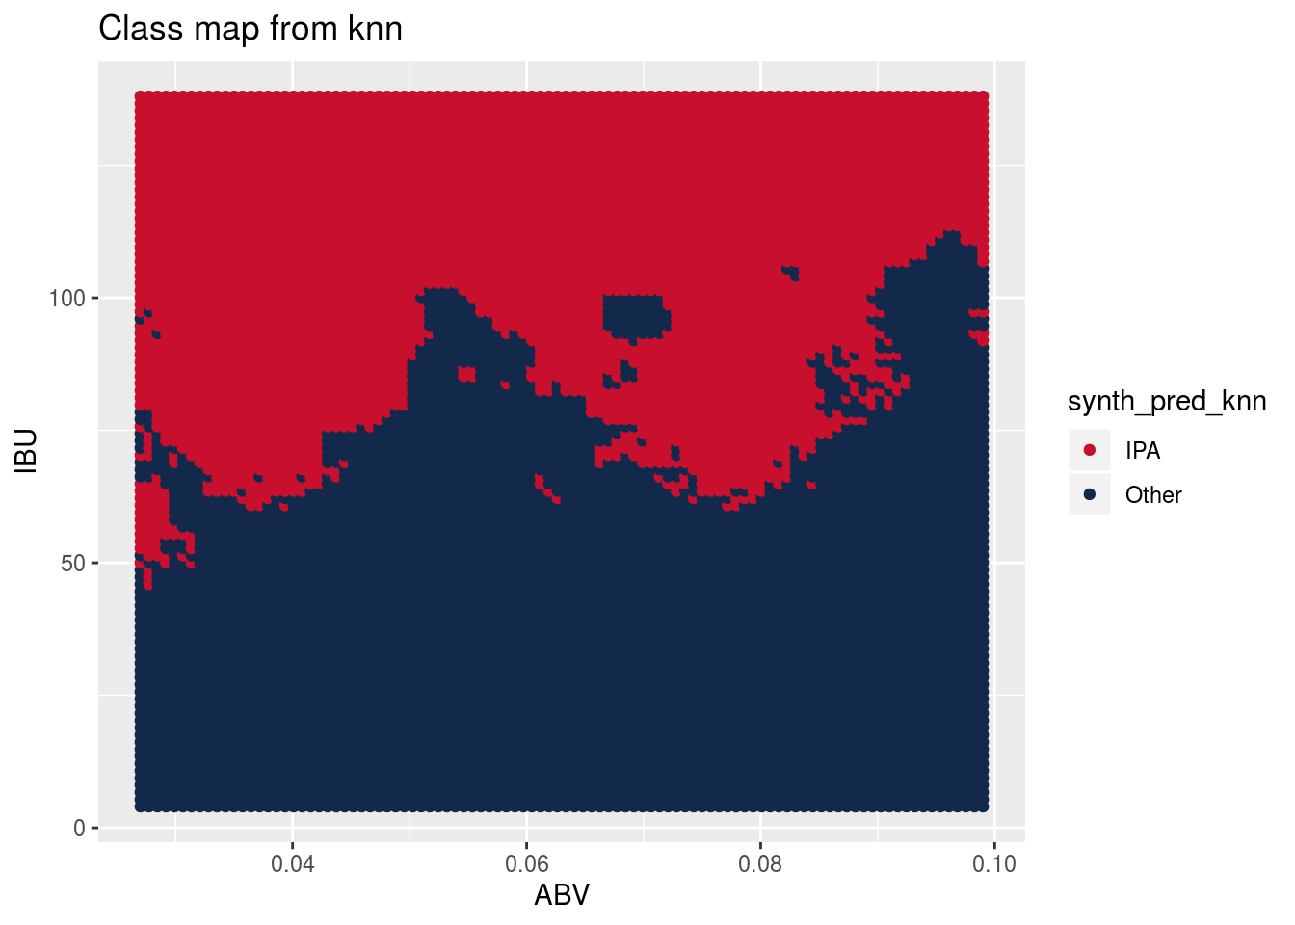
WHAT TYPE OF BEER WOULD SELL IN EACH UNDERSERVED MARKET?
Target Market: | Suggested Beer Style
GA, FL, NY: | IPA
MO, TX, MD, IL, TN, OH, CA: | Higher Alcohol Ale
NJ: | Lower Alcohol Ale

Slide 17
CONCLUSIONS
Craft beers are available across the country; but are most popular in the Rocky Mountain states, particularly Colorado.
There are modest variations in alcoholic content (ABV) and bitterness (IBU) throughout the US. The variations correlate well with beer style.
We have identified 11 states with potentially underserved market and have grouped them with recommended styles based on current tastes.

