Slide 1
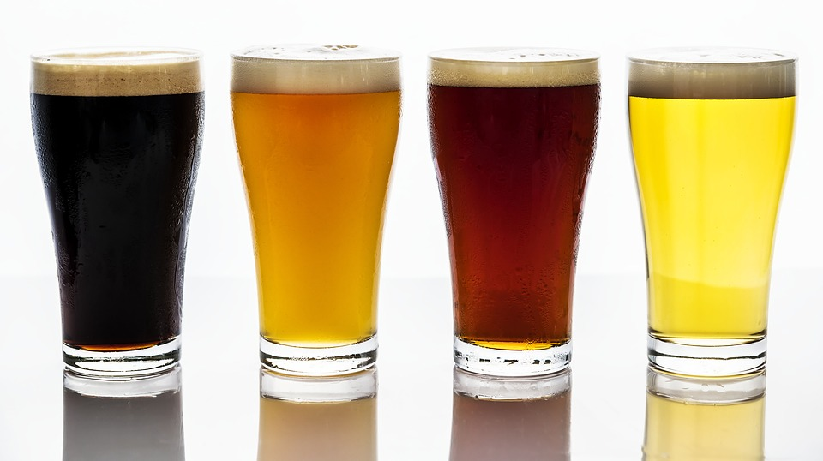
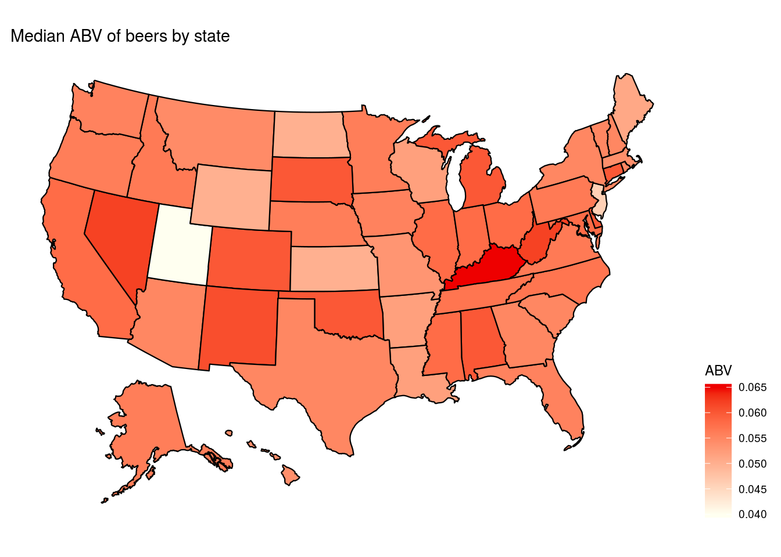
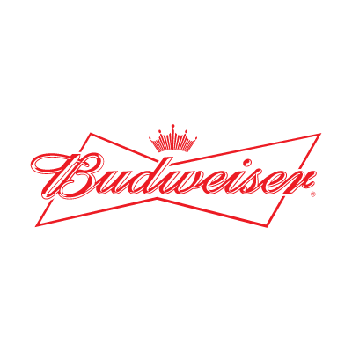
Beers in the United States
Preliminary Analysis prepared for
Budweiser CEO and CFO
17 October 19
Steven Garrity and Richard Palmer

Slide 2
Introduction
We were presented with data on 2410 beers produced by 558 breweries in the United States.
For each brewery, we have its name, and the city and state it is located in.
For each beer, we have its style as well as numeric values for ABV (alcohol by volume), IBU (international bitterness units), and the serving size in ounces.
In this dataset, there were 100 different styles of beer represented.
There were beers produced in every state of the nation, as well as in the District of Columbia.
Today we will present a summary of what we have found in the data so far, including
Count of breweries by state
Study of ABV and IBU by state
Distribution of ABV and its relationship to IBU
Examination of missing data and actions to address it

Slide 3
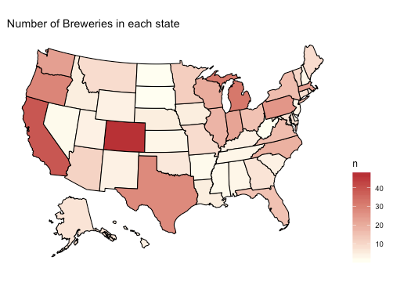
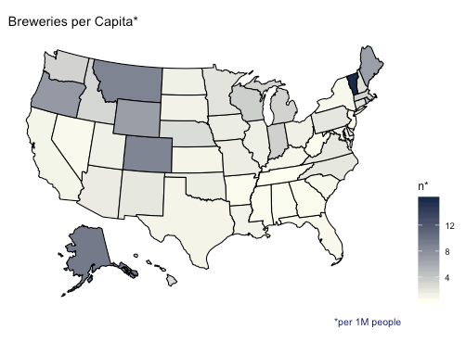
QUESTION 1 - BREWERIES BY STATE

Slide 4
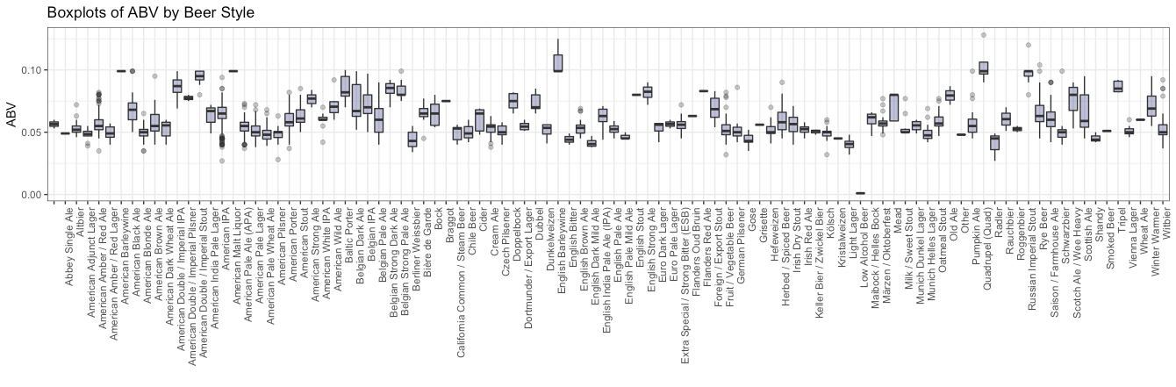
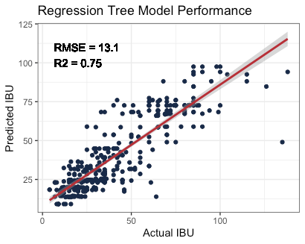
QUESTION 3 - ADDRESS THE MISSING VALUES
We found that ABV had 62 NAs and IBU had 1005 NAs. All of the ABV NAs also had NA IBU. We decided to fill ABV values with the median ABV from beers of the same type. To fill missing values in IBU, we fit a regression tree to observations without missing values and then used that model to predict each missing IBU value.

Slide 5
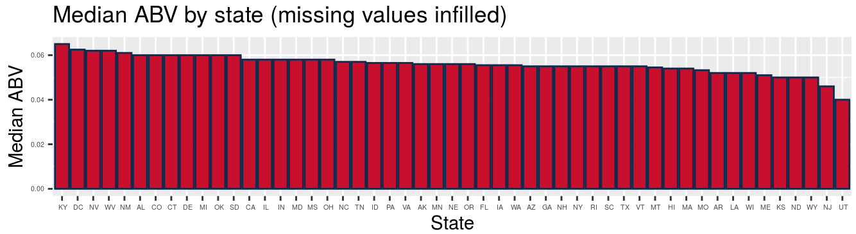
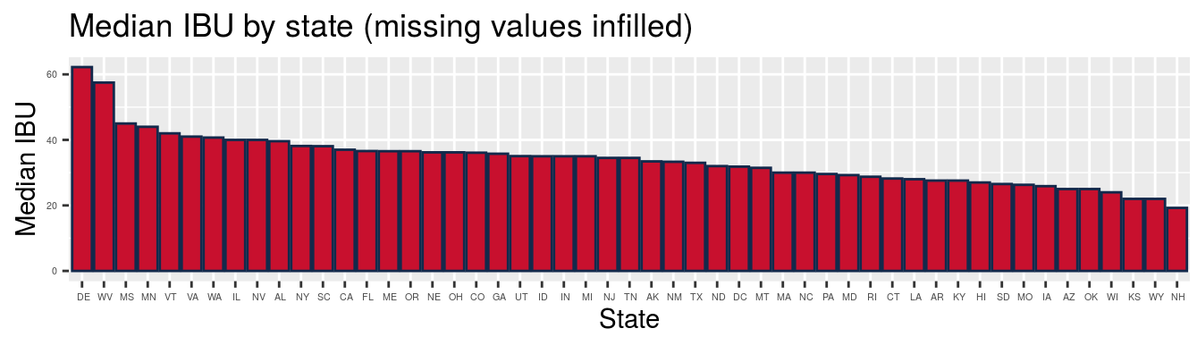

Slide 6
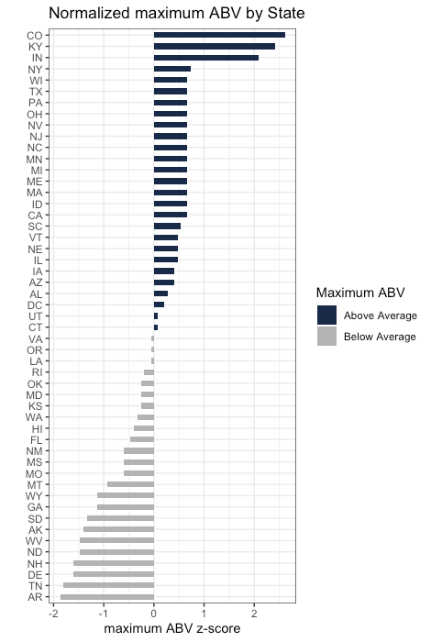
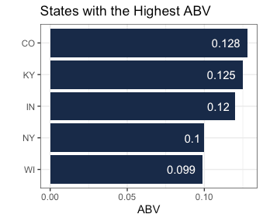
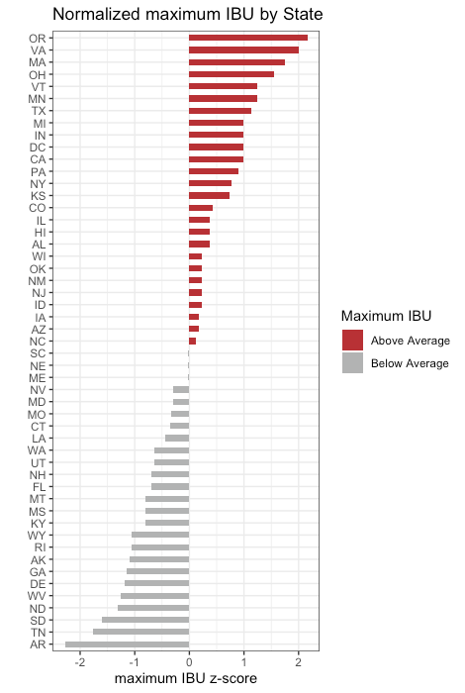
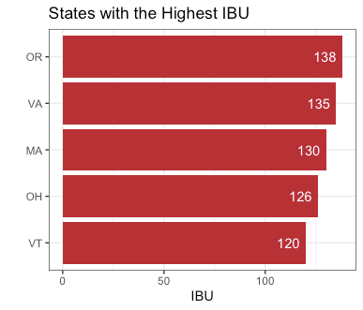
QUESTION 5 - Max ABV and IBU by state

Slide 7
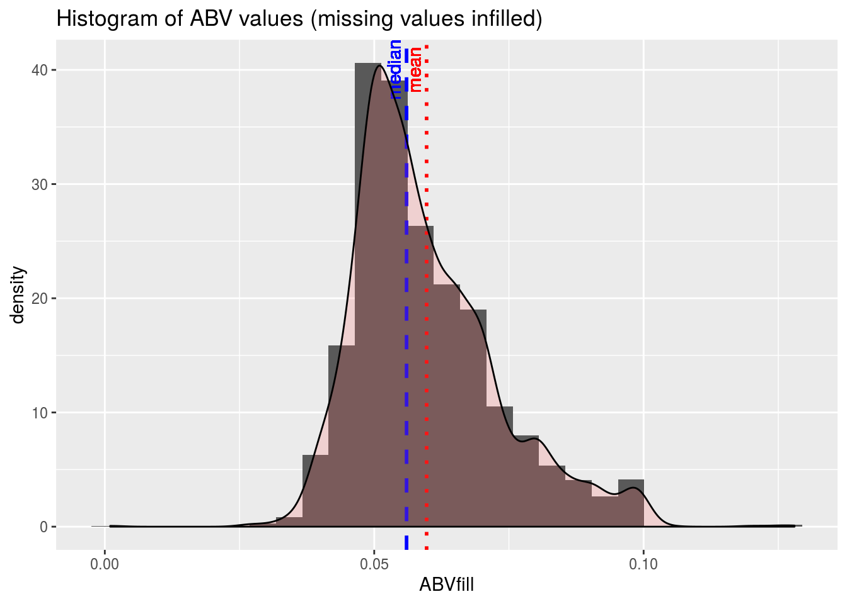
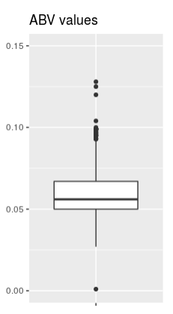
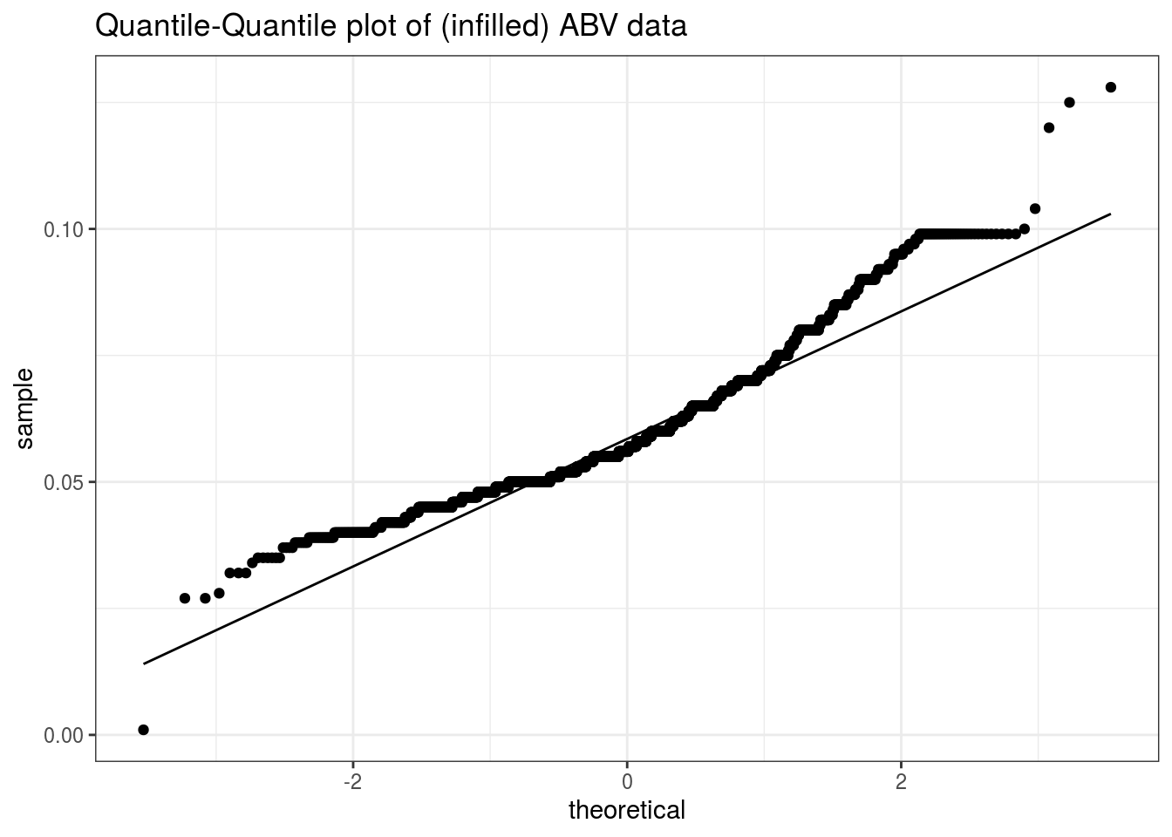
QUESTION 6 - Examine distribution of ABV values.
The mean is slightly higher than the median, which would indicate a right skewed distribution, one with a long tail of high values.
The histogram bears this out, as does a box plot.
To investigate whether the ABV values are normally distributed, we do a Q-Q plot. This is a plot of the quantiles of the actual data against what would be expected from a normal distribution. If the data do follow a normal distribution, the plot would show a straight line. The more the plot deviates from a straight line, the less closely the data follow a normal distribution.
From the upward curve in this plot, we infer that the data are somewhat skewed. This confirms what the histogram shows. The apparent discontinuities at the ends of the curve are an indication that the ABV values have a few more extreme values than would be expected from a normal distribution. This confirms what was shown in the box plot.

Slide 8
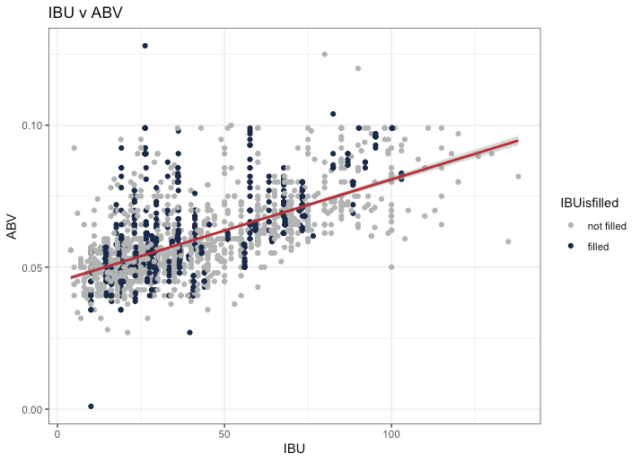
QUESTION 7 - SCATTERPLOT OF IBU VS. ABV
There is a moderate, positive relationship between IBU and ABV.
R² (w/ filled data) = 0.42
R² (w/o filled data) = 0.45

Slide 9
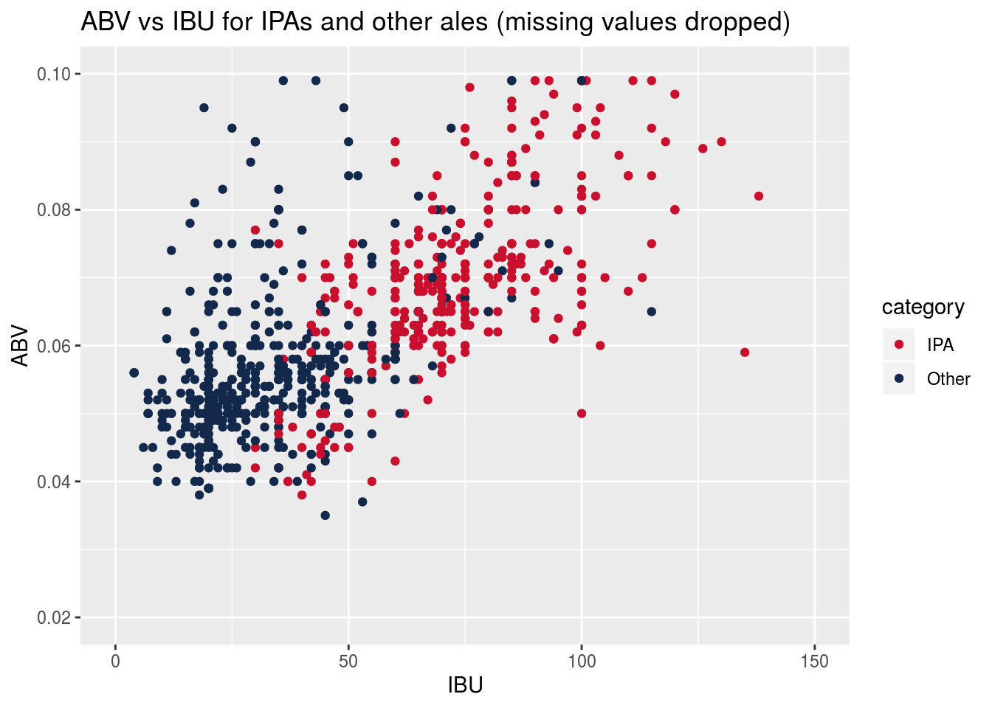
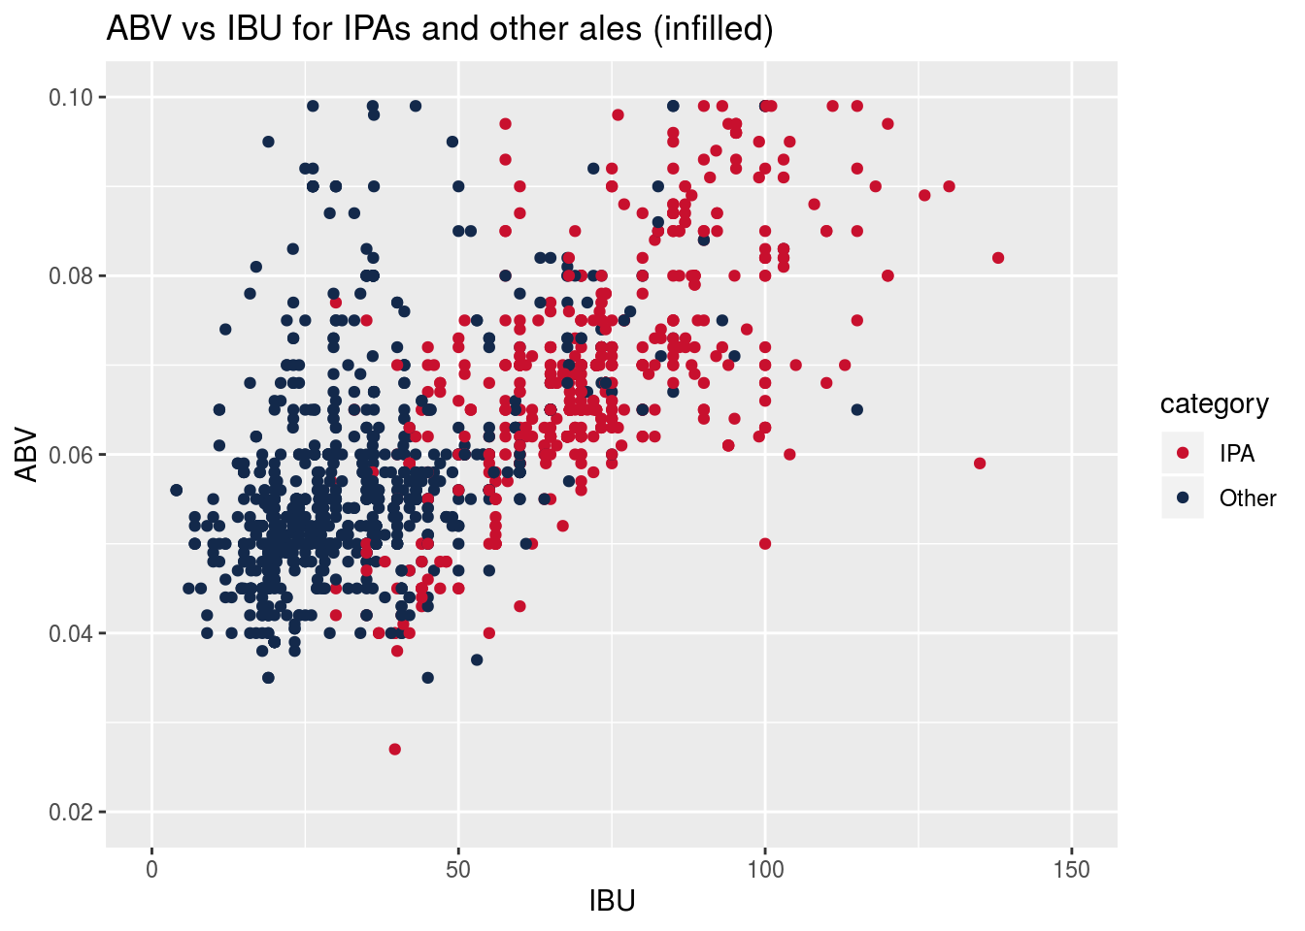
Question 8 - Investigate difference in ABV and IBU between IPAs and other ales.
Infilling missing values for ABV and IBU does not change the character of their relationship, so subsequent analyses will use infilled datasets

Slide 10
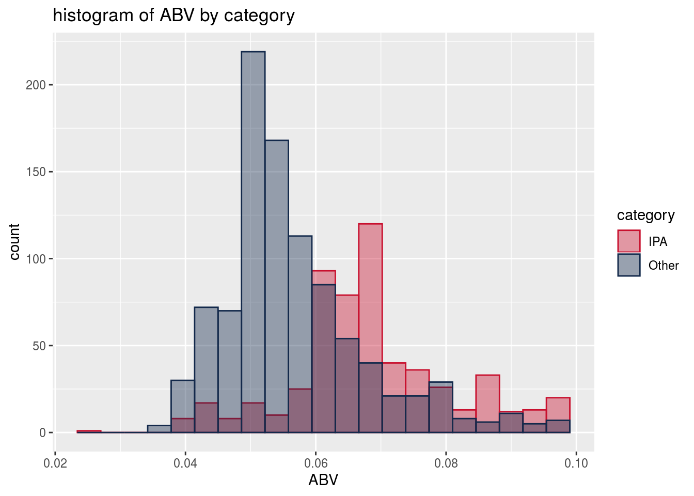
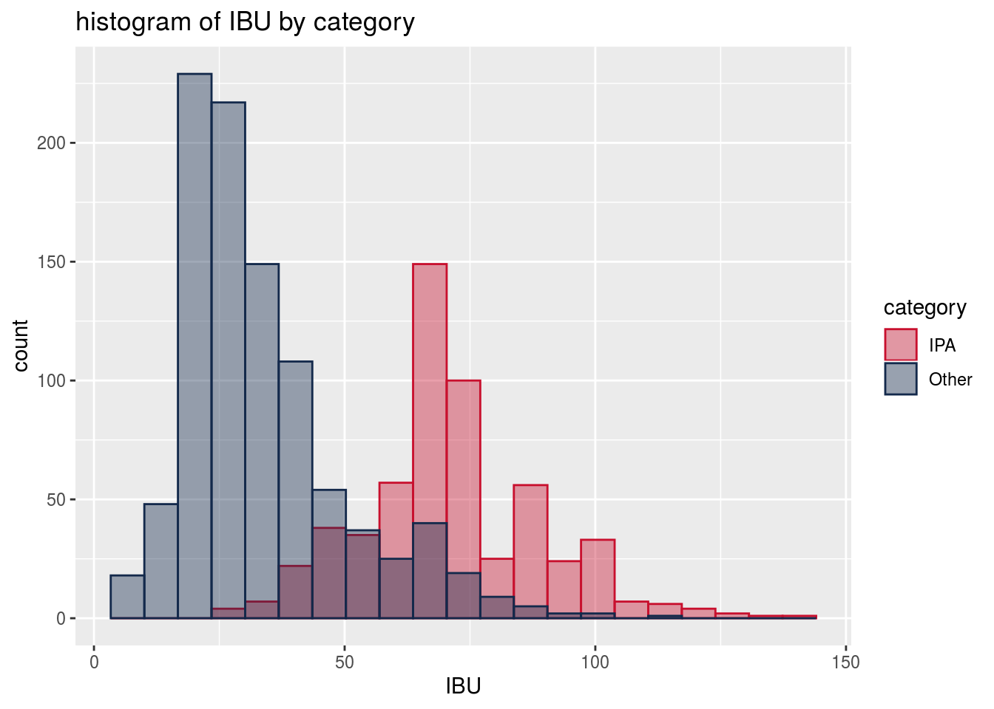
Look at distributions of ABV and IBU by category, for potential use in classifier.
Welch’s two-sample t-test shows statistically significant differences in both ABV and IBU between IPA’s and other ales
 | ABV (%) | IBU (Intl Bitterness Units)
IPA | 5.67 | 71.2
Other Ales | 6.88 | 33.9
95% Conf Interval for difference | [1.08 .. 1.33] | [35.4 .. 39.1]

Slide 11
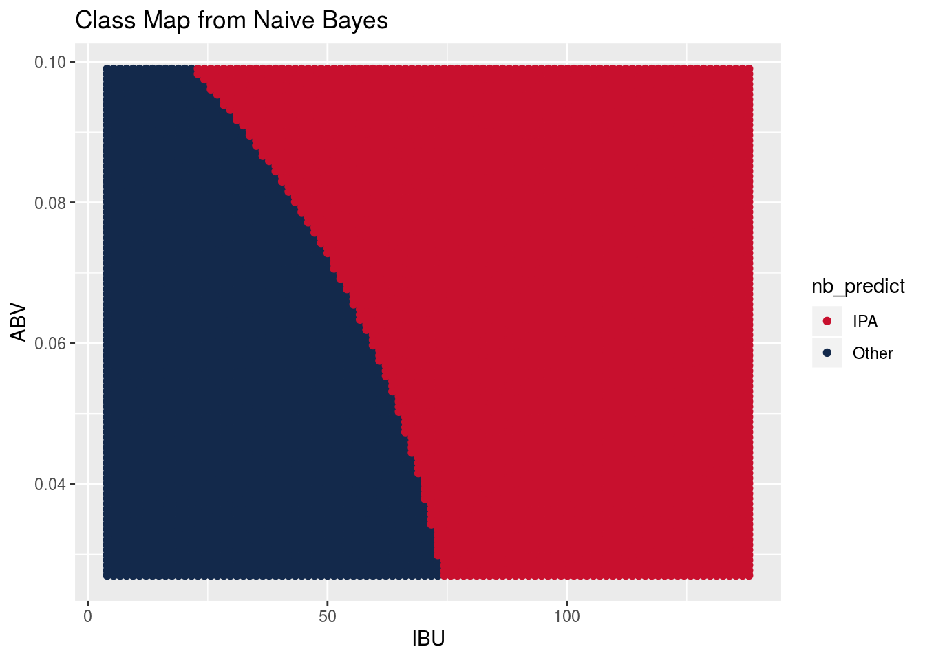
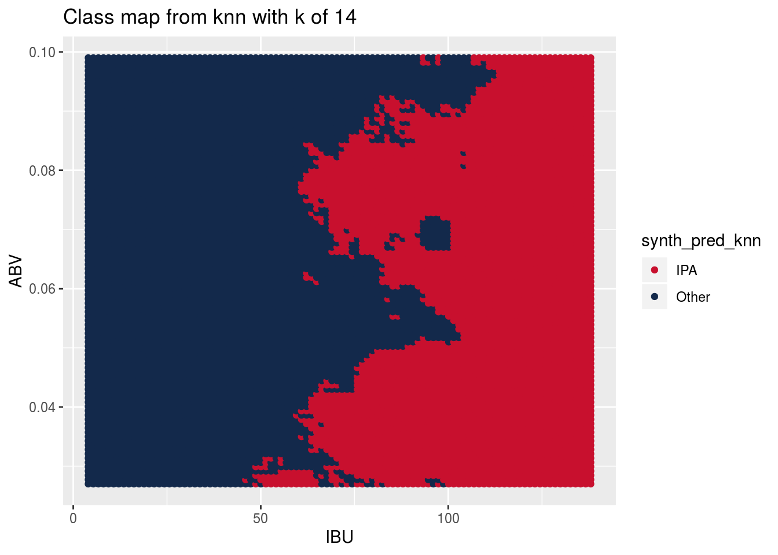
Naive Bayes vs KNN - which captures the relationship between IPA and Other ales?
Truth

Slide 12
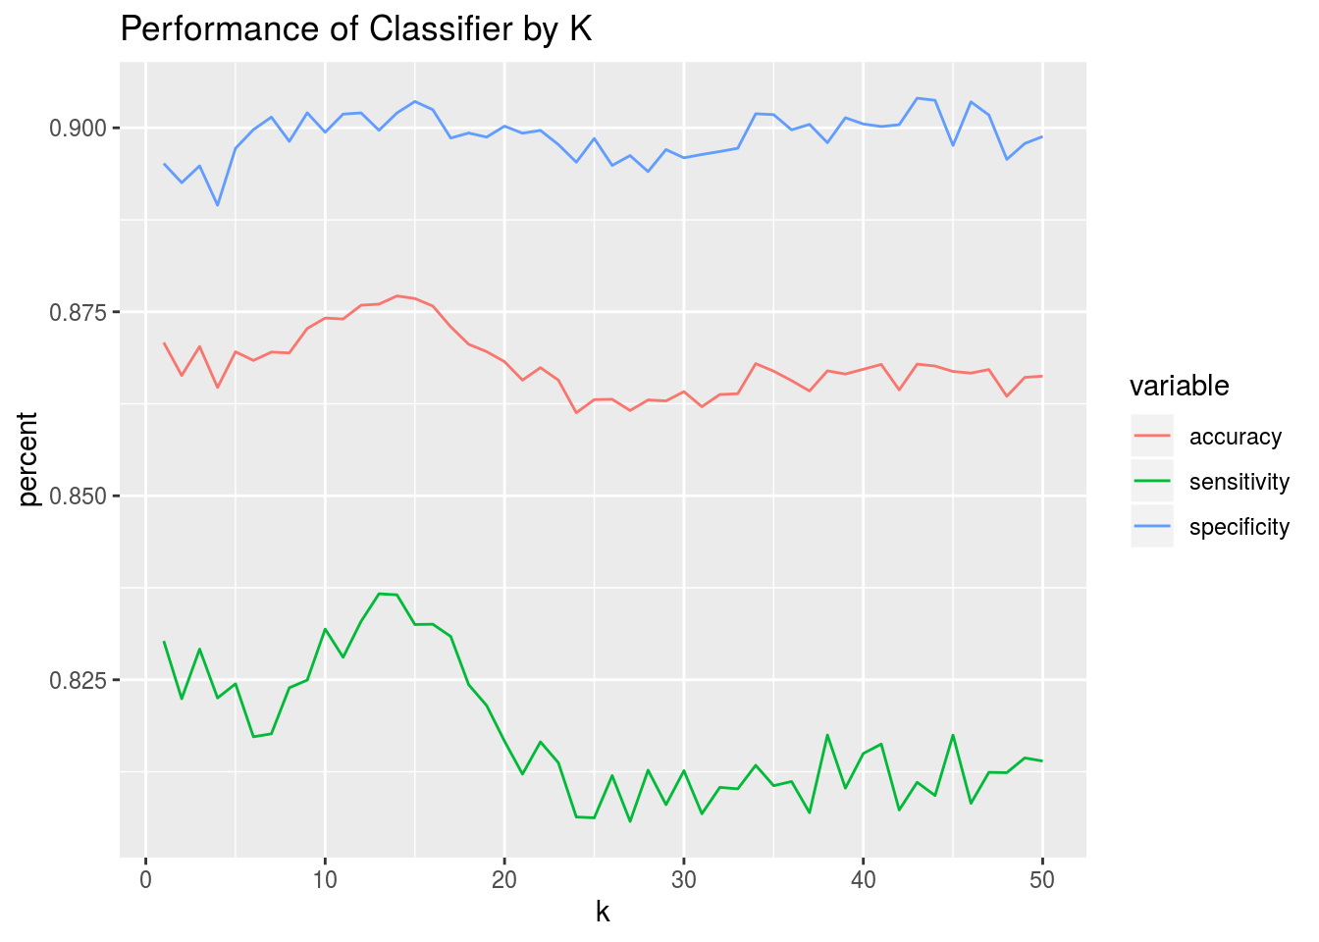
Constructing KNN Classifier
Do KNN classification. Make 100 iterations of the model, splitting the data into training (70%) and test (30%) datasets each time and averaging the performance statistics of the model. Do this for a number of different k values.
Look at all 50 values of k to determine what k value gives best performance.
k of 14 is best for accuracy.
k of 13 is best for sensitivity. k of 43 is best for specificity.
we choose 14 as best overall, since it gives the highest sum of accuracy, sensitivity, and specificity.

Slide 13
Comparing Performance of Predictors
 | Constant ‘Other’ | Random | Naive Bayes | KNN
Sensitivity | 100% | 63% | 89% | 92%
Specificity | 0% | 37% | 81% | 85%
Overall Accuracy | 63% | 53% | 86% | 89%
Model Sophistication

Slide 14
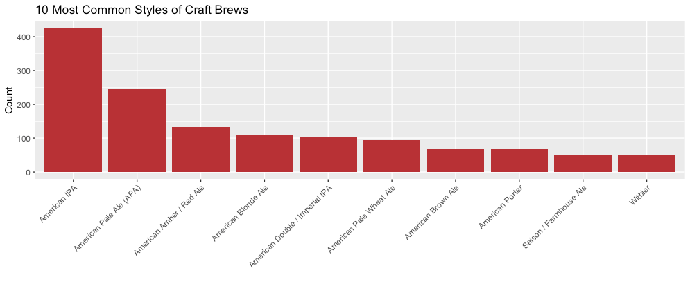
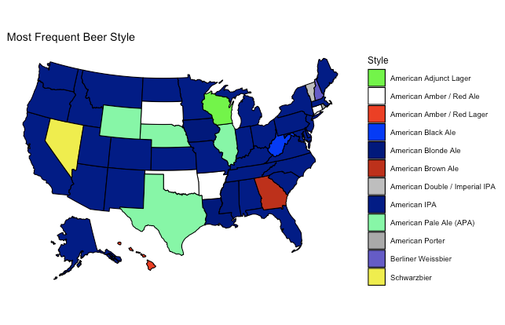

Slide 15
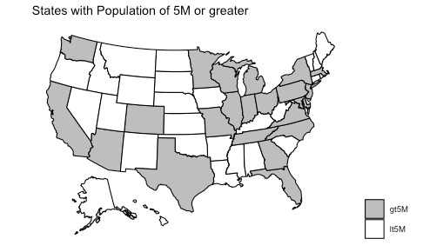
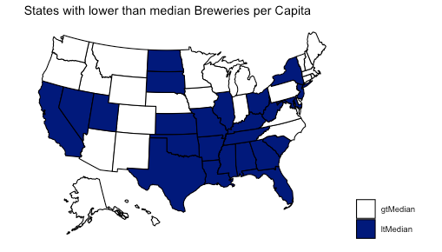
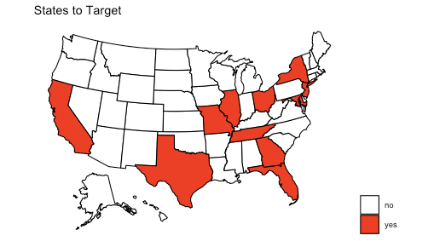
States to target are those that have population > 5M and a lower than median number of breweries per capita. (they are underrepresented by craft breweries...Budweiser should investigate further.)

Slide 16
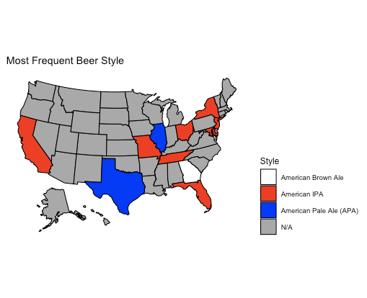
What is the most frequent beer style in each of the “states to target”

Slide 17
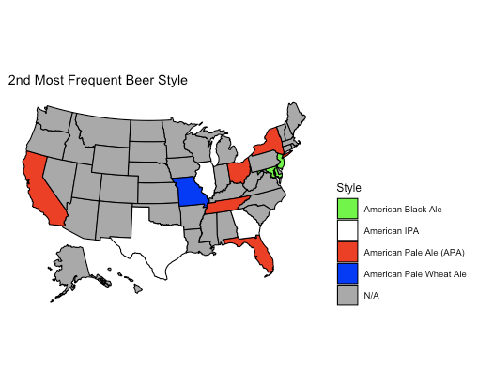

Slide 18
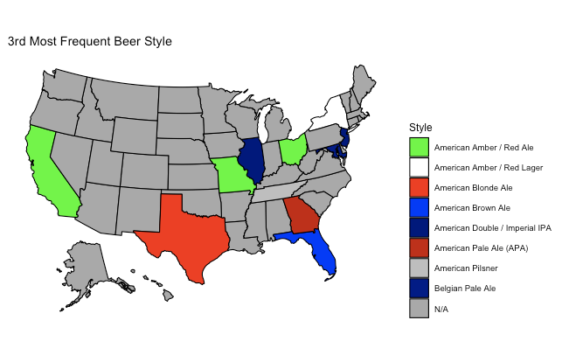

Slide 19
Directions for Additional Work
Ideas for question 9: a) Group states into geographic regions and repeat analysis for mean/max ABV and IBU by region, b) do some feature engineering (IBU:ABV ratio) or external data (census data, etc.), c) deep dive into one state...maybe one with lots of breweries...and provide some state-level insights. I’m currently most inclined toward option “b”.

