Slide 1
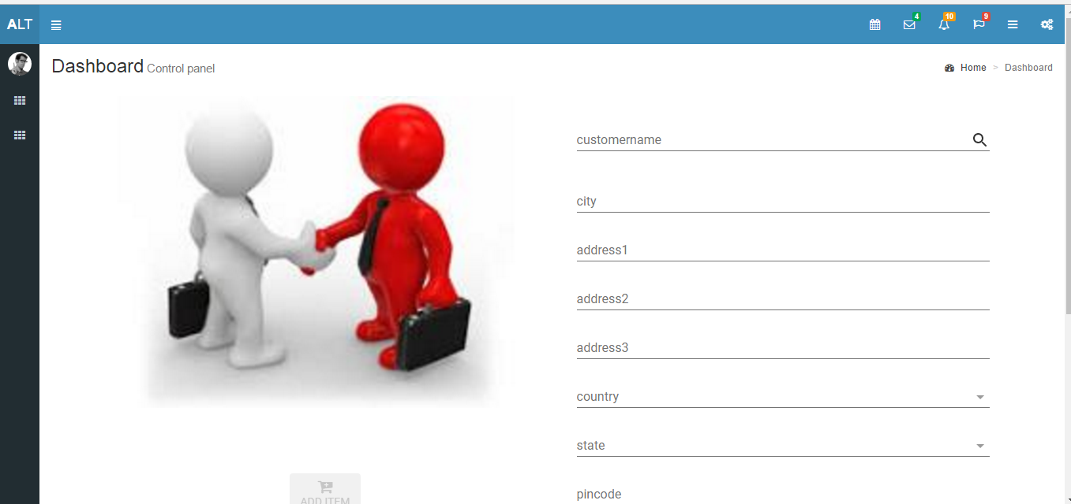
Customer-Details

Slide 2
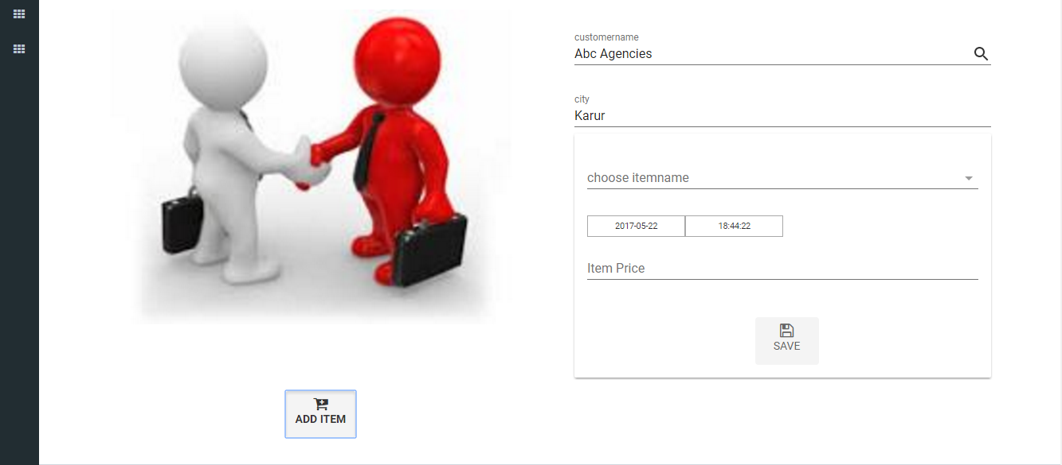
customer choose item(supplier-item-mapping)

Slide 3
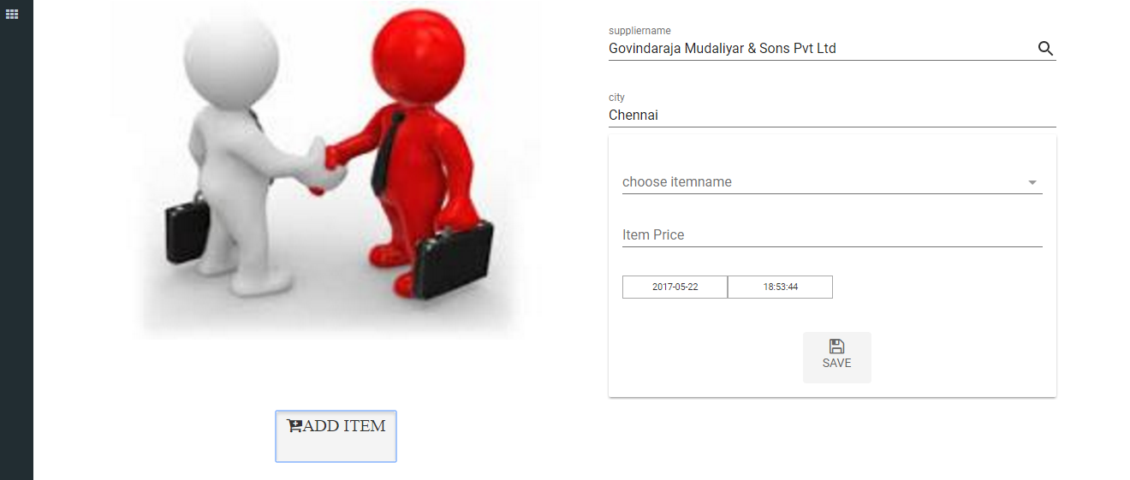
supplier choose item(supplier-item-mapping)

Slide 4
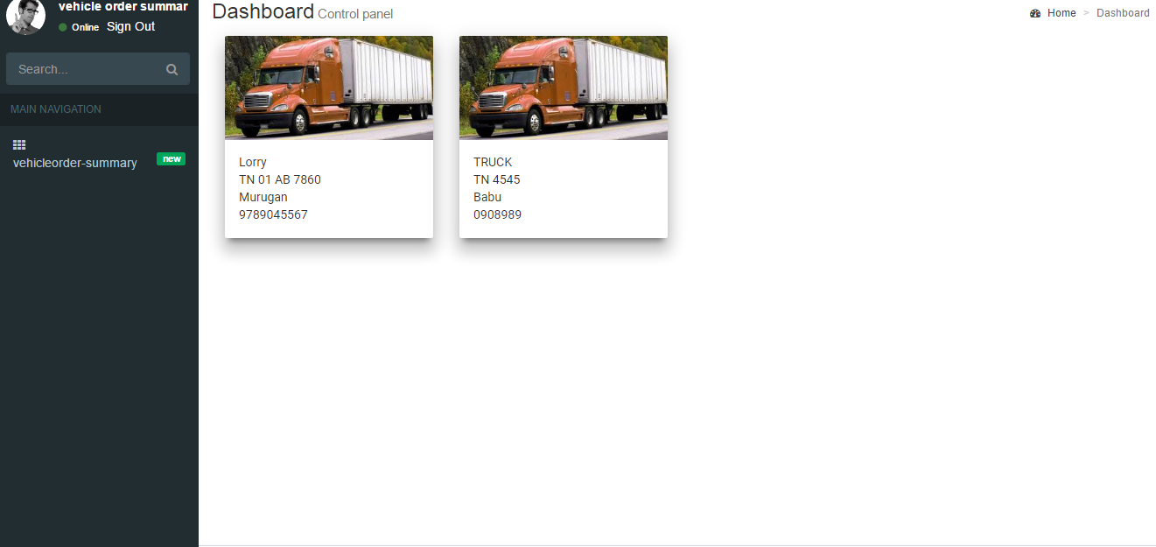
Vehicle summary page

Slide 5
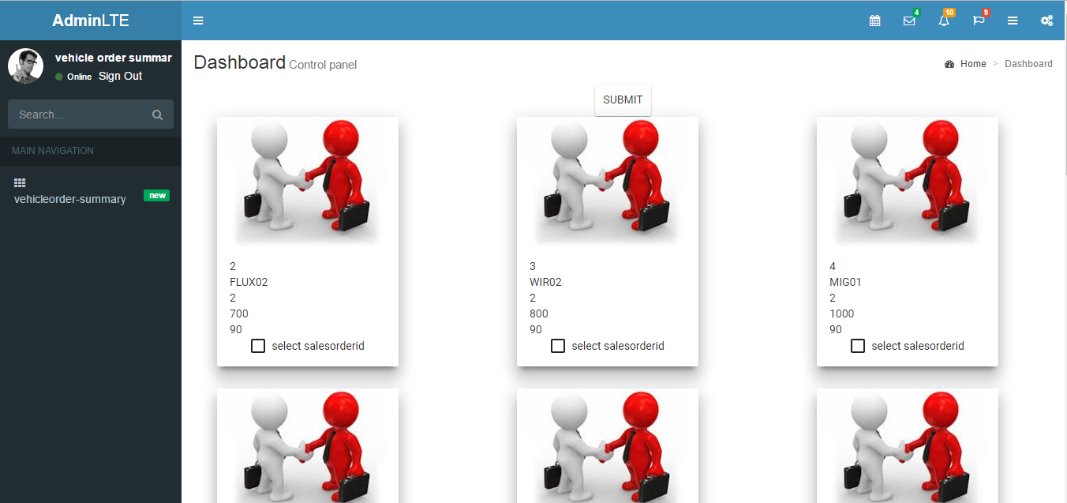
Choose sales order for vehicle

Slide 6
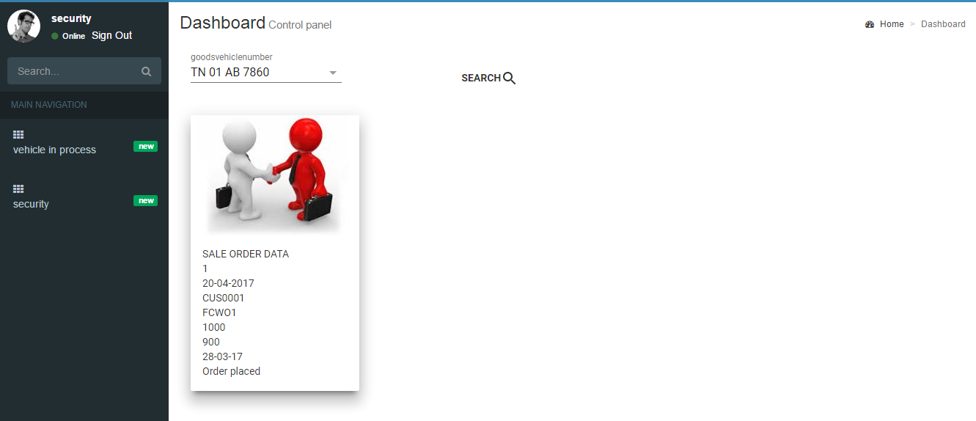
Vehicle outcome process

Slide 7
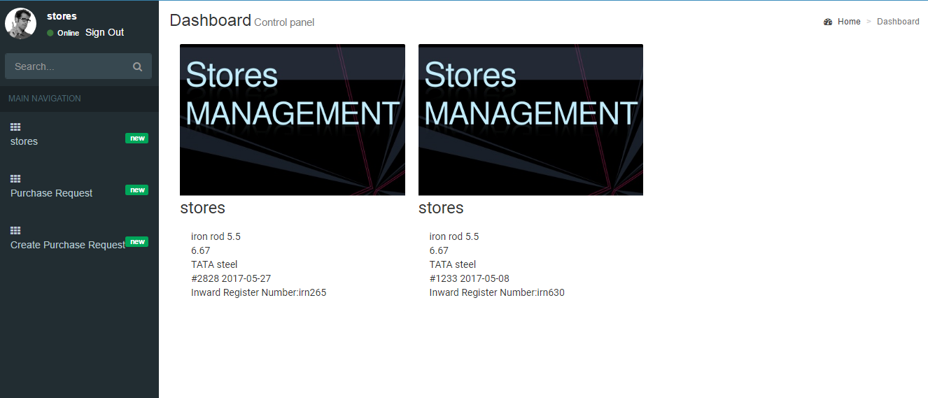
Stores Summary Page

Slide 8
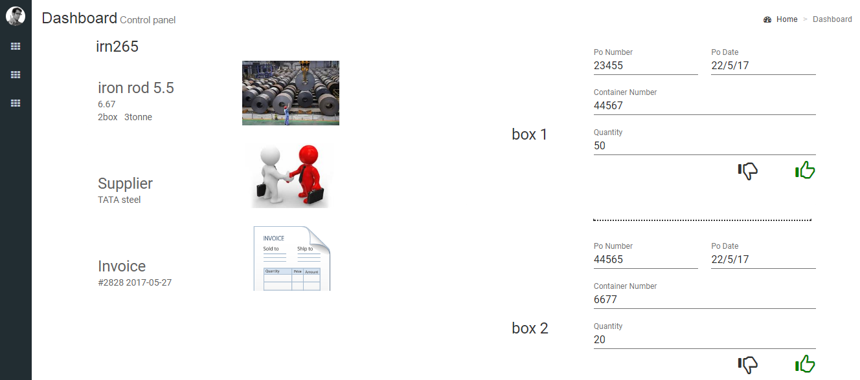
Stores Details

Slide 9
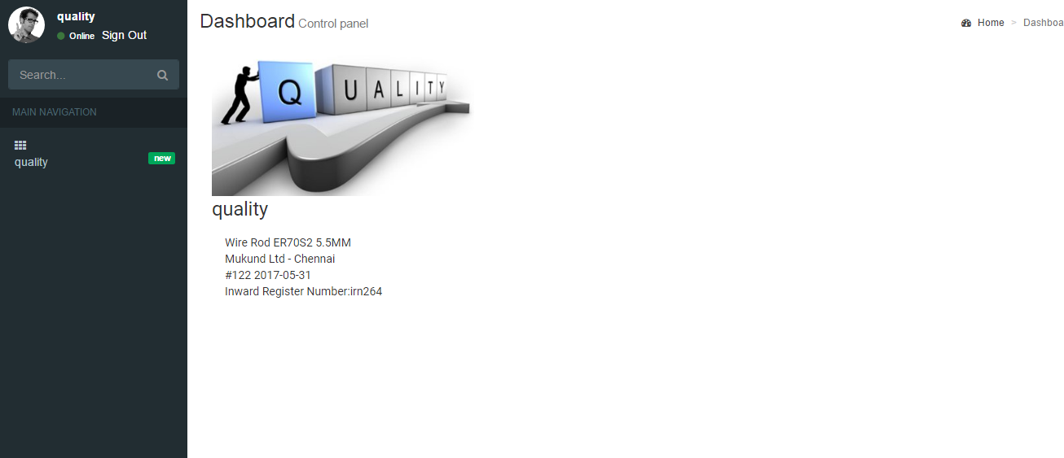
Quality Summary Page

Slide 10
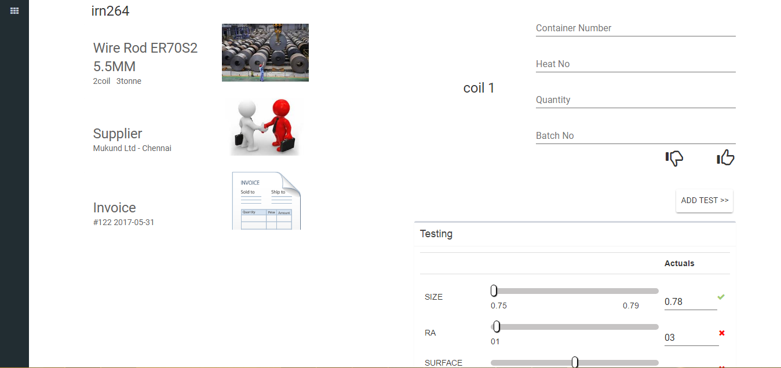
Quality Details

Slide 11
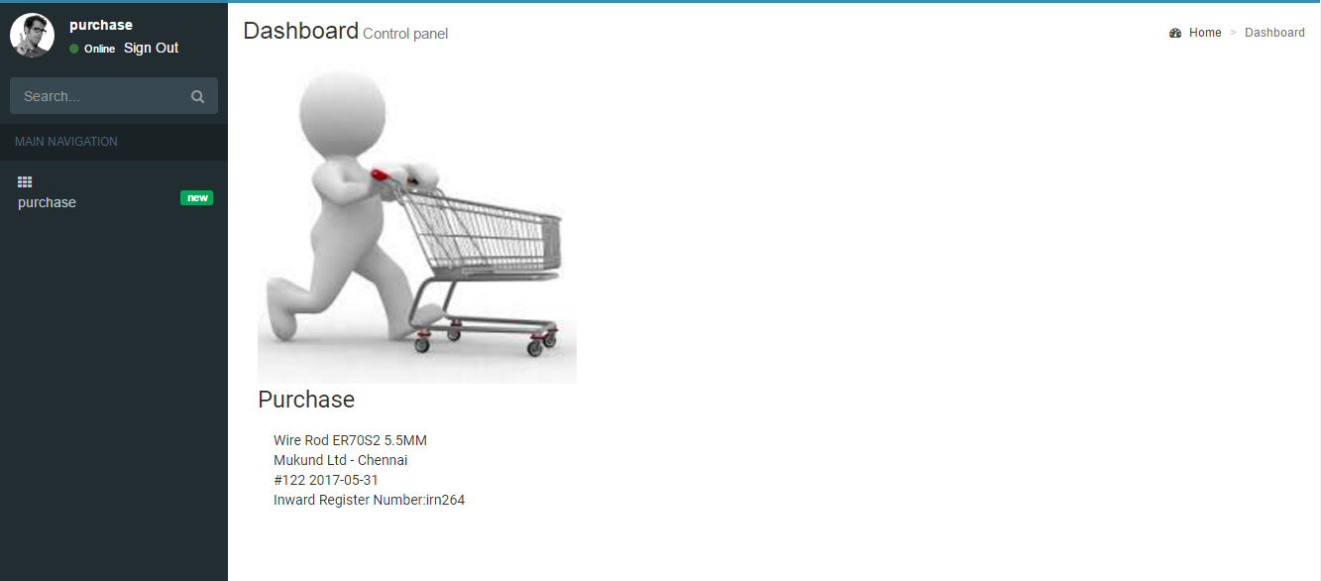
Purchase Summary Page

Slide 12
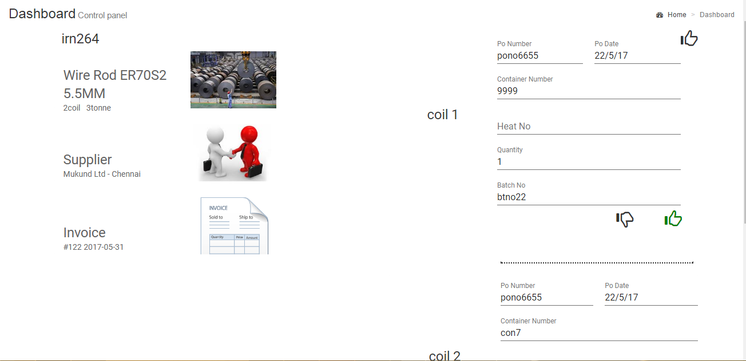
Purchase Details

Slide 13
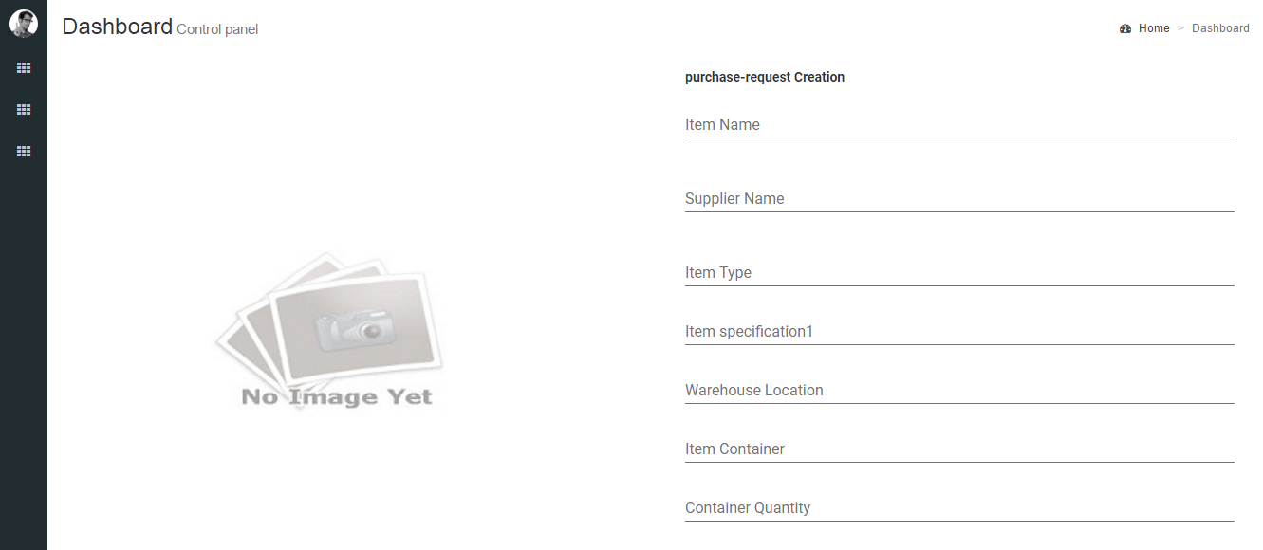
Purchase Request Creation

Slide 14
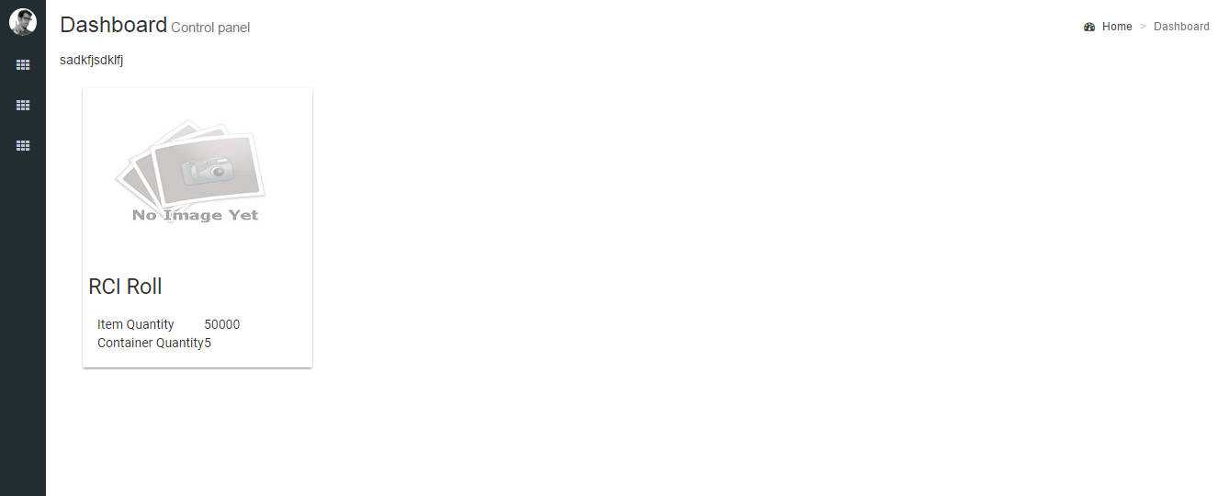
Purchase Order Summary

Slide 15
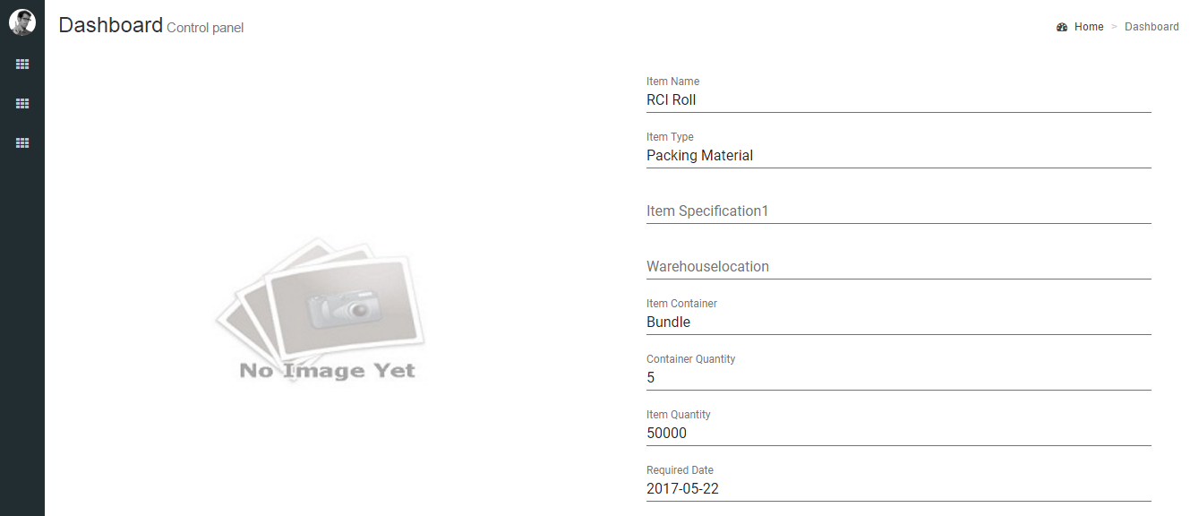
Approve Purchase Order

