Slide 1

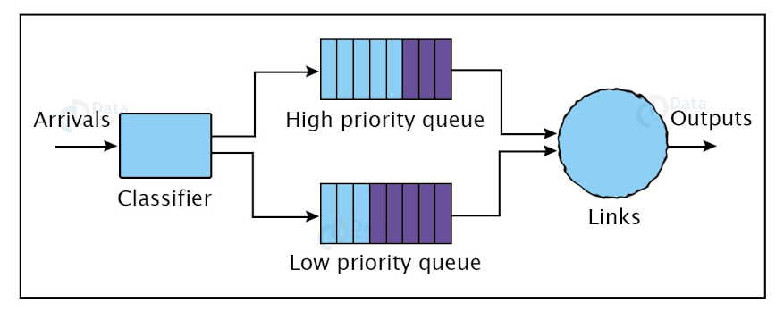


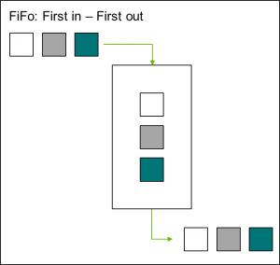
Advanced Python
Priority Scheduling vs FIFO Queue
Team Members:
Aditya Sanjay Pawar
Utkarsh Anil Gaigole
Sreelakshmi Koyambrath Sivaraman
Kalaivani Sivakumar
Mentor : Mobasher, Dr. Ghadeer (Dr. G)

Slide 2

Agenda
3- Python Implementation
7-Real World Examples
1 -What is Scheduling ?
5- Comparison & Diagrams
2- Priority Scheduling
8-Conclusion
4-FIFO Scheduling (Concept)
6- Advantages & Limitations

Slide 3
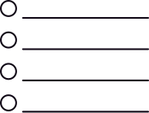
What is Scheduling?
This is the overarching strategy used by operating systems or frameworks to determine which process gets access to CPU time and resources .
The main goal is to balance efficiency, throughput, and fairness.
A scheduling algorithm affects
Use cases
Response time
Operating Systems
Fairness
Cloud Computing
Resource utilization
Data Processing
Overall system performance
Task Automation

Slide 4



Starvation in Priority Scheduling
Starvation in priority scheduling happens when low-priority processes are indefinitely delayed because higher-priority processes continuously monopolize the CPU
Priority Scheduling
Preemptive
Priority scheduling is an operating system algorithm that assigns a priority to each process and allocates the CPU to the process with the highest priority first. It is widely used in batch processing and real-time systems to ensure that critical or time-sensitive tasks receive immediate attention.
If a new process arrives with a higher priority than the currently running task, the scheduler immediately interrupts the current task and assigns the CPU to the new one. This is ideal for critical real-time systems
Non-Preemptive
Once the CPU begins executing a process, it runs that process to completion regardless of the priorities of incoming tasks

Slide 5
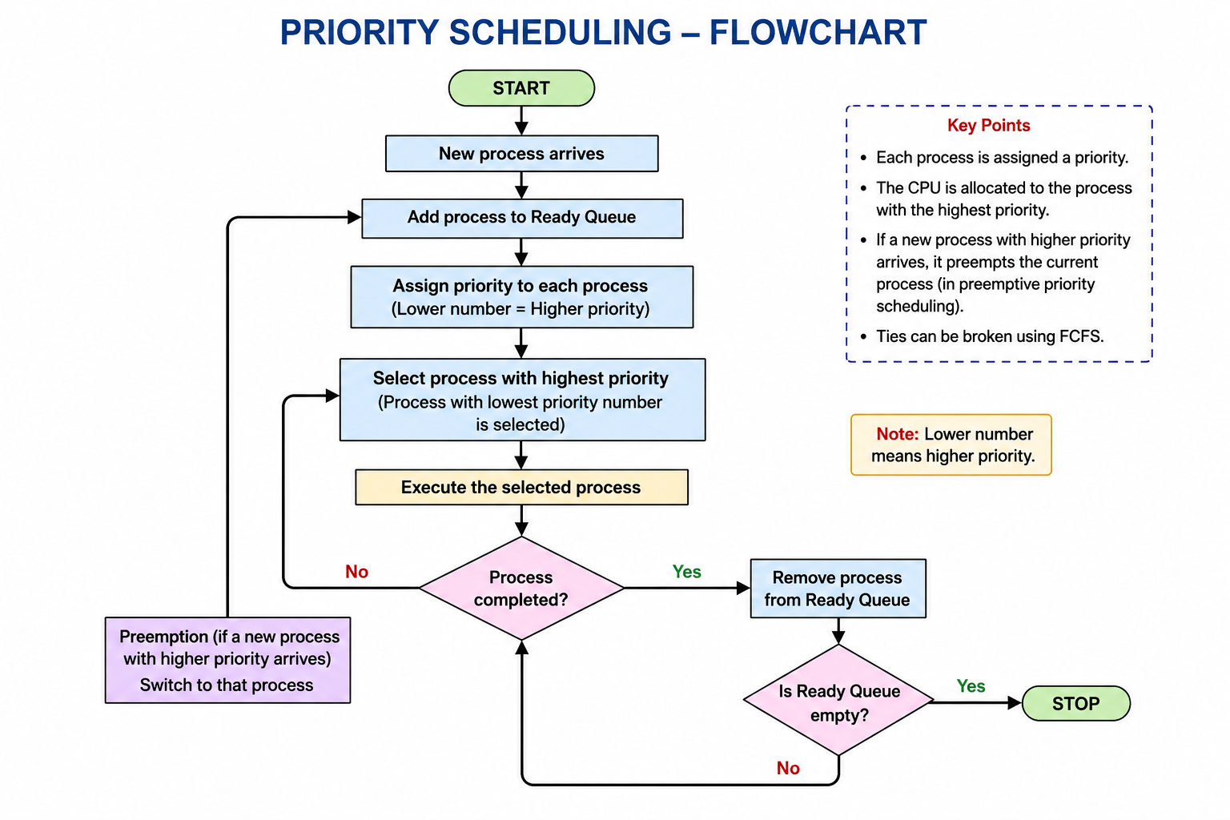
Priority Scheduling - flowchart

Slide 6

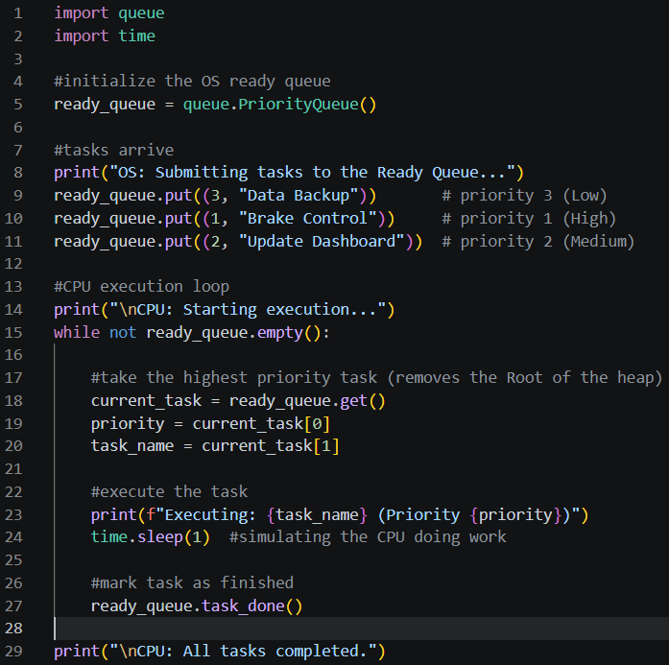
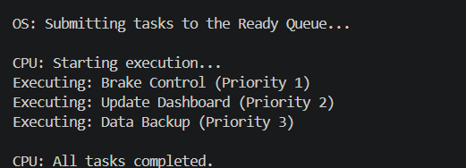
Python Implementation
CODE EXPLANATION
We instantiate the queue. It is empty.
We insert a tuple. The queue uses the '3' to place it in the heap.
The CPU spins in a loop, constantly checking if there is work to do.
It instantly grabs the most urgent task and removes it from the heap.
We force Python to pause for 1 second. This represents the "Burst Time" we discussed in Module 3.
Tells the queue's internal tracker that we have fully finished processing this item. (Crucial for multi-threaded programming).

Slide 7

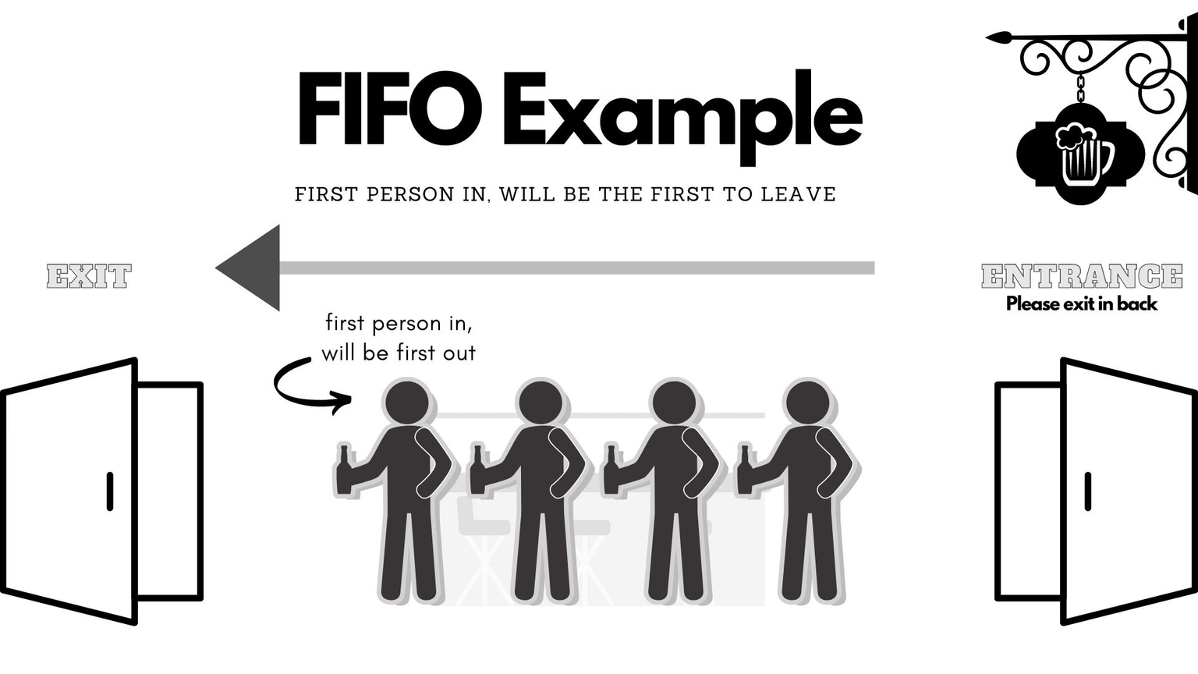
FIFO Scheduling
FIFO (First-In, First-Out) Scheduling (also known as First-Come, First-Served or FCFS) is the simplest CPU scheduling algorithm used in operating systems. It processes tasks, requests, or data packets strictly in the order they arrive, meaning the first task to enter the queue is the first one executed. [1, 2, 3, 4, 5]

Slide 8
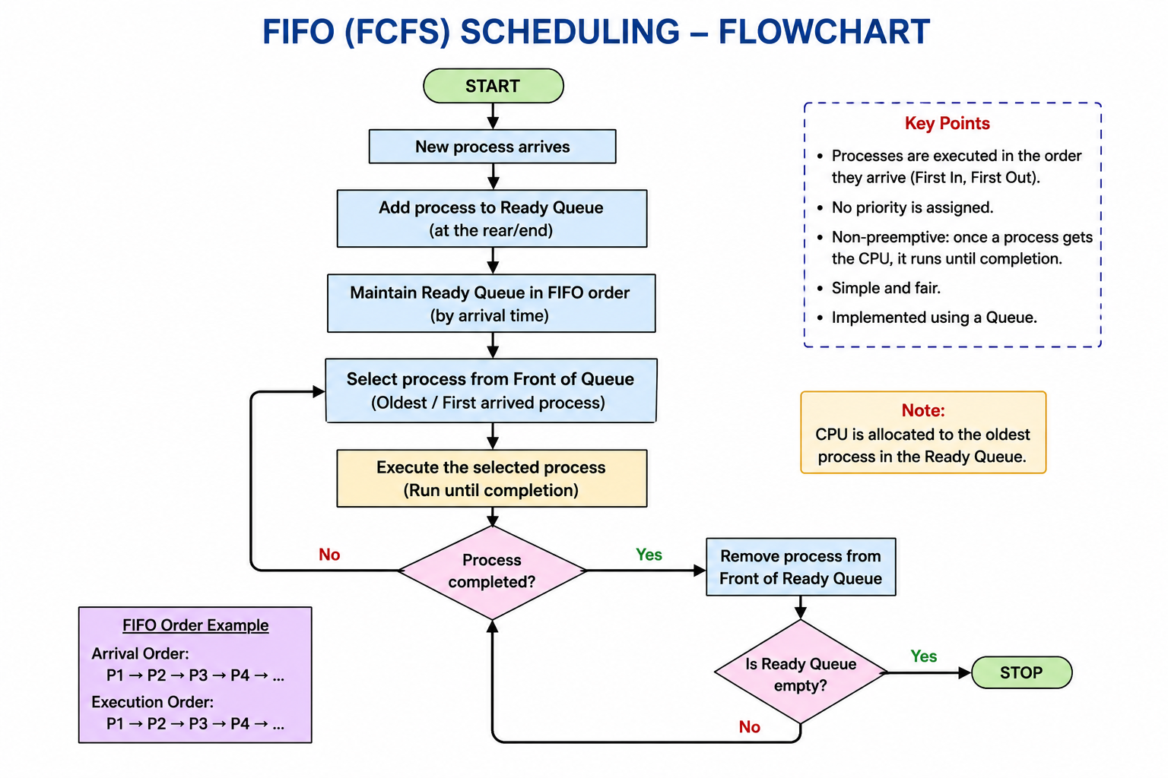
FIFO Scheduling - Flowchart

Slide 9
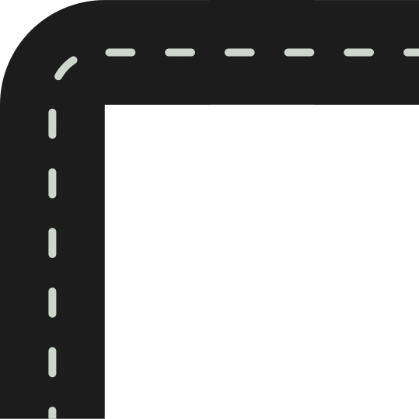
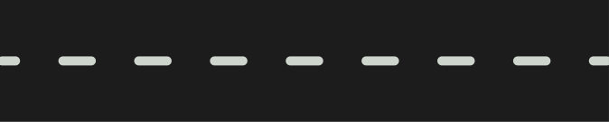
FIFO Characteristics
Advantages
Very simple concept and easy to implement. It is fair for arriving task and has predictable execution order.
Limitations
Urgent tasks cannot jump ahead . Long Tasks dealys other shorter tasks. It has lower responsiveness and not suitable for mixed priority workloads

Slide 10


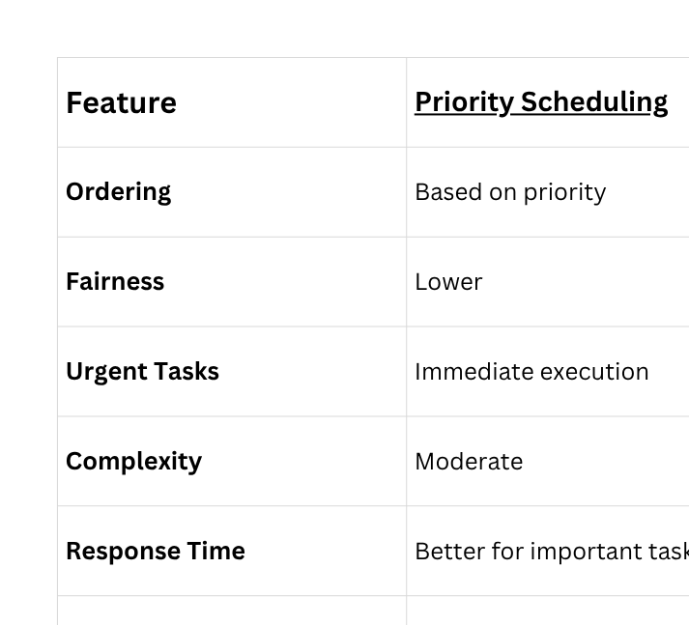
Comparison

Slide 11

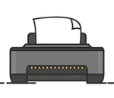
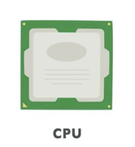





Real-World Applications
Priority Scheduling
FIFO Queue
Hospital emergency rooms
Printer queues
CPU process scheduling
Ticket counters
Air traffic control
Supermarket checkout
Customer support tickets
Call waiting systems
Growth strategy implementation
Scaling creative businesses while maintaining artistic integrity and quality standards

Slide 12

Conclusion
Key Takeaways
Priority Scheduling
Executes urgent tasks first
Better responsiveness
May cause starvation for low-priority tasks
FIFO Queue
First to in first to out
Easy concept to apply
Cannot handle urgent tasks efficiently
Choosing the right scheduling strategy depends on the application's requirements.

