Slide 1
CONCURRENCY MODELS
Pipeline vs Fork-Join
Structuring computation as sequential stages vs parallel decomposition with aggregation
Vivek Sawant
Gaurav Awasare
Group Assignment | SRH Hochschule Heidelberg

Slide 2
Part 1 - The Pipeline Pattern
Data flows through a fixed sequence of processing stages
Stage 1
Stage 2
Stage 3
Output
Read the value
Square the number
Format the squared result
Key characteristics
Sequential flow — each item moves stage 1 → stage 2 → stage 3
Stages run concurrently on separate threads, connected by queues
Throughput-oriented: while stage 3 finishes item A, stage 1 starts item B
Well suited to streaming / continuous data (ETL, I/O-bound workloads)
Pipeline vs Fork-Join | SRH Hochschule Heidelberg
3

Slide 3
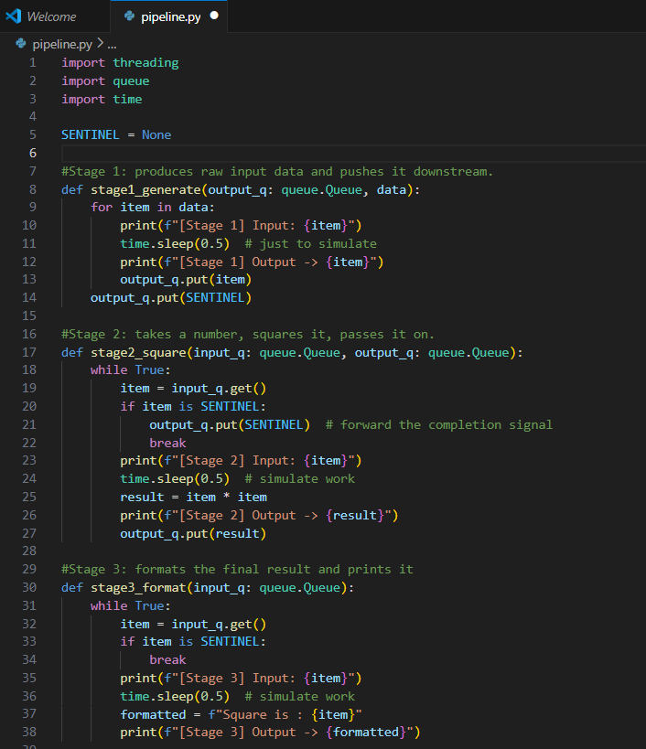
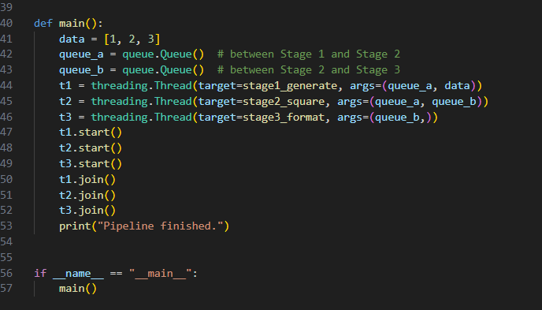
Implementation - threading + queue
Standard library only: threading, queue, time
Pipeline vs Fork-Join | SRH Hochschule Heidelberg
4

Slide 4
Pipeline in action
Each stage prints its input and output as data flows through
Stage 1 (Read the items)
Stage 2 (Square the items)
Stage 3 (Print in formatted way)
Input: 1 → Output: 1
Input: 2 → Output: 2
Input: 3 → Output: 3
…
Input: 1 → Output: 1
Input: 2 → Output: 4
Input: 3 → Output: 9
…
Input: 1 → Square is (1)
Input: 4 → Square is (4)
Input: 9 → Square is (9)
…
Because stages overlap in time, Stage 1 can already be processing item 3 while Stage 3 is still finishing item 1, this is the throughput benefit of pipelining.
Pipeline vs Fork-Join | SRH Hochschule Heidelberg
5

Slide 5
Part 2 - The Fork-Join Model
A task is split into subtasks, executed in parallel, then merged
Subtask A
Task
Fork
Subtask B
Join
Result
Subtask C
Key characteristics
Decomposition - one large task is split (forked) into independent subtasks
Subtasks execute simultaneously across cores/processes
A join step waits for all subtasks and aggregates their results
Latency-oriented: best for CPU-bound, computationally heavy problems
Pipeline vs Fork-Join | SRH Hochschule Heidelberg
6

Slide 6
How Fork-Join Coordinates Work
1. Fork (split)
2. Parallel execution
The main task divides its input into independent chunks - e.g. splitting a large array into N equal ranges, one per worker.
Each subtask runs concurrently on its own CPU core or process; a scheduler / pool coordinates workers and load-balances work.
3. Join (merge)
4. Why for heavy compute
The main task blocks until every subtask finishes, then combines partial results into one final output (sum, concatenation, reduction, …).
CPU-bound work (image processing, numerical simulation, sorting) benefits because true parallel cores bypass Python's GIL via separate processes.
Pipeline vs Fork-Join | SRH Hochschule Heidelberg
7

Slide 7
Fork-Join in Python
concurrent.futures.ProcessPoolExecutor
A high-level pool that forks work across separate processes; submit() dispatches subtasks, and results() / as_completed() perform the join.
multiprocessing
The lower-level module ProcessPoolExecutor is built on - gives direct control over Process, Pool, and shared memory for manual fork/join.
Both let a task “fork” into a pool of workers and “join” by collecting each worker’s return value - conceptually identical to the diagram on the previous slide.
Pipeline vs Fork-Join | SRH Hochschule Heidelberg
8

Slide 8
Comparison
Design differences, not implementation details
Dimension | Pipeline | Fork-Join
Structure of computation | Flow - sequential stages, data passed forward | Decomposition - one task split into independent parts
Execution strategy | Stages run concurrently, overlapping in time on a stream | Subtasks run simultaneously, then explicitly synchronized (join)
Coordination mechanism | Queues connect stages; consumer/producer handoff | Pool/scheduler dispatches forks; blocking join collects results
Scalability under workload | Bounded by the slowest stage (throughput-limited) | Scales with available cores; limited by task-splitting overhead
Best suited for | Streaming / I/O-bound, continuous data (ETL, media) | CPU-bound, computationally heavy, divisible workloads
Pipeline vs Fork-Join | SRH Hochschule Heidelberg
9

Slide 9
Trade-offs at a Glance
Pipeline
Fork-Join
Strengths
Strengths
High throughput for continuous streams
Simple mental model: data flows one way
Stages can be scaled/tuned independently
Speeds up a single heavy task via parallel cores
Scales naturally with available CPUs
Clear structure: split → compute → merge
Limitations
Limitations
Overall speed capped by the slowest stage
Adds latency per item (must pass every stage)
Splitting/merging adds coordination overhead
Uneven subtask sizes cause idle workers
Pipeline vs Fork-Join | SRH Hochschule Heidelberg
10

Slide 10
Conclusion
Pipeline and fork-join both achieve concurrency, but answer different questions: pipeline asks “how do items flow through stages?”, fork-join asks “how do we split one big job across workers?” Choosing the right model - or combining both - depends on whether the workload is a continuous stream or a single divisible task.
Thank you

