Slide 1

SCHEDULER vs FUTURE / PROMISE
A comparison of time-driven and result-driven concurrency models
Group Members (Team A):
Akshay Myakal
Hrithik Wadile
Priyansh Rangwala
Vivek Attri
SRH Hochschule Heidelberg
Prof, Mobasher Ghadeer

Slide 2
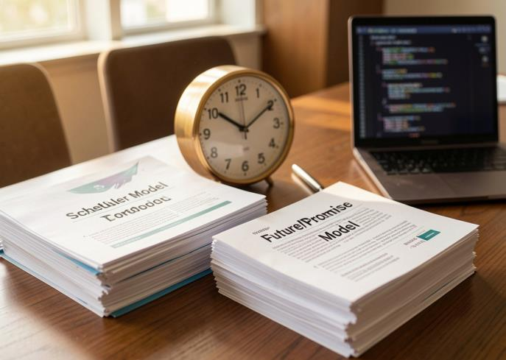
Introduction
Two concurrency models, side by side.
We implement a time-based scheduler and analyze the future/promise model conceptually clarifying what triggers execution, how work is coordinated, and where each one fits.
The goal: understand time-driven execution versus result-driven asynchronous computation.
2

Slide 3
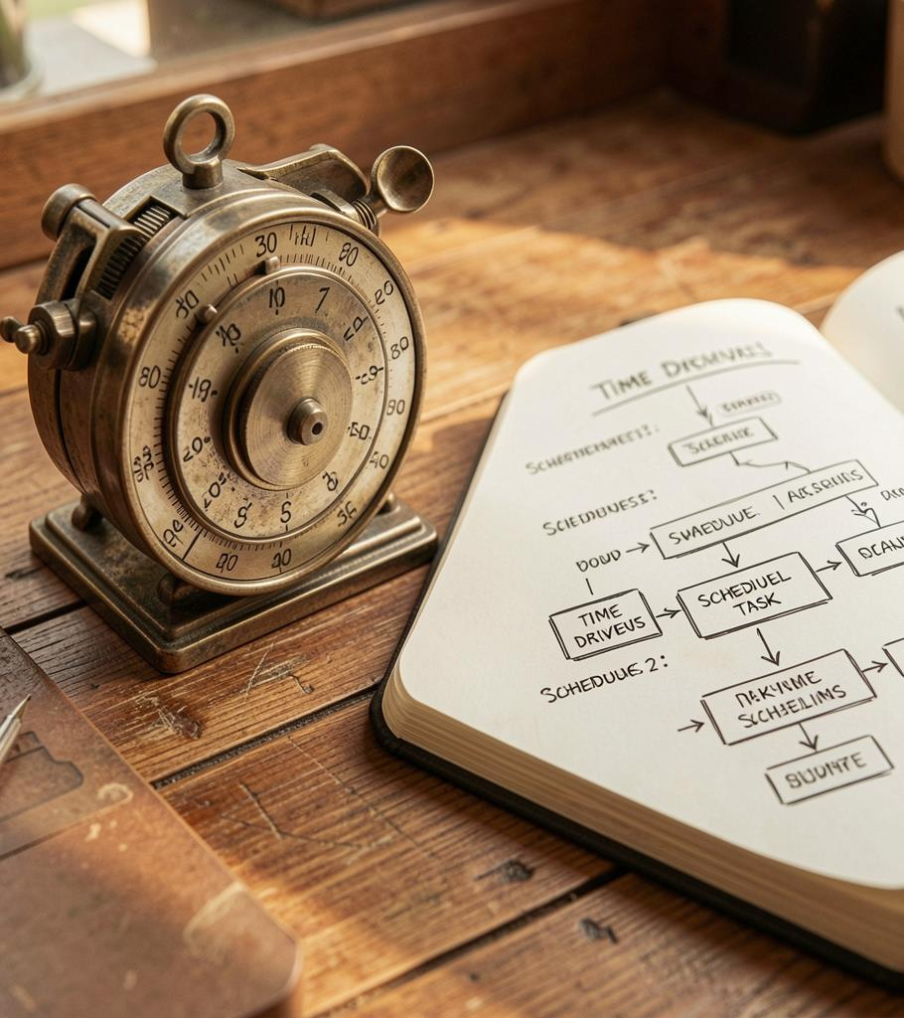
01
Scheduler
Time-driven execution implemented with Python's threading module.

Slide 4
What a Scheduler Actually Does
“I know exactly when to run this.”
Time is the trigger
It doesn't wait for a signal - it waits for the clock to hit a value, then fires.
Execution is external
The task has no say in when it runs. The clock decides.
No built-in result
A scheduler tells you a task ran not what it produced.
Single- or multi-threaded
sched = one sequential lane. threading.Timer = independent, concurrent countdowns.
4

Slide 5
Implementation:- threading.Timer
Each task runs on its own independent timer thread no shared blocking wait.
import threading, time
def func(name):
print('Time:', time.ctime(),
'Name:', name)
names = ['task_a','task_b','task_c']
delays = [3, 2, 1]
threads = []
for name, delay in zip(names, delays):
t = threading.Timer(delay, func,
args=(name,))
threads.append(t)
t.start()
for t in threads:
t.join()
threading.Timer(delay, func, args)
creates a timer doesn't run yet
.start()
launches the countdown in its own thread
zip(names, delays)
pairs each task with its own delay
.join()
waits for every thread to finish
5

Slide 6
Scheduler Diagram
time → task execution
t = 1s
t = 2s
t = 3s
Clock
task_c
task_b
task_a
Reading the diagram: each task lands on the timeline the moment its own delay elapses. Registration order (a, b, c) doesn't matter only time does. With threading.Timer each countdown runs independently and concurrently, unlike sched's single sequential lane.
6

Slide 7

02
Future / Promise
Result-driven execution

Slide 8
What a Future Represents
“I’ll get this eventually I don’t know when, and I don’t need to.”
A Future is a receipt, not the item
How results are retrieved
pending
Blocking pull
future.result() the caller stops and waits until the value is ready.
Non-blocking push
future.add_done_callback(fn) register and move on immediately.
running
finished (result)
finished (exception)
A Future is an object that represents the value that does not exist yet, but will, eventually.
Driven by completion, not the clock the caller cares whether it's done, not when.
8

Slide 9
Comparison
Design differences, not just a feature list.
Aspect | Scheduler Pattern | Future / Promise Model
Focus | Timing of execution | Retrieval of results
Driven by | Time | Task completion
Execution | Runs after a delay / schedule | Runs asynchronously
Result handling | Usually not required | Central concept
Coordination | Scheduler triggers tasks | Future tracks completion
Typical use | Timers, reminders, cron jobs | API calls, parallel processing
9

Slide 10
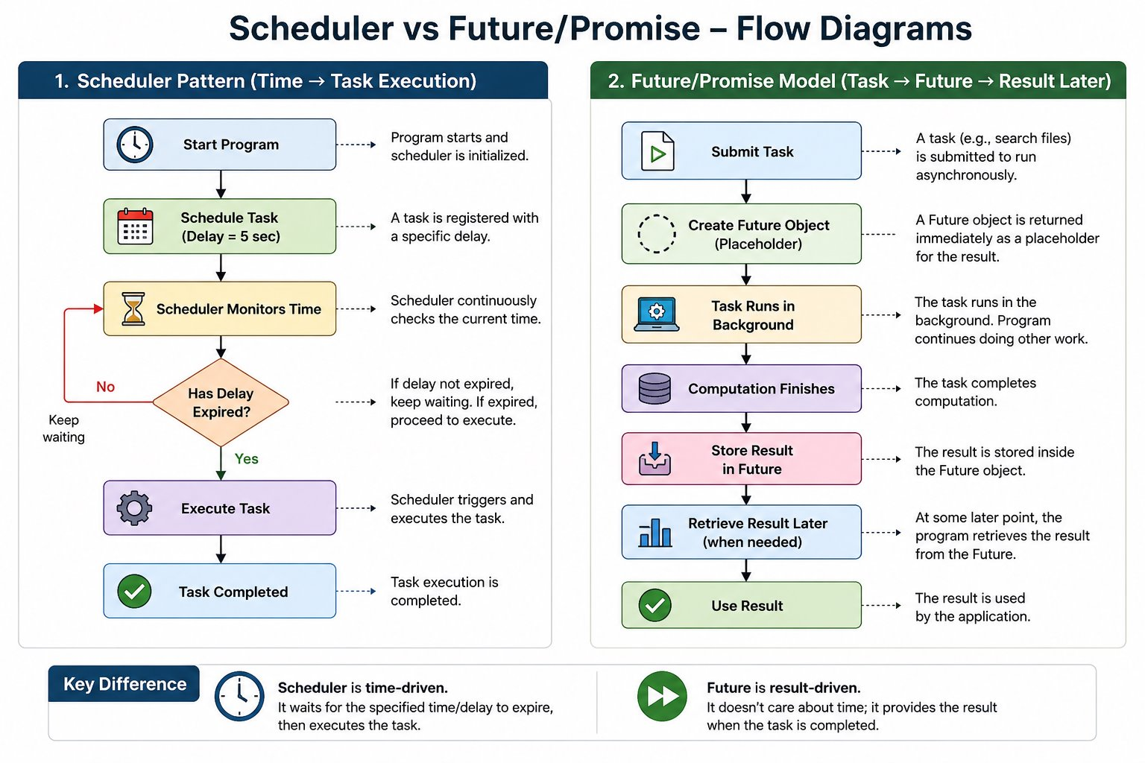
Flow Diagrams
10

Slide 11
Conclusions
Choose a Scheduler for deterministic timing and centralized orchestration when the moment of execution is what matters.
Choose a Future / Promise for parallel, result-driven workflows that aggregate outcomes asynchronously, when what comes back matters more than when.
Match the model to the problem: prioritize timing when the execution moment is critical, and completion semantics when outcomes drive the system.
12

Slide 12
Thank you.

