Slide 1



Case Study- 1
CitePrism: LLM-Driven Audit of Self-Citations and Reference Relevance
Team Members:
Darshan Gowda Budanur Madappa(100004574)
Gowrika Mahesh(100004973)
Kavana Gopladevarahalli Papegowda(100004573)
Prajwal Basavaraj(100004572)
Under the guidance of:
Prof. Dr. Mehrdad Jalali
Github : https://github.com/SRH-Heidelberg-University-ADSA/CitePrism
12.03.2026
SRH University Heidelberg
1

Slide 2
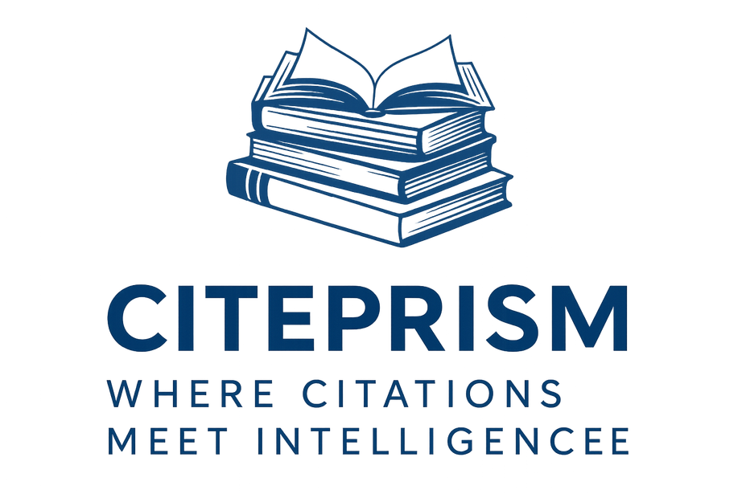
Introduction
CitePrism is a modern system for auditing academic manuscripts on citation relevance, with a focus on evaluating self-citations. By leveraging Large Language Models (LLMs) and embedding techniques, CitePrism ensures clarity in scholarly practices by detecting off-topic citations, ranking references by relevance, and generating audit-ready reports.
SRH University Heidelberg
2

Slide 3

Problem Statement
Checking every reference in a research paper is too slow for humans to do alone. Because of this, some authors 'cheat' by citing themselves or their friends just to boost their scores, even if the work isn't relevant. This makes academic research less trustworthy.
SRH University Heidelberg
3

Slide 4
User story
As a research checker,
I want an AI dashboard that quickly spots useless citations,
So that I can make sure every reference is actually needed without doing all the work by hand.
SRH University Heidelberg
4

Slide 5
Business Questions
How does CitePrism improve audit efficiency?
The Problem: Manual citation review currently takes 3–4 hours per manuscript.
The Result: CitePrism reduces this time to 30–45 minutes, allowing a single analyst to process 4x–5x more papers every day.
SRH University Heidelberg
5

Slide 6
Business Questions
How do we prevent "False Positives" (wrongly flagging good citations)?
The Solution: The system doesn't just look for "self-citations"; it combines relevance scoring with contextual analysis.
Human-in-the-Loop: Only citations that fall below a specific user-defined threshold (τ) trigger a flag, ensuring high-quality research isn't penalized by mistake
SRH University Heidelberg
6

Slide 7
Business Questions
Can the AI’s decisions be challenged by a human?
Transparency: Every score includes quoted evidence and a clear LLM-generated rationale.
Control: Analysts can manually adjust the threshold, review the AI's logic, and override any automated decision based on their own expertise.
SRH University Heidelberg
7

Slide 8
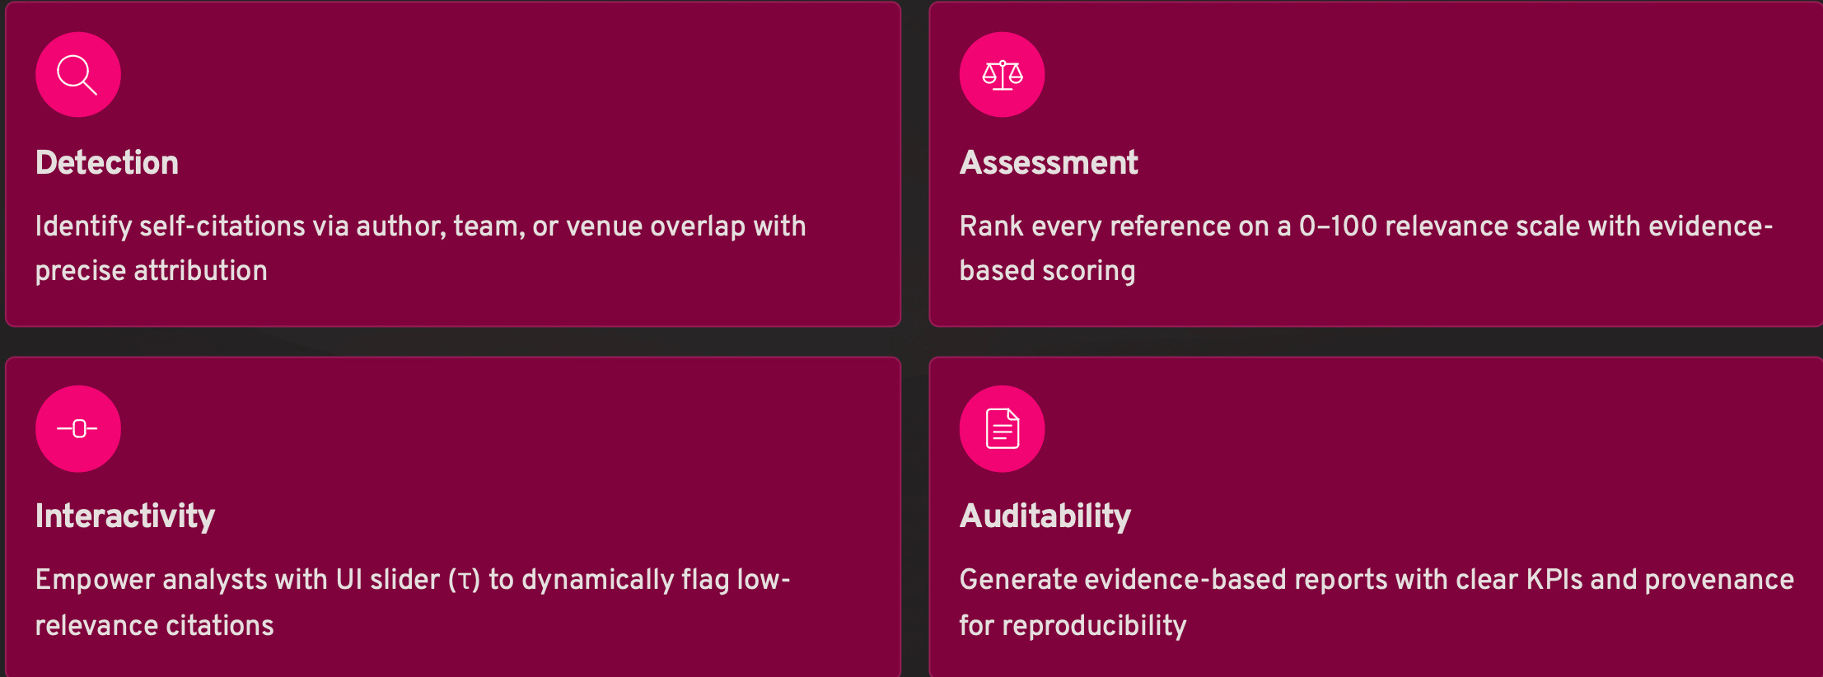
Core Objectives
SRH University Heidelberg
8

Slide 9
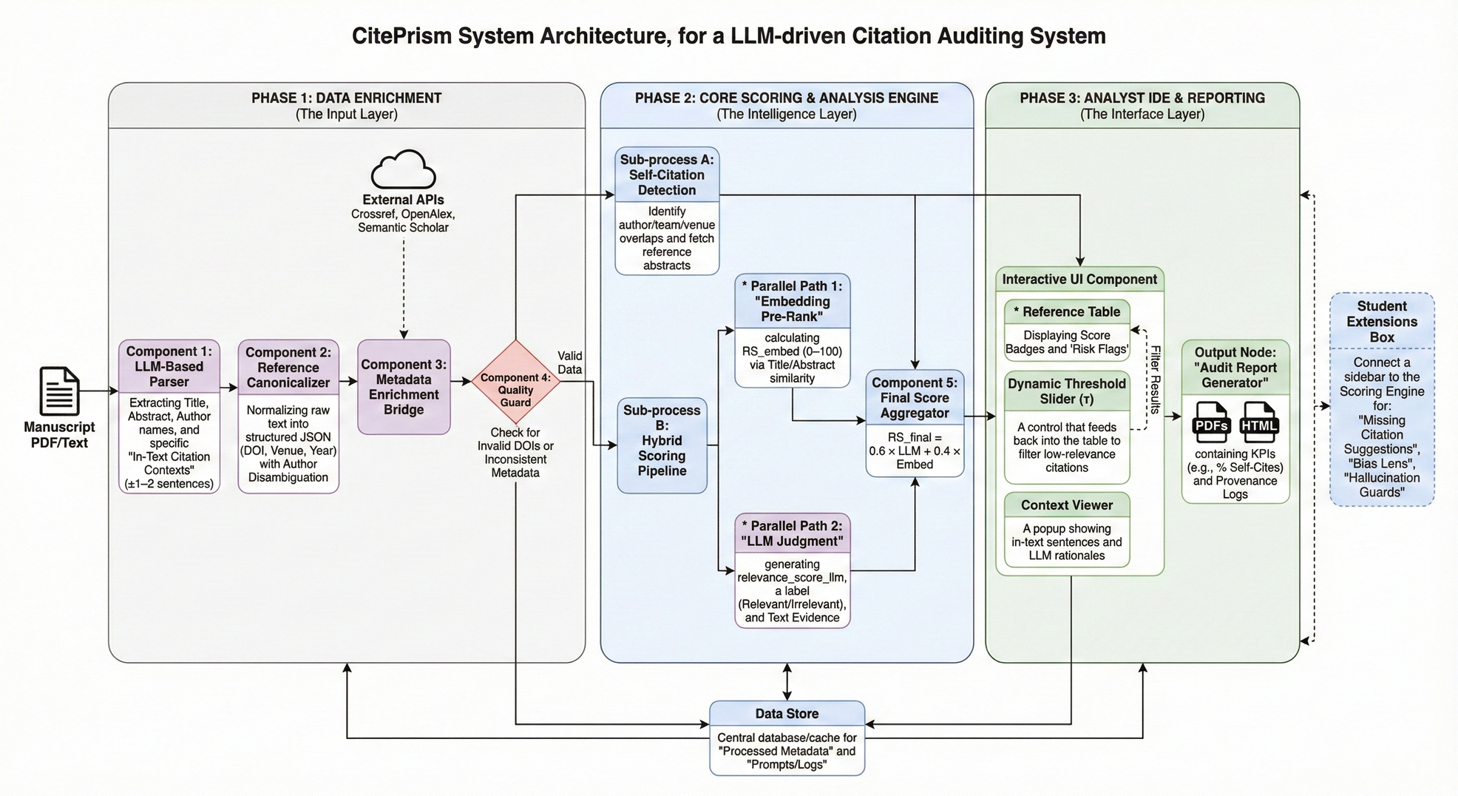
Architecture
SRH University Heidelberg
9

Slide 10
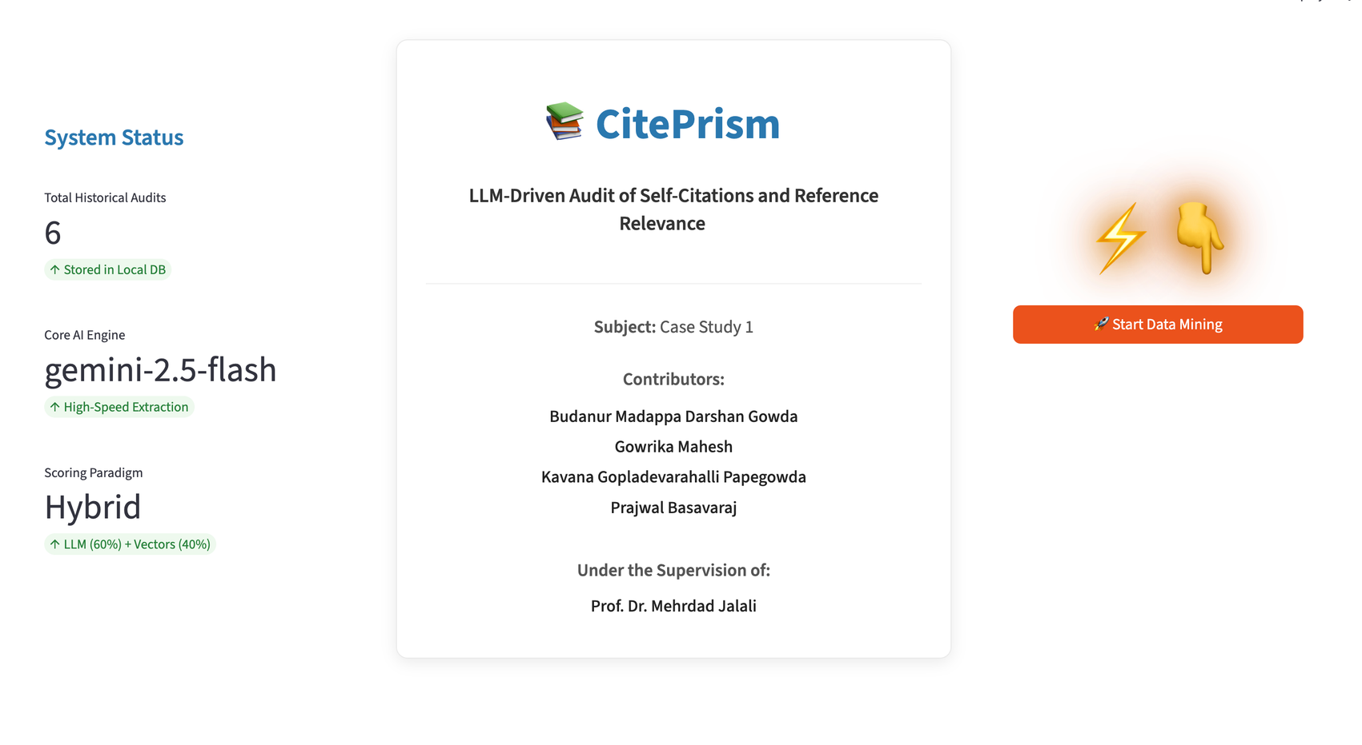
Live demonstration
SRH University Heidelberg
10

Slide 11
Future scope
Multi-Model Consensus Scoring: Implement an ensemble scoring system where multiple LLMs (e.g., Gemini, Llama, and Claude) cross-validate citation relevance to eliminate individual model bias and improve overall audit reliability.
Springer and ScienceDirect API Integration: Expand the metadata enrichment pipeline by integrating official Springer and ScienceDirect API keys to retrieve full-text access and high-fidelity abstracts, directly addressing the current "Missing Abstract" bottleneck.
Autonomous AI Audit Agents: Develop specialized AI agents capable of autonomously searching the web to resolve metadata hallucinations and "Hallucination Guard" mismatches without requiring manual human intervention.
Explainable AI (XAI) Dashboards: Integrate SHAP or LIME-based visualization layers to provide transparent, feature-level explanations for why specific references were flagged, transforming "Black Box" scores into actionable editorial insights.
SRH University Heidelberg
11

Slide 12
Thank you!
Any Questions ?
SRH University Heidelberg
12

