Slide 1
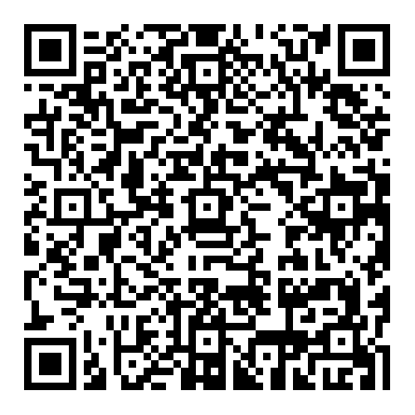
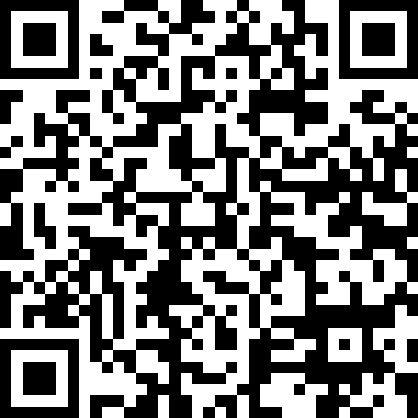
Python Foundations for Data Science
Week(5): Files & Input/Output
Friday, 15th May 2026, 09:30–12:45
Week (5)- Hands-on
sg96um
Week (5)- Attendance

Slide 2
Agenda
Files Systems and Directory Structure Hierarchical structure of directories / folders
Reading and Writing Text Files Text File
Working with CSV Files CSV File
Structured Data Formats JSON File
Error Handling and Exception Concepts Error Handling
Your Voice Matters! Instant Honest Feedback

Slide 3
How did you prepare for today's practical lecture? What did you do to prepare? How did you feel after the preparation? For those who missed the last practical lecture, how did you catch up? Were you lost, or was the material clear enough for you to catch up?

Slide 4
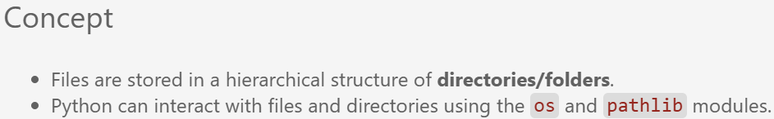
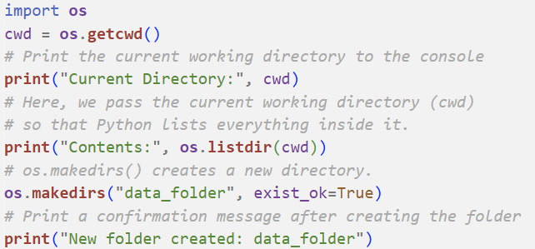
File Systems and Directory Structure
Step 1: Get the current working Directory
It returns the full path of the directory where the current Python script or notebook is running.
Step 2: List all files and folders inside the current directroy
Step 3: Create a new directory. exit_ok = True → ignores the request if the folder exists

Slide 5
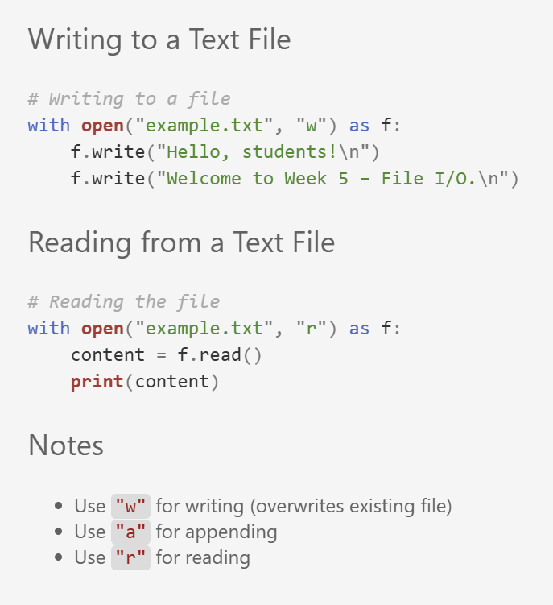
Reading and Writing Text Files
Open the file "example.txt" in write mode ('w’). If the file does not exist, it will be created; if it exists, its content will be overwritten.
Open the file "example.txt" in read mode (‘r’), this allows reading the file content without modifying it. Read the entire content of the file as a single string. Print the content to the console.
What is the difference between “w“ and “a“ modes?

Slide 6
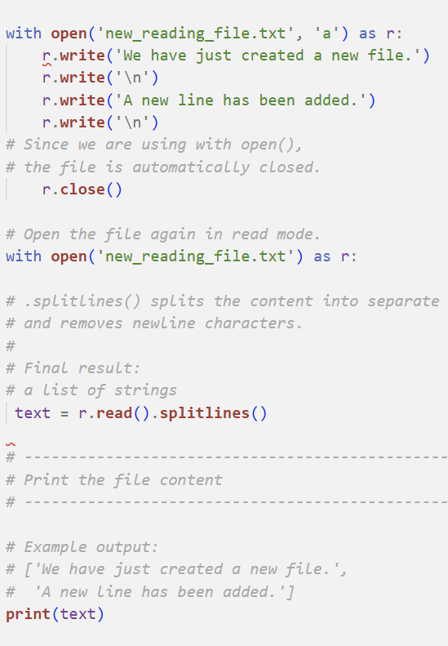
Update Text File
In this example, what if `new_reading_file.txt` doesn‘t exist?
Write the first line into the file. Add a newline character. Write another line into the file
Read the file and split it into lines. .read() reads the full content as one string. .splitlines() splits the content into separate lines and removes newline characters.
['We have just created a new file.','A new line has been added.']

Slide 7
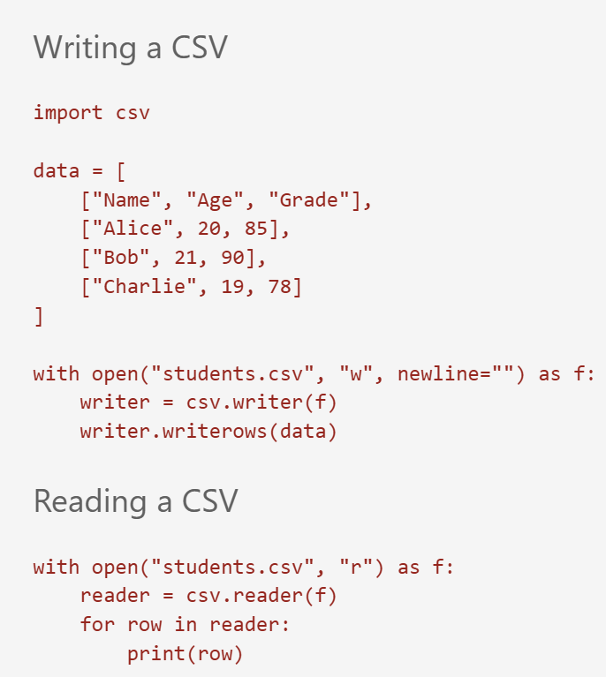
Reading and Writing CSV Files
Create a nested list containing the table data. Each inner list represents one row in the CSV file.
Open a file named "students.csv" in write mode ("w") newline=“ " prevents extra blank lines in some operating systems.
Create a CSV writer object linked to the file. Write all rows from the 'data' list into the CSV file
Open the CSV file named "students.csv" in read mode ("r"). Create a CSV reader object to read the file content. Loop through each row in the CSV file. Print the current row as a list

Slide 8
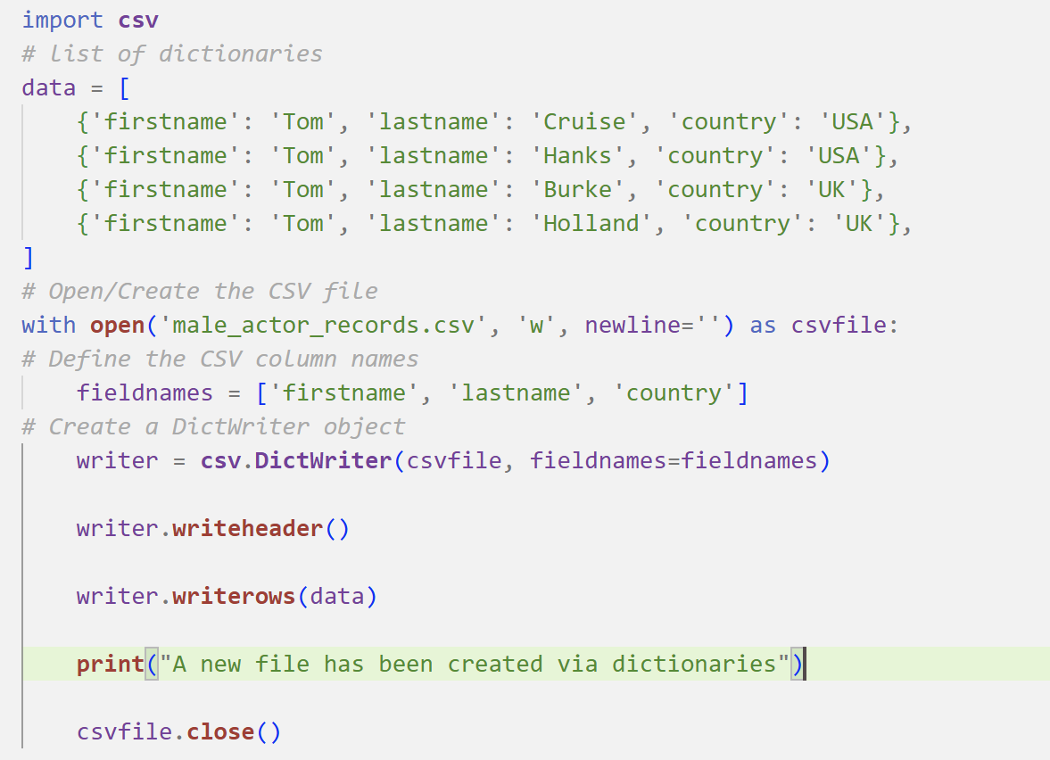
Creating a CSV file using dictionaries
Defines a list of dictionaries called data, where each dictionary represents one actor record with the keys firstname, lastname, and country.
The file male_actor_records.csv is opened in write mode using a context manager, which ensures automatic file closure after execution.
A list of column names is defined in fieldnames, specifying the structure and order of the CSV columns.
A csv.DictWriter object is then created to map dictionary keys to CSV columns. The writeheader() method writes the column names as the first row in the file.
The writerows(data) method writes each dictionary in the list as a separate row in the CSV file.

Slide 9
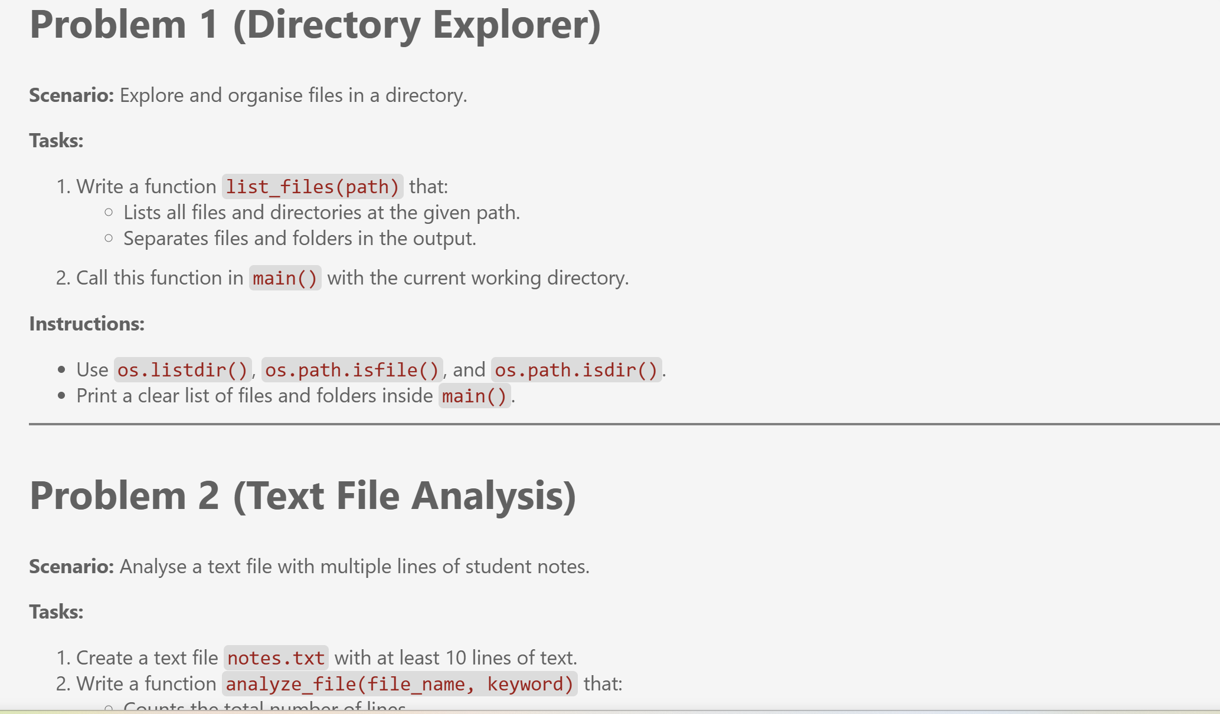
Exercises
Solve Problems 1-7 in “Week5_Exercise.ipynb“ and you have 40 minutes to finish all the problems. Don’t forget to split your screen.

Slide 10
Pause / Break
See you in 15 minutes ☺!
Please be on time.
Wednesday, 15 April 2026, 14:00–17:15

Slide 11
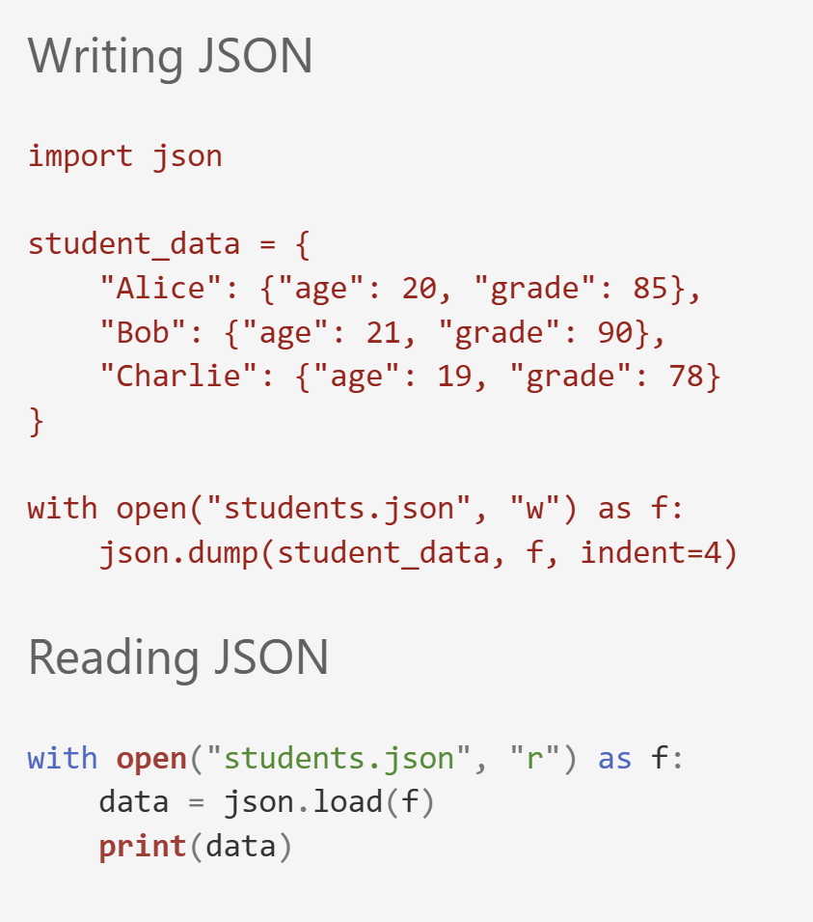
Reading and Writing JSON Files
Create a dictionary containing student information Structure: key → student name value → another dictionary containing student details
Write the Python dictionary into the JSON file.
Parameters: student_data → the data to save f → the opened file object indent=4 → formats the JSON with readable indentation
Load and convert the JSON content into a Python dictionary

Slide 12
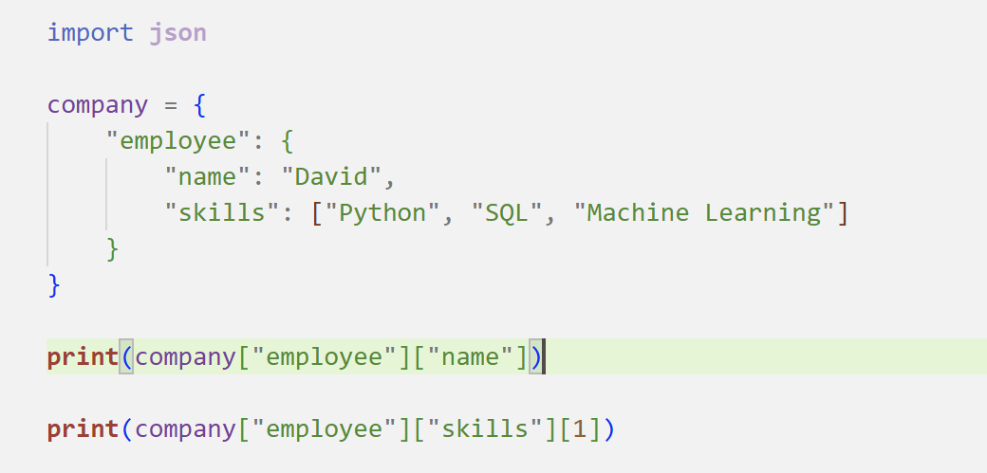
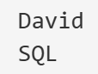
Access nested JSON data

Slide 13
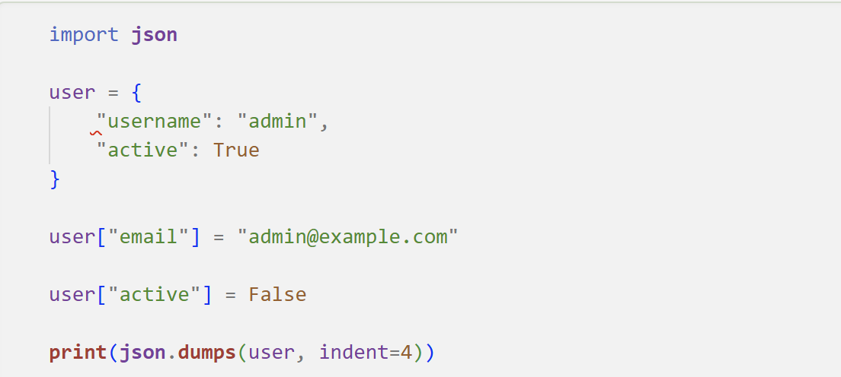
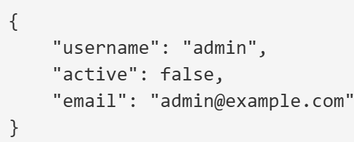
Update JSON data

Slide 14
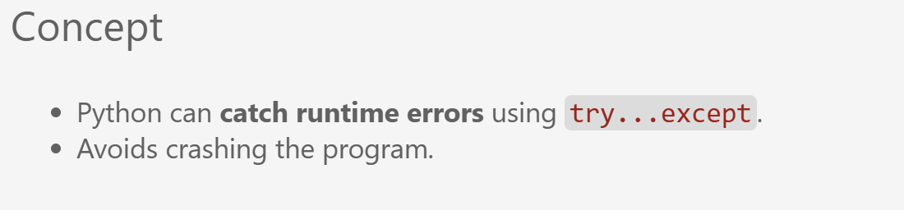

Error Handling and Exception Concepts
# Attempt to execute the main program logic
Prompt the user to enter a number and convert it to an integer. Compute and print the reciprocal of the number
# Multiplicative Inverse
Handle the case where input cannot be converted to an integer.
Handle the case where division by zero occurs.
This block always executes, regardless of whether an exception occurred

Slide 15
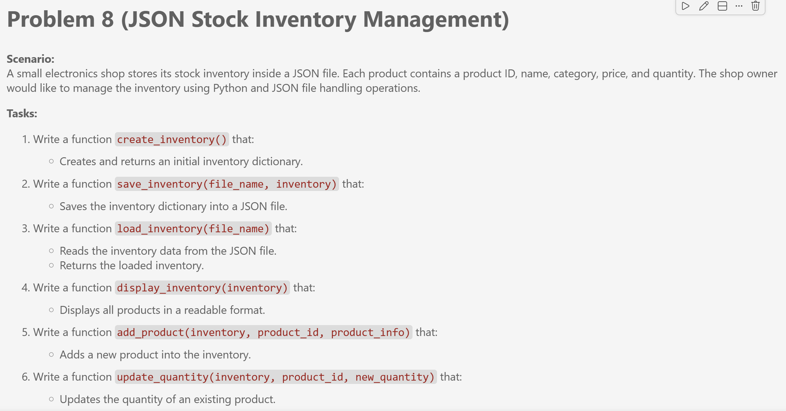
Exercises
Solve Problems 8-9 in “Week5_Exercise.ipynb“ and you have 40 minutes to finish all the problems. Don’t forget to split your screen.

Slide 16
What did we learn today?
Files Systems and Directory Structure
Reading and Writing Text Files
Hierarchical structure of directories / folders
Text Files
62.0
Working with CSV Files
Structured Data Formats
CSV Files
JSON Files
Error Handling and Exception Concepts
Error Handling

Slide 17
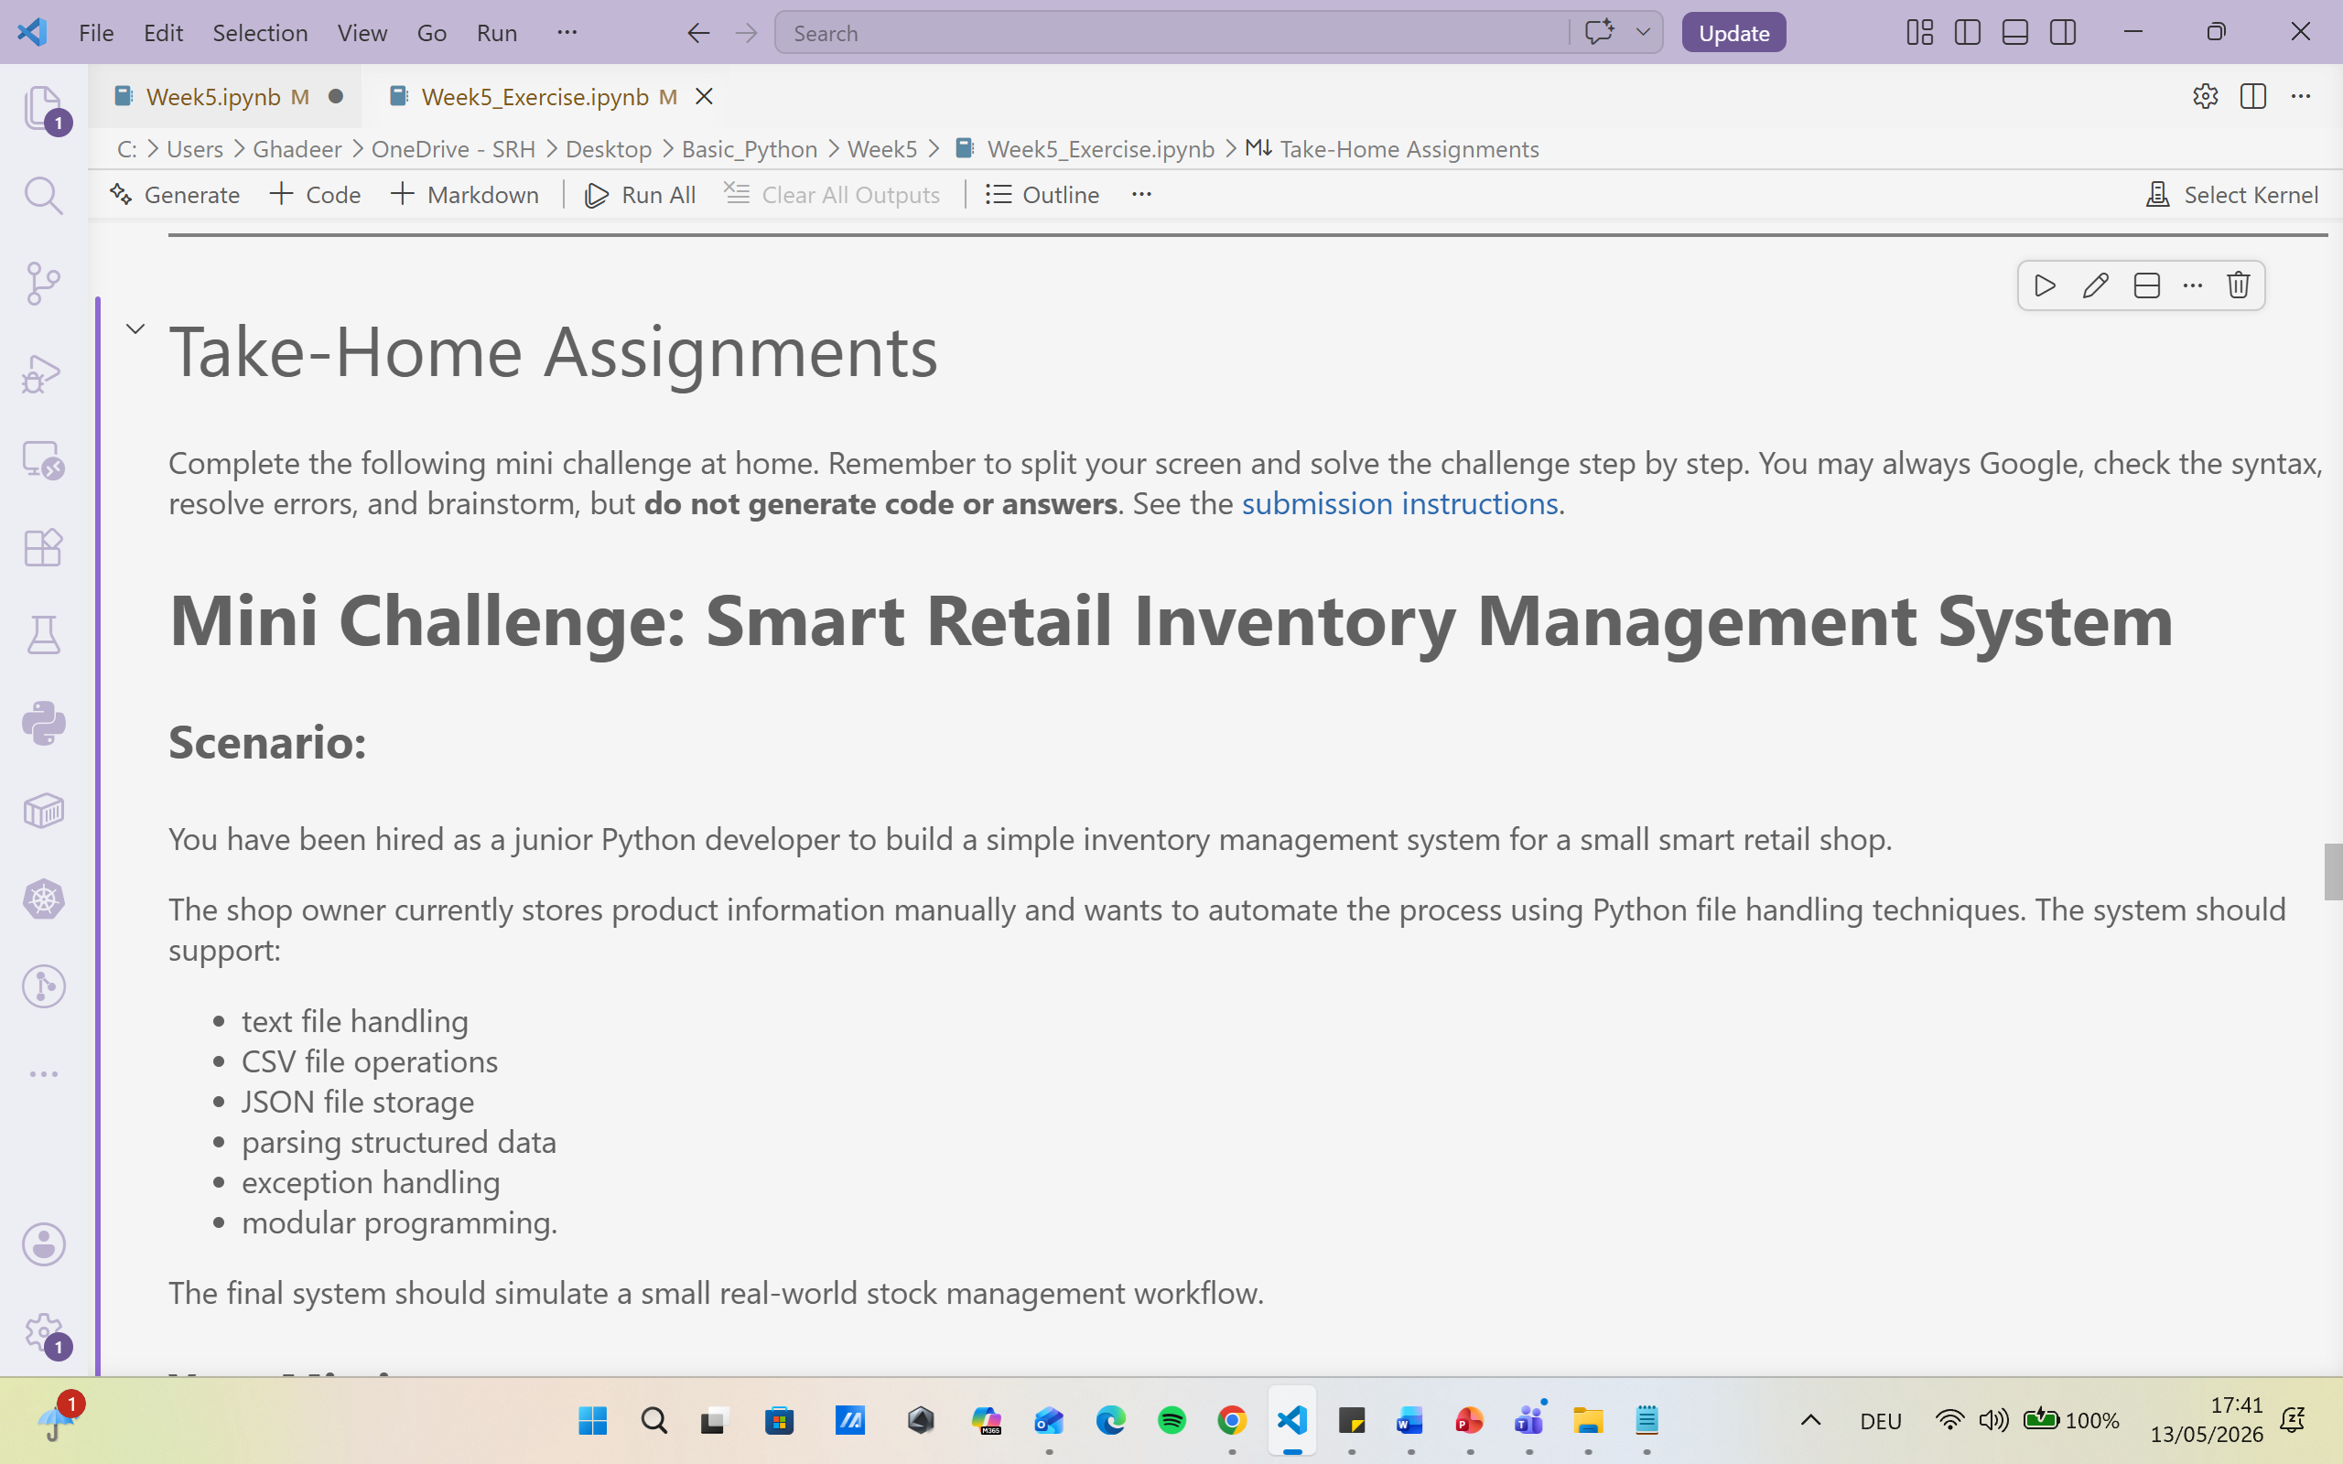
Take-Home Assignment
Solve Mini Challenge: Smart Retail Inventory Management System in “Take-Home Assignments “and push it to your private individual repository in Week(5) directory. The deadline is Wednesday, 20.05.2026, at 23:59. For more details, please have a look at our course’s GitHub Repository and submission instructions.

Slide 18
Coming Up : Week (6) So far, we have stored data in files and handled errors when reading and writing. How can we now work with data at scale by loading, exploring, cleaning, and summarising datasets using Python's most powerful data tools? • Role of NumPy in numerical computing • Arrays and vectorized operations • pandas Series and DataFrames • Loading structured datasets• Data selection, filtering, and aggregation • Basic descriptive statistics • Data cleaning principles

Slide 19

Your Voice Matters: Lab Session Feedback

Slide 20

Dr. Ghadeer Mobasher
ghadeer.mobasher@srh-hochschulen.de
https://www.linkedin.com/in/ghadeermobasher/
LGS 6, 2. OG, Arc 213

