Slide 1
Real time face mask detection
- dr. ranjeet kumar ranjan
1.Rohit reddy (23bcs205)
2.Raj harsha (23bcs234)
3.Sai sangeeth (23bcs177)
4.Sharvaani (23bcs230)
5.Vyshnavi (23bcs156)

Slide 2
about
1. Introduction : CamMask AI is a real-time face mask detection system developed using the YOLOv8s model from Ultralytics. It classifies individuals into five categories based on mask usage, aiming to help enforce mask-wearing in public areas.
2. Problem Statement : Due to the COVID-19 pandemic and similar future events, it is essential to identify whether individuals are properly wearing face masks. Traditional surveillance requires manual monitoring, which is inefficient. This project automates this process using deep learning.

Slide 3
objectives
Detect and classify 5 face-mask-related classes in real time: Mask Worn Properly, No Mask, Nose Visible, Mouth Visible, and Remove Hand.
Use live webcam feed or static image input for flexible detection options.
Achieve high detection accuracy (mAP50 of 0.9798) and robust classification across varied face positions.
Ensure fast and lightweight inference using YOLOv8 for real-time performance.
Enable reliable multi-face detection under different lighting and background conditions.

Slide 4
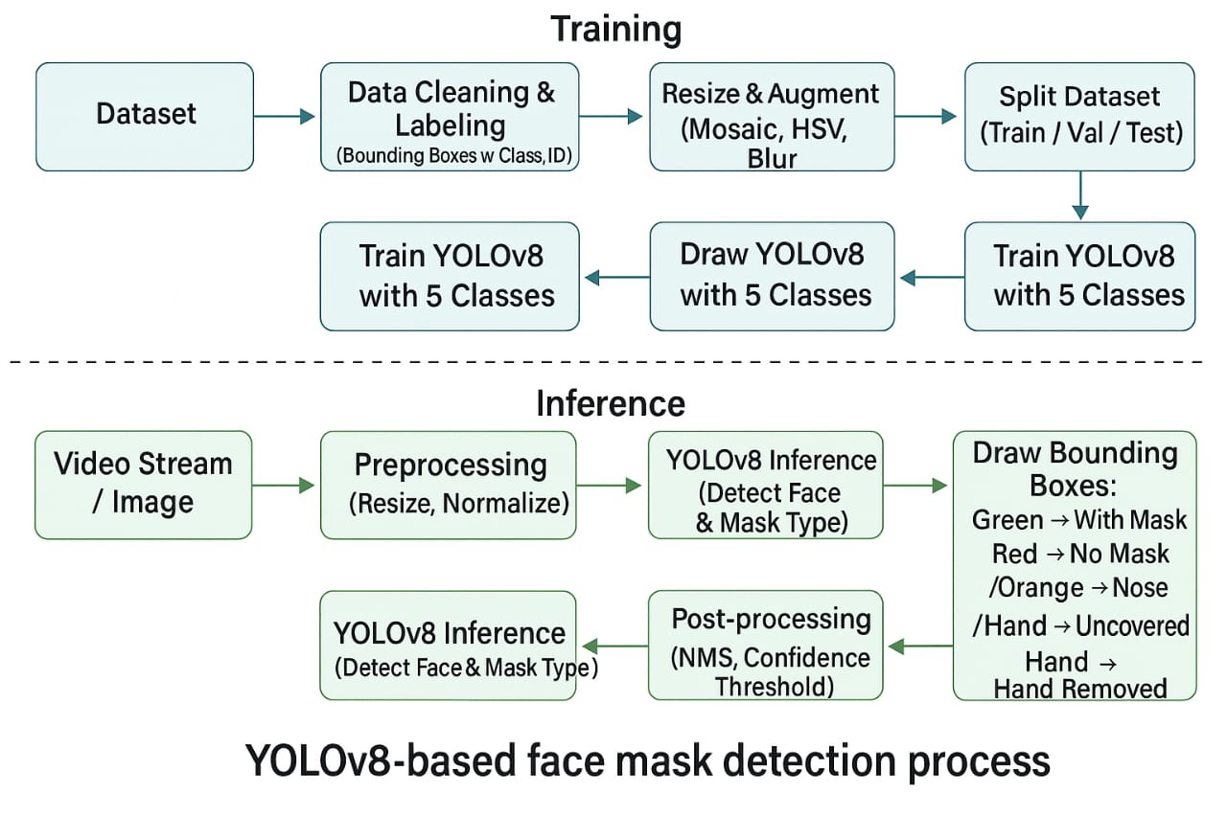
Model architecture

Slide 5
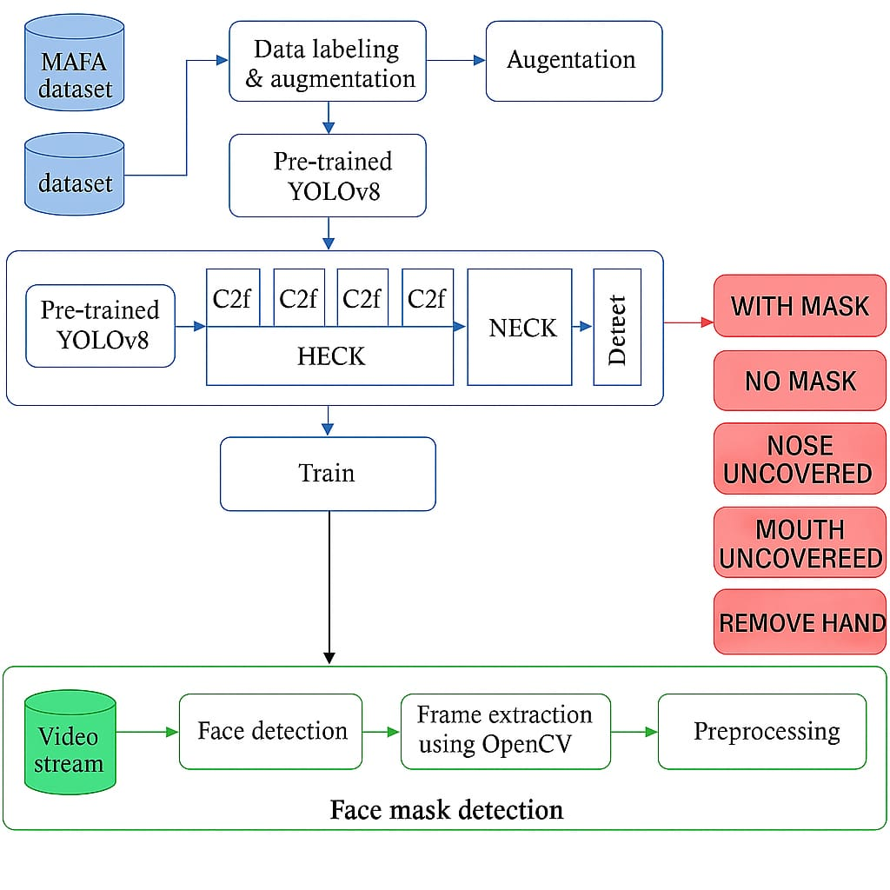

Slide 6
Dataset
TRAIN SET: Class 0: 6389 images Class 1: 6759 images Class 2: 6945 images Class 3: 6855 images Class 4: 4606 images
VAL SET: Class 0: 1755 images Class 1: 1977 images Class 2: 1963 images Class 3: 2004 images Class 4: 658 images
TEST SET: Class 0: 900 images Class 1: 953 images Class 2: 975 images Class 3: 1023 images Class 4: 1323 images
OVERALL TOTAL: Class 0: 9044 images Class 1: 9689 images Class 2: 9883 images Class 3: 9882 images Class 4: 6587 images

Slide 7
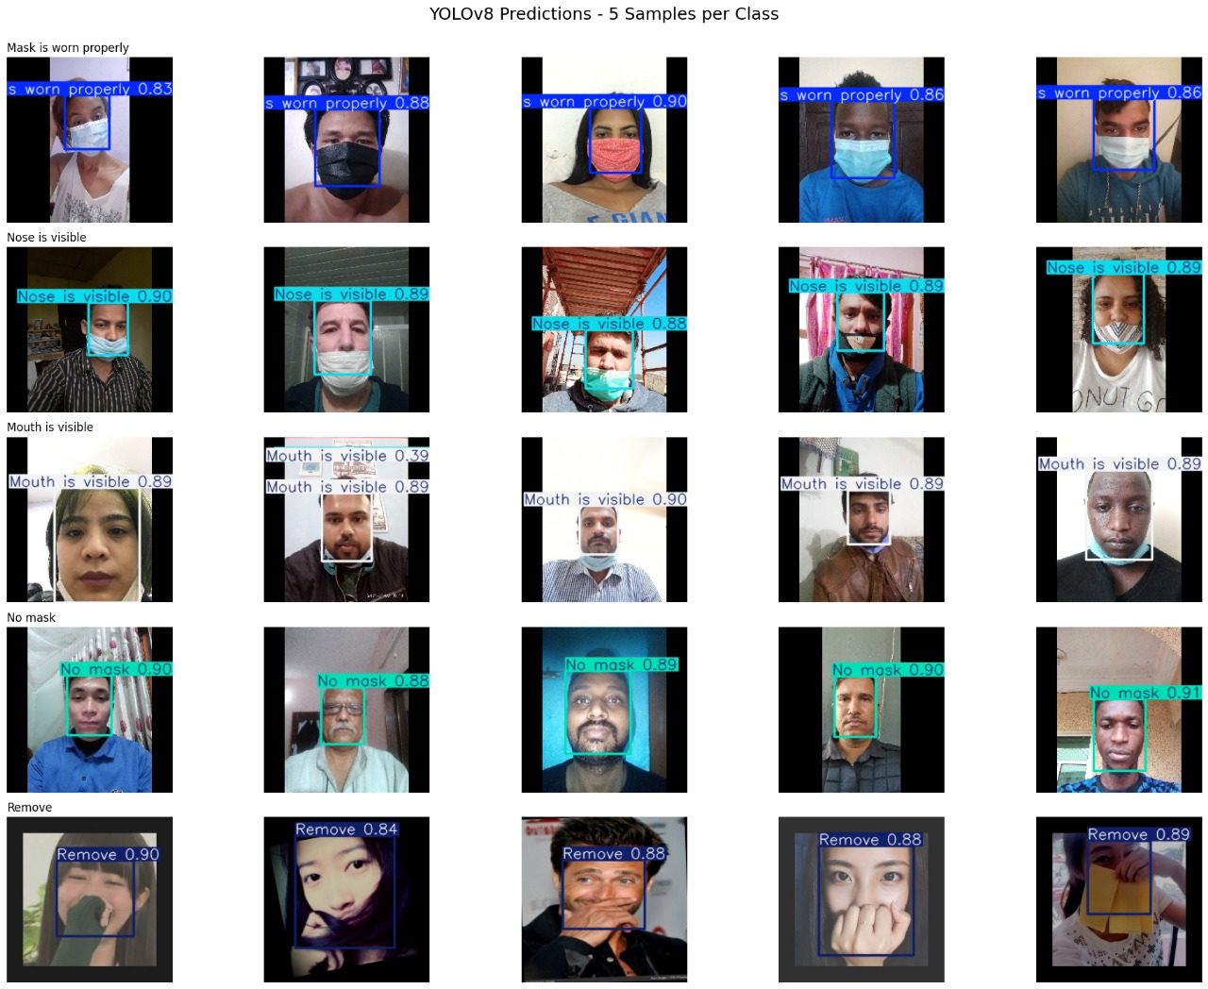

Slide 8
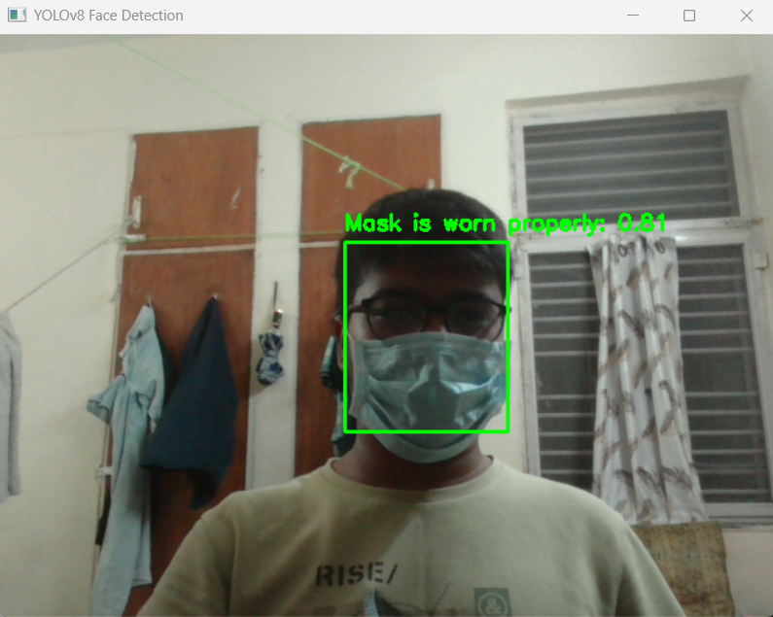
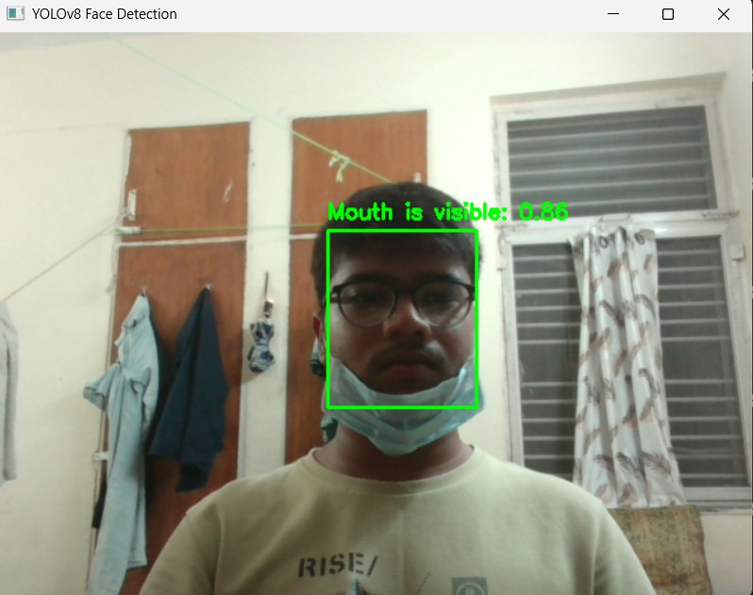
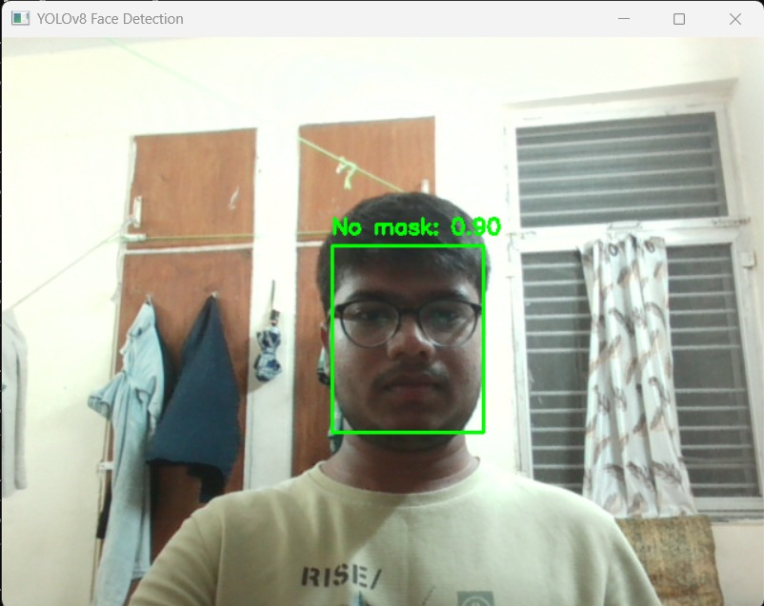
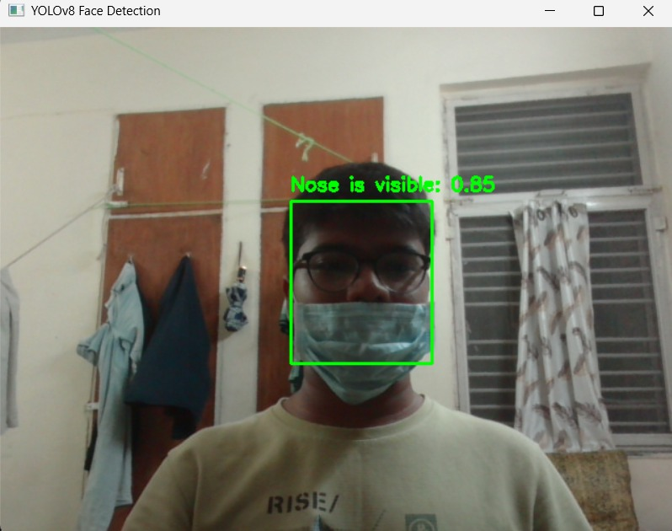
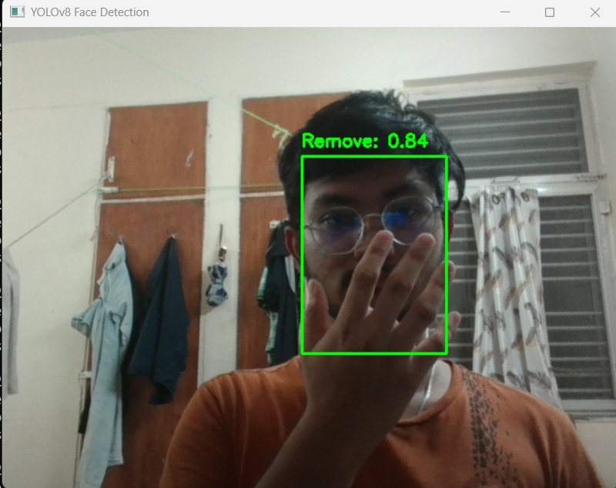

Slide 9
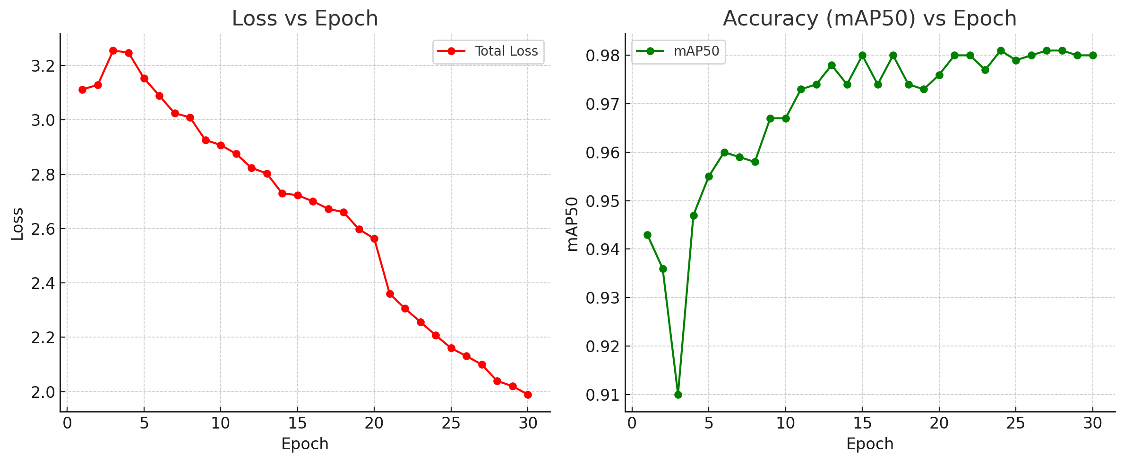
Loss and Accuracy over Epochs

Slide 10
Performance metrics
mAP@0.5: 0.9798 → Mean Average Precision (IoU ≥ 0.5) — commonly used as accuracy proxy
Precision: 97.11% → High accuracy in positive predictions.
Recall: 95.94% → High ability to detect actual positives.
F1 Score ≈ 0.9648 (96.48%) → combined metric of Precision and Recall

Slide 11
THANK YOU

