Slide 1
RREVIEW-3 · OCTOBER 2026
Time-Series Demand Forecasting:
Feature Selection and Hybrid Residual Correction
A Leakage-Safe Comparative Evaluation of Statistical, Machine-Learning and Hybrid Models
STUDENT
ROLL NO.
DEPARTMENT
GUIDE
REVIEW
N.Abhinav
M Siddardha
J Sridarsh
G Anirudh
2420030470
2420030214
2420030145
2420030758
CSE
Dr.Swapnika
Review-3 — October 2026
RESEARCH QUESTION
How does feature selection and hybrid residual correction affect forecasting performance for demand time-series data?
Flow: Literature → Baselines → Gap → Hybrid Candidates → Validation → Unseen Test → Comparison → Explanation
Notes:
This review presents a leakage-safe comparison of statistical, machine-learning and hybrid forecasting models. The central question is how feature selection and hybrid residual correction affect demand time-series forecasting performance.

Slide 2
LITERATURE REVIEW
GAP → PROPOSED DIRECTION
Existing literature
Specific combination, controlled protocol
Naive and Seasonal Naive; Holt-Winters; AutoRegressive models
01
Existing techniques separately address seasonality, nonlinear relationships, redundancy and residual errors.
Simple RF + Naive or RF + Seasonal Naive combinations are not themselves novel.
Seasonal Naive + training-only two-stage feature selection + RF residual correction + validation-selected correction strength + leakage-safe evaluation.
Novelty is claimed only for the specific combination and experimental protocol; global novelty is not claimed.
Random Forest, feature selection, statistical + ML hybrids, residual learning
02
Ozdemir & Yozgatligil (2024): ML, time-series and hybrid forecasting comparison
03
Mejía & Aguilar (2024): feature engineering, correlation filtering, RF selection and ensemble learning
04
IEEE 2026: RF–Naive hybrid already published; IEEE 2024: Seasonal Naive + tree ensemble approaches already published
05
TIME-SERIES DEMAND FORECASTING: FEATURE SELECTION AND HYBRID RESIDUAL CORRECTION
02 / 09
Notes:
The literature covers classical baselines, Random Forest, feature selection and hybrid residual learning. The gap is not a claim that RF and Seasonal Naive are individually new. The proposed direction is the specific combination and its leakage-safe experimental protocol.

Slide 3
EXPERIMENTAL DESIGN
Research methodology and experimental design
Study published models
Reproduce baselines
01
02
Identify the gap
Engineer temporal features
03
04
Select features using training data only
Generate multiple hybrid candidates
05
06
Select using validation data
Run the final unseen test
07
08
Compare statistically and visually
Explain model behaviour
09
10
LEAKAGE PROTECTION
TRAIN → VALIDATION → TEST
No shuffling; test remains unseen; feature selection uses training only; hybrid selection uses validation only; final test is evaluation only.
TIME-SERIES DEMAND FORECASTING: FEATURE SELECTION AND HYBRID RESIDUAL CORRECTION
03 / 09
Notes:
The workflow proceeds from literature to baselines, feature engineering and selection, candidate hybrids, validation, unseen testing, comparison and explanation. The key protection is the strict TRAIN to VALIDATION to TEST separation. No shuffling is used.

Slide 4
Prescribed Dataset and Implemented Models
DATASET RECORD
IMPLEMENTED MODELS
Actual NN5-001 experiment
Baselines, ML and hybrids
File | NN5_FINAL_DATASET_WITH_TEST_DATA.xlsx
Frequency | Daily · 791 observations · seasonal period = 7
Split | Train = 596 | Validation = 106 | Final test = 56
Test period | 23 Mar 1998 – 17 May 1998
Demand | CV ≈ 0.42 · zero-demand ≈ 0.6%
Baselines
ML
Hybrids
Naive
Seasonal Naive
Holt-Winters
AutoReg
RF Basic
RF All Features
RF Selected Features
H1 Equal Blend
H2 Validation-Optimized Blend
H3 Proposed DCRF Residual Hybrid
Scope note: only the supplied NN5-001 run is verified; do not claim all five benchmark datasets were executed.
TIME-SERIES DEMAND FORECASTING: FEATURE SELECTION AND HYBRID RESIDUAL CORRECTION
04 / 09
Notes:
The experiment uses the prescribed NN5-001 file, with daily observations and a weekly seasonal period. The data are split into 596 training, 106 validation and 56 final test observations. Only this supplied NN5-001 run is verified.

Slide 5
Feature Selection and Multiple Hybrid Candidates
FEATURE SELECTION
MULTIPLE HYBRID CANDIDATES
Training-only selection focuses the RF
Different correction ideas were tested
H1 · Equal blend
17 candidate features → 14 after correlation filtering → 8 selected features
01
0.5 RF Selected + 0.5 Seasonal Naive
SELECTED TEMPORAL SIGNALS
lag_7, lag_28, lag_14, lag_1
change_1, change_7, growth_7, rolling_std_7
H2 · Optimized blend
02
Validation-optimized RF Selected + Seasonal Naive blend
Selection was fitted using training data only.
H3 · Proposed DCRF
03
Seasonal Naive → residual calculation → RF residual correction → final forecast
Multiple hybrid combinations were implemented and evaluated before final selection.
TIME-SERIES DEMAND FORECASTING: FEATURE SELECTION AND HYBRID RESIDUAL CORRECTION
05 / 09
Notes:
Feature selection reduces 17 candidate features to 14 after correlation filtering and then to 8 selected features. Selection uses training data only. Three hybrid candidates are evaluated: equal blending, validation-optimized blending and the proposed residual-correction architecture.

Slide 6
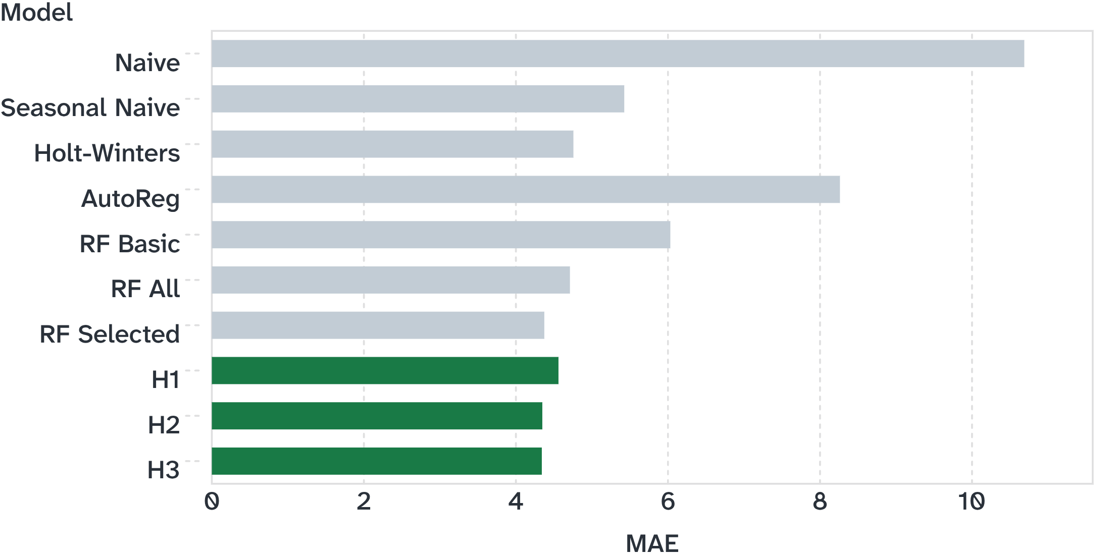
VALIDATION → UNSEEN TEST
Validation selected H2; H3 had the lowest observed test MAE
FINAL UNSEEN-TEST MAE BY MODEL
VALIDATION CANDIDATE COMPARISON
H2 = 6.671429 MAE — validation winner
H3 = 6.813035 MAE
H1 = 6.844132 MAE
Selection rule: H2 was selected using validation data. H3 had the lowest observed test MAE, but was not retroactively selected using test performance.
TIME-SERIES DEMAND FORECASTING: FEATURE SELECTION AND HYBRID RESIDUAL CORRECTION
06 / 09
Notes:
Validation selected H2 because it had the lowest validation MAE at 6.671429. On the final unseen test, H3 recorded the lowest observed MAE at 4.3404, followed closely by H2 at 4.3471. The test result was not used to select the model.

Slide 7
FINAL TEST COMPARISON
Performance, statistical and visual comparison
MODEL | MAE | RMSE | SMAPE
Naive | 10.6867 | 12.5965 | 27.4590%
Seasonal Naive | 5.4245 | 6.6480 | 15.2515%
Holt-Winters | 4.7557 | 6.1168 | 14.1948%
RF All | 4.7101 | 6.0615 | 13.1242%
RF Selected | 4.3733 | 5.5679 | 12.2693%
H2 | 4.3471 | 5.4926 | 12.2913%
H3 | 4.3404 | 5.6121 | 12.3119%
FEATURE-SELECTION IMPACT
EXPLORATORY PAIRED-ERROR COMPARISONS
RF All MAE 4.7101 → RF Selected MAE 4.3733
Observed reduction ≈ 7.15%
Hybrid vs Seasonal Naive p = 0.006766
Hybrid vs Holt-Winters p = 0.348211
Hybrid vs RF All p = 0.288953
Hybrid vs RF Selected p = 0.993492
Do not claim universal statistical superiority.
Visual evidence: actual vs predicted test-period plot, model MAE comparison, feature-importance plot, residual/error comparison.
TIME-SERIES DEMAND FORECASTING: FEATURE SELECTION AND HYBRID RESIDUAL CORRECTION
07 / 09
Notes:
Feature selection reduced RF test MAE from 4.7101 to 4.3733, an observed reduction of approximately 7.15%. The paired-error comparisons are exploratory. The p-values do not support a claim of universal statistical superiority. Visual evidence includes the actual versus predicted plot, MAE comparison, feature importance and residual/error comparison.

Slide 8
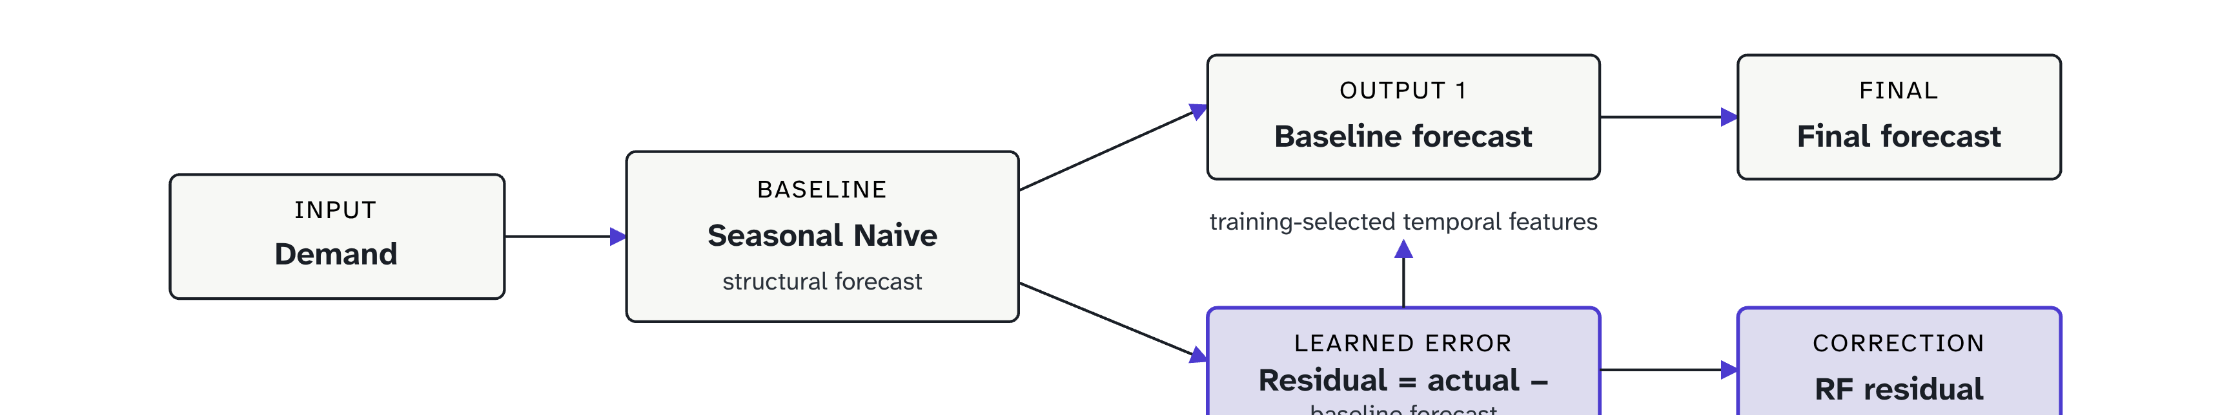
MODEL INTERPRETATION
Why does the hybrid behave differently?
01
02
03
04
STRUCTURE
NONLINEARITY
FOCUS
TASK SHIFT
Seasonal Naive captures recurring weekly demand structure.
Random Forest captures nonlinear relationships among lag, change and rolling temporal features.
Feature selection reduces redundant or less useful predictors and focuses RF on stronger temporal signals.
Residual learning targets systematic errors remaining after the structural forecast, not the entire demand series.
Seasonal Naive MAE = 5.4245 · RF Selected MAE = 4.3733 · H2 MAE = 4.3471 · H3 MAE = 4.3404
Interpretation: the hybrid can improve forecasts when the baseline captures structure and residuals contain learnable temporal information; improvement is dataset/series dependent.
TIME-SERIES DEMAND FORECASTING: FEATURE SELECTION AND HYBRID RESIDUAL CORRECTION
08 / 09
Notes:
The hybrid behaves differently because each component has a distinct task. Seasonal Naive captures weekly structure. Random Forest captures nonlinear temporal relationships. Feature selection focuses the RF. Residual learning changes the prediction target from the full demand series to the systematic error left by the baseline.

Slide 9
CONCLUSION
Research findings
Existing forecasting and hybrid literature reviewed; baseline and literature-grounded models implemented.
Research gap identified and existing workflow modified.
Three hybrid candidates evaluated with validation-based selection.
Prescribed NN5-001 dataset executed; final 56-step unseen test completed.
Multiple forecasting metrics, statistical comparisons and visual comparisons performed.
Hybrid behaviour explained; preliminary literature-based novelty verification completed.
KEY FINDINGS
Seasonal Naive strongly outperformed Naive.
RF benefited from temporal features; feature selection reduced RF test MAE by ≈7.15% on NN5-001.
H2 was the validation-selected hybrid; H3 achieved the lowest observed test MAE.
Test performance was not used to select the model; hybrid superiority is not assumed universal.
The project provides a leakage-safe, reproducible framework for evaluating how temporal feature selection and hybrid residual correction affect demand forecasting performance.
TIME-SERIES DEMAND FORECASTING: FEATURE SELECTION AND HYBRID RESIDUAL CORRECTION
09 / 09
Notes:
The work reviewed the literature, identified a specific gap, implemented the prescribed NN5-001 experiment and completed a 56-step unseen test. H2 was selected using validation, while H3 had the lowest observed test MAE. The conclusion remains appropriately scoped: hybrid improvement is dataset and series dependent, and global novelty or universal superiority is not claimed.

