Slide 1
FEDERAL REAL PROPERTY PROFILE
The federal Real Property Profile (FRPP) dataset servers as a comprehensive repository real property like City, State, Country, Address, owned, leased, Property type, Parking Spaces.
Dataset provides valuable insight from the federal government real estate holdings, facilitating strategic decision-making, asset management and policy department. It Includes details information such as property type, parking spaces.

Slide 2
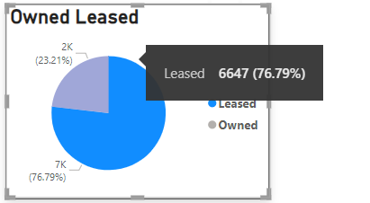
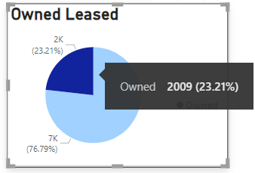
The Leased building has garnered 6,647 , which accounts for approximately 76.79% of the total. This indicated a significant level of approval and Interest in the property.
The owned building has accumulated 2009, making up 23.21% if the total buildings. This suggests notable level of appreciation and support for the property.
Leased property type has most accumulated building which means 53.58% increased by owned property buildings.
Because of their leased property owners are swift to other country or state for day to day work.

Slide 3
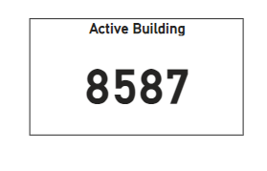
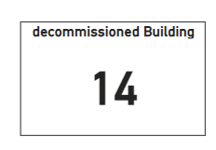
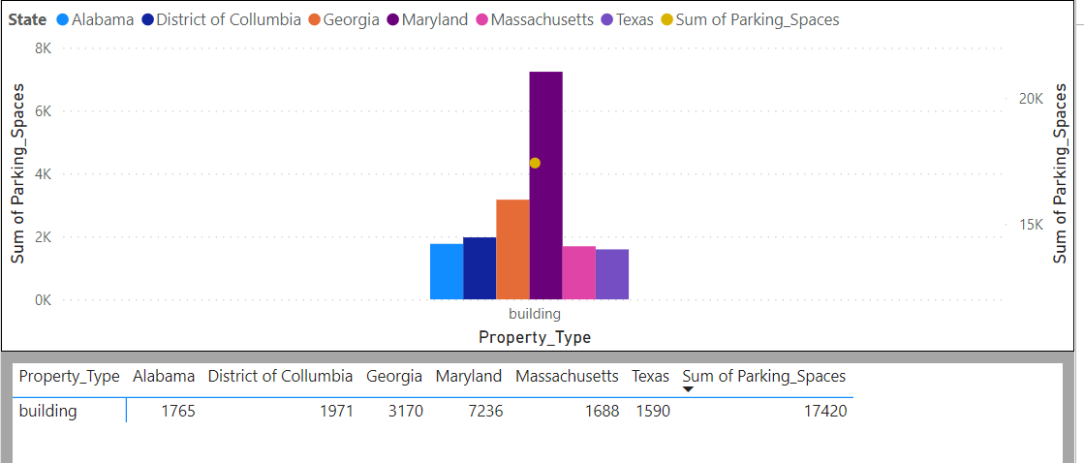
Active building have 8587 accumulated like all over buildings are active because of metropolitan areas are the most building.
Their least of the buildings are like 14 decommissioned for what their buildings are not maintenance.
Over all evaluated parking spaces Marland has most parking spaces because of their building property so that’s why has parking space.
Secondly Georgia has 3170 Parking spaces with this also building property slightly increase in total.

Slide 4
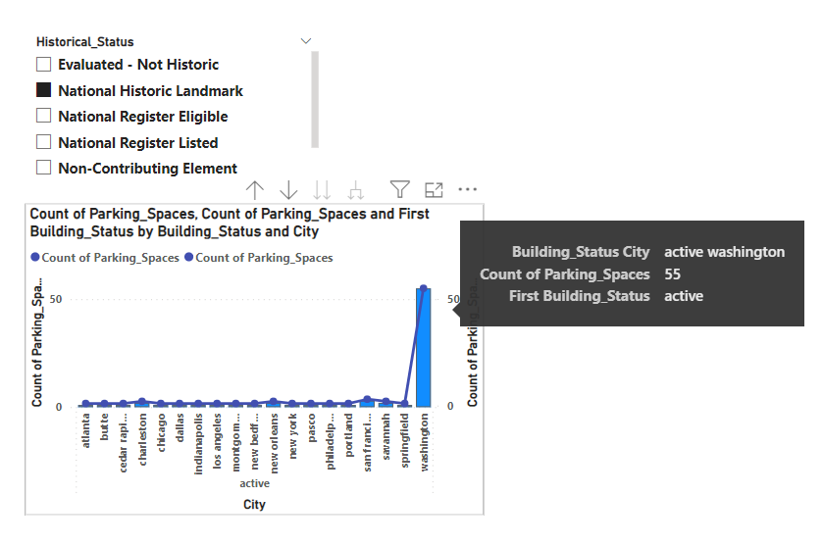
Washington has most parking spaces with National Historic Landmark around 55.
Next of San Francisco has most parking spaces.
In Summary, The federal Real Property Profile dataset represents a valuable resources, managing, optimizing the vast real estate portfolio of the United States government, Contributing to effective governance and public service delivery.

