Slide 1
FINAL PRESENTATION GROUP - 11
LATE DELIVERY RISK PREDICTION

Slide 2
Batch details : DSE – July 2022 (Chennai)
Team Members : Sridhar T
Sakthivel M C
Madhuranya S
Nithin S
Asher J F
Project Domain : Logistics (Supply Chain)
Proposed Project Title : Late – Delivery Risk Prediction
Group Number : Group 11
Mentor Name : Pratik Sonar

Slide 3
PROBLEM STATEMENT
Many industrial companies are working to optimize the supply chain system in order to produce products and deliver them on time. The time between placing an order and receiving it is referred to as delivery time. As a result, the concept of delivery time can be said to be related to customer perception of performance. The project focuses on predicting late order delivery risk in order to ensure that appropriate measures are taken ahead of time to avoid them.

Slide 4
BUSINESS UNDERSTANDING
When a customer orders a product, they expect it to reach as early as possible as the current trend of the world is all about being instant and quick. Late Delivery is considered bad for the business as it is directly compared with the performance of the company. ML Predictive analysis can schedule the production, supply chain and inventory to help in forecasting product delivery delay which in return increase the customer satisfaction.
In the modern world of E-commerce, a wide range of products are readily available at customers disposal. Consequently, the number of orders handled by the E-commerce business holders in a day has sharply increased. Nevertheless, despite all the cutting-edge business models, machine learning techniques it's hard to cope with extensive uncertainty in the number of orders and to maintain on time delivery.
Nowadays, most of the company’s use Machine learning predictive analysis to predict late orders to overcome the additional expenses incurred. We have performed some. The outcomes of the project are to help to choose the appropriate machine learning model for predicting late order delivery risk.

Slide 5
DATA DESCRIPTION
FIELDS | DESCRIPTION
Type | Type of transportation mode (DEBIT, TRANSFER, CASH, PAYMENT)
Days for shipping (real) | Actual shipping days of the product
Days for shipping (scheduled) | Days of scheduled delivery of the purchased product
Benefit per order | Earnings per order placed
Sales per customer | Total sales per customer
Delivery status | Delivery status of order : Advance shipping, Late delivery, Shipping Canceled, Shipping on time
Category ID | Product category code
Category Name | Description of the product category
Customer city | City where the customer made the purchase
Customer Country | Country where the customer made the purchase
Customer Email | Customer’s Email ID

Slide 6
DESCRIPTION
Fields | Description
Customer Fname | Customer’s Email ID
Customer ID | Customer’s Id
Customer Lname | Customer’s Last name
Customer Password | Masked customer key
Customer segment | Types of customer (Consumer, Home Office, Corporate)
Customer state | State to which the store where the purchase is registered belong
Customer street | Street to which the store where the purchase is registered belong
Customer zipcode | Customer zipcode
Department ID | Department code of the store
Department Name | Department name of the store
Latitude | Latitude corresponding to location of store
Longitude | Longitude corresponding to location of store
Market | Market to where the order is delivered (Pacific Asia, USCA, Africa, Europe, LATAM)

Slide 7
description
Fields | Description
Order city | Destination city of the order
Order country | Destination country of the order
Order Customer ID | Customer order code
Order date (DateOrder) | Date on which the order is made
Order ID | Order Code
Order Item cardprod ID | Product code generated through the REID reader
Order Item Discount | Order item discount value
Order Item Discount Rate | Order item discount percentage
Order Item ID | Order item code
Order Item Product Price | Price of products without discount
Order Item Profit Ratio | Order Item Profit ratio
Order Item Quantity | Number of products per order
Sales | Value in sales

Slide 8
description
Fields | Description
Order Item Total | Total amount per order
Order Profit Per Order | Order Profit Per Order
Order Region | Region of the world where the order is delivered
Order State | State of the region where the order is delivered
Order Status | Status of the order
Product Card Id | Product Code
Product Category Id | Product category code
Product Description | Product Description
Product Name | Product Name
Product Price | Product Price
Product Status | Status of the product stock
Shipping Date (DateOrders) | Exact date and time of shipment
Shipping Mode | Modes of shipping (Standard Class, First Class, Second Class, Same Day)

Slide 9
Variable categorization
1. Independent variables:
Numerical column: 28
Categorical column: 23
2. Target variable:
Categorical (encoded) - 1
3. Total columns: 53

Slide 10
Preprocessing Data

Slide 11
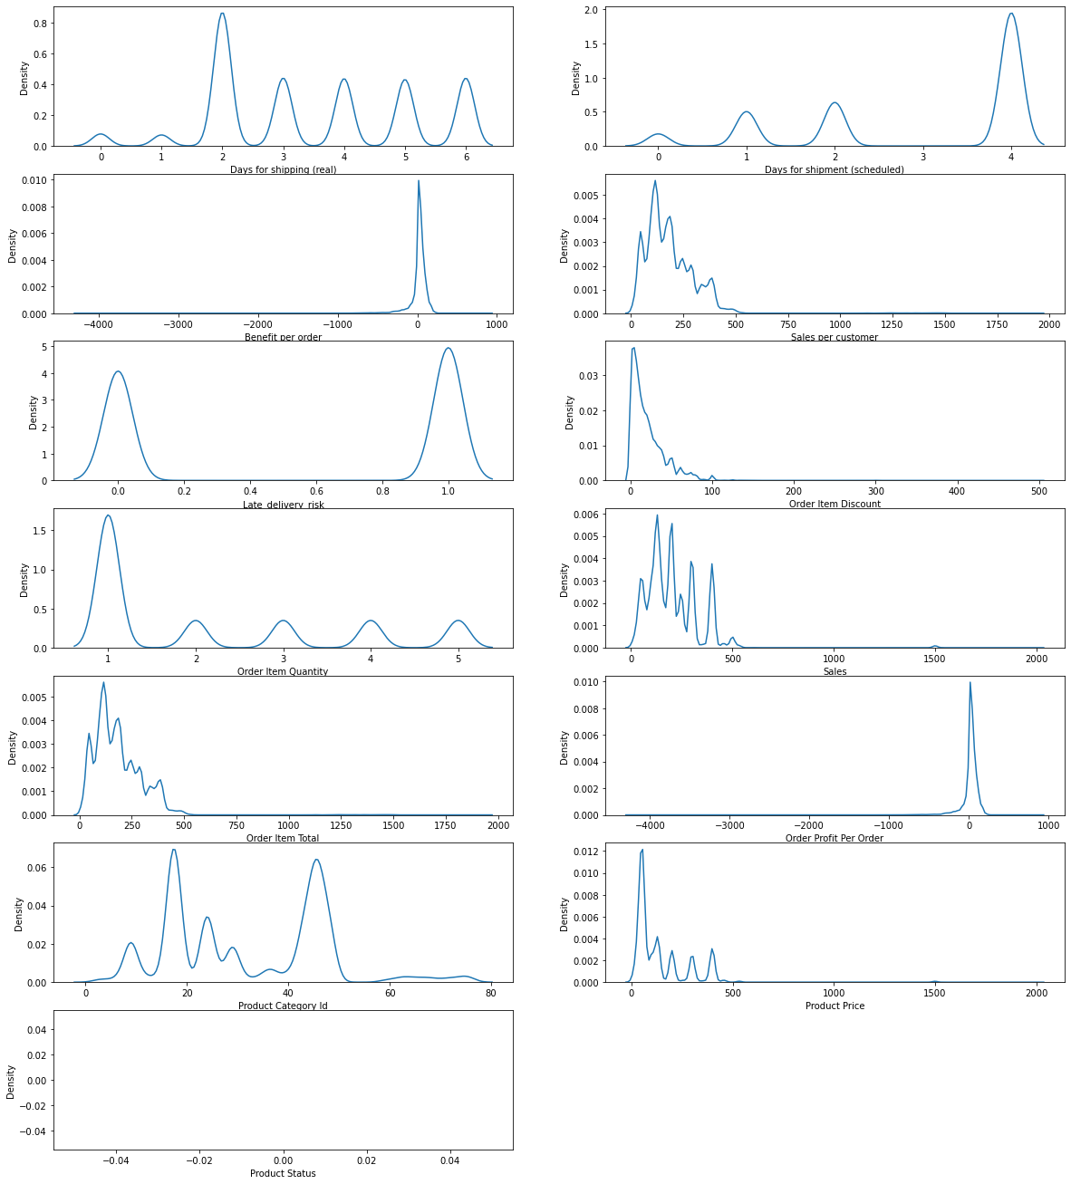
Distribution of numeric variabels

Slide 12
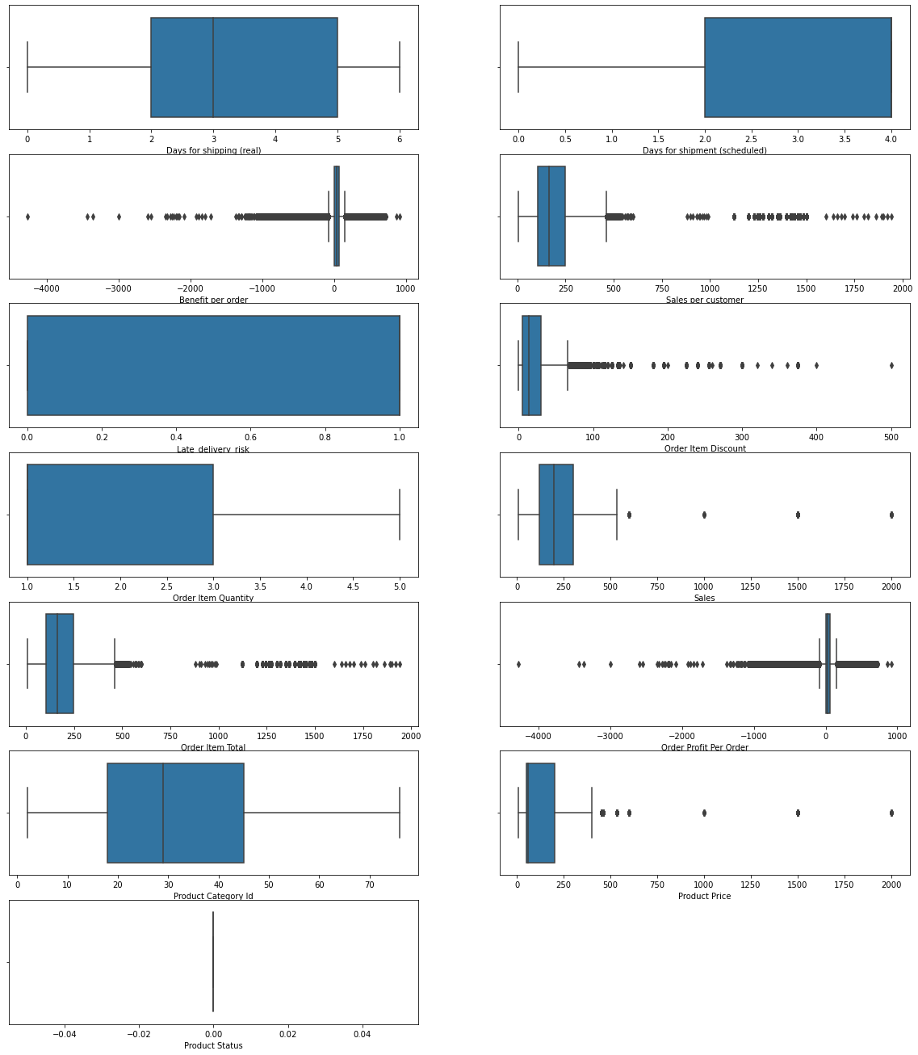
Outliers of numeric variables

Slide 13
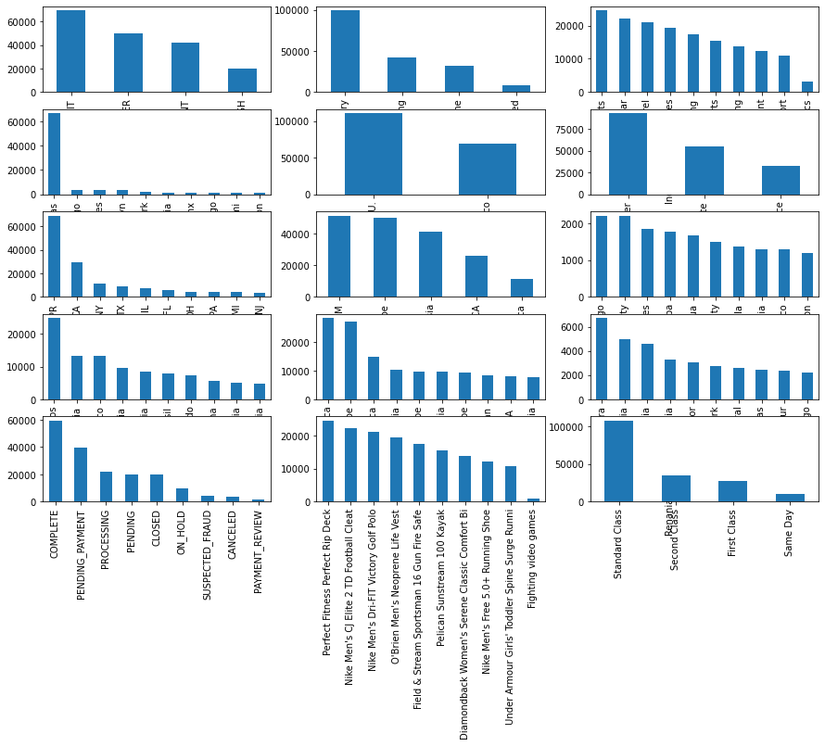
Visualization in categorical variables

Slide 14
Redundant features
'Delivery Status','Category Name','Customer Email', 'Customer Fname', 'Customer Id’,
'Customer Lname', 'Customer Password', 'Customer Street', 'Customer Zipcode', 'Department Name’,
'Latitude', 'Longitude','Order Customer Id','order date (DateOrders)', 'Order Id’,
'Order Item Cardprod Id','Order Item Discount','Order Item Id','Order Region', 'Order State’,
'Order City','Product Card Id', 'Product Category Id', 'Product Name', 'Product Price’,
'Product Status', 'shipping date (DateOrders)', 'Benefit per order', 'Sales per customer','Order Item Product Price'
The above features are considered redundant / don’t add any value to the dataset and hence can be dropped.

Slide 15
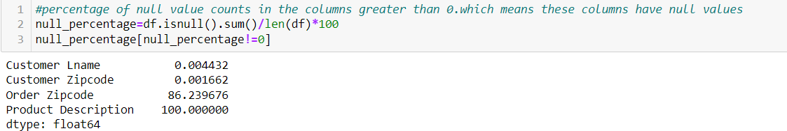
Null value Detection
From the above figure, it is seen that only 4 variables have null values. The variable ‘Product Description’ has 100% null values, so the variable can be dropped. The other variables having null values are ‘Customer Lname’, ‘Customer Zipcode’, ‘Order Zipcode’. These columns contain unique details of customer and order, and so the variables can be dropped

Slide 16
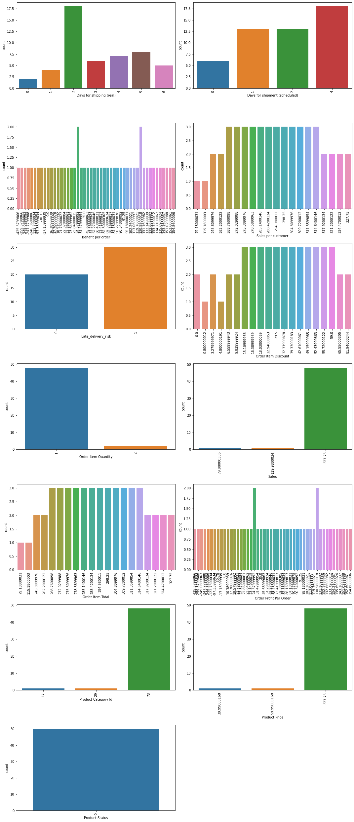
Univariate analysis of numerical variables

Slide 17
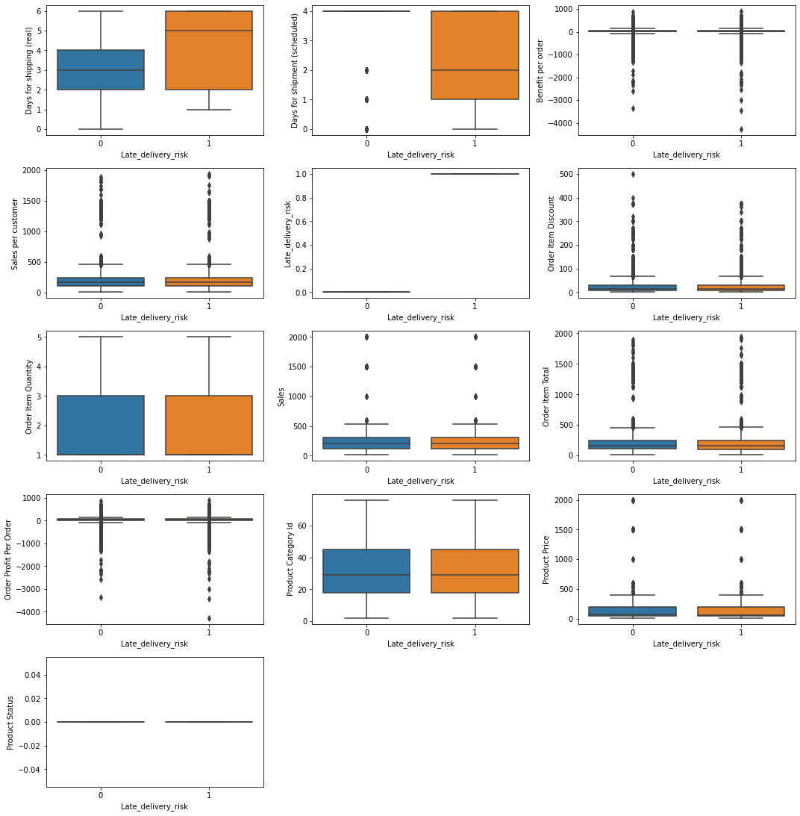
Bivariant analysis of numerical variable

Slide 18
Inferences

Slide 19
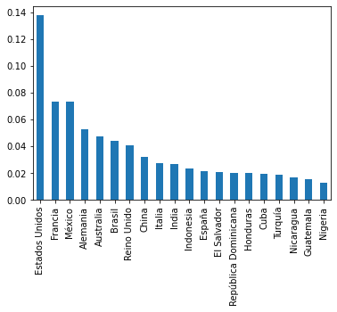
Top 20 order countries where deliveries were late
Estados,France,Mexico,Alemania,Brazil are top 5 countries where deliveries are late

Slide 20
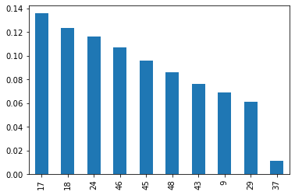
Top 10 Categories that were always delivered late
Category ID 17,18,24,46,45 are the top 5 categories that are always supplied late
17 – Cleats
18 – Men’s Footwear
24 – Women’s Apparel
45 - Fishing
46 – Indoor/Outdoor Games

Slide 21
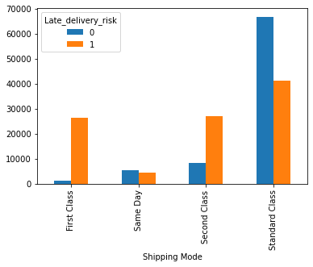
Deliveries according to shipping mode
The graph shows us that First Class shipping and Second Class shipping have the maximum late deliveries comparatively.
Though Standard Class has higher late deliveries the number of on time order are much larger.

Slide 22
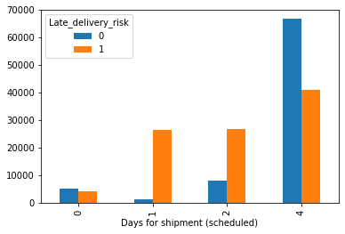
Scheduled shipment
The Shipments scheduled to be sent out in 1 and 2 days have higher percentage of late deliveries meaning the orders scheduled to be sent out on these days were always late

Slide 23
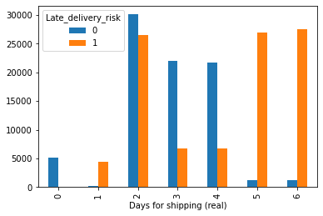
Actual shipping
The graph shows us majority of the orders shipped on the 2nd,5th and 6th day were delayed.
Day 1 shows us that almost all orders sent out were at Risk of Late Delivery.

Slide 24
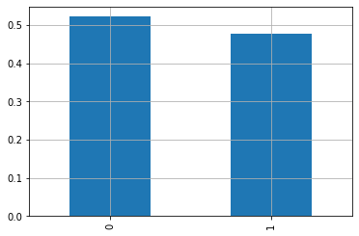
Same day delivery
48% of orders that were scheduled to be delivered on the same day were sent only the next day.

Slide 25
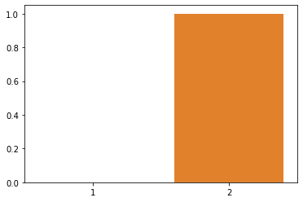
1 day shipments
The shipment's that were suppose to be sent out in 1 day was always pushed to the second day as late shipment

Slide 26
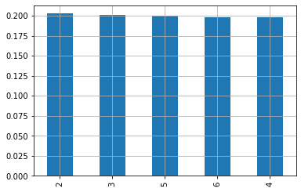
2day delivery scheduled
Only 20% of the order that were scheduled to be sent on the second day were actually sent.
The balance 80% were distributed from 3 to 6 days.

Slide 27
Feature engineering

Slide 28
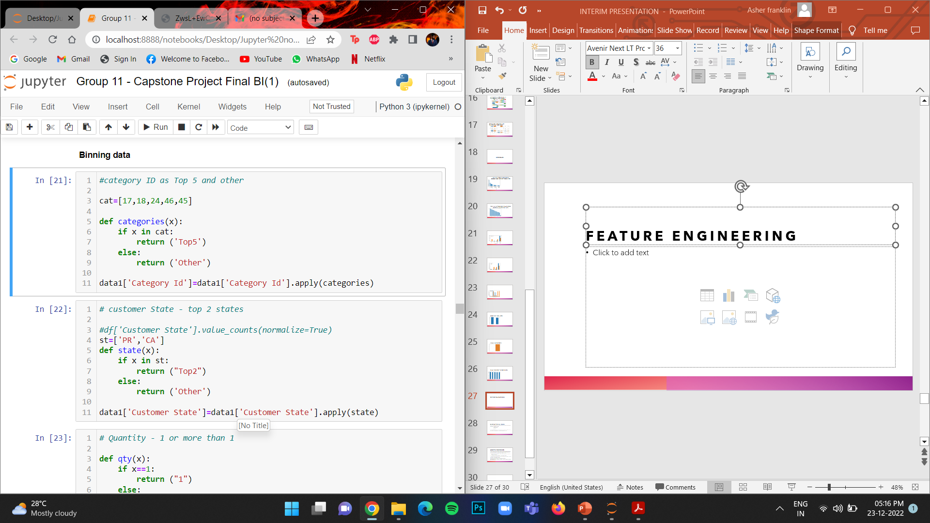
Top 5 categories
The top 5 categories accounted for almost 57% in the data set hence we Bin the category as top 5 and other

Slide 29
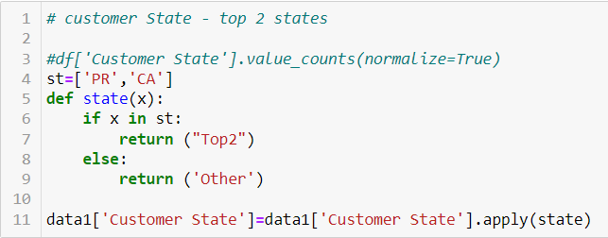
Top 2 states
The states PR and CA are contribute to 61% of the total in the data set hence we bin the 2 states as Top2 and others

Slide 30
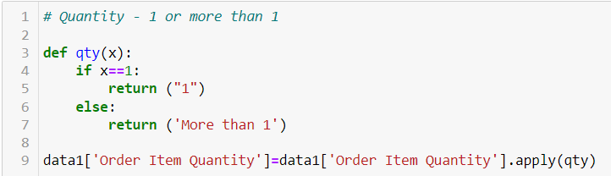
Quantity
Majority of the customers ordered only 1 quantity of the product accounting for 60% of the value in the dataset
Hence quantity is binned at 1 and more than 1

Slide 31
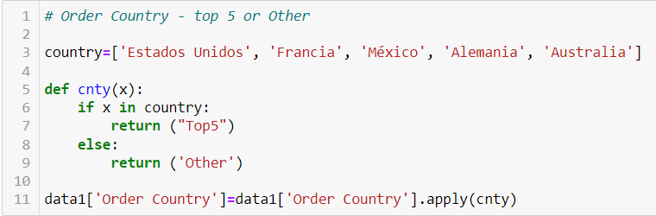
Top 5 order country
The Top 5 countries customers ordered from accounted for 55% in value.
Hence we bin the data as Top5 and other

Slide 32
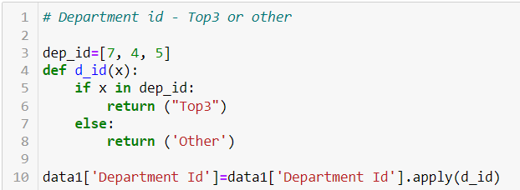
Top 3 department id
The Top 3 Department ID accounted for 55% in the data
Hence we bin the data as Top3 and Other.

Slide 33
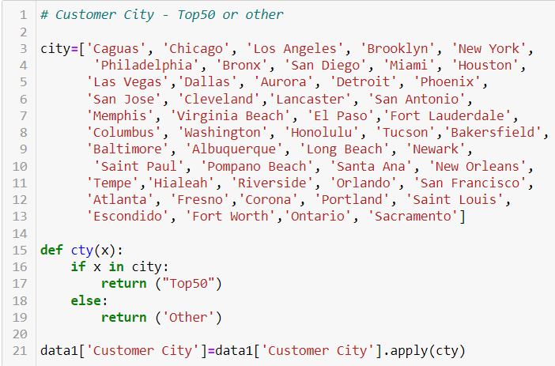
Top 50 Cities
The Top 50 out of 563 cities account for 55% of the total value
Hence we bin the data as Top50 and Other

Slide 34
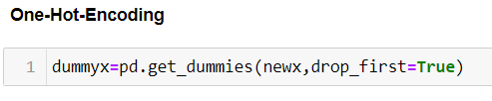
Encoding
The encoding used for the categorical data is One Hot Encoding or Dummy Encoding where the categories are converted to 1’s and 0’s similar to a truth table.
We give the statement ‘Drop first=True’ to make sure there is no collinearity in the data

Slide 35
Base model building
We have used Logistic Regression classification models as base model and the metrics that we used to validate our model is
Classification report
Accuracy score
AUC score
For binary classification, the AUC score and kappa score are the best validation metrics. Hence, we try to increase the AUC score rather than the accuracy score.

Slide 36
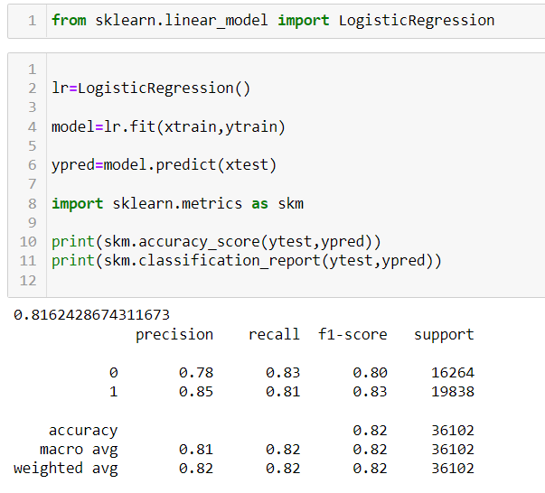

Logistic regression
We have considered Logistic Regression as a base model. The dependent variable has only two values, so we are using binary logistic regression
The Observed AUC score for the base model was 81.72% hence increasing this value will give us a better model.

Slide 37
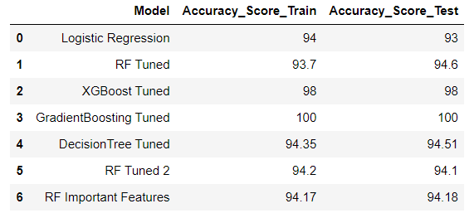
Model summary
The Table shows the summary of the all the models built along with their accuracy score.
From the table we can see that majority of the models lie in the range of 93% to 94%
Random Forest gives an accuracy of 94% and Gradient boosting overfits at 100%

Slide 38
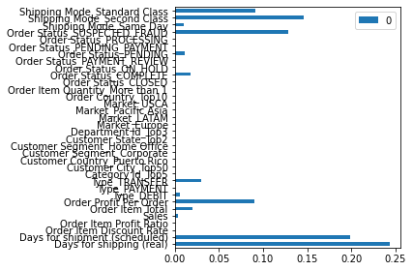
Important features
The Graph shows us the important features that contribute to the model where only 13 features are considered to add relevance to the model
Only those features are enough to build the model to get similar accuracy.

Slide 39
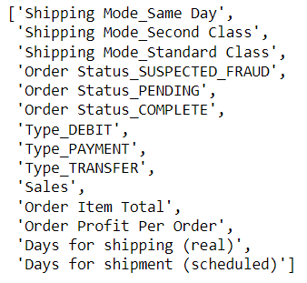
List of important features
The list of 13 features are displayed showing us that from the original features only a select few (8) such as
Shipping Mode
Order Status
Type
Sales
Order Item Total
Order Profit Per Order
Days for Shipping (real)
Days for Shipment (scheduled)
are important to build our model

Slide 40
Conclusion
The Random forest model giving us an accuracy of 94% in both train and test is considered to be a better model.
Hence we choose Random forest as the best model.

Slide 41
Thank you

