Slide 1

SMART ATTENDANCE SYSTEM USING COMPUTER VISION
A Project Report submitted to
Jawaharlal Nehru Technological University, Hyderabad.
In partial fulfillment for the requirement for the award of B.Tech Degree in Computer Science and Engineering
By
S . Vishnu Priya 17641A0558
T . Bindumathi 17641A0519
A .Sridhar Reddy 17641A0513
A . Chandu 17641A0533
Under the guidance of Mr. Shekar, Assistant Professor
DEPARTMENT OF COMPUTER SCIENCE & ENGINEERING VAAGDEVI COLLEGE OF ENGINEERING
(UGC Autonomous, Accredited by NBA, Accredited by NAAC with “A”)
Warangal - 506001
i

Slide 2
Team No : T26 Name of the project: SMART ATTENDANCE SYSTEM USING COMPUTER VISION
Abstract: The conventional attendance system requires manual marking of attendance, which is a time consuming process and hence is inefficient. So to digitalize the system, we have proposed an
automated student attendance system based on face recognition. Face is the representation of one’s
identity. Face recognition systems are very useful and powerful in applications especially in
security control systems in airports and crime investigations.
In our proposed approach, firstly, attendance marking is performed by activating the camera
through a user friendly interface. The system is built by five modules - Student Registration
(creating datasets and storing in a database), Training the model with the datasets, Face detection
and Recognition, Automatic Attendance Marking and Attendance Report Generation. The system is
built using OpenCV, Python and modules like tkinter for UI, openpyxl for automating excel, sqlite
database for storing datasets etc.,
The core of the project which is the face recognition can be used in many other applications where
face recognition is used for authentication.

Slide 3
Team No : T26 Name of the project: SMART ATTENDANCE SYSTEM USING COMPUTER VISION
Problem Statement: Maintaining attendance is essential in every foundation for checking the performance of students as well as employees. Each organization has its own technique. Traditionally a student's attendance is taken physically on the attendance register or sheet, given by the student in class. These stamping techniques are repetitive and tedious. An automatic attendance management system using biometrics would provide the needed solution. The results showed improved performance over the manual attendance management system. Biometric Based techniques have emerged as the most promising option for recognizing individuals in recent years since, instead of authenticating people and granting them access to physical and virtual domains.
Project Scope: The algorithm will be tested with multiple students in the scene and also captured faces at different angles in the scene. The algorithm delivers good results but there is room to improve the algorithm performance in case of large numbers of students and also in case of faces captured in a dark environment, and detect multiple faces at a time. The efficiency of the algorithm also can be increased further so there is also a room for future work in this area. This system can be enhanced further in terms of achieving more efficiency by ease of analysis of patterns in the data.

Slide 4
Team No: T26 Name of the project: SMART ATTENDANCE SYSTEM USING COMPUTER VISION
Application Areas:
Can be embedded in educational systems
Can be used in residential areas for security purpose
Can be used by employees in daily basis to keep track of their presence
Challenges:
The inability of detect faces from a faraway distance.
The inability to detect in dim lightings.
Project Features:
The system provides connectivity to database to store large number of datasets.
The system also automatically updates in an excel sheet so that the computations of average lectures present, attendance percentages for each subject can be computed in no time.

Slide 5
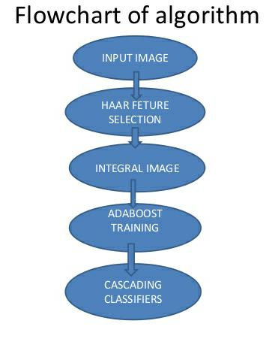
Team No: T26 Name of the project: SMART ATTENDANCE SYSTEM USING COMPUTER VISION
Software/ Hardware Requirements
a. Python
b. OpenCV framework
c. MS Excel and openpyxl library
d. SQLlite3
Project Objective: The main goal and objective of this automated Attendance System using Computer Vision is to present face recognition in a real time environment to see and mark the attendance of their students and employees on a daily basis to keep track of their presence. This system is automated and users can capture video and accordingly attendance will be marked, improving the accuracy to great extent and finally the attendance report will be generated. The main motive behind developing this system is to eliminate all the drawbacks, which were associated with manual attendance systems. The drawbacks ranging from wastage of time and paper, till the proxy issues arising in a class, are eliminated.

Slide 6
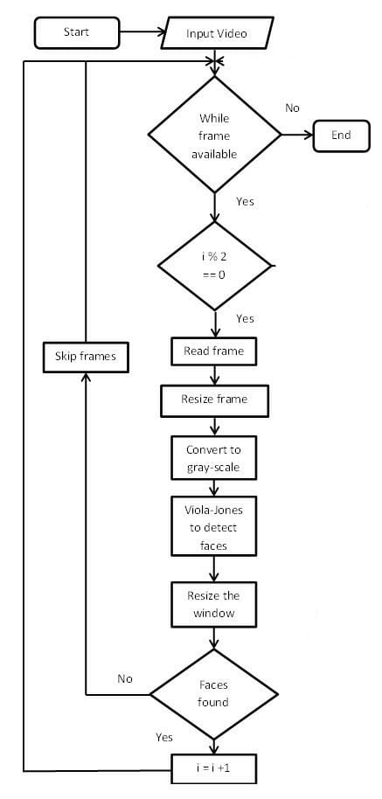





Team No: T26 Name of the project: SMART ATTENDANCE SYSTEM USING COMPUTER VISION
Module-1 : Data Set Creation
Description: For creating a dataset, we capture 10 frames of the student and convert them to grayscale and detect the face and convert it to 24*24 size and save the image in the database along with other information of the student like name, phone no, class, section etc., as needed
i<=10
Inputs : a video frame
Outputs : 10 images of the student of 24 * 24 pixels size

Slide 7
Team No: T26 Name of the project: SMART ATTENDANCE SYSTEM USING COMPUTER VISION
Module-2 : Training the Classifier
Description: After the dataset creation, the classifier is trained with the data to distinguish what is a face and what is not , so that it is ready for recognizing
The GoogleNet Convolutional Neural Network has 144 layers of which is modified in the last 3 layers which are task specific layers to generate a training model for recognizing faces.
Input: Gray scale images of pixel size 24*24
Output: Trained model

Slide 8
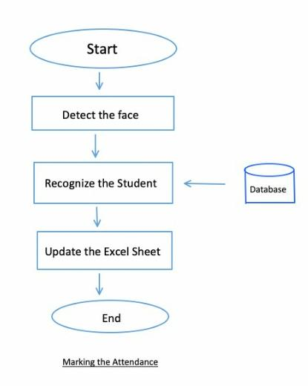
Team No: T26 Name of the project: SMART ATTENDANCE SYSTEM USING COMPUTER VISION
Module-3 : Marking the attendance
Description: In this module, a frame is captured and face is detected and further processed for recognition by matching it with a person in the data reserve which is SQLlite3 in the system and the Microsoft excel sheet is updated as present for the student for the particular hour using a python library openpyxl lib automatically without the user interference.
Input: Student video frame
Output: Updating Excel sheet .

Slide 9

Team No: T26 Name of the project: SMART ATTENDANCE SYSTEM USING COMPUTER VISION EXPECTED OUTPUT:
Face Detection
Attendance System Using Face Recognition
Student Registration
Mark Attendance
Attendance Report
About
Exit

