Slide 1

SMART ATTENDANCE SYSTEM USING COMPUTER VISION
A Project Report submitted to
Jawaharlal Nehru Technological University, Hyderabad.
In partial fulfillment for the requirement for the award of B.Tech Degree in Computer Science and Engineering
By
S . Vishnu Priya 17641A0558
T . Bindumathi 17641A0519
A .Sridhar Reddy 17641A0513
A . Chandu 17641A0533
Under the guidance of Mr. Shekar, Assistant Professor
DEPARTMENT OF COMPUTER SCIENCE & ENGINEERING VAAGDEVI COLLEGE OF ENGINEERING
(UGC Autonomous, Accredited by NBA, Accredited by NAAC with “A”)
Warangal - 506001
i

Slide 2
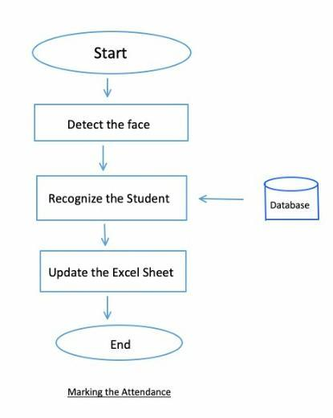
Team No: T26 Name of the project: Smart Attendance System using Computer Vision
Project Objective:
The main goal and objective of this Smart Attendance System using Computer Vision is to present face recognition in a real time environment to see and mark the attendance of their students and employees on a daily basis to keep track of their presence with the help of a database and generate attendance reports.
The main motive behind developing this system is to eliminate all the drawbacks, which were associated with manual attendance systems. The drawbacks ranging from wastage of time and paper, till the proxy issues arising in a class, are eliminated.

Slide 3
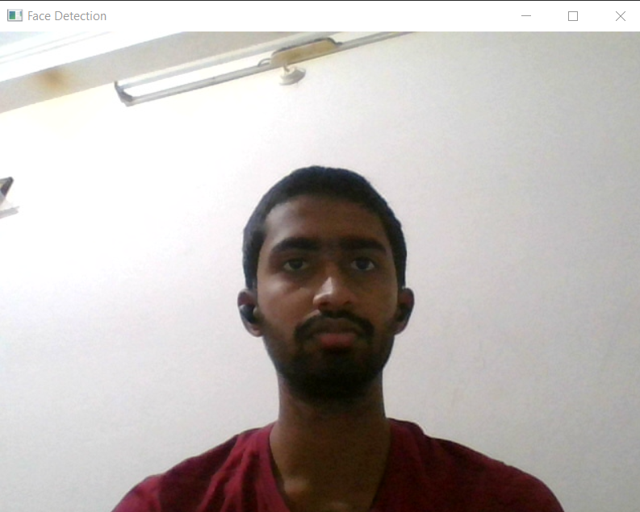
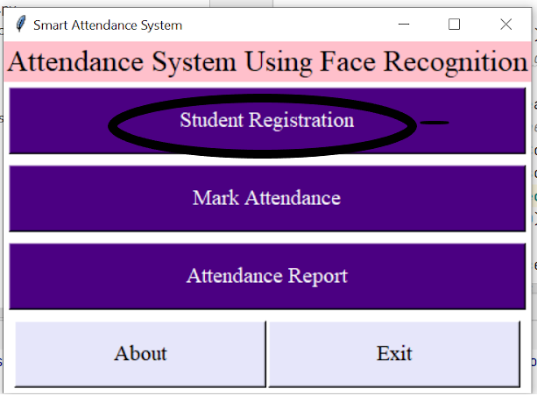
Team No: T26 Name of the project: Smart Attendance System using Computer Vision
Implementation of Module-1 : Student Registration
Software Environment Used : pycharm
Sub-modules: datasetCreator, trainer, UI
Major Functions used : cascadeclassifier, detectMultiScale
Number of lines of code : 110
Test cases for Module 1:
Input:

Slide 4
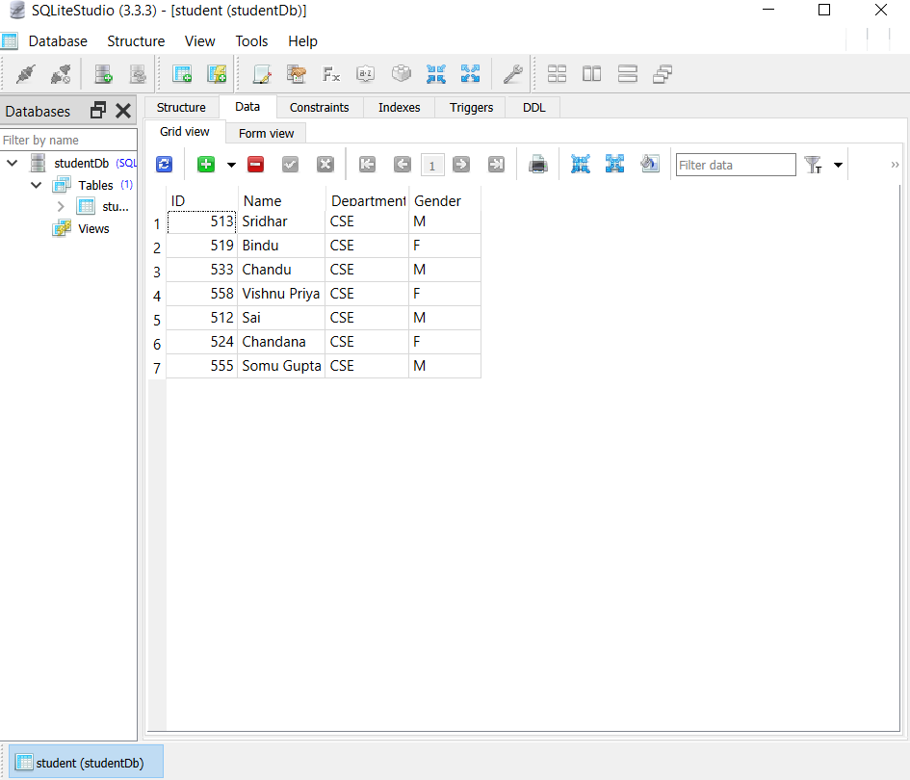
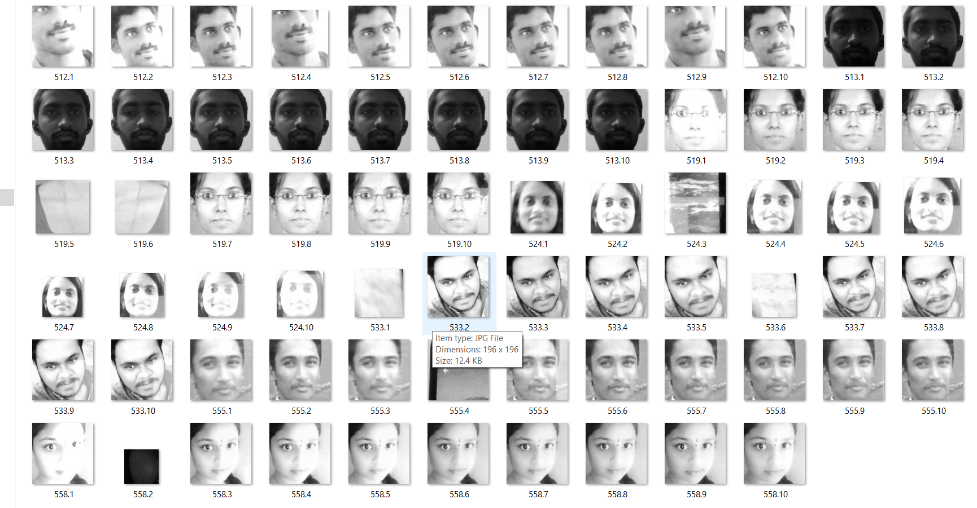
Team No : T26 Name of the project: Smart Attendance System using Computer Vision
Output : Database Reserve

Slide 5
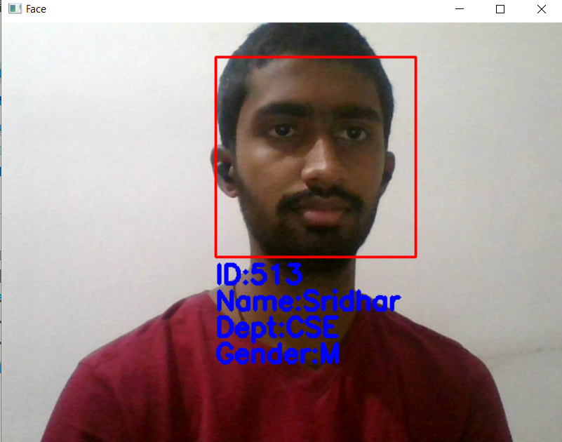
Team No: T26 Name of the project: Smart Attendance System using Computer Vision
Implementation of Module-2: Marking Attendance
Software Environment Used : pycharm
Sub modules : detector
Major Functions used : LBPH Algorithm
Number of lines of code : 66
Test cases for Module 2:
Test case1:
Input:
Output:

Slide 6

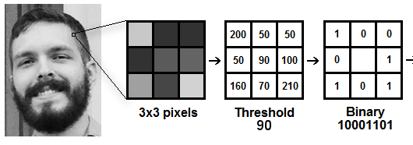
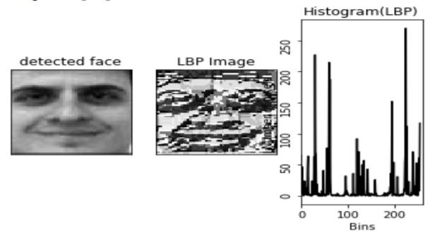
Team No: T26 Name of the project: Smart Attendance System using Computer Vision
Implementation of Module-2: Marking Attendance
LBPH Face Recognizer : Local Binary Pattern (LBP) is a simple yet very efficient texture operator which labels the pixels of an image by thresholding the neighborhood of each pixel and considers the result as a binary number.
 | 141
Integer 141
is Binary
10001101
The histogram vector is known as feature vector of the image. We compare the histograms of the test image and the images in the database and then we return the image with the closest euclidean distance histogram.

Slide 7

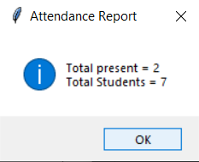

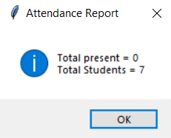
Team No: T26 Name of the project: Smart Attendance System using Computer Vision
Implementation of Module-3 : Attendance Reports
Software Environment Used : pycharm
Major Functions used : openpyxl library functions
Number of lines of code : 40
Test cases for Module 3:
Test case1: Excel Sheet
Input:
Output:
Test case2:
Input:
Output:

Slide 8
Team No: T26 Name of the project: Smart Attendance System using Computer Vision
Integration & Deployment
Technical challenges faced / Issues addressed
The inability of detect faces from a faraway distance.
The inability to detect in dim lightings because gray scale images are used.
Low performance in case of large number of students.

Slide 9
Team No: T26 Name of the project: Smart Attendance System using Computer Vision
Project Demo
Demo of project : Student Registration -> Dataset Capture -> Database Updation -> Mark Attendance -> Detect Student -> Extract information from dataset -> Update Student Presence in Excel Sheet -> Attendance Report Generation
Subjective Evaluation :
(As observed )
Objective Evaluation (of diff algorithms for face recognition):
LBPH algorithm: 400 images of each object, recognition accuracy was 92.6% obtained
AxelNet CNN has an accuracy of 98.5% using 2500 variant images in a class.
VGG 16 model achieves 92.7%, top-5 test accuracy in ImageNet, which is a dataset of over 14 million images belonging to 1000 classes
Of all the convolutional neural networks approaches for face recognition, LBPH is the simplest in comparison to other approaches like VGG16 , AxelNet , Googlenet which require high computational power and other resources but provide better efficiency.

Slide 10
Team No: T26 Name of the project: Smart Attendance System using Computer Vision
Conclusion & Future scope
Conclusion:
Maintaining the attendance is essential in every foundation for checking the performance of students as well as employee in terms of attendance percentage. The task to compute the attendance percentage becomes a major task as manual computation produces errors. So we would like to build a system which is both cost and time efficient and demands minimum voluntary action by the users for both taking attendance and making attendance reports in just one click.
Future Scope:
The algorithm will be tested with multiple students in the scene and also captured faces at different angles in the scene. The algorithm delivers good results but there is room to improve the algorithm performance in case of large numbers of students and also in case of faces captured in a dark environment, and detect multiple faces at a time. The efficiency of the algorithm also can be increased further so there is also a room for future work in this area. This system can be enhanced further in terms of achieving more efficiency by ease of analysis of patterns in the data.

Slide 11


