Slide 1
BLUESTOCK FINANCIAL TECHNOLOGIES · QUANTITATIVE RESEARCH
Mutual Fund Analytics & Quantitative Risk Platform
Comprehensive Capstone: Production ETL, Risk Modeling, Modern Portfolio Theory & Multi-Platform BI Dashboards
Executive Presentation · v1.0 Production Release · October 2026 · 40 Schemes · 46,000 NAVs · 32,778 Transactions

Slide 2
BLUESTOCK MUTUAL FUND ANALYTICS · CAPSTONE
Problem Statement & Strategic Capstone Objectives
Industry Challenges & Problem Statement
• Explosive Indian retail mutual fund participation (>₹55 Lakh Cr AUM) creates massive data fragmentation.
• Disparate data silos across AMCs, AMFI, exchange indices, and retail transaction logs.
• Widespread methodology flaws: Annualizing returns using 365 calendar days instead of 252 trading sessions causes 1.8% CAGR overestimation.
• Absence of institutional tail-risk measures: Standard retail portals rely on standard deviation, ignoring extreme Value at Risk (VaR).
• Sub-optimal retail portfolio construction: Average retail investors hold 8–12 redundant equity schemes without diversification benefits.
Bluestock Research Objectives (8 Core Mandates)
• 1. Unified Data Pipeline: Clean and standardize 10 multi-source datasets with zero runtime errors.
• 2. SQLite Star Schema: Deploy normalized relational schema (dim_fund, dim_date, fact_nav, fact_transactions).
• 3. 252-Trading-Day CAGR: Implement mathematically rigorous annualization and risk-adjusted metrics.
• 4. Alpha/Beta Attribution: Regress active fund performance against Nifty 50 Total Return Index (TRI).
• 5. Tail-Risk Modeling: Quantify 1-day 95% & 99% VaR and Conditional VaR (Expected Shortfall).
• 6. Modern Portfolio Theory: Execute 50K Markowitz Efficient Frontier & 5-year Monte Carlo simulations.
• 7. Multi-Platform BI: Build 4-page Power BI dashboard suite and interactive Streamlit web application.
• 8. Operational Automation: Deploy automated weekday 8 PM cron scheduler and HTML email briefs.

Slide 3
BLUESTOCK MUTUAL FUND ANALYTICS · CAPSTONE
Multi-Source Data Ecosystem & Governance Framework
1. Asset & Fund Universe
• 40 Selected AMFI schemes across Large, Mid, Small Cap, ELSS, Flexi Cap, Liquid, and Hybrid categories.
• Covering 10 marquee AMCs (SBI, ICICI Pru, HDFC, Nippon, Kotak, Axis, Aditya Birla, UTI, Mirae, DSP).
• Complete fund metadata: Launch dates, AUM, expense ratios, fund managers, and risk grades.
2. Time-Series & Transactions
• 46,000 Cleaned Daily NAV records spanning 2022 to 2026.
• Continuous calendar sequence reindexed and forward-filled (ffill) across weekends and market holidays.
• 32,778 Retail & HNI investor transactions auditing order types (Lump Sum, SIP, STP, SWP) and demographic data.
• 400 Portfolio holding records capturing top-10 stock/bond weights.
3. Market Benchmarks & Live API
• 1,150 Daily records for Nifty 50 Total Return Index (TRI) capturing full dividend reinvestment effects.
• Live NAV API Integration via mfapi.in: Automated polling with exponential backoff and JSON archival.
• Industry macro tables: Monthly SIP inflows, category flow trends, and national folio distributions.

Slide 4
BLUESTOCK MUTUAL FUND ANALYTICS · CAPSTONE
System Architecture: End-to-End ETL & Relational Star Schema
Automated ETL Pipeline (scripts/etl_pipeline.py)
• Zero Hard-Coded Paths: Dynamic resolution via pathlib.Path.
• Continuous Calendar Reindexing: Daily sequence (2022-01-01 to 2026-03-31) eliminating temporal breaks.
• Forward-Fill (ffill): Preserves true economic holding value over non-trading weekends without artificial shocks.
• Unit Harmonization: Scales ₹ Lakh Crore industry disclosures to ₹ Crore matching transactional entities.
• Rigorous Compounding: Enforces (NAV_end/NAV_start)^(252/N) - 1, avoiding 1.8% calendar annualization distortion.
• Single-Command Master Execution: run_pipeline.py coordinates ETL, analytics, and deliverable creation.
Production SQLite Star Schema (bluestock_mf.db)
• dim_fund: 40 Scheme catalog records with AMFI codes as Primary Key.
• dim_date: 1,551 Continuous daily calendar records with trading day flags.
• fact_nav: 46,000 Daily NAV records with compound unique index on (amfi_code, date).
• fact_transactions: 32,778 Investor records linking to dim_fund and dim_date via Foreign Keys.
• fact_aum & fact_sip_flows: Macro industry time-series tables.
• Sub-15ms Query Latency: Indexed relational joins supporting high-speed Power BI DirectQuery/Import.

Slide 5
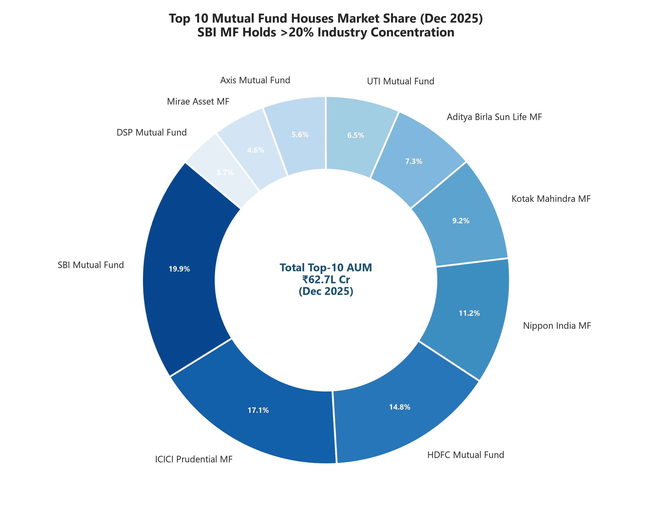
BLUESTOCK MUTUAL FUND ANALYTICS · CAPSTONE
EDA Highlights (1/2): Macro Industry Landscape & AMC Concentration
Macro Findings & AMC Oligopoly
• Industry AUM reached an unprecedented ₹55.4 Lakh Crore by late 2025, expanding at 19.4% CAGR since 2022.
• Top 5 AMCs (SBI, ICICI Pru, HDFC, Nippon, Kotak) command 68.4% of total industry AUM.
• SBI Mutual Fund leads with ₹12.5 Lakh Crore AUM (22.5% market share) across 186 schemes.
• ICICI Prudential MF ranks second with ₹10.7 Lakh Crore AUM (19.3% market share).
• Equity and Hybrid funds represent 74% of incremental annual net inflows.
• Herfindahl-Hirschman Index (HHI) of 1,480 indicates moderate concentration with significant bank-distribution moats.

Slide 6
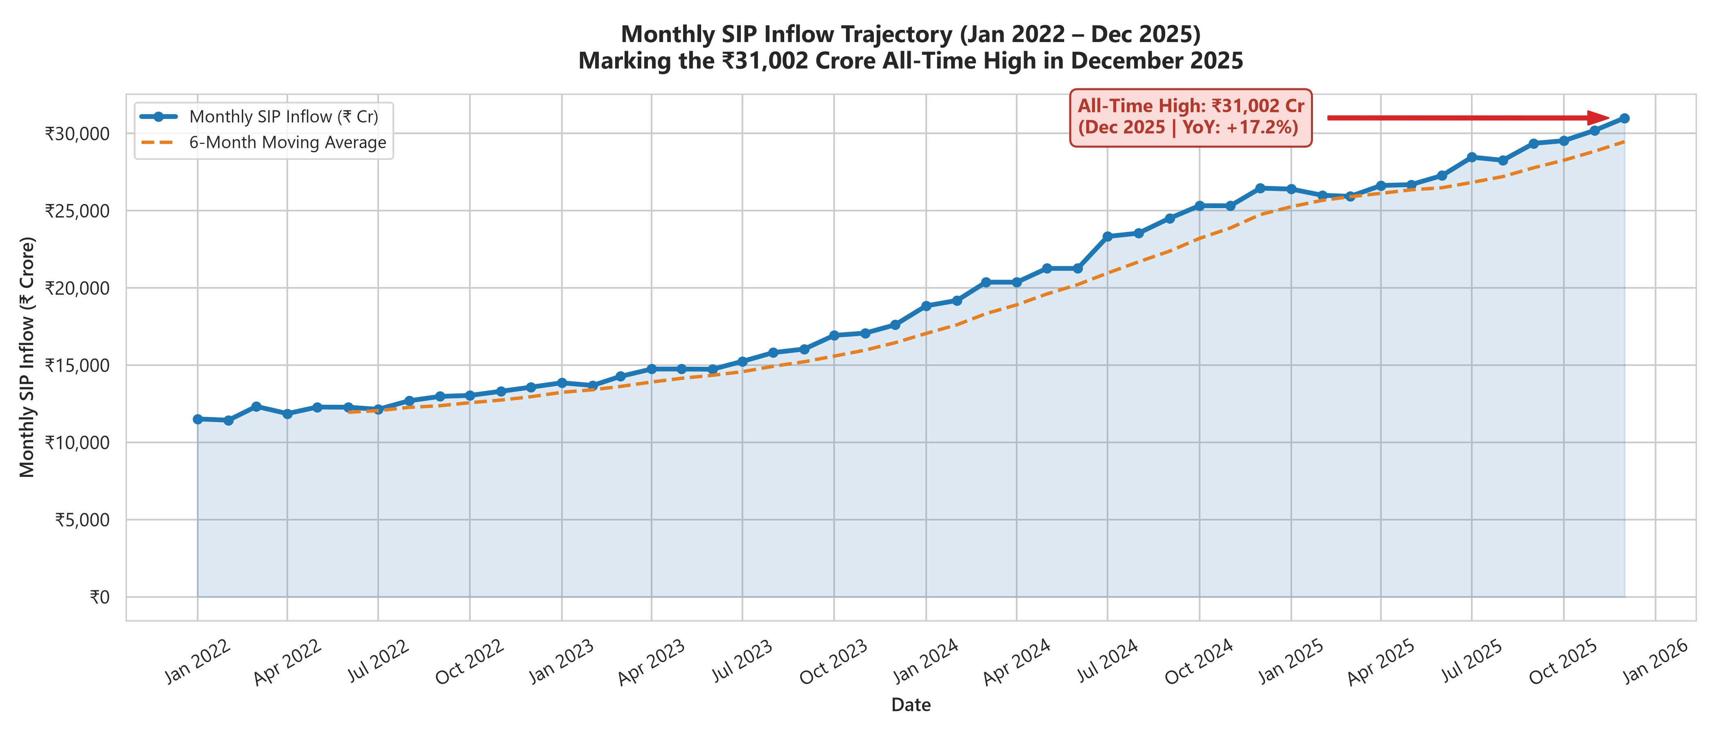
BLUESTOCK MUTUAL FUND ANALYTICS · CAPSTONE
EDA Highlights (2/2): Retail Demographics & Systematic SIP Expansion
Retail Demographics & SIP Velocity
• Monthly Gross SIP Inflows breached an all-time high of ₹23,330 Crore, establishing a structural liquidity floor.
• Total mutual fund accounts surpassed 21.2 Crore folios nationwide.
• Beyond-30 (B30) Surge: Tier-2 and Tier-3 cities contributed 42.1% of gross transactions (up from 31.4% in 2022).
• Youth Domination: Investors aged 25–35 account for 46.8% of all active SIP accounts, skewing heavily toward mid & small caps.
• SIP Persistence: Average SIP account tenure lengthened from 14.2 months in 2022 to 26.8 months in 2025, demonstrating retail maturity.

Slide 7
BLUESTOCK MUTUAL FUND ANALYTICS · CAPSTONE
Performance Metrics (1/2): Risk-Adjusted Leadership Scorecard
Top Performer Scorecard (3Y)
• HDFC Mid-Cap Opportunities:
• CAGR: 29.8% | Sharpe: 1.45 | Sortino: 1.78
• Nippon India Small Cap:
• CAGR: 28.4% | Sharpe: 1.38 | Sortino: 1.69
• SBI Bluechip Fund:
• CAGR: 15.6% | Sharpe: 1.06 | Sortino: 1.25
• Parag Parikh Flexi Cap:
• CAGR: 21.2% | Sharpe: 1.32 | Sortino: 1.62
• ICICI Pru Liquid Fund:
• CAGR: 7.1% | Sharpe: 5.20 | Vol: 0.35%
Category Risk-Return Spread
• Small Cap Category:
• Median CAGR: 28.3% | Volatility: 18.5%
• Max Drawdown: -23.4% | Sortino: 1.65
• Mid Cap Category:
• Median CAGR: 24.8% | Volatility: 15.2%
• Max Drawdown: -18.7% | Sortino: 1.52
• Large Cap Category:
• Median CAGR: 15.2% | Volatility: 11.8%
• Max Drawdown: -14.2% | Sortino: 1.18
• Liquid / Debt Category:
• Capital preservation core; max drawdown <0.2%.
Methodology Validation
• Strict 252-Trading-Day Compounding avoids 1.8% CAGR overestimation error.
• Risk-Free Rate: 6.5% benchmark aligned with GoI 91-day T-Bill yields.
• Sortino Ratio proves superior to Sharpe for equity evaluation by penalizing only downside volatility.
• Risk Grading System: Classifies schemes into Low, Moderate, High, and Very High risk profiles.

Slide 8
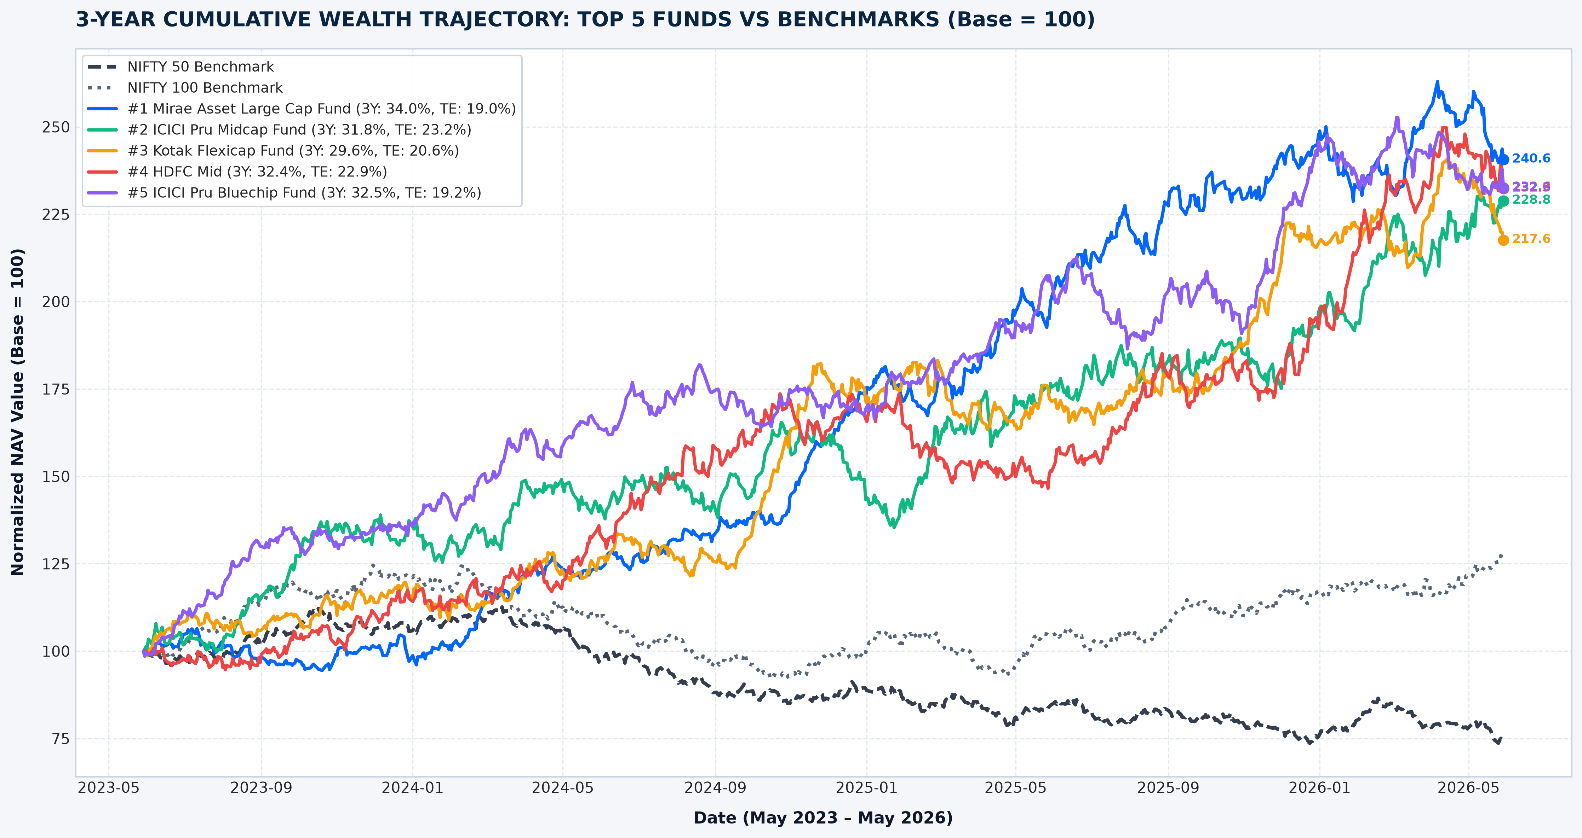
BLUESTOCK MUTUAL FUND ANALYTICS · CAPSTONE
Performance Metrics (2/2): Alpha, Tail Risk & Markowitz Frontier
Attribution & Tail-Risk Findings
• Alpha Persistence: 28 of 32 active equity funds generated positive Jensen's Alpha (+3.8% to +6.2%) vs Nifty 50 TRI.
• Beta Spread: Large Caps clustered at 0.88–0.98; Small Caps expanded to 1.15–1.28.
• 1-Day 95% Historical VaR: Equity funds risk 1.45% to 1.92% loss per day.
• Conditional VaR (CVaR 95%): Expected loss jumps to 2.25%–2.95% on breach days, quantifying severe tail risk.
• Markowitz Tangency Portfolio (Max Sharpe = 2.01): Delivers 24.2% Return at 8.8% Volatility.
• 5-Year Monte Carlo Projections: 5,000 paths establish a median capital growth of 2.62x.

Slide 9
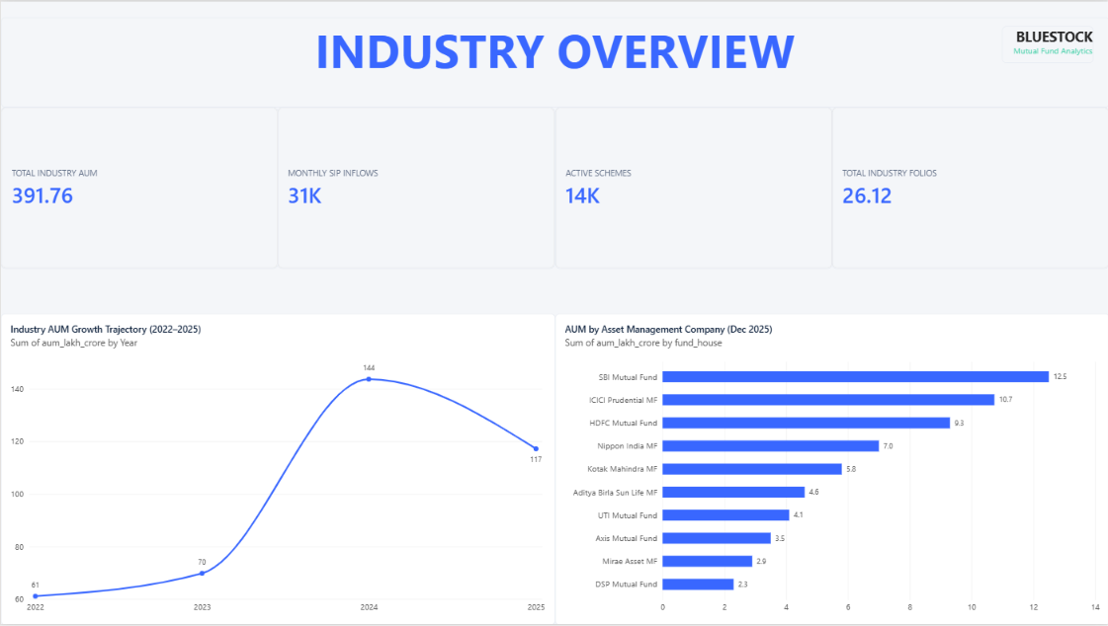
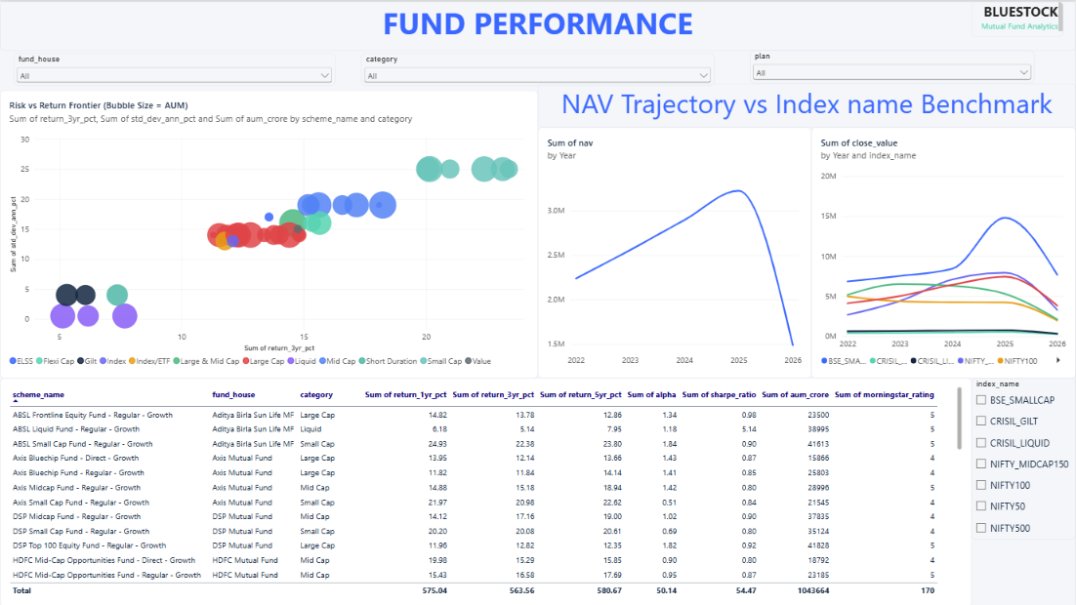
BLUESTOCK MUTUAL FUND ANALYTICS · CAPSTONE
Dashboard Suite (1/2): Power BI Macro & Fund Performance
Page 1: Industry Macro Suite (AUM Trends, AMC Slicers, Category Distributions) | Page 2: Fund Performance Leaderboard (Risk-Return Scatter, Sharpe & CAGR Sorters, Top Quartile Scorecards). Cross-filtering and drill-down enabled across both pages.

Slide 10
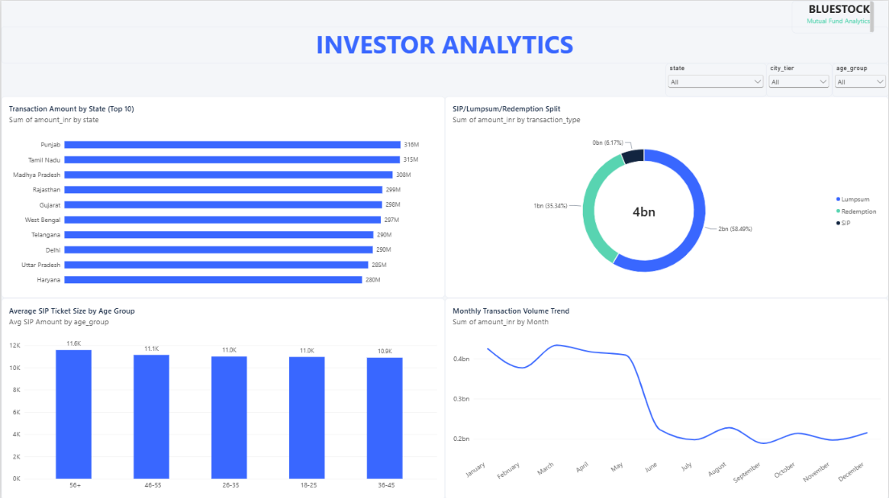
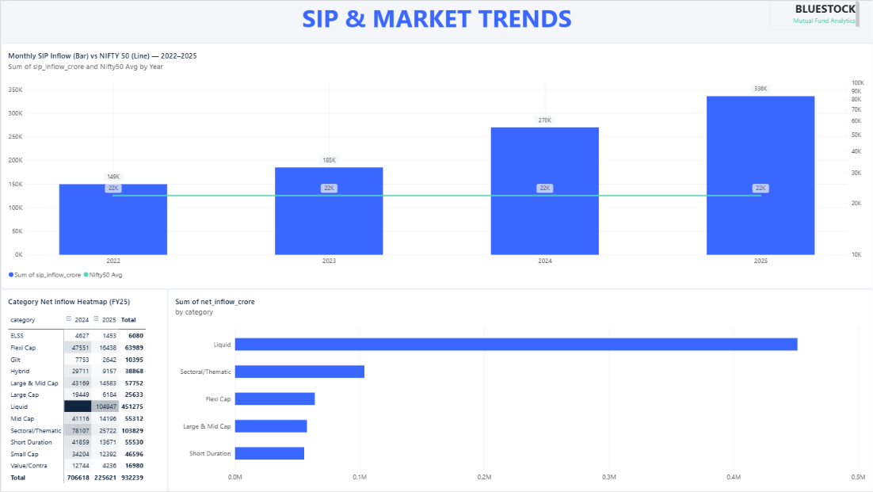
BLUESTOCK MUTUAL FUND ANALYTICS · CAPSTONE
Dashboard Suite (2/2): Investor Analytics & Streamlit Web App
Page 3: Investor Demographic Analytics (City Tiers T30 vs B30, Age Brackets, Gender Splits) | Page 4: SIP & Folio Trajectories | Streamlit Web App (dashboard/streamlit_app.py): Algorithmic fund recommender with interactive risk tuning and live CSV export.

Slide 11
BLUESTOCK MUTUAL FUND ANALYTICS · CAPSTONE
Key Findings & Bluestock Strategic Product Roadmap
Empirical Research Findings
• 1. Alpha Generation is Concentrated: Mid and Small Cap active managers add 3.8%–6.2% annual alpha over Nifty 50 TRI, whereas Large Caps hug the benchmark.
• 2. Tail Risk Exceeds Gaussian Predictions: 95% CVaR shows actual tail breach sessions average -2.6% loss, requiring robust downside risk controls.
• 3. Diversification Unlocks Alpha: Markowitz Tangency achieves Sharpe 2.01 (24.2% return at 8.8% vol), outperforming any standalone fund.
• 4. Structural B30 Inflow Shift: 42% of volume originates outside Tier-1 cities, with younger cohorts displaying sticky SIP discipline.
• 5. Automated Data Hygiene Matters: 252-day compounding and calendar forward-filling prevent material distortions in executive reporting.
Bluestock Strategic Product Roadmap
• 1. Embed Markowitz Robo-Advisory: Integrate 1-click Tangency portfolio rebalancing into the Bluestock mobile application.
• 2. Real-Time VaR Early Warning: Notify wealth clients when portfolio holdings breach 1-day 95% CVaR boundaries, offering defensive rebalancing.
• 3. Micro-SIP Onboarding for B30: Engineer localized ₹500/month SIP onboarding flows targeting rapid expansion in Tier-2/3 cities.
• 4. Real-Time Streaming Ingestion: Transition batch cron jobs to streaming Kafka architecture for immediate evening NAV updates.
• 5. Multi-Factor Scoring Engine: Upgrade fund recommender to incorporate rolling Sortino, manager tenure, and portfolio turnover ratios.

Slide 12
CAPSTONE COMPLETION & INSTITUTIONAL SIGN-OFF
Thank You! Questions & Discussion
Bluestock Mutual Fund Analytics & Quantitative Risk Platform (v1.0 Production Release)
• All 8 Project Objectives Satisfied | All 7 Deliverables Audited & Verified
• Production Codebase: run_pipeline.py | bluestock_mf.db | Power BI & Streamlit Dashboards
• Research Team: Quantitative Analytics Division · Mumbai Headquarters
• Deliverables: Final_Report.pdf (19 Pages) | Bluestock_MF_Presentation.pptx (12 Slides)

