Slide 1
Graph Representation and Chromatic Number Computation for Engineering Applications
Dharineesh J

Slide 2



Problem statement
What is the Problem?
Determine the minimum number of colors needed to color a graph without adjacent vertices sharing the same color.
How to solve the Problem?
Develop efficient algorithms to compute the chromatic number for various graph structures.
Why to solve the problem for various graph structures?
Analyze the chromatic number's behavior across different types of graphs.

Slide 3
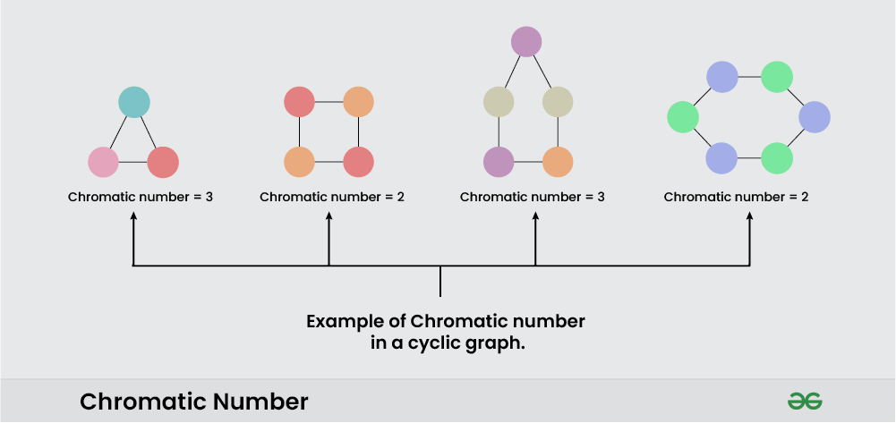
Introduction
  The chromatic number, χ(G), as the minimum colors needed to color a graph with no adjacent vertices sharing a color.
  Develops algorithms to calculate chromatic numbers for different graph structures.
  Uses visualization techniques for intuitive understanding of graph coloring.
  Explores applications of chromatic number in fields like networking, education, and circuit design.
  Presents experimental results, including chromatic numbers and algorithm execution times, across various graph types.

Slide 4
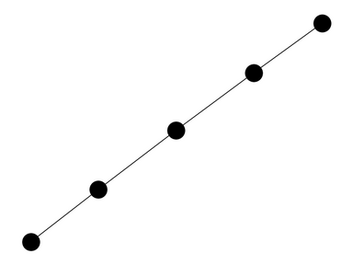
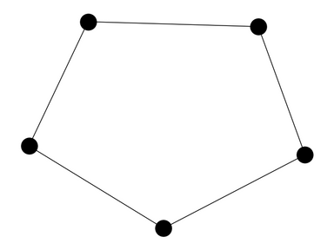
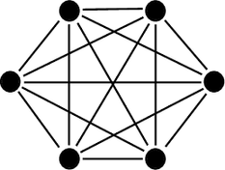
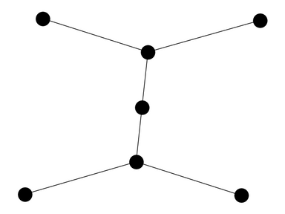
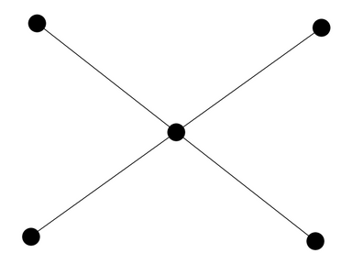
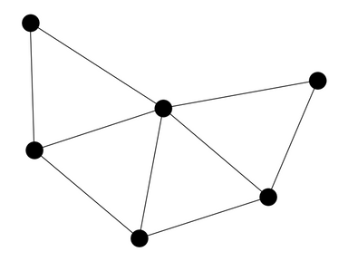
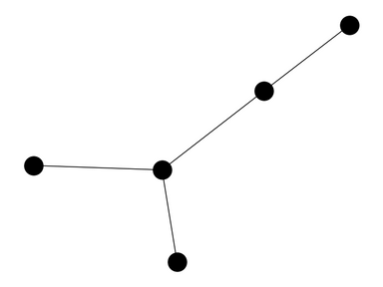
Graph Types
Cycle Graph
Complete Graph
Path Graph
Star Graph
Fan Graph
Binary Tree
Sibling Tree

Slide 5

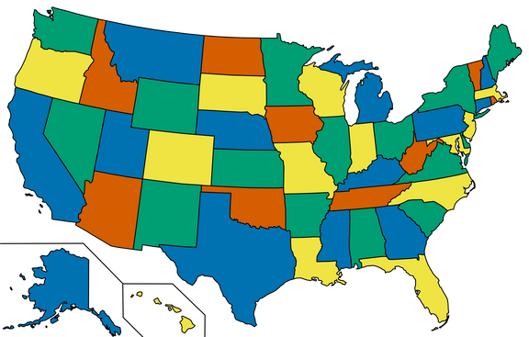
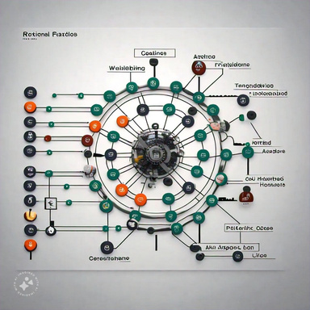
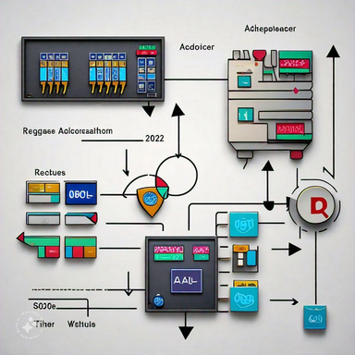
Applications
Exam Scheduling
Map Coloring
Routing and wave length assignment
Register Allocation

Slide 6
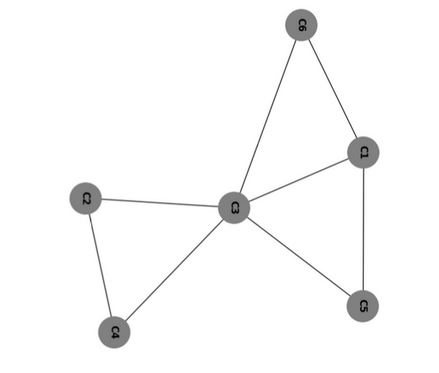
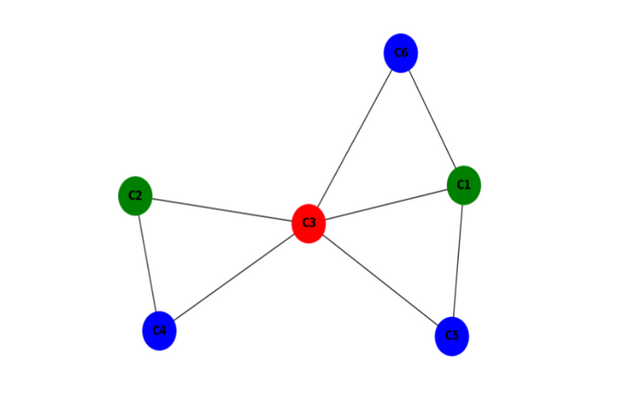
1. Exam Scheduling
  Objective: Schedule exams to prevent overlapping for students with multiple courses.
  Goal: Minimize the number of time slots required for exams to optimize resources and reduce the exam period.
  Graph Representation: Model the problem as a graph, where courses are nodes and conflicts are edges.
  Solution Method: Use graph coloring algorithms to assign time slots (colors) to courses, ensuring no conflicting exams occur at the same time.

Slide 7

2. Map Coloring
  Objective: Color a map so that no two adjacent regions share the same color.
  Goal: Identify the minimum number of colors needed, called the chromatic number.
  Graph Representation: Represent the map as a graph with regions as nodes and edges for adjacent regions.
  Solution Methods: Use algorithms like backtracking to solve the coloring problem, supported by the four color theorem.

Slide 8
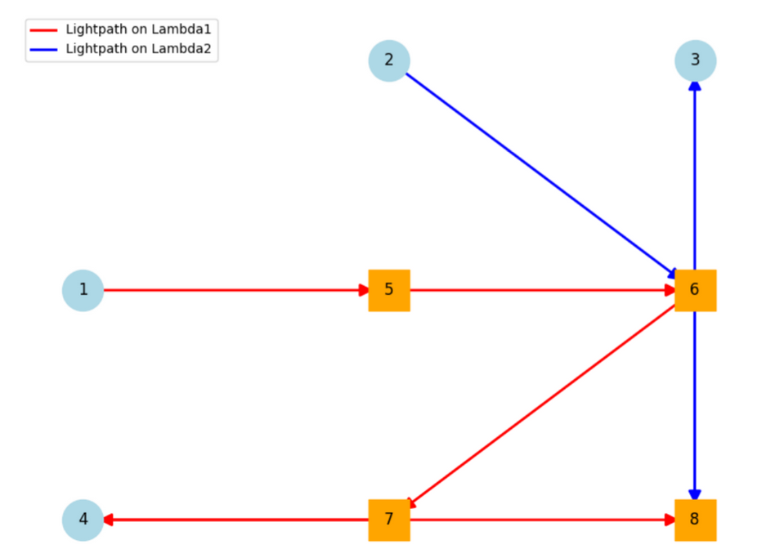
3. Routing and Wave Length Assigment
  Objective: Prevent signal interference by managing routing and wavelength assignment in an optical network.
  Goal: Minimize errors by ensuring that no two signals on the same link use the same wavelength.
  Graph Representation: Represent the optical network as a graph with nodes for access points and switches and edges for light paths.
  Solution Method: Use the graph's chromatic number to determine the minimum distinct wavelengths needed for edge assignments.

Slide 9
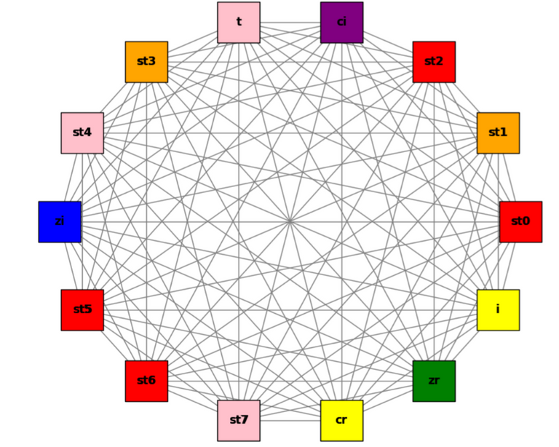
4. Register Allocation
  Objective: Assign intermediate computation values to registers during the compiler design phase to optimize storage.
  Goal: Ensure that no two interfering variables are assigned to the same register, minimizing the total number of registers needed.
  Graph Representation: Represent register allocation as a graph, where nodes are registers and edges indicate interference between variables.
  Solution Method: Use a priority-based coloring algorithm to determine the chromatic number, minimizing the number of colors (registers) used in allocation.

Slide 10
Literature Review
  Discrete Optimization Techniques: E. Malaguti et al. proposed heuristic and Tabu Search methods for discrete optimization and stable graph determination.
  Local Search for Maximum Clique: Grosso et al. created a local search algorithm with a swap move for optimizing clique formation in graphs.
  Chromatic Number via Graph Decomposition: Jansen and Nederlof introduced matrix rank-based algorithms to determine chromatic numbers efficiently.
  Exam Scheduling Optimization: Akbulut and Yılmaz optimized exam scheduling by using graph structures to maximize hall usage and reduce cheating.
  Four-Color Theorem for Planar Graphs: Sanders et al. proved that all loopless planar graphs require only four colors, confirming the four-color theorem.
  Benchmarking with Random Graphs: A DIMACS-based system was proposed for benchmarking, using randomly distributed vertices within a unit square.
  Parameterized Complexity in Graph Coloring: Jansen and Nederlof designed parameterized algorithms for graph coloring, focusing on input complexity.
  Topological Bounds for Chromatic Number: Matoušek et al. examined lower bounds on chromatic numbers in planar and non-planar graphs, tackling 3-colorability challenges.

Slide 11
Implementation
  Graph Coloring Process: The algorithm constructs the graph, assigns colors to nodes, and tracks available colors for adjacent vertices.
  Chromatic Number Determination: It determines the chromatic number based on the maximum color used after all vertices are colored.
  Execution Time Measurement: The execution time is calculated by subtracting the start time from the end time, reflecting performance efficiency.
  Visualization Methodology: A visualization technique represents graph coloring, helping users understand the relationship between graph structure and chromatic number.
  Practical Applications: The algorithm is efficient for network design and resource allocation, returning zero if valid coloring is not achievable

Slide 12
Algorithm
Algorithm ChromaticNumber() {
start_time := Current time;
graph_coloring := Empty dictionary;
for each vertex in vertices do {
available_colors := Set of integers from 1 to the number of vertices;
for each edge in vertex.edge_list do {
neighbor_color := graph_coloring.get(edge.destination_vertex_id);
if neighbor_color is not None then {
Remove neighbor_color from available_colors;
}
}
if available_colors is empty then {
print "Graph is not properly colored.";
} else {
chosen_color := Minimum value in available_colors;
graph_coloring[vertex.state_id] := chosen_color;
}
}
end_time := Current time;
execution_time := end_time - start_time;
if graph_coloring is not empty {
chromatic_number := Maximum value in graph_coloring.values();
return chromatic_number, execution_time;
} else {
return 0, execution_time;
}
}

Slide 13
Results
Types of graphs | Execution time for n nodes(sec) | Execution time for n nodes(sec) | Execution time for n nodes(sec) | Execution time for n nodes(sec) | Chromatic number
Types of graphs | 128 | 256 | 512 | 1024 | Chromatic number
Complete graph Kn | 0.14 | 0.73 | 5.67 | 40.72 | 128, 256, 512, 1024
Cycle graph Cn | 0.003 | 0.007 | 0.021 | 0.088 | 2
Star graph K1,n | 0.002 | 0.006 | 0.018 | 0.079 | 2
Fan graph Fn | 0.004 | 0.008 | 0.035 | 0.116 | 3
Path graph Pn | 0.003 | 0.008 | 0.025 | 0.086 | 2
Binary Tree Tn | 0.001 | 0.002 | 0.004 | 0.015 | 2
Sibling tree STn1 | 0001 | 0.002 | 0.004 | 0.011 | 2

Slide 14

  This work presented efficient algorithms for computing and visualizing chromatic numbers across diverse graph types, with performance validated on graphs with over 5000 nodes.
  The algorithm has practical applications in map coloring, register allocation, and exam scheduling, with future potential to support additional graph types and extended use cases.
  The implemented algorithms and visualizations offer insights into graph structures and chromatic numbers, enhancing understanding of graph-based optimization.
  Comprehensive literature reviews and use cases highlight the algorithm’s relevance, demonstrating its adaptability for real-world problems in scheduling and resource allocation.

Slide 15

Thanks!
Do you have any questions?
dharineeshj2@gmail.com
+91 77 08 18 07 04

