Slide 1
PSG Institute of Technology and Applied Research, Coimbatore
Machine Learning Techniques for Analyzing Disaster-Tweets
Team Members
Kavisri S ( 715517104033)
Vasundhra M (715517104059)
Project Guide
Dr. R. Manimegalai M.E.,Ph.D.
Professor & HOD
Disaster Tweet Analysis
1

Slide 2
Introduction to Twitter Data Analytics
Availability of social media data - massive, open and free.
Limitation in making sense of this data - high volume, variety, velocity, value, variability and veracity.
Current work is giving a far-reaching structure of text handling and examination
Performed on countless tweets shared on Twitter during catastrophic event occasions
Assisting legislators, public affairs experts, emergency preparedness organizations in using Twitter to communicate with the public.
Classifies the disaster based tweets into different categories.
Intended for timely action in disaster relief and recovery as quickly as possible.
Disaster Tweet Analysis

Slide 3
Problem Statement
To provide a comprehensive framework of text processing and analysis performed on several thousands of tweets shared on Twitter during natural disaster events.
This project classifies disaster based tweets into three categories namely
  precautionary
  informative
  recovery
Disaster Tweet Analysis

Slide 4
Literature Survey
Muhmmed Sit, Caglar Koylu,Ibrahim Demir “Identifying disaster-related tweets and their semantic, spatial and temporal context using deep learning” University of Iowa, 2019.
Problem Solved | To identify and categorize fine-grained details about a disaster such as affected individuals, damaged infrastructure and disrupted services
Proposed Solution | Logistic Regression, Linear SVM, Ridge, CNN and LSTM on the binary classification of disaster-related information
Results | For real-time identification of damage and emergency information, and making informed decisions by assessing the situation in impacted areas
Merits | Spatial and temporal patterns of categorized tweets to pinpoint potential areas for emergency response and recovery efforts and identify geographic biases in social media
Demerits | Due to the limited space, we did not provide an in-depth analysis of the site-specific information we gained through analysis
Future Work | To evaluate damage, extract site and individual specific information from various categories of disaster-relevant tweets.
Disaster Tweet Analysis

Slide 5
Literature Survey
Qunying Huang , Yu Xiao “Geographic Situational Awareness: Mining Tweets for Disaster Preparedness, Emergency Response, Impact, and Recovery” University of Wisconsin-Madison, 2015
Problem Solved | effort in coding social media messages into different themes within different disaster phases during a time-critical crisis
Proposed Solution | unigram feature vector to train the classifiers
Results | for automatically mining and classifying the social media messages into various topic categories during various disaster phases.
Merits | Information generated from the classification can be used by the social science research communities to study various aspects of preparedness, response, impact and recovery.
Demerits | the social and spatiotemporal inequality in the usage of social media data should be fully considered before such data can be leveraged to predict damage, investigate impacted populations and prioritize activities
Future Work | a more sophisticated classification model that can handle unbalanced data may be developed to increase the classification accuracy.
Disaster Tweet Analysis

Slide 6
Literature Survey
Arshdeep Kaur, “Analysing Twitter Feeds to Facilitate Crises Informatics and Disaster Response During Mass Emergencies” , Technological University Dublin, Research-Data Analytics 2017.
Problem Solved | Processing and analysis of textual content of twitter feeds collected during five different natural disaster events with an aim to generate key insights in terms of sentiment polarity
Proposed Solution | Artificial Intelligence for disaster response platform for automation tweet classification
Results | Sentimental analysis on variety of methods and comparison of their accuracy levels
Merits | Has the potential to be supplemented with additional information like images multimedia and other content published on twitter
Demerits | Do not show any significant improvement in classification performance, certain behavioural differences in text classification are evident
Future Work | Information Systems (GIS) in real time and location, helping disaster management and planning considerably
Disaster Tweet Analysis

Slide 7
Gaps Identified
Organisation should tweet on time and in clear manner during disaster to counter up fake news
Social and spatiotemporal inequality in the usage of social media data should be fully considered before such data can be leveraged to predict damage
Investigate impacted populations and prioritize activities
Classification model - handle unbalanced data may be developed to increase the accuracy.
Disaster Tweet Analysis

Slide 8
Objectives of Disaster-Tweet Analysis
To classify disaster and non-disaster tweets
To further classify disaster related tweets into three categories based on mitigation, preparedness, response, and recovery
To compare performance of algorithms based on accuracy, precision, recall, F1-score and time.
To assist legislators, public affairs experts, emergency preparedness organizations in using Twitter to communicate with the public.
Disaster Tweet Analysis

Slide 9
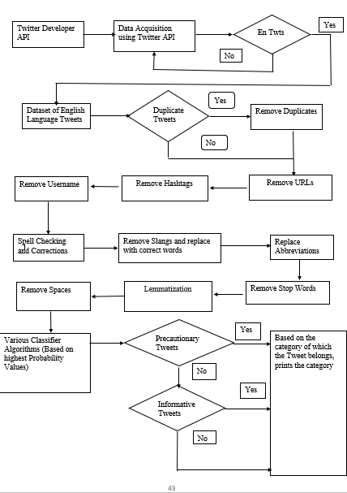
Proposed Methodology of Disaster Tweet Analysis
Disaster Tweet Analysis

Slide 10
Steps involved in Tweet Analysis
Data set preparation
Applying various Algorithms
  Using Count Vectorization
    Naïve Bayes
    Logistic Regression
    Random Forest
  Using TF-IDF Vectorization
    Support Vector Machine
    Extreme Gradient Boosting
Calculation of Metrics
Comparing the results of various Algorithms
Disaster Tweet Analysis

Slide 11
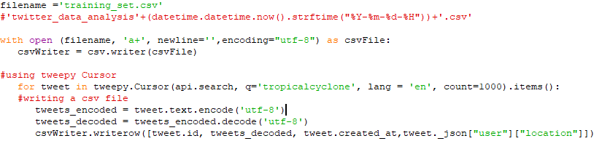
Preparing Data Set
Disaster Tweet Analysis

Slide 12
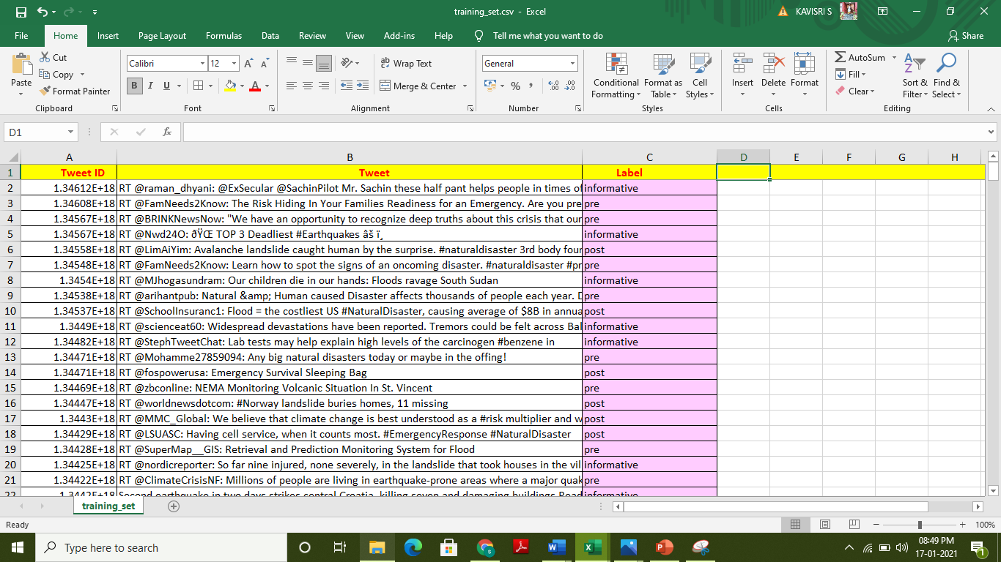
Training Set with Label
Disaster Tweet Analysis

Slide 13
Count Vectorizer
The model doesn’t accept textual data and only understands numbers, this data needs to be vectorized. i.e., Transforms text into a sparse matrix
The Count Vectorizer provides a simple way to both tokenize a collection of text documents and build a vocabulary of known words
Count Vectorizer does the following:
  - lowercases your text (set lowercase=false if you don’t want lowercasing)
  - uses utf-8 encoding
  - performs tokenization (converts raw text to smaller units of text)
  - ignores single characters during tokenization
  - removes the punctuation marks
Fit Function :
  - The fit method is calculating the mean and variance of each of the features present in our data
Transform Function :
  - The transform method is transforming all the features using the respective mean and variance.
Disaster Tweet Analysis

Slide 14
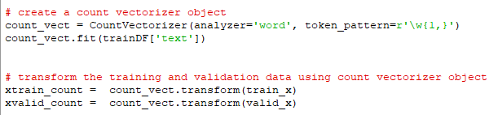
Count Vectorizer
Example Tweet: Atleast six people died and at least ten people had injured during earthquake
at least | six | people | died | and | ten | had | injured | during | earthquake
2 | 1 | 2 | 1 | 1 | 1 | 1 | 1 | 1 | 1
0 | 1 | 2 | 3 | 4 | 5 | 6 | 7 | 8 | 9
2 | 1 | 2 | 1 | 1 | 1 | 1 | 1 | 1 | 1
Disaster Tweet Analysis

Slide 15
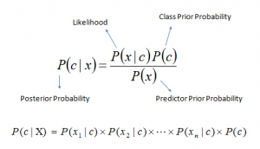
Naïve Bayes Classifiers
A classification Technique based on Bayes’ Theorem with an assumption of independence among predictors.
Naive Bayes model is easy to build and particularly useful for very large data sets.
where
P(c|x) is the posterior probability of
class (c, target) given predictor
(x, attributes).
P(c) is the prior probability of class.
P(x|c) is the likelihood which is the probability of predictor given class.
P(x) is the prior probability of predictor.
Disaster Tweet Analysis

Slide 16
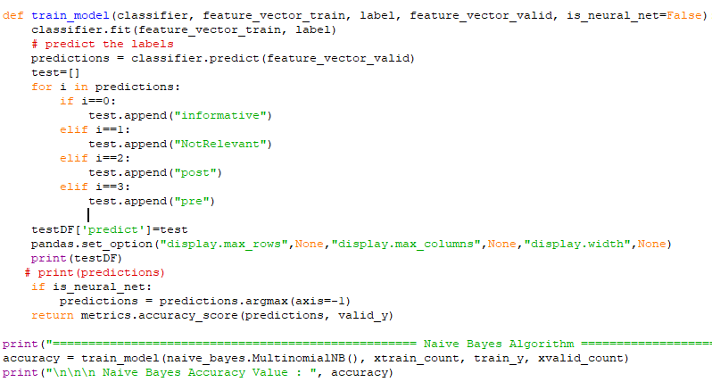
Naïve Bayes Classifiers
Disaster Tweet Analysis

Slide 17
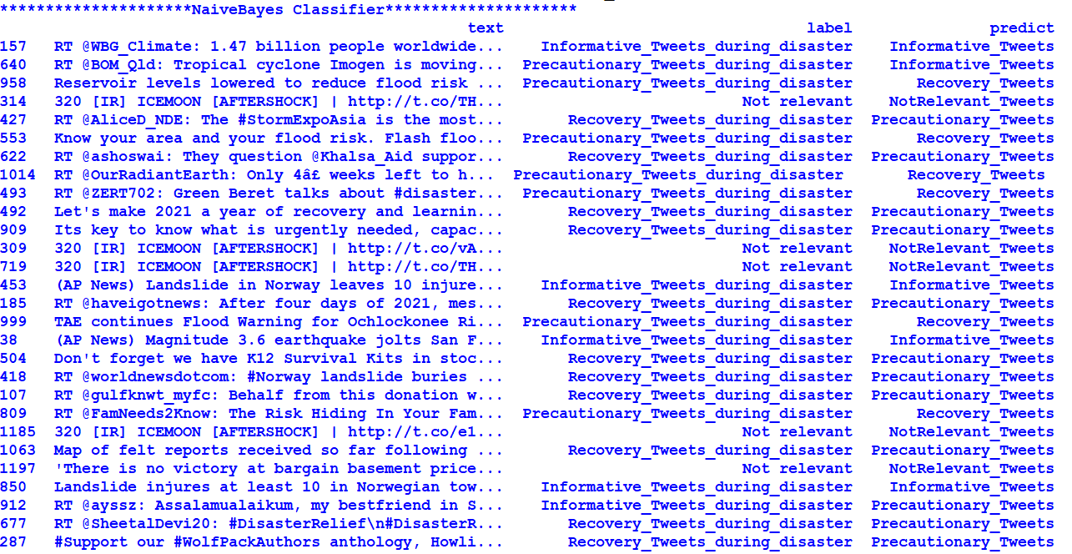
Output for Naïve Bayes Algorithm
Disaster Tweet Analysis

Slide 18
Inferences of Naïve Bayes Algorithm
Varying Test Set Size |  | 20 % | 40% | 60% | 80%
M E T R I C S | Accuracy | 0.97689 | 0.95545 | 0.93564 | 0.83917
 | Precision | 0.98392 | 0.96005 | 0.93920 | 0.84346
 | Recall | 0.97689 | 0.95545 | 0.93564 | 0.83917
 | F1- Score | 0.78306 | 0.76539 | 0.74849 | 0.67135
Time for Execution(mins) |  | 0.557 | 0.467 | 0.993 | 1.559
Disaster Tweet Analysis

Slide 19
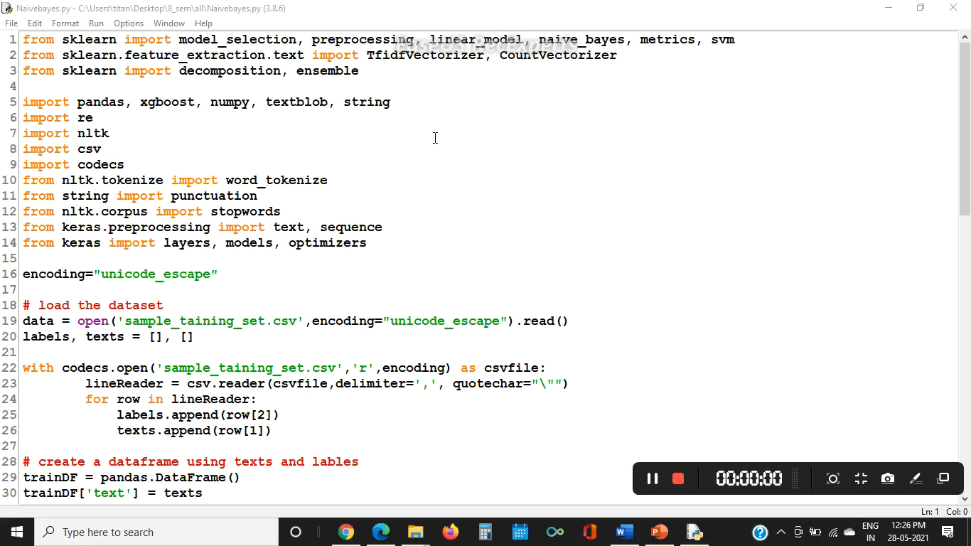
Naïve Bayes Algorithm Demo
Disaster Tweet Analysis

Slide 20
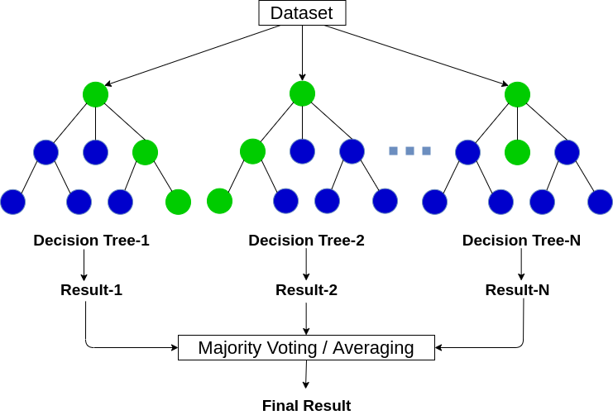
Random Forest Algorithm
Random forest is a classifier that evolves from decision trees.
Random forest model is a bagging-type ensemble (collection)
of decision trees that trains several trees in parallel and uses the
majority decision of the trees as the final
decision of the random forest
model
Random Forest Regression has
become a commonly used tool in
multiple prediction scenarios due
to their high accuracy and ability
to handle large features with
small samples
Disaster Tweet Analysis

Slide 21
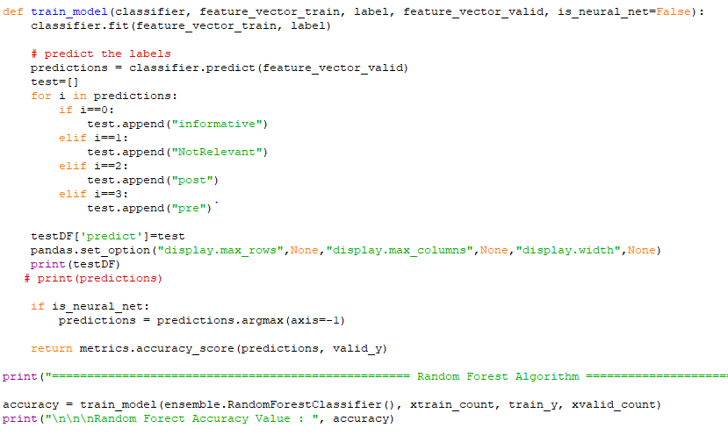
Random Forest Algorithm
Disaster Tweet Analysis

Slide 22
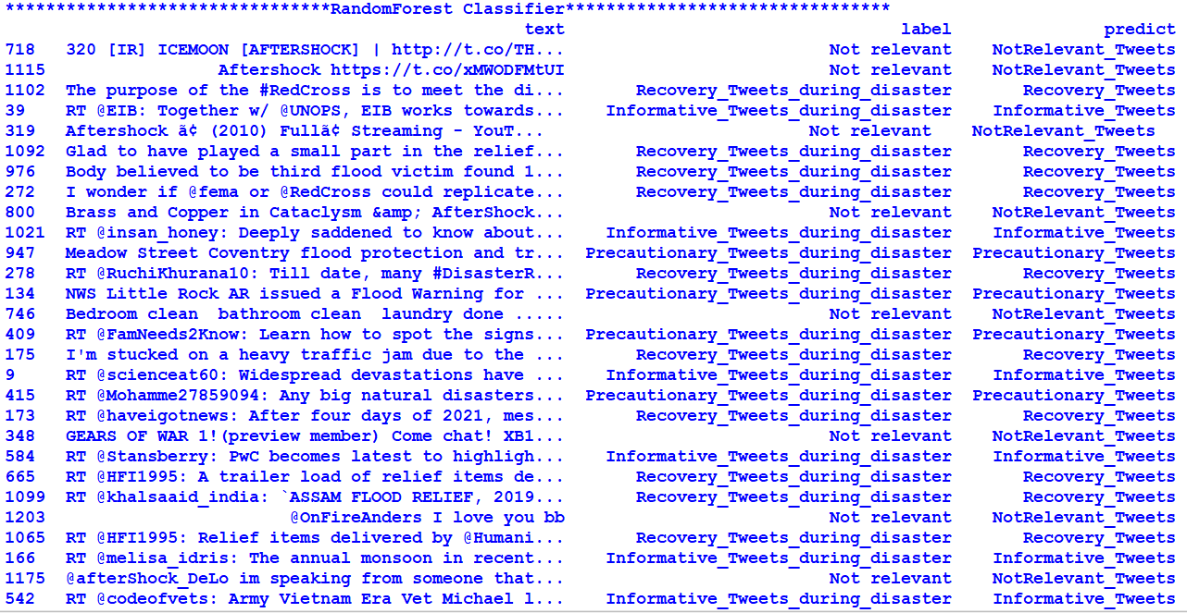
Output for Random Forest Algorithm
Disaster Tweet Analysis

Slide 23
Inferences of Random Forest Algorithm
Varying Test Set Size |  | 20% | 40% | 60% | 80%
M E T R I C S | Accuracy | 0.9702 | 0.9665 | 0.8993 | 0.8175
 | Precision | 0.9714 | 0.9671 | 0.9023 | 0.8553
 | Recall | 0.9702 | 0.9665 | 0.8993 | 0.8175
 | F1- Score | 0.9762 | 0.9727 | 0.9191 | 0.6528
Time for Execution(mins) |  | 2.052 | 1.582 | 1.161 | 2.050
Disaster Tweet Analysis

Slide 24

Random Forest Algorithm Demo
Disaster Tweet Analysis

Slide 25
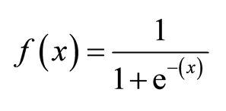
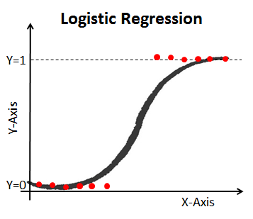
Logistic Regression Algorithm
Logistic Regression is a significant machine learning algorithm because it has the ability to provide probabilities and classify new data using continuous and discrete datasets.
The sigmoid function (S – Shaped curve ) is a mathematical function used to map the predicted values to probabilities.
In multinomial Logistic regression, there can be 3 or more possible unordered types of the dependent variable
Estimation is done through maximum likelihood.
Logistic regression requires quite
large sample sizes.
Disaster Tweet Analysis

Slide 26
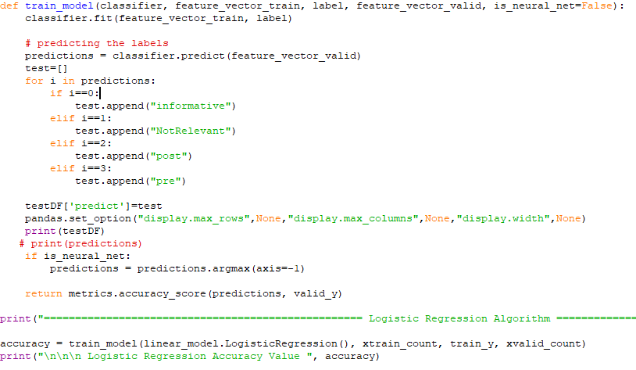
Logistic Regression Algorithm
Disaster Tweet Analysis

Slide 27
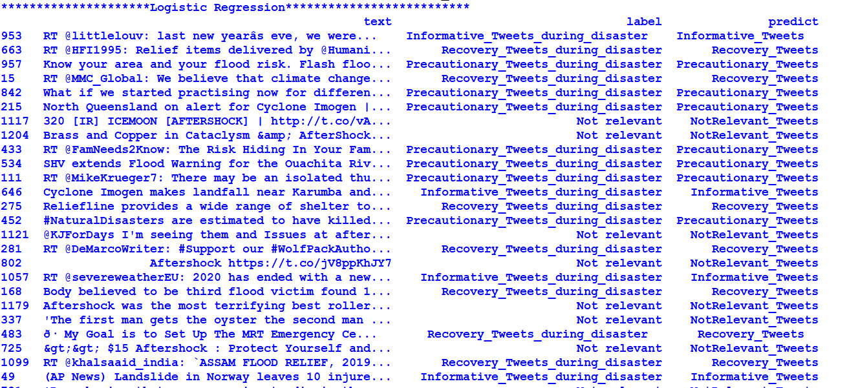
Output for Logistic Regression Algorithm
Disaster Tweet Analysis

Slide 28
Inferences of Logistic Regression Algorithm
Varying Test Set Size |  | 20 % | 40% | 60% | 80%
M E T R I C S | Accuracy | 0.98019 | 0.97104 | 0.92807 | 0.7845
 | Precision | 0.98132 | 0.97247 | 0.92928 | 0.7948
 | Recall | 0.98019 | 0.97104 | 0.92807 | 0.7845
 | F1- Score | 0.97847 | 0.97023 | 0.92687 | 0.8247
Time for Execution(mins) |  | 1.475 | 1.202 | 1.674 | 1.819
Disaster Tweet Analysis

Slide 29

Logistic Regression Algorithm Demo
Disaster Tweet Analysis

Slide 30
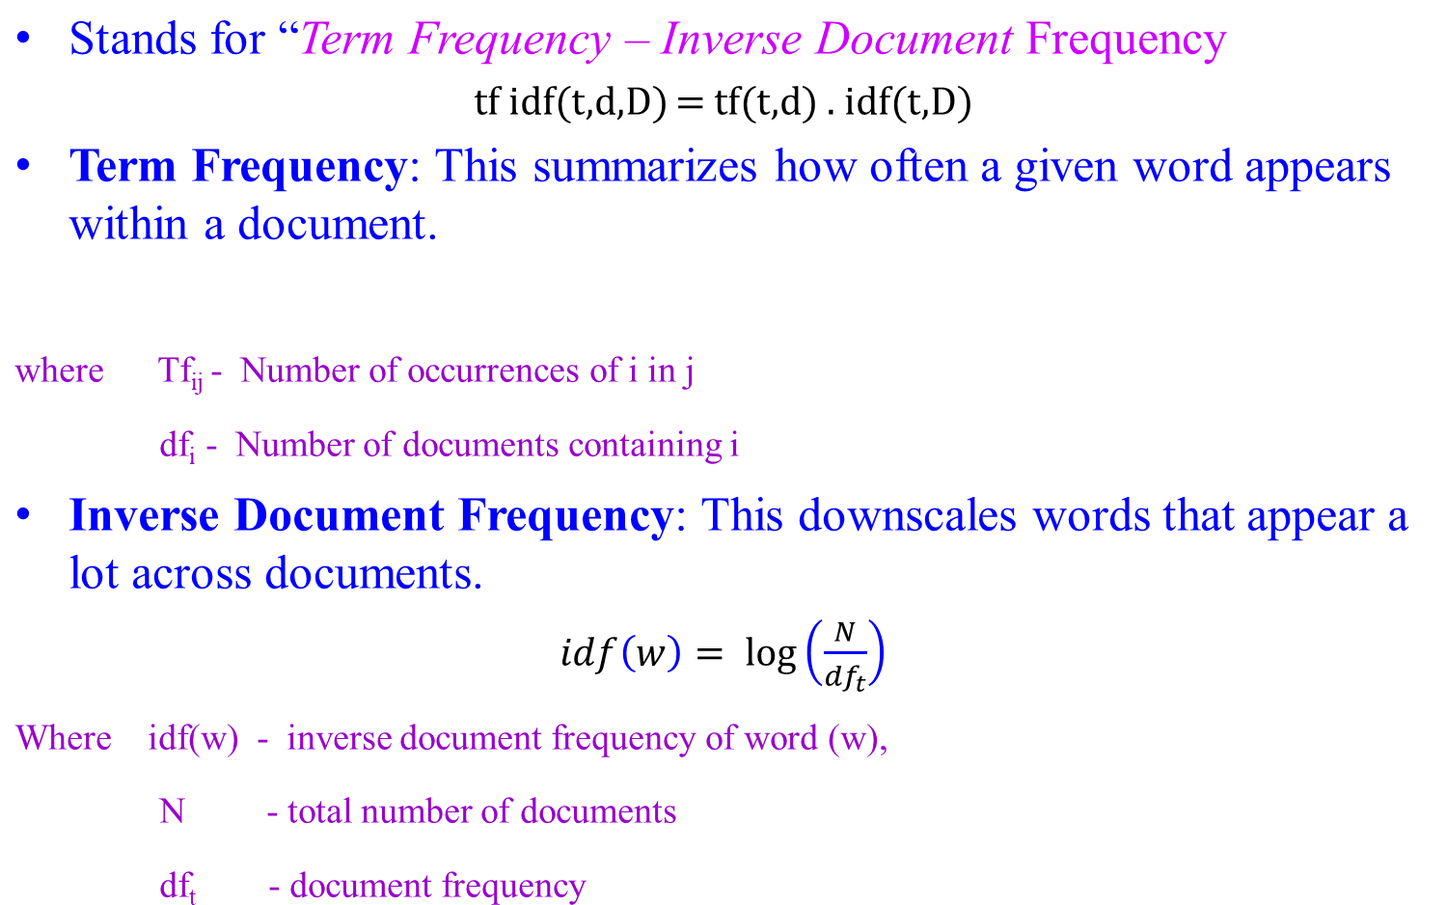

TF-IDF
Disaster Tweet Analysis

Slide 31
Example Tweets:
Sentence 1: Two people died during the earthquake
Sentence 2: Three people injured during the flood.
Word | TF |  | IDF | TF * IDF
 | Sen 1 | Sen 2 |  | Sen 1 | Sen 2
Two | 1/7 | 0 | Log (2/2) =0 | 0.043 | 0
Three | 0 | 1/7 | log(2/1)=0.3 | 0 | 0.043
People | 1/7 | 1/7 | log(2/1)=0.3 | 0 | 0
Died | 1/7 | 0 | log(2/1)=0.3 | 0.043 | 0
During | 1/7 | 1/7 | log(2/2)= 0 | 0 | 0
the | 1/7 | 1/7 | log(2/2)=0 | 0 | 0
Earthquake | 1/7 | 0 | log(2/1)=0.3 | 0.043 | 0
flood | 0 | 1/7 | log(2/1)=0.3 | 0 | 0.043
Injured | 0 | 1/7 | log(2/1)=0.3 | 0 | 0.043
Disaster Tweet Analysis

Slide 32
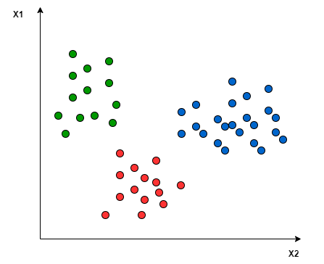
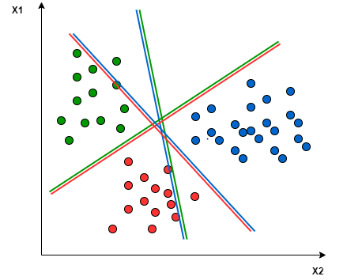
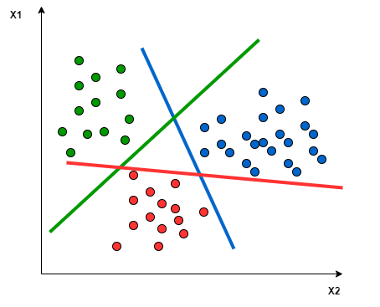
Support Vector Machine Algorithm
SVM doesn’t support multiclass classification natively.
The binary classification principle is utilized after breaking down the multiclassification problem into multiple binary classification problems.
One-to-One approach: which breaks down the multiclass problem into multiple binary classification problems. A binary classifier per each pair of classes.
One-to-Rest approach : the breakdown is set to a binary classifier per each class.
Disaster Tweet Analysis

Slide 33
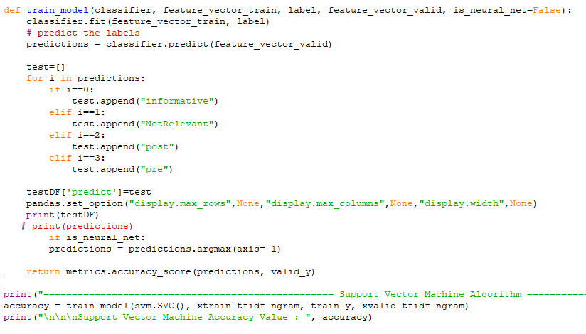
Support Vector Machine Algorithm
Disaster Tweet Analysis

Slide 34
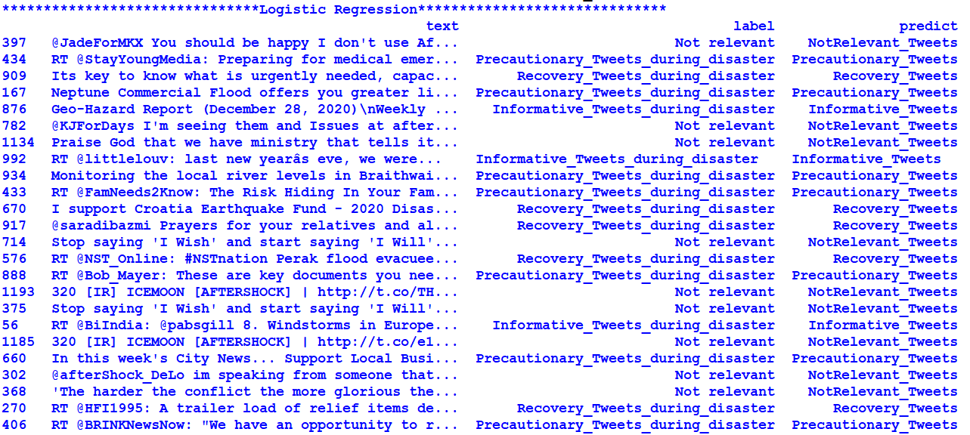
Output for Support Vector Machine Algorithm
Disaster Tweet Analysis

Slide 35
Inferences of the Support Vector Machine Algorithm
Varying Test Set Size |  | 20 % | 40% | 60% | 80%
M E T R I C S | Accuracy | 0.96039 | 0.94877 | 0.93894 | 0.7226
 | Precision | 0.96102 | 0.95276 | 0.94432 | 0.8364
 | Recall | 0.96039 | 0.94877 | 0.93894 | 0.7226
 | F1- Score | 0.95962 | 0.95794 | 0.751736 | 0.5822
Time for Execution(mins) |  | 1.232 | 3.852 | 1.291 | 1.644
Disaster Tweet Analysis

Slide 36

Support Vector Machine Algorithm Demo
Disaster Tweet Analysis

Slide 37
Extreme Gradient Boosting Algorithm
Extreme Gradient Boosting (XGBoost) is open-source library that provides efficient and effective implementation of gradient boosting algorithm.
Gradient Boosting refers to class of ensemble machine learning algorithms that can be used for classification or regression predictive modelling.
Weights are the important part in XGBoost.
Weights are being assigned to all independent variables which are then fed into decision tree which predicts the results.
These individual classifiers then ensemble to give strong and more precise model.
Bagging and boosting are widely used ensemble learners.
Disaster Tweet Analysis

Slide 38
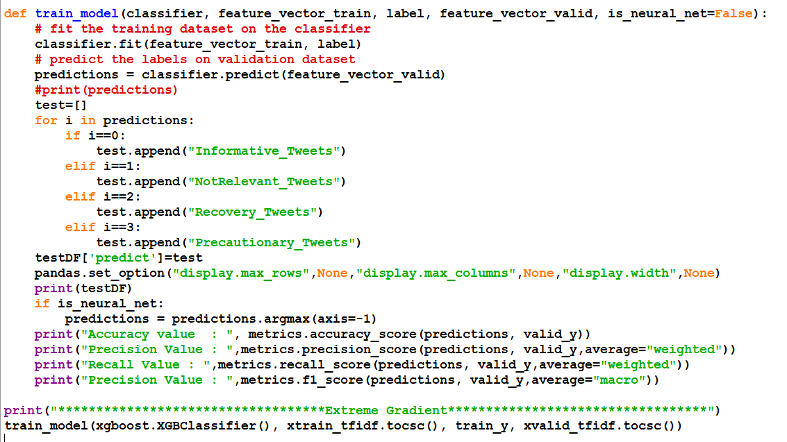
Extreme Gradient Boosting Algorithm
Disaster Tweet Analysis

Slide 39
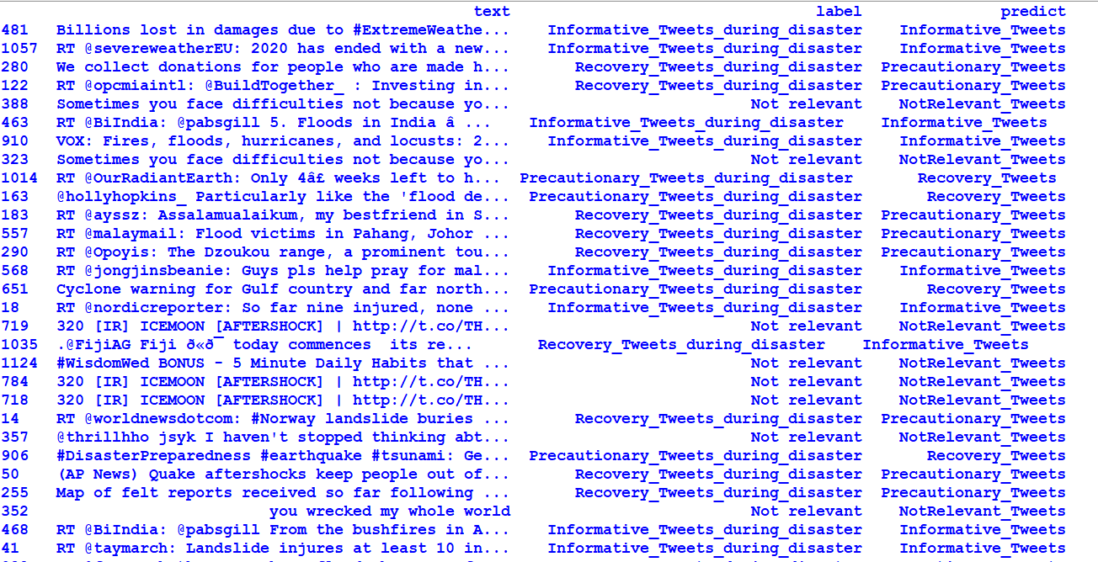
Extreme Gradient Boosting Algorithm
Disaster Tweet Analysis

Slide 40
Inferences for the Extreme Gradient Boosting Algorithm
Varying Test Set Size |  | 20% | 40% | 60% | 80%
M E T R I C S | Accuracy | 0.99009 | 0.95768 | 0.92244 | 0.7567
 | Precision | 0.99023 | 0.95845 | 0.92321 | 0.7623
 | Recall | 0.99009 | 0.95768 | 0.92244 | 0.7567
 | F1- Score | 0.98977 | 0.96569 | 0.93618 | 0.6064
Time for Execution(mins) |  | 3.760 | 3.344 | 2.372 | 3.764
Disaster Tweet Analysis

Slide 41

Extreme Gradient Boosting Algorithm Demo
Disaster Tweet Analysis

Slide 42
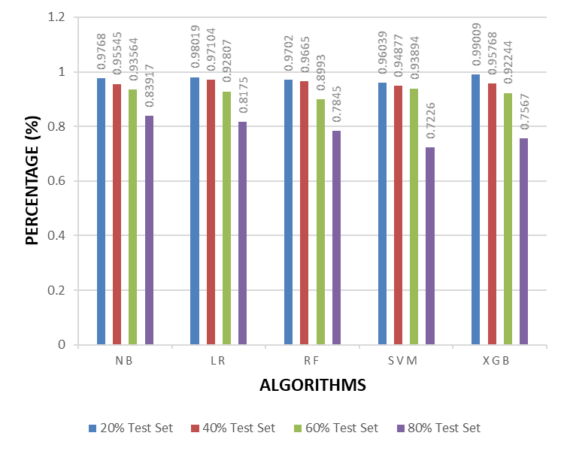
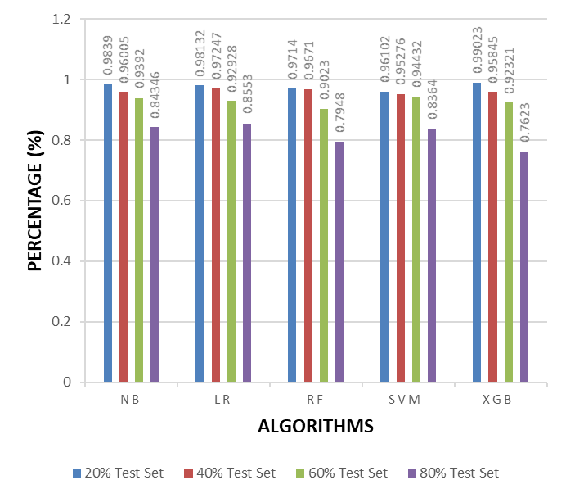
Comparison Chart for Accuracy and Precision
From the Figure, we can conclude that XGBoost has the highest accuracy score 0.99 with 20% test set and SVM with 80% test set has the least recall score 0.72.
From the Figure, we can conclude that XGBoost has the highest precision 0.99 with 20% test set and XGBoost with 80% test set has the least precision 0.76.
ACCURACY
PRECISION
Disaster Tweet Analysis

Slide 43
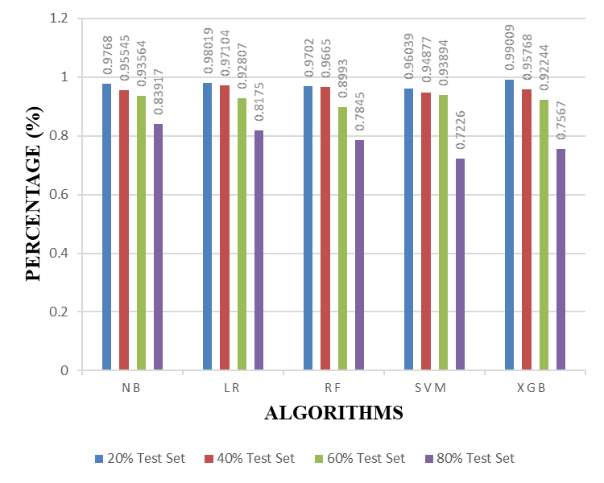
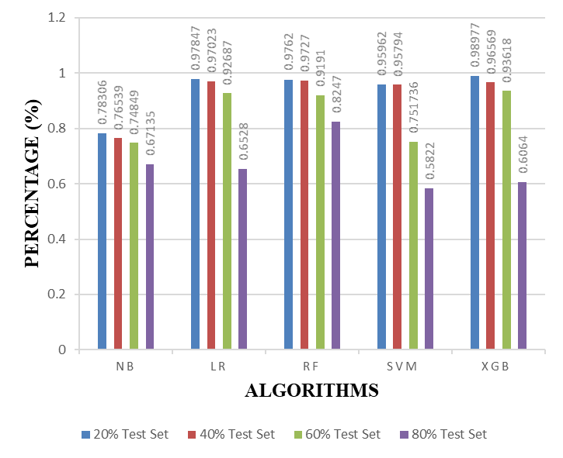
Comparison Chart for Recall and F1 - Score
From the Figure, we can conclude that XGBoost has the highest recall score 0.99 with 20% test set and SVM with 60% test set has the least recall score 0.72.
From the Figure, we can conclude that XGBoost has the highest f1-score 0.98 with 20% test set and SVM with 80% test set has the least f1-score 0.56.
RECALL
F1-SCORE
Disaster Tweet Analysis

Slide 44
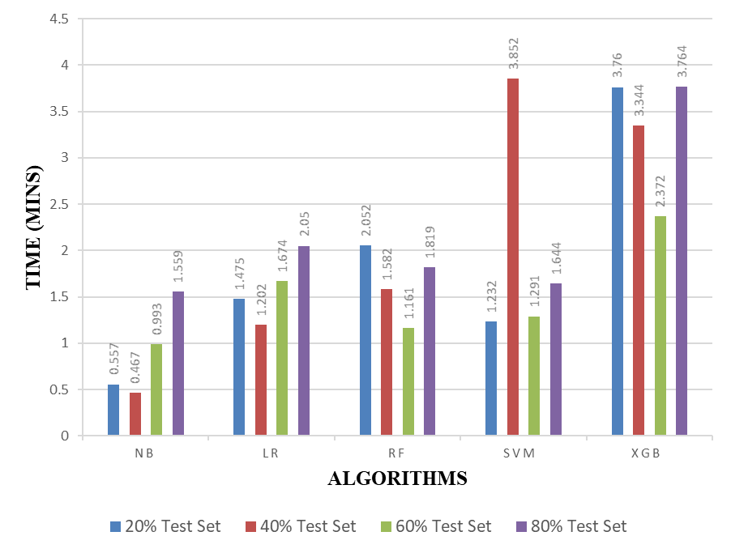
Comparison Chart For Total Time Taken for Execution
From the Figure, we can conclude that SVM takes the longest time of 3.852 mins with 40% test set and Naïve Bayes with 40% test set takes the least time of 0.467 mins.
TIME FOR EXECUTION
Disaster Tweet Analysis

Slide 45
Future Work
Using other social media networks (such as YouTube and Facebook) - to increase the database's information
Model that can predict Location based disaster trends
Multi-label classification of English and multilingual tweets to improve situational awareness
Disaster Tweet Analysis

Slide 46
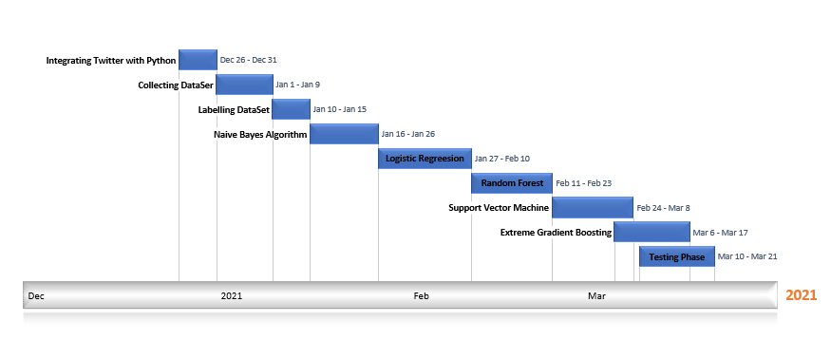
Timeline of the project
Disaster Tweet Analysis

Slide 47
Roles and Responsibilities
Integrating Twitter with Python - Vasundhra M
Preparing the Data set – Kavisri S
Pre-processing Tweets – Vasundhra M
Training model - Both
  Naïve Bayes Algorithm
  Logistic Regression
  Random Forest
  Support Vector Machine
  Extreme Gradient Boosting
Testing Phase - Both
Disaster Tweet Analysis

Slide 48
References
1. Kaur, A. “Analyzing Twitter Feeds to Facilitate Crises Informatics and Disaster Response During Mass Emergencies” Dissertation M.Sc. in Computing (Data Analytics), TU Dublin, 2019.
https://arrow.tudublin.ie/scschcomdis/166/
2. A. Sen, K. Rudra and S. Ghosh, "Extracting situational awareness from microblogs during disaster events," 7th International Conference on Communication Systems and Networks (COMSNETS), 2015, pp. 1-6, doi: 10.1109/COMSNETS.2015.7098720.
3. Gopnarayan, Archan, Deshpande, Sachin, “Tweets Analysis for Disaster Management: Preparedness, Emergency Response, Impact, and Recovery”, Innovative Data Communication Technologies and Application Book, Jan 2020, pp -760 – 764
4. H. To, S. Agrawal, S. H. Kim and C. Shahabi, "On Identifying Disaster-Related Tweets: Matching-Based or Learning-Based?," 2017 IEEE Third International Conference on Multimedia Big Data (BigMM), 2017, pp. 330-337, doi: 10.1109/BigMM.2017.82.
5. Huang Q, Xiao Y “Geographic situational awareness: mining tweets for disaster preparedness, emergency response, impact, and recovery”, ISPRS Journal of Photogrammetry and Remote Sensing, 2015, pp. 1549–1568.
Disaster Tweet Analysis

Slide 49
References Contd
6. T. Funayama, Y. Yamamoto, M. Tomita, O. Uchida and Y. Kajita, "Disaster mitigation support system using Twitter and GIS," 2014 Twelfth International Conference on ICT and Knowledge Engineering, 2014, pp. 18-23, doi: 10.1109/ICTKE.2014.7001528.
7. H. Shekhar and S. Setty, "Disaster analysis through tweets," 2015 International Conference on Advances in Computing, Communications and Informatics (ICACCI), 2015, pp. 1719-1723, doi: 10.1109/ICACCI.2015.7275861.
8. Boaz, John & Ybañez, Michael & De Leon, Marlene & Estuar, Ma.Regina.. “Understanding the Behavior of Filipino Twitter Users during Disaster” GSTF Journal on Computing (JoC), 2013, Vol:3, doi: 10.7603/s40601-013-0007-z.
9. Kumar, Shamanth & Barbier, Geoffrey & Abbasi, Mohammad Ali & Liu, Huan, “TweetTracker: An Analysis Tool for Humanitarian and Disaster Relief.”, Proceedings of the Fifth International Conference on Weblogs and Social Media, Barcelona, Catalonia, Spain, July 17-21, 2011.
10. Stowe, Kevin & Paul, Michael & Palmer, Martha & Palen, Leysia & Anderson, Kenneth, “Identifying and Categorizing Disaster-Related Tweets”, Proceedings of The Fourth International Workshop on Natural Language Processing for Social Media, 2016, pp.1-6, doi: 10.18653/v1/W16-6201.
Disaster Tweet Analysis

Slide 50

Disaster Tweet Analysis

