Slide 1
PSG Institute of Technology and Applied Research, Coimbatore
Machine Learning Techniques for Analyzing Disaster-Tweets
Team Members
Kavisri S ( 715517104033)
Vasundhra M (715517104059)
Project Guide
Dr. R. Manimegalai M.E.,Ph.D
Professor & HOD
Disaster Tweet Analysis
1

Slide 2
Outline of the Presentation
Introduction
Problem Statement
Literature Survey
Proposed Methodology of Disaster Tweet Analysis
  Deep Learning & Natural Language Processing
  Flow Chart
  Count Vectorizer and Tf-idf vectorizer.
  Classification using various Algorithms
  Comparison of the Performance.
Progress
Timeline of the project
Requirements
Roles and Responsibilities
References
Disaster Tweet Analysis

Slide 3
Introduction
The availability of social media data is massive, open and free.
But there is a significant limitation in making sense of this data due to its high volume, variety, velocity, value, variability and veracity.
The project mainly classifies the disaster based tweets into different categories
Disaster Tweet Analysis

Slide 4
Problem Statement
To provide a comprehensive framework of text processing and analysis performed on several thousands of tweets shared on Twitter during natural disaster events.
This project classifies disaster based tweets into three categories namely
  precautionary
  informative
  recovery.
Disaster Tweet Analysis

Slide 5
Proposed Methodology of Disaster Tweet Analysis
Machine Learning
Automation of analytical model building is obtained by the method of data analysis.
A part of Artificial Intelligence which is based on the concept of
  system can study from the data,
  identify particular patterns and
  derive conclusions with minimum human intervention.
Makes the system to think and react like humans- the ability to learn.
Natural Language Processing
A branch of artificial intelligence that deals with the interaction between computers and humans using the natural language.
objective of NLP :
  read, decipher, understand, and make sense of the human languages in a manner that is valuable.
Disaster Tweet Analysis

Slide 6
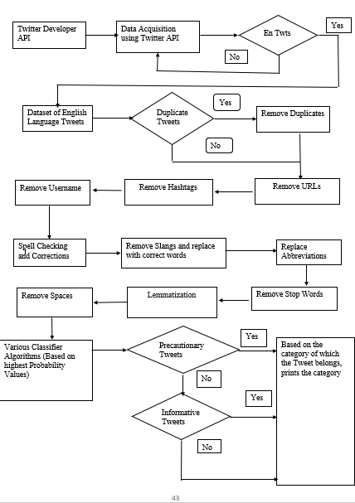
Flowchart of Disaster Tweet Analysis
Disaster Tweet Analysis

Slide 7
Steps involved in Tweet Analysis
Integrating Twitter with Python
Data set preparation
Applying various Algorithms
  Using Count Vectorization
    Naïve Bayes
    Logistic Regression
    Random Forest
  Using TF-IDF Vectorization
    Support Vector Machine
    Extreme Gradient Boosting
Calculation of Metrics
Comparing the results of various Algorithms
Disaster Tweet Analysis

Slide 8
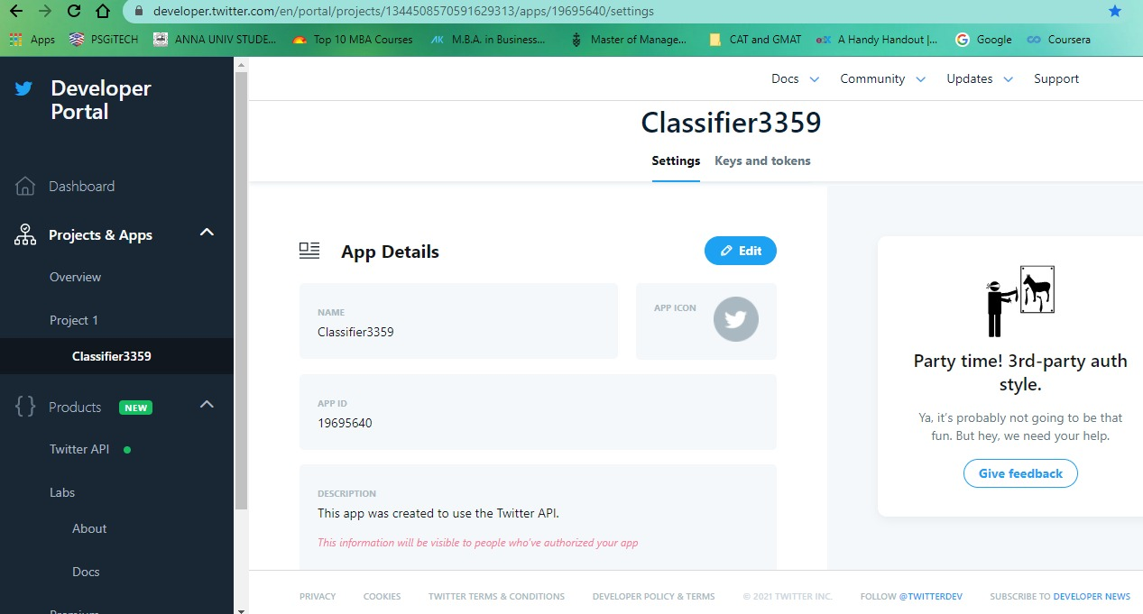
Integrating Twitter with Python
Disaster Tweet Analysis

Slide 9
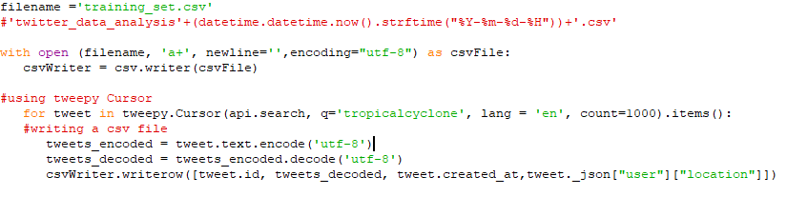
Preparing Data Set
Disaster Tweet Analysis

Slide 10
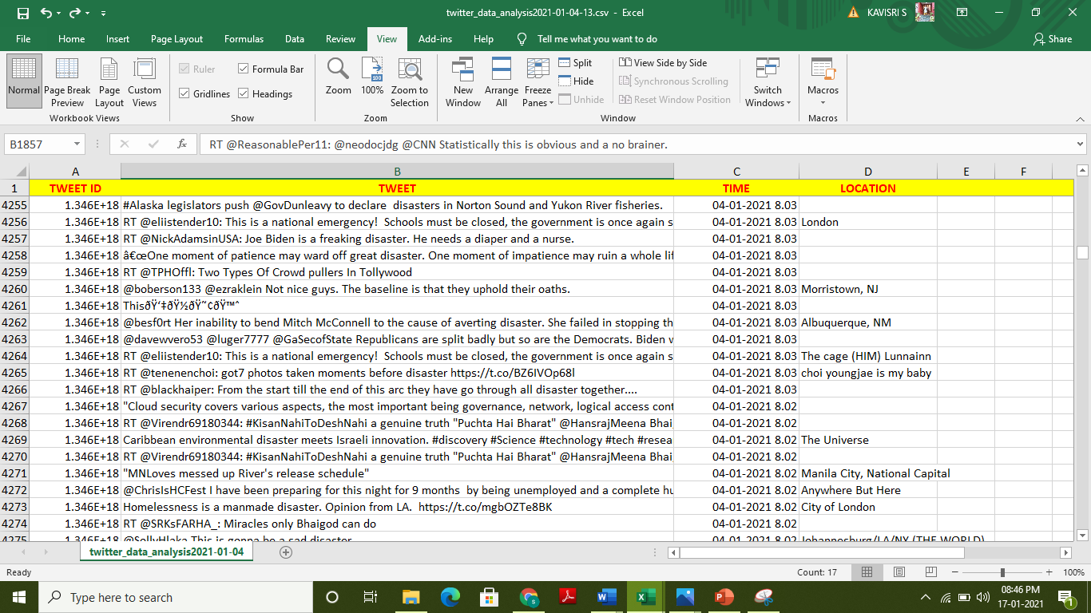
Preparing Data Set
Disaster Tweet Analysis

Slide 11
Preparing Data Set
Tweet ID
  Unique 64-bit unsigned integers
  To identify the same tweet in future for reference
Tweet
  The tweets which are related to disaster.
Location
  To identify the geographic location
  To send rescue teams to that location
Time Stamp
  To identify the which time the tweets are posted
Label
  Categorizing tweets as
    Precautionary
    Informative
    Recovery
Disaster Tweet Analysis

Slide 12
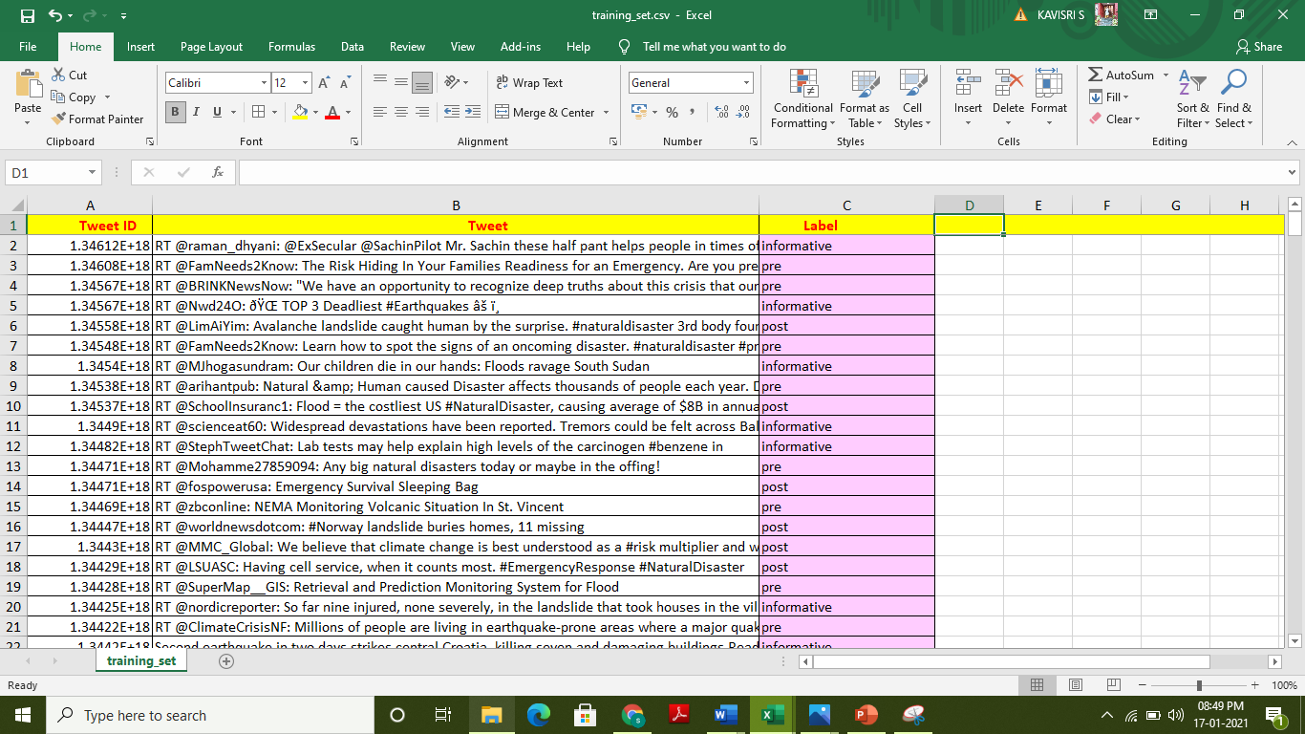
Training Set with Label
Disaster Tweet Analysis

Slide 13
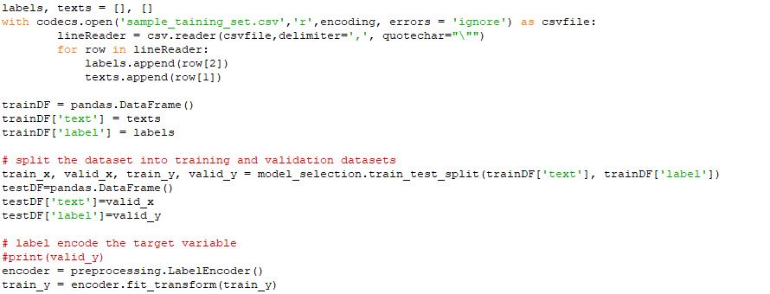
Splitting of Test Set and Training Set
Disaster Tweet Analysis

Slide 14
Count Vectorizer
The model doesn’t accept textual data and only understands numbers, this data needs to be vectorized. i.e., Transforms text into a sparse matrix
The Count Vectorizer provides a simple way to both tokenize a collection of text documents and build a vocabulary of known words
Count Vectorizer does the following:
  lowercases your text (set lowercase=false if you don’t want lowercasing)
  uses utf-8 encoding
  performs tokenization (converts raw text to smaller units of text)
  ignores single characters during tokenization
  removes the punctuation marks
Fit Function :
  The fit method is calculating the mean and variance of each of the features present in our data
Transform Function :
  The transform method is transforming all the features using the respective mean and variance.
Disaster Tweet Analysis

Slide 15
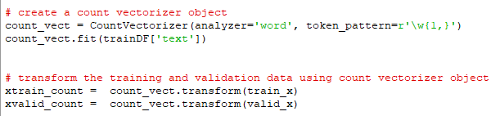
Count Vectorizer
Example Tweet: Atleast six people died and at least ten people had injured during earthquake
atleast | six | people | died | and | ten | had | injured | during | earthquake
2 | 1 | 2 | 1 | 1 | 1 | 1 | 1 | 1 | 1
0 | 1 | 2 | 3 | 4 | 5 | 6 | 7 | 8 | 9
2 | 1 | 2 | 1 | 1 | 1 | 1 | 1 | 1 | 1
Disaster Tweet Analysis

Slide 16
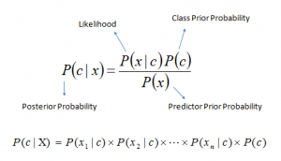
Naïve Bayes Classifiers
A classification Technique based on Bayes’ Theorem with an assumption of independence among predictors.
Naive Bayes model is easy to build and particularly useful for very large data sets.
where
P(c|x) is the posterior probability of
class (c, target) given predictor
(x, attributes).
P(c) is the prior probability of class.
P(x|c) is the likelihood which is the probability of predictor given class.
P(x) is the prior probability of predictor.
Disaster Tweet Analysis

Slide 17
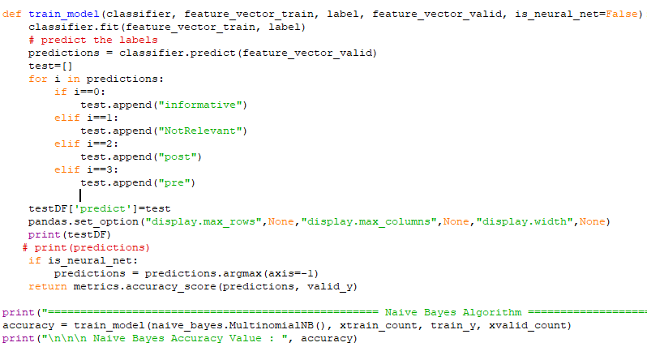
Naïve Bayes Classifiers
Disaster Tweet Analysis

Slide 18
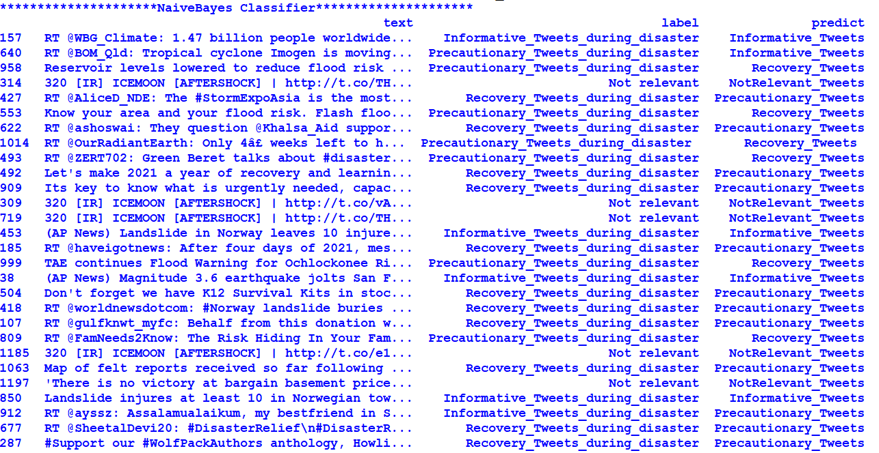
Output for Naïve Bayes Algorithm
Disaster Tweet Analysis

Slide 19
Inferences of Naïve Bayes Algorithm
Varying Test Set Size |  | 25 % | 37% | 50%
M E T R I C S | Accuracy | 0.97689 | 0.95545 | 0.93564
 | Precision | 0.98392 | 0.96005 | 0.93920
 | Recall | 0.97689 | 0.95545 | 0.93564
 | F1- Score | 0.78306 | 0.76539 | 0.74849
Time for Execution |  | 0.557 secs | 0.467 secs | 0.993 secs
Disaster Tweet Analysis

Slide 20
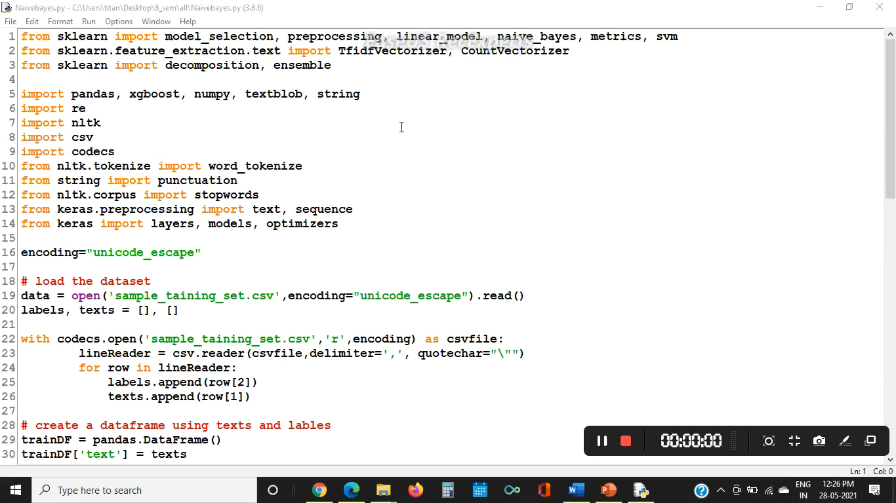
Naïve Bayes Algorithm Demo
Disaster Tweet Analysis

Slide 21
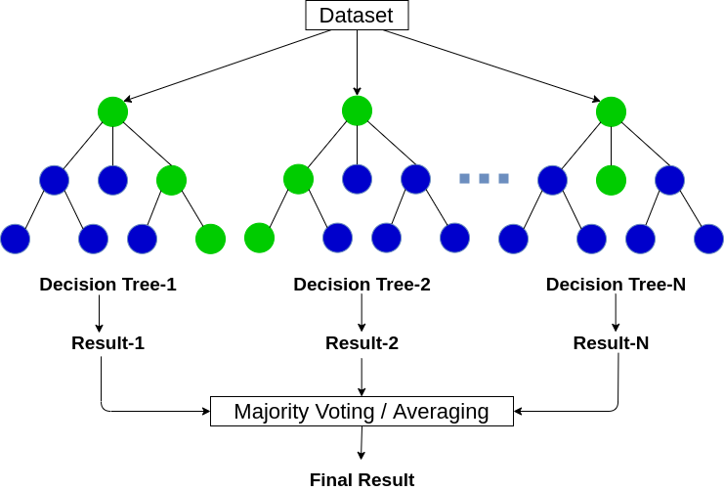
Random Forest Algorithm
Random forest is a classifier that evolves from decision trees.
Random forest model is a bagging-type ensemble (collection)
of decision trees that trains several trees in parallel and uses the
majority decision of the trees as the final
decision of the random forest
model
Random Forest Regression has
become a commonly used tool in
multiple prediction scenarios due
to their high accuracy and ability
to handle large features with
small samples
Disaster Tweet Analysis

Slide 22
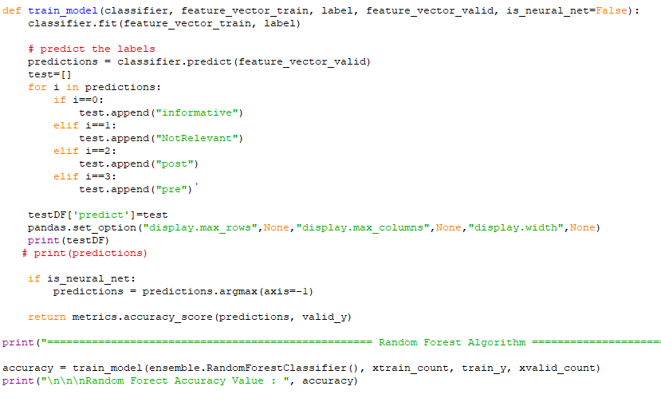
Random Forest Algorithm
Disaster Tweet Analysis

Slide 23
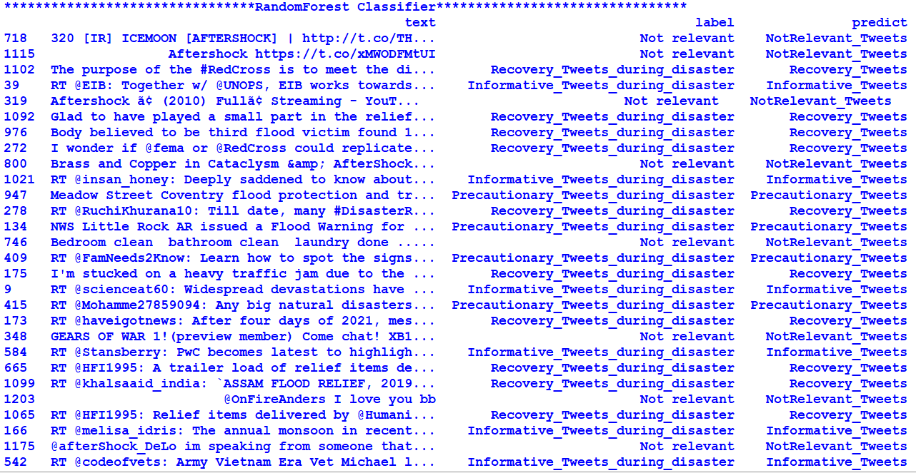
Output for Random Forest Algorithm
Disaster Tweet Analysis

Slide 24
Inferences of Random Forest Algorithm
Varying Test Set Size |  | 25 % | 37% | 50%
M E T R I C S | Accuracy | 0.9702 | 0.9665 | 0.8993
 | Precision | 0.9714 | 0.9671 | 0.9023
 | Recall | 0.9702 | 0.9665 | 0.8993
 | F1- Score | 0.9762 | 0.9727 | 0.9191
Time for Execution |  | 2.052 secs | 1.582 secs | 1.161 secs
Disaster Tweet Analysis

Slide 25
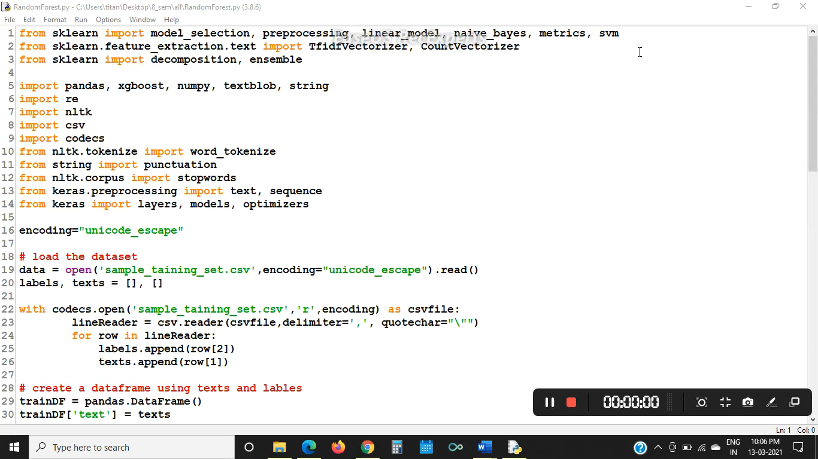
Random Forest Algorithm Demo
Disaster Tweet Analysis

Slide 26
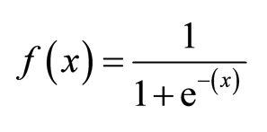
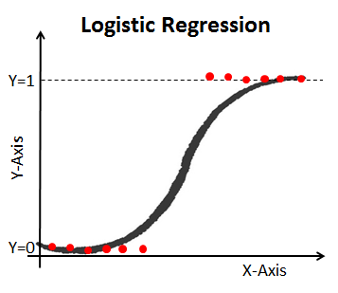
Logistic Regression Algorithm
Logistic Regression is a significant machine learning algorithm because it has the ability to provide probabilities and classify new data using continuous and discrete datasets.
The sigmoid function (S – Shaped curve ) is a mathematical function used to map the predicted values to probabilities.
In multinomial Logistic regression, there can be 3 or more possible unordered types of the dependent variable
Estimation is done through maximum likelihood.
Logistic regression requires quite
large sample sizes.
Disaster Tweet Analysis

Slide 27
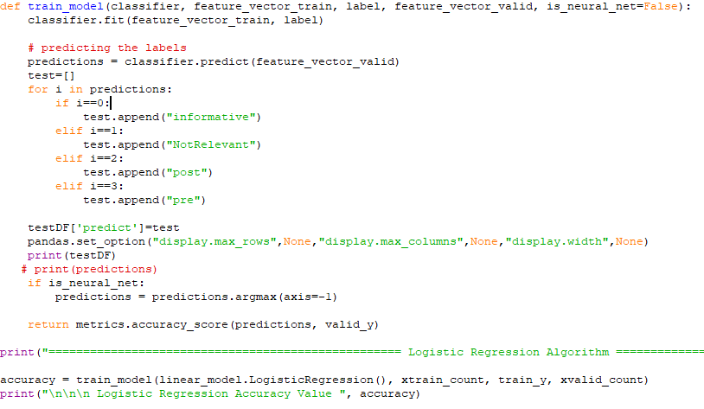
Logistic Regression Algorithm
Disaster Tweet Analysis

Slide 28
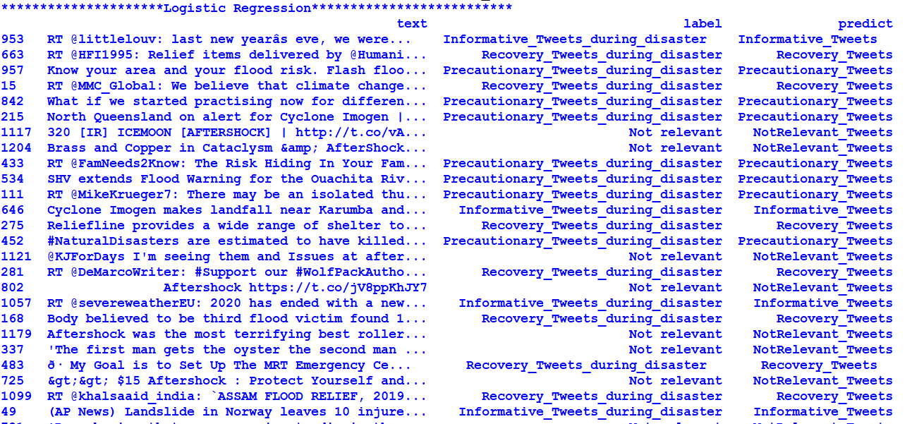
Output for Logistic Regression Algorithm
Disaster Tweet Analysis

Slide 29
Inferences of Logistic Regression Algorithm
Varying Test Set Size |  | 25 % | 37% | 50%
M E T R I C S | Accuracy | 0.98019 | 0.97104 | 0.92807
 | Precision | 0.98132 | 0.97247 | 0.92928
 | Recall | 0.98019 | 0.97104 | 0.92807
 | F1- Score | 0.97847 | 0.97023 | 0.92687
Time for Execution |  | 1.475 secs | 1.202 secs | 1.674secs
Disaster Tweet Analysis

Slide 30

Logistic Regression Algorithm Demo
Disaster Tweet Analysis

Slide 31


TF-IDF
stands for “Term Frequency – Inverse Document Frequency
tf idf(t,d,D) = tf(t,d) . idf(t,D)
Term Frequency: This summarizes how often a given word appears within a document.
Inverse Document Frequency: This downscales words that appear a lot across documents.
Disaster Tweet Analysis

Slide 32
Types of TF-IDF
Word Level tf-idf
  representing tf-idf scores of every term in different documents
N-gram Level tf-idf
  N-grams are the combination of N terms together.
Disaster Tweet Analysis

Slide 33
Example Tweets:
Sentence 1: Two people died during the earthquake
Sentence 2: Three people injured during the flood.
Word | TF |  | IDF | TF * IDF
 | Sen 1 | Sen 2 |  | Sen 1 | Sen 2
Two | 1/7 | 0 | Log (2/2) =0 | 0.043 | 0
Three | 0 | 1/7 | log(2/1)=0.3 | 0 | 0.043
People | 1/7 | 1/7 | log(2/1)=0.3 | 0 | 0
Died | 1/7 | 0 | log(2/1)=0.3 | 0.043 | 0
During | 1/7 | 1/7 | log(2/2)= 0 | 0 | 0
the | 1/7 | 1/7 | log(2/2)=0 | 0 | 0
Earthquake | 1/7 | 0 | log(2/1)=0.3 | 0.043 | 0
flood | 0 | 1/7 | log(2/1)=0.3 | 0 | 0.043
Injured | 0 | 1/7 | log(2/1)=0.3 | 0 | 0.043
Disaster Tweet Analysis

Slide 34
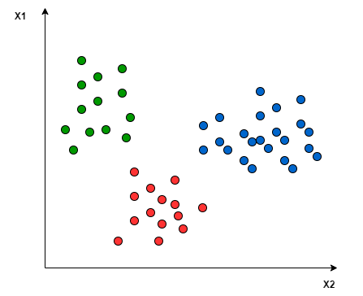
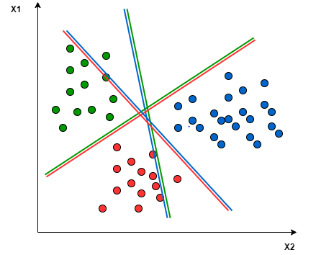
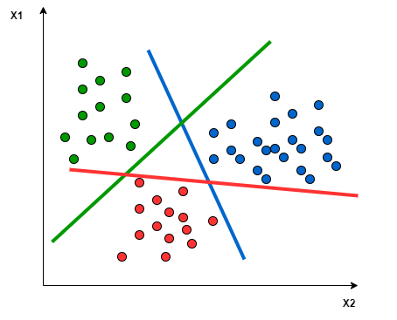
Support Vector Machine Algorithm
SVM doesn’t support multiclass classification natively.
The binary classification principle is utilized after breaking down the multiclassification problem into multiple binary classification problems
One-to-One approach: which breaks down the multiclass problem into multiple binary classification problems. A binary classifier per each pair of classes.
One-to-Rest approach : the breakdown is set to a binary classifier per each class
Disaster Tweet Analysis

Slide 35
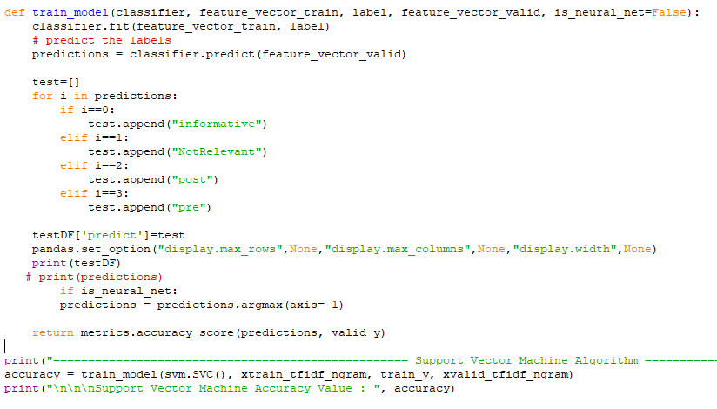
Support Vector Machine Algorithm
Disaster Tweet Analysis

Slide 36
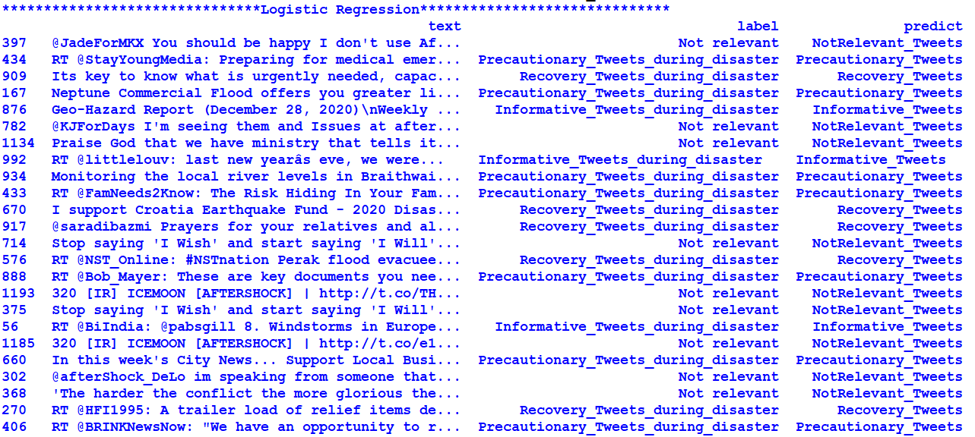
Output for Support Vector Machine Algorithm
Disaster Tweet Analysis

Slide 37
Inferences of the Support Vector Machine Algorithm
Varying Test Set Size |  | 25 % | 37% | 50%
M E T R I C S | Accuracy | 0.96039 | 0.94877 | 0.93894
 | Precision | 0.96102 | 0.95276 | 0.94432
 | Recall | 0.96039 | 0.94877 | 0.93894
 | F1- Score | 0.95962 | 0.95794 | 0.751736
Time for Execution |  | 1.232 secs | 3.852 secs | 1.291 secs
Disaster Tweet Analysis

Slide 38

Support Vector Machine Algorithm Demo
Disaster Tweet Analysis

Slide 39
Extreme Gradient Boosting Algorithm
Extreme Gradient Boosting (XGBoost) is open-source library that provides efficient and effective implementation of gradient boosting algorithm.
Gradient Boosting refers to class of ensemble machine learning algorithms that can be used for classification or regression predictive modelling.
Weights are the important part in XGBoost.
Weights are being assigned to all independent variables which are then fed into decision tree which predicts the results.
These individual classifiers then ensemble to give strong and more precise model.
Bagging and boosting are widely used ensemble learners.
Disaster Tweet Analysis

Slide 40
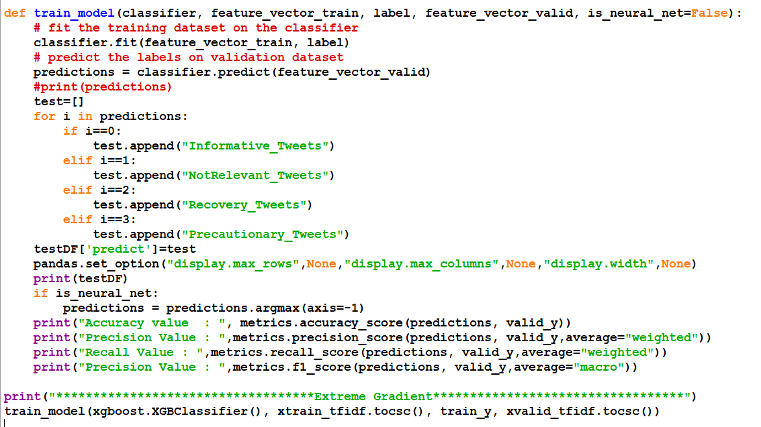
Extreme Gradient Boosting Algorithm
Disaster Tweet Analysis

Slide 41
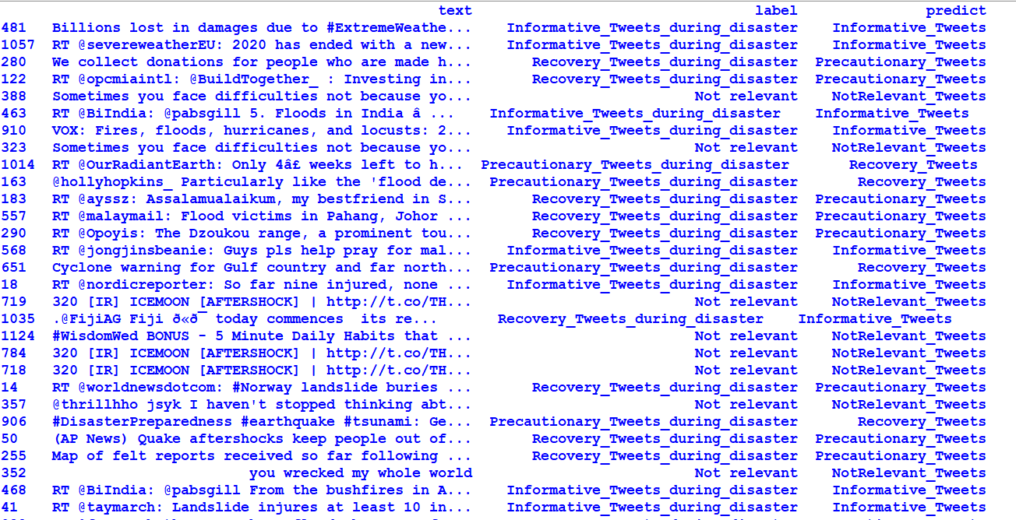
Extreme Gradient Boosting Algorithm
Disaster Tweet Analysis

Slide 42
Inferences for the Extreme Gradient Boosting Algorithm
Varying Test Set Size |  | 25 % | 37% | 50%
M E T R I C S | Accuracy | 0.99009 | 0.95768 | 0.92244
 | Precision | 0.99023 | 0.95845 | 0.92321
 | Recall | 0.99009 | 0.95768 | 0.92244
 | F1- Score | 0.98977 | 0.96569 | 0.93618
Time for Execution |  | 3.760 secs | 3.344 secs | 2.372 secs
Disaster Tweet Analysis

Slide 43

Extreme Gradient Boosting Algorithm Demo
Disaster Tweet Analysis

Slide 44
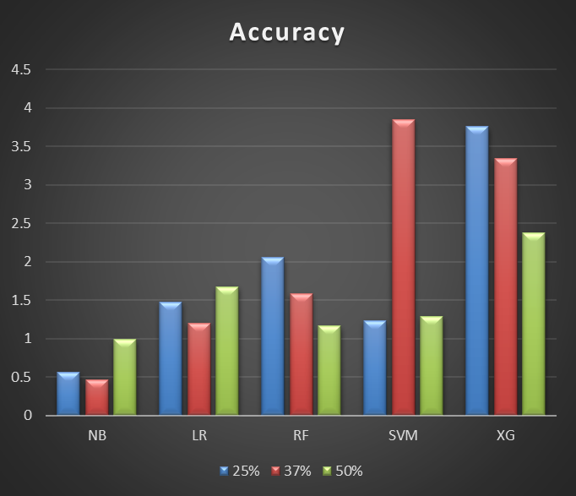
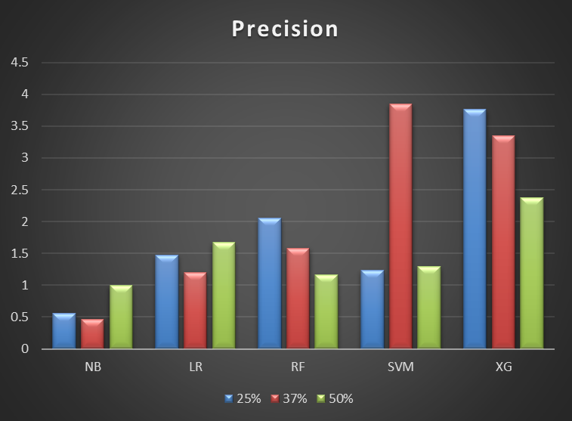
Comparison Chart for Accuracy and Precision
Disaster Tweet Analysis

Slide 45
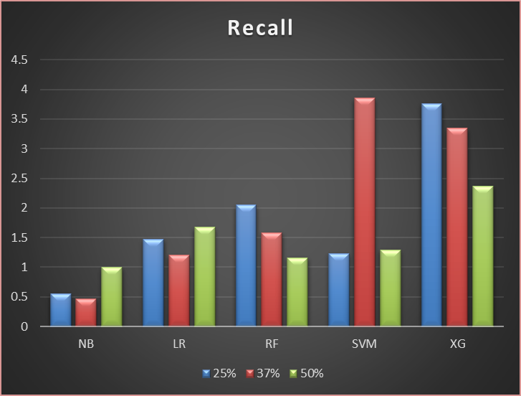
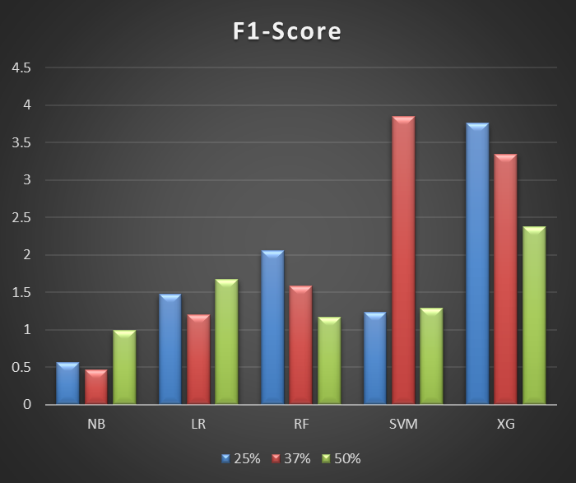
Comparison Chart for Recall and F1 - Score
Disaster Tweet Analysis

Slide 46
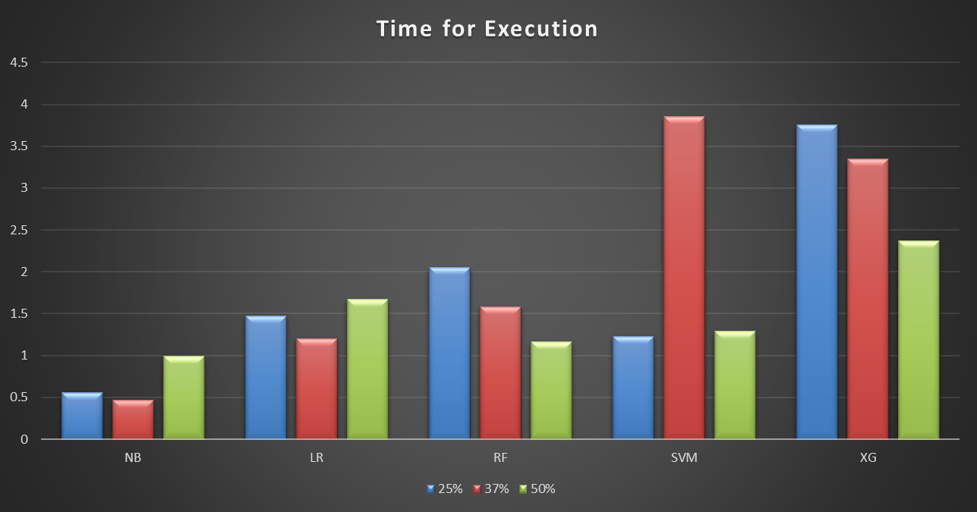
Comparison Chart For Total Time Taken for Execution
Disaster Tweet Analysis

Slide 47
Progress
Completed :
  Naïve Bayes Algorithm
  Logistic Regression Algorithm
  Random Forest Algorithm
  Support Vector Machine Algorithm
  Extreme Gradient Boosting Algorithm
Disaster Tweet Analysis

Slide 48
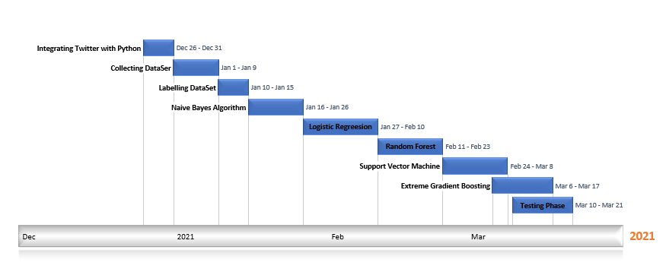
Timeline of the project
Disaster Tweet Analysis

Slide 49
Requirements
Hardware Requirements
  RAM : 8 GB & Above
  Processor : i5 & Above
Software Requirements
  Windows
  Twitter API
  NLTK package
  Python Interpreter
Disaster Tweet Analysis

Slide 50
Roles and Responsibilities
Integrating Twitter with Python - Vasundhra M
Preparing the Data set – Kavisri S
Pre-processing Tweets – Vasundhra M
Training model - Both
  Naïve Bayes Algorithm
  Logistic Regression
  Random Forest
  Support Vector Machine
  Extreme Gradient Boosting
Testing Phase - Both
Disaster Tweet Analysis

Slide 51
References
1. Kaur, A. “Analyzing Twitter Feeds to Facilitate Crises Informatics and Disaster Response During Mass Emergencies” Dissertation M.Sc. in Computing (Data Analytics), TU Dublin, 2019.
https://arrow.tudublin.ie/scschcomdis/166/
2. A. Sen, K. Rudra and S. Ghosh, "Extracting situational awareness from microblogs during disaster events," 7th International Conference on Communication Systems and Networks (COMSNETS), 2015, pp. 1-6, doi: 10.1109/COMSNETS.2015.7098720.
3. Gopnarayan, Archan, Deshpande, Sachin, “Tweets Analysis for Disaster Management: Preparedness, Emergency Response, Impact, and Recovery”, Innovative Data Communication Technologies and Application Book, Jan 2020, pp -760 – 764
4. H. To, S. Agrawal, S. H. Kim and C. Shahabi, "On Identifying Disaster-Related Tweets: Matching-Based or Learning-Based?," 2017 IEEE Third International Conference on Multimedia Big Data (BigMM), 2017, pp. 330-337, doi: 10.1109/BigMM.2017.82.
5. Huang Q, Xiao Y “Geographic situational awareness: mining tweets for disaster preparedness, emergency response, impact, and recovery”, ISPRS Journal of Photogrammetry and Remote Sensing, 2015, pp. 1549–1568.
Disaster Tweet Analysis

Slide 52
References Contd
6. T. Funayama, Y. Yamamoto, M. Tomita, O. Uchida and Y. Kajita, "Disaster mitigation support system using Twitter and GIS," 2014 Twelfth International Conference on ICT and Knowledge Engineering, 2014, pp. 18-23, doi: 10.1109/ICTKE.2014.7001528.
7. H. Shekhar and S. Setty, "Disaster analysis through tweets," 2015 International Conference on Advances in Computing, Communications and Informatics (ICACCI), 2015, pp. 1719-1723, doi: 10.1109/ICACCI.2015.7275861.
8. Boaz, John & Ybañez, Michael & De Leon, Marlene & Estuar, Ma.Regina.. “Understanding the Behavior of Filipino Twitter Users during Disaster” GSTF Journal on Computing (JoC), 2013, Vol:3, doi: 10.7603/s40601-013-0007-z.
9. Kumar, Shamanth & Barbier, Geoffrey & Abbasi, Mohammad Ali & Liu, Huan, “TweetTracker: An Analysis Tool for Humanitarian and Disaster Relief.”, Proceedings of the Fifth International Conference on Weblogs and Social Media, Barcelona, Catalonia, Spain, July 17-21, 2011.
10. Stowe, Kevin & Paul, Michael & Palmer, Martha & Palen, Leysia & Anderson, Kenneth, “Identifying and Categorizing Disaster-Related Tweets”, Proceedings of The Fourth International Workshop on Natural Language Processing for Social Media, 2016, pp.1-6, doi: 10.18653/v1/W16-6201.
Disaster Tweet Analysis

Slide 53
References Contd
11. Imran, Muhammad & Elbassuoni, Shady & Castillo, Carlos & Diaz, Fernando & Meier, Patrick, “Practical Extraction of Disaster-Relevant Information from Social Media”, Proceedings of the 22nd International Conference on World Wide Web Social Web for Disaster Management (SWDM), 2013, doi: 10.1145/2487788.2488109.
12. Acar, Adam & Muraki, Yuya, “Twitter for crisis communication: Lessons learned from Japan's tsunami disaster. IJWBC”, International Journal of Web Based Communities, 2011, Vol.7, pp.392-402, doi: 10.1504/IJWBC.2011.041206.
13. B. Abedin, A. Babar and A. Abbasi, "Characterization of the Use of Social Media in Natural Disasters: A Systematic Review," 2014 IEEE Fourth International Conference on Big Data and Cloud Computing, 2014, pp. 449-454, doi: 10.1109/BDCloud.2014.17.
14. Son Doan, Bao-Khanh Ho Vo, Nigel Collier, “An Analysis of Twitter Messages in the 2011 Tohoku Earthquake”, International Conference on Electronic Healthcare, 2012, Volume: 91, pp 58-66, ISBN: 978-3-642-29261-3
15. Kanhabua, Nattiya & Nejdl W, “Understanding the diversity of tweets in the time of outbreaks”, Proceedings of the 22nd International Conference on World Wide Web, 2013, pp.1335-1342.
Disaster Tweet Analysis

Slide 54
References Contd
16. Singh, Jyoti & Dwivedi, Yogesh & Rana, Nripendra & Kumar, Abhinav & Kapoor, Kawal., “Event Classification and Location Prediction from Tweets during Disasters.”, Annals of Operations Research, 2019,Vol.283, doi: 10.1007/s10479-017-2522-3.
17. Goswami, Shriya and Raychaudhuri, Debaditya, “Identification of Disaster-Related Tweets Using Natural Language Processing”, International Conference on Recent Trends in Artificial Intelligence, IOT, Smart Cities & Applications, 2020.
18. Parilla-Ferrer, Beverly & Fernandez, Proceso & IV, Jaime, “Automatic Classification of Disaster-Related Tweets”, International conference on Innovative Engineering Technologies, 2014.
19. Go,A., Richa, B. and Lei,H.(2009). “Twitter Sentiment Classification using Distant Supervision. In Processing”, 2009, pp.1–6. http://cs.stanford.edu/people/alecmgo/papers/TwitterDistantSupervision09.pdf
20. Bhat, F., Oussalah, M., Challis, K., & Schnier, T., “A Software System for Data Mining with Twitter”, Proceedings of the 2011 IEEE 10th International Conference on Cybernetic Intelligent Systems (CIS) London, United Kingdom, 2011, pp.139–144, doi: IEEE.10.1109/CIS.2011.6169149
Disaster Tweet Analysis

Slide 55

Disaster Tweet Analysis

