Slide 1
Compact Wisdom at Small Scale
Small Language Models as Cultural Assistants
Manimegalai R • Aravinda Krishnan L • Swaathi S. M
PSG Institute of Technology and Applied Research, Coimbatore
Venkatapathy Subramanian — IIT Bombay

Slide 2
AGENDA
What we'll cover
01
Abstract & Motivation
Why small models need retrieval to be trustworthy
02
Research Question
Can retrieval + light adaptation replace scale?
03
Methodology
Pipeline, knowledge graph, indexing strategies, model setup
04
Results
Retrieval quality and end-to-end generation performance
05
Conclusion
What we tried, what we found, and what's next
2

Slide 3
ABSTRACT
Can small models be faithful cultural assistants?
The Question
The Testbed: Thirukkural
LLMs reason well but cost too much to deploy widely. Can small models still be faithful and cite their sources?
1,330 Tamil couplets in a stable Paal → Iyal → Adhigaram hierarchy — ideal for retrieval-based grounding.
Key result: BERTScore-F1 ≥ 0.80 — small models approach large-model quality.
3

Slide 4
INTRODUCTION
Why cultural assistants need more than scale
01
Deployment constraints
Cost, memory, and energy limit LLMs in low-resource settings.
02
Two strict requirements
Faithfulness to the source, and transparent, citable attribution.
03
The open question
Can retrieval plus light adaptation replace raw scale?
4

Slide 5
RESEARCH QUESTION
RQ1 and three contributions
Can small models, with retrieval and light adaptation, match LLMs on faithful, attributable generation?
Bilingual corpus
Retrieval pipeline
Systematic comparison
Separates retrieval accuracy from generation faithfulness.
Sparse + dense retrieval tailored to compact corpora.
Base vs. RAG vs. RAG+LoRA vs. large LLMs.
5

Slide 6
METHODOLOGY
Task definition and pipeline
1
2
3
4
Retrieve
→
Ground
→
Generate
→
Attribute
Find matching verses
Attach evidence block
Write explanation
Cite Kural IDs
Corpus & QA construction
Final dataset
1,330 Kurals, bilingual. 1,114 validated across 133 Adhigarams.
Split 2,193 / 219 / 219. 216 Kurals held out for generalization testing.
6

Slide 7
METHODOLOGY
Retrieval pipeline: query to grounded answer
User
Query
Dense
Retriever
Top-k
Kurals
Knowledge
Graph
Output
→
→
→
→
What does kural say about Education
Embeddings
calculated
By semantic
similarity
SIMILAR-TO
expansion
Grounded &
cited
How the Knowledge Graph step works
Top-k Kurals expand into their Adhigaram neighborhood via SIMILAR-TO edges — so the generator sees coherent evidence, not isolated couplets.
7

Slide 8
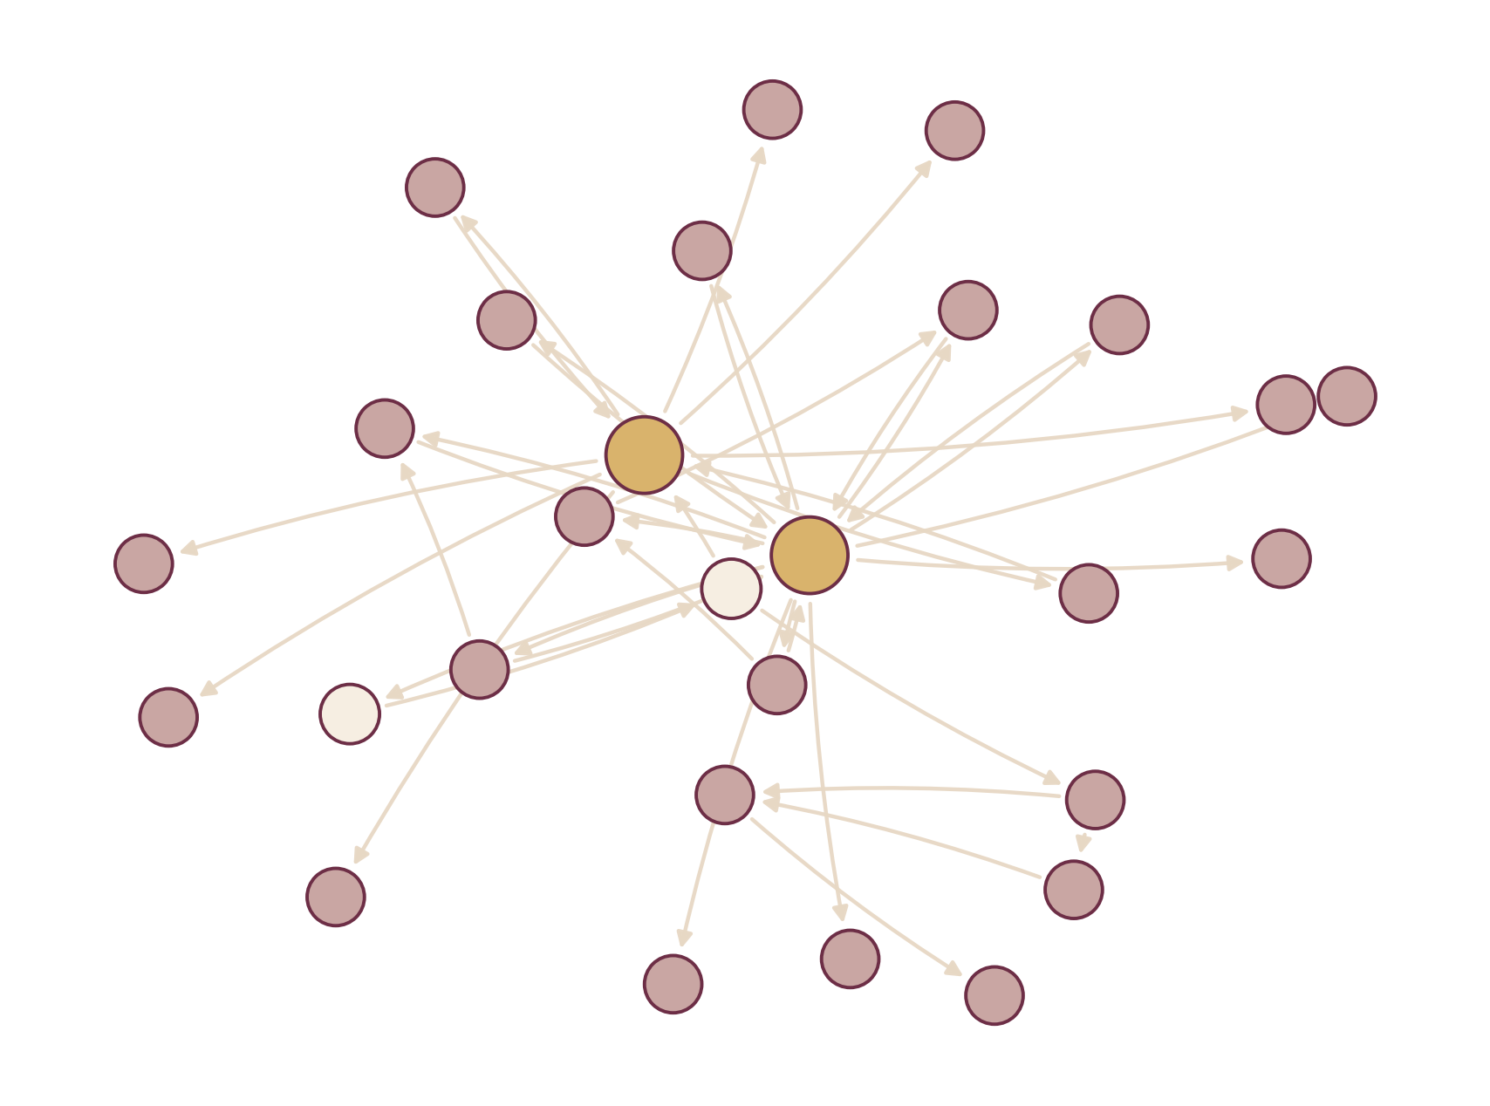
METHODOLOGY
Knowledge graph: Adhigaram similarity network
Structure
Gold = hub Kurals · Purple = neighbors · Cream = bridge nodes
Edges = SIMILAR-TO links from embedding similarity
Hierarchy Paal→Iyal→Adhigaram→Kural is encoded in Neo4j
8

Slide 9
METHODOLOGY
Three indexing granularities
01
02
03
Kural-level
Adhigaram-level
Clustered Adhigaram
Atomic verse unit.
Grouped by chapter.
Graph-linked chapters.
Precise, but brittle.
Better thematic recall.
Near-perfect recall.
9

Slide 10
METHODOLOGY
Models, retrieval, and adaptation setup
Models evaluated
LoRA adaptation
Gemma-3 270M
Gemma-3 1B
Baselines: GPT-OSS-20B, Gemini-2.5-Flash, Sonar
Rank r
8, 16
Alpha α
16, 32
Epochs
3 – 7
Retrieval pipeline
Learning rate
1e-5 – 1e-3
BM25 + BGE-M3, top-k = 10
Bilingual cross-encoder reranking
Training: NVIDIA A6000 (48GB) · AdamW · bf16
10

Slide 11
RESULTS
Retrieval quality across indexing strategies
Indexing Strategy | Recall | Precision | nDCG
Kural-level | 0.009 | 0.005 | 0.256
Adhigaram-level | 0.408 | 0.245 | 0.705
Clustered Adhigaram | 0.999 | 0.777 | 0.986
0.999
recall under clustered retrieval
Retrieval structure is the single dominant lever in this study.
11

Slide 12
RESULTS
End-to-end generation: RAG closes the gap
Gemma-3 1B (fine-tuned)
Without retrieval
Kural
0.71
Performance is dominated by model scale alone.
Fine-tuning improves style, not faithfulness.
Retrieval — not adaptation — enables attribution.
Adhigaram
0.84
Clustered
0.87
Grounding partly compensates for limited capacity.
12

Slide 13
CONCLUSION
What we tried, achieved, and found
What we tried
What we achieved
Key result
Bilingual RAG pipeline over the Thirukkural
Three indexing strategies, incl. a graph-based clustered approach
Gemma-3 270M / 1B, with & without LoRA
Near-perfect retrieval (0.999 recall) via clustered indexing
Fine-tuned 1B SLM approaching large-model BERTScore
A citation-checked, attribution-safe generation pipeline
Retrieval structure — not model scale — is the dominant factor
SLMs can be faithful, deployable cultural assistants
Frugal AI is viable for stable, bounded canonical texts
Future work: Tamil-first generation · richer evidence selection · multi-verse evaluation
13

