Slide 1
Robo - Scout
Multi-Robot Coordinated System for Optimized
Warehouse Management
Harshavardan K K (715521104015)
Sridhar R (715521104310)
Mugunthan R (715521104305)
Project Guide:
Dr. Manimegalai R

Slide 2
Outline of the Presentation
Introduction and Background
Literature Review
Gaps Identified
Objectives
Proposed Methodology for the Multi-Robot Coordinated System for Warehouse Management
Progress After the Previous Review
Roles and Responsibilities
Time of the Project
Demo
Conclusions
References

Slide 3
Objective of the Problem
To design and develop a Multi-Robot Coordinated System capable of using multiple autonomous bots to collaboratively perform tasks for warehouse navigation, collision avoidance and do pickup and drop of warehouse pallets.
Each bot in the swarm should be equipped with motors that will help in navigating through the environment and identify the desired pallet and drop in its delivery zone which is achieved with minimal human intervention.
The system should optimize task allocation, navigation, and data exchange to enable effective coordinated action for multiple bots to exist.

Slide 4
Abstract
The system will manage a fleet of small, autonomous robots in a warehouse-simulated environment, each equipped with ArUco markers for unique identification.
A master PC with an eagle-eye view of the warehouse will plan collision-free paths for the robots, including speed and angle, to ensure efficient navigation.
Each bot will receive its navigational instructions via a NodeMCU, allowing the robots to travel seamlessly and deliver pallets to their designated locations.

Slide 5
Module(s)
Camera Module - to enable the computer vision.
Robot & Pallet Localization - this is implemented using ArUco Markers and the boundaries of the environment is marked
Task Coordination and Command Module - to transfer commands from central server to bots.
Path Planner - this is to plan the route for the bot from it current position to the pallets and after collecting the pallets from there to the drop off points.
Motor Control module - Servo motor inputs are provided.
Electromagnet - to pick up the pallets.

Slide 6
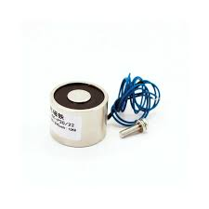
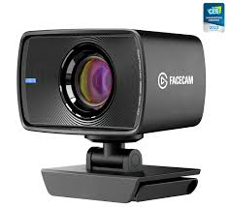
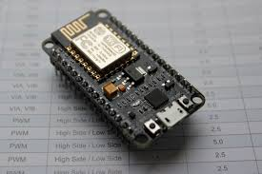
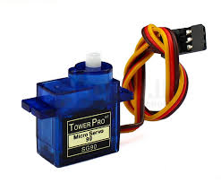
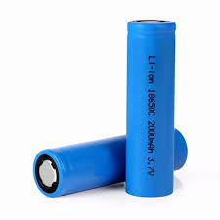
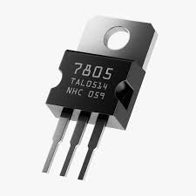
Hardware Components

Slide 7
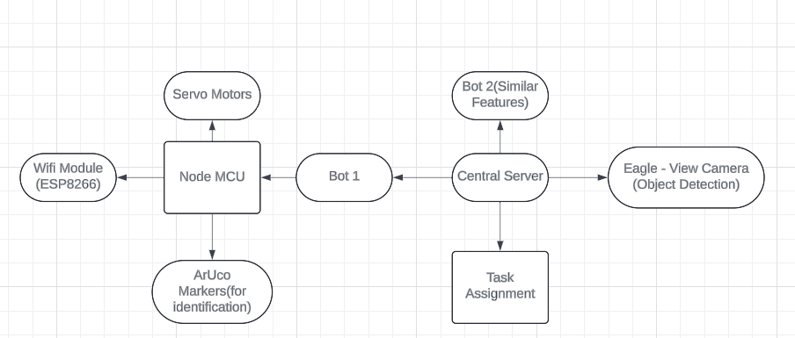
Block Diagram (Hardware)

Slide 8
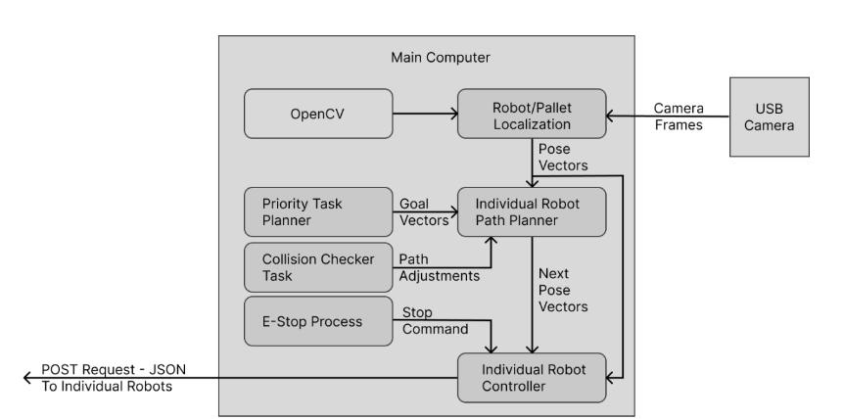
Block Diagram (Modules)

Slide 9
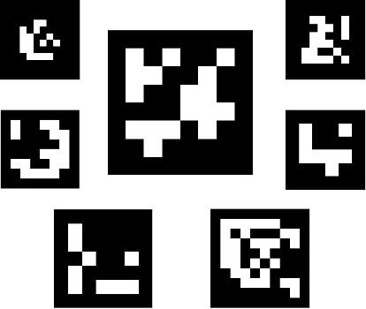
Robot and Pallet Localization Module
Overview: Implemented using a Overhead Camera to detect ArUco Markers
Components:
  Camera: Captures images/videos for processing.
  OpenCV: Library used for image processing and computer vision tasks.
Features:
  The Master Computer is connected with a webcam that runs a python program
  This is able to detect all the ArUco Marker which is present in the environment
  Application: Facilitates autonomous navigation and decision-making for bots.

Slide 10
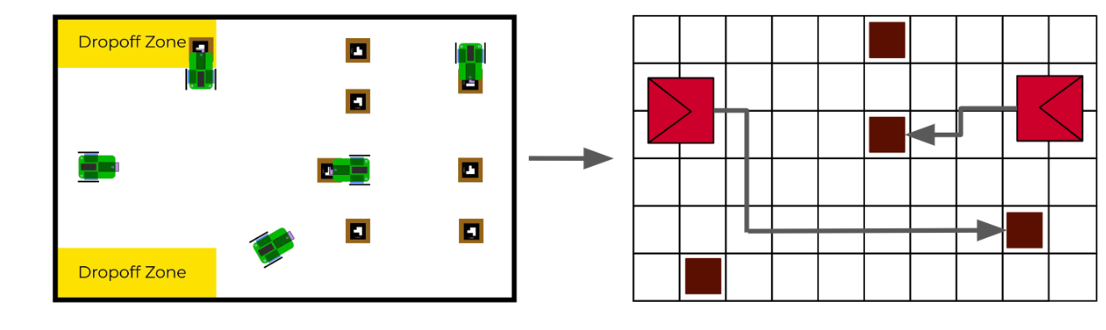
Path Planner Module
Overview: The system incorporates a path planner module that uses the A* search algorithm to navigate bots efficiently within the warehouse environment.
A* Search Algorithm: A pathfinding algorithm used to calculate the optimal path for each bot from its current position to the target location.
The path planner uses A* to compute the shortest collision-free path for each bot, taking into account obstacles and other bots.
Application: This path planner ensures efficient and collision-free movement for the bots, allowing them to reach their destination while avoiding obstacles and optimizing travel time.

Slide 11
Bot-Master Communication Module
Overview: Utilizes a WiFi module for seamless communication between bots and the central server.
Components:
  WiFi Module (e.g., ESP8266): Enables network connectivity.
Features:
  Supports HTTP protocols for reliable data transfer.
  Allows for multi-bot communication for coordinated tasks.
  Facilitates status updates and command acknowledgments.
Application: Ensures synchronization and collaboration among bots during operations.

Slide 12
Motor Control Module
Overview: The motor control system utilizes 360-degree servo motors to drive two wheels, with a passive third axis supported by a ball bearing for stability and maneuverability.
Servo 1, Servo 2: Control the continuous rotation and speed of the two wheels, providing forward, backward, and directional movement.
Ball Bearing (Third Axis): Acts as a passive stabilizer, allowing smooth pivoting and balancing without requiring active control.
360-degree servo motors enable precise control over both wheels, allowing the robot to move in various directions.
The ball bearing on the third axis provides free movement and supports the robot’s weight, enabling smooth turns without friction or resistance.
PWM signals control the speed and direction of the servo-driven wheels.

Slide 13
Current Progress
Currently the following modules are completed, which are
Robot and Pallet Localization Module,
Path Planner Module,
Motor Control Module(partial)
Bot-Master Communication Module and Integration of the components are still pending.
The Completed Module(s) are added in a demo video

Slide 14
Roles
Robot and Pallet Localization Module – Harshavardan K K
Path Planner Module – Sridhar R
Motor Control Module – Mugunthan R
Rest of the Module(s) are currently worked by:
Bot – Master Communication Module - Sridhar
Integration of Components – Harshavardan and Mugunthan

Slide 15
Literature Review
S. No | Title of the Paper/Patent | Authors | Inference
1 | Cooperative 3D Exploration and Mapping using Distributed Multi-Robot Teams | André Ribeiro, Meysam Basiri (2024) | This paper addresses multi-robot exploration of unknown environments, aiming to minimize exploration time by assigning optimal target points. The proposed coordination method balances target cost and utility, effectively distributing robots to explore different regions. The algorithm also accommodates limited communication ranges and has been validated through extensive real-world experiments and simulations.
2 | The Concept of an Autonomous Mobile Robot for Automating Transport Tasks in High-Bay Warehouses | Waldemar Małopolski, Sebastian Skoczypiec (2024) | The article presents an autonomous mobile robot for Smart Warehouses, improving transport efficiency with a unique drive mechanism and elevator compatibility.
3 | Analysis of Swarm Robotics Cooperative Control Strategy from the Patent Perspective | Xiaofen Fang, Haoran Xu, Bei Chen, Kunli Fang (2022) | The paper analyzes swarm robotics control strategies, noting China's dominance in patents and predicting future focus on swarm intelligence and collaboration.

Slide 16
S. No | Title of the Patent/Paper | Authors | Inference
4 | OBSTACLE AVOIDANCE IN AUTONOMOUS VEHICLES (Patent - 202117000083) | Ofir Cohen, Dina Appelman (2021) | The disclosed method allows an autonomous vehicle with an asymmetric shape to perform a collision-free point-turn in crowded areas, executing the maneuver quickly without needing to stop for obstacles.
5 | A REAL-TIME AUTONOMOUS NAVIGATION SYSTEM FOR A VEHICLE AND A METHOD THEREOF (Patent - 202041055232) | K. Senthil Kumar, D. Malathi, P. Nithika, P. Nithesh, Jayaseeli J. D. Dorathi (2021) | The abstract presents a real-time autonomous navigation system for vehicles, utilizing a stereo camera and processing unit to detect features, create a 3D map, identify obstacles, and plan safe navigation paths.
6 | Method and system for dynamically integrating bots (Patent - US20170269972A1) | R. Hosabettu, R. K. Ramanna, R. Mannopantar, P.Ananthasankaranarayanan, H. V. Natarajan (2017) | The method integrates multiple BOTs providing automated services, assigning functions and calculating maturity scores for synchronization, allowing dynamic collaboration based on their performance and predefined parameters.

Slide 17
7 | SYSTEM AND METHOD FOR MANAGING AN INSECT SWARM USING DRONES (Patent - 202011043508) | K. T. Gandhi (2020) | This disclosure outlines a system and method for managing insect swarms using drones. It includes detecting and tracking the swarm, enabling drones to communicate and align into a formation. Drones electromagnetically couple for coordination, deploy nets to trap insects, and use high voltage to incapacitate them.
8 | Recent trends in robot learning and evolution for swarm robotics | Jonas Kuckling (2023) | The article reviews advancements in swarm robotics, focusing on offline robot evolution, embodied evolution, and offline learning. It highlights design methods, challenges, and future research trends to enhance collective robot behavior.
9 | The cooperation of swarm-bots: Physical interactions in collective robotics | Francesco Mondada, Luca Maria Gambardella, Dario Floreano, Stefano Nolfi (2005) | The paper reviews the SWARM-BOTS project, detailing robot design, a simulator for testing adaptive algorithms, and showcasing cooperative behaviors in both simulations and hardware, demonstrating effective swarm-based collaboration.

