Slide 1
Human Presence Detection in the ROI of an Image
Department of Computer Science and Engineering
Project Review
Submitted By
Kavisri S - 715520104022
Megadarshini V - 715520104028
Kartik R - 715520104303
Guided By
Dr. R. Manimegalai
Professor & HOD,
Department of Computer Science and Engineering

Slide 2
Abstract
In this project, we introduce a robust system for real-time people counting within a defined region of interest (ROI).
Compared performance of HOG, Roboflow 3.0, YOLOv5, and YOLOv8 algorithms.
Identified YOLOv8 as the most accurate and efficient algorithm.
Created a user-friendly frontend interface for seamless interaction, providing results in image, video, and real-time camera formats.

Slide 3
Introduction
Accurate people counting plays a crucial role in numerous domains, including retail, public safety, transportation, and event management. Traditional methods often fall short in providing real-time solutions with high precision, leading to inefficiencies and inaccuracies. To tackle this challenge, we propose a novel approach that integrates advanced object detection algorithms with a user-friendly frontend interface. By harnessing the power of deep learning techniques, particularly YOLOv8, we aim to deliver a reliable solution capable of accurately counting people within a specified ROI. Through rigorous experimentation and comparative analysis, we identify the most effective algorithm for real-time people counting, laying the foundation for a robust and efficient system.

Slide 4
Literature Review
Details of the Paper (with author names, title, forum, year and page number in IEEE format) | Summary of the Paper
Nguyen, Duc Thanh, Wanqing Li, and Philip O. Ogunbona. "Human detection from images and videos: A survey." Pattern Recognition 51 (2016). | Introduction: The paper addresses recent advancements in human detection, organizing the survey around human object descriptors to guide practical application selection. Solution Approach: Utilizing a unique organizational framework, the survey critically analyzes state-of-the-art human detection methods, providing insights into their strengths and limitations. Applications in Livestock: Beyond conventional scenarios, the survey explores the adaptability of human detection methodologies to innovative applications in livestock for enhanced agricultural processes. Gap in Current Studies: Identifying critical gaps in existing studies, the paper underscores the need for further research to address shortcomings and advance human detection technologies. Concluding Remarks: The comprehensive overview concludes by highlighting successes, recent advances, and future research directions, emphasizing the ongoing evolution of human detection for diverse applications.

Slide 5
Literature Review
Details of the Paper (with author names, title, forum, year and page number in IEEE format) | Summary of the Paper
Dalal, Navneet, Bill Triggs, and Cordelia Schmid. "Human detection using oriented histograms of flow and appearance." Computer Vision–ECCV 2006: 9th European Conference on Computer Vision, Graz, Austria, May 7-13, 2006. Proceedings, Part II 9. Springer Berlin Heidelberg, 2006. | Introduction: This paper introduces a novel human detection method using depth information from the Kinect for Xbox 360. Solution Approach: The proposed method leverages depth data for efficient human detection, incorporating a segmentation scheme and a tracking algorithm. Applications: The depth-based approach extends to livestock scenarios, offering potential improvements in agricultural processes and animal welfare. Gap in Studies: The paper addresses a gap in human detection research by exploring the untapped potential of depth information compared to traditional visible-light cameras. Conclusion: In conclusion, the paper presents a pioneering depth-based human detection method, signaling a promising direction for future research in computer vision.

Slide 6
Literature Review
Details of the Paper (with author names, title, forum, year and page number in IEEE format) | Summary of the Paper
Christopoulos, Charilaos, Joel Askelof, and Mathias Larsson. "Efficient methods for encoding regions of interest in the upcoming JPEG2000 still image coding standard." IEEE Signal Processing Letters 7.9 (2000). | Introduction: This paper introduces a method for generating regions of interest (ROI) masks for the upcoming JPEG2000 still image coding standard. Solution Approach: The paper proposes a simple method for generating ROI masks for rectangular-shaped ROIs and a coding approach for arbitrary-shaped ROIs without transmitting shape information, incurring a small coding penalty. Applications: Enhancing JPEG2000, the methods provide flexibility for arbitrarily shaped ROIs without requiring shape information, applicable to image coding standards. Gaps Identified: The paper addresses gaps in current studies, specifically the complexity of decoding arbitrary-shaped ROIs without transmitted shape information, introducing an approach with a modest coding penalty. Concluding Remarks: The proposed ROI generation and coding methods, included in the Final Committee Draft of JPEG2000 Part 1, offer efficiency for encoding and decoding in the JPEG2000 standard.

Slide 7
Problem Statement
Crowd counting and monitoring play pivotal roles in security, resource optimization, and public safety.
Existing methods often lack accuracy and fail to deliver real-time insights, posing challenges in decision-making processes.
This project seeks to address this problem by focusing on the precise counting of individuals within a specified ROI.
The objective is to develop a reliable solution that can contribute to enhanced crowd management, security measures, and resource allocation in various sectors.

Slide 8
Proposed Methodology
Evaluate the performance of HOG, Roboflow 3.0, YOLOv5, and YOLOv8 for people counting and select YOLOv8 for its superior real-time accuracy and efficiency within a defined ROI.
Establish standardized experimental protocols and metrics for accuracy assessment, and collect diverse datasets representative of real-world scenarios to ensure comprehensive testing.
Integrate the YOLOv8 algorithm into the system architecture for seamless execution, and develop preprocessing, detection, and post-processing modules to optimize performance.
Design an intuitive frontend interface allowing users to interact effortlessly with features for ROI specification, visualization of detected individuals, and real-time count updates.
Present people counting results in various formats including images, videos, and real-time camera feeds, and conduct rigorous validation tests in diverse real-world environments to ensure system reliability and accuracy.

Slide 9
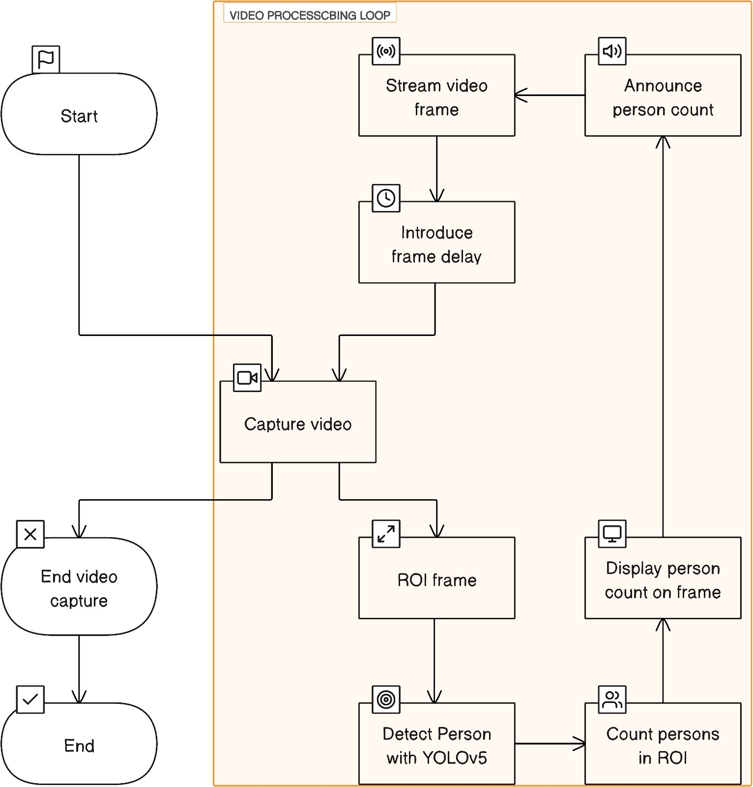
System Flow

Slide 10
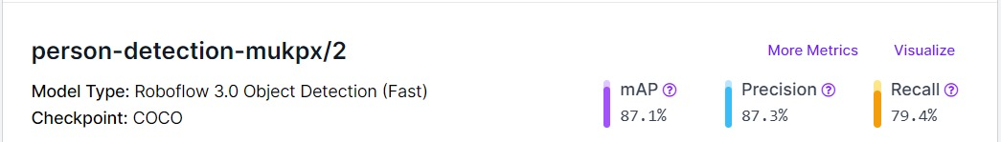
Roboflow Object detection

Slide 11
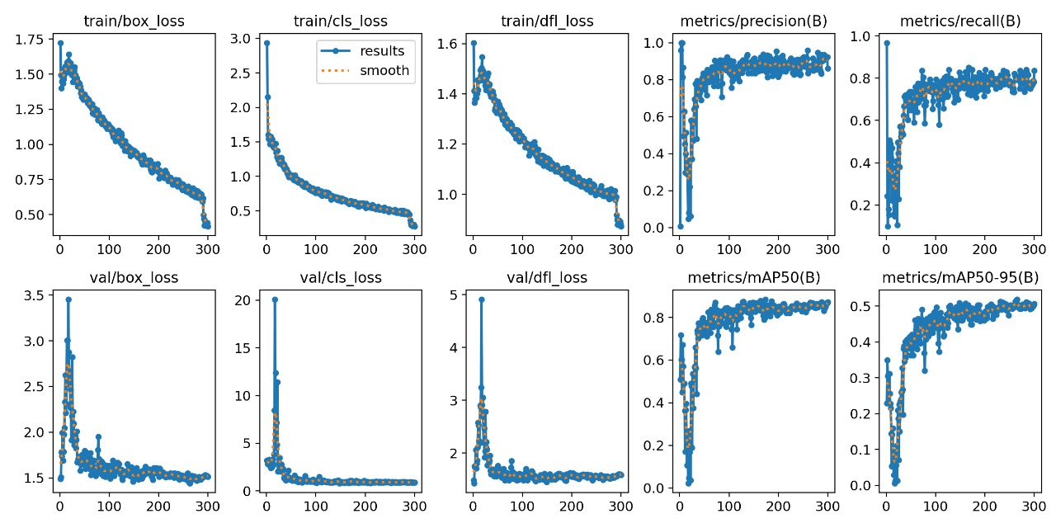
Roboflow – Visualization

Slide 12
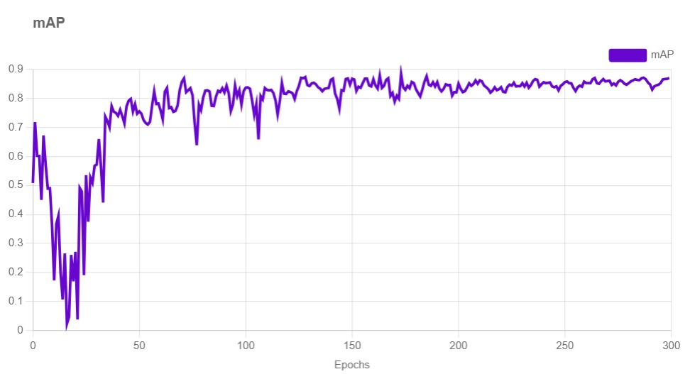
Roboflow - mAP

Slide 13
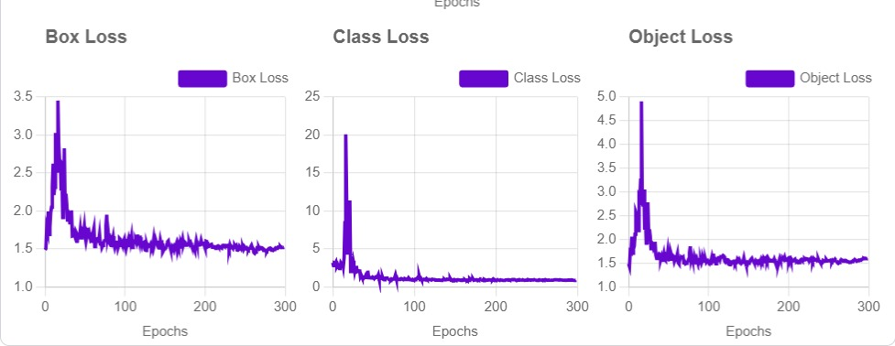

Slide 14
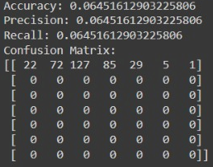
HOG - Result

Slide 15
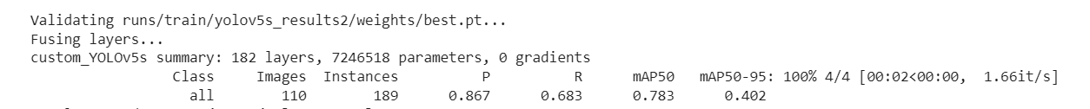
YOLOv5

Slide 16
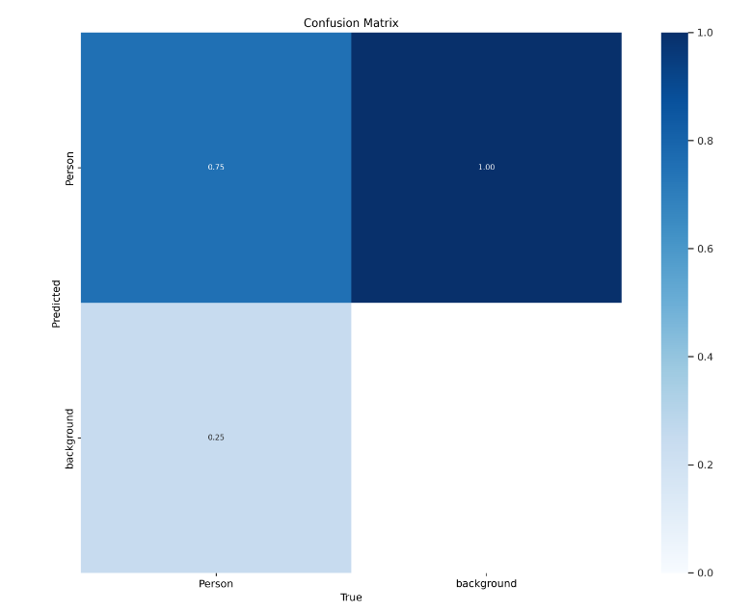
YOLOv5 – Confusion Matrix

Slide 17
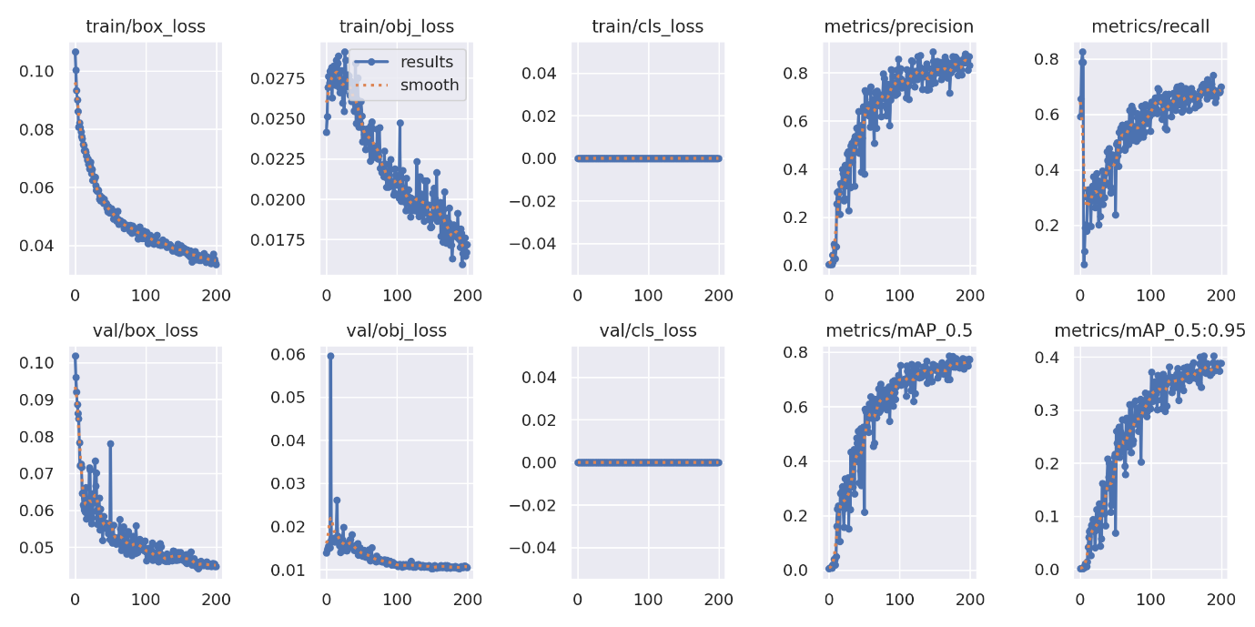
YOLOv5 - Visualization

Slide 18
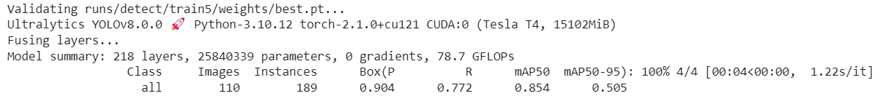
YOLOv8

Slide 19
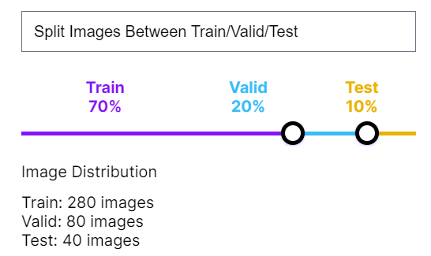
YOLOv8 – Dataset split-up

Slide 20
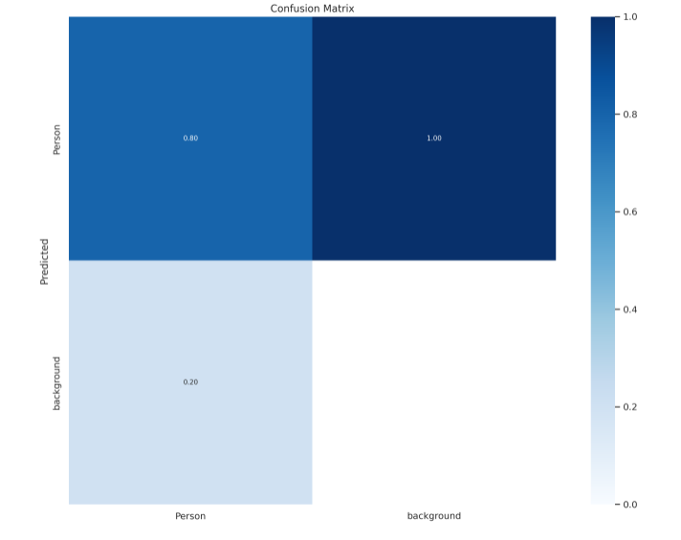
YOLOv8 – Confusion Matrix

Slide 21
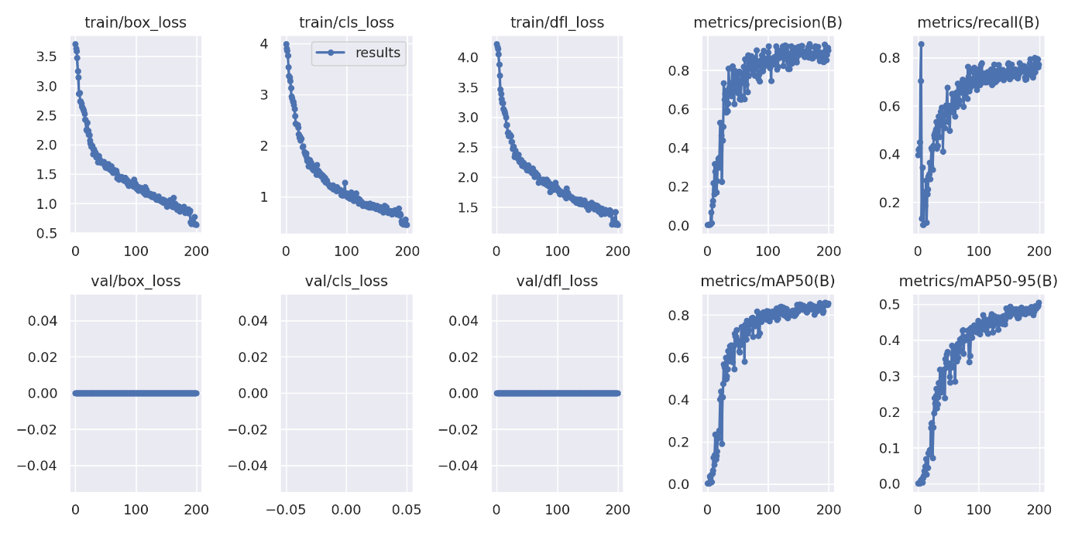
YOLOv8 - Visualization

Slide 22
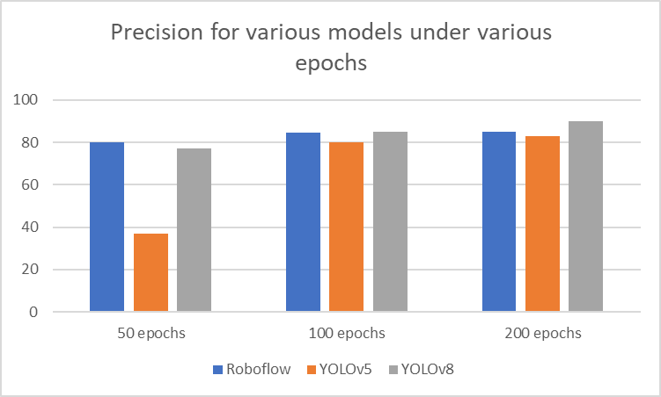
Bar Chart Visualization - Precision

Slide 23
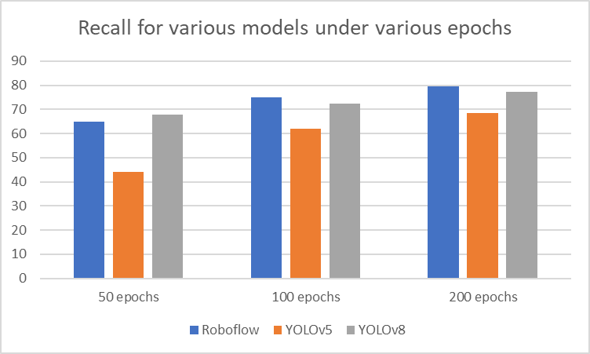
Bar Chart Visualization - Recall

Slide 24
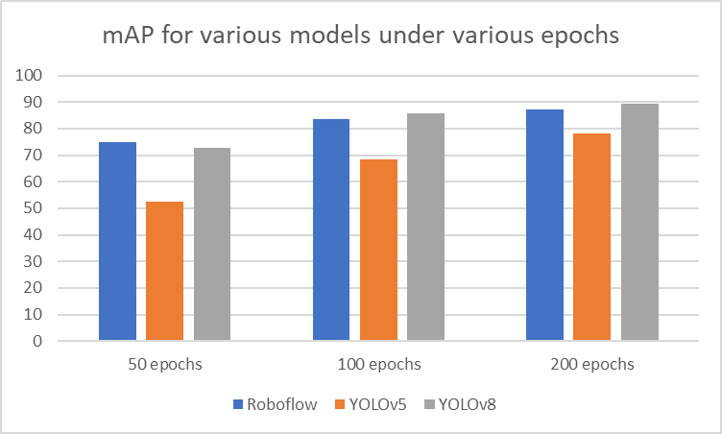
Bar Chart Visualization - mPA

Slide 25
Comparative results
Model/Metrics | Precision (%) | Recall(%) | mAP(%)
Roboflow 3.0 Object Detection | 87.3 | 79.4 | 87.1
HOG | 64.5 | 64.5 | 64.1
YOLOv5 | 86.7 | 68.3 | 78.3
YOLOv8 | 90.4 | 77.2 | 89.4

Slide 26
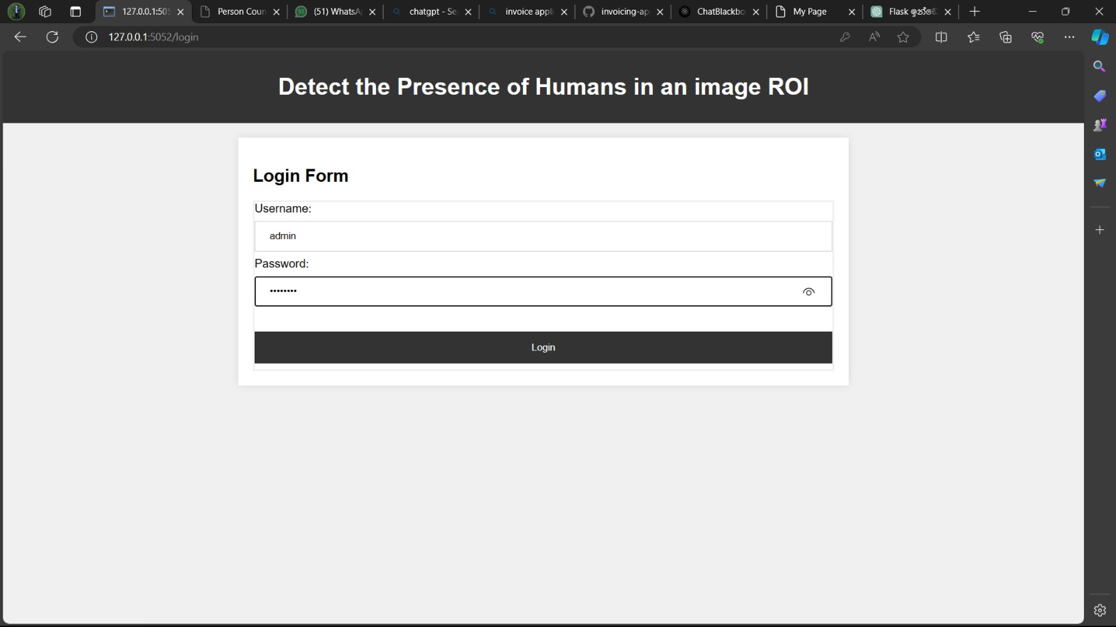
Output Screenshots

Slide 27
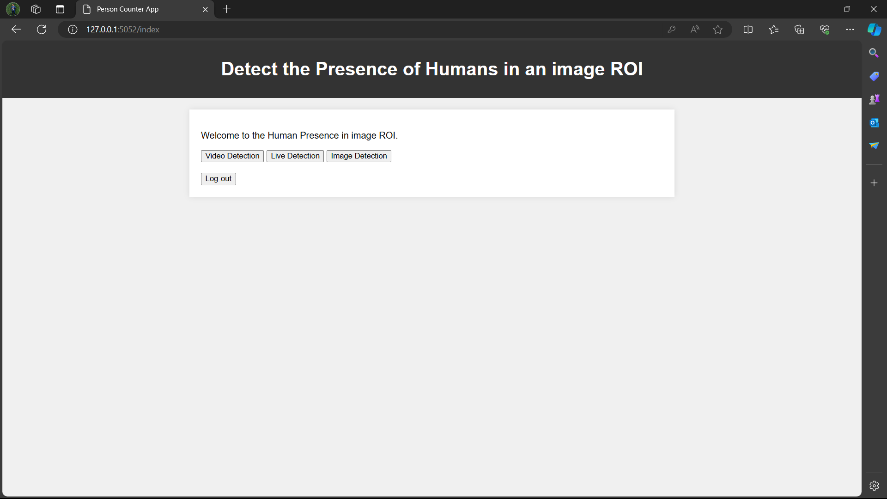
Output Screenshots

Slide 28
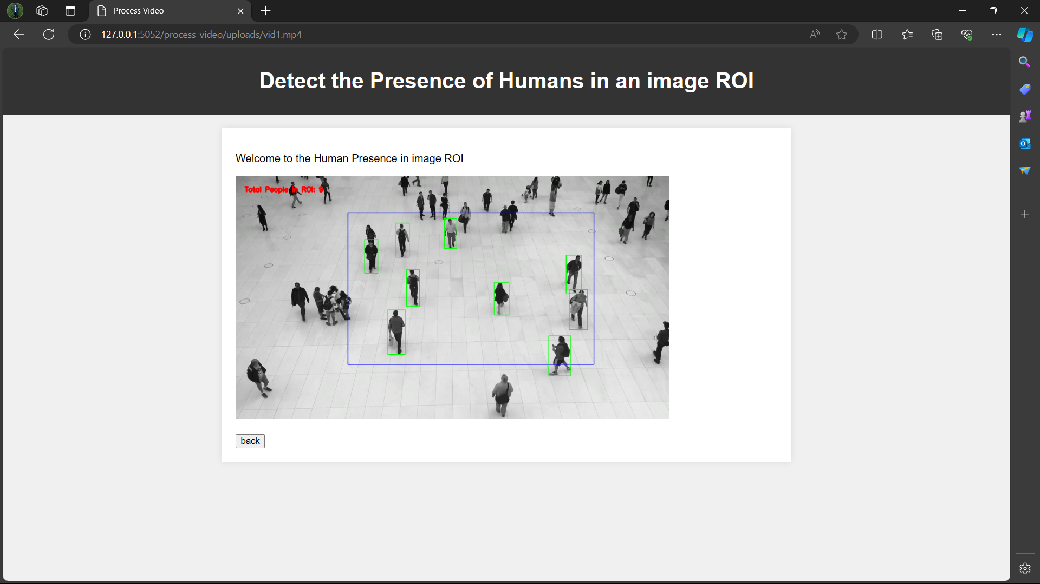
Output Screenshots

Slide 29
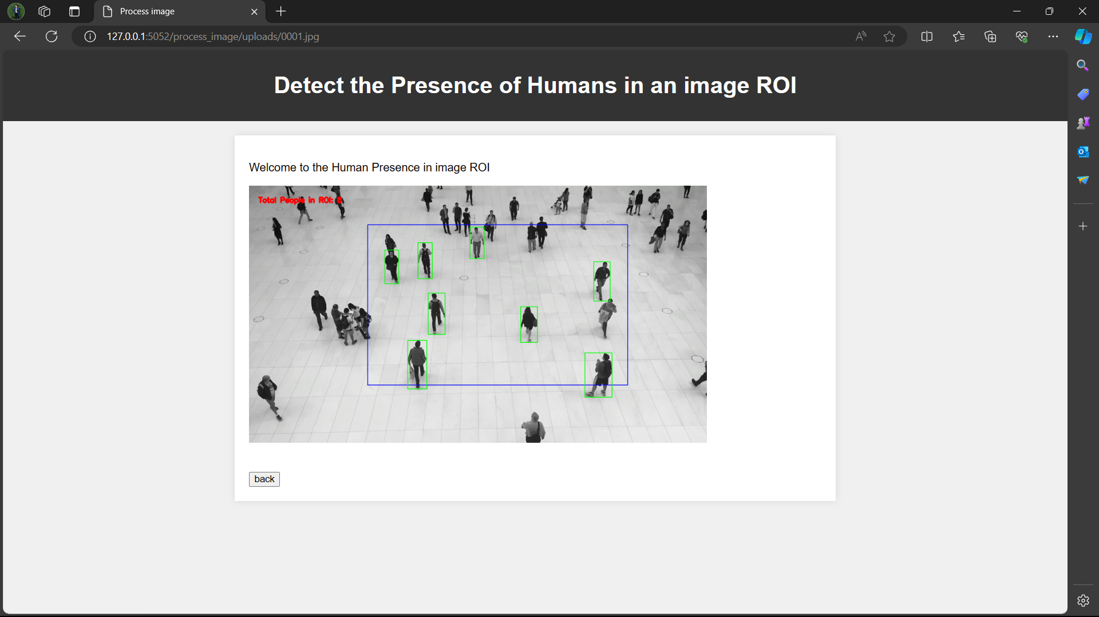
Output Screenshots

Slide 30
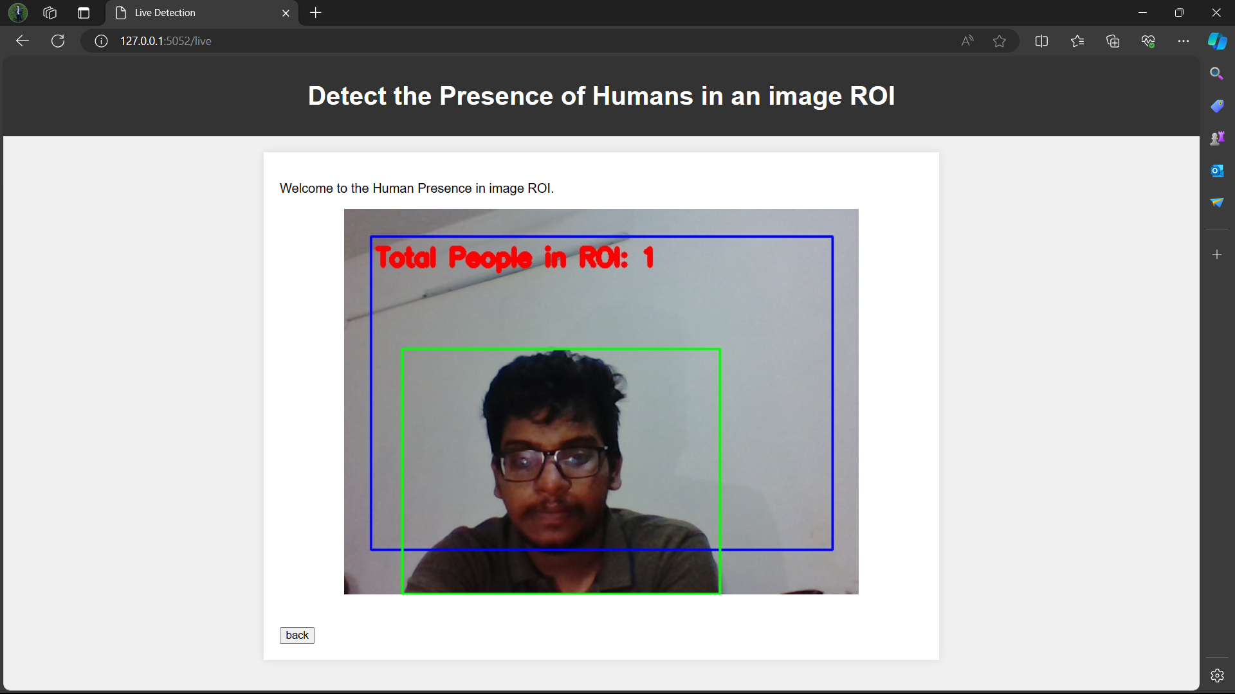
Output Screenshots

Slide 31
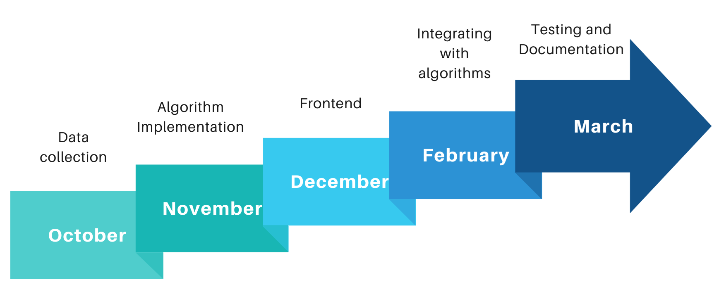
Timeline of the Project

Slide 32
Roles and Responsibilities
Kavisri
– ROI and Text-to-speech, Algorithm Implementation
Megadarshini
– Dataset Collection and preprocessing, Algorithm Implementation
Kartik
– Front-end, Algorithm Implementation

Slide 33
Conclusion
The proposed real-time crowd monitoring and counting system leverages advanced computer vision techniques, for object detection, to efficiently monitor individuals within a specified Region of Interest (ROI).
By combining YOLOv5 for accurate object detection, a robust Flask framework for web application development, and text-to-speech synthesis, the project aims to contribute to enhanced crowd management, security measures, and resource allocation in various sectors.

Slide 34
References
[1] M. Rizk and I. Bayad, "Human Detection in Thermal Images Using YOLOv8 for Search and Rescue Missions," 2023 Seventh International Conference on Advances in Biomedical Engineering (ICABME), Beirut, Lebanon, 2023.
[2] Paul, M., Haque, S.M.E. & Chakraborty, S. Human detection in surveillance videos and its applications - a review. EURASIP J. Adv. Signal Process. 2013
[3] Nguyen, Duc Thanh, Wanqing Li, and Philip O. Ogunbona. "Human detection from images and videos: A survey." Pattern Recognition 51 2016.
[4] Dalal, Navneet, Bill Triggs, and Cordelia Schmid. "Human detection using oriented histograms of flow and appearance." Computer Vision–ECCV 2006: 9th European Conference on Computer Vision, 2006.
[5] Christopoulos, Charilaos, Joel Askelof, and Mathias Larsson. "Efficient methods for encoding regions of interest in the upcoming JPEG2000 still image coding standard." IEEE Signal Processing Letters 7.9, 2000.
[6] Byeon, Yeong-Hyeon, Dohyung Kim, Jaeyeon Lee, and Keun-Chang Kwak, "Body and Hand–Object ROI-Based Behavior Recognition Using Deep Learning, 2021.
[7] Zhu, Qiang & Yeh, Mei-Chen & Cheng, K.-T. Tim & Avidan, Shai, Fast Human Detection Using a Cascade of Histograms of Oriented Gradients, Proceedings of the IEEE Computer Society Conference on Computer Vision and Pattern Recognition, 2006.

Slide 35
References
[8] Stauffer C, Grimson W: Adaptive background mixture models for real-time tracking. In IEEE Conference on Computer Vision and Pattern Recognition (CVPR), 1999.
[9] Nwakanma, Cosmas & Oluigbo, Ikenna & Izunna, Okpala, “Text – To – Speech Synthesis (TTS)”, 2014.
[10] M. Ivasic-Kos, M. Krišto and M. Pobar, "Human detection in thermal imaging using YOLO", Proceedings of the 2019 5th International Conference on Computer and Technology Applications, 2019.
[11] H. Shi, Q. Peng, J. Yang, X. Bai and Y. Zhuang, "A Practical ROI and Object Detection Method for Vision Robot," 2020 IEEE International Conference on Integrated Circuits, Technologies and Applications (ICTA), Nanjing, China, 2020.
[12] J. Redmon, S. Divvala, R. Girshick and A. Farhadi, "You only look once: Unified real-time object detection", Proceedings of the IEEE conference on computer vision and pattern recognition, 2016.
[13] Lu, Yao & Qiu, Zhibin & Liao, Caibo & Zhou, Zhibiao & Li, Tonghongfei & Wu, Zijian, A GIS Partial Discharge Defect Identification Method Based on YOLOv5. Applied Sciences, 2022.
[14] Hussain, Muhammad, "YOLO-v1 to YOLO-v8, the Rise of YOLO and Its Complementary Nature toward Digital Manufacturing and Industrial Defect Detection", 2023.
[15] Sulman N, Sanocki T, Goldgof D, Kasturi R: How effective is human video surveillance performance? In 19th International Conference on Pattern Recognition, (ICPR), 2008

Slide 36
References
[16] Kim W, Kim C: Background subtraction for dynamic texture scenes using fuzzy color histograms. Signal Process. Lett. IEEE 2012.
[17] Cheng F-C, Huang S-C, Ruan S-J: Scene analysis for object detection in advanced surveillance systems using Laplacian distribution model. Syst. Man Cybern. Part C Appl. Rev. IEEE Trans. 2011
[18] Wang J, Bebis G, Miller R: Robust video-based surveillance by integrating target detection with tracking. In IEEE Computer Vision and Pattern Recognition Workshop (CVPRW), 2006.
[19] Kang, W., Deng, F. Research on Intelligent visual surveillance for public security, 2007.
[20] Redmon, J.; Divvala, S.; Girshick, R.; Farhadi, A. You only look once: Unified, real-time object detection. In Proceedings of the IEEE Conference on Computer Vision and Pattern Recognition (CVPR), Las Vegas, NV, USA, 2015.

Slide 37
Thank You !
*
News classifier
37

