Slide 1

PSG Institute of Technology and
Applied Research, Coimbatore
RSCPF_ML: Region-Specific Crop Price Forecasting Through Machine Learning Techniques
TEAM MEMBERS
Rahul S
Rahulkhanna V
Nithikbalaji S
Nithika Murugan
PROJECT GUIDE
Dr. R. Manimegalai M.E.,Ph.D.
Professor

Slide 2
Outline of the Presentation
Introduction and Overview of Crop Price
Literature Review
Gaps Identified
Problem Statement and Objectives
Proposed Methodology for Region-Specific Crop Price Forecasting using ML Algorithms
Innovation and Social Impact of the Proposed Crop-Price Prediction System
Modules to be Implemented
Roles and Responsibilities of Team Members
Timeline of the Project
Conclusions
References

Slide 3
Introduction to Region-Specific Crop Price Forecasting
Agricultural Prices are high and volatile
  - seasonality, supply– demand shifts, and climatic factors
Lack of reliable forecasts
  - financial uncertainty for farmers and traders
Existing platforms provide historical data but limited predictive insights
  - Combining historical and weather data improves understanding of region – specific price trends
Need for data-driven forecasting system
- supports informed and sustainable decision-making

Slide 4
Technical Architecture
Advanced Data Foundation:
  Multi-Model Engine: Unified storage for Relational (Market), Time-Series (Weather), and Document (XAI Logs) data.
  Data Sources: Agmarknet (Prices)+IMD/OpenWeather/NASA (Environment).
The Predictive Ensemble:
  SARIMA: Statistical baseline for linear seasonality.
  XGBoost: High-performance Gradient Boosting for tabular weather features.
  LSTM: Deep Learning for long-term temporal dependencies.
Implementation Stack:
  Backend: Python (TensorFlow, Scikit-Learn), FastAPI.
  Explainability: SHAP Framework for feature importance visualization.
  Frontend: React.js + D3.js for the dynamic prediction dashboard.

Slide 5
Enhanced Crop Price Prediction with Explainable AI (XAI)
Project Objective:
  System Evolution: Transitioning from single-model to Weather-Aware Ensemble.
  Research Goal: Improvising on existing frameworks for higher accuracy.
Key Technical Improvisations:
  XAI Integration: Using SHAP/LIME to eliminate "Black Box" uncertainty.
  Weather Dynamics: Real-time correlation of Rainfall, Temp, & Humidity to price.
  Local Granularity: District/State-specific data filtering (e.g., Tamil Nadu).
System Impact:
  Trust Building: Bridging the gap between Deep Learning and user confidence.
  Transparency: Providing the "Why" through an Interactive XAI Dashboard.

Slide 6
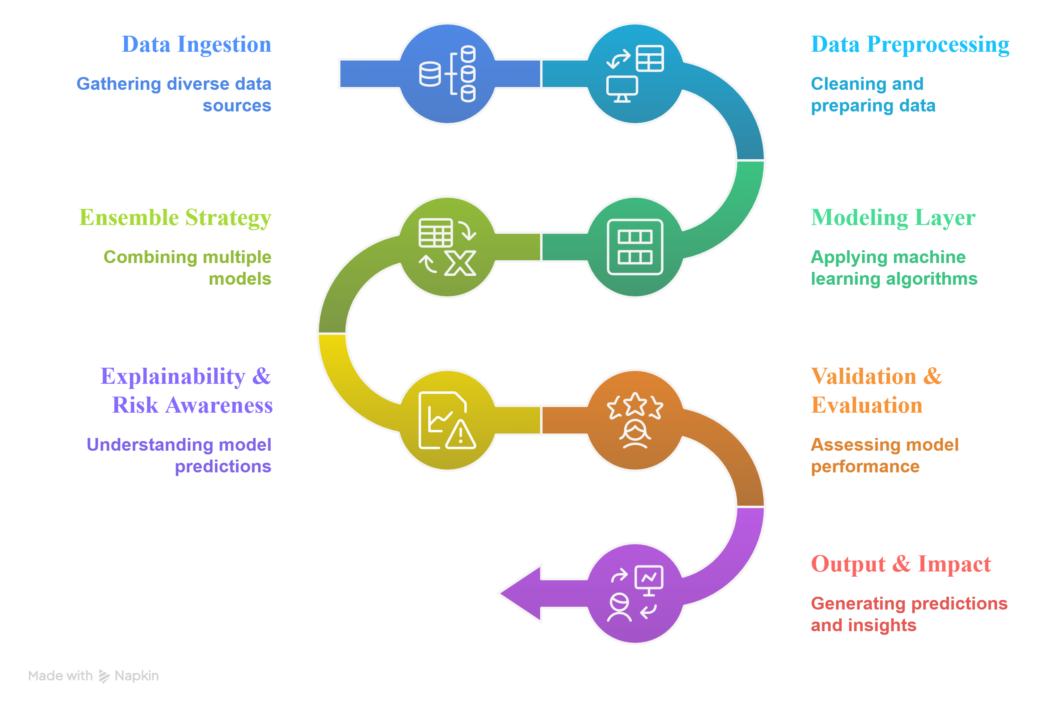
Workflow Implementation

Slide 7
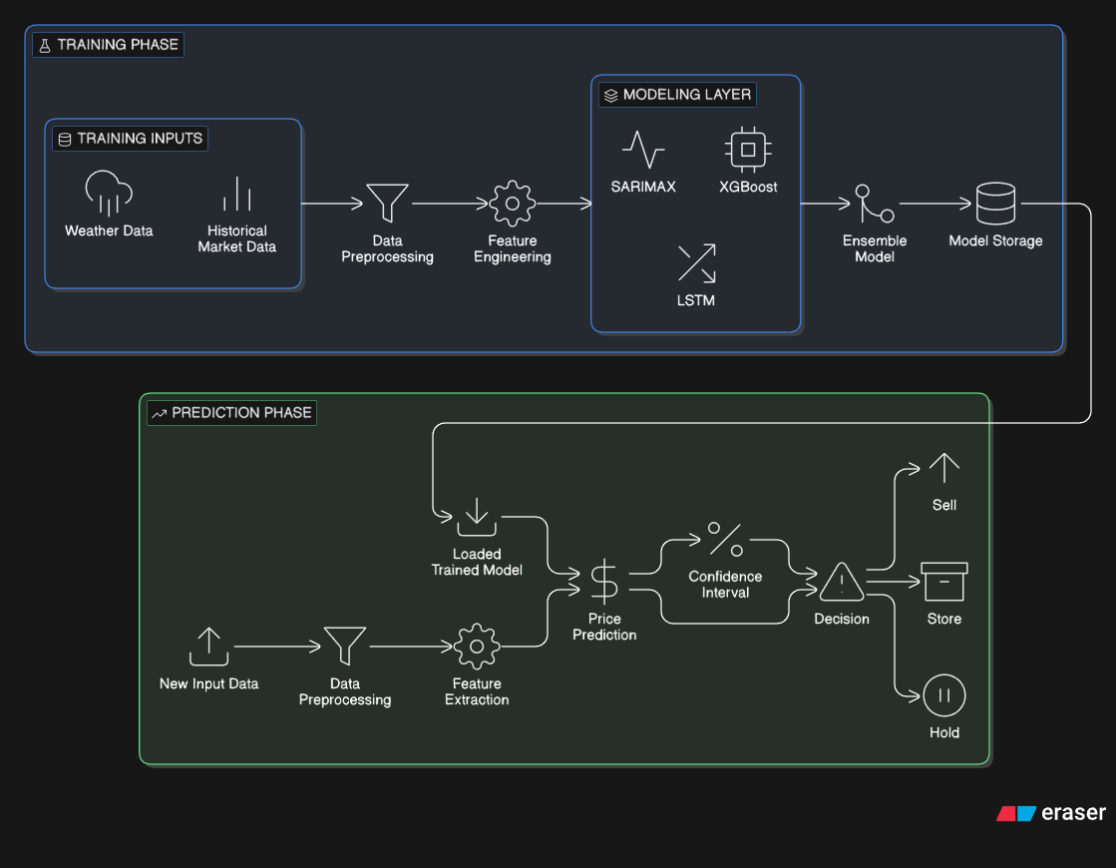
Block Diagram

Slide 8
Prospects
Expected Outcome:
  • Reduced financial uncertainty.
  • Risk-aware decision support using confidence intervals.
  • Scalable forecasting framework.
Future scope:
  • Inclusion of additional economic factors.
  • Adoption of advanced deep learning models.
  • Expansion to multi-crop and multi-region systems.

Slide 9
Social Impact
Empowers farmers with data-backed price intelligence
Enhances financial security for small & marginal farmers
Promotes transparent and explainable AI-driven decisions
Supports regional policy-making and agricultural planning
Contributes to rural economic resilience and digital transformation

