Slide 1

AI IN AUTONOMOUS VEHICLES
A Database Management System for Autonomous Vehicles
KANUMURI LALITH SHREEKAR (RA2411003012051)
SRIJAI KUBENDIRAN (RA2411003012049)
Subject: Database Management Systems (DBMS)

Slide 2
INTRODUCTION
Revolutionizing Autonomous Vehicle Validation
DriveLearn is a specialized Database Management System (DBMS) meticulously engineered to address critical challenges in autonomous vehicle (AV) safety validation. Its core function is to curate and organize "Edge Case" scenarios, which are rare or complex driving situations that often expose vulnerabilities in AI models.
By systematically managing the intricate relationship between different AI software versions and real-world environmental data, DriveLearn provides a robust, logical framework for safety certification. This is achieved by enabling precise comparison of AI predictions against human-verified Ground Truth data, ensuring that AVs operate safely and reliably across an exhaustive range of conditions.

Slide 3
PROBLEM STATEMENT
Navigating the Data Deluge in AV Testing
Exponential Data Influx
The Contextual Disconnect
Performance Bottleneck
A single autonomous vehicle generates approximately 4 terabytes (TB) of data daily. This massive volume includes sensor readings, camera feeds, lidar scans, and more, creating an overwhelming challenge for traditional data processing methods.
Traditional data logging systems typically store information as "flat files." This approach lacks indexing based on environmental context, making it nearly impossible to efficiently query specific conditions like "heavy rain at night" or "dense urban traffic during rush hour."
Without a structured system, engineers face significant hurdles in efficiently querying and comparing how different AI models perform under identical, specific conditions. This bottleneck severely impedes the iterative development and validation cycles essential for AV safety.

Slide 4
MOTIVATION & SCOPE
Establishing a Source of Truth for AI Improvement
Motivation
Key Scopes of DriveLearn
Continuous improvement of AI models necessitates a "Source of Truth" – a reliable, queryable repository that can precisely identify where a model fails, particularly in "Edge Case" scenarios. DriveLearn provides this critical foundation.
Fleet & Hardware Tracking: Comprehensive management of the physical test vehicles and their hardware configurations.
Environmental Scenario Cataloging: Detailed classification and storage of diverse driving environments and conditions.
AI Perception Validation: Objective assessment of AI model performance through confidence scoring against ground truth.
Automated Safety Reporting via SQL: Streamlined generation of safety compliance reports through direct database queries.

Slide 5





DATA MODELING
Identifying Core Entities for DriveLearn
AI_Models
Tracks distinct software versions, such as v1.0, v2.5, including their unique architectural details and deployment status.
Vehicles
Manages the physical test fleet, including unique vehicle identifiers, hardware specifications, and operational status.
Scenarios
Categorizes environmental metadata such as weather conditions (e.g., Rainy, Foggy), light levels (e.g., Urban, Highway), and road types.
Test_Runs
Records specific driving sessions, linking a particular vehicle and AI model to a defined environmental scenario at a given time.
Detections
Stores the actual AI output, including the object type identified (e.g., pedestrian, vehicle) and its associated confidence score.

Slide 6
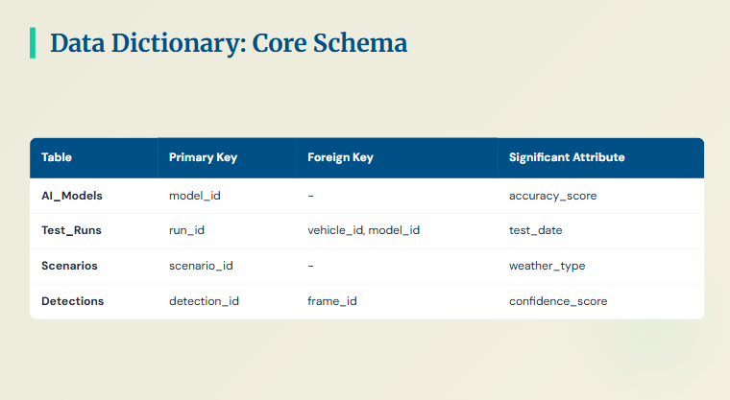

Slide 7
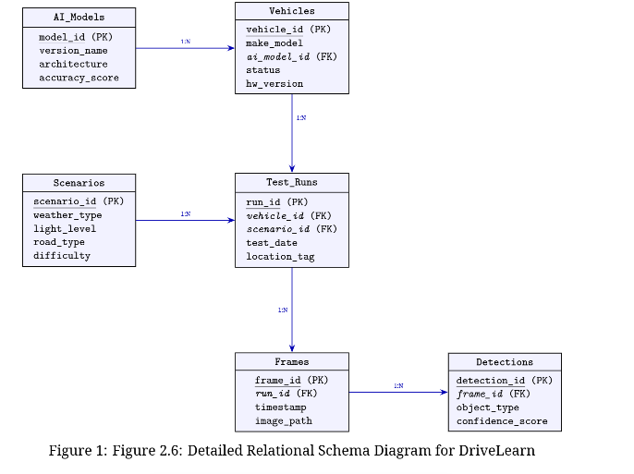
SCHEMA

Slide 8
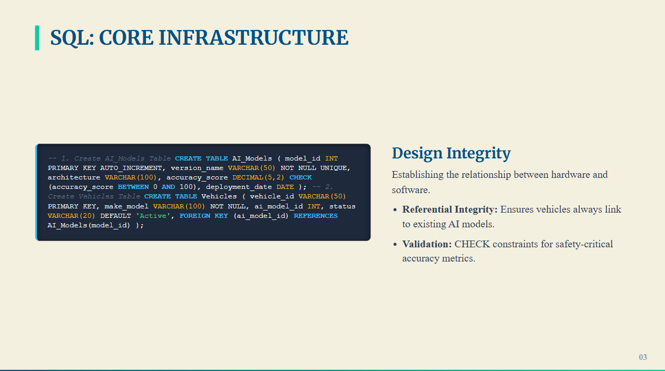

Slide 9
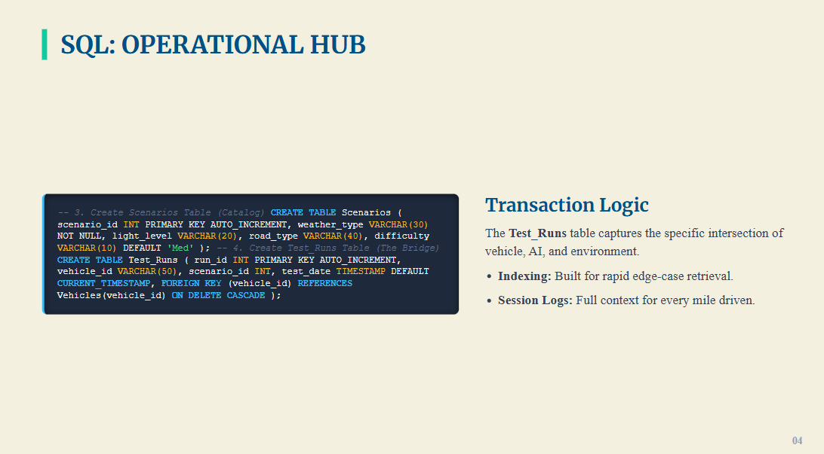

Slide 10
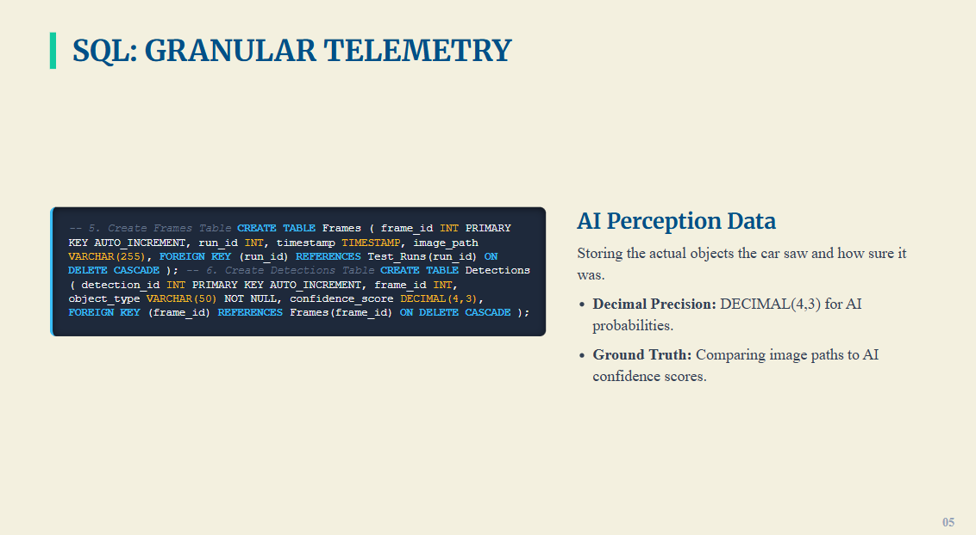

Slide 11
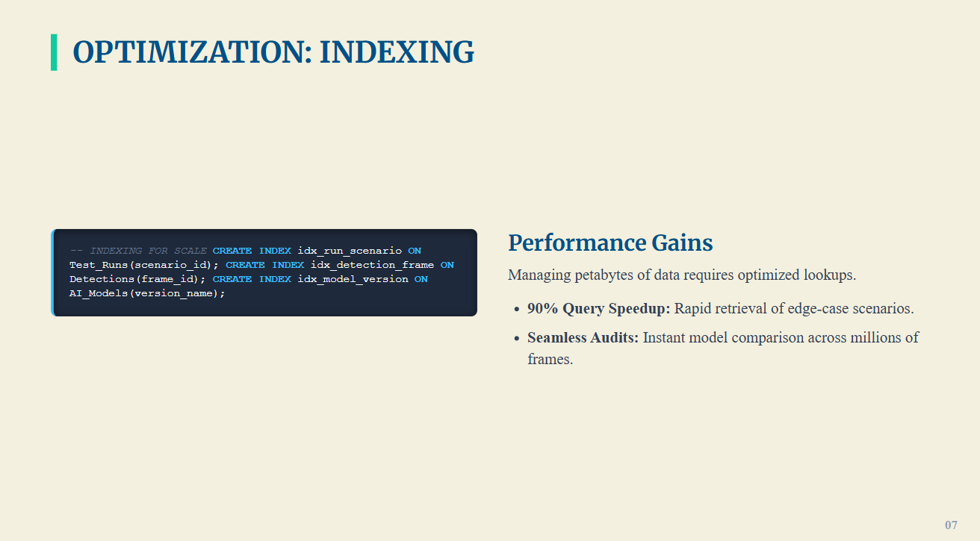

Slide 12
IMPLEMENTATION & ANALYTICS
Bringing DriveLearn to Life with DDL, DML, and SQL Analytics
Implementation Details
SQL Analytics & Insights
DDL (Data Definition Language): We utilize CREATE TABLE statements with explicit FOREIGN KEY constraints. This ensures referential integrity, preventing orphaned records (e.g., no detection can exist without a valid associated test run).
DML (Data Manipulation Language): INSERT INTO commands are used to systematically populate the DriveLearn database. This includes importing diverse environmental conditions, AI model versions, and real-world test data to build a comprehensive benchmarking library.
The true "Power of DBMS" lies in its ability to extract actionable insights. For instance, we can query: "What is the average AI confidence for Model v3.5 during Rainy Night scenarios?"
This capability is invaluable for identifying specific "Training Gaps" in AI models, allowing engineers to focus development efforts precisely where they are most needed, significantly accelerating the path to safer autonomous driving.

Slide 13
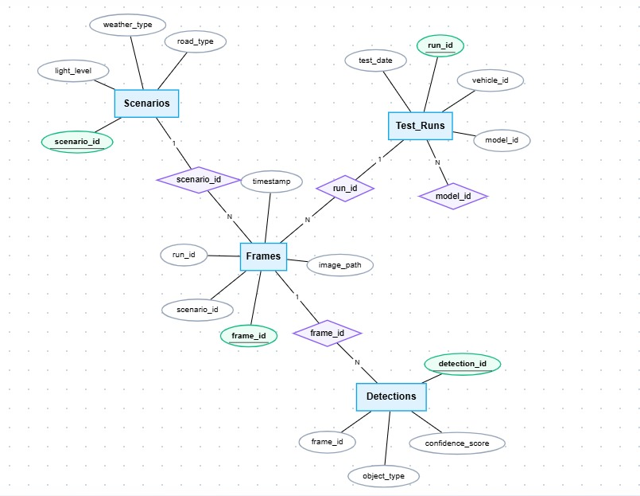
ER DIAGRAM

Slide 14
RELATIONAL SCHEMA
Structural Foundation of DriveLearn Tables
AI_Models
model_id, version_name, architecture, deployment_date
Vehicles
vehicle_id, make, model, year, sensor_config
Scenarios
scenario_id, weather, light_level, road_type, traffic_density
Test_Runs
run_id, vehicle_id (FK), model_id (FK), scenario_id (FK), test_date, duration_minutes
Detections
detection_id, run_id (FK), object_type, confidence_score, bounding_box_coords
This relational schema defines the tables and their attributes, establishing primary keys for unique identification and foreign keys to enforce referential integrity across the database.

Slide 15





DATA DICTIONARY
Key Attributes and Their Significance
Detections.confidence_score
Scenarios.weather_type
Data Type: DECIMAL(4,3). This attribute is crucial for precise AI probability analysis, quantifying the AI's certainty in its object identifications (e.g., 0.985 for high confidence).
Data Type: VARCHAR(30). This categorical data enables efficient filtering and analysis of AI performance under diverse conditions (e.g., 'Rain', 'Fog', 'Sunny', 'Snow').
Test_Runs.test_date
Scenarios.road_type
Data Type: TIMESTAMP. Essential for time-series analysis, allowing engineers to track AI model improvements and regressions over time in safety performance.
Data Type: VARCHAR(30). Provides context on the driving surface, such as 'Urban', 'Highway', 'Rural', or 'Off-Road', enabling scenario-specific performance evaluation.

Slide 16


ENTITY-RELATIONSHIP LOGIC
Defining Relationships within DriveLearn
AI_Model to Vehicle (1:M)
One AI model version can be deployed across many different physical vehicles in the test fleet, allowing for widespread testing and data collection under diverse conditions.
Vehicle to Test_Run (1:M)
A single vehicle can perform multiple distinct test sessions, each contributing unique data points under varying scenarios.
Scenario to Test_Run (1:M)
One specific environmental scenario (e.g., "heavy rain at night") can be utilized in many different test runs, enabling controlled comparison across AI models and vehicles.
Test_Run to Detection (1:M)
Each individual test run generates thousands of AI detections, representing the AI's perception of objects and events during that specific session.

Slide 17
DATABASE NORMALIZATION
Achieving Data Integrity with 3NF
01
02
03
First Normal Form (1NF)
Second Normal Form (2NF)
Third Normal Form (3NF)
Ensures that all fields contain atomic values, meaning no multi-valued attributes (e.g., a "sensor_list" array) are stored in a single column. This prevents complex data structures within cells.
Removes partial dependencies by ensuring all non-key attributes are fully dependent on the primary key. For example, AI architecture metadata is moved to its own dedicated table to avoid repetition across every test log entry.
Eliminates transitive dependencies, ensuring that non-key attributes are directly dependent on the primary key, not on other non-key attributes. Scenario metadata (weather, light level) is stored independently of specific test run details, promoting data independence and reducing redundancy.

