Slide 1
K-NEAREST NEIGHBORS (KNN)
KNN is a method which is used for classifying objects based on closest training examples in the feature space. KNN is the most basic type of instance-based learning or lazy learning. It assumes all instances are points in n-dimensional space. A distance measure is needed to determine the “closeness” of instances. KNN classifies an instance by finding its nearest neighbors and picking the most popular class among the neighbors.
ALGORITHM

Slide 2
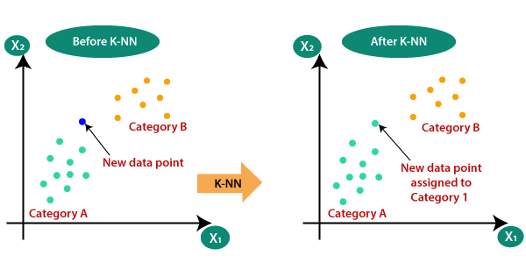
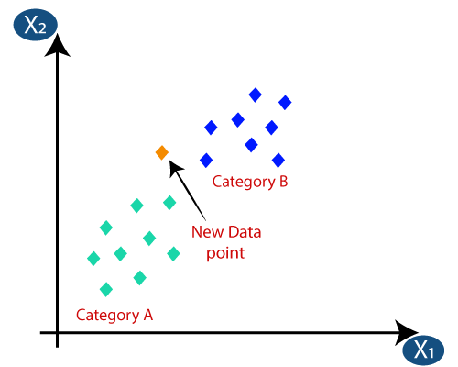
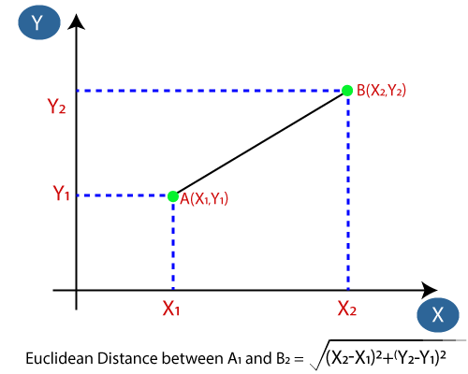
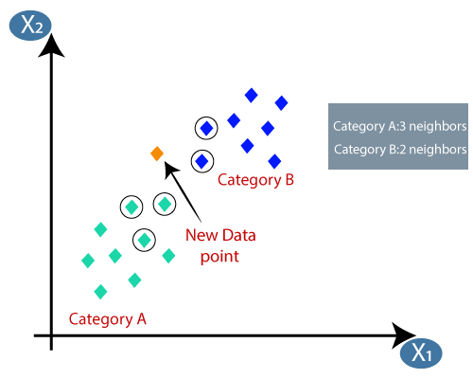
WHY DO WE NEED A K-NN ALGORITHM
Suppose there are two categories, i.e., Category A and Category B, and we have a new data point x1, so this data point will lie in which of these categories. To solve this type of problem, we need a K-NN algorithm. With the help of K-NN,we can easily identify the category or class of a particular dataset. Consider the diagram.
HOW DOES KNN WORK
Suppose we have a new data point and we need to put it in the required category.
Consider the below image:
.
Firstly, we will choose the number of neighbors, so we will choose the k=5. Next, we will calculate the Euclidean distance between the data points. The Euclidean distance is the distance between two points, which we have already studied in geometry. It can be calculated as:
By calculating the Euclidean distance we got the nearest neighbors, as three nearest neighbors in category A and two nearest neighbors in category B. Consider the image:
As we can see the 3 nearest neighbors are from category A, hence this new data point must belong to category A

Slide 3
LITERATURE SURVEY
IJCST et. al.[1] have taken one sample training dataset containing 100 rows and 11 columns of the above mentioned attributes. We have applied K- Nearest neighbor algorithm on the training and test sample data and obtained results for different values of K. Accuracy for K=3,Testdata1=70%,Testdata2=50% and K= 5, Testdata1=69%,Testdata2=63%.
Asha Gowda Karegowda et. al.[2], used cascading K mean ad K nearest neighbor algorithm for categorization of diabetic patients in their proposed work. Accuracy achieved by the proposed system is 82%.
[1]International Journal of Computer Science Trends and Technology (IJCST)
[2]Asha Gowda Karegowda, Punya V M.A.Jayaram, A.S .Manjunath,.” Rule based Classification for Diabetic Patients using Decision Tree C4.5 “, International Journal of Computer Applications (0975 – 8887) Volume 45– No.12, May 2012

Slide 4
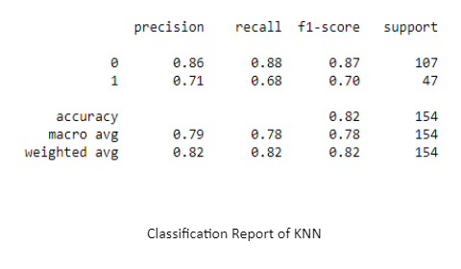
WORK IMPLEMENTATION OF KNN
After applying KNN with the PIMA Indian dataset we get the value of True positive =94,True negative=32,False positive=13,False negative=15. F1_score=69%.
ACTUAL VALUES
P R E D I T E D V A L U E S
POSITIVE(1)
NEGATIVE(0)
TP 94 | FP 13
FN 15 | TN 32
POSITIVE(1)
NEGATIVE(0)
The K- NEAREST NEIGHBOR classifiers shows the accuracy level of nearly 81%, more precisely 0.81818181818182 with k value=11,which indicates that the performance of these techniques are pretty well.

