Slide 1

Comparison between decision tree and random forest towards recommendation system or engine
PROJECT
Submitted By
Name University Roll No.
Pritam Roy
Rupak Pal
Pritam Das
Srijon Mallick
Souvik Saha
Under the supervision of
Dr. S. S. Thakur
Associate Professor, Department of Computer Science and Engineering
Department of Computer Science & Engineering,
MCKV Institute of Engineering
243, G.T. Road (N)
Liluah, Howrah-711204

Slide 2
Acknowledgement
We express our sincere gratitude to Dr. S. S. Thakur, Associate Professor, Department of Computer Science and Engineering, our project guide and Mr. Avijit Bose, Assistant Professor and Head of Department (CSE) for providing us their guidance and cooperation for the project. We also extend our sincere thanks to all other faculty members of Computer Science & Engineering Department and our friends for their support and encouragement. We will be failing in duty if we do not acknowledge with grateful thanks to the authors of the references and other literatures referred to in this project. Last but never the least we are very much thankful to our parents who guided and supported us in every step which we took.

Slide 3
Content
Introduction
What is Machine Learning
Supervised Learning Vs Unsupervised Learning
Decision Tree
Decision Tree Algorithm
Attribute Selection Measure (ASM)
Random Forest
Random Forest Algorithm
Ensemble Learning
Implementation
Result and Discussion

Slide 4
Introduction
On the Internet, where the number of choices is overwhelming, there is need to filter, prioritize and efficiently deliver relevant information in order to alleviate the problem of information overload, which has created a potential problem to many Internet users. Recommendation system solve this problem by searching through large volume of dynamically generated information to provide users with personalized content and services.
Different machine learning algorithms like decision tree classifier and random forest classifier plays a significant role in providing personalized content and services to all internet users.

Slide 5
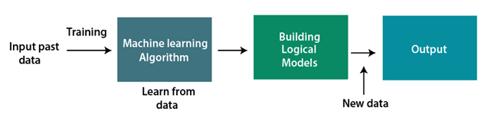
What is Machine Learning
Machine learning is a subset of artificial intelligence, that enables a machine to automatically learn from data, improve performance from experiences, and predict things without being explicitly programmed.
Two types of learning technique are there in machine learning:
1. Supervised Learning
2. Unsupervised Learning

Slide 6
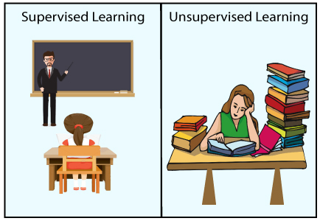
Supervised Learning Vs Unsupervised Learning
Supervised learning is the types of machine learning in which machines are trained using well "labelled" training data, and on basis of that data, machines predict the output.
Unsupervised learning is a machine learning technique in which models are not supervised using training dataset. Instead, models itself find the hidden patterns and insights from the given data

Slide 7

Decision Tree
Decision Tree is a graphical representation for getting all the possible solutions to a problem/decision based on given conditions.
It is a Supervised learning technique where internal nodes represent the features of a dataset, branches represent the decision rules and each leaf node represents the outcome.

Slide 8
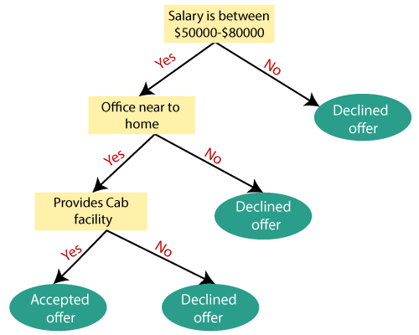
Decision Tree Algorithm
Step-1: Begin the tree with the root node, says S, which contains the complete dataset.
Step-2: Find the best attribute in the dataset using Attribute Selection Measure (ASM).
Step-3: Divide the S into subsets that contains possible values for the best attributes.
Step-4: Generate the decision tree node, which contains the best attribute.
Step-5: Recursively make new decision trees using the subsets of the dataset created in step - 3 Continue this process until a stage is reached where you cannot further classify the nodes and called the final node as a leaf node.

Slide 9
Attribute Selection Measure (ASM)
While implementing a Decision tree, the main issue arises that how to select the best attribute for the root node and for sub-nodes. So, to solve such problems there is a technique which is called as Attribute selection measure or ASM.
There are two popular techniques for ASM, which are:
Information Gain:
Information gain is the measurement of changes in entropy after the segmentation of a dataset based on an attribute.
Gini Index:
Gini index is a measure of impurity or purity used while creating a decision tree

Slide 10
Pros
It is simple to understand as it follows the same process which a human follow while making any decision in real-life.
It can be very useful for solving decision-related problems.
It helps to think about all the possible outcomes for a problem.
There is less requirement of data cleaning compared to other algorithms.
Cons
The decision tree contains lots of layers, which makes it complex.
It may have an overfitting issue, which can be resolved using the Random Forest algorithm.
For more class labels, the computational complexity of the decision tree may increase.

Slide 11
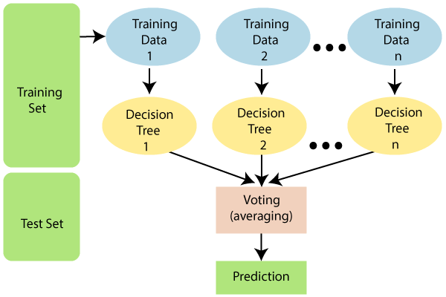
Random Forest
Random Forest is a popular machine learning algorithm that belongs to the supervised learning technique.
Random Forest is a classifier that contains a number of decision trees on various subsets of the given dataset and takes the average to improve the predictive accuracy of that dataset.

Slide 12
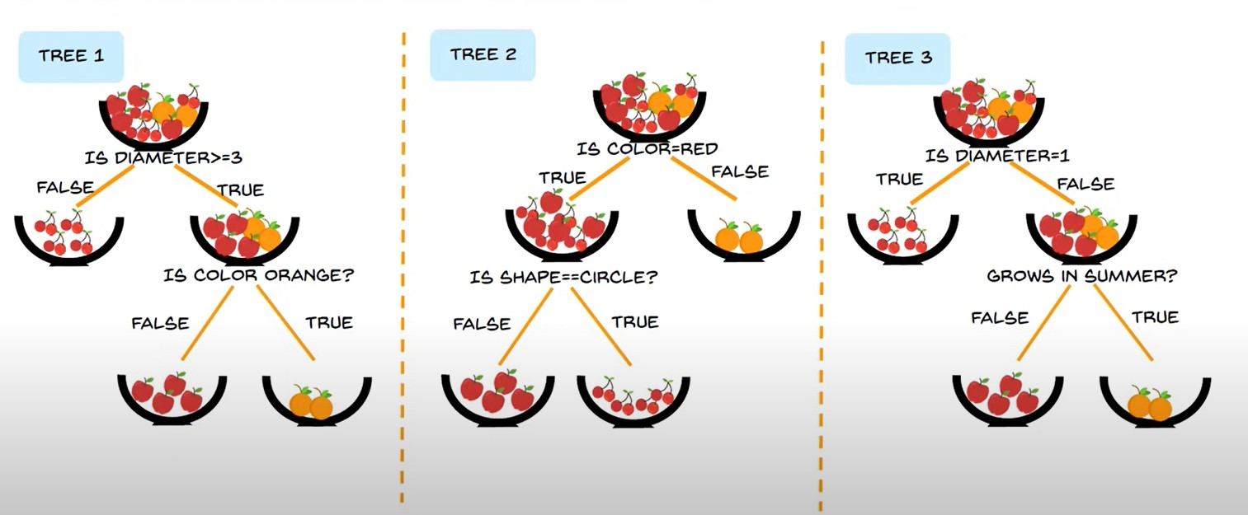
Random Forest Algorithm
Step-1: Select random K data points from the training set.
Step-2: Build the decision trees associated with the selected data points (Subsets).
Step-3: Choose the number N for decision trees that you want to build.
Step-4: Repeat Step 1 & 2.
Step-5: For new data points, find the predictions of each decision tree, and assign the new data points to the category that wins the majority votes.

Slide 13


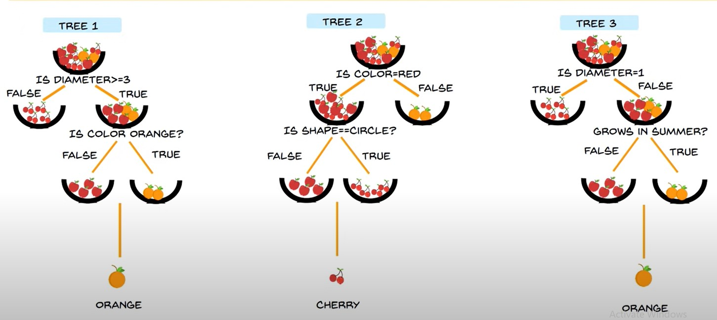

Random Forest Algorithm
Majority Voting

Slide 14
Pros
Random Forest is capable of performing both Classification and Regression tasks.
It is capable of handling large datasets with high dimensionality.
It enhances the accuracy of the model and prevents the overfitting issue.
Cons
Although random forest can be used for both classification and regression tasks, it is not more suitable for Regression tasks.

Slide 15
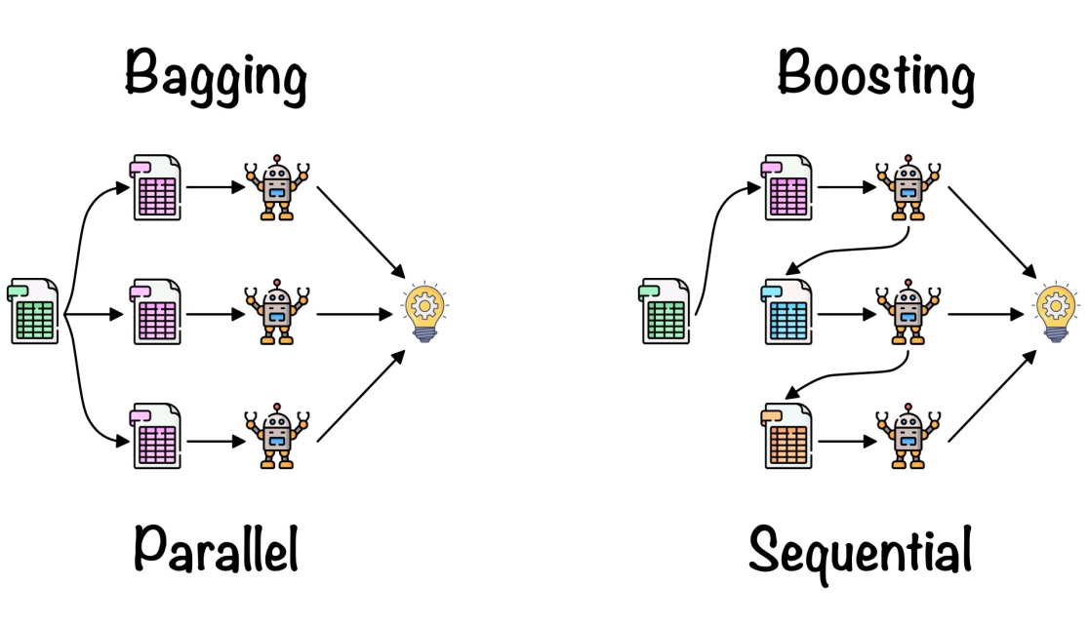
Ensemble Learning
Ensemble learning: is a machine learning paradigm where multiple models (often called weak learners or base models) are trained to solve the same problem and combined to get better performances.
Bagging
Bagging consists in fitting several base models on different bootstrap samples and build an ensemble model that “average” the results of these weak learners.
Boosting
Boosting consists in, iteratively, fitting a weak learner, aggregate it to the ensemble model and “update” the training dataset to better take into account the strengths and weakness of the current ensemble model when fitting the next base model.

Slide 16
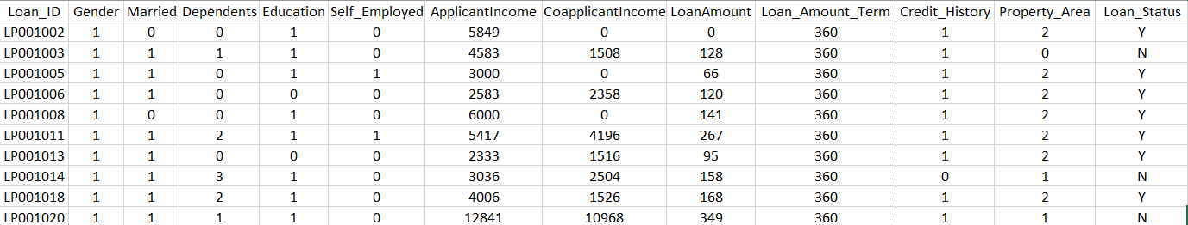
Implementation
In our case a dataset from Dream Housing Finance company which lends home loans or approves customers for home loans based on certain criteria’s.
The dataset has 614 customers data where the following fields’ data is captured.
Unique Loan ID
Male/ Female
Applicant married (Y/N)
Number of dependents
Applicant Education (Graduate/ Under Graduate)
Self-employed (Y/N)
Applicant income
Co-applicant income
Loan amount in thousands
Term of loan in months
credit history meets guidelines
Urban/ Semi Urban/ Rural
Loan approved (Y/N)

Slide 17
Implementation (Contd.)
In this experiment we have considered decision tree classification and random forest classification algorithms and implemented them on our dataset.
For training the classifiers we have used 80% of the dataset and 20% was used for testing.
For making the dataset more manageable from classifier’s point of view, following fields values were changed from string to numbers.
Gender : Male – 1, Female - 2
Married : Yes – 1, No - 0
Education : Graduate – 1, Not graduate - 0
Self Employed : Yes – 1, No – 0
Property Area : Rural – 0, Semi Urban – 1, Urban – 2

Slide 18
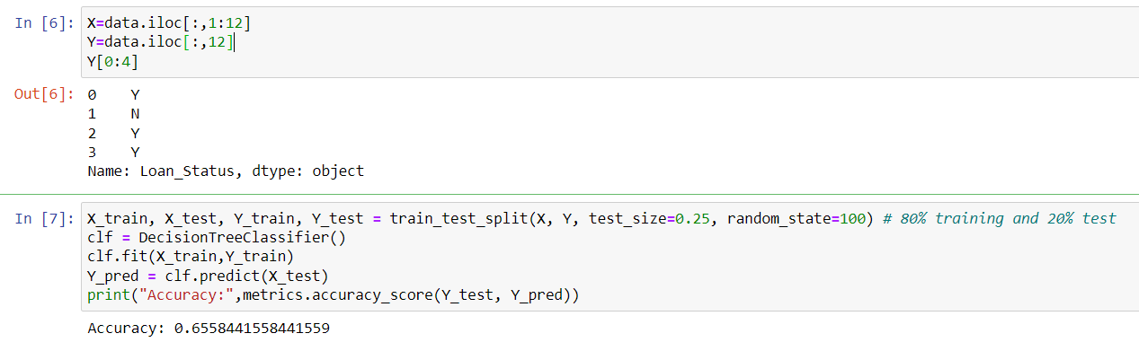
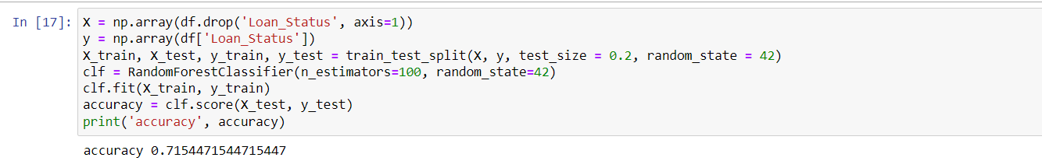
Result and Discussion
Random forest classifier produces more accurate predictions than decision tree classifier.
Decision Tree | Random Forest
66% (0.65584) | 71% (0.71544)

Slide 19
Thank You

