Slide 1

Comparison between decision tree and random forest towards recommendation system or engine
PROJECT
Submitted By
Name University Roll No.
Pritam Roy 11600118037
Srijon Mallick 11600118017
Souvik Saha 11600118020
Rupak Pal 11600118032
Pritam Das 11600118038
Under the supervision of
Dr. S. S. Thakur
Associate Professor, Department of Computer Science and Engineering
Department of Computer Science & Engineering,
MCKV Institute of Engineering
243, G.T. Road (N)
Liluah, Howrah-711204

Slide 2
Acknowledgement
We express our sincere gratitude to Dr. S. S. Thakur, Associate Professor, Department of Computer Science and Engineering, our project guide and Mr. Avijit Bose, Assistant Professor and Head of Department (CSE) for providing us their guidance and cooperation for the project. We also extend our sincere thanks to all other faculty members of Computer Science & Engineering Department and our friends for their support and encouragement. We will be failing in duty if we do not acknowledge with grateful thanks to the authors of the references and other literatures referred to in this project. Last but never the least we are very much thankful to our parents who guided and supported us in every step which we took.

Slide 3
Content
Introduction
What is Machine Learning
Supervised Learning Vs Unsupervised Learning
Decision Tree
Decision Tree Algorithm
Random Forest
Random Forest Algorithm
Methodology
Data Sampling
Data Understanding
Data Cleaning
Data Analysis
Modelling
Result and Discussion
Future Scope

Slide 4
Introduction
Without a doubt, financial lending services hold a great amount of significance for any individual, business, or enterprise.
Financial loans are a major part of the primary source of capital.
The economic growth of the real economy is the primary role of the financial firms.
With such great importance and benefits of financial lending come some major issues and bottleneck problems. The most common and substantial issue in the domain of financial lending is the fair and successful lending of loans while keeping the ratio of loan defaulters to the least minimum value.
Different machine learning algorithms like decision tree classifier and random forest classifier plays a significant role in providing personalized content and services to all internet users.
This study is to provide a comparison between the Decision Tree and Random Forest algorithm and test their ability for loan default prediction.

Slide 5
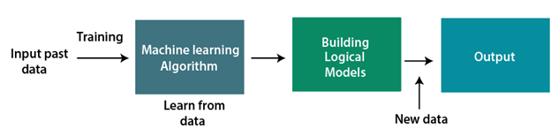
What is Machine Learning
Machine learning is a subset of artificial intelligence, that enables a machine to automatically learn from data, improve performance from experiences, and predict things without being explicitly programmed.
Two types of learning technique are there in machine learning:
1. Supervised Learning
2. Unsupervised Learning

Slide 6
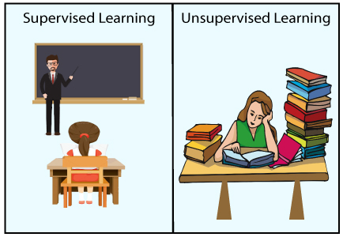
Supervised Learning Vs Unsupervised Learning
Supervised learning is the types of machine learning in which machines are trained using well "labelled" training data, and on basis of that data, machines predict the output.
Unsupervised learning is a machine learning technique in which models are not supervised using training dataset. Instead, models itself find the hidden patterns and insights from the given data

Slide 7

Decision Tree
Decision Tree is a graphical representation for getting all the possible solutions to a problem/decision based on given conditions.
It is a Supervised learning technique where internal nodes represent the features of a dataset, branches represent the decision rules and each leaf node represents the outcome.

Slide 8
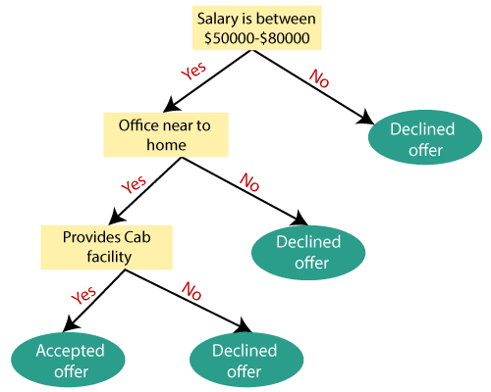
Decision Tree Algorithm
Step-1: Begin the tree with the root node, says S, which contains the complete dataset.
Step-2: Find the best attribute in the dataset using Attribute Selection Measure (ASM).
Step-3: Divide the S into subsets that contains possible values for the best attributes.
Step-4: Generate the decision tree node, which contains the best attribute.
Step-5: Recursively make new decision trees using the subsets of the dataset created in step - 3 Continue this process until a stage is reached where you cannot further classify the nodes and called the final node as a leaf node.

Slide 9
Pros
It is simple to understand as it follows the same process which a human follow while making any decision in real-life.
It can be very useful for solving decision-related problems.
It helps to think about all the possible outcomes for a problem.
There is less requirement of data cleaning compared to other algorithms.
Cons
The decision tree contains lots of layers, which makes it complex.
It may have an overfitting issue, which can be resolved using the Random Forest algorithm.
For more class labels, the computational complexity of the decision tree may increase.

Slide 10
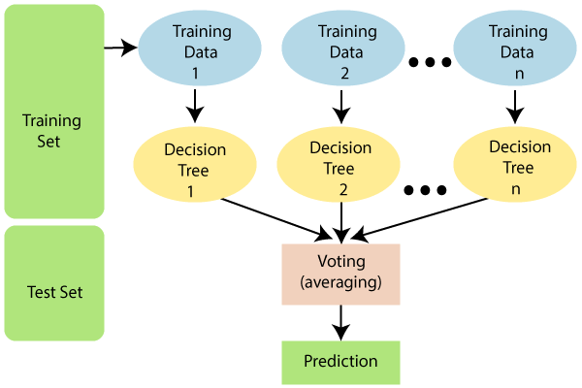
Random Forest
Random Forest is a popular machine learning algorithm that belongs to the supervised learning technique.
Random Forest is a classifier that contains a number of decision trees on various subsets of the given dataset and takes the average to improve the predictive accuracy of that dataset.

Slide 11
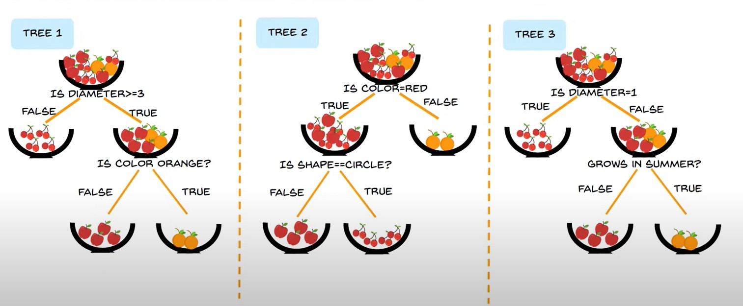
Random Forest Algorithm
Step-1: Select random K data points from the training set.
Step-2: Build the decision trees associated with the selected data points (Subsets).
Step-3: Choose the number N for decision trees that you want to build.
Step-4: Repeat Step 1 & 2.
Step-5: For new data points, find the predictions of each decision tree, and assign the new data points to the category that wins the majority votes.

Slide 12


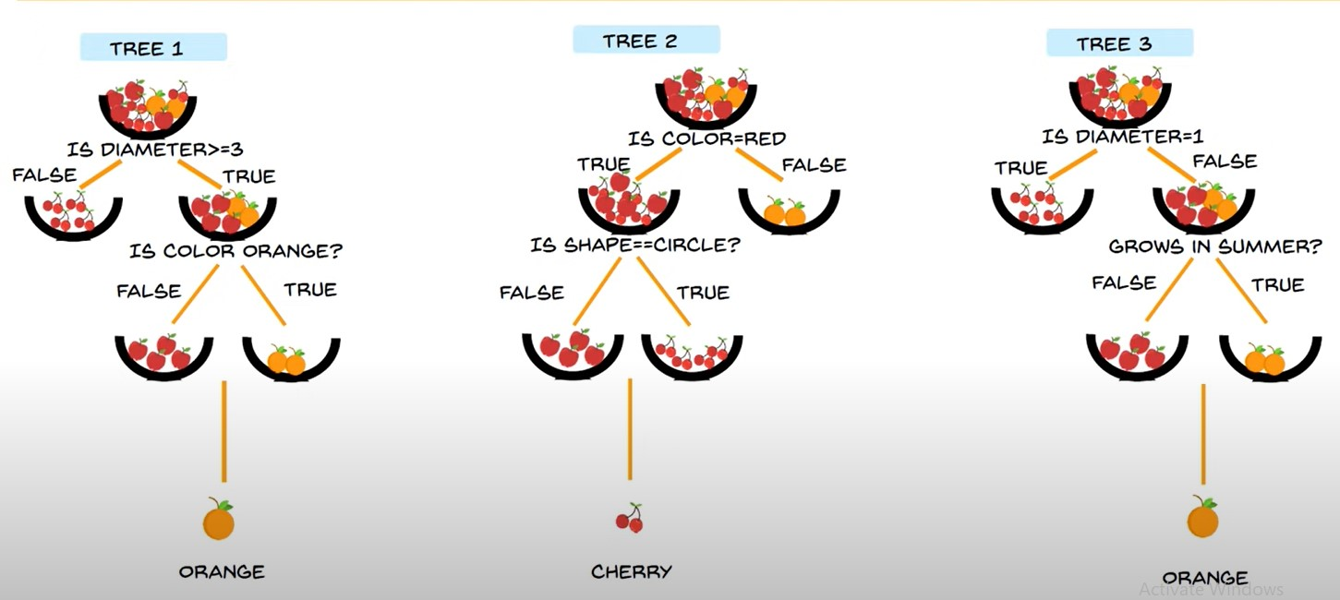

Random Forest Algorithm
Majority Voting

Slide 13
Pros
Random Forest is capable of performing both Classification and Regression tasks.
It is capable of handling large datasets with high dimensionality.
It enhances the accuracy of the model and prevents the overfitting issue.
Cons
Although random forest can be used for both classification and regression tasks, it is not more suitable for Regression tasks.

Slide 14
Methodology
We have selected Decision trees and Random forests as two
of the fundamental Machine learning approaches ever known.
Using them we will be generating loan default predictions to
suggest the financial service providers’ chance to make a more
accurate decision.

Slide 15
Data Sampling
The process of collecting data from the entire population is a significantly difficult task and when the data is related to loans it is even harder to gather sufficient data to conduct any research. Manually recording the same would take years to compile and the individuals taking loans do not always share anything.
The data sample was obtained from the Lending Club organization 2015 database release

Slide 16
Data Understanding
Understanding the structure of the data is one of the vital and initial step.
Dataset structure
Dataset initially had around 111 attributes with each attribute having 42542 data.
The provided data is divided into two datasets each for the training purpose of the model and for the performance testing of the model.
Both of the datasets have 13 attributes related to the feature of individuals although the testing dataset has no values in its class variable as they have to be predicted by the developed model. Furthermore, the attributes are comprised of six categorical, seven continuous including a class variable.

Slide 17
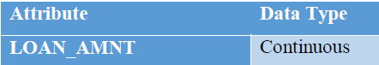
Data Understanding (Continued…)
Dataset structure

Slide 18
Data Cleaning
The next step is cleaning and modification of the data in a presentable manner
Steps involved :
Handling the missing values
Getting rid of unwanted data
Conversion of the datatypes

Slide 19
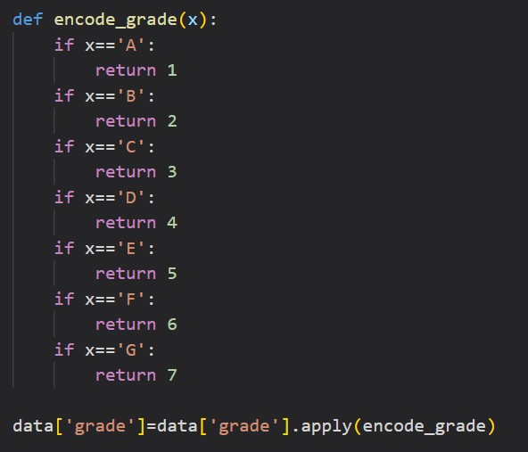
Data Cleaning (Continued…)
The column that has no significance or contribution in prediction has also been dropped along with duplicate columns.
To cope with this classifiers all the values in the categorical attributes are converted to numeric as factors.

Slide 20
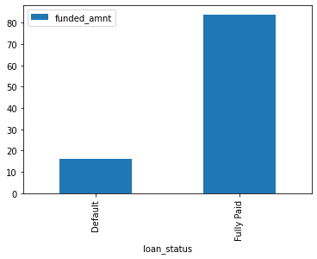
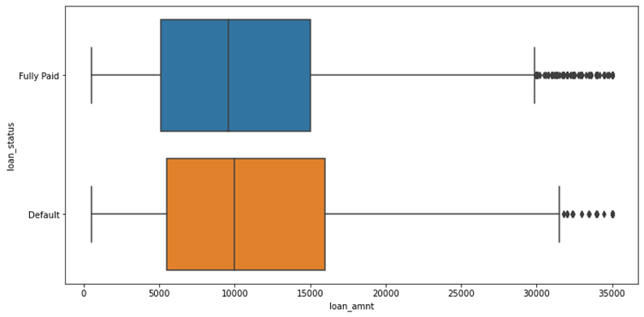
Data Analysis
Data analysis is an integral part in understanding the lending club dataset.
Data is skewed with the ratio of 15/85. That is, in 100 rows, only 15 rows refers to 'Default' case which is expected as defaulted cases will always be minimal.

Slide 21
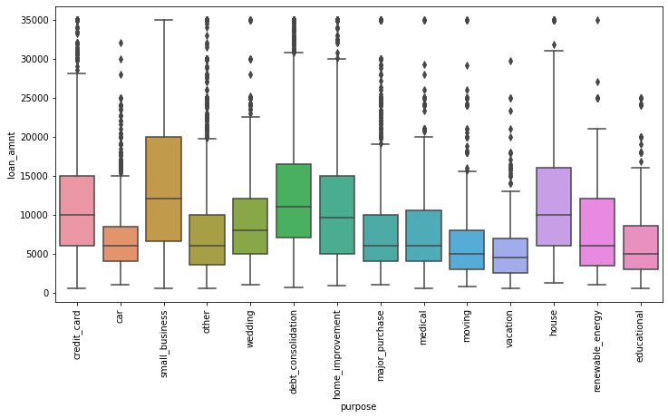
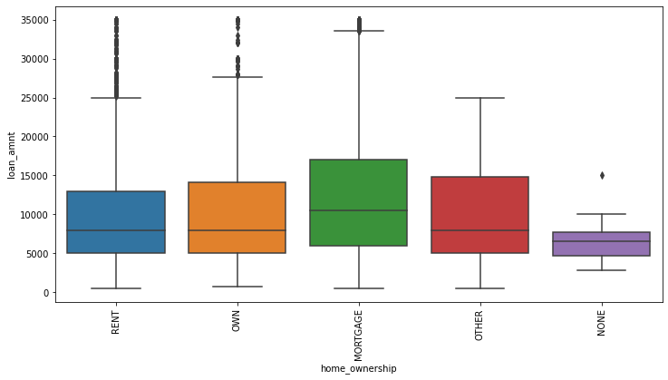
Data Analysis (Continued…..)

Slide 22
Modelling
Machine learning is about predicting and recognizing patterns and generate suitable results.
It is vital to split the data into training and test sets first. We split the Lending Club data into Training set which was 80% of the whole dataset and Test set which was the remaining 20%.
We used 2 algorithms for our modelling purpose which were the Random Forest and the Decision Tree.

Slide 23
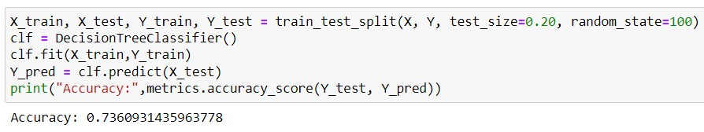
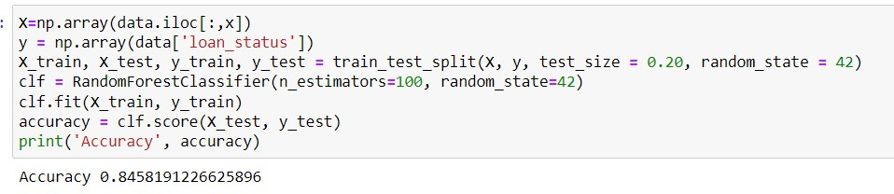
Result and Discussion
Random forest classifier produces more accurate predictions than decision tree classifier.
Decision Tree | Random Forest
74% (0.736093) | 84% (0.845819)
Decision Tree
Random Forest

Slide 24
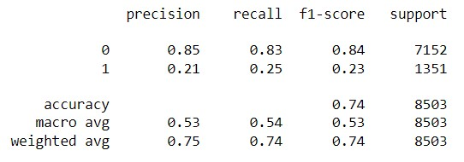
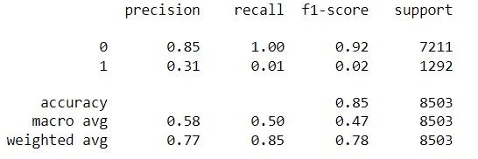
Result and Discussion (Continued…)
Decision Tree
Random Forest
True Class
Predicted Class |  | Positive | Negative
 | Positive | 5927 | 1225
 | Negative | 1019 | 332
True Class
Predicted Class |  | Positive | Negative
 | Positive | 7177 | 34
 | Negative | 1277 | 15
Confusion Matrix
Classification Report

Slide 25
Conclusion
In our study, we have compared the two important machine learning algorithms and tested their ability for loan default prediction.
This study aimed to explore, analyze, and suggest a machine learning algorithm to correctly identify whether a person, given certain attributes, has a high probability to default on a loan.
This type of model could be used by Lending Club to identify certain financial traits of future borrowers that could have the potential to default and not pay back their loan by the designated time.
The Random Forest Classifier provided us with an accuracy of 84% while the Decision 28 Tree method provided us with an accuracy of 74%. Hence, the Random Forest model appears to be a better option for such kind of data.

Slide 26
Future Scope
The broader idea behind the proposed recommendation system is that the system will take specific details about the loan and return a value or an amount up to which the system suggests to the lender that up to that limit the borrower will be able to pay back the loaned amount. Above that limit that it would not be possible for the borrower to pay back.
We suggest that lenders should judge the borrower’s payback capacity based on certain criteria which will be fed into the recommendation system to give the output.
Different related criteria such as Loan-To-Value, Loan Type, Type Of Bank Account, Valuation Of Stake and many other related data is required as an input to the proposed recommendation system.
As of now no such dataset is available and no bank, govt or private, doesn’t share their data, implementation is not possible at present.
In future if dataset is available and system is rightly implemented, the scope is very promising.

Slide 27
Thank You

