Slide 1



Post Graduate major Project. Algorithmic Trading using neural networks
D Srinivas
SID:2021497
MOD002726

Slide 2
Aim and Objectives
Aim
Conduct an empirical study and analysis with the goal to predict intraday stock price using deep learning-based algorithms
Objectives
Compare the performance of algorithms with respect to minimization achieved in the error rates in prediction.
The models are fine-tuned and evaluated with better hyperparameters for better models to predict prices close to real value.
Notes:
My Aim of the project is to study and analyse deep learning algorithms on intraday dataset.
My main objective is to compare the performance between models and minimize the error rates
And then the final model is choosed, fine-tuned with better hyperparameters to predict close price values
How close the models can predict for the next minutes of data?
Whether these complex models affect the computational time?

Slide 3
Motivation
Most of the research papers include predicting prices with recurrent neural networks which are specifically designed for sequence data for next day price prediction.
From this research, I have not found papers to predict intraday price. So, in this project, i decide to use Neural Networks and Reinforcement Learning to predict the stock movement for minute-to-minute data.
Notes:
My motive towards this project is, Stock market investing is always a interesting topic to start with, one of it is intraday trading. It is interesting to see that there are many research papers on stock market price prediction on various dataset. I find it more interesting to see this project with a intraday minute to minute dataset as it is more complicated.
With this motive, I choose this project on algorithmic trading using neural networks on minute-to-minute data.
for this

Slide 4
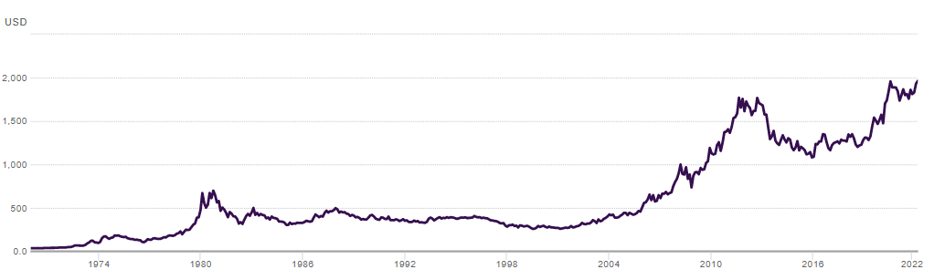
Dataset
Gold data- Dukascopy
Liquidity - According to the World Gold Council (WGC) (Das et al., 2022) gold is the second most liquid asset
About Gold Importance or Why Gold spot(xau/usd):- As per Weng, F. et al (2020), they have compared the annual growth rates of gold(GLD) as 7.69% and S&P 500 as 6.79% stocks from 2014 to 2019 stating.
Figure: Gold prices from 1974 to 2022. Dukascopy Swiss Banking Group, 2022
Notes:
I choose gold as my dataset to train my model. I have downloaded this minute to minute dataset from Dukascopy website.
I choose this dataset only because of two reasons – it is second most liquid asset according to world gold council and as per research from 2014 to 2019, I found that the annual growth of gold when compared to s&p 500 is more.
For this
About Gold Importance or Why Gold spot(xau/usd):- As per Weng, F. et al (2020), they have compared the annual growth rates of gold(GLD) as 7.69% and S&P500 as 6.79% stocks from 2014 to 2019 stating.
image cite form report

Slide 5
Literature
Author Name | Title of the paper | Methodology | Findings
Chen, Wenjing, 2022 | Gold price forecasting research based on an improved online extreme learning machine algorithm | Proposed combination of support vector machine (SVM) and the long short-term memory (LSTM) | A hybrid model was validated on a gold dataset by calculating the important features with the correlation values using Pearson Correlation coefficient.
D Makala and Z Li, 2021 | Prediction of gold price with ARIMA and SVM | Studied ARIMA and SVM models on daily data from World Gold Council from 1979 to 2019. | The study results show that the SVM is a better one compared to ARIMA. RMSE and MAPE are used as performance metrics
DR. T. Chandrabai & DR. K. Suresh, 2020 | Assessment of Machine Learning Techniques for Gold price predictions | studied gold price prediction using three models-Linear Regression, Random forest and support vector 240 months. | Out of 3 models, Linear regression, shown as the best model as it fits on the selected data. The authors used a moving average method to calculate moving average prices.R-Square and RMSE scores are used for evaluating the results.
Ka, Manjula and .P, Karthikeyan,2019 | Gold Price Prediction using Ensemble based Machine Learning Techniques | used three regression models namely linear regression, random forest and gradient boosting regression algorithms | Validated models based on specific time periods and compared models using MSE, RMSE, and MAE as metrics.
Notes:
To do this project There are some of the research papers I have read,
while gaining knowledge about this project. I find these as more relative to my project. Most of the papers I have gone through are trained on machine learning regression tasks or recurrent neural networks on Gold Data Set. All these models are trained on daily gold data
Some of the models from these research papers include Linear regression,some regression algorithms, and Recurrent Neural Networks and they have evaluated their models with error metrics. So I have chosen to train my model with popular neural network models and compare them.
One of the similar reseach to use intraday data is by vitality Milke, have used forex data to predict minute prices using CNN.

Slide 6
Models
First baseline Convolutional Neural Networks
Recurrent Neural Networks
Long Short-Term Memory
Gated Recurrent Units
Reinforcement Learning - Actor-Critic
Compare the models
Evaluate the results
Notes:
My contribution to this project are
Frist is to choose the dataset and then train the models on intraday data, I have started my baseline model with CNN, recurrent Neural networks, and RL. Because they are performing well on daily prediction.
after training few models – then compare the results and evaluated the models with metrics

Slide 7
Data Preprocessing
Removed weekend data
Combining columns for Ask and Bid
Summarized volumes for Ask and Bid
Removing Unnecessary columns
Removing missing values
Removing negative values
Downsizing
Normalization
Splitting the data
Notes:
Combining columns for Ask and Bid - The price values i.e., (Open, High, Low and Close) for each Ask and Bid are combined to determine one price stick
Downsizing- for better computation.
Normalization- for better organization of data.
Now my data is ready to trained

Slide 8
Convolution Nueral Networks(CNN)
Why to use CNN ?
Importance of CNN in Analyzing Images
Analysis of short-term trading can be compared to analysis of images
CNN implementation
Data split- 187 days for training and 20 days for validation
Window size 50
the two-dimensional arrays of prices and volumes are transformed into a three-dimensional tensor
Classification problem to predict Open, High, Low and Close prices.
Notes:
1. A CNN is a type of artificial neural network that has successfully been applied to analyzing two-dimensional visual imagery. CNN is popular and best performing network for images where the features features from images are interpreted in a sequence of layers. CNN has been proven successful in the analysis of images and is able to find local patterns in a picture, the analysis of short-term trading can be compared with the analysis of images. As previously stated, this is a time series project. Therefore, the CNN network is chosen as a baseline neural network model to begin.
A total of one year data which is 371279 rows of data is trained . After preprocessing the data is split into training and test, 187 days for training and 20 days for testing.
For Time series data, the important step in the data-preprocessing is setting the window size before training the model. The CNN takes a 50 minute moving image window of prices and volumes versus time, progressing left-to-right (increasing time) in increments.
And then the two-dimensional arrays of prices and volumes are transformed into a three-dimensional tensor.
Trained the sequential model with 2,4, and 6 convolutional layers with pooling layers and fully connected layers in the end with 4.
This problem is treated as classification to predict 4 prices - Open, High, Low and Close.

Slide 9
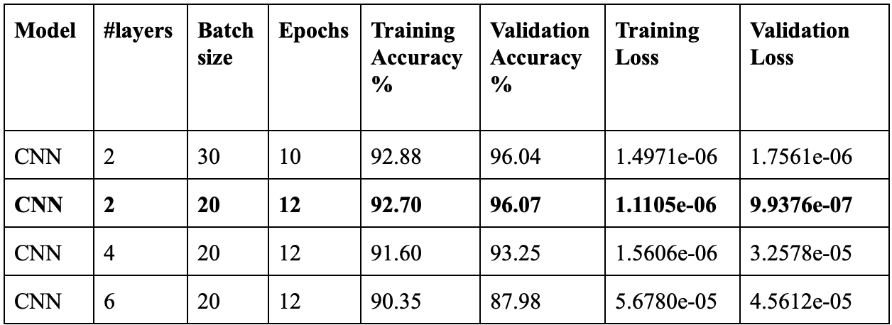
Model comparison
Notes:
Once the models are trained I have changed number of convolutional layers, batch size and epochs to find best performing model .
I found that with increase in conv layered the validation accuracy is decreased. The best performing cnn is with 2 conv layers with batch size 20 and in 12 epochs, I am able to achieve 96 % validation accuracy with better loss values.

Slide 10
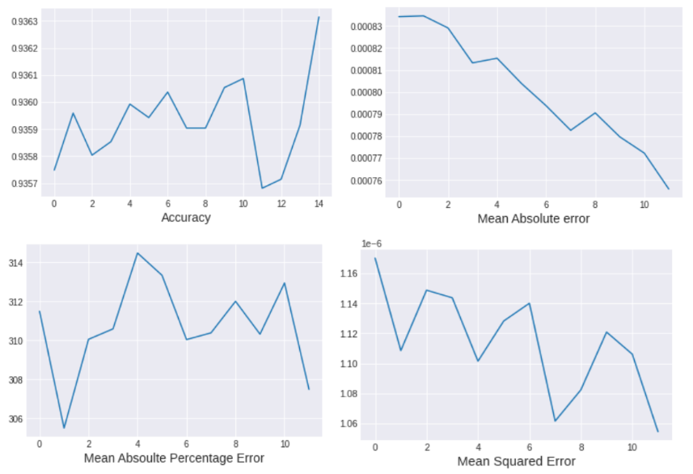
Metrics
Notes:
Once I have trained the model, and found the best parameters, I have evaluated my model with metrics like MSE, MAE, and MAPE values.
for the data selected we found that these are the metrics where accuracy is increasing, the falls in the graph is because of noise or volatility of data, but the error from MAE and MSE graphs with increase in the epoch shows the loss values are decreasing stating that model is training well.
with increase in the size of batch and epochs, it is observed that validation loss is reducing stating that model is not overfitting.

Slide 11
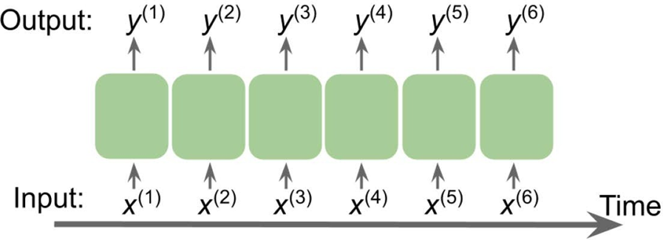
Recurrent Neural Networks(RNN)
Why? Sequential Data
RNN- Long Short-term Memory(LSTM) and Gated Recurrent Units(GRU)
Additional data pre-processing - reshaping
Regression problem to predict price with close
Notes:
Explanation for RNN
Recurrent neural networks (RNNs) are a special case of neural networks, the goal of which is to predict the next step in an observation sequence in relation to the previous step observed in the sequence. The same previously recorded data forms the base for prediction.
The timesteps for superscripted input sequence are represented by the ‘X’s. For the same time axis, ‘y’s represent the output and ‘T’ represent the sequence length.
Additionally, we have to reshape the data to a one-dimensional array from the CNN model since it is sequence data which has to be imputed to the LSTM layer as an ID array.

Slide 12
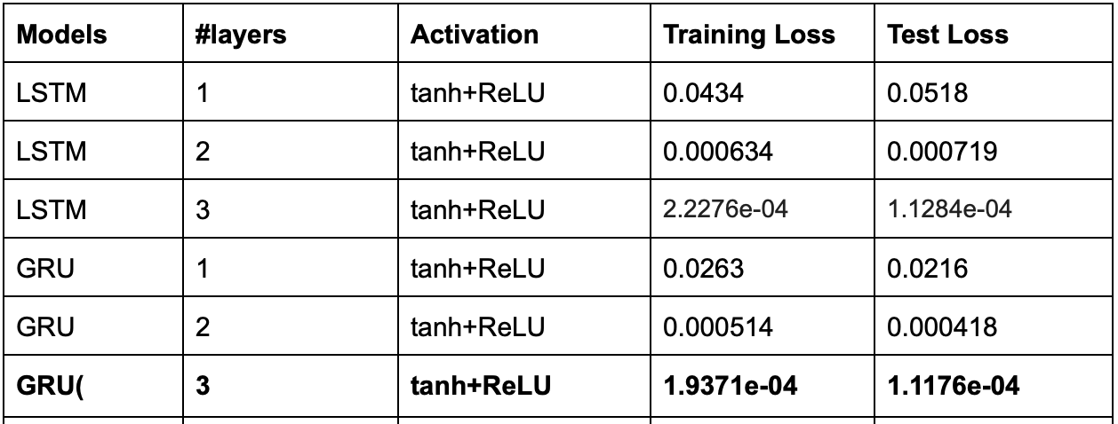
Comparison
The main difference between LSTM and GRU are
data
Training parameters
Computational time
Training and validation loss
Notes:
I have compared 3 layered network with small dataset and large dataset, i have not found overfitting of model. so i have used the same dataseplit i.e using 30K for training and 20 days for testing. Interestingly, the models are performing good with 3 layered network for both LSTM and GRU with GRU upper hand with validation dataset.
Differences
data - small and large
The number of training parameters in GRU are less than LSTM
Computational time - GRU takes longer time than LSTM
Training and validation loss for three- layer GRU neural network is slightly less when compared to a three-layered LSTM neural network. The values are shown in table -
basic difference in network makes GRU work better for intraday

Slide 13
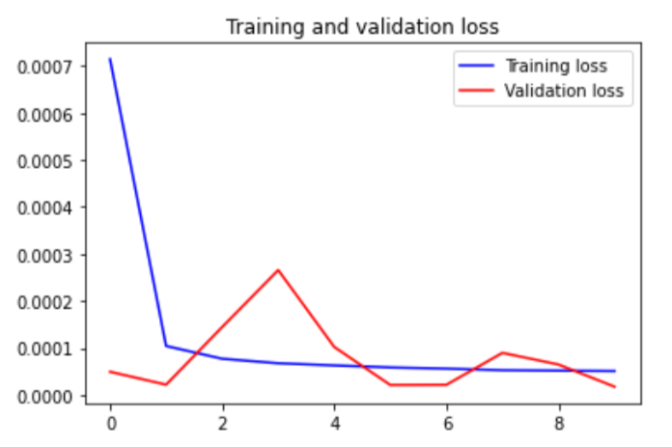
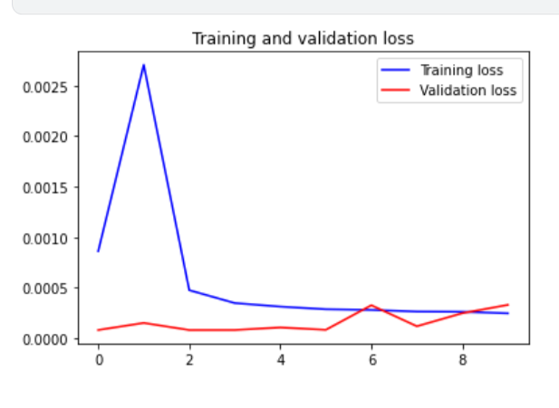
Evaluation
Learning Curves
Metrics
LSTM
GRU
Notes:
Graph to validate training and validation loss to check the fluctuations in the data, the first graph is loss values for LSTM with 3 layers and the other one is for GRU with three layers.
You can see that there are no many fluctuations and loss values remains nearly same for training and validation
I have used RMSE, MSE and MAE as evaluation metrics. it can be seen that values are decreasing

Slide 14
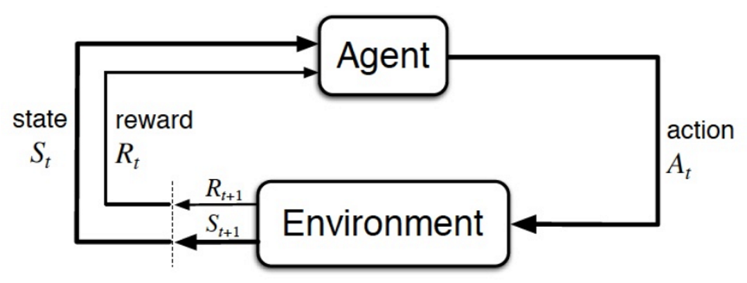
Reinforcement Learning(RL)
Create enviorment.
Algorithm - Actor-Critic A2c
Classification - Predicted the next position to buy
or sell the stock
Notes:
Reinforcement Learning –
it is a classification
RL learning which uses Trail and error mechanism to learn, starts with zero knowledge and makes error and learn with no data (similar to human) on a long run , RL can master the model.
RL proven with some examples like Alpha Go which calculates faster, accurate and has even overcome humans in some of the examples like chess, alphaGO and
Reinforcement learning is usually about sequential decision making.
As we know the importance of using Actor-critic algorithms on both continuous and discrete data to improve learning and reduce variance. I straight away used the best performing Actor-critic algorithm A2C for the train gold dataset.
The first step is to install gym-anytrading environment from openai (Greg Brockman et al, 2016). AnyTrading is a set of OpenAi gym environments for RL based trading algorithm.
steps
Create environment with anytrading gym library from openAI
and then train the model without technical indicators
and then trained again with technical indicatore - SMA, RSI, and OBV - there is nearly 2 times change in performance, that is 35% without indicators and 59% with indicators.
rewards and profits for each model is calculated
Policy- set of rules that agent take to manipulate the environment.
Value- How valuable it is to be in a particular state.

Slide 15
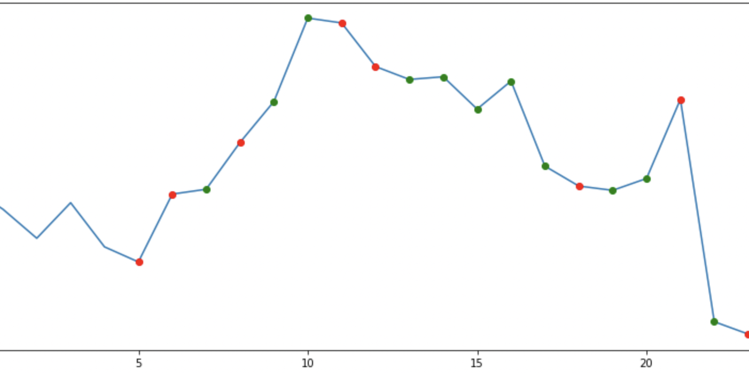
RL Model Variations
variations
With and without Technical Indicators
with variation in frame size and window size
best model with frame(5,250), window size- 5
Notes:
as you can see in the graph green dots denote that the next minute to buy and red for selling
without indicators i got 35 % and with indicators 59%.
increasing the frame and window size the model - increase in sizes lead to overfit of model

Slide 16
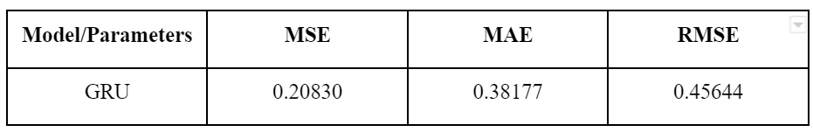
Final Model
GRU with the following parameters
Parameters-390,259
Parameter | Parameter settings
Loss function | Mean squared error
Optimizer | Adam
Batch size | 1
Number of neurons in each layer | 64,128,256
Epochs | 10
Time | Model prediction error %
5 Min | 3.5%
10 Min | 5.6%
15 Min | 8.7%
Notes:
After comparing all these models, I have selected GRU as final model because of error rates and how close the model is predicting the values in next minute.
in the next 5 minutes, this model is predicting the values with

Slide 17
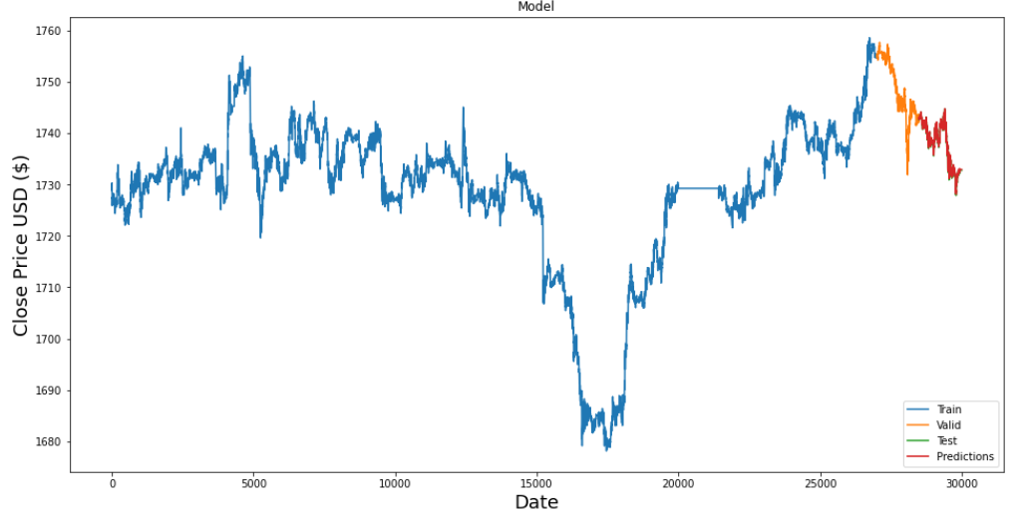
Results

Slide 18
Comparison with state of art results
Authors | Models | Final Model
Chen, Wenjing,2022 | SVM and LSTM | Hybrid Model of SVM and LSTM
Manjula, K. A. and Karthikeyan, P. (2019) | Linear Regression, Random Forest, Gradient Boosting | Random Forest and Gradient Boosting
Dr T Chadrabai and Dr. K. Suresh, 2020 | Linear Regression, Random Forest, SVM | Linear Regression
My work | CNN, LSTM, GRU, RL | GRU

Slide 19
Conclusion
In conclusion, I have tried using CNN, RNN, and RL models on gold dataset with no moderation in data.
GRU model with explained parameters has worked better in producing the results more accurately.
My future work will be mostly based on RL to achieve more accurate results .
Notes:
In conclusion, I have tried using CNN, RNN, and RL models on gold dataset with no moderation in data. i conclude saying that on my dataset, GRU model with explained parameters has worked better in producing the results more accurately. keeping the importance of RL in Algorthimic trading, my future work will be mostly based on RL to achieve more accurate results .

Slide 20
References
Weng, F., Chen, Y., Wang, Z. et al,2020. Gold price forecasting research based on an improved online extreme learning machine algorithm. J Ambient Intell Human Comput 11, 4101–4111 (2020).[Online]. Available at: <https://doi.org/10.1007/s12652-020-01682-z>
Das, S., Nayak, J., Kamesh Rao, B., Vakula, K. and Ranjan Routray, A., 2022. Gold Price Forecasting Using Machine Learning Techniques: Review of a Decade. Computational Intelligence in Pattern Recognition, pp.679-695.
Chen, Wenjing, 2022. Estimation of International Gold Price by Fusing Deep/Shallow Machine Learning. Journal of Advanced Transportation. 2022. 1-8. 10.1155/2022/6211861.
Makala, Daniel & Li, Z. (2021. Prediction of gold price with ARIMA and SVM. Journal of Physics: Conference Series. 1767. 012022. 10.1088/1742-6596/1767/1/012022. J. Phys.: Conf. Ser. 1767 012022 [Online] Available at:<https://www.researchgate.net/publication/349451531_Prediction_of_gold_price_with_ARIMA_and_SVM> [accessed March 18 2022].
Thumma, Chandrabai & Suresh, Dr. , 2020. ASSESSMENT OF MACHINE LEARNING TECHNIQUES FOR GOLD PRICE PREDICTIONS. 10. 5879-5886.
Ka, Manjula & .P, Karthikeyan, 2019. Gold Price Prediction using Ensemble based Machine Learning Techniques.[Online] Available at:DOI: <10.1109/ICOEI.2019.8862557>.
Dukascopy Swiss Banking Group, 2022. Historical Data Feed, [online]Available at: <https://www.dukascopy.com/swiss/english/marketwatch/historical/> [Accessed March 1, 2022].
Notes:
and these are my references . if everything goes fine i would like to publish my research paper in the near future thank you. I would like to thank my supervisor vitaliy for guiding completing throughout my project.

Slide 21
Any questions?

