Slide 1
Exertis Technical Task -1
Data Analysis
Presented By: Srinivas Devarajula

Slide 2
Contents
Background
Data Understanding
Data Exploration
Data cleaning
Purchase Insights
Time period analysis
Monthly analysis
Yearly analysis
Customer insights

Slide 3
Background
Business Problem : To identify sales trends and patterns to improve sales performance and profitability. Additionally, the analysis could aim to identify top-performing products, customer segments, and sales teams, and to optimize pricing and marketing strategies to drive sales growth.
Objectives :
To identify sales trends and patterns to improve sales performance and profitability.
To identify top-performing product types, brands, customer segments, and sales teams.
To develop actionable insights and recommendations for the business to improve sales performance and profitability.

Slide 4
Data Understanding
Areas to investigate:
Are there any missing or incomplete data in the dataset?
Are there any columns mismatching data-types?
What does negative numbers in Quantity with Analysis?
What are the top and least selling product types and brands?
What is the distribution of Revenue, Profit, Customers, and Orders across the dataset?
What is the relationship between revenue and the number of items purchased (quantity)?
Which sales team generates the most revenue, profit, customers and orders?
What is the relationship between revenue, profit, and freight cost?
How does the dataset vary over time (e.g. month-on-month analysis, year-on-year analysis)?
How has the customers, revenue, orders and quantity changed over time?
How many customers are carried over, left and newly added from year to year?

Slide 5
Data Exploration
12 Features
Timeframe of the data: 2021-01-05 to 2023-12-02
Total data points : 486424
Assumptions:
For this analysis, I have assumed that the revenue and profit values are in GBP since the unit of measurement is not specified.
As it is not mentioned, Negative values in the Quantity column are not considered invalid and are instead interpreted as returned or cancelled orders.

Slide 6
Dataset
Column Name | Explanation
CustomerId | Identification number for the customer purchasing goods/services from Exertis
SalesOrderNumber | Identification number for the order that has been placed
SalesOrderLineNumber | Identification of each line item within the sales order e.g. a customer may purchase a computer and a keyboard in a single order. These would have the same SalesOrderNumber but will have two different SalesOrderLineNumber
ShipDate | Date the item(s) were shipped and therefore customer invoiced
Qty | Number of items purchased
Brand | Brand of the item being purchased
ProductType | Type of product being purchased
ProductSupplierID | Identification number for the supplier providing the item for Exertis to sell
Revenue | Total value of sale
Profit | Profit
Freight Cost | Cost of shipping
SalesTeamName | Name of the sales team that made the sale

Slide 7
Data cleaning
Used Pandas to perform statistical analysis
Categorical and numeric types in the data
Categorical - CustomerId, Brand, ProductType, Object, SalesTeamName
Numerical - SalesOrderNumber, SalesOrderLineNumber, Qty, Revenue, Profit, Freight cost,
Datetime - ShipDate
Removed missing values after calculating the missing percentage of values
Brand and product type missing percentage is negligible (1%) when compared to total count but almost 4.6% of ProductSupplierId is missing
Checked for duplicate values

Slide 8
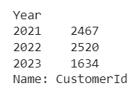
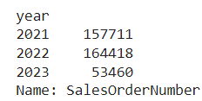
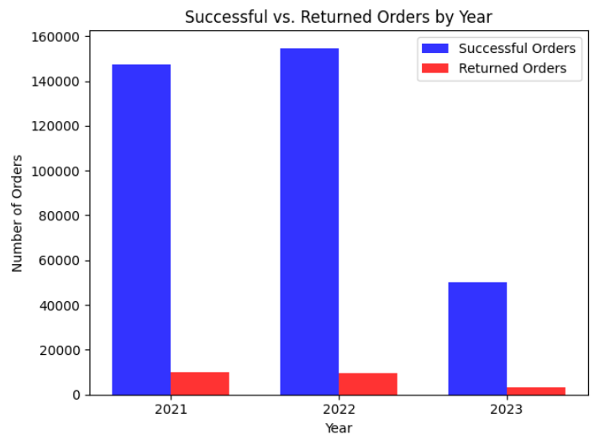
Orders Insights
Orders and Customers : Total number of orders increased with number of customer in 2022
Returned or Cancelled orders:
Total returned orders - 24820
Number of returned orders decreased
from year to year.

Slide 9
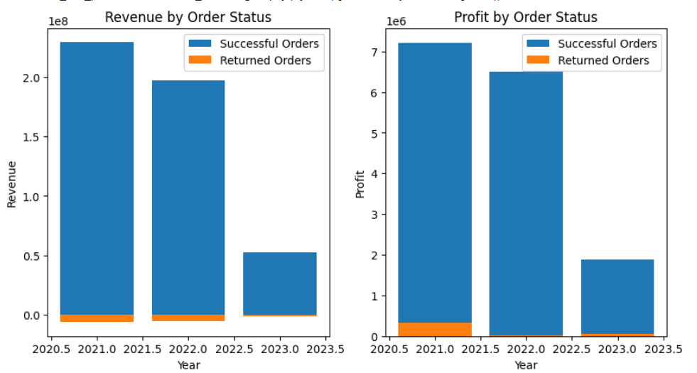
Revenue and Profit for Successful vs Returned Orders

Slide 10
SalesOrderNumber and SalesOrderLineNumber
SalesOrderNumber is used as a unique identifier for a sales order placed by a customer, while SalesOrderLineNumber represents a specific item or product within that order. Therefore, there is a one-to-many relationship between SalesOrderNumber and SalesOrderLineNumber, with each sales order having multiple sales order line items.
On average, each SalesOrderNumber has 13.78 ordersMax=60, Min=1.

Slide 11
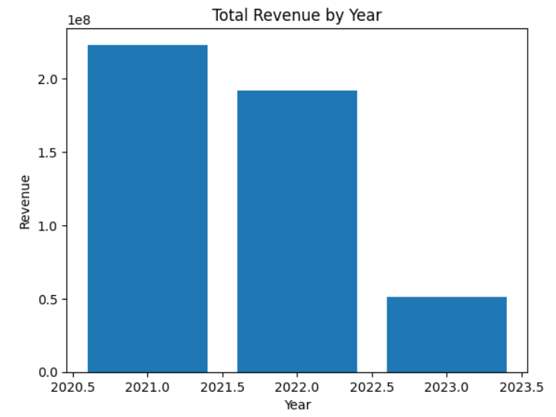
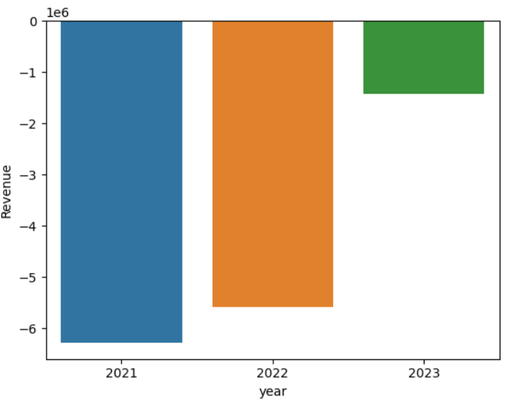
Revenue Insights
The average revenue per order is: 1244.98 GBP
Average Revenue for the dataset : 958.29 GBP
Revenue less than zero:
Number of orders with negative revenue: 22971 which is 23.67% of total distinct orders
Total revenue for orders with negative revenue: -13292990 GBP.

Slide 12
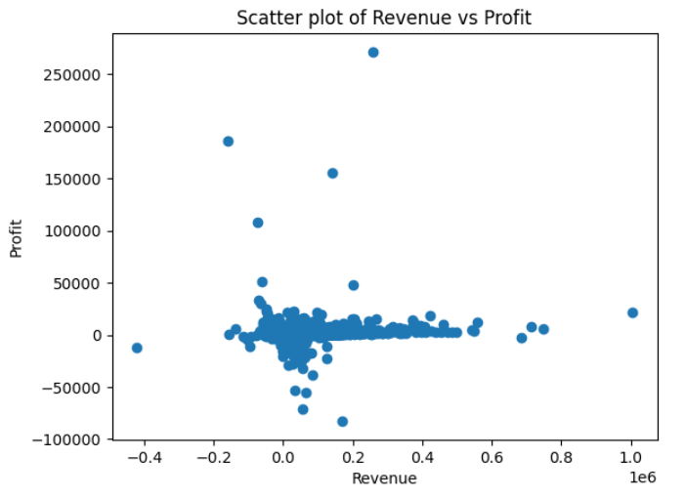
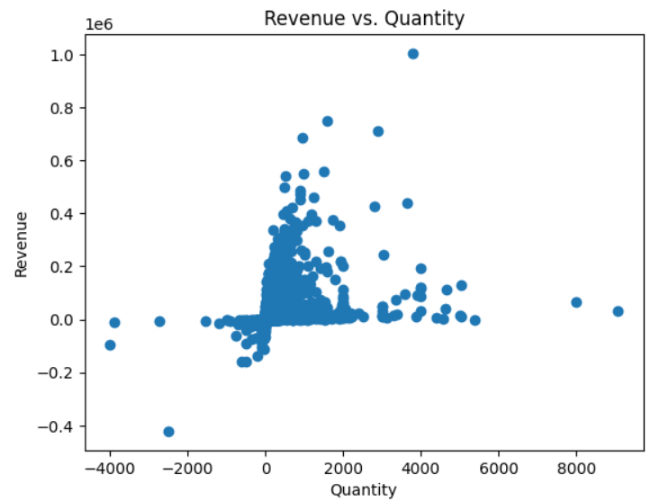
Relationship for Revenue vs profit and quantity
A correlation coefficient between revenue and profit is positive
A correlation coefficient of 0.4 indicates a moderate positive relationship between Revenue and Quantity

Slide 13
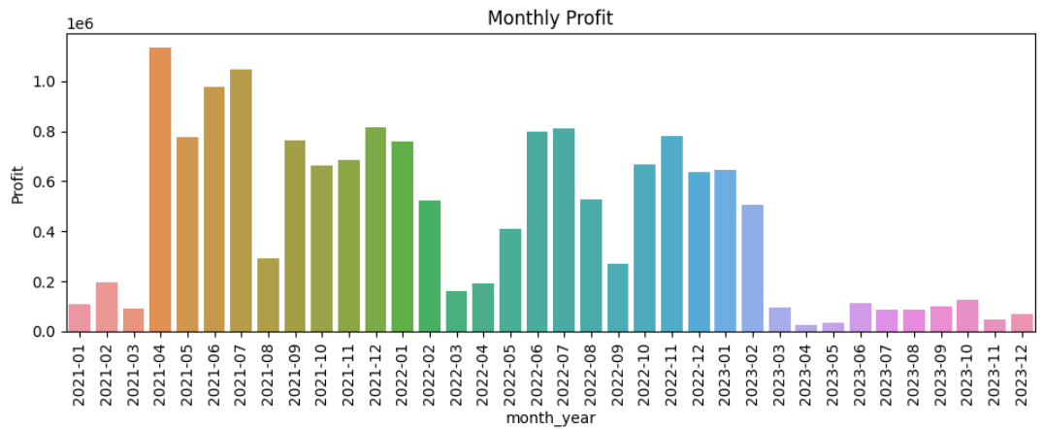
Profit Insights
Month with highest profitability: April 2021
Month with lowest profitability: Mar 2021
Profit less than zero: -2589274.3 GBP
Number of orders with negative profit: 28.93% of total distinct orders
Total revenue for orders with negative revenue: -2589274.3 GBP.

Slide 14
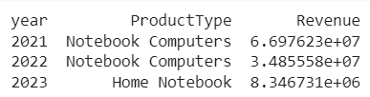
Product Types Insights
Top 3 popular Product types:
Top Products by Revenue for each year :
 | Quantity | Revenue | Profit | #Customers | #Orders
1. | Monitors | Notebook comp | Notebook comp | Monitors | Monitors
2. | Headset | Monitors | Monitors | Notebook com | Notebook comp
3. | Notebook Comp | Prof.Notebooks | Graphic Cards | Prof Notebooks | Prof Notebooks

Slide 15
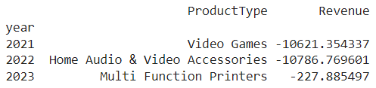
Product Types Insights Continuation
Least 3 Product types:
Revenue from least product type for each year:
 | Quantity | Revenue | Profit | #Customers | #Orders
1. | Jug Blender | A/V Recorders | Earphones | Gaming Cases | Console servers
2. | Navigational equip | Jug Blender | Speakers | Virtualisation s/w | Hand held mixer
3. | A/V Recorders | Drone | Cable locks | Floor steamer | Binoculars

Slide 16
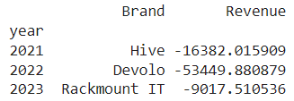
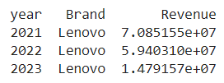
Brand Insights
The Popular and least popular Brands based on Quantity, Revenue, Profit, SalesOrderNumber, and CustomerID
Top 5 popular Brands:
Lenovo is most popular brand by Quantity, Revenue, and Profit but the most popular for customers is Dell and that is why the number of orders for Dell is also more.
Devolo is the least popular brand based on Quantity and Revenue but Maclocks brand is least favourite for customers and the same can be seen with the number of orders.
Top Brand by Revenue based on year
Least popular Brand by Revenue based on year
Notes:
It is important to notice that the most popular brand Lenovo, tops every year being most trustable brand for company, it should be noted that revene for lenovo is reduced from 70 million pounds to 59 million pounds.

Slide 17
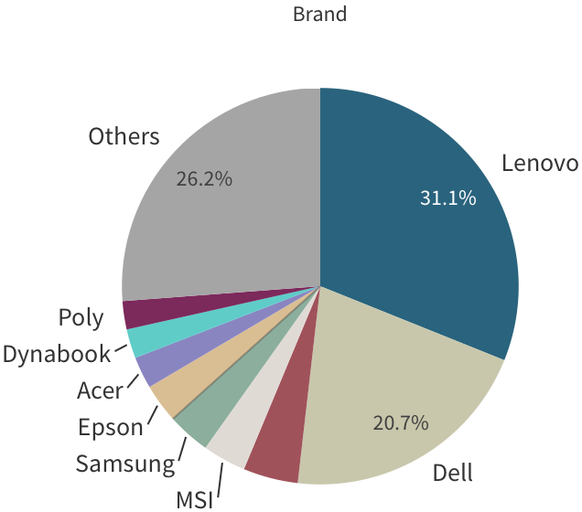
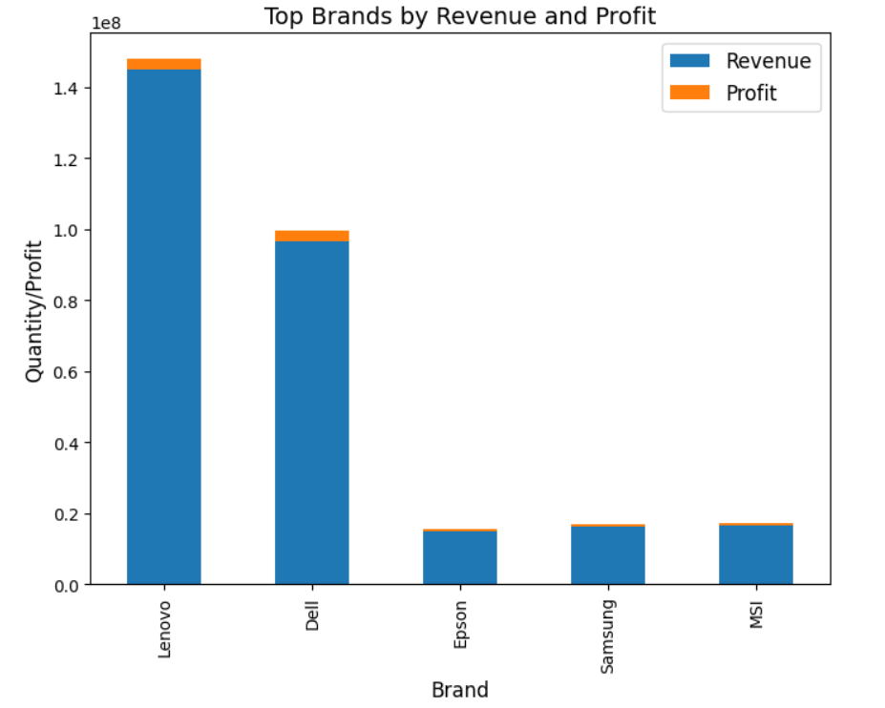
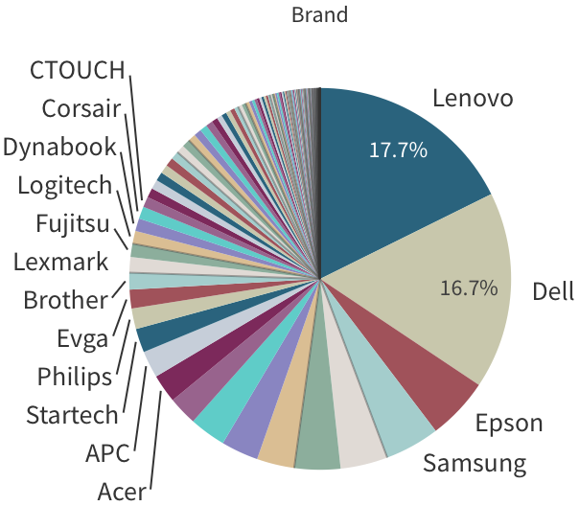
Top Brands by Revenue and Profit

Slide 18
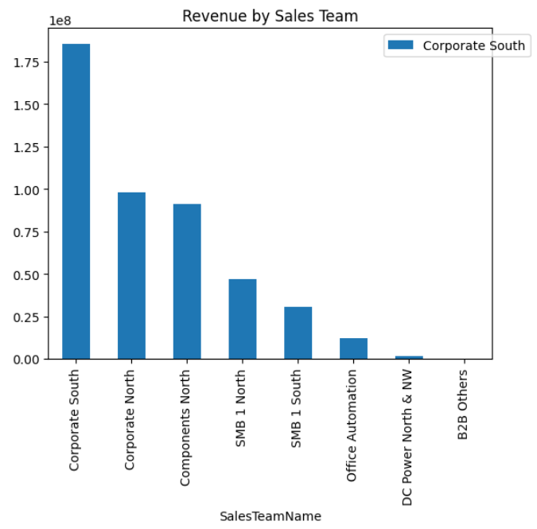
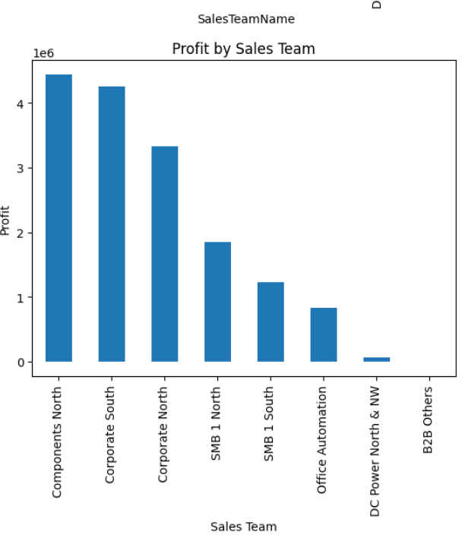
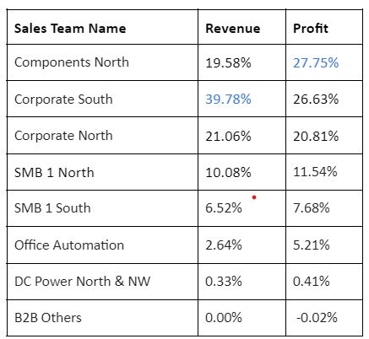
Sales team Insights
Notes:
Setup in powerpoint

Slide 19
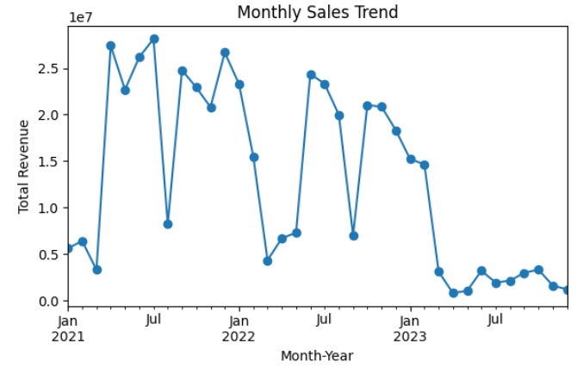
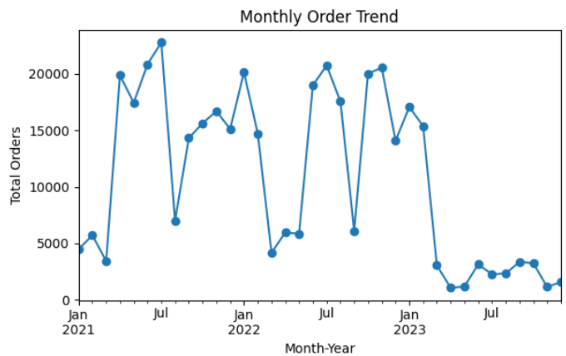
Time period analysis:
Monthly analysis

Slide 20
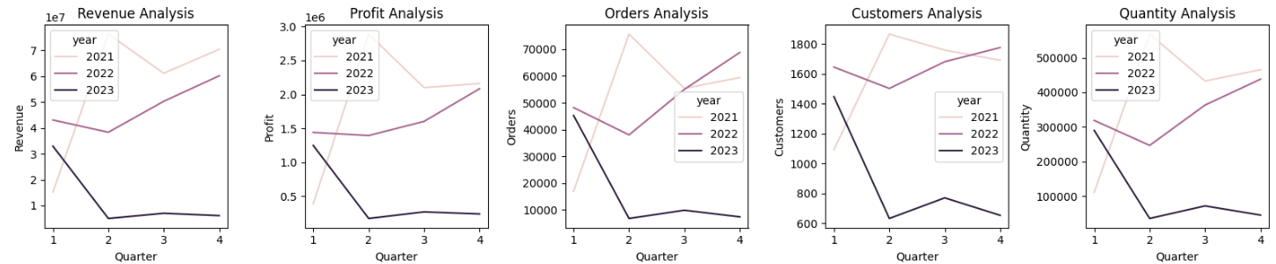
Quarterly Analysis
Q1 of 2021 is high performing based on COPQR
There is slight increase in the Q2, Q3, and Q4 performance for year 2022
Q1 of 2022, 2023 is low performing quarters

Slide 21
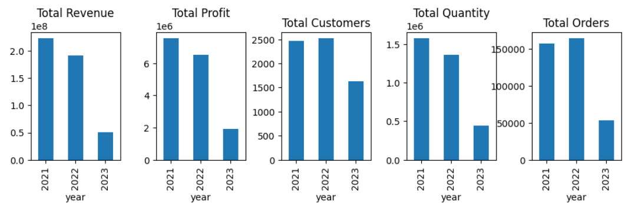
Yearly analysis

Slide 22
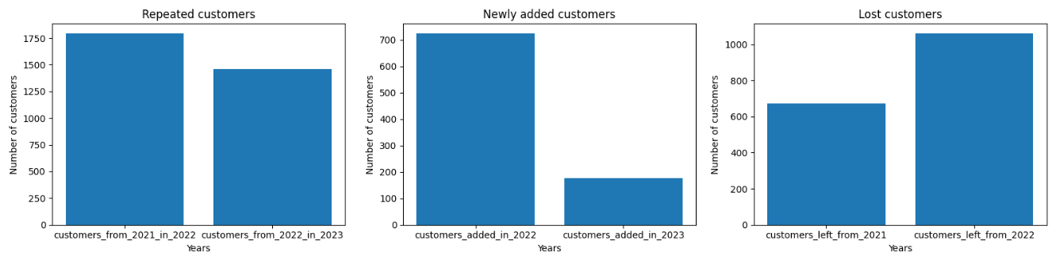
Customer Analysis
1.Comparison for the customers repeated from 2021 to 2022:
71.27% of customers repeated from 2021
And the remaining are newly added - 28.73%
2. Lack of 2023 data implies lose of many customers and very less number of repeated and newly added customers.

Slide 23
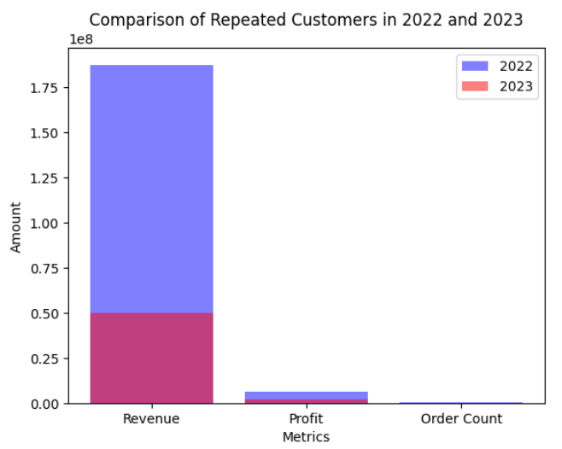
Metrics of customers of 2022 and 2023
With decrease in number of orders,
customers from year to year the total
revenue and profit from the
customers moved to next year
also decreased.

Slide 24
Conclusions
Total Revenue, Profit, and Orders gradually decreased from 2020 to 2023
Although the number of customers, orders increased from 2021 to 2022, The profit and revenue was not increased
There are 24,820 total return orders and number of return orders reduced from year to year
23.67% of total distinct orders has negative revenue. 28.93% of total distinct orders has negative profit.
Notebook computers are the top product type by revenue & profit but more number of orders and customers are for monitors
Lenovo and Dell together contribute to 51% of the total revenue as top brands. Lenovo accounts for 31% and Dell accounts for 20% of the total revenue.
Lenovo and Dell account for 18% and 17% of the total profit, respectively, making them the top profit-generating brands in the dataset.
Corporate south sales team is high performing sales team with revenue. Components north is high profitable. Notably, Components north, corporate south and corporate north teams overall getting 60.51 % of total-revenue and 75.19% of total-profit.
Comparision for the customers repeated from 2021 to 2022:
71.27% of customers repeated from 2021
And the remaining are newly added - 28.73%
Freight cost has increased in 2022 and gradually decreased in 2023
The relation between Revenue, Profit, and Frieght cost is positive correlated but not strong.

Slide 25
Recommendations
Based on the conclusions drawn from the sales analysis, here are some recommendations that can potentially contribute to the company's growth:
Analyze the drop in Total Revenue, Profit, customers, and orders from 2022 to 2023: Investigate the potential reasons for the decline in revenue, profit, customers, and orders from 2022 to 2023. Identify the root causes and take appropriate actions to address them.
Focus on improving profitability: Despite an increase in customers and orders from 2021 to 2022, the profit did not increase significantly. Analyze the profitability of different products, sales teams, and customer segments to identify areas where profit margins can be improved. This could involve optimizing pricing strategies, reducing costs, and increasing operational efficiency.
Leverage top performing brands: Lenovo and Dell are the top contributing brands to the total revenue and profit. The total revenue and profit from lenovo has also reduced from 2021 to 2022. Explore opportunities to further strengthen partnerships and collaborations with these brands. Develop targeted marketing and sales strategies to maximize revenue and profit from these brands, such as offering exclusive promotions, customized solutions, or after-sales support.

Slide 26
Recommendations
4. Enhance customer retention strategies: With 71.27% of customers repeating from 2021 to 2022, it indicates a significant portion of repeat customers. Implement effective customer retention strategies, such as personalized offers, loyalty programs, excellent customer service, and relationship management, to retain existing customers and drive repeat business.
5. Monitor and optimize freight cost: As freight cost has increased in 2022 and gradually decreased in 2023, keep a close eye on freight costs and work with logistics partners to optimize shipping methods, negotiate better rates, and streamline transportation processes to reduce shipping costs without compromising on service quality.
6. Strengthen sales team performance: Based on the sales team analysis, identify areas of improvement for individual team members and provide training, incentives to boost their performance. Recognize and reward top performers to motivate and encourage a positive sales culture. Regularly review and align sales targets and strategies to align with overall company goals.
7. Continuously analyze and improve correlations: Keep monitoring and analyzing the relationship between revenue, profit, and freight cost to identify any changes in patterns or trends. Leverage the insights to fine-tune pricing strategies, cost management, and supply chain optimization for better profitability and efficiency.

