Slide 1
Exertis Technical Task 2
- Data Modelling
Presented by : Srinivas Devarajula

Slide 2
Contents
Background
Approach
RFM analysis
K means clustering
Strengths and weakness
Conclusions

Slide 3
Background
Business problem: To group the customers so they are similar to one another.
AIM: Aim of this task is to create a simple ML model that generates clustered groups based on similarity between customers. why these are suitable groups.

Slide 4
Approach
Group customers based on similarity: Use k-means clustering to group customers based on their RFM data, which includes Recency, Frequency, and Monetary values.
RFM Analysis
Create a simple ML model: Develop a machine learning model using k-means clustering that can automatically generate customer groups without predefined labels or categories.
Elbow method : Use to identify the best K value in K-mean clustering and enhance the performance of customer segmentation.
Identify meaningful clusters: Generate clusters that have similar RFM characteristics, such as recent purchases, frequent purchases, and similar spending amounts, to create meaningful and interpretable customer groups.
Facilitate targeted marketing efforts: Use the clustering results to better understand customer behavior, preferences, and needs, and tailor marketing strategies to different customer segments.
Justify groupings: Explain the rationale behind the clustering results, interpret the characteristics of each cluster in terms of RFM data, and provide justifications for the relevance of the customer groups in the business context.
Enhance decision-making: Use the k-means clustering analysis to gain insights into customer segments, identify opportunities for business growth, and support data-driven decision-making in marketing and sales strategies.

Slide 5
RFM analysis
Recency refers to the number of days since a customer's last purchase. Customers who made a purchase more recently are typically more engaged and valuable.
Recency = Current Date - Last Transaction Date
Frequency refers to the number of purchases a customer has made. Customers who have made more purchases are typically more loyal and valuable.
Frequency = Count of Unique Transactions or Interactions
Monetary Value refers to the amount of money a customer has spent on purchases. Customers who have spent more money are typically more profitable and valuable.
Monetary Value = Sum of Monetary Value or Revenue of All Transactions
Notes:
It is a widely used technique in customer segmentation and stands for Recency, Frequency, and Monetary Value.

Slide 6
RFM scores and Groups
RFM Scores
RFM (Recency, Frequency, Monetary) score is a marketing analysis technique used to segment customers based on their purchasing behavior.
It involves assigning numerical values or scores to each component (Recency, Frequency, Monetary) using methods such as quantiles or percentile ranks.
The scores for each component are combined to create a single composite score for each customer.
E.g : 3 (for 111 RFM values combined) , 5 ( for 122 RFM values combined)
RFM groups
RFM groups are segments of customers created based on their RFM scores, which are composite scores derived from the Recency, Frequency, and Monetary components.
RFM groups are typically created by dividing customers into segments based on ranges or thresholds of RFM scores.
Platinum(high-valued customers), Gold(loyal customers), Silver(customers that need attention), Bronze(at risk or customers about to loose)
E.g : Platinum(111), Bronze(444)

Slide 7
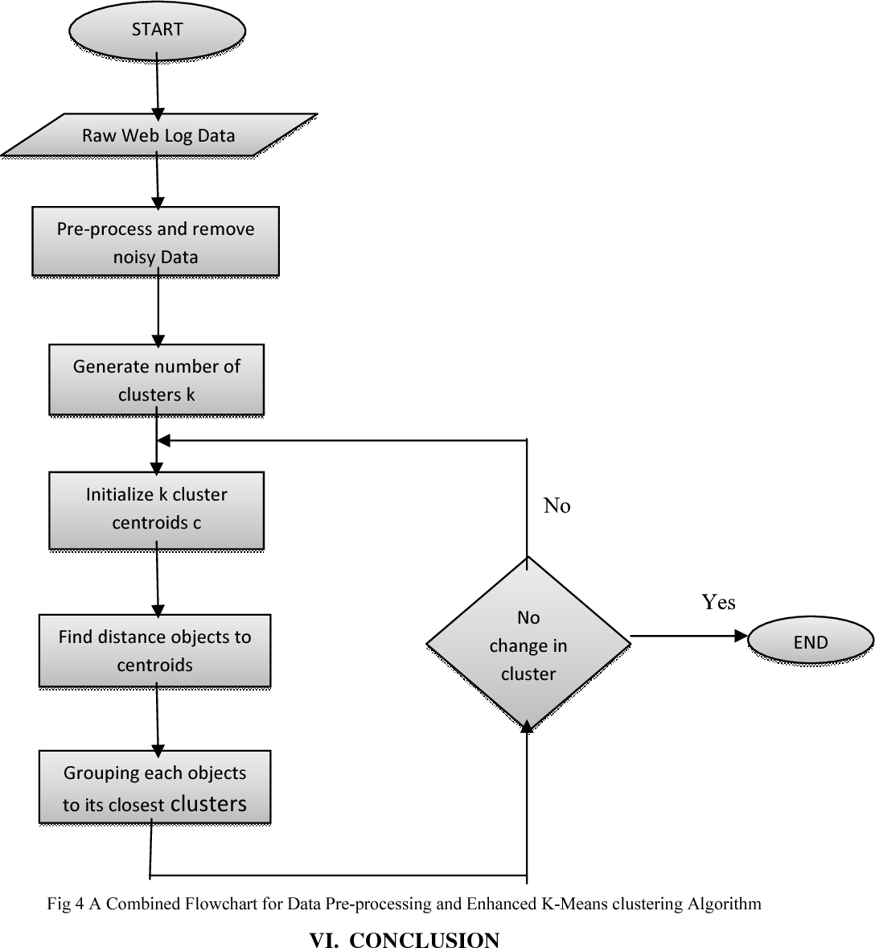
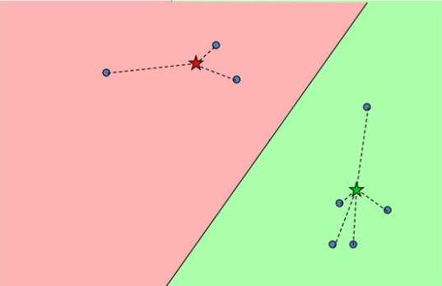
K-Means clustering
Objective : High level description
Group data into k-cluster by :
Determining the k-centroid
Group the data points to the nearest centroid
Algorithm works by iterating between two stages
until the data points converge
Notes:
K-means clustering is a widely used unsupervised machine learning algorithm that is commonly employed for grouping or clustering data points based on their similarity. It is an iterative algorithm that aims to minimize the variance within each cluster and maximize the variance between clusters. K-means clustering is a powerful tool for identifying patterns and relationships in data, and it has various applications in fields such as marketing, customer segmentation, anomaly detection, image segmentation, and more.
In this analysis, we have utilized k-means clustering to group customers based on their RFM (Recency, Frequency, Monetary) data, with the objective of creating meaningful customer segments for targeted marketing efforts. Let's explore the details of our k-means clustering analysis and the results obtained.

Slide 8
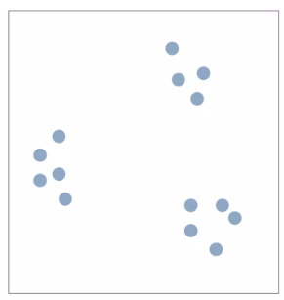
K means Illustration
Suppose k=3

Slide 9
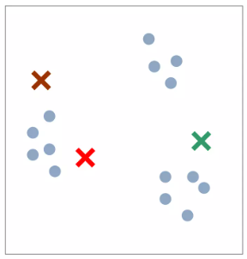
K means Illustration
Start with random positions of centroids
Iteration 0

Slide 10
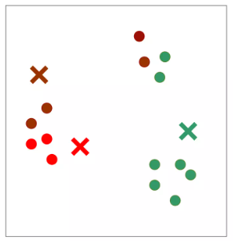
K means Illustration
Start with random positions of centroids
Assign each data point to closest centroid
Iteration 1

Slide 11
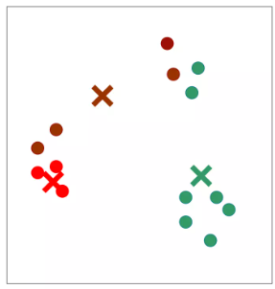
K means Illustration
Start with random positions of centroids
Assign each data point to closest centroid
Move centroid to center of assigned points
(recalculation centroids)
Iteration 2

Slide 12
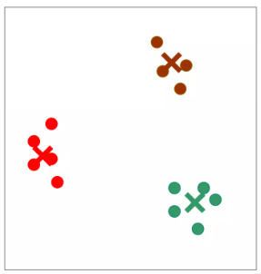
K means Illustration
Start with random positions of centroids
Assign each data point to closest centroid
Move centroid to center of assigned points (recalculation centroids)
Iterate till minimum cost
Iteration 3

Slide 13
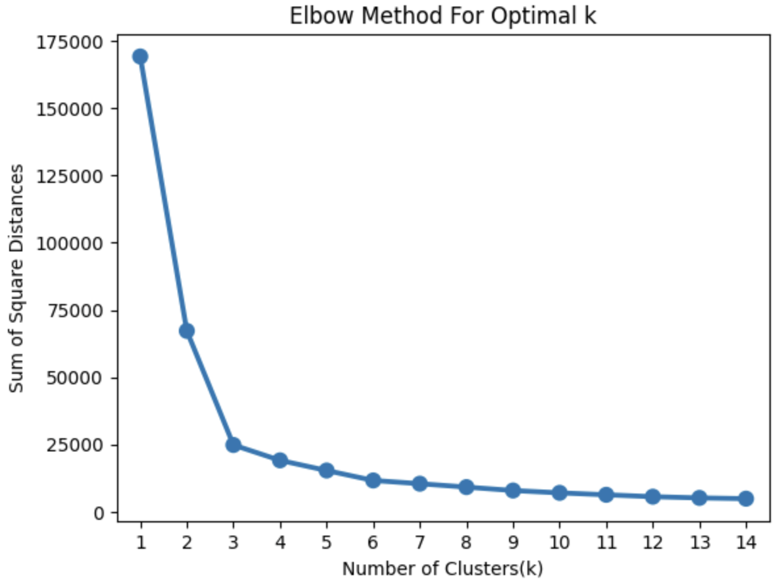
Elbow method - Optimal Number of cluster
Determining the optimal number of clusters using the Elbow Method:
One of the challenges in k-means clustering is determining the optimal number of clusters, denoted as 'k', to use for grouping the data. A common approach for determining the optimal 'k' is the Elbow Method, which involves plotting the within-cluster sum of squares (WCSS) against different values of 'k' and identifying the "elbow" point in the plot, where the rate of decrease in WCSS starts to level off.
Here we got k value = 4
Platinum (high valued customers)
Gold (valued customers)
Silver (customers that need attention)
Bronze ( customers at risk)

Slide 14
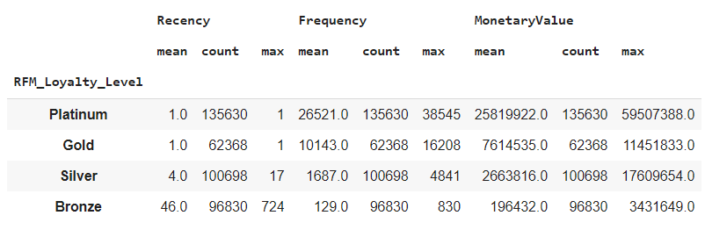
Interpretations of Descriptive statistics of segments

Slide 15
Platinum (high valued customers)
Customers in the Platinum level have the highest RFM scores, indicating that they are the most loyal and valuable customers.
They have a mean recency score of 1.0, which means they have made recent purchases before 1 day, indicating they are not at risk of churning.
On an average the customer from this cluster has made 26521 orders with average revenue of 25819922.0 are also significantly high, indicating that they are frequent purchasers and have a high monetary value, making them "can't lose" customers for the business.
Recommendation: These customers should be given the highest priority as they are the most valuable and loyal, and efforts should be made to maintain and strengthen their relationship with the business.

Slide 16
Gold (valued customers)
Customers in the Gold level have slightly lower RFM scores compared to Platinum level, but are still valuable.
They have a mean recency score of 1.0, which means they have made purchases before one day. and On an average the customers from this cluster has made 10143 orders, indicating moderate frequency of purchases.
Their mean revenue value is 7614535.0 which is also substantial. Although they may not be as loyal or valuable as Platinum level customers, they still require attention to retain their loyalty and maximize their value to the business.
Recommendation: These customers should be considered as "needs attention" customers, and efforts should be made to nurture their loyalty and increase their purchasing frequency.

Slide 17
Silver (customers that need attention)
Customers in the Silver level have lower RFM scores compared to Platinum and Gold levels.
They have a mean recency score of 4.0, which means they have made recent purchases before 4 days indicating less recent purchases compared to higher levels, and On an average the customers from this cluster has made 1687 orders, indicating moderate frequency of purchases.
Their mean revenue value score of 2663816.0 is also lower than higher levels.
Recommendation:These customers may be at risk of churning as they show less frequent purchasing behavior. They should be considered as "at risk" customers, and efforts should be made to re-engage them, understand their needs, and provide incentives or promotions to retain their loyalty and prevent them from churning.

Slide 18
Bronze ( customers at risk)
Customers in the Bronze level have the lowest RFM scores, indicating lower loyalty and value compared to higher levels.
They have a mean recency score of 46.0, which means they have made recent purchases before 46 days indicating longer time since their last purchase, and On an average the customers from this cluster has made 129 orders, indicating infrequent purchases.
Their mean revenue value score of 196432.0 is also the lowest among all levels.
Recommendation: These customers require attention and efforts to increase their loyalty and value to the business. They should be considered as "customers at risk" customers, with appropriate strategies, such as targeted marketing campaigns or personalized offers, to encourage repeat purchases and increase their loyalty.

Slide 19
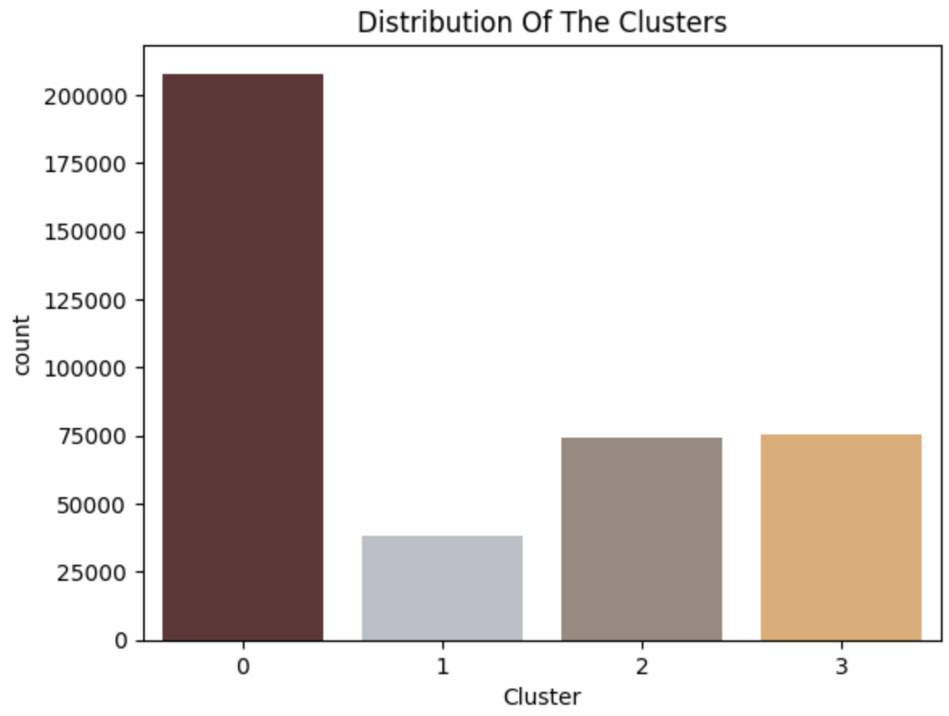
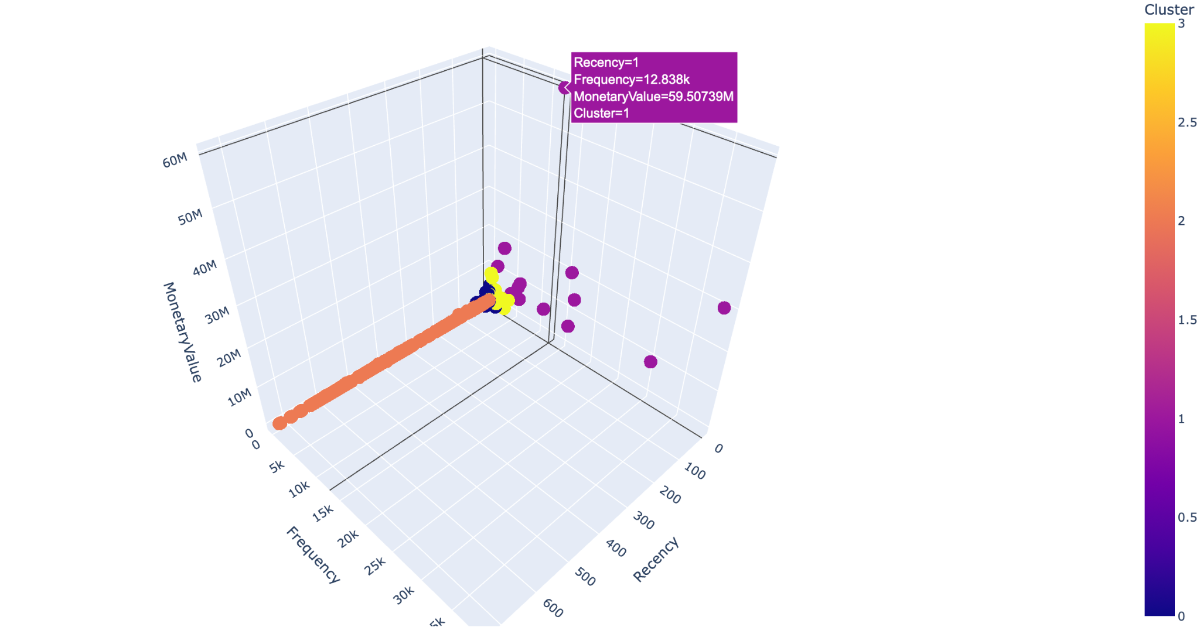
Clustered image
Interactive 3d clustering:Link
Download the link and open in browser to see interactive clusters for left image.

Slide 20
Strengths and weakness
Strengths :
Simple iterative method
Relatively Efficient and fast, It computed result at O(tkn), where n is number of data points, k is number of clusters and t is number of iterations.
User provides “K”
May need to scale data
Good initial method
Weakness :
Often too simple can give bad results.
When the number of data are not so many, initial grouping will determine the cluster significantly
It is sensitive to initial condition. Different initial condition may produce different result fo cluster. The algorithm may be trapped in the local optimum.
One can never know the real cluster, using the same data, because if it is inputted in different order it may produce different cluster if the number of data is few.

Slide 21
Conclusions
In summary, customers in the Platinum level should be given the highest priority as they are the most loyal and valuable, followed by customers in the Gold, Silver, and Bronze levels in descending order of priority.
Efforts should be made to maintain and strengthen relationships with Platinum and Gold level customers, re-engage and retain Silver level customers, and increase loyalty and value of Bronze level customers.

