Slide 1
Home Security System with Server Monitoring and Automation Control
BY: K.SRINIVASH(30123P08037)
UNDER THE GUIDANCE OF
MRS.K.SANGEETHA , MCA., M.PHIL., B.ED., ASSISTANT PROFESSOR

Slide 2
ABSTRACT
The IoT-Based Home Security System is designed to enhance residential security using Smart sensors, real-time alerts, and remote monitoring. This system integrates PIR Motion sensors, door break sensors, an ESP32 microcontroller, a buzzer, and a web Based dashboard to detect intrusions and notify homeowners instantly . When motion or unauthorized entry is detected, the ESP32 processes the data and triggers an alarm while simultaneously sending an alert notification to the user via the web or mobile interface. The system ensures 24/7 surveillance, provides real-time access, and enhances security with remote monitoring and cloud data storage. This project aims to offer a cost effective , user friendly, and scalable solution for modern Home security. Future enhancements include AI-based threat detection, mobile app integration, cloud computing, and smart home automation to further improve reliability and efficiency.

Slide 3
EXISITING SYSTEM
In recent years, Traditional home automation systems have become low popular among homeowners. The low ability to control devices such as lighting, heating, and security systems through a single system has made life much hard for homeowners to monitor.
Drawbacks:-
• Traditional home security systems lack real-time monitoring.
• No remote access or automated alerts.

Slide 4
Proposed System
In our project there are two sides as consumer and producer. Producer section is the part of the web application where the producer can manage the system and interact with the consumers. The producer is the administrator of the system who can perform various tasks such as:
View, edit and delete users and their information.
View, edit,delete ,create rooms and their devices.
View the graphs of the consumer and act upon it according the how much consumer like to use this project.
View,edit,delete and create devices and can handle the settings of devices.
View consumer activities and logs.
View and respond to messages from consumers.
Edit their own profile and password

Slide 5
Advantages of Proposed System
• Device Control
• Device Monitoring
• Device Scheduling:
• Admin Management
• Admin Control

Slide 6
Methodology Used
As Tools we used XAMPP Control Panel , MySQL , PhpMyAdmin. For the coding part we used visual studio code.
As method we used PHP , JavaScript , html tags , CSS and Bootstrap.

Slide 7
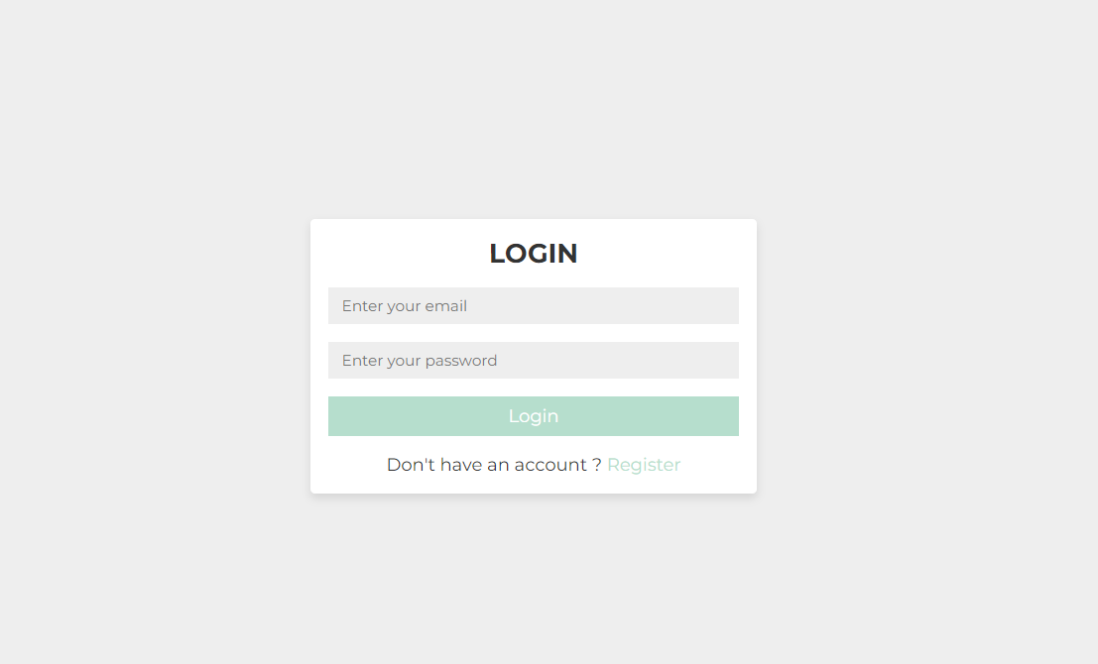
Screenshots of Proposed System
Login & Signup
(Figure 1 - This is our Login Page )

Slide 8
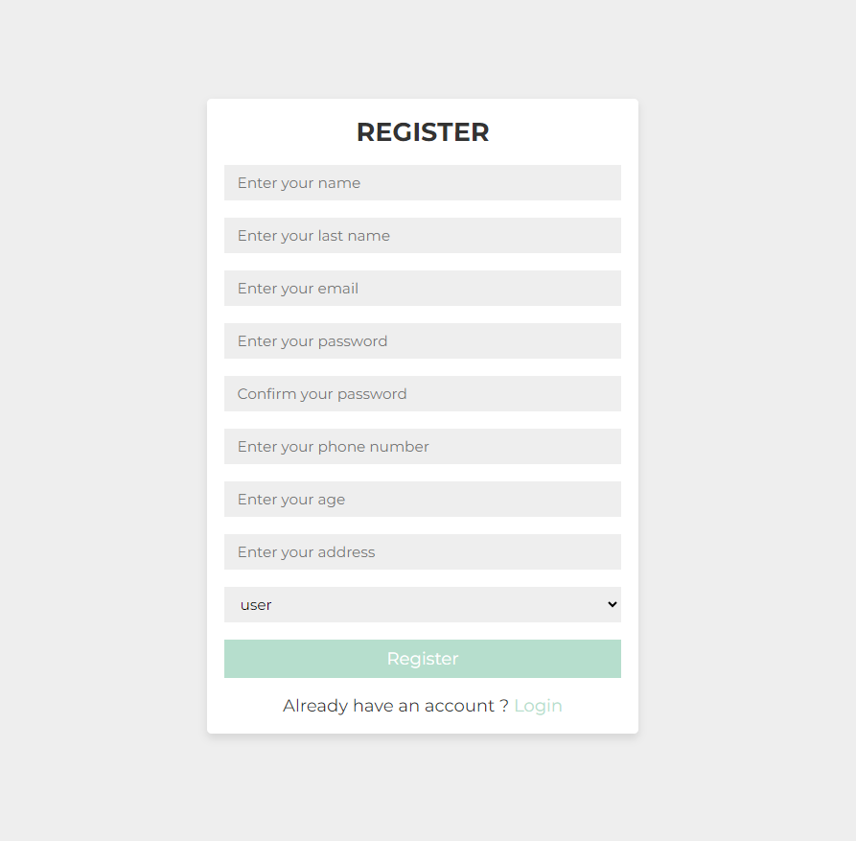
Register page
(Figure 2 - This is our registration page)

Slide 9
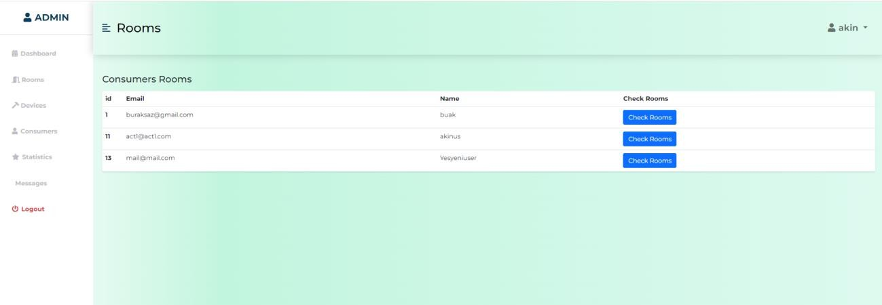
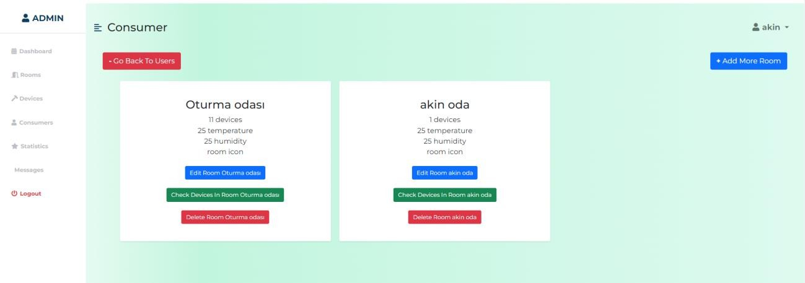
Admin
(Figure 3 - This is the producer room page where i can see consumers room)
(Figure 4 - This is the rooms page where i can check singular consumers room)

Slide 10
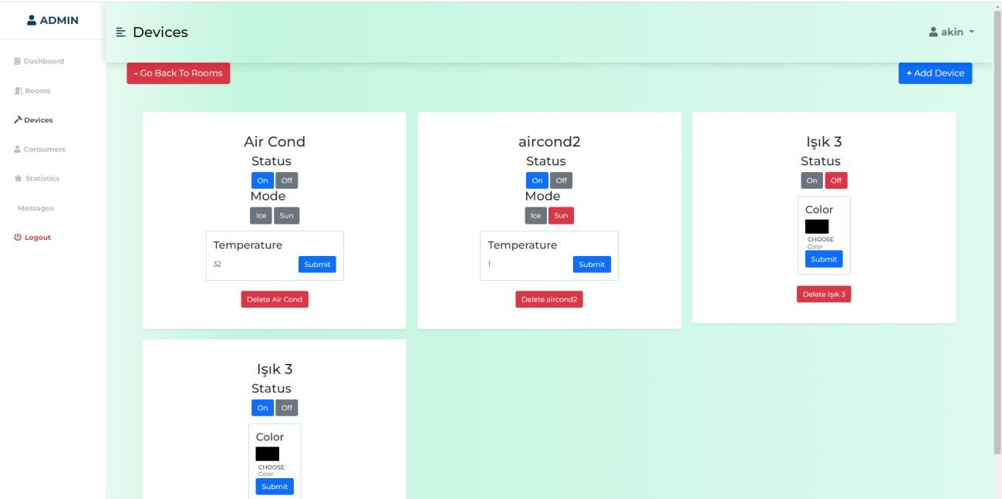
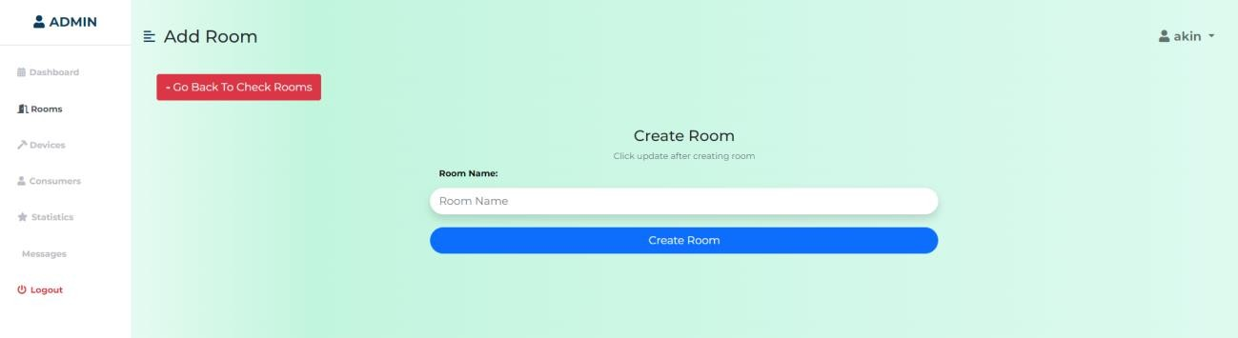
Devices & Add Rooms
(Figure 5 – This is the page where we can see the devices)
So Lets Add More Room to consumer using the button says “Add More Room”
(Figure 6– Using this I can create rooms for that user)

Slide 11
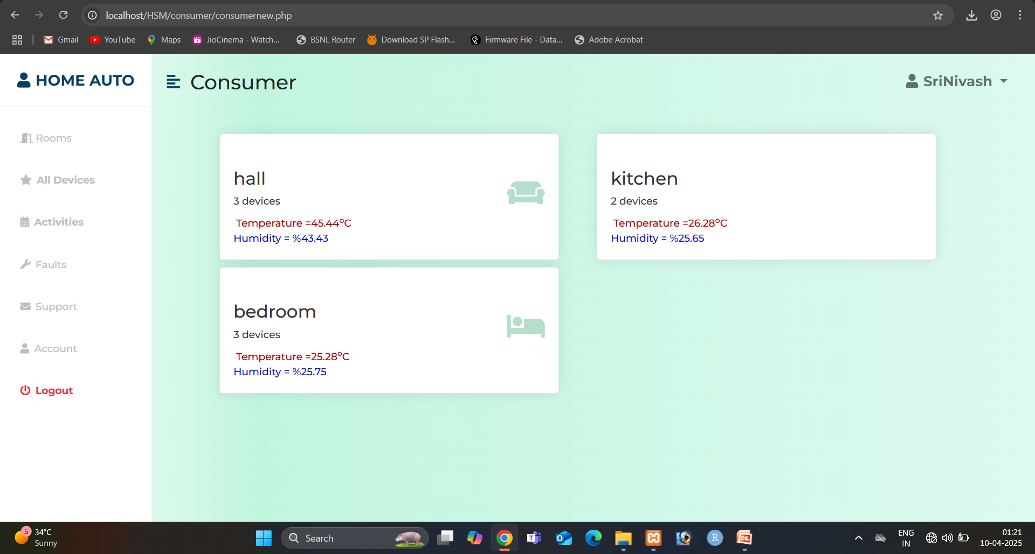
User interface

Slide 12
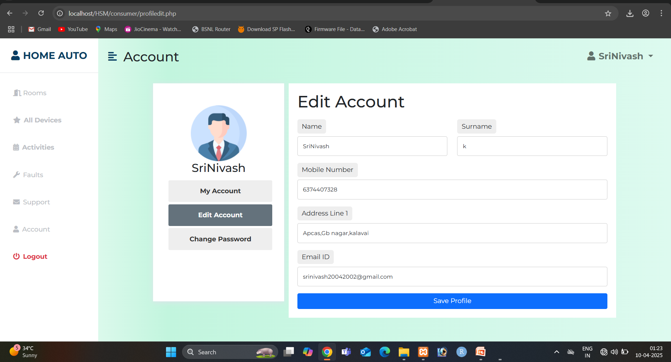
User Profile

Slide 13
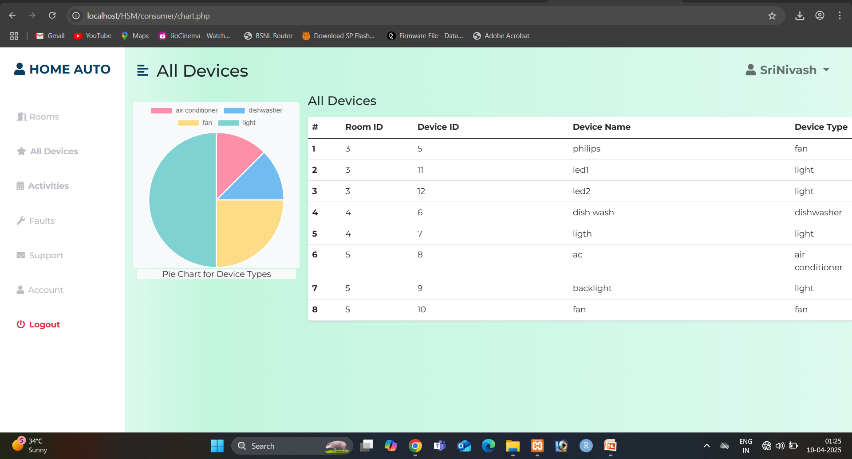
Dashboard

Slide 14
Risks & Solutions
Sensor Failure → Backup sensors, maintenance.
Power Failure → Battery backups, UPS.
Network Issue → Offline mode, auto-reconnect.
Data Loss → Cloud backups, redundancy.

Slide 15
CONCLUSION & FUTURE ENHANCEMENTS
Provides real-time security monitoring.
Enhancements: AI-based detection, voice control.
Future upgrades include AI-based detection, mobile app integration, and smart home automation for improved reliability.

Slide 16
Thank you

